Slide 1
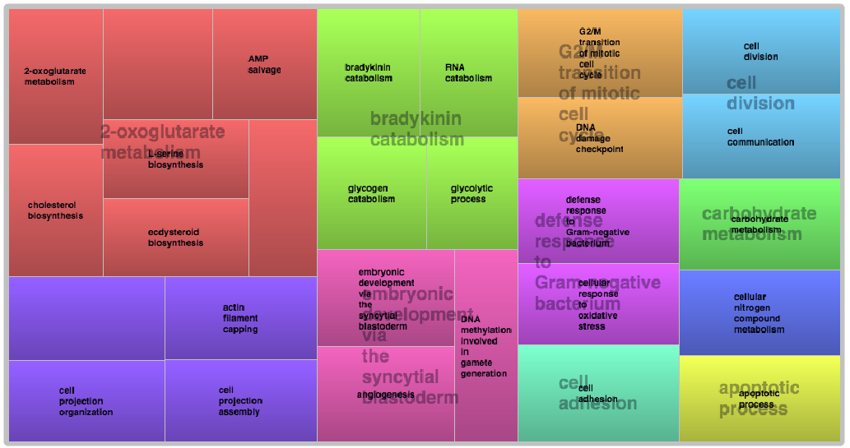
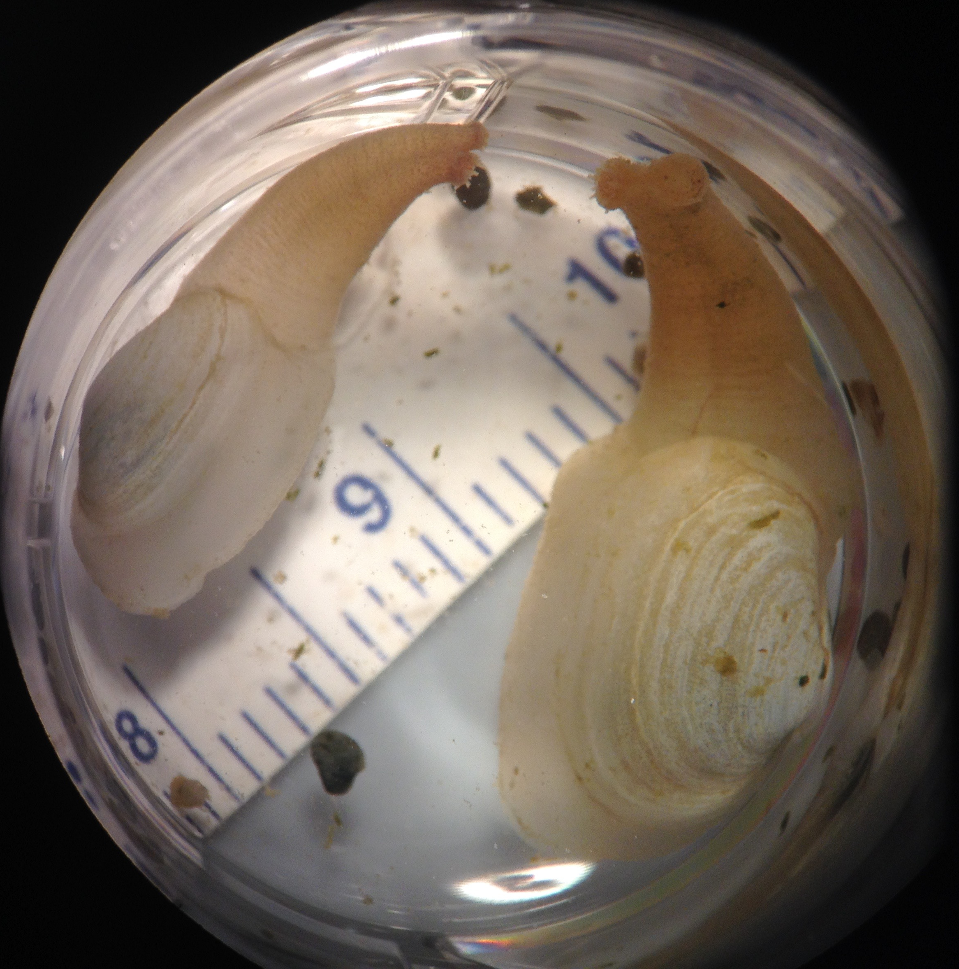
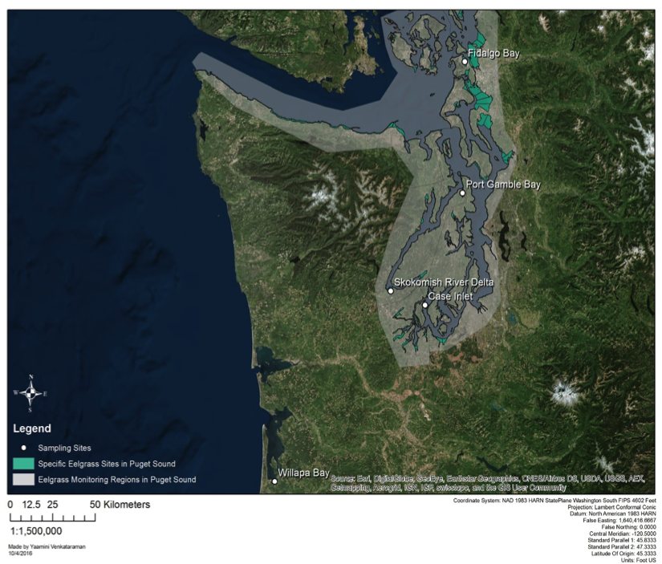
Geoduck as indicators of environmental change
Laura H. Spencer¹, Micah Horwith², Alex Lowe³, Emma Timmins-Schiffman⁴, Brook L Nunn⁴, Steven Roberts¹ [ADD SEAN?]
1: UW SAFS 2: WA DNR 3: UW Biology 4: UW Genome Sciences
The initial results
The animal
The questions
Pacific geoduck (Panopea generosa)
Largest clam native to the Pacific Northwest
Important commercial fishery (wild & farmed), $X million annual exports
Sedentary, calcifying, subtidal
Likely to be impacted by rising ocean temperature and pCO₂
Can we detect an environmental signature via differential protein expression?
Does treatment (eelgrass, no eelgrass) correlate with expression of stress-related proteins?
What is the overall variability in protein expression in juvenile geoduck?
Do we see a difference in protein expression between geographical sites?
The analysis
Extract proteins & fragment
[insert method used]
Sonication and cell lyses
Protein quantification
Mini-Trypsin digestion
Desalting and peptide isolation
Add standards
Data-Independent Tandem Mass Spectrometry
Orbitrap Fusion Lumos machine
Does not require pre-selected precursor ions
Captures all peptides within designated mass/charge ratio
The trials
Identify and quantify peptides
5 sites throughout western Washington
2 treatments per site: eelgrass bed, bare sediment
4 replicates per treatment
2 month-long trials in June and August 2016
Continuous water quality measurements via Seabird CTD and Durafet pH Probe to collect: pH, temperature, salinity, depth, chlorophyll
Gill tissue sampled and frozen on-site for protein extraction
In summer 2016 we performed two trials in which sibling juvenile geoduck were out-planted in five sites throughout Washington State, each site containing cohorts placed inside and outside eelgrass beds. Geoduck were enclosed to minimize predation, water chemistry was continuously monitored, and after four weeks of exposure geoduck gill tissue was taken for proteomic analysis. The gill proteome was sequenced using tandem mass spectrometry to reveal expression pattern associated with local conditions. Together these results demonstrate that protein profiles can provide valuable information on local conditions including how environmental change can influence bivalve physiology.
Identify proteins in samples
PECAN
Survey peptides against annotated background proteome
Generate summary file for direct use in Skyline
Quantify relative protein abundance
Skyline
View summary statistics for peptide abundance
Export statistics for processing and visualization
30 days
5 sites
2 treatments per site
-Eelgrass
-Bare
Thank you
This project is supported by the National Science Foundation Graduate Research Fellowship Program, in collaboration with the Washington Department of Natural Resources, and the [grant funding for supplies etc?]?
Special thanks to:
Dr. Emma Timmins-Schiffman, Dr. Brook L. Nunn, and the rest of the MacCoss lab of Biological Mass Spectrometry at the University of Washington Department of Genome Sciences.
University of Washington Proteomics Resource
Sean (unless he should be a co-author?)

