Slide 1
Broodstock into winter treatments
Larval rearing begins
(12-week trial only)
Broodstock collected from Mud Bay, Bremerton, WA
7-week exposure ends, spawning begins
12-week exposure ends, spawning begins
Last larval pulse collected to rear
(n=12 per treat.
48 total)
November 6, 2017
December 8, 2018
January 24, 2018
February 28, 2018
March 30, 2018
April 19, 2018
Post-set counted for survival
(35-days after release)
May - June 2018
Nov 30
Dec 20
Jan 4
Jan 23
Feb 9
Feb 27
Mar 13
Mar 23
Broodstock
Winter broodstock treatments
7ºC+high-food, 7ºC+low-food
10ºC +high-food, 10ºC +low-food
7-week trial, broodstock
spawned common conditions
~18ºC, 100k cells/mL
Environmental conditions
12-week trial, broodstock
spawned common conditions
~18ºC, 100k cells/mL
Dates broodstock sampled
Larvae
12-week trial, larvae
reared common conditions
static, ~18ºC, 100k cells/mL

Slide 2
Predominant Gonad Sex
Oocyte stage
Spermatocyte Stage
Wild
7°C+
low-food
Number of oysters
10°C+
low-food
7°C+
high-food
10°C+
high-food

Slide 3
Predominant Gonad Sex
Oocyte stage
Spermatocyte Stage
Wild
7°C+
high-food
Percent of oysters sampled
7°C+
low-food
10°C+
high-food
10°C+
low-food

Slide 4
7-week exposure
12 week exposure
Cumulative larvae released
broodstock⁻¹
7°C+
high-food
7°C+
low-food
No. larvae
released day⁻¹
10°C+
high-food
10°C+
low-food

Slide 6
7-week trial
Percent survival
12-week trial

Slide 9
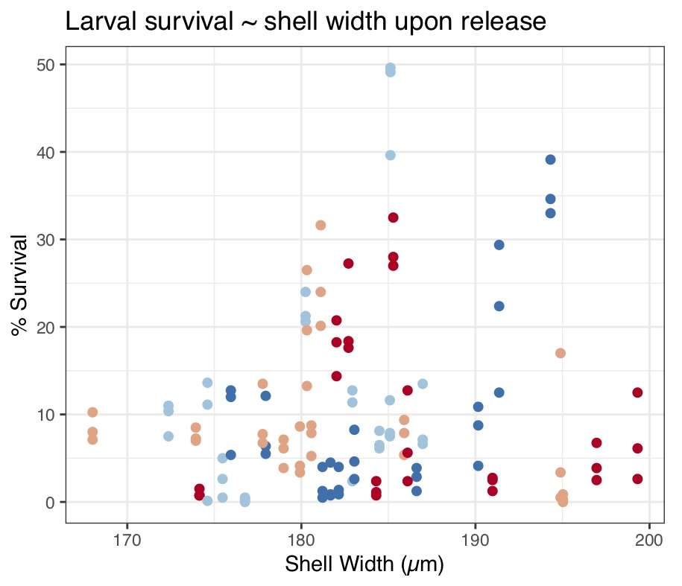

Slide 10
Broodstock into winter treatments
Larval rearing begins
Broodstock collected from Mud Bay, Bremerton, WA
Broodstock exposure ends, conditioning & spawning begins
Last larval pulse collected to rear
(n=12 per treat.
48 total)
November 6, 2017
December 8, 2018
February 28, 2018
March 30, 2018
April 19, 2018
Post-set counted for survival
(35-days after release)
May - June 2018
ADULT
Winter broodstock treatments
7ºC+high-food, 7ºC+low-food
10ºC +high-food, 10ºC +low-food
Broodstock spawn
spawned common conditions
~18ºC, 100k cells/mL
Environmental conditions
OFFSPRING
Larvae reared
common conditions
static, ~18ºC, 100k cells/mL

Slide 11
Broodstock into winter treatments
Larval rearing begins
Broodstock collected from Mud Bay, Bremerton, WA
Broodstock exposure ends, conditioning & spawning begins
Last larval pulse collected to rear
(n=12 per treat.
48 total)
November 6, 2017
December 8, 2018
February 28, 2018
March 30, 2018
April 19, 2018
Post-set counted for survival
(35-days after release)
May - June 2018
ADULT
Winter broodstock treatments
7ºC+high-food, 7ºC+low-food
10ºC +high-food, 10ºC +low-food
Broodstock spawn
spawned common conditions
~18ºC, 100k cells/mL
Environmental conditions
OFFSPRING
Larvae reared
common conditions
static, ~18ºC, 100k cells/mL

Slide 12
Adults into winter treatments
Adults collected
Adults begin conditioning & spawning
Larval rearing
Survival assessed
December 2018
March 2018
April 2018
November 2017
May - June 2018
ADULT
Winter broodstock treatments
7ºC+high-food, 7ºC+low-food
10ºC +high-food, 10ºC +low-food
Broodstock spawn
spawned common conditions
~18ºC, 100k cells/mL
Environmental conditions
OFFSPRING
Larvae reared
common conditions
static, ~18ºC, 100k cells/mL

Slide 13
Adults into winter treatments
Adults collected
Adults begin conditioning & spawning
Larval rearing
Survival assessed
December 2018
March 2018
April 2018
November 2017
May - June 2018
ADULT
Winter broodstock treatments
7ºC+high-food, 7ºC+low-food
10ºC +high-food, 10ºC +low-food
Broodstock spawn
spawned common conditions
~18ºC, 100k cells/mL
Environmental conditions
OFFSPRING
Larvae reared
common conditions
static, ~18ºC, 100k cells/mL

