Slide 1

Exploration of Airbnb Hawai`i
Web Scraping Project
July 21, 2019
By: Laura Joel Elliott, MPH

Slide 2
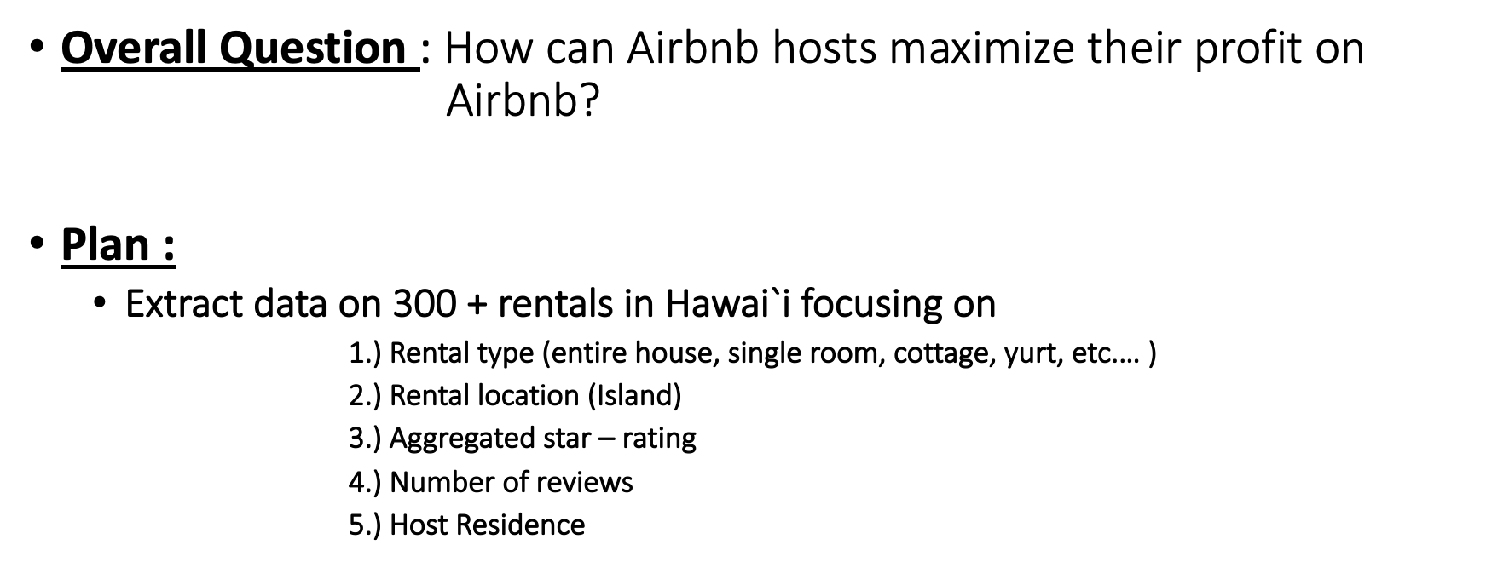
Purpose

Slide 3
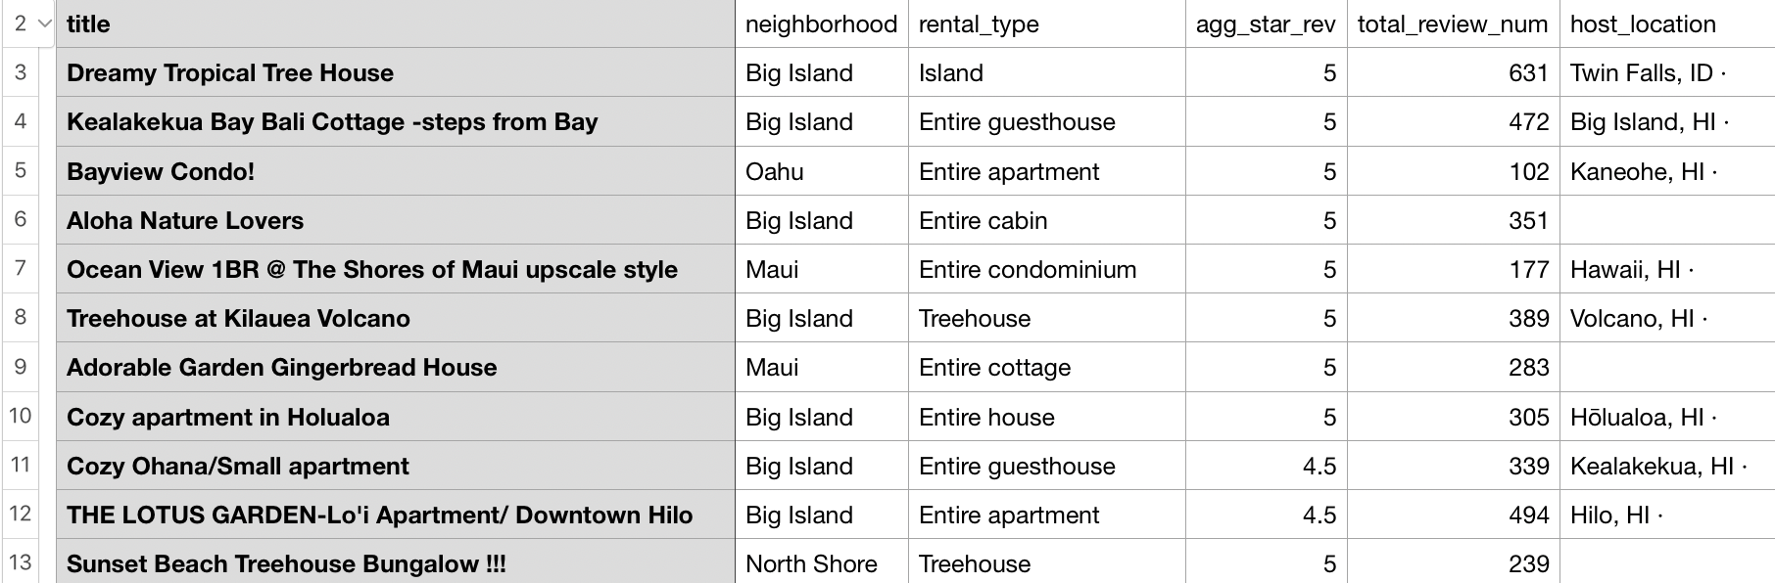
Extraction
Using Selenium, extracted the following .csv file
Contains 311 properties

Slide 4
Analysis
Using R, analyze the data collected.
So far, trying to clean the data collected.
When data is clean I will explore more questions I can answer
    1.) Host location vs. star reviews
    2.) Host location and correlation with number of reviews, rates etc.
    3.) I would like to see if host location effects the rentals due to new restrictive legislation in
    Hawai`i
So far, my exploratory analysis in R has revealed a unexpectedly large number of hosts that are not located in Hawai`i
Will have to extract more data to answer overall question

