Slide 1
Maximizing Profit for Airbnb Hosts
An analysis of Airbnb properties in Hawai`i
By :
Laura Elliott, MPH

Slide 2
Main Research Question
What factors contribute to the value of an Airbnb rental in the state of Hawai’i?
Hypotheses:
Rentals will increase in value as number of featured amenities increases
Rentals will increase in value as number of host reviews increases
Value will decrease as rental age increases
Factors will differ across islands

Slide 3
How Airbnb works:
It is an online market that allows private citizens to rent their property under a short term lease.
Airbnb takes 3% commission of every booking from hosts, and between 6% and 12% from guests
Guests like it because it offers cheaper accommodations
Hosts like it because it gives them an opportunity to earn extra cash with little cost to them.
Source: bt.com (2018)

Slide 4
Hawai’i and Airbnb
The relationship between locals and Airbnb is strained
Main Issues :
  Taxes : Full time vacation rentals decreases the number of property owning residents, and brings in more non-residents that do not work for the state. The state claims that they could have collected upwards of $64M in taxes in 2018.
  Overcrowding: As the number of rentals increases tourism grows, multiple people share rentals at a time
  Displacement: As tourism grows property values go up. The median household income is $77,765, Median property value is $795,000, Hawai’i has the 5th highest poverty rate in the country.
This year, Hawai`i tried a bill that would require Airbnb to to collect lodging taxes
Requires vacation rental operators to register with the state Department of Taxation

Slide 5
Importance
It is important for Airbnb and hosts to adapt to changes to their environment to maximize their profit
It may be important for those living in a state where cost of living is high, and median income is low.

Slide 6
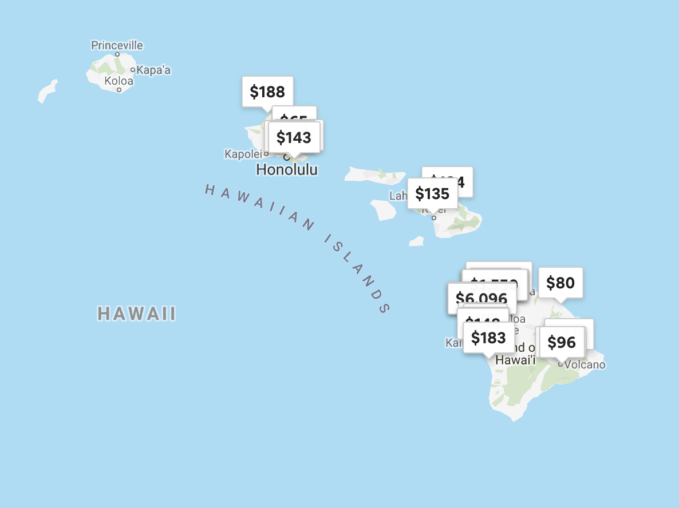
Analysis
Used Selenium for scraping
This analysis focuses on unique features of each property
Variables of Interest:
  Featured Amenities
  Rental Age
  Host reviews
  Island Location
  Rental Rate/night
Oahu
Kauai
Molokai
Maui
Due to the unavailability of ‘nightly rate,’ a property’s value is measured by ‘host reviews.’
Big Island

Slide 7

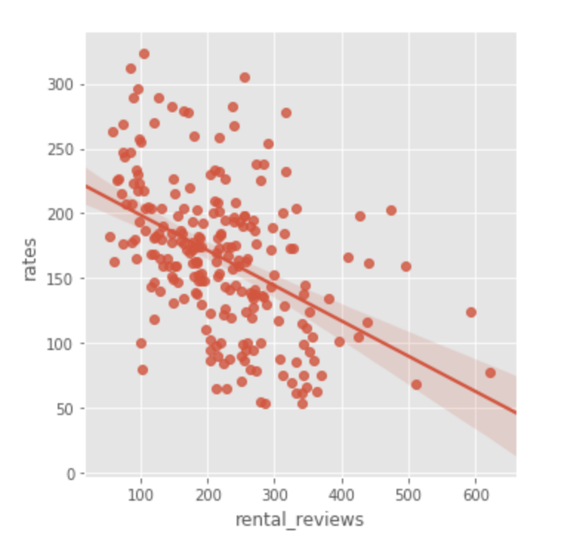
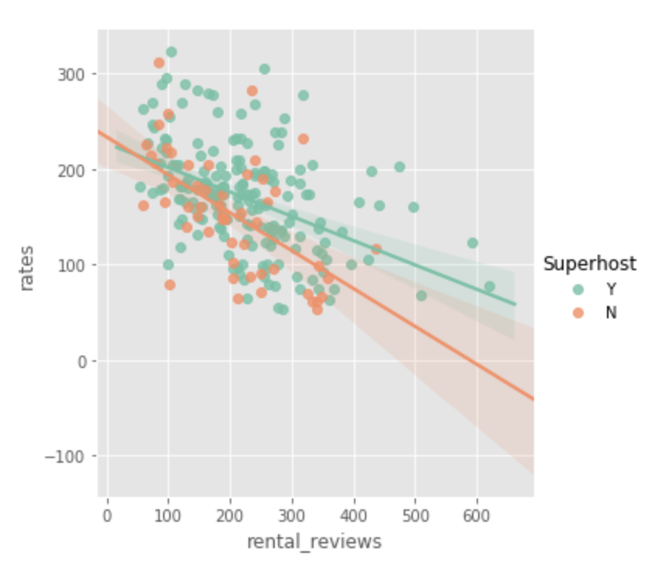
All Islands:
Rates vs Number of Rental Reviews
Plot 1 illustrates the relationship between
  Number of Rental Reviews(x) and Number of Rates (y)
  This plot shows a possible negative relationship between the two after two outliers removed.
Number of Rental Reviews
Plot 1
Plot 2 illustrates the relationship between
  Number of Rental Reviews (x) and Rates (y) for super-hosts and regular hosts who live in Hawai’i and those who do not
  This plot shows a possible negative relationship between the two for super-hosts and hosts that live in Hawai`i
Plot 2
Number of Featured Amenities

Slide 8
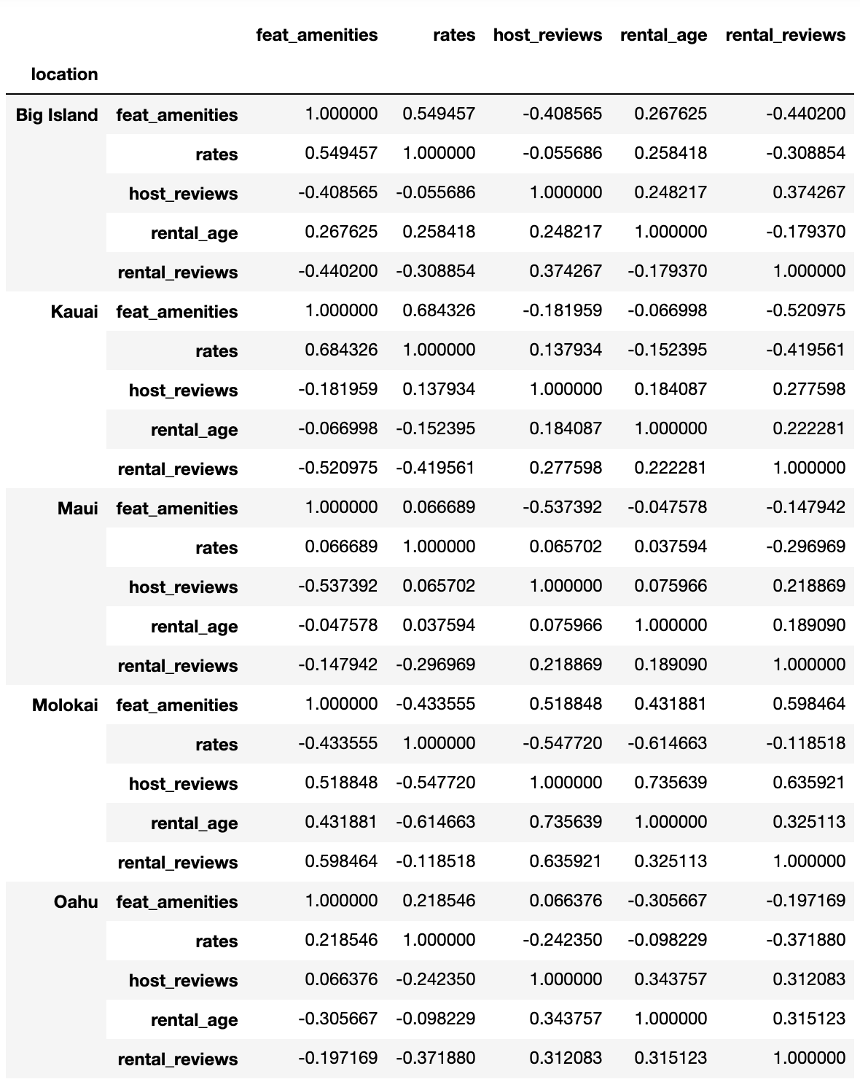
Correlation by Island
Correlation analysis demonstrates that linear relationships differ across islands
Strong correlations between nightly rate and featured amenities, rental age, and rental reviews are observed for each island.
The strongest observed for the Big Island, Kauai, and Molokai is between rate and featured amenities
For Maui and Oahu, the correlation between rate and rental reviews was the strongest

Slide 9
Linear Regression
To analyze the relationship between rates and the factors that show a strong correlation simple linear regressions were performed, then a multi-linear regression including all factors
Simple linear regression results:
  rate vs. rental reviews: the relationship was significant showing a -7.947 decrease in rate for every 1 unit increase in rental reviews (p = < 0.0001)
  rate vs. featured amenities: the relationship was significant showing a 0.6633 increase in rate for every addition of an amenity (p = < 0.0001)
  rate vs. rental age : the relationship between rate and rental age was not significant with a p value of 0.161
Multiple Linear Regression results:
The model included rental reviews, featured amenities, and rental age
  The results for the multiple linear regression shows significant relationship between
    Rate vs .Number of Rental Reviews (p< 0.0001)
    Rate vs. Number of Featured Amenities (p < 0.001)

Slide 10
Conclusions
Rate shares a significant relationship with number of rental reviews (p < 0.0001) and number of featured amenities (p > 0.001) after conducting a MLR, controlling for rental age.
The analysis shows that decreasing your rental rate will increase the number of reviews, which, could result in more credibility as a rental, higher total ratings, and a higher value rating. All of these things could contribute to more profit for a host in Hawaii
More in-depth analyses should be conducted to see which amenities, specifically, increase the rate of a rental
An analysis between islands should be conducted as well

