Slide 1

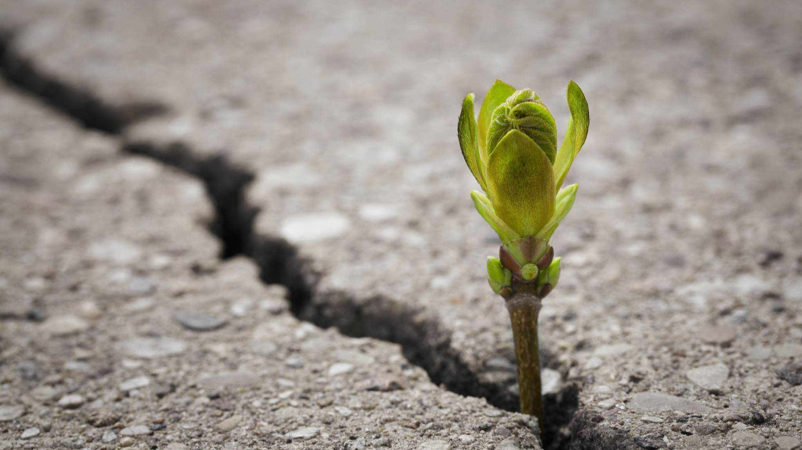
Legacy Lion
Introducing…
Connecting Family by Much More Than Just DNA
Laura Jimenez

Slide 2
Agenda
Overview of the project topic
The Process: Methods and libraries used
Challenges
Future Enhancements
The story!

Slide 3
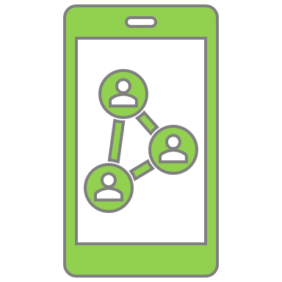





What better Story to tell than you OWN?
The Past
The Present
The Future
Legacy Lion
Word of mouth
Tales said through generation
If you are lucky: Scripts stored and paintings
Printed Images
Digitalized images through social media
Word of mouth, notebook, online diary
DNA testing
An online tool that can be inherited by future generations to view generational milestones and family hierarchy.

Slide 4
The Process
Flask powered blog-based platform
About page with information on migration and mobility across states (dataset from Kaggle), with two graphs using Plotly
Blog with ability to have input posts, saved through sql alchemy database
Other libraries used, such as AOS for plot animations and Balkan OrgChartJS to create family tree

Slide 5
The Vision & Challenges
Posts: Milestones and pictures
Keep track of special days
Family Tree:
Inherit and continue legacy
Geo-location
Legacy Lion

Slide 6
Legacy Lion
Introducing…
Connecting Family by Much More Than Just DNA
Laura Jimenez

