Slide 1
Dynamical Modeling and Analysis of Epidemics: Ebola as a Case Study
Sun HONG “Mark” Kim
Sung A Kim
October 6, 2014

Slide 2

Motivation & background
Future of Medicine and Biotechnology
Dynamical Systems and Their Bifurcations

Slide 3
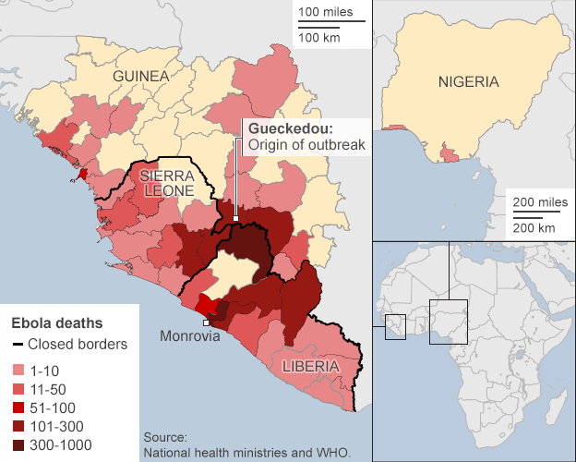
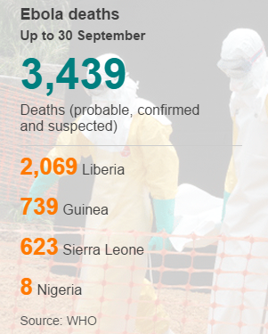
A SNAPSHOT of the 2014 Ebola OUTBREAK in west Africa
Source: http://www.bbc.com/news/world-africa-28755033

Slide 4
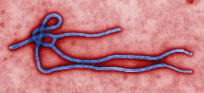
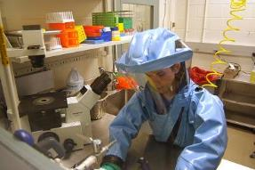
the 2014 Ebola OUTBREAK in west Africa
Geography:
Majority of cases in Liberia, Guinea, and Sierra Leone
Transported to Nigeria and Senegal
Since 22 March 2014:
Over 3,000 deaths
Over 6,500 cases
50~90% mortality rate
No FDA-approved treatments, cures or vaccines

Slide 5
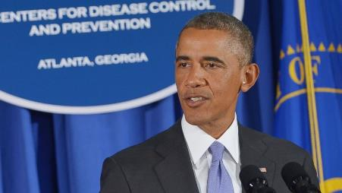
Obama: Ebola‘ is spiraling out of control’
“Here’s the hard truth: In West Africa, Ebola is now an epidemic of the likes we have not seen before. It is spiraling out of control. It is getting worse. It is spreading faster and exponentially. If the outbreak is not stopped now, we could be looking at hundreds of thousands of people infected.".
– President Obama, September 16th, 2014
Source: http://www.whitehouse.gov/the-press-office/2014/09/16/remarks-president-ebola-outbreak

Slide 6
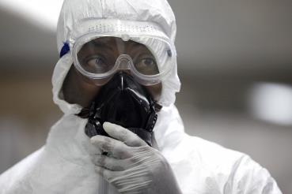
A mathematical approach to study the outbreaks of ebola
Objective:
Better understand the mathematical dynamics of a population infected by Ebola
Model the progress of an epidemic in a large population
Deterministic Compartmental Models:
The SIR model

Slide 7

A Simple Model of an Epidemic: sir model
THE SIR MODEL (1927: W. O. Kermack and A. G. McKendrick)
Three compartments:
Susceptible,
Infected,
Removed,
Uses a fixed population:

Slide 8
A Simple Model of an Epidemic: sir model (cont’d)
Please see the board for the process of the derivation:

Slide 9



A Simple Model of an Epidemic: sir model (cont’d)

Slide 10
A Simple Model of an Epidemic: sir model (cont’d)
R₀ < 1
infection will die out in the long run
R₀ > 1
infection will be able to spread in a population

Slide 11
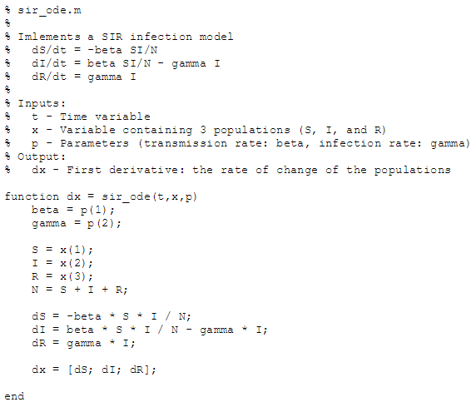
matlab: solving the ode

Slide 12
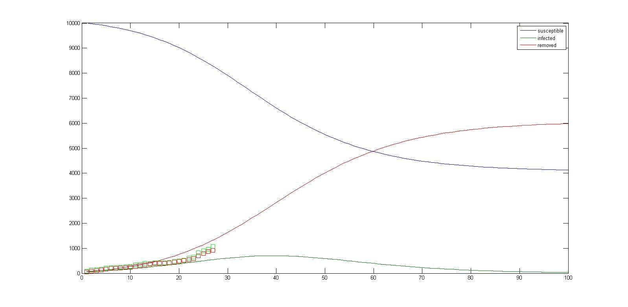
Outlook: an ominous ebola forecast in Guinea
β = 0.27, γ = 0.18
R₀ = 1.51
S = 10,000, I = 86, R = 60

Slide 13
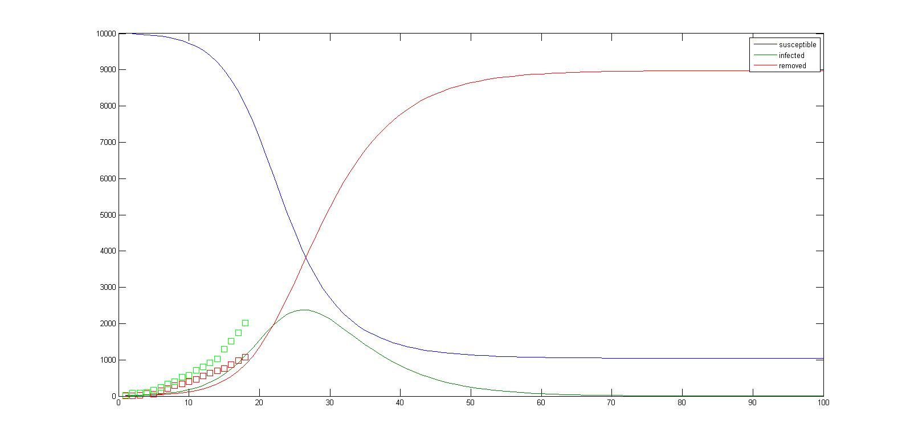
Outlook: an ominous ebola forecast in Sierra Leone
β = 0.45, γ = 0.18
R₀ = 2.52
S = 10,000, I = 16, R = 5

Slide 14
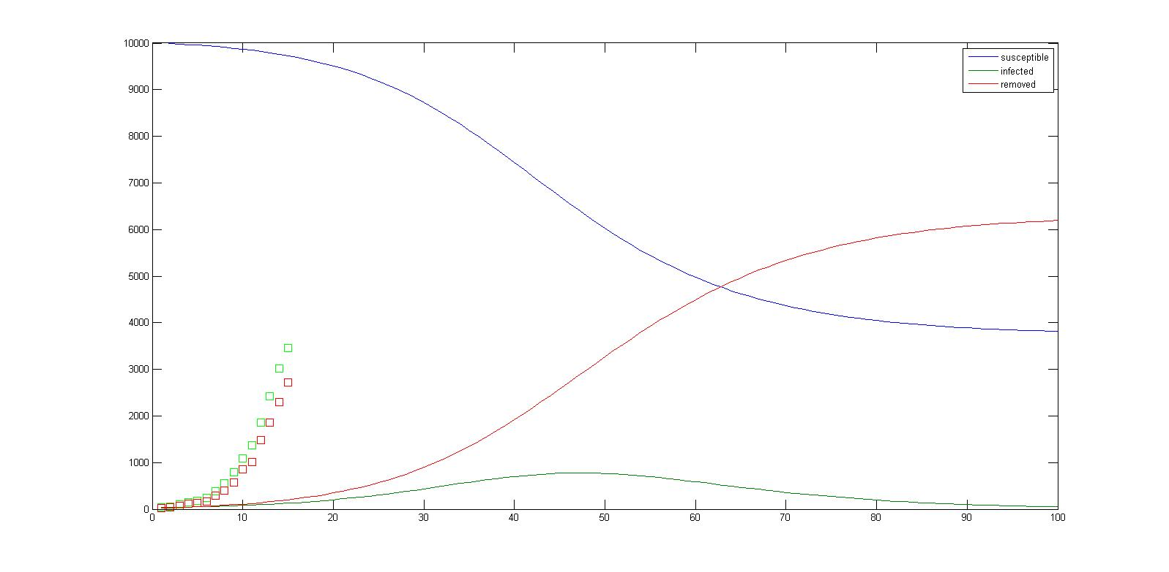
Outlook: an ominous ebola forecast in Liberia
β = 0.28, γ = 0.18
R₀ = 1.57
S = 10,000, I = 33, R = 24

Slide 15
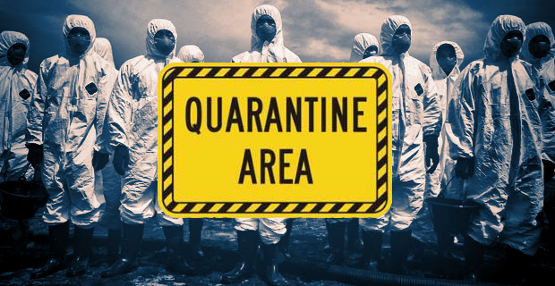
Regression analysis: we need containment

Slide 16
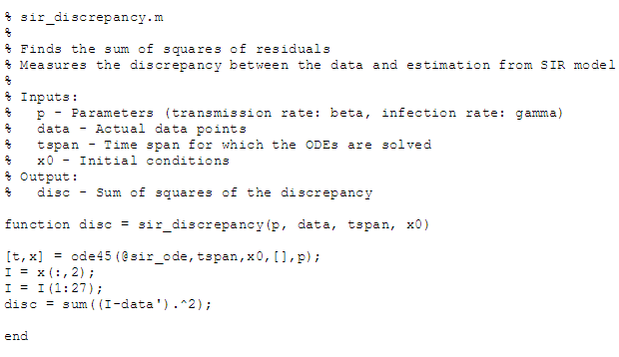
matlab: finding the sums of the residuals

Slide 17
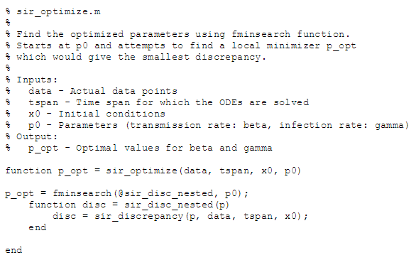
matlab: optimizing the parameters

Slide 18
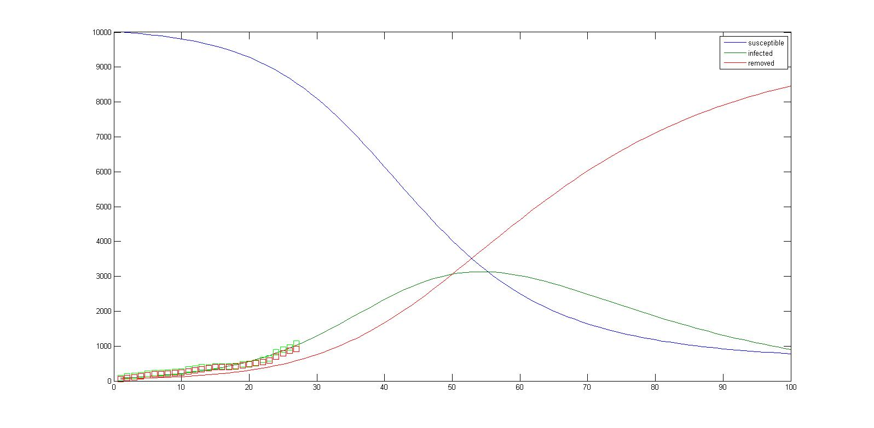
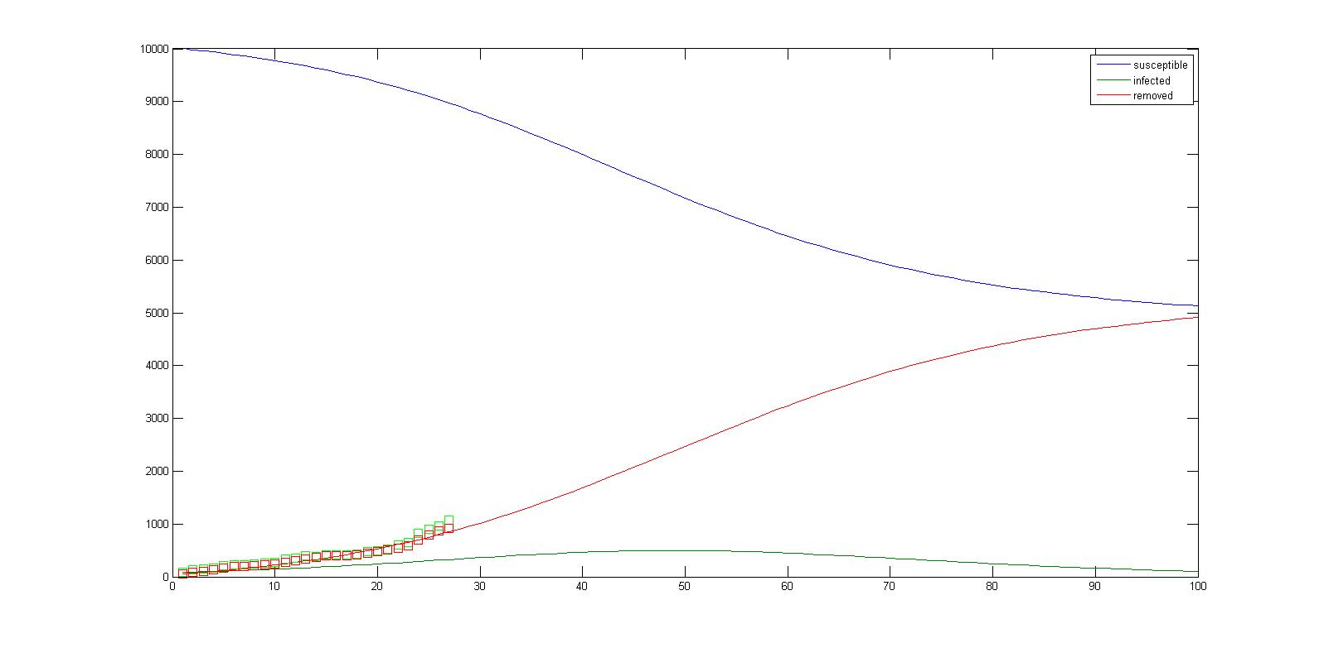
Fitting the sir model – optimize the parameters: Guinea
β = 0.16, γ = 0.05
R₀ = 3.08
β = 0.22, γ = 0.16
R₀ = 1.40

Slide 19
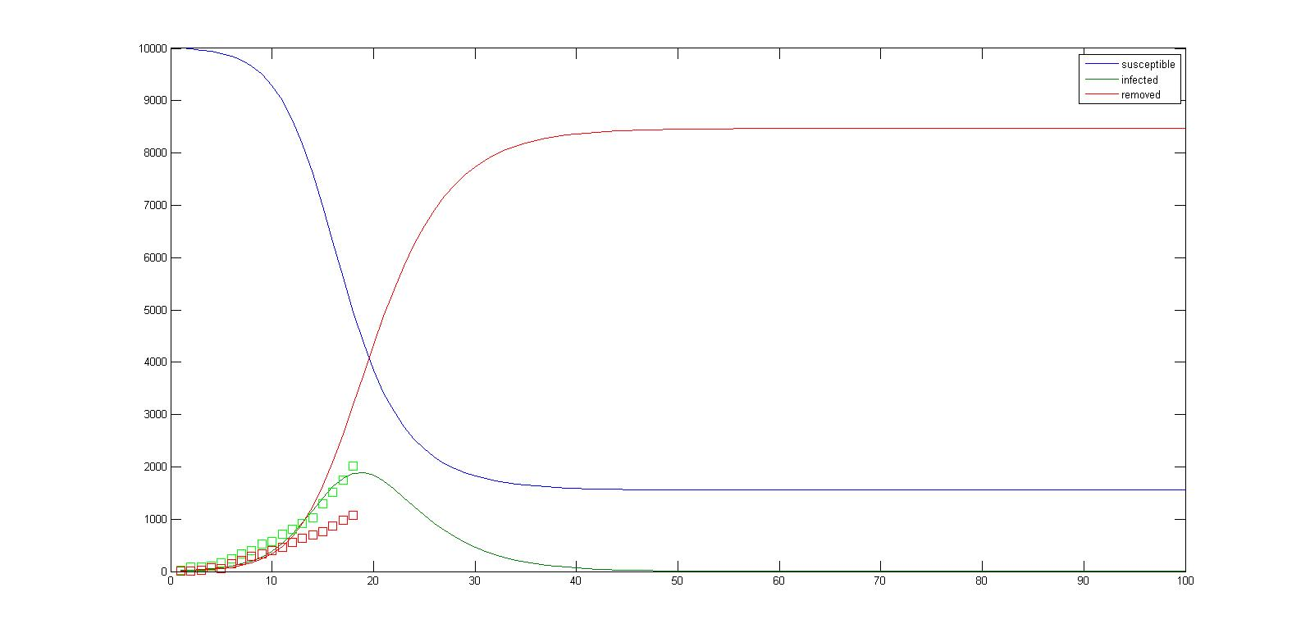
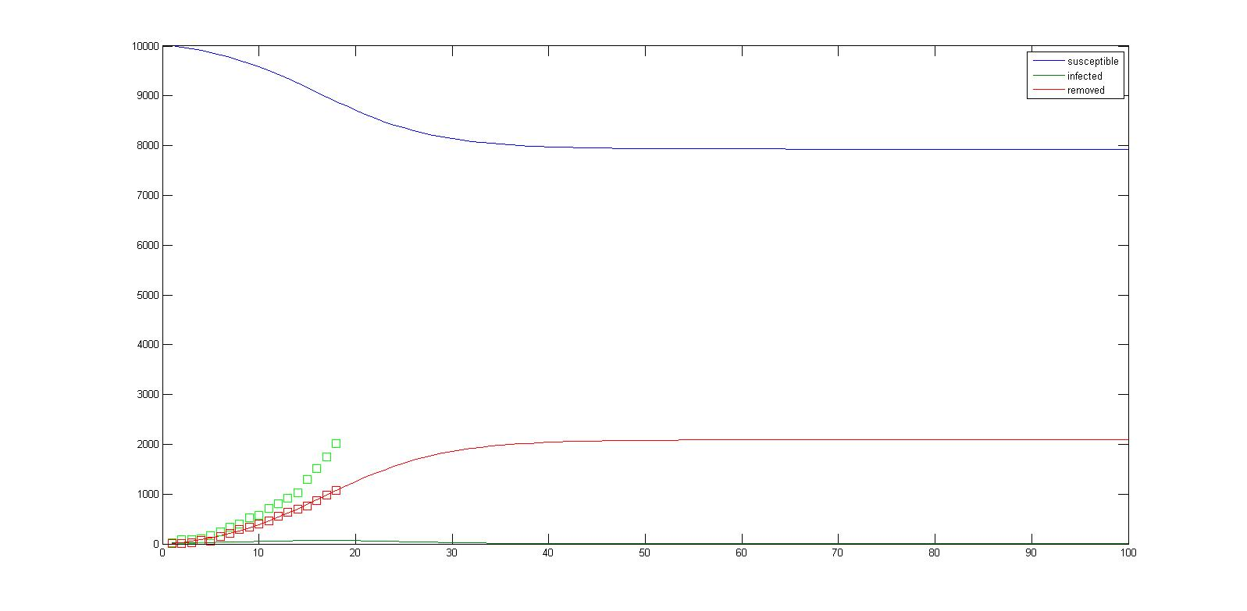
Fitting the sir model – optimize the parameters: Sierra Leone
β = 0.68, γ = 0.31
R₀ = 2.21
β = 1.52, γ = 1.36
R₀ = 1.11

Slide 20
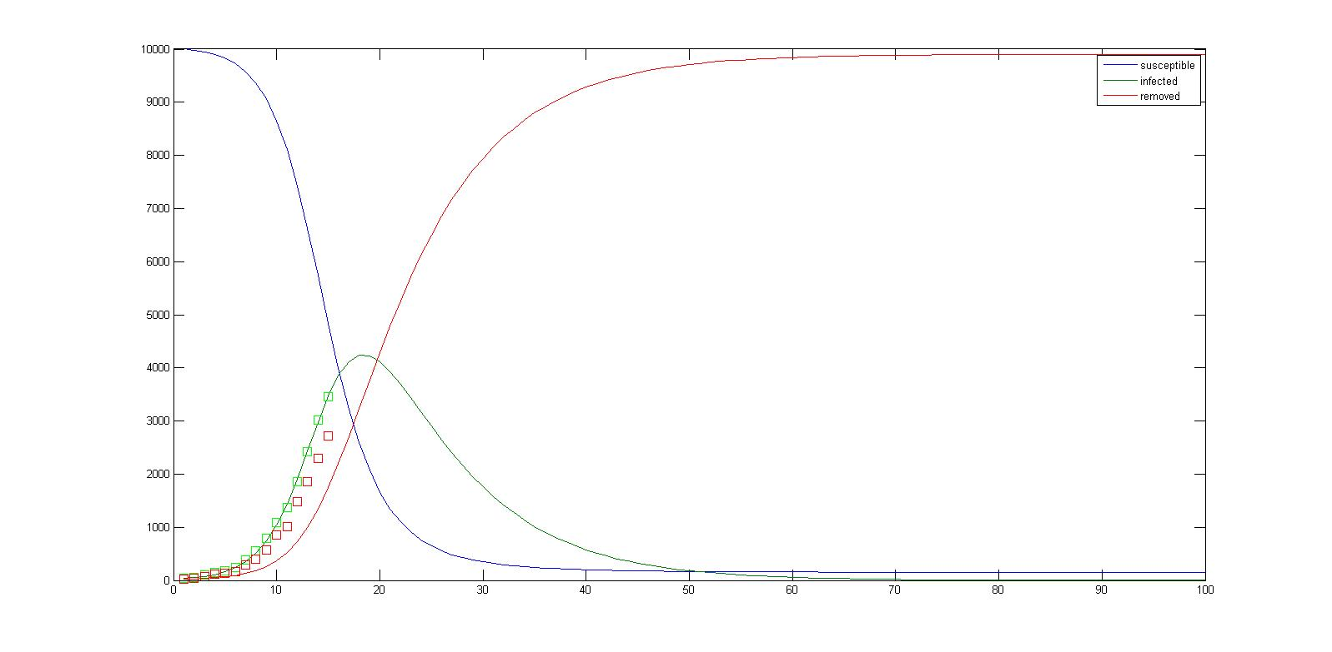
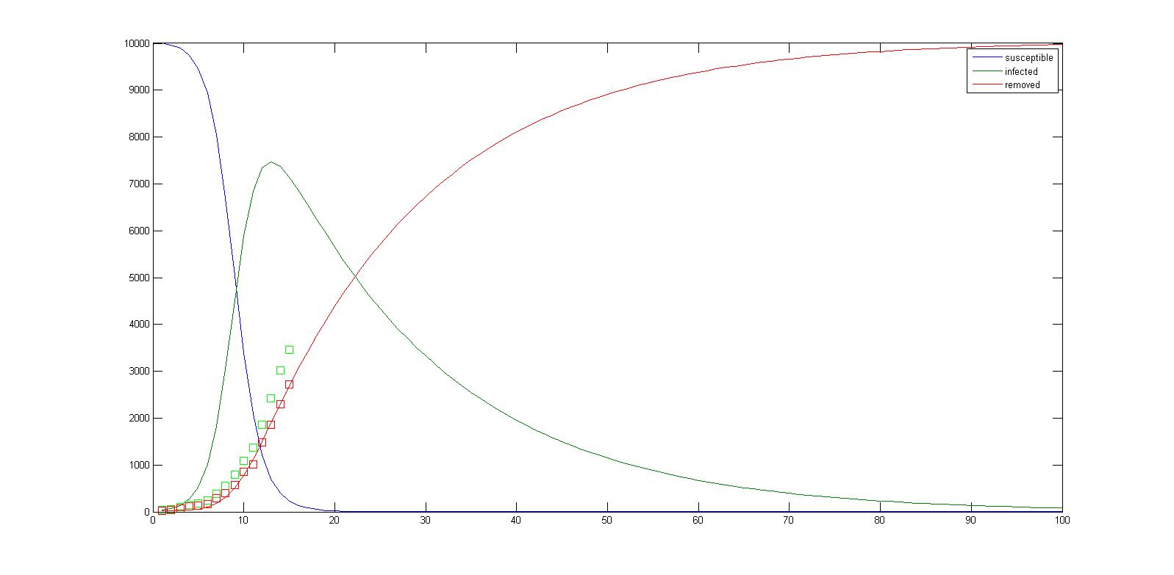
Fitting the sir model – optimize the parameters: Liberia
β = 0.53, γ = 0.13
R₀ = 4.24
β = 0.76, γ = 0.05
R₀ = 14.32

Slide 21
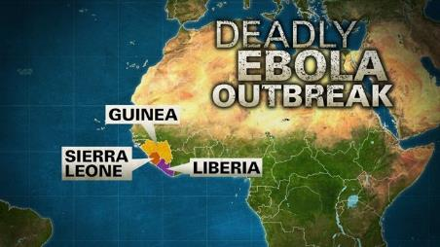
Outlook: U.S. Intervention
U.S. military will lead $750 million fight against Ebola in West Africa
– The Washington Post, September 16th, 2014
Source: http://www.washingtonpost.com/national/health-science/us-military-to-lead-ebola-fight/2014/09/15/69db3da0-3d32-11e4-b0ea-8141703bbf6f_story.html

Slide 22
Outlook: U.S. Intervention (cont’d)
Benchmark Analysis - Pre-Obama Intervention | Guinea | Liberia | Sierra Leone
Transmission rate, ß (per day) | 0.270 | 0.280 | 0.450
US Effort | $ 175 | $ 175 | $ 175
Benchmark Analysis - Post-Obama Intervention | Guinea | Liberia | Sierra Leone
Transmission rate, ß (per day) | 0.063 | 0.065 | 0.105
Transmission rate, ß (per day) - Discounted | 0.095 | 0.098 | 0.158
US Effort | $ 750 | $ 750 | $ 750

Slide 23
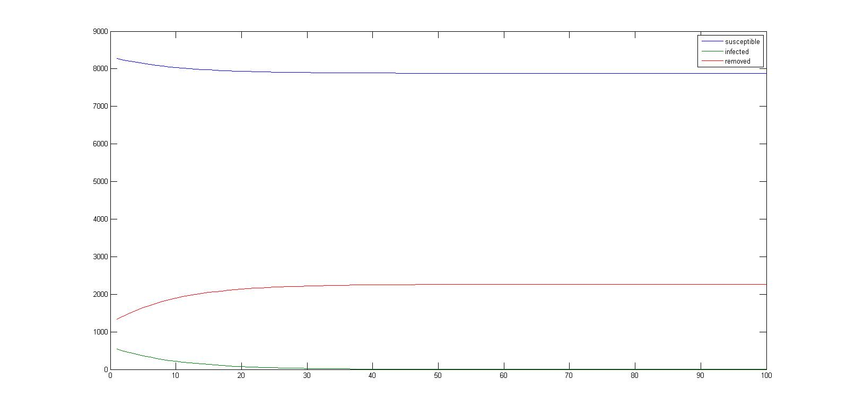
Outlook: a promising ebola forecast in Guinea post-us intervention
β = 0.095, γ = 0.18
R_{f} = 0.53
S = 8,277, I = 542, R = 1,326

Slide 24
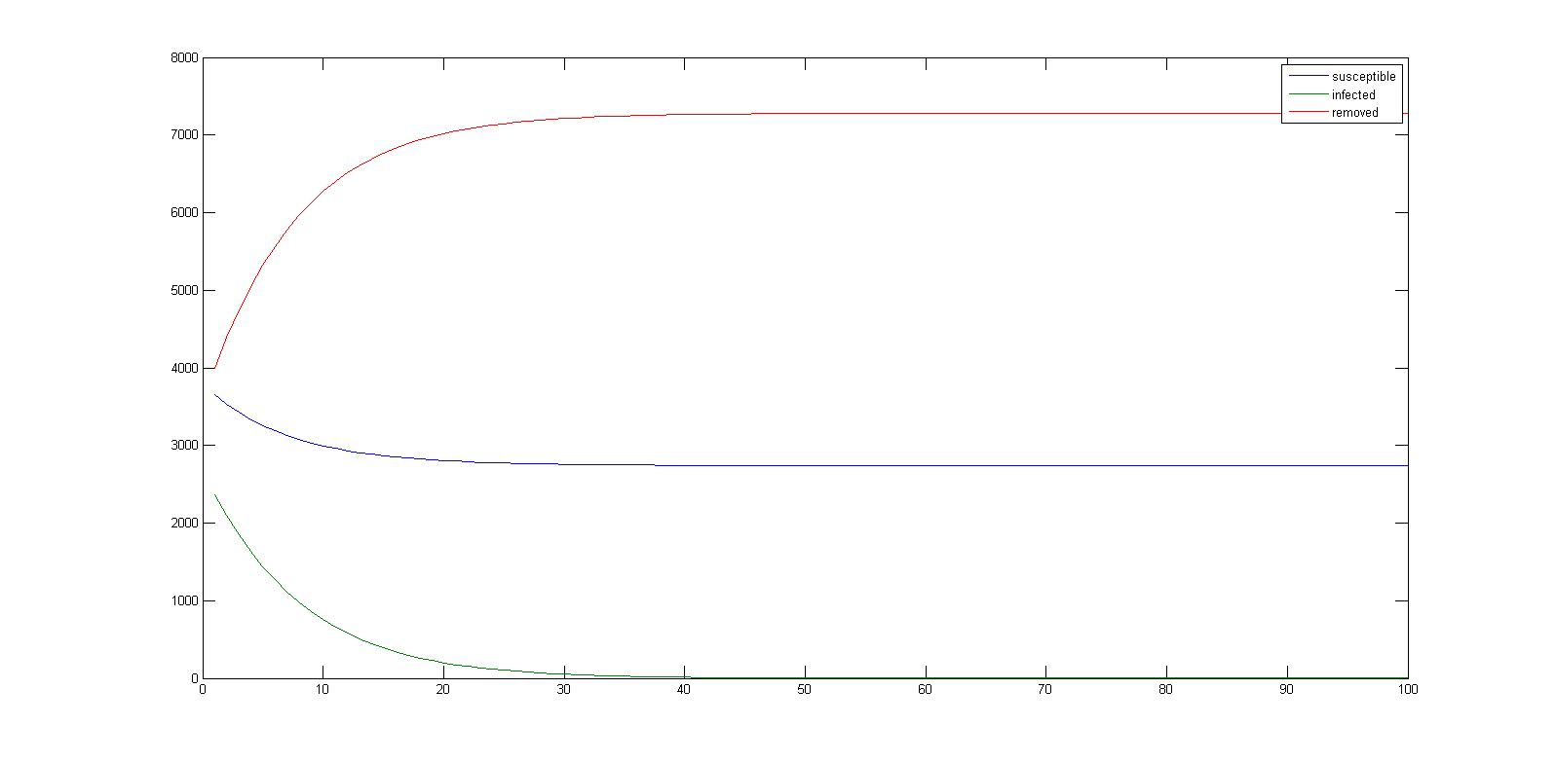
Outlook: a promising ebola forecast in Sierra Leone post-us intervention
β = 0.016, γ = 0.18
R_{f} = 0.88
S = 3,661, I = 2,367, R = 3,992

Slide 25
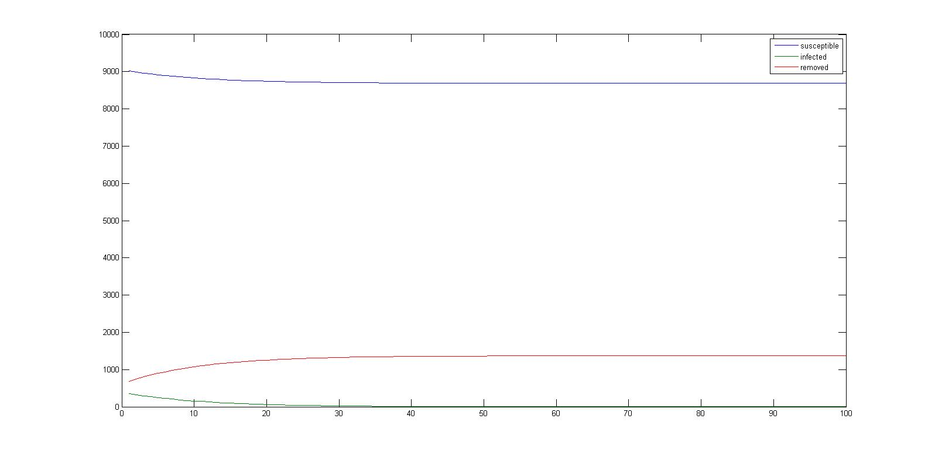
Outlook: a promising ebola forecast in Liberia post-us intervention
β = 0.098, γ = 0.18
R_{f} = 0.55
S = 9,018, I = 353, R = 686

Slide 26
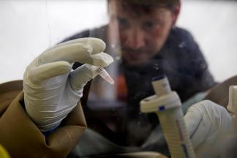
Further research
Extension of the SIR model:
Factors such as a quarantine, immunity being passed from mother to child and even a zombie apocalypse
e.g. SEIR MODEL (Exposed)
What we can do as engineers / applied scientists:
Equipment Decontamination
Personnel Decontamination
Point of Care Diagnostic Devices
Improved Patient and Body Transport
Data Collection and Management

Slide 27

Questions?

Slide 28
references
Elkadry, Alaa. Transmission Rate in Partial Differential Equation in Epidemic Models. Marshall University 2013.
Lekone, Phenyo. G. Statistical Inference in a Stochastic Epidemic SEIR Model with Control Intervention: Ebola as a Case Study. Biometrics 2006.
Fisman, David. Early Epidemic Dynamics of the West African 2014 Ebola Outbreak: Estimates Derived with a Simple Two-Parameter Model. Plos Current Outbreaks 2014.
Astacio, Jaime. Mathematical Models to Study the Outbreak of Ebola. Cornell University 1995.
Shaby, Ben. Fitting the SIR model to data. Samsi 2010: http://www.samsi.info/sites/default/files/Shaby_sir_lab.pdf
Levin, Drew. Modeling with ODEs in Matlab – Part 3. MatlabGeeks 2011: http://matlabgeeks.com/tips-tutorials/modeling-with-odes-in-matlab-part-3/

Slide 29
The END

