Slide 1
GGPlot and the Grammar of Graphics
Laura K. Wiley, M.S.
Nashville Data Science Meetup
August 10, 2015
Presentation and Code Available at:
www.github.com/laurakwiley/

Slide 2
Goals
Leave with:
A passing familiarity with the Grammar of Graphics
An understanding of both the basics and the extensibility of ggplot2
An appreciation for asking the right question/telling the right story with your graphics

Slide 3
Caveats
We are not covering:
Munging and reshaping your data
All preprocessing my scripts are with dplyr and tidyr
The specifics of each command used in ggplot
Check out the manual: http://docs.ggplot2.org/current/
Interactive graphics with Shiny or ggvis

Slide 4
Agenda
Foundation of Grammar of Graphics
Building a plot based on GoG
Examples of ggplot options
Worked example

Slide 5
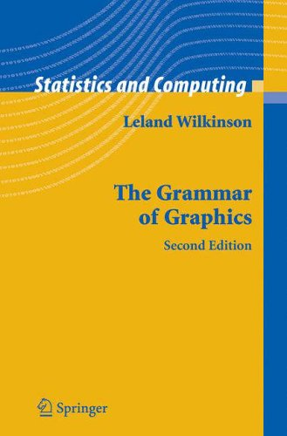
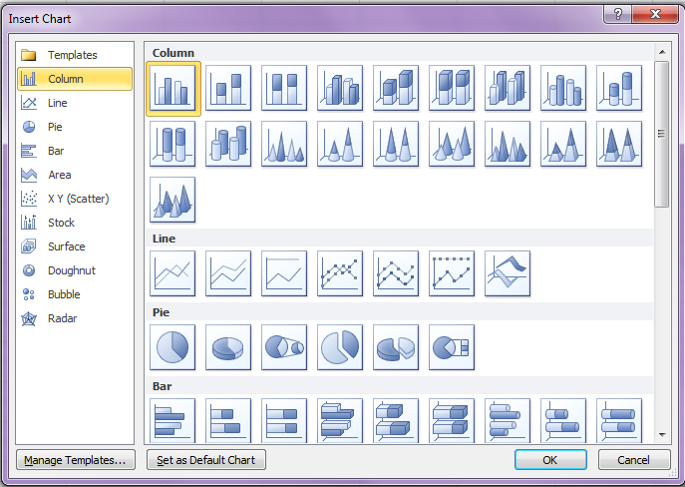
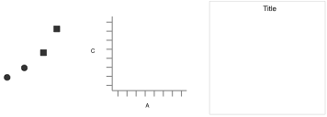
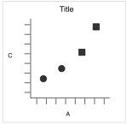
Grammar of Graphics
Move From:
Toward:
+
+

Slide 6
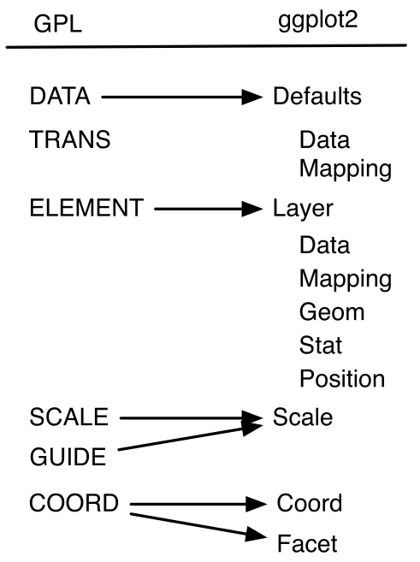
Grammar of Graphics and ggplot
DATA – operations that create variables from datasets
TRANS – variable transformations
ELEMENT – graphs and their aesthetic attributes
SCALE – scale transformations
GUIDE – one or more guides
COORD – a coordinate system
Adapted from: http://www.slideshare.net/maikroeder/introduction-to-ggplot2?related=1
and http://vita.had.co.nz/papers/layered-grammar.pdf

Slide 7
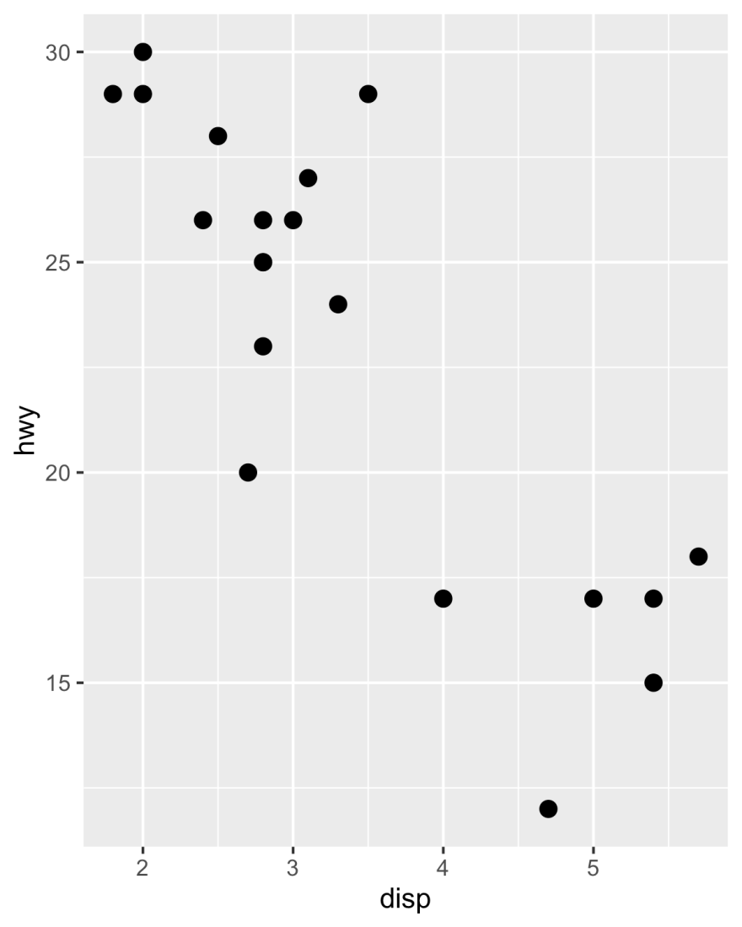
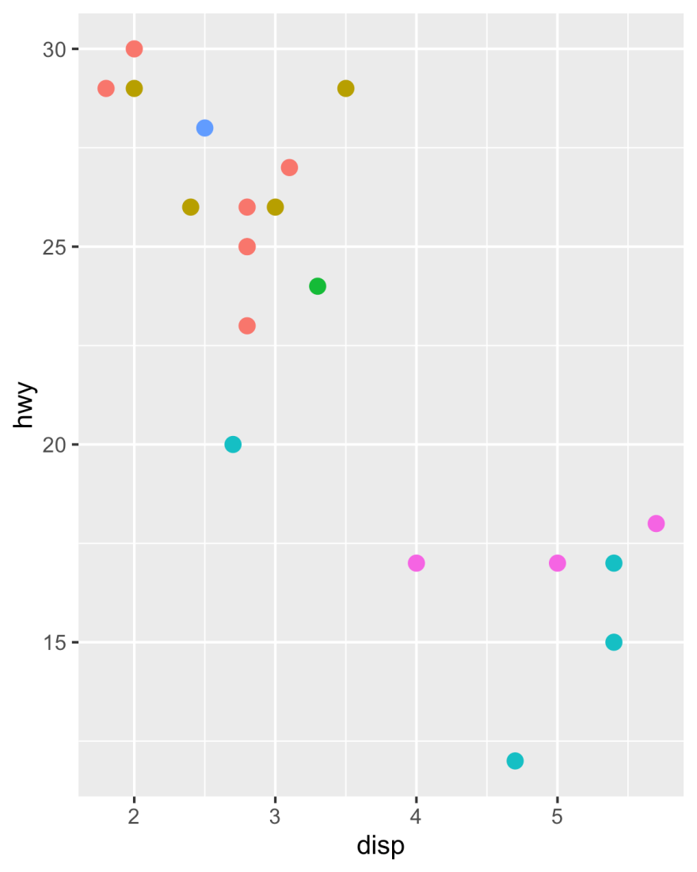
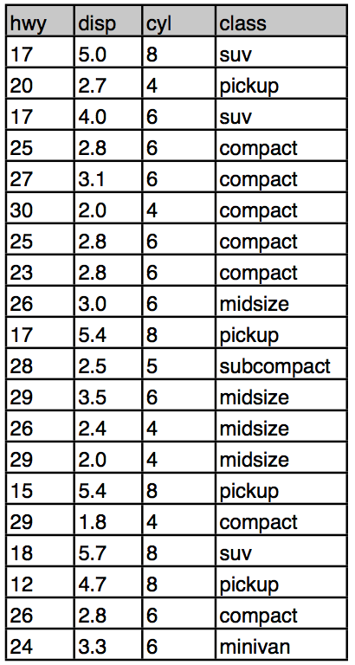
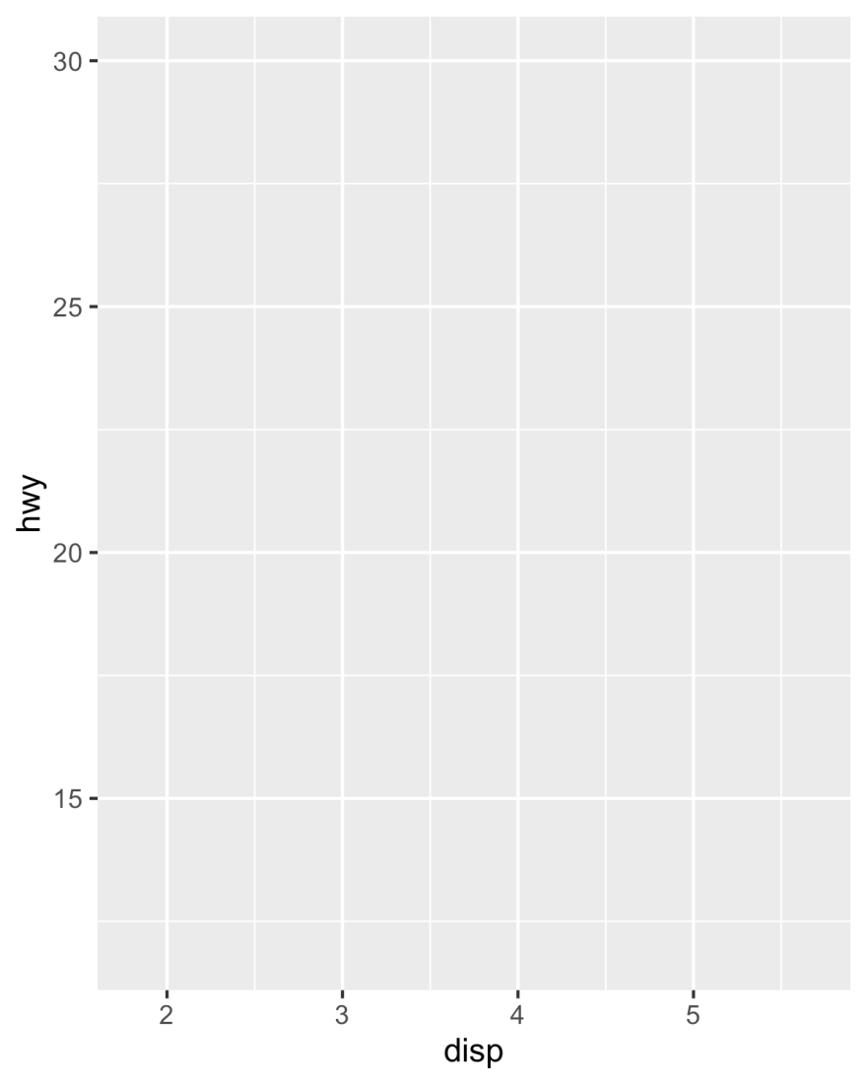
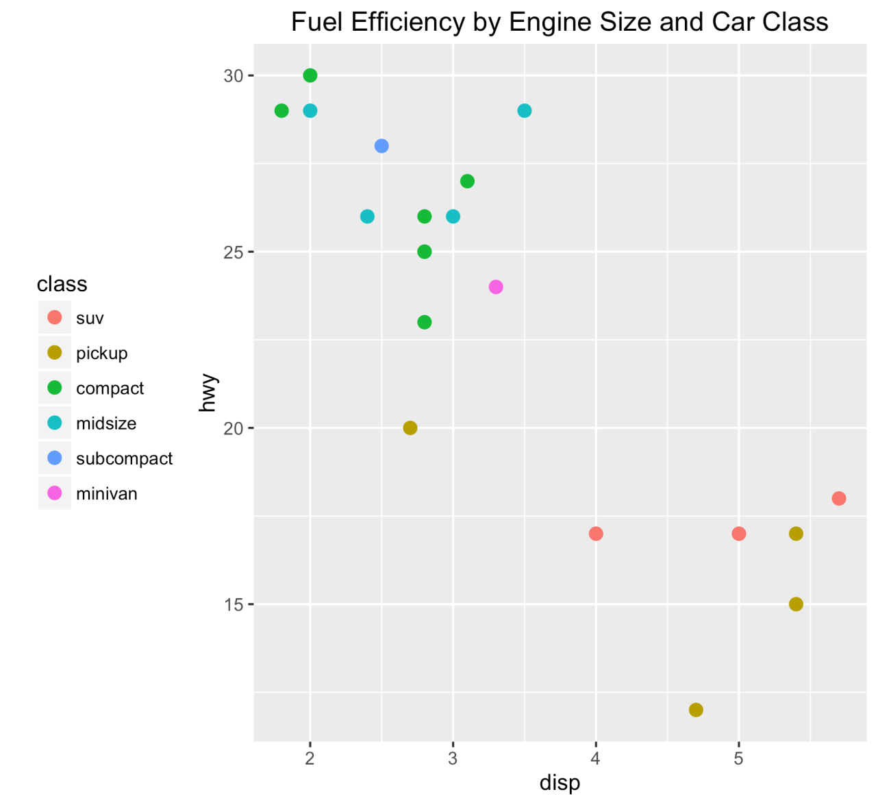
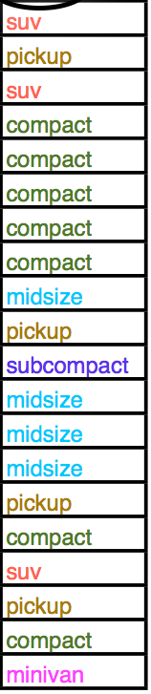
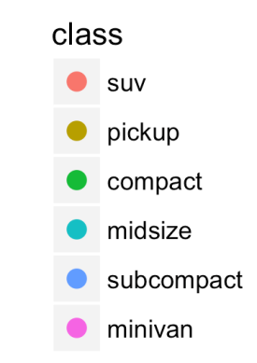
Building a Plot
= y
= x
Color
Mapping (aesthetics)
Guides
Element(geom)
Coordinate System
Data
Adapted from: https://www.r-project.org/nosvn/conferences/useR-2013/Tutorials/Grolemund.html

Slide 8
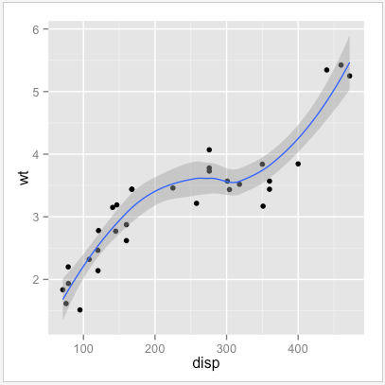
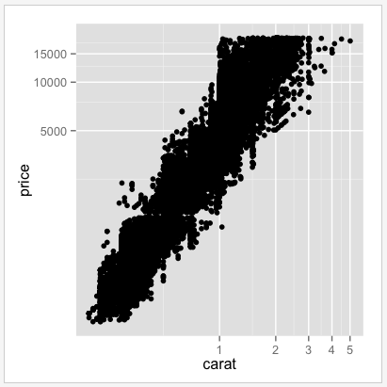
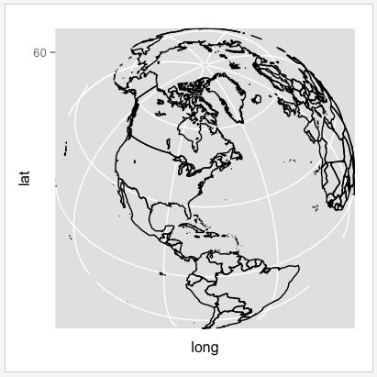
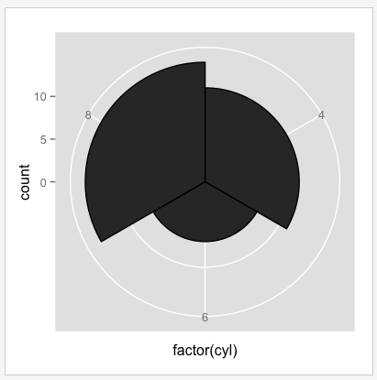
Coordinate Options
coord_cartesian (default)
coord_trans
coord_map
coord_polar

Slide 9
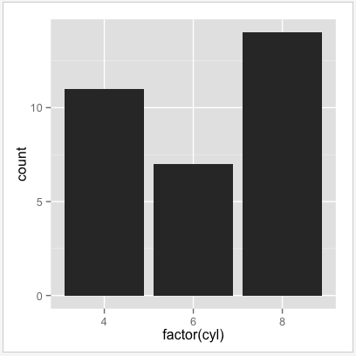
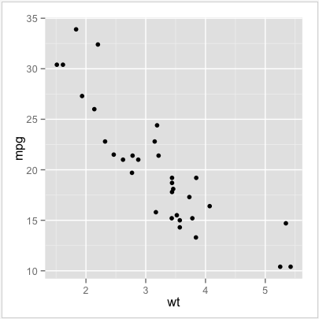
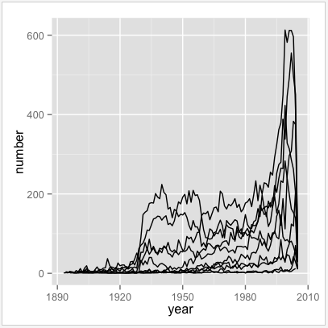
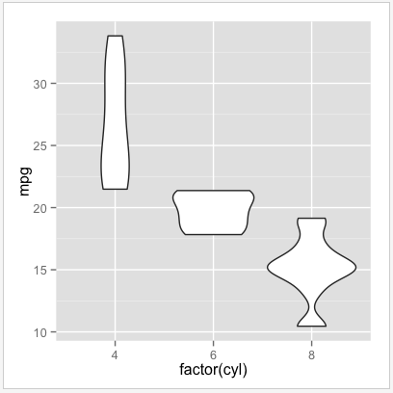
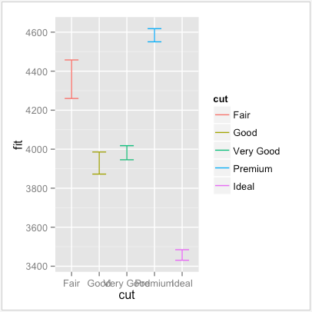
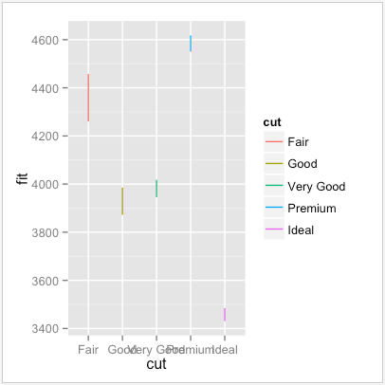
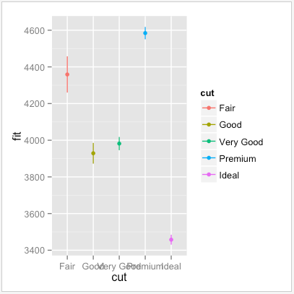
Geoms (subset)
geom_bar
geom_point
geom_line
geom_violin
geom_errorbar
geom_linerange
geom_pointrange

Slide 10
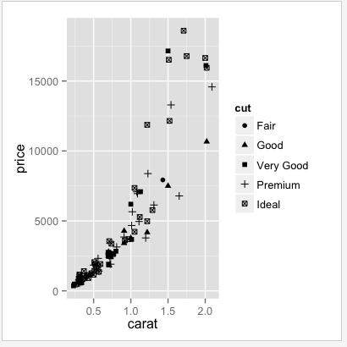
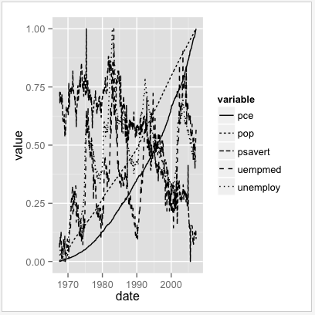
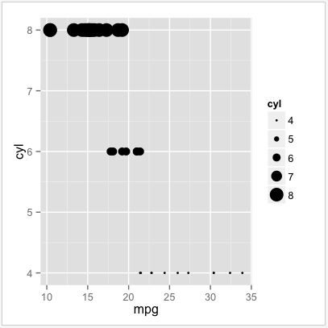
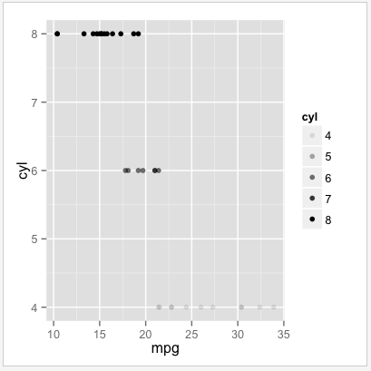
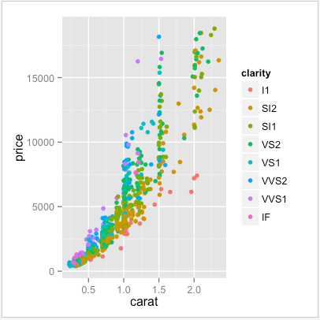
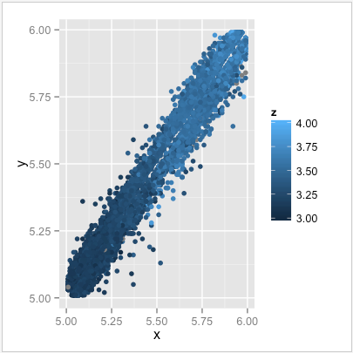
Scales (subset)
scale_shape
scale_linetype
scale_size
scale_alpha
scale_colour_brewer
scale_colour_gradient

Slide 11
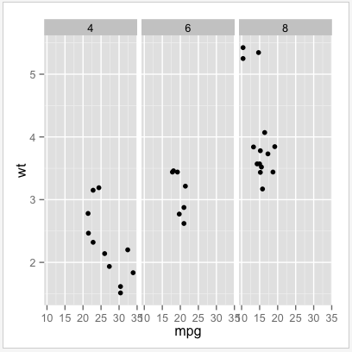
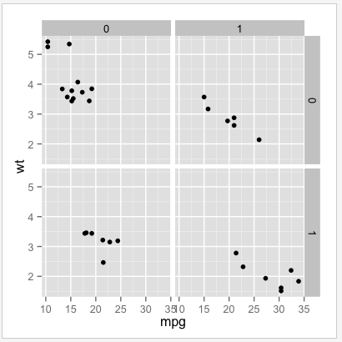
Faceting
facet_grid
(1 variable)
facet_grid
(2 variables)

Slide 12
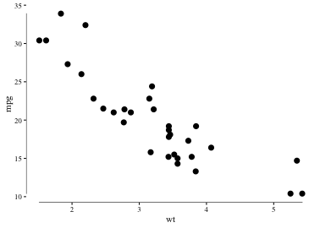
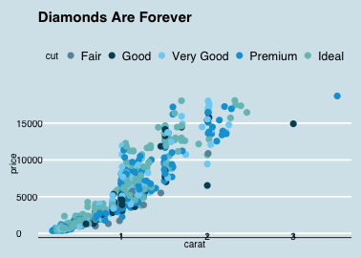
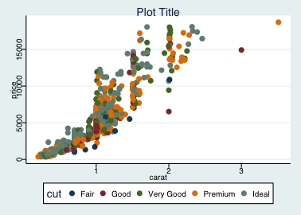
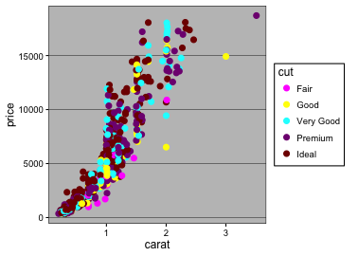
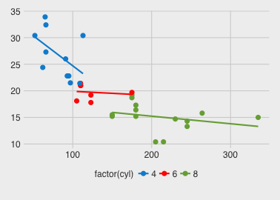
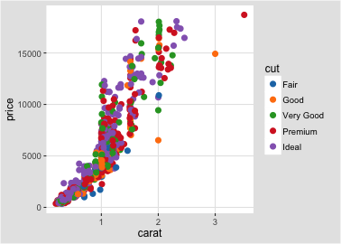
Themes (from jrnold/ggthemes)
theme_tufte
theme_economist
theme_stata
theme_excel
theme_fivethirtyeight
Tableau:
theme_igray

Slide 13
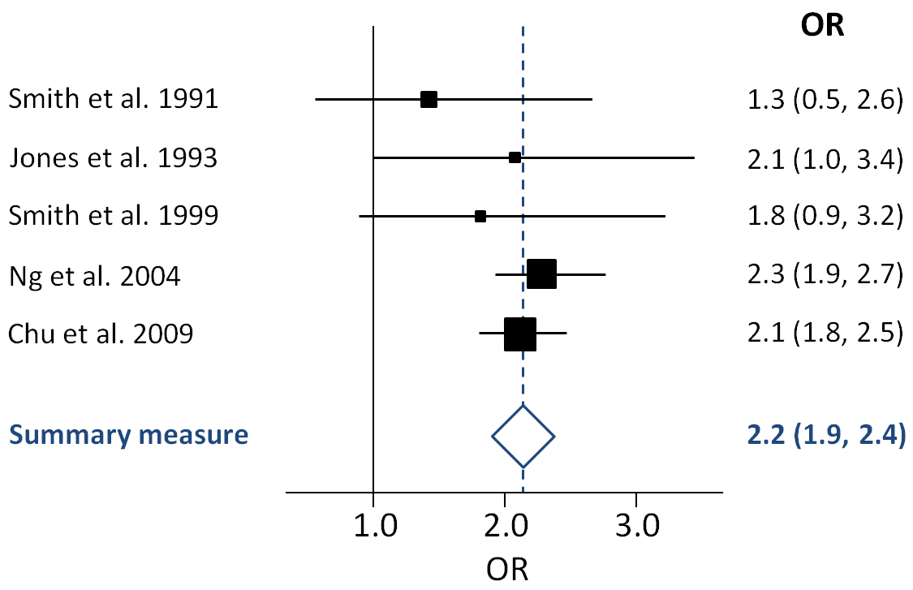
Example
Data:
Variables:
Odds Ratio
95th Percent Confidence Interval
P-Value
Fields
Genetic Markers
Unadjusted
Adjusted using gold standard
Adjusted using new method
Original Association Odds Ratios
Goal: Show how my new method compared to current gold standard when used as covariate

