Slide 1


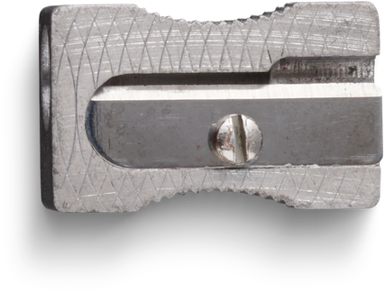




2026
REPTE D’HORARIS I ESPAIS
Presented by
404:braincells

Slide 2

Gracias

