Slide 1
DATA SCIENCE Class 3: Data Visualization
Notes:
~15-20 min on initial stuff
Note: example DS problem…write down some features, how could you build a predictive model from these?

Slide 2
I. The importance of visualization II. Visualization as a medium Lab: III. Visualization in R
agenda
Notes:
All of our classes will involve some hands-on work (in the exercises section)

Slide 3
I. The importance of visualization
INTRO TO DATA SCIENCE
Notes:
~45 min?

Slide 4
Visualization vs. summary statistics
THE IMPORTANCE OF DATA VISUALIZATION
Notes:
~15-20 min for this section?

Slide 5
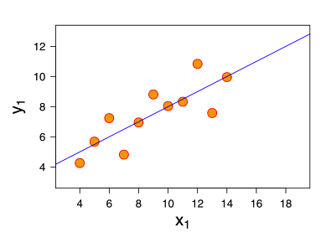
THE IMPORTANCE OF DATA VISUALIZATION
Consider the following dataset:
eleven (x, y) points
Notes:
So far so good

Slide 6
THE IMPORTANCE OF DATA VISUALIZATION
Consider the following dataset:
eleven (x, y) points
mean of x = 9, mean of y = 7.5
Notes:
Q: Does everyone know what the mean is?

Slide 7
THE IMPORTANCE OF DATA VISUALIZATION
Consider the following dataset:
eleven (x, y) points
mean of x = 9, mean of y = 7.5
variance of x = 11, variance of y = 4.1
Notes:
Q: Does anyone know what the variance is?
Q: More importantly, do you know what the variance tells you?

Slide 8
THE IMPORTANCE OF DATA VISUALIZATION
Consider the following dataset:
eleven (x, y) points
mean of x = 9, mean of y = 7.5
variance of x = 11, variance of y = 4.1
correlation of x and y = 0.8
Notes:
Q: Does everyone know what correl is?
Q: More importantly, do you know what correl tells you?
(Pearson’s correlation, of course)

Slide 9
THE IMPORTANCE OF DATA VISUALIZATION
Consider the following dataset:
eleven (x, y) points
mean of x = 9, mean of y = 7.5
variance of x = 11, variance of y = 4.1
correlation of x, y = 0.8
line of best fit: y = 3.00 + 0.500x
Notes:
Q: Does everyone know what a line of best fit is?
Q: More importantly, do you know what the line of best fit tells you?

Slide 10
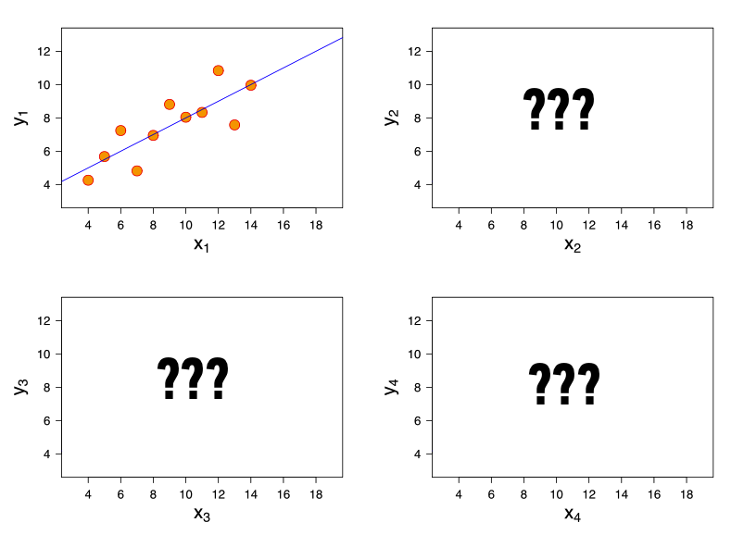
THE IMPORTANCE OF DATA VISUALIZATION
Now, suppose I give you
three more datasets
with exactly the same
characteristics…
Q: how similar are these datasets?

Slide 11
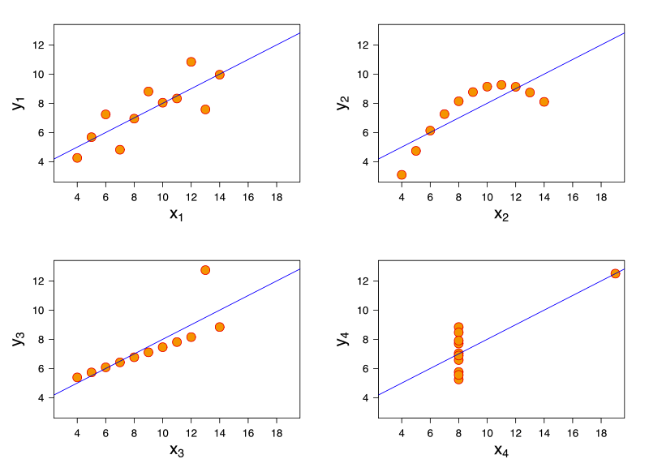
THE IMPORTANCE OF DATA VISUALIZATION
Now, suppose I give you
three more datasets
with exactly the same
characteristics.
Q: how similar are these datasets?
A: not very!
http://en.wikipedia.org/wiki/Anscombe's_quartet

Slide 12
Visualization INTERACTS WITH INTERPRETATION
THE IMPORTANCE OF DATA VISUALIZATION
Notes:
~15-20 min for this section?

Slide 13
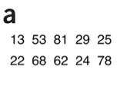
THE IMPORTANCE OF DATA VISUALIZATION

Slide 14
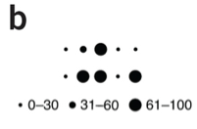
THE IMPORTANCE OF DATA VISUALIZATION

Slide 15
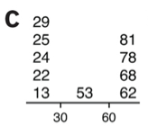
THE IMPORTANCE OF DATA VISUALIZATION

Slide 16
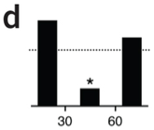
THE IMPORTANCE OF DATA VISUALIZATION

Slide 17
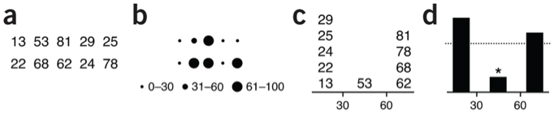
THE IMPORTANCE OF DATA VISUALIZATION

Slide 18
II. Visualization as a medium
INTRO TO DATA SCIENCE
Notes:
Show some viz, talk about viz

Slide 19
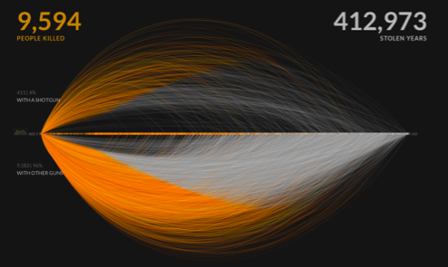
VISUALIZATION AS A MEDIUM
Notes:
Show some viz, talk about viz

Slide 20
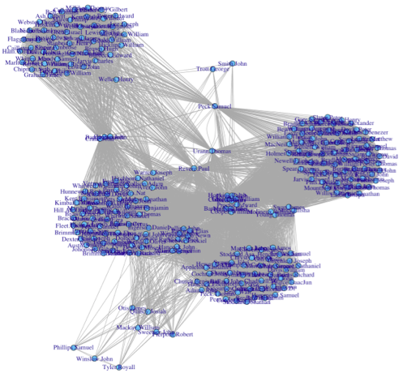
VISUALIZATION AS A MEDIUM
Notes:
Show some viz, talk about viz

Slide 21
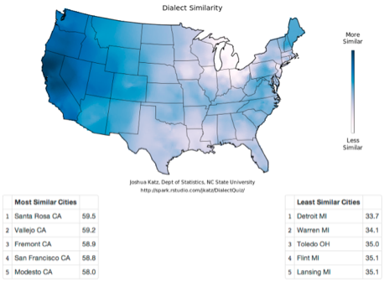
VISUALIZATION AS A MEDIUM
Notes:
Show some viz, talk about viz

Slide 22
III. Visualization in R
INTRO TO DATA SCIENCE

