Slide 1
INTRO to DATA SCIENCE machine learning / KNN
Notes:
High level, but ‘zooming in’ from last lecture

Slide 2
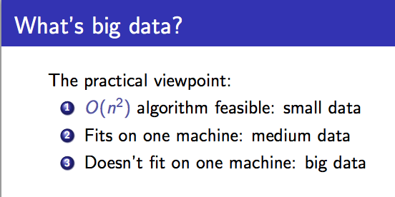
Buzzword break
source: http://people.cs.umass.edu/~mcgregor/stocworkshop/langford.pdf

Slide 3
I. what is machine learning? iI. machine learning problems III. Classification with K Nearest Neighbors
agenda

Slide 4
I. What is machine learning?
INTRO TO DATA SCIENCE
Notes:
~20 min

Slide 5
What is machine learning?
from Wikipedia:
“Machine learning, a branch of artificial intelligence, is about the construction and study of systems that can learn from data.”
source: http://en.wikipedia.org/wiki/Machine_learning
Notes:
Data-oriented

Slide 6
What is machine learning?
from Wikipedia:
“Machine learning, a branch of artificial intelligence, is about the construction and study of systems that can learn from data.”
“The core of machine learning deals with representation and generalization…”
source: http://en.wikipedia.org/wiki/Machine_learning

Slide 7
What is machine learning?
from Wikipedia:
“Machine learning, a branch of artificial intelligence, is about the construction and study of systems that can learn from data.”
“The core of machine learning deals with representation and generalization…”
representation – extracting structure from data
source: http://en.wikipedia.org/wiki/Machine_learning
Notes:
Representation: Helps you figure out what you’re looking at
Q: can you think of examples?

Slide 8
What is machine learning?
from Wikipedia:
“Machine learning, a branch of artificial intelligence, is about the construction and study of systems that can learn from data.”
“The core of machine learning deals with representation and generalization…”
representation – extracting structure from data
generalization – making predictions from data
source: http://en.wikipedia.org/wiki/Machine_learning
Notes:
Genlzn: helps you figure out what is likely to happen in the future
Keep these terms in mind…later we will use them to think about ML problems (write these on the white board)

Slide 9
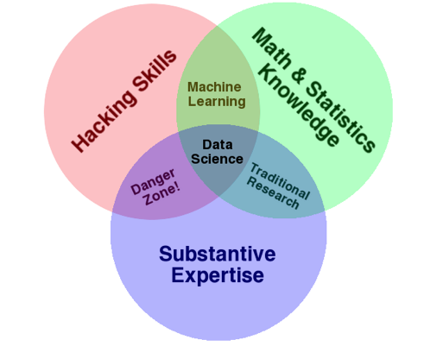

You want to go here
+ PROBLEM SOLVING!
source: http://www.dataists.com/2010/09/the-data-science-venn-diagram/

Slide 10
II. machine learning problems
INTRO TO DATA SCIENCE
Notes:
~20 min

Slide 11
Types of learning problems
supervised making predictions
unsupervised extracting structure
Notes:
Q: can you think of examples?
Q: how could an algorithm “learn” from data in either of these cases?

Slide 12
generalization
supervised making predictions
unsupervised extracting structure
representation
Notes:
“Core of ML” from before ←→ types of learning problems

Slide 13
generalization
supervised making predictions
unsupervised extracting structure
representation
NOT EXCLUSIVELY DICHOTOMOUS!
Notes:
“Core of ML” from before ←→ types of learning problems

Slide 14
Types of data
continuous categorical
quantitative qualitative
Notes:
Note: these characterize
Q: can you think of examples?
Q: what kinds of learning tasks could we carry out with these types of data?

Slide 15
TYPES OF DATA
15
continuous categorical
color RGB-values {red, blue}
ratings 1 – 10 rating 1-5 star rating
Notes:
Note: these characterize
Q: can you think of examples?
Q: what kinds of learning tasks could we carry out with these types of data?

Slide 16
Types of data
continuous categorical
quantitative qualitative
NOTE
The space where data live is called the feature space.
Each point in this space is called a record.
Notes:
Note: these characterize the dependent (target) variables!

Slide 17
Types of ML solutions
continuous categorical
supervised regression classification
unsupervised dimension reduction clustering
Notes:
Q: do you know of any particular models/algorithms that fit into these categories?
Classification for targeting ads (likely purchasers), regression, clustering (recsys), dim reduction (mtx decomposition)
Combo: nnmf (netflix prize)

Slide 18
Types of ML solutions
continuous categorical
supervised regression classification
unsupervised dimension reduction clustering
NOTE
We will implement solutions using models and algorithms.
Each will fall into one of these four buckets.
Notes:
Q: are these terms familiar?
Q: can you think of particular algorithms that fit into these categories?

Slide 19
What is the goal of machine learning?
QUESTION
Notes:
~3 min
Talk to the person next to you for a couple minute, decide on an answer together

Slide 20
goals of ml
Academic goal: make good predictions by some metric.
supervised making predictions
unsupervised extracting structure
Practical goal: provide insight and solve problems.
The goal is determined by the type of problem.
Notes:
Aha!

Slide 21
How do you determine the right approach?
QUESTION
Notes:
~3 min
Talk amongst yourselves

Slide 22
Approaches to ml problems
continuous categorical
supervised regression classification
unsupervised dimension reduction clustering
ANSWER
The right approach is determined by the desired solution and the data available.
Notes:
Makes sense

Slide 23

TYPES OF ML SOLUTIONS
23
What type of problem is this?
Music Recommendation
Notes:
Q: are these terms familiar?
Q: can you think of particular algorithms that fit into these categories?

Slide 24
TYPES OF ML SOLUTIONS
24
What type of problem is this?
Music Recommendation
It could be either.
Notes:
Q: are these terms familiar?
Q: can you think of particular algorithms that fit into these categories?

Slide 25
TYPES OF ML SOLUTIONS
25
What type of problem is this?
Music Recommendation
as Supervised Learning
Predict which songs a user
will ‘thumbs-up’
Notes:
Q: are these terms familiar?
Q: can you think of particular algorithms that fit into these categories?

Slide 26
TYPES OF ML SOLUTIONS
26
What type of problem is this?
Music Recommendation
As Unsupervised Learning
Cluster songs based on attributes
and recommend songs in the same group
Notes:
Q: are these terms familiar?
Q: can you think of particular algorithms that fit into these categories?

Slide 27
HOW do you KNOW IF you’rE DOING WELL?
QUESTION
Notes:
~3 min
Discuss

Slide 28
ASSESSING ML PERFORMANCE
28
supervised making predictions
unsupervised extracting structure
Notes:
Aha!

Slide 29
ASSESSING ML PERFORMANCE
29
supervised test out your predictions
Notes:
Aha!

Slide 30
ASSESSING ML PERFORMANCE
30
supervised test out your predictions
unsupervised …
Notes:
Aha!

Slide 31
ASSESSING ML PERFORMANCE
31
supervised test out your predictions
unsupervised …
ALSO
There may be external sources of feedback, for example conversion rates in production systems.
Notes:
Aha!

Slide 32
what do you do with your results?
QUESTION
Notes:
~3 min
Discuss

Slide 33
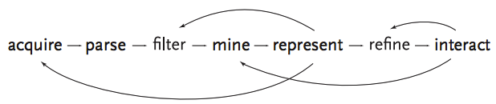
the data science workflow
ANSWER
Interpret them and react accordingly - application.
source: http://benfry.com/phd/dissertation-110323c.pdf
Notes:
Plug yourself back into the workflow at the right stage
Q: How do you know what the right stage is?

Slide 34
the data science workflow
ANSWER
Interpret them and react accordingly
NOTE
This also relies on your problem solving skills!
source: http://benfry.com/phd/dissertation-110323c.pdf
Notes:
Do your results justify action? Further analysis? Revising your original analysis? Changing your approach altogether?
→ These are the types of practical questions we will gain experience with through the hands-on sections of the course!

Slide 35
III. Classification wITH KNN
INTRO TO DATA SCIENCE

Slide 36
Classification problems
continuous categorical
supervised ??? ???
unsupervised ??? ???
Notes:
Q: Where does classification belong in this diagram?
Making predictions or extracting structure?
Quantitative data or qualitative data?

Slide 37

Classification problems
continuous categorical
supervised regression classification
unsupervised dimension reduction clustering
Notes:
Supervised learning problem w/ categorical target variables
→ What do these terms mean?

Slide 38
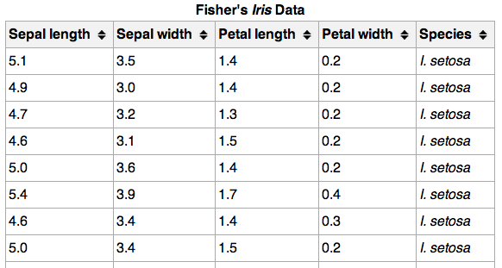
Classification problems
Here’s (part of) an example dataset:
Notes:
variables = columns, observations/records = rows

Slide 39
Classification problems
Here’s (part of) an example dataset:
{
independent
variables
Notes:
4 independent vars (cts)
Note: vars = columns, records = rows

Slide 40
Classification problems
Here’s (part of) an example dataset:
{
{
independent
variables
class
labels
(categorical)
Notes:
Class label = target variable, the thing we want to predict

Slide 41
Classification problems
Q: What does “supervised” mean?
Notes:
Q: any ideas?

Slide 42
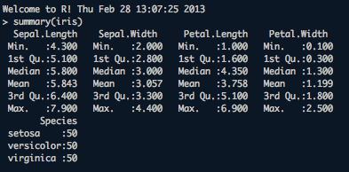
Classification problems
Q: What does “supervised” mean?
A: We know the labels.

Slide 43
Classification problems
Q: How does a classification problem work?
Notes:
Q: how are we going to use the data?

Slide 44
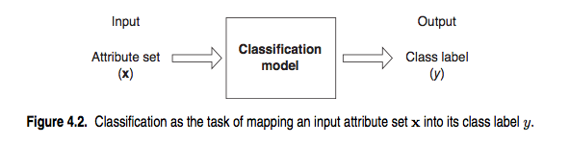
Classification problems
Q: How does a classification problem work?
A: Data in, predicted labels out.
source: http://www-users.cs.umn.edu/~kumar/dmbook/ch4.pdf

Slide 45
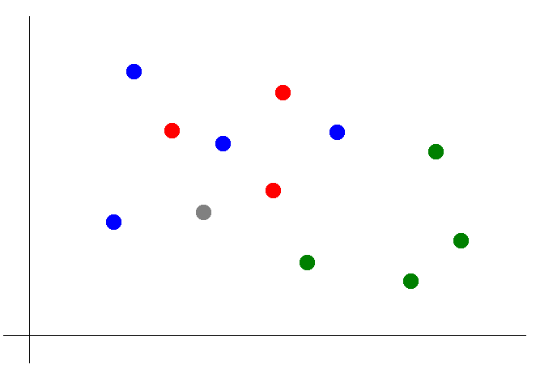
Knn classification - basics
Suppose we want to predict the color of the grey dot.

Slide 46
Knn classification - basics
Suppose we want to predict the color of the grey dot.
QUESTION:
What are the features? What are the labels?

Slide 47
Knn classification - basics
Suppose we want to predict the color of the grey dot.

Slide 48
Knn classification
Suppose we want to predict the color of the grey dot.
1) Pick a value for k.
k = 3

Slide 49
Knn classification
Suppose we want to predict the color of the grey dot.
1) Pick a value for k.
2) Find colors of k nearest neighbors.
k = 3

Slide 50
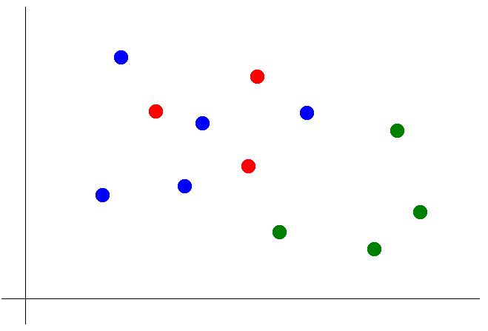
Knn classification
Suppose we want to predict the color of the grey dot.
1) Pick a value for k.
2) Find colors of k nearest neighbors.
3) Assign the most common color
to the grey dot.

Slide 51
Knn classification
Suppose we want to predict the color of the grey dot.
1) Pick a value for k.
2) Find colors of k nearest neighbors.
3) Assign the most common color
to the grey dot.
NOTE:
Our definition of “nearest” implicitly uses the Euclidean distance function.
Notes:
We will have more to say about distance functions later

Slide 52
INTRO TO DATA SCIENCE
Notes:
~20 min
Q: what do you think of the math we saw?
Q: how do you like using R?
Q: does anything seem mysterious?

