Slide 1
INTRO to DATA SCIENCE EVALUATION METRICS AND PROCEDURES

Slide 2
FOR PREDICTION: I. EVALUATION METRICS iI. EVALUATION PROCEDURES
agenda

Slide 3
I. Evaluation METRICS
INTRO TO DATA SCIENCE

Slide 4
EVALUATION METRICS
For categorical labels
For rankings/scorings
For numeric predictions

Slide 5
EVALUATION METRICS
> confusionMatrix(predicted, truth)
Confusion Matrix and Statistics
Reference
Prediction OJ VC
OJ 25 9
VC 5 21
Accuracy : 0.7667
No Information Rate : 0.5
Kappa : 0.5333
Sensitivity : 0.8333
Specificity : 0.7000
Pos Pred Value : 0.7353
Neg Pred Value : 0.8077
Prevalence : 0.5000
Detection Rate : 0.4167
Detection Prevalence : 0.5667
Balanced Accuracy : 0.7667

Slide 6
EVALUATION METRICS
more

Slide 7
II. Evaluation PROCEDURES
INTRO TO DATA SCIENCE

Slide 8
Training error
Q: What’s wrong with training error?

Slide 9
Training error
Q: What’s wrong with training error?
Thought experiment:
Suppose we train our model using the entire dataset.

Slide 10
Training error
Q: What’s wrong with training error?
Thought experiment:
Suppose we train our model using the entire dataset.
Q: How low can we push the training error?

Slide 11
Training error
Q: What’s wrong with training error?
Thought experiment:
Suppose we train our model using the entire dataset.
Q: How low can we push the training error?
We can make the model arbitrarily complex (effectively
“memorizing” the entire training set).

Slide 12
Training error
Q: What’s wrong with training error?
Thought experiment:
Suppose we train our model using the entire dataset.
Q: How low can we push the training error?
We can make the model arbitrarily complex (effectively
“memorizing” the entire training set).
A: Down to zero!

Slide 13

Training error
Q: What’s wrong with training error?
Thought experiment:
Suppose we train our model using the entire dataset.
Q: How low can we push the training error?
We can make the model arbitrarily complex (effectively
“memorizing” the entire training set).
A: Down to zero!
NOTE
This phenomenon
is called
overfitting.

Slide 14
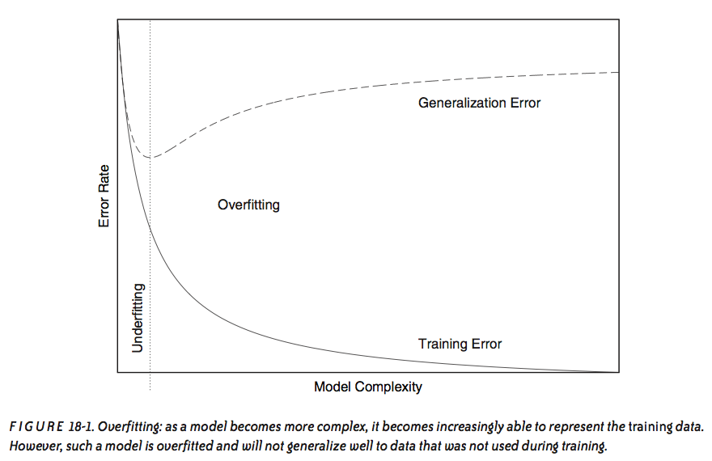
Overfitting
source: Data Analysis with Open Source Tools, by Philipp K. Janert. O’Reilly Media, 2011.

Slide 15
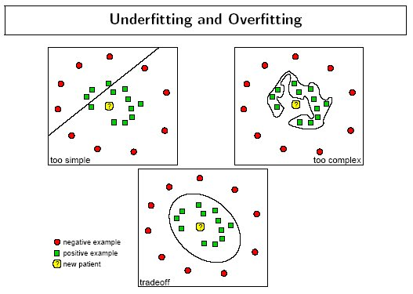
Overfitting - example
source: http://www.dtreg.com
Notes:
vocab: “decision boundary”

Slide 16
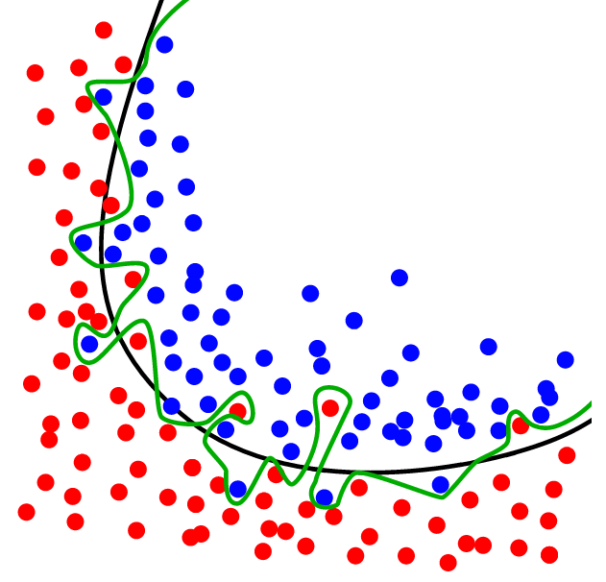
Overfitting - example
source: http://www.dtreg.com

Slide 17
Training error
Q: What’s wrong with training error?
Thought experiment:
Suppose we train our model using the entire dataset.
Q: How low can we push the training error?
We can make the model arbitrarily complex (effectively
“memorizing” the entire training set).
A: Down to zero!
A: Training error is not a good estimate of accuracy beyond training data.
NOTE
This phenomenon
is called
overfitting.
Notes:
Need to use genlzn error to get a better estimate.
Recall “useful things” paper: we don’t have direct access to our objective function

Slide 18

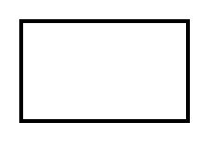
EVALuation PROCEDURES
Q: How can we make a model that generalizes well?
model
dataset

Slide 19
EVALuation PROCEDURES
Q: How can we make a model that generalizes well?
1) split dataset
model
dataset
Notes:
this split is random & uneven…70/30 is a good place to start
We’ll talk about the reason for this in just a minute.

Slide 20

EVALuation PROCEDURES
Q: How can we make a model that generalizes well?
1) split dataset
2) train model
training set
model
dataset

Slide 21

EVALuation PROCEDURES
Q: How can we make a model that generalizes well?
1) split dataset
2) train model
3) test model
training set
model
test set
dataset

Slide 22
EVALuation PROCEDURES
Q: How can we make a model that generalizes well?
1) split dataset
2) train model
3) test model
4) iterate
training set
model
test set
dataset

Slide 23
EVALuation PROCEDURES
Q: How can we make a model that generalizes well?
1) split dataset
2) train model
3) test model
4) iterate
5) choose final model
training set
model
test set
dataset

Slide 24
EVALuation PROCEDURES
Q: How can we make a model that generalizes well?
1) split dataset
2) train model
3) test model
4) iterate
5) choose final model
6) train on all data
training set
model
test set
dataset

Slide 25
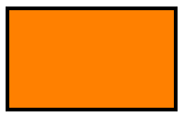
EVALuation PROCEDURES
Q: How can we make a model that generalizes well?
1) split dataset
2) train model
3) test model
4) iterate
5) choose final model
6) train on all data
7) make predictions
training set
model
test set
new data
dataset
Notes:
Q: how is the new data different?
A: we don’t know the labels…predicting these labels = purpose of our model

Slide 26
EVALuation PROCEDURES
Q: How can we make a model that generalizes well?
1) split dataset
2) train model
3) test model
4) iterate
5) choose final model
6) train on all data
7) make predictions
NOTE
This new data is called out of sample
data.
We don’t know the labels for these OOS records!
training set
model
test set
new data
dataset
Notes:
Q: how is the new data different?
A: we don’t know the labels → predicting these labels = purpose of our model

Slide 27
EVALuation PROCEDURES
Q: What types of prediction error will we run into?
training set
model
test set
new data
dataset
Notes:
Think in terms of our diagram.

Slide 28
EVALuation PROCEDURES
Q: What types of prediction error will we run into?
1) training error
training set
model
test set
new data
dataset

Slide 29
EVALuation PROCEDURES
Q: What types of prediction error will we run into?
1) training error
2) generalization error
training set
model
test set
new data
dataset
Notes:
also called test-set error

Slide 30
EVALuation PROCEDURES
Q: What types of prediction error will we run into?
1) training error
2) generalization error
3) OOS error
training set
model
test set
new data
dataset
Notes:
Recall OOS = out of sample

Slide 31
EVALuation PROCEDURES
Q: What types of prediction error will we run into?
1) training error
2) generalization error
3) OOS error
NOTE
We want to estimate
OOS prediction error so we know what to expect from our model.
training set
model
test set
new data
dataset

Slide 32
Generalization error
Suppose we do the train/test split.

Slide 33
Generalization error
Suppose we do the train/test split.
Q: How well does generalization error predict OOS accuracy?

Slide 34
Generalization error
Suppose we do the train/test split.
Q: How well does generalization error predict OOS accuracy?
Thought experiment:
Suppose we had done a different train/test split.

Slide 35
Generalization error
Suppose we do the train/test split.
Q: How well does generalization error predict OOS accuracy?
Thought experiment:
Suppose we had done a different train/test split.
Q: Would the generalization error remain the same?

Slide 36
Generalization error
Suppose we do the train/test split.
Q: How well does generalization error predict OOS accuracy?
Thought experiment:
Suppose we had done a different train/test split.
Q: Would the generalization error remain the same?
A: Of course not!

Slide 37
Generalization error
Suppose we do the train/test split.
Q: How well does generalization error predict OOS accuracy?
Thought experiment:
Suppose we had done a different train/test split.
Q: Would the generalization error remain the same?
A: Of course not!
A: On its own, not very well.

Slide 38
Generalization error
Suppose we do the train/test split.
Q: How well does generalization error predict OOS accuracy?
Thought experiment:
Suppose we had done a different train/test split.
Q: Would the generalization error remain the same?
A: Of course not!
A: On its own, not very well.
NOTE
The generalization error gives a
high-variance estimate
of OOS accuracy.
Notes:
Bias-variance tradeoff!
(Training error is biased estimate of OOS prediction error)

Slide 39
Generalization error
Something is still missing!
Notes:
Q: any ideas at this point what we can do to improve our estimate?

Slide 40
Generalization error
Something is still missing!
Q: How can we do better?

Slide 41
Generalization error
Something is still missing!
Q: How can we do better?
Thought experiment:
Different train/test splits will give us different generalization errors.

Slide 42
Generalization error
Something is still missing!
Q: How can we do better?
Thought experiment:
Different train/test splits will give us different generalization errors.
Q: What if we did a bunch of these and took the average?

Slide 43
Generalization error
Something is still missing!
Q: How can we do better?
Thought experiment:
Different train/test splits will give us different generalization errors.
Q: What if we did a bunch of these and took the average?
A: Now you’re talking!

Slide 44
Generalization error
Something is still missing!
Q: How can we do better?
Thought experiment:
Different train/test splits will give us different generalization errors.
Q: What if we did a bunch of these and took the average?
A: Now you’re talking!
A: Cross-validation.

Slide 45
Cross-validation
Steps for n-fold cross-validation:
Notes:
Draw n-fold partition on the whiteboard

Slide 46
Cross-validation
Steps for n-fold cross-validation:
1) Randomly split the dataset into n equal partitions.

Slide 47
Cross-validation
Steps for n-fold cross-validation:
1) Randomly split the dataset into n equal partitions.
2) Use partition 1 as test set & union of other partitions as training set.
Notes:
Q: partitions = equally-sized subsets st. none intersect & union of all partitions is the entire set

Slide 48
Cross-validation
Steps for n-fold cross-validation:
1) Randomly split the dataset into n equal partitions.
2) Use partition 1 as test set & union of other partitions as training set.
3) Find generalization error.

Slide 49
Cross-validation
Steps for n-fold cross-validation:
1) Randomly split the dataset into n equal partitions.
2) Use partition 1 as test set & union of other partitions as training set.
3) Find generalization error.
4) Repeat steps 2-3 using a different partition as the test set at each iteration.

Slide 50
Cross-validation
Steps for n-fold cross-validation:
1) Randomly split the dataset into n equal partitions.
2) Use partition 1 as test set & union of other partitions as training set.
3) Find generalization error.
4) Repeat steps 2-3 using a different partition as the test set at each iteration.
5) Take the average generalization error as the estimate of OOS accuracy.

Slide 51
Cross-validation
Features of n-fold cross-validation:

Slide 52
Cross-validation
Features of n-fold cross-validation:
1) More accurate estimate of OOS prediction error.

Slide 53
Cross-validation
Features of n-fold cross-validation:
1) More accurate estimate of OOS prediction error.
2) More efficient use of data than single train/test split.
- Each record in our dataset is used for both training and testing.
Notes:
Q: How often is each record used for training/testing?
A: Each record used for training n-1 times, used for testing exactly once

Slide 54
Cross-validation
Features of n-fold cross-validation:
1) More accurate estimate of OOS prediction error.
2) More efficient use of data than single train/test split.
- Each record in our dataset is used for both training and testing.
3) Presents tradeoff between efficiency and computational expense.
- 10-fold CV is 10x more expensive than a single train/test split
Notes:
10 is a typical value for n, can also do n = total number of records (leave-one-out CV)

Slide 55
Cross-validation
Features of n-fold cross-validation:
1) More accurate estimate of OOS prediction error.
2) More efficient use of data than single train/test split.
- Each record in our dataset is used for both training and testing.
3) Presents tradeoff between efficiency and computational expense.
- 10-fold CV is 10x more expensive than a single train/test split
4) Can be used for model selection.
Notes:
(we won’t talk about this today)

Slide 56
Cross-validation
Features of n-fold cross-validation:
1) More accurate estimate of OOS prediction error.
2) More efficient use of data than single train/test split.
- Each record in our dataset is used for both training and testing.
3) Presents tradeoff between efficiency and computational expense.
- 10-fold CV is 10x more expensive than a single train/test split
4) Can be used for model selection.
NOTE
Leave one out cross-validation is a special case of n-fold cross-validation.
Notes:
(we won’t talk about this today)

Slide 57
INTRO TO DATA SCIENCE

