Slide 1
INTRO to DATA SCIENCE support vector machines

Slide 2
I. support vector machines II. Maximum margin hyperplanes III. Slack variables Iv. Nonlinear classification exercise: V. svm in scikit-learn
agenda

Slide 3
I. support vector machines
INTRO TO DATA SCIENCE

Slide 4
Support vector machines
Q: What is a support vector machine?

Slide 5
Support vector machines
Q: What is a support vector machine?
A: A binary linear classifier whose decision boundary is explicitly
constructed to minimize generalization error.

Slide 6
Support vector machines
Q: What is a support vector machine?
A: A binary linear classifier whose decision boundary is explicitly
constructed to minimize generalization error.
recall:
binary classifier – solves two-class problem
linear classifier – creates linear decision boundary (in 2d)
Notes:
Note: linear classifier – assumes data is *linearly separable*

Slide 7
Support vector machines
Q: How is the decision boundary derived?

Slide 8
Support vector machines
Q: How is the decision boundary derived?
A: Using geometric reasoning (as opposed to the algebraic reasoning we’ve used to derive other classifiers).

Slide 9

Support vector machines
Q: How is the decision boundary derived?
A: Using geometric reasoning (as opposed to the algebraic reasoning we’ve used to derive other classifiers).
NOTE
These are two different ways of looking at the same problem.
Familiarity with both leads to deeper understanding!
Notes:
Einstein: talking about physics w/o geometry is like talking about thoughts w/o words

Slide 10
Support vector machines
Q: How is the decision boundary derived?
A: Using geometric reasoning (as opposed to the algebraic reasoning we’ve used to derive other classifiers).
The generalization error is equated with the geometric concept of margin, which is the region along the decision boundary that is free of data points.

Slide 11
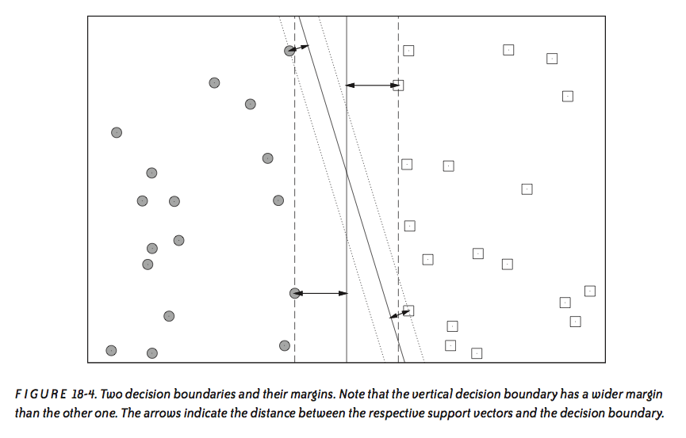
Support vector machines
source: Data Analysis with Open Source Tools, by Philipp K. Janert. O’Reilly Media, 2011.

Slide 12
Support vector machines
Q: How is the decision boundary derived?
A: Using geometric reasoning (as opposed to the algebraic reasoning we’ve used to derive other classifiers).
The goal of an SVM is to create the linear decision boundary with the largest margin. This is commonly called the maximum margin hyperplane.

Slide 13
Support vector machines
Q: How is the decision boundary derived?
A: Using geometric reasoning (as opposed to the algebraic reasoning we’ve used to derive other classifiers).
The goal of an SVM is to create the linear decision boundary with the largest margin. This is commonly called the maximum margin hyperplane.
NOTE
A hyperplane is just a high-dimensional generalization of a line.

Slide 14
Support vector machines
Q: If SVM is a linear classifier, how can you use it for nonlinear
classification?

Slide 15
Support vector machines
Q: If SVM is a linear classifier, how can you use it for nonlinear
classification?
A: Using a clever maneuver called the kernel trick.

Slide 16
The Kernel trick
Nonlinear applications of SVM rely on an implicit (nonlinear) mapping Φ that sends vectors from the original feature space K into a higher-dimensional feature space K’.

Slide 17
The Kernel trick
Nonlinear applications of SVM rely on an implicit (nonlinear) mapping Φ that sends vectors from the original feature space K into a higher-dimensional feature space K’.
Nonlinear classification in K is then obtained by creating a linear decision boundary in K’.

Slide 18
The Kernel trick
Nonlinear applications of SVM rely on an implicit (nonlinear) mapping Φ that sends vectors from the original feature space K into a higher-dimensional feature space K’.
Nonlinear classification in K is then obtained by creating a linear decision boundary in K’.
In practice, this involves no computations in the higher dimensional space!

Slide 19
II. maximum margin hyperplanes
INTRO TO DATA SCIENCE

Slide 20
Maximum margin hyperplanes
Q: How is the decision boundary (mmh) derived?

Slide 21

Maximum margin hyperplanes
Q: How is the decision boundary (mmh) derived?
A: By the discriminant function,
such that w is the weight vector and b is the bias.

Slide 22
Maximum margin hyperplanes
Q: How is the decision boundary (mmh) derived?
A: By the discriminant function,
such that w is the weight vector and b is the bias.
The sign of f(x) determines the (binary) class label of a record x.

Slide 23
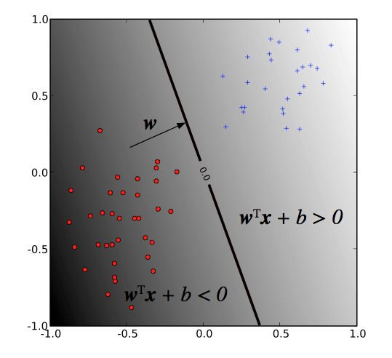
Maximum margin hyperplanes
NOTE
The weight vector determines the orientation of the decision boundary.
The bias determines its translation from the origin.
source: http://pyml.sourceforge.net/doc/howto.pdf

Slide 24
Maximum margin hyperplanes
As we said before, SVM solves for the decision boundary that minimizes generalization error, or equivalently, that has the maximum margin.
Q: Why are these the same thing?

Slide 25
Maximum margin hyperplanes
As we said before, SVM solves for the decision boundary that minimizes generalization error, or equivalently, that has the maximum margin.
Q: Why are these the same thing?
A: Because using the mmh as the decision boundary minimizes the
probability that a small perturbation in the position of a point
produces a classification error.

Slide 26
Maximum margin hyperplanes
As we said before, SVM solves for the decision boundary that minimizes generalization error, or equivalently, that has the maximum margin.
Q: Why are these the same thing?
A: Because using the mmh as the decision boundary minimizes the
probability that a small perturbation in the position of a point
produces a classification error.
NOTE
Intuitively, the wider the margin, the clearer the distinction between classes.

Slide 27
Maximum margin hyperplanes
Selecting the mmh is an exercise in analytic geometry.
In particular, this task reduces to the optimization of a convex objective function.
Notes:
details can be found in refs posted on schoology

Slide 28
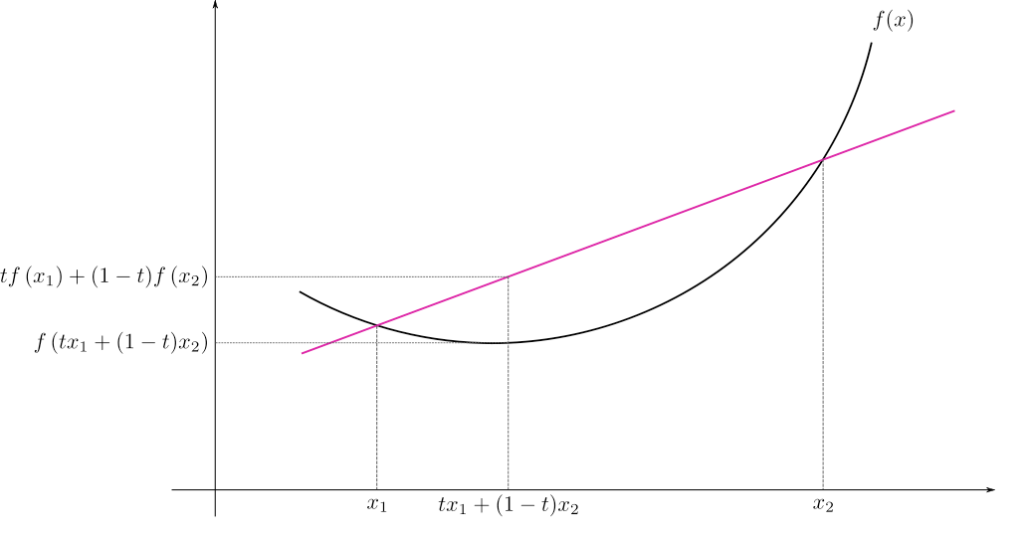
Convex functions
NOTE
The black curve f(x) is a convex function of x.
source: http://en.wikipedia.org/wiki/File:ConvexFunction.svg
Notes:
This picture illustrates “jensen’s inequality”: secant line of convex function f(x) lies above the graph of f(x)

Slide 29
Maximum margin hyperplanes
Selecting the mmh is a straightforward exercise in analytic geometry (we won’t go through the details here).
In particular, this task reduces to the optimization of a convex objective function.
This is nice because convex optimization problems are guaranteed to give global optima (and they’re easy to solve numerically too).

Slide 30
Maximum margin hyperplanes
Selecting the mmh is a straightforward exercise in analytic geometry (we won’t go through the details here).
In particular, this task reduces to the optimization of a convex objective function.
This is nice because convex optimization problems are guaranteed to give global optima (and they’re easy to solve numerically too).
NOTE
The heuristic techniques we’ve discussed (eg greedy algorithms) are not necessary with convex optimization!

Slide 31
Maximum margin hyperplanes
Notice that the margin depends only on a subset of the training data; namely, those points that are nearest to the decision boundary.

Slide 32
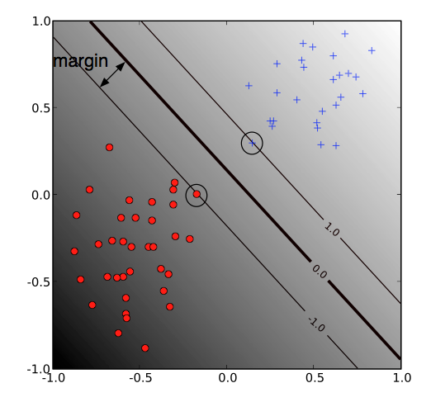
Maximum margin hyperplanes
source: http://pyml.sourceforge.net/doc/howto.pdf

Slide 33
Maximum margin hyperplanes
Notice that the margin depends only on a subset of the training data; namely, those points that are nearest to the decision boundary.
These points are called the support vectors.

Slide 34
Maximum margin hyperplanes
Notice that the margin depends only on a subset of the training data; namely, those points that are nearest to the decision boundary.
These points are called the support vectors.
The other points (far from the decision boundary) don’t affect the construction of the mmh at all!

Slide 35
Maximum margin hyperplanes
All of the decision boundaries we’ve seen so far have split the data perfectly; eg, the data are linearly separable, and therefore the training error is 0.

Slide 36

Maximum margin hyperplanes
All of the decision boundaries we’ve seen so far have split the data perfectly; eg, the data are linearly separable, and therefore the training error is 0.
The optimization problem that this SVM solves is:
Notes:
note: margin = 1/norm(w), so this min will maximize the margin
note: y = label (-1, +1)

Slide 37
Maximum margin hyperplanes
All of the decision boundaries we’ve seen so far have split the data perfectly; eg, the data are linearly separable, and therefore the training error is 0.
The optimization problem that this SVM solves is:
NOTE
This type of optimization problem can be solved with quadratic programming.
The result of this qp is the hard margin classifier we’ve been discussing.
Notes:
QP: quadratic opt w/ linear constraints

Slide 38
III. Slack varIables
INTRO TO DATA SCIENCE

Slide 39
Slack variables
Recall that in building the hard margin classifier, we assumed that our data was linearly separable (eg, that we could perfectly classify each record with a linear decision boundary).

Slide 40
Slack variables
Recall that in building the hard margin classifier, we assumed that our data was linearly separable (eg, that we could perfectly classify each record with a linear decision boundary).
Suppose that this was not true, or suppose that we wanted to use a larger margin at the expense of incurring some training error.

Slide 41
Slack variables
Recall that in building the hard margin classifier, we assumed that our data was linearly separable (eg, that we could perfectly classify each record with a linear decision boundary).
Suppose that this was not true, or suppose that we wanted to use a larger margin at the expense of incurring some training error.
This can be done using by introducing slack variables.

Slide 42
Slack variables
Slack variables ξ_{i} generalize the optimization problem to permit some misclassified training records (which come at a cost C).
Notes:
note: C = cost parameter, soft-margin constant
Greek letter is “zai” or “sai” or “ksai”

Slide 43

Slack variables
Slack variables ξ_{i} generalize the optimization problem to permit some misclassified training records (which come at a cost C).
The resulting soft margin classifier is given by:
Notes:
note: C = cost parameter, soft-margin constant

Slide 44
Slack variables
Slack variables ξ_{i} generalize the optimization problem to permit some misclassified training records (which come at a cost C).
The resulting soft margin classifier is given by:
This an example of bias-variance tradeoff.
Notes:
→ C (cost parameter, soft-margin constant) controls complexity by specifying penalty for training error
→ sum zetas gives upper bound on the number of misclassified examples

Slide 45
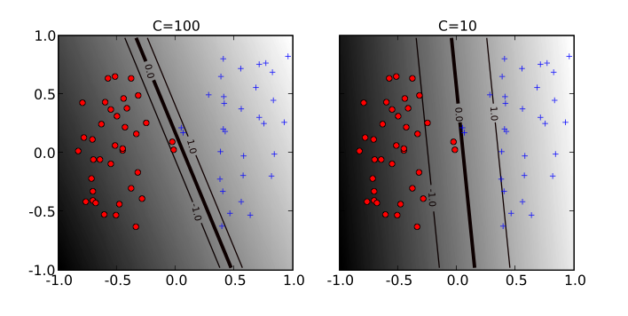
Slack variables – soft margin constant
source: http://pyml.sourceforge.net/doc/howto.pdf
Notes:
Note: high penalty → fewer misclassified results → narrow margin → more generalization error

Slide 46

Slack variables
The soft-margin optimization problem can be rewritten as:
Notes:
alphas etc. amount to re-writing the w from earlier

Slide 47
Slack variables
The soft-margin optimization problem can be rewritten as:
NOTE
This is called the dual formulation of the optimization problem.
(reached via Lagrange multipliers)

Slide 48
Slack variables
The soft-margin optimization problem can be rewritten as:
Notice that this expression depends on the features x_{i} only via the inner product
<x_{i}, x_{j}> = x_{i}^{T}x_{j}
Notes:
Dot product when vectors are in Euclidean space

Slide 49
Inner products
The inner product is an operation that takes two vectors and returns a real number.

Slide 50
Inner products
The inner product is an operation that takes two vectors and returns a real number.
The fact that we we can rewrite the optimization problem in terms of the inner product means that we don’t actually have to do any calculations in the feature space K.

Slide 51
Inner products
The inner product is an operation that takes two vectors and returns a real number.
The fact that we we can rewrite the optimization problem in terms of the inner product means that we don’t actually have to do any calculations in the feature space K.
In particular, we can easily change K to be some other space K’.

Slide 52
Iv. Nonlinear classification
INTRO TO DATA SCIENCE

Slide 53
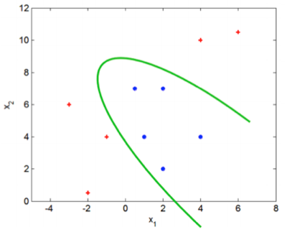
Nonlinear classification
Suppose we need a more complex classifier than a linear decision boundary allows.

Slide 54
Nonlinear classification
Suppose we need a more complex classifier than a linear decision boundary allows.
One possibility is to add nonlinear combinations of features to the data, and then to create a linear decision boundary in the enhanced (higher-dimensional) feature space.

Slide 55
Nonlinear classification
Suppose we need a more complex classifier than a linear decision boundary allows.
One possibility is to add nonlinear combinations of features to the data, and then to create a linear decision boundary in the enhanced (higher-dimensional) feature space.
This linear decision boundary will be mapped to a nonlinear decision boundary in the original feature space.

Slide 56
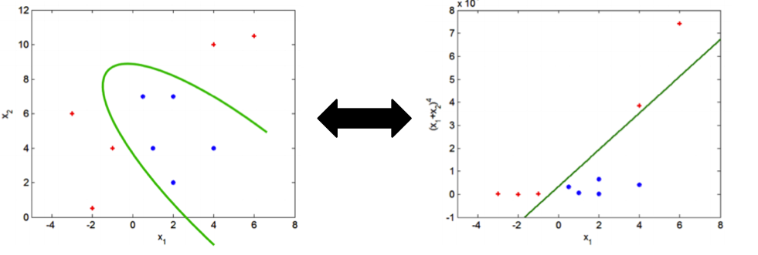
Nonlinear classification
original feature space K
higher-dim feature space K’
Notes:
Feature spaces have same dims here, but logic generalizes to higher dims

Slide 57
Nonlinear classification
The logic of this approach is sound, but there are a few problems with this version.

Slide 58
Nonlinear classification
The logic of this approach is sound, but there are a few problems with this version.
In particular, this will not scale well, since it requires many high-dimensional calculations.

Slide 59
Nonlinear classification
The logic of this approach is sound, but there are a few problems with this version.
In particular, this will not scale well, since it requires many high-dimensional calculations.
It will likely lead to more complexity (both modeling complexity and computational complexity) than we want.
Notes:
we need a more clever approach

Slide 60
Nonlinear classification
Let’s hang on to the logic of the previous example, namely:

Slide 61
Nonlinear classification
Let’s hang on to the logic of the previous example, namely:
- remap the feature vectors x_{i} into a higher-dimensional space K’
- create a linear decision boundary in K’
- back out the nonlinear decision boundary in K from the result

Slide 62
Nonlinear classification
Let’s hang on to the logic of the previous example, namely:
- remap the feature vectors x_{i} into a higher-dimensional space K’
- create a linear decision boundary in K’
- back out the nonlinear decision boundary in K from the result
But we want to save ourselves the trouble of doing a lot of additional high-dimensional calculations. How can we do this?

Slide 63
Nonlinear classification
Recall that our optimization problem depends on the features only through the inner product x^{T}x:

Slide 64
Nonlinear classification
Recall that our optimization problem depends on the features only through the inner product x^{T}x:
We can replace this inner product with a more general function that has the same type of output as the inner product.

Slide 65

Nonlinear classification
Formally, we can think of the inner product as a map that sends two vectors in the feature space K into the real line .

Slide 66
Nonlinear classification
Formally, we can think of the inner product as a map that sends two vectors in the feature space K into the real line .
We can replace this with a generalization of the inner product called a kernel function that maps two vectors in a higher-dimensional feature space K’ into .

Slide 67
Nonlinear classification
The upshot is that we can use a kernel function to implicitly train our model in a higher-dimensional feature space, without incurring additional computational complexity!

Slide 68
Nonlinear classification
The upshot is that we can use a kernel function to implicitly train our model in a higher-dimensional feature space, without incurring additional computational complexity!
As long as the kernel function satisfies certain conditions, our conclusions above regarding the mmh continue to hold.

Slide 69
Nonlinear classification
The upshot is that we can use a kernel function to implicitly train our model in a higher-dimensional feature space, without incurring additional computational complexity!
As long as the kernel function satisfies certain conditions, our conclusions above regarding the mmh continue to hold.
NOTE
These conditions are contained in a result called Mercer’s theorem.

Slide 70
Nonlinear classification
The upshot is that we can use a kernel function to implicitly train our model in a higher-dimensional feature space, without incurring additional computational complexity!
As long as the kernel function satisfies certain conditions, our conclusions above regarding the mmh continue to hold.
In other words, no algorithmic changes are necessary, and all the benefits of a linear SVM are maintained.

Slide 71



Nonlinear classification
some popular kernels:
linear kernel
polynomial kernel
Gaussian kernel
Notes:
note: gamma = width of gaussian kernel (corresp to SD)

Slide 72
Nonlinear classification
some popular kernels:
linear kernel
polynomial kernel
Gaussian kernel
The hyperparameters d, γ affect the flexibility of the decision bdy.
Notes:
note: gamma = width of gaussian kernel (corresp to SD)
note: more hyperparams, more model complexity (tougher to avoid overfitting)

Slide 73
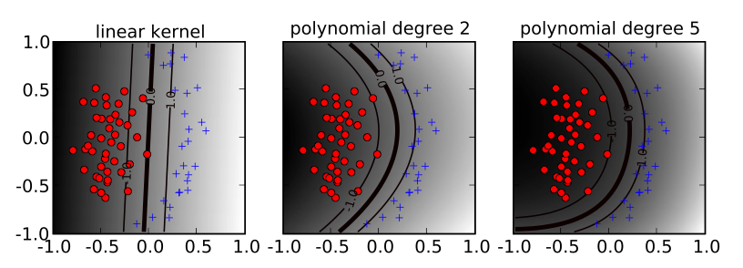
Nonlinear classification – polynomial kernel
source: http://pyml.sourceforge.net/doc/howto.pdf

Slide 74
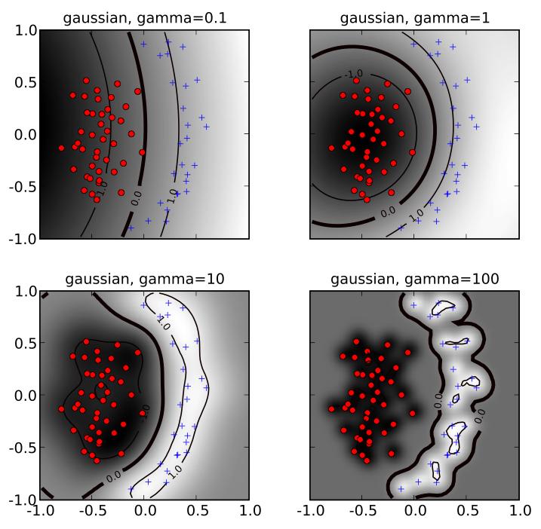
Nonlinear classification – Gaussian kernel
source: http://pyml.sourceforge.net/doc/howto.pdf
Notes:
note overfitting for high values of gamma!

Slide 75
Svm strengths & weaknesses
SVMs (and kernel methods in general) are versatile, powerful, and popular techniques that can produce accurate results for a wide array of classification problems.
The main disadvantage of SVMs is the lack of intuition they produce. These models are truly black boxes!

Slide 76
Ex: svm in scikit-learn
INTRO TO DATA SCIENCE

