Slide 1
INTRO to DATA SCIENCE EVALUATION METRICS AND PROCEDURES

Slide 2
FOR PREDICTION: I. EVALUATION METRICS iI. EVALUATION PROCEDURES
agenda

Slide 3
I. Evaluation METRICS
INTRO TO DATA SCIENCE

Slide 4
EVALUATION METRICS
For categorical labels
For rankings/scorings
For numeric predictions

Slide 5
EVALUATION METRICS – Categorical labels
Confusion Matrix:
 | Predicted Spam | Predicted Ham
Actually Spam | 1516 | 2
Actually Ham | 1 | 855

Slide 6
EVALUATION METRICS – Categorical labels
Confusion Matrix:
What are the labels?
 | Predicted Spam | Predicted Ham
Actually Spam | 1516 | 2
Actually Ham | 1 | 855

Slide 7
EVALUATION METRICS – Categorical labels
Confusion Matrix:
What are the labels?
What is “positive”? (Connect to “true positives” etc.)
 | Predicted Spam | Predicted Ham
Actually Spam | 1516 | 2
Actually Ham | 1 | 855
Notes:
“spam” is “positive”

Slide 8
EVALUATION METRICS – Categorical labels
Confusion Matrix:
What are the labels?
What is “positive”? (Connect to “true positives” etc.)
How good is the result?
 | Predicted Spam | Predicted Ham
Actually Spam | 1516 | 2
Actually Ham | 1 | 855

Slide 9
EVALUATION METRICS – Categorical labels
Confusion Matrix:
What are the labels?
What is “positive”? (Connect to “true positives” etc.)
How good is the result?
How can we quantify how good it is?
 | Predicted Spam | Predicted Ham
Actually Spam | 1516 | 2
Actually Ham | 1 | 855

Slide 10
EVALUATION METRICS – Categorical labels
Confusion Matrix:
What are the labels?
What is “positive”? (Connect to “true positives” etc.)
How good is the result?
How can we quantify how good it is?
How can we extend to more than two labels?
 | Predicted Spam | Predicted Ham
Actually Spam | 1516 | 2
Actually Ham | 1 | 855

Slide 11
EVALUATION METRICS – Categorical labels
 | Predicted Spam | Predicted Ham
Actually Spam | 1516 | 2
Actually Ham | 1 | 855

Slide 12
EVALUATION METRICS – Categorical labels
Accuracy = (blue + green) / total
Precision = blue / (blue + red)
Recall = blue / (blue + yellow)
 | Predicted Spam | Predicted Ham
Actually Spam | 1516 | 2
Actually Ham | 1 | 855

Slide 13
EVALUATION METRICS – Categorical labels
Accuracy = (blue + green) / total
Precision = blue / (blue + red)
Recall = blue / (blue + yellow)
 | Predicted Spam | Predicted Ham
Actually Spam | 1516 | 2
Actually Ham | 1 | 855
True Positive Rate =
blue / (blue + yellow)
False Positive Rate =
red / (red + green)

Slide 14
EVALUATION METRICS – Categorical labels
Accuracy = (blue + green) / total
Precision = blue / (blue + red)
Recall = blue / (blue + yellow)
Also F scores, which combine precision and recall
 | Predicted Spam | Predicted Ham
Actually Spam | 1516 | 2
Actually Ham | 1 | 855
True Positive Rate =
blue / (blue + yellow)
False Positive Rate =
red / (red + green)

Slide 15
EVALUATION METRICS – Categorical labels
Accuracy = (blue + green) / total
Precision = blue / (blue + red)
Recall = blue / (blue + yellow)
Also F scores, which combine precision and recall
and kappas
 | Predicted Spam | Predicted Ham
Actually Spam | 1516 | 2
Actually Ham | 1 | 855
True Positive Rate =
blue / (blue + yellow)
False Positive Rate =
red / (red + green)

Slide 16

EVALUATION METRICS – Categorical labels
Accuracy = (blue + green) / total
Precision = blue / (blue + red)
Recall = blue / (blue + yellow)
Also F scores, which combine precision and recall
and kappas
 | Predicted Spam | Predicted Ham
Actually Spam | 1516 | 2
Actually Ham | 1 | 855
True Positive Rate =
blue / (blue + yellow)
False Positive Rate =
red / (red + green)
NOTE
There are more methods and many more terms that can be used for many of these!

Slide 17
EVALUATION METRICS – Ratings/Scoring
Every email gets a spamminess score.
Choosing a cut-off, this becomes a classification.
How do we choose a cut-off?
How do we evaluate the ranking without choosing a cut-off?
Email Number | Score | True Label
5 | 0.93 | Spam
8 | 0.91 | Spam
2 | 0.84 | Spam
1 | 0.6 | Ham
7 | 0.54 | Spam
3 | 0.22 | Ham
4 | 0.10 | Ham
6 | 0.02 | Ham

Slide 18
EVALUATION METRICS – Ratings/Scoring
ROC curve
Email Number | Score | True Label
5 | 0.93 | Spam
8 | 0.91 | Spam
2 | 0.84 | Spam
1 | 0.6 | Ham
7 | 0.54 | Spam
3 | 0.22 | Ham
4 | 0.10 | Ham
6 | 0.02 | Ham
TPR
FPR
Notes:
draw it out!

Slide 19
EVALUATION METRICS – Ratings/Scoring
ROC curve
Email Number | Score | True Label
5 | 0.93 | Spam
8 | 0.91 | Spam
2 | 0.84 | Spam
1 | 0.6 | Ham
7 | 0.54 | Spam
3 | 0.22 | Ham
4 | 0.10 | Ham
6 | 0.02 | Ham
TPR
AUC
FPR

Slide 20
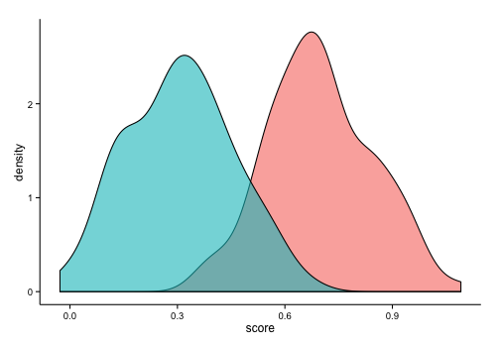
EVALUATION METRICS – Ratings/Scoring
Another interpretation of AUC (cf. common language effect size)
ham
spam
Notes:
probability that if you choose a spam and a ham their scores are correctly ordered
Code that made plot:
x <- data.frame(label=rep(c("a", "b"), each=100), score=c(rnorm(100, mean=0.7, sd=0.15), rnorm(100, mean=0.3, sd=0.15)))
ggplot(x, aes(x=score, fill=label)) + geom_density(alpha=0.6) + theme_classic() + guides(fill=FALSE)
Didn’t save seed – sorry!

Slide 21
EVALUATION METRICS – Ratings/Scoring
For ratings/scoring that aren’t for classification, there are other evaluation metrics such as Kendall’s tau, types of gain, etc.
Notes:
probability that if you choose a spam and a ham their scores are correctly ordered
Code that made plot:
x <- data.frame(label=rep(c("a", "b"), each=100), score=c(rnorm(100, mean=0.7, sd=0.15), rnorm(100, mean=0.3, sd=0.15)))
ggplot(x, aes(x=score, fill=label)) + geom_density(alpha=0.6) + theme_classic() + guides(fill=FALSE)
Didn’t save seed – sorry!

Slide 22
EVALUATION METRICS – Numeric predictions
Briefly:
Mean Squared Error
Mean Absolute Error
others possible
Notes:
probability that if you choose a spam and a ham their scores are correctly ordered
Code that made plot:
x <- data.frame(label=rep(c("a", "b"), each=100), score=c(rnorm(100, mean=0.7, sd=0.15), rnorm(100, mean=0.3, sd=0.15)))
ggplot(x, aes(x=score, fill=label)) + geom_density(alpha=0.6) + theme_classic() + guides(fill=FALSE)
Didn’t save seed – sorry!

Slide 23
II. Evaluation PROCEDURES
INTRO TO DATA SCIENCE

Slide 24
Training error
Q: What’s wrong with training error?

Slide 25
Training error
Q: What’s wrong with training error?
Thought experiment:
Suppose we train our model using the entire dataset.

Slide 26
Training error
Q: What’s wrong with training error?
Thought experiment:
Suppose we train our model using the entire dataset.
Q: How low can we push the training error?

Slide 27
Training error
Q: What’s wrong with training error?
Thought experiment:
Suppose we train our model using the entire dataset.
Q: How low can we push the training error?
We can make the model arbitrarily complex (effectively
“memorizing” the entire training set).

Slide 28
Training error
Q: What’s wrong with training error?
Thought experiment:
Suppose we train our model using the entire dataset.
Q: How low can we push the training error?
We can make the model arbitrarily complex (effectively
“memorizing” the entire training set).
A: Down to zero!

Slide 29
Training error
Q: What’s wrong with training error?
Thought experiment:
Suppose we train our model using the entire dataset.
Q: How low can we push the training error?
We can make the model arbitrarily complex (effectively
“memorizing” the entire training set).
A: Down to zero!
NOTE
This phenomenon
is called
overfitting.

Slide 30
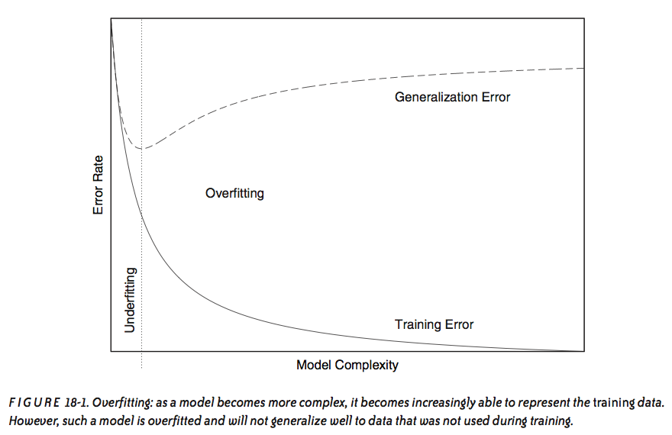
Overfitting
source: Data Analysis with Open Source Tools, by Philipp K. Janert. O’Reilly Media, 2011.

Slide 31
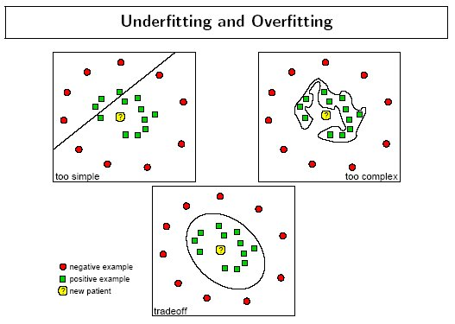
Overfitting - example
source: http://www.dtreg.com
Notes:
vocab: “decision boundary”

Slide 32
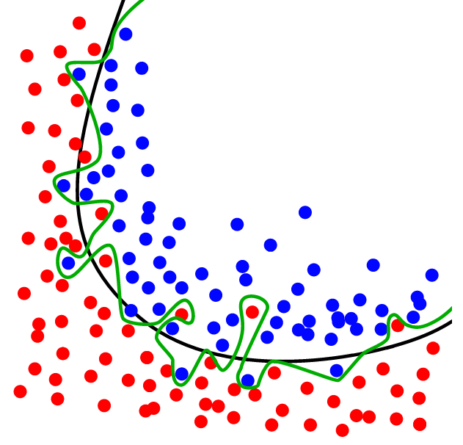
Overfitting - example
source: http://www.dtreg.com

Slide 33
Training error
Q: What’s wrong with training error?
Thought experiment:
Suppose we train our model using the entire dataset.
Q: How low can we push the training error?
We can make the model arbitrarily complex (effectively
“memorizing” the entire training set).
A: Down to zero!
A: Training error is not a good estimate of accuracy beyond training data.
NOTE
This phenomenon
is called
overfitting.
Notes:
Need to use genlzn error to get a better estimate.
Recall “useful things” paper: we don’t have direct access to our objective function

Slide 34


EVALuation PROCEDURES
Q: How can we make a model that generalizes well?
model
dataset

Slide 35
EVALuation PROCEDURES
Q: How can we make a model that generalizes well?
1) split dataset
model
dataset
Notes:
this split is random & uneven…70/30 is a good place to start
We’ll talk about the reason for this in just a minute.

Slide 36

EVALuation PROCEDURES
Q: How can we make a model that generalizes well?
1) split dataset
2) train model
training set
model
dataset

Slide 37

EVALuation PROCEDURES
Q: How can we make a model that generalizes well?
1) split dataset
2) train model
3) test model
training set
model
test set
dataset

Slide 38
EVALuation PROCEDURES
Q: How can we make a model that generalizes well?
1) split dataset
2) train model
3) test model
4) iterate
training set
model
test set
dataset

Slide 39
EVALuation PROCEDURES
Q: How can we make a model that generalizes well?
1) split dataset
2) train model
3) test model
4) iterate
5) choose final model
training set
model
test set
dataset

Slide 40
EVALuation PROCEDURES
Q: How can we make a model that generalizes well?
1) split dataset
2) train model
3) test model
4) iterate
5) choose final model
6) train on all data
training set
model
test set
dataset

Slide 41

EVALuation PROCEDURES
Q: How can we make a model that generalizes well?
1) split dataset
2) train model
3) test model
4) iterate
5) choose final model
6) train on all data
7) make predictions
training set
model
test set
new data
dataset
Notes:
Q: how is the new data different?
A: we don’t know the labels…predicting these labels = purpose of our model

Slide 42
EVALuation PROCEDURES
Q: How can we make a model that generalizes well?
1) split dataset
2) train model
3) test model
4) iterate
5) choose final model
6) train on all data
7) make predictions
NOTE
This new data is called out of sample
data.
We don’t know the labels for these OOS records!
training set
model
test set
new data
dataset
Notes:
Q: how is the new data different?
A: we don’t know the labels → predicting these labels = purpose of our model

Slide 43
EVALuation PROCEDURES
Q: What types of prediction error will we run into?
training set
model
test set
new data
dataset
Notes:
Think in terms of our diagram.

Slide 44
EVALuation PROCEDURES
Q: What types of prediction error will we run into?
1) training error
training set
model
test set
new data
dataset

Slide 45
EVALuation PROCEDURES
Q: What types of prediction error will we run into?
1) training error
2) generalization error
training set
model
test set
new data
dataset
Notes:
also called test-set error

Slide 46
EVALuation PROCEDURES
Q: What types of prediction error will we run into?
1) training error
2) generalization error
3) OOS error
training set
model
test set
new data
dataset
Notes:
Recall OOS = out of sample

Slide 47
EVALuation PROCEDURES
Q: What types of prediction error will we run into?
1) training error
2) generalization error
3) OOS error
NOTE
We want to estimate
OOS prediction error so we know what to expect from our model.
training set
model
test set
new data
dataset

Slide 48
Generalization error
Suppose we do the train/test split.

Slide 49
Generalization error
Suppose we do the train/test split.
Q: How well does generalization error predict OOS accuracy?

Slide 50
Generalization error
Suppose we do the train/test split.
Q: How well does generalization error predict OOS accuracy?
Thought experiment:
Suppose we had done a different train/test split.

Slide 51
Generalization error
Suppose we do the train/test split.
Q: How well does generalization error predict OOS accuracy?
Thought experiment:
Suppose we had done a different train/test split.
Q: Would the generalization error remain the same?

Slide 52
Generalization error
Suppose we do the train/test split.
Q: How well does generalization error predict OOS accuracy?
Thought experiment:
Suppose we had done a different train/test split.
Q: Would the generalization error remain the same?
A: Of course not!

Slide 53
Generalization error
Suppose we do the train/test split.
Q: How well does generalization error predict OOS accuracy?
Thought experiment:
Suppose we had done a different train/test split.
Q: Would the generalization error remain the same?
A: Of course not!
A: On its own, not very well.

Slide 54
Generalization error
Suppose we do the train/test split.
Q: How well does generalization error predict OOS accuracy?
Thought experiment:
Suppose we had done a different train/test split.
Q: Would the generalization error remain the same?
A: Of course not!
A: On its own, not very well.
NOTE
The generalization error gives a
high-variance estimate
of OOS accuracy.
Notes:
Bias-variance tradeoff!
(Training error is biased estimate of OOS prediction error)

Slide 55
Generalization error
Something is still missing!
Notes:
Q: any ideas at this point what we can do to improve our estimate?

Slide 56
Generalization error
Something is still missing!
Q: How can we do better?

Slide 57
Generalization error
Something is still missing!
Q: How can we do better?
Thought experiment:
Different train/test splits will give us different generalization errors.

Slide 58
Generalization error
Something is still missing!
Q: How can we do better?
Thought experiment:
Different train/test splits will give us different generalization errors.
Q: What if we did a bunch of these and took the average?

Slide 59
Generalization error
Something is still missing!
Q: How can we do better?
Thought experiment:
Different train/test splits will give us different generalization errors.
Q: What if we did a bunch of these and took the average?
A: Now you’re talking!

Slide 60
Generalization error
Something is still missing!
Q: How can we do better?
Thought experiment:
Different train/test splits will give us different generalization errors.
Q: What if we did a bunch of these and took the average?
A: Now you’re talking!
A: Cross-validation.

Slide 61
Cross-validation
Steps for n-fold cross-validation:
Notes:
Draw n-fold partition on the whiteboard

Slide 62
Cross-validation
Steps for n-fold cross-validation:
1) Randomly split the dataset into n equal partitions.

Slide 63
Cross-validation
Steps for n-fold cross-validation:
1) Randomly split the dataset into n equal partitions.
2) Use partition 1 as test set & union of other partitions as training set.
Notes:
Q: partitions = equally-sized subsets st. none intersect & union of all partitions is the entire set

Slide 64
Cross-validation
Steps for n-fold cross-validation:
1) Randomly split the dataset into n equal partitions.
2) Use partition 1 as test set & union of other partitions as training set.
3) Find generalization error.

Slide 65
Cross-validation
Steps for n-fold cross-validation:
1) Randomly split the dataset into n equal partitions.
2) Use partition 1 as test set & union of other partitions as training set.
3) Find generalization error.
4) Repeat steps 2-3 using a different partition as the test set at each iteration.

Slide 66
Cross-validation
Steps for n-fold cross-validation:
1) Randomly split the dataset into n equal partitions.
2) Use partition 1 as test set & union of other partitions as training set.
3) Find generalization error.
4) Repeat steps 2-3 using a different partition as the test set at each iteration.
5) Take the average generalization error as the estimate of OOS accuracy.

Slide 67
Cross-validation
Features of n-fold cross-validation:

Slide 68
Cross-validation
Features of n-fold cross-validation:
1) More accurate estimate of OOS prediction error.

Slide 69
Cross-validation
Features of n-fold cross-validation:
1) More accurate estimate of OOS prediction error.
2) More efficient use of data than single train/test split.
- Each record in our dataset is used for both training and testing.
Notes:
Q: How often is each record used for training/testing?
A: Each record used for training n-1 times, used for testing exactly once

Slide 70
Cross-validation
Features of n-fold cross-validation:
1) More accurate estimate of OOS prediction error.
2) More efficient use of data than single train/test split.
- Each record in our dataset is used for both training and testing.
3) Presents tradeoff between efficiency and computational expense.
- 10-fold CV is 10x more expensive than a single train/test split
Notes:
10 is a typical value for n, can also do n = total number of records (leave-one-out CV)

Slide 71
Cross-validation
Features of n-fold cross-validation:
1) More accurate estimate of OOS prediction error.
2) More efficient use of data than single train/test split.
- Each record in our dataset is used for both training and testing.
3) Presents tradeoff between efficiency and computational expense.
- 10-fold CV is 10x more expensive than a single train/test split
4) Can be used for model selection.
Notes:
(we won’t talk about this today)

Slide 72
Cross-validation
Features of n-fold cross-validation:
1) More accurate estimate of OOS prediction error.
2) More efficient use of data than single train/test split.
- Each record in our dataset is used for both training and testing.
3) Presents tradeoff between efficiency and computational expense.
- 10-fold CV is 10x more expensive than a single train/test split
4) Can be used for model selection.
NOTE
Leave one out cross-validation is a special case of n-fold cross-validation.
Notes:
(we won’t talk about this today)

Slide 73
INTRO TO DATA SCIENCE

