Slide 1
INTRO to DATA SCIENCE Linear regression

Slide 2
I. Linear regression iI. Polynomial Regression exercises: III. Linear Regression in R IV. Predicting Baseball Salaries
agenda

Slide 3
I. linear regression
INTRO TO DATA SCIENCE

Slide 4
Regression problems
continuous categorical
supervised ??? ???
unsupervised ??? ???
Notes:
Q: Where does regression belong in this diagram?

Slide 5
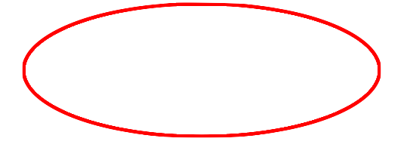
Regression problems
continuous categorical
supervised regression classification
unsupervised dimension reduction clustering
Notes:
Supervised learning problem w/ cts target variables
(predictions are real numbers)

Slide 6
Intro to regression
Q: What is a regression model?

Slide 7
Intro to regression
Q: What is a regression model?
A: A functional relationship between input & response variables.
Notes:
Parametric relationship

Slide 8
Intro to regression
Q: What is a regression model?
A: A functional relationship between input & response variables
The simple linear regression model captures a linear relationship between a single input variable x and a response variable y:

Slide 9
Intro to regression
Q: What is a regression model?
A: A functional relationship between input & response variables
The simple linear regression model captures a linear relationship between a single input variable x and a response variable y:
y = α + βx + ε

Slide 10
Intro to regression
Q: What do the terms in this model mean?
y = α + βx + ε

Slide 11
Intro to regression
Q: What do the terms in this model mean?
y = α + βx + ε
A: y = response variable (the one we want to predict)
Notes:
Dependent var, target var, output var

Slide 12
Intro to regression
Q: What do the terms in this model mean?
y = α + βx + ε
A: y = response variable (the one we want to predict)
x = input variable (the one we use to train the model)
Notes:
Indep var, covariate

Slide 13
Intro to regression
Q: What do the terms in this model mean?
y = α + βx + ε
A: y = response variable (the one we want to predict)
x = input variable (the one we use to train the model)
α = intercept (where the line crosses the y-axis)

Slide 14
Intro to regression
Q: What do the terms in this model mean?
y = α + βx + ε
A: y = response variable (the one we want to predict)
x = input variable (the one we use to train the model)
α = intercept (where the line crosses the y-axis)
β = regression coefficient (the model “parameter”)

Slide 15
Intro to regression
Q: What do the terms in this model mean?
y = α + βx + ε
A: y = response variable (the one we want to predict)
x = input variable (the one we use to train the model)
α = intercept (where the line crosses the y-axis)
β = regression coefficient (the model “parameter”)
ε = residual (the prediction error)
Notes:
Error term, disturbance
White noise (usually assumed to follow Gaussian distribution)

Slide 16
Intro to regression
We can extend this model to several input variables, giving us the multiple linear regression model:

Slide 17
Intro to regression
We can extend this model to several input variables, giving us the multiple linear regression model:
y = α + β₁x₁ + … + β_{n}x_{n} + ε

Slide 18
Intro to regression
Linear regression involves several technical assumptions and is often presented with lots of mathematical formality.
The details are not very important for our purposes, but you can check them out if you’re interested.

Slide 19
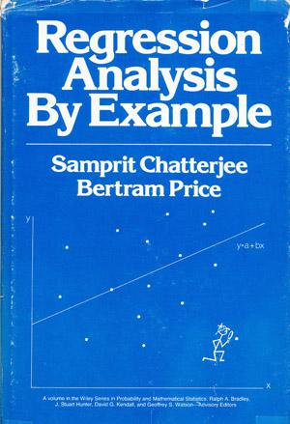
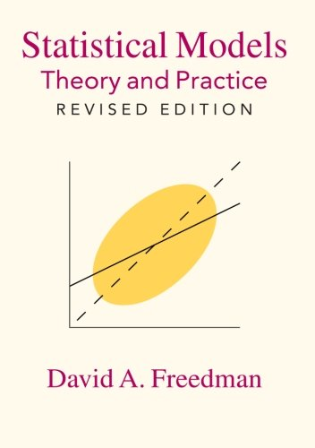
Intro to regression

Slide 20
Intro to regression
Q: How do we fit a regression model to a dataset?

Slide 21
Intro to regression
Q: How do we fit a regression model to a dataset?
A: Minimize the sum of the squared residuals (Ordinary Least Squares).

Slide 22
Intro to regression
Q: How do we fit a regression model to a dataset?
A: Minimize the sum of the squared residuals (Ordinary Least Squares).
In practice, any respectable piece of software will do this for you.

Slide 23
Intro to regression
Q: How do we fit a regression model to a dataset?
A: Minimize the sum of the squared residuals (Ordinary Least Squares).
In practice, any respectable piece of software will do this for you.
And there are other ways.

Slide 24
Intro to regression
Q: How do we fit a regression model to a dataset?
A: Minimize the sum of the squared residuals (Ordinary Least Squares).
In practice, any respectable piece of software will do this for you.
And there are other ways.
And software implements them as well.

Slide 25
II: POLYNOMIAL REGRESSION
INTRO TO DATA SCIENCE
Notes:
Polynomial regression is a linear modeling technique

Slide 26
Polynomial regression
Consider the following polynomial regression model:
y = α + β₁x + β₂x² + ε

Slide 27
Polynomial regression
Consider the following polynomial regression model:
y = α + β₁x + β₂x² + ε
Q: This represents a nonlinear relationship. Is it still a linear model?

Slide 28
Polynomial regression
Consider the following polynomial regression model:
y = α + β₁x + β₂x² + ε
Q: This represents a nonlinear relationship. Is it still a linear model?
A: Yes, because it’s linear in the β’s!
Notes:
Linear in the parameter vector.

Slide 29
Polynomial regression
Consider the following polynomial regression model:
y = α + β₁x + β₂x² + ε
Q: This represents a nonlinear relationship. Is it still a linear model?
A: Yes, because it’s linear in the β’s!
“Although polynomial regression fits a nonlinear model to the data, as a statistical estimation problem it is linear, in the sense that the regression function E(y|x) is linear in the unknown parameters that are estimated from the data. For this reason, polynomial regression is considered to be a special case of multiple linear regression.” -- Wikipedia
Notes:
Note: nonlinear regression refers to something different!

Slide 30
Polynomial regression
Polynomial regression allows us to fit very complex curves to data.
y = α + β₁x + β₂x² + … + β_{n}x^{n} + ε

Slide 31
Polynomial regression
Polynomial regression allows us to fit very complex curves to data.
y = α + β₁x + β₂x² + … + β_{n}x^{n} + ε
But there is a problem with the model we’ve written down so far.

Slide 32

Polynomial regression

Slide 33

Polynomial regression
This model displays collinearity, which means the predictor variables are highly correlated with each other.
y = α + β₁x + β₂x² + … + β_{n}x^{n} + ε
Notes:
Show scatterplot of x9, x10 in R.

Slide 34
Polynomial regression
This model displays collinearity, which means the predictor variables are highly correlated with each other.
y = α + β₁x + β₂x² + … + β_{n}x^{n} + ε
Collinearity causes the linear regression model to “break down”, because it can’t tell the predictor variables apart.

Slide 35

Polynomial regression
This model displays collinearity, which means the predictor variables are highly correlated with each other.
y = α + β₁x + β₂x² + … + β_{n}x^{n} + ε
Collinearity causes the linear regression model to “break down”, because it can’t tell the predictor variables apart.
NOTE
For identical features, this results in a singularity. We will see an example of this in just a minute!

Slide 36
Polynomial regression
Q: What can we do about this?

Slide 37
Polynomial regression
Q: What can we do about this?
A: Replace the correlated predictors with uncorrelated predictors.

Slide 38
Polynomial regression
Q: What can we do about this?
A: Replace the correlated predictors with uncorrelated predictors.
y = α + β₁f₁(x) + β₂f₂(x²) + … + β_{n}f_{n}(x^{n}) + ε

Slide 39
Polynomial regression
Q: What can we do about this?
A: Replace the correlated predictors with uncorrelated predictors.
y = α + β₁f₁(x) + β₂f₂(x²) + … + β_{n}f_{n}(x^{n}) + ε
OPTIONAL NOTE
These polynomial functions form an orthogonal basis of the function space.
Notes:
R can handle this for us automatically, and it’s really easy as we will see!

Slide 40
Intro to regression
Q: So, how do we select a linear regression model?

Slide 41
Intro to regression
Q: So, how do we select a linear regression model?
Techniques for producing designs

Slide 42
Intro to regression
Q: So, how do we select a linear regression model?
Techniques for producing designs
Theory

Slide 43
Intro to regression
Q: So, how do we select a linear regression model?
Techniques for producing designs
Theory
Forward selection

Slide 44
Intro to regression
Q: So, how do we select a linear regression model?
Techniques for producing designs
Theory
Forward selection
Backward elimination

Slide 45
Intro to regression
Q: So, how do we select a linear regression model?
Techniques for producing designs
Theory
Forward selection
Backward elimination
More

Slide 46
Intro to regression
Q: So, how do we select a linear regression model?
Techniques for producing designs
Theory
Forward selection
Backward elimination
More
Techniques for evaluating designs

Slide 47
Intro to regression
Q: So, how do we select a linear regression model?
Techniques for producing designs
Theory
Forward selection
Backward elimination
More
Techniques for evaluating designs
Training metrics

Slide 48
Intro to regression
Q: So, how do we select a linear regression model?
Techniques for producing designs
Theory
Forward selection
Backward elimination
More
Techniques for evaluating designs
Training metrics
Test set performance / Cross-validation

Slide 49
Exercises
INTRO TO DATA SCIENCE

