Slide 1
INTRO to DATA SCIENCE regularization for Regression

Slide 2
I. Regularization for Regression exercises: II. Implementing a regularized fit in r
agenda

Slide 3
I: REGULARIZATION
INTRO TO DATA SCIENCE

Slide 4
Overfitting
Recall our earlier discussion of overfitting.

Slide 5
Overfitting
Recall our earlier discussion of overfitting.
When we talked about this in the context of classification, we said that it was a result of matching the training set too closely.

Slide 6
Overfitting
Recall our earlier discussion of overfitting.
When we talked about this in the context of classification, we said that it was a result of matching the training set too closely.
In other words, a model that is overfit has learned from the noise in the dataset instead of just the signal.

Slide 7
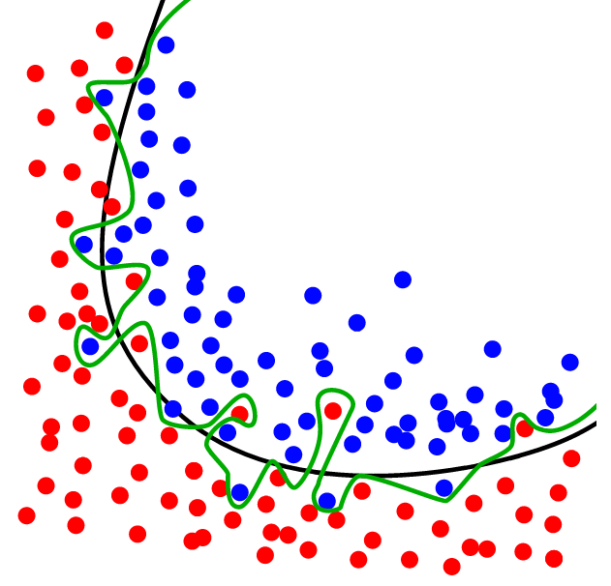
Overfitting example (classification)
source: http://upload.wikimedia.org/wikipedia/commons/1/19/Overfitting.svg

Slide 8
overfitting
The same thing can happen in regression.
It’s possible to design a regression model that matches the noise in the data instead of the signal.
This happens when our model becomes too complex for the data to support.

Slide 9
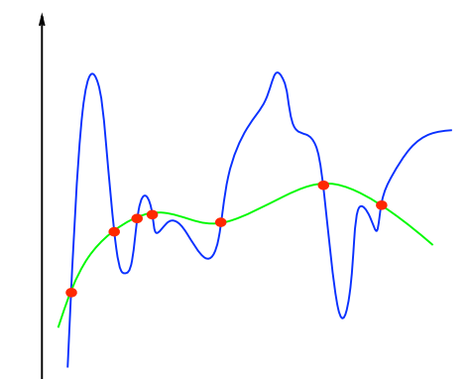
Overfitting example (regression)
source: http://www.mit.edu/~9.520/spring12/slides/class02/class02.pdf
Notes:
note: the blue curve is more “complex” than the green curve

Slide 10
Model complexity
Q: How do we define the complexity of a regression model?

Slide 11
Model complexity
Q: How do we define the complexity of a regression model?
A: One method is to define complexity as a function of the size of the
coefficients.
Notes:
Alternative: degree of polynomial (less general, can’t use for non-poly cases)

Slide 12
Model complexity
Q: How do we define the complexity of a regression model?
A: One method is to define complexity as a function of the size of the
coefficients.
Ex 1: Σ |β_{i}|
Ex 2: Σ β_{i}²

Slide 13
Model complexity
Q: How do we define the complexity of a regression model?
A: One method is to define complexity as a function of the size of the
coefficients.
Ex 1: Σ |β_{i}| this is called the L1-norm
Ex 2: Σ β_{i}² this is called the L2-norm

Slide 14
regularization
These measures of complexity lead to the following regularization techniques:

Slide 15
regularization
These measures of complexity lead to the following regularization techniques:
L1 regularization: y = Σ β_{i}x_{i} + ε st. Σ |β_{i}| < s

Slide 16
regularization
These measures of complexity lead to the following regularization techniques:
L1 regularization: y = Σ β_{i}x_{i} + ε st. Σ |β_{i}| < s
L2 regularization: y = Σ β_{i}x_{i} + ε st. Σ β_{i}² < s
Notes:
L1 – lasso method
L2 – ridge regression, tikhonov regularization

Slide 17

regularization
These measures of complexity lead to the following regularization techniques:
L1 regularization: y = Σ β_{i}x_{i} + ε st. Σ |β_{i}| < s
L2 regularization: y = Σ β_{i}x_{i} + ε st. Σ β_{i}² < s
NOTE
L1 regularization is also known as lasso regularization. L2 regularization is also known as ridge regression.
Notes:
L1 – lasso method
L2 – ridge regression, tikhonov regularization

Slide 18
regularization
These measures of complexity lead to the following regularization techniques:
L1 regularization: y = Σ β_{i}x_{i} + ε st. Σ |β_{i}| < s
L2 regularization: y = Σ β_{i}x_{i} + ε st. Σ β_{i}² < s
Regularization refers to the method of preventing overfitting by explicitly controlling model complexity.
NOTE
L1 regularization is also known as lasso regularization. L2 regularization is also known as ridge regression.
Notes:
Important sentence

Slide 19
Regularization
These regularization problems can also be expressed as:
L1 regularization: min(||y – xβ||² + λ||x||)
L2 regularization: min(||y – xβ||² + λ||x||²)

Slide 20
Regularization
These regularization problems can also be expressed as:
L1 regularization: min(||y – xβ||² + λ||x||)
L2 regularization: min(||y – xβ||² + λ||x||²)
This (Lagrangian) formulation reflects the fact that there is a cost associated with regularization.

Slide 21
Regularization
These regularization problems can also be expressed as:
L1 regularization: min(||y – xβ||² + λ||x||)
L2 regularization: min(||y – xβ||² + λ||x||²)
This (Lagrangian) formulation reflects the fact that there is a cost associated with regularization.
NOTE
Lasso tends to eliminate coefficients, so it’s useful for reducing the number of features. L2 tends to make coefficients small but not necessarily zero.

Slide 22
Bias and variance
Q: What are bias and variance?

Slide 23
Bias and variance
Q: What are bias and variance?
A: Bias refers to predictions that are systematically inaccurate.

Slide 24
Bias and variance
Q: What are bias and variance?
A: Bias refers to predictions that are systematically inaccurate.
Variance refers to predictions that are generally inaccurate.

Slide 25
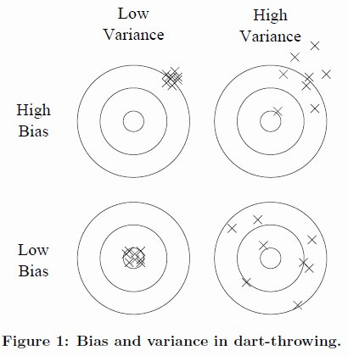
Bias and variance
source: http://homes.cs.washington.edu/~pedrod/papers/cacm12.pdf
Notes:
Low bias – on target
Low variance – tight grouping

Slide 26
Bias and variance
Q: What are bias and variance?
A: Bias refers to predictions that are systematically inaccurate.
Variance refers to predictions that are generally inaccurate.
Generalization error can be decomposed into a bias component and variance component.

Slide 27
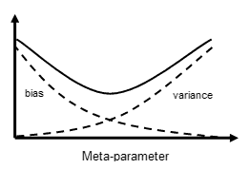
Bias-variance tradeoff
This is another example of the bias-variance tradeoff.
source: http://www.isu.edu/chem/images/kalivasmeta.gif

Slide 28
Bias-variance tradeoff
This is another example of the bias-variance tradeoff.
NOTE
The “meta-parameter” (or “hyperparameter”) here is the lambda we saw above.
source: http://www.isu.edu/chem/images/kalivasmeta.gif

Slide 29
Bias-variance tradeoff
L1 regularization: min(||y – xβ||² + λ||x||)
L2 regularization: min(||y – xβ||² + λ||x||²)
So regularization represents a method to trade away some variance for a little bias in our model, thus achieving a better overall fit.
This tradeoff is regulated by a hyperparameter λ, which we’ve already seen.

Slide 30
Bias-variance tradeoff
L1 regularization: min(||y – xβ||² + λ||x||)
L2 regularization: min(||y – xβ||² + λ||x||²)
So regularization represents a method to trade away some variance for a little bias in our model, thus achieving a better overall fit.
This tradeoff is regulated by a hyperparameter λ, which we’ve already seen.
NOTE
Combining the regularization terms (with a balancing parameter) we have elastic net regularization.

Slide 31
Exercises
INTRO TO DATA SCIENCE

