Slide 1
INTRO to DATA SCIENCE logistic regression

Slide 2
I. logistic regression II. Outcome variables III. Error terms iv. Interpreting results exercises: Implementing a logistic fit in r
agenda

Slide 3
I. logistic regression
INTRO TO DATA SCIENCE

Slide 4
Logistic Regression
continuous categorical
supervised ??? ???
unsupervised ??? ???
Notes:
Q: Where does logistic regression belong in this diagram?

Slide 5

Logistic regression
continuous categorical
supervised regression classification
unsupervised dimension reduction clustering

Slide 6
Logistic regression
Q: What is logistic regression?

Slide 7
Logistic regression
Q: What is logistic regression?
A: A generalization of the linear regression model to classification problems.
Notes:
Popularized in clinical studies due to ease of use, interpretation.

Slide 8
Logistic regression
In linear regression, we used a set of covariates to predict the value of a (continuous) outcome variable.

Slide 9
Logistic regression
In linear regression, we used a set of covariates to predict the value of a (continuous) outcome variable.
In logistic regression, we use a set of covariates to predict probabilities of (binary) class membership.

Slide 10
Logistic regression
In linear regression, we used a set of covariates to predict the value of a (continuous) outcome variable.
In logistic regression, we use a set of covariates to predict probabilities of (binary) class membership.
These probabilities are then mapped to class labels, thus solving the classification problem.
Notes:
Eg, by threshholding at 50%

Slide 11
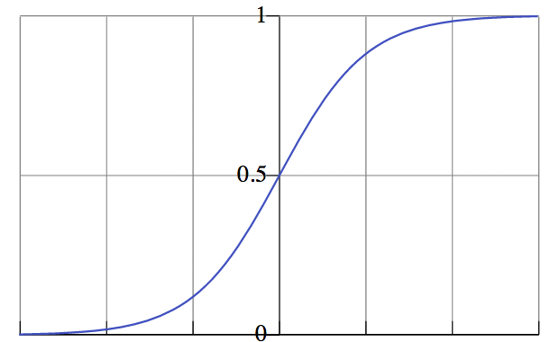

probabilities
probability of
belonging to
class
NOTE
Probability predictions look like this.
value of independent variable
Notes:
smoothly varying, between 0 and 1 (y-axis: probability of belonging to class 1)
→ looks like a cdf

Slide 12
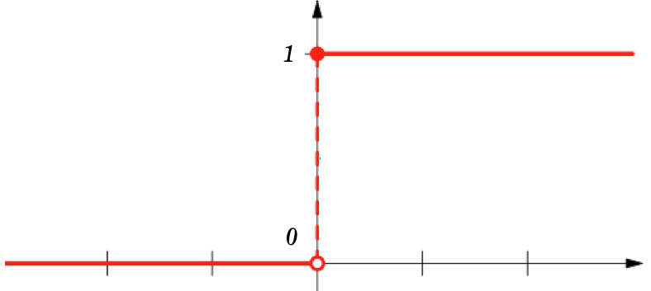
Class labels
class label
NOTE
Probabilities are “snapped” to class labels (eg by threshholding at 50%).
value of independent variable
Notes:
Sharply varying, w/ step at threshhold level
→ looks like a heaviside function

Slide 13
Logistic regression
The logistic regression model is an extension of the linear regression model, with a couple of important differences.

Slide 14
Logistic regression
The logistic regression model is an extension of the linear regression model, with a couple of important differences.
The first difference is in the outcome variable.

Slide 15
Logistic regression
The logistic regression model is an extension of the linear regression model, with a couple of important differences.
The first difference is in the outcome variable.
The second difference is in the error term.
Notes:
We’ll do the outcome var first

Slide 16
II. Outcome variables
INTRO TO DATA SCIENCE

Slide 17

Outcome variables
The key variable in any regression problem is the conditional mean of the outcome variable y given the value of the covariate x:
Notes:
this is what we’re estimating

Slide 18

Outcome variables
The key variable in any regression problem is the conditional mean of the outcome variable y given the value of the covariate x:
In linear regression, we assume that this conditional mean is a linear function taking values in (-∞, +∞):
Notes:
Linear in x or some function of x; eg, linear in beta

Slide 19
Outcome variables
In logistic regression, we’ve seen that the conditional mean of the outcome variable takes values only in the unit interval [0, 1].
Notes:
Remember the ‘S’ curve

Slide 20
Outcome variables
In logistic regression, we’ve seen that the conditional mean of the outcome variable takes values only in the unit interval [0, 1].
The first step in extending the linear regression model to logistic regression is to map the outcome variable E(y|x) into the unit interval.

Slide 21
Outcome variables
In logistic regression, we’ve seen that the conditional mean of the outcome variable takes values only in the unit interval [0, 1].
The first step in extending the linear regression model to logistic regression is to map the outcome variable E(y|x) into the unit interval.
Q: How do we do this?

Slide 22

The logistic function
A: By using a transformation called the logistic function:

Slide 23
The logistic function
A: By using a transformation called the logistic function:
We’ve already seen what this looks like:
Notes:
This function was first studied in the mid-19th century in the context of modeling population growth (note the saturation effect).

Slide 24
The logistic function
A: By using a transformation called the logistic function:
We’ve already seen what this looks like:
NOTE
For any value of x, y is in the interval [0, 1]
This is a nonlinear transformation!
Notes:
Another alternative would be to use the normal cdf…this leads to the probit model (and gives similar prediction results)

Slide 25

The logistic function
The logit function is an important transformation of the logistic function. Notice that it returns the linear model!

Slide 26
The logistic function
The logit function is an important transformation of the logistic function. Notice that it returns the linear model!
The logit function is also called the log-odds function.

Slide 27
The logistic function
The logit function is an important transformation of the logistic function. Notice that it returns the linear model!
The logit function is also called the log-odds function.
NOTE
This name hints at its usefulness in interpreting our results.
We will see why shortly.

Slide 28
III. Error terms
INTRO TO DATA SCIENCE

Slide 29
Error terms
The second difference between linear regression and the logistic regression model is in the error term.

Slide 30

Error terms
The second difference between linear regression and the logistic regression model is in the error term.
One of the key assumptions of linear regression is that the error terms follow independent Gaussian distributions with zero mean and constant variance:
Notes:
Related terms: homoskedasticity, spherical errors

Slide 31
Error terms
In logistic regression, the outcome variable can take only two values: 0 or 1.

Slide 32

Error terms
In logistic regression, the outcome variable can take only two values: 0 or 1.
It’s easy to show from this that instead of following a Gaussian distribution, the error term in logistic regression follows a Bernoulli distribution:

Slide 33
Error terms
In logistic regression, the outcome variable can take only two values: 0 or 1.
It’s easy to show from this that instead of following a Gaussian distribution, the error term in logistic regression follows a Bernoulli distribution:
NOTE
This is the same distribution followed by a coin toss.
Think about why this makes sense!

Slide 34
An aside: glm
These two key differences define the logistic regression model, and they also lead us to a kind of unification of regression techniques called generalized linear models.

Slide 35
An aside: glm
These two key differences define the logistic regression model, and they also lead us to a kind of unification of regression techniques called generalized linear models.
Briefly, GLMs generalize the distribution of the error term, and allow the conditional mean of the response variable to be related to the linear model by a link function.
Notes:
If there’s such a thing as an elegant result in statistics, this is high on the list.

Slide 36
An aside: glm
In the present case, the error term follows a Bernoulli distribution, and the logit is the link function that connects us to the linear predictor.

Slide 37
An aside: glm
In the present case, the error term follows a Bernoulli distribution, and the logit is the link function that connects us to the linear predictor.

Slide 38
An aside: glm
In the present case, the error term follows a Bernoulli distribution, and the logit is the link function that connects us to the linear predictor.
Since the Bernoulli distribution and the logit function share a common parameter π, we say that the logit is the canonical link function for the Bernoulli distribution.

Slide 39
An aside: glm
In the present case, the error term follows a Bernoulli distribution, and the logit is the link function that connects us to the linear predictor.
Since the Bernoulli distribution and the logit function share a common parameter π, we say that the logit is the canonical link function for the Bernoulli distribution.
NOTE
This terminology is just FYI!

Slide 40
IV. Interpreting results
INTRO TO DATA SCIENCE

Slide 41
Interpreting results
In linear regression, the parameter β represents the change in the response variable for a unit change in the covariate.

Slide 42
Interpreting results
In linear regression, the parameter β represents the change in the response variable for a unit change in the covariate.
In logistic regression, β represents the change in the logit function for a unit change in the covariate.

Slide 43
Interpreting results
In linear regression, the parameter β represents the change in the response variable for a unit change in the covariate.
In logistic regression, β represents the change in the logit function for a unit change in the covariate.
Interpreting this change in the logit function requires another definition first.

Slide 44

Interpreting results
The odds of an event are given by the ratio of the probability of the event by its complement:
Notes:
Complement: 1 – p

Slide 45

Interpreting results
The odds of an event are given by the ratio of the probability of the event by its complement:
The odds ratio of a binary event is given by the odds of the event divided by the odds of its complement:
Notes:
Note: sometimes you’ll see ‘dichotomous’ event instead of ‘binary’

Slide 46

Interpreting results
Substituting the definition of π(x) into this equation yields (after some algebra),

Slide 47
Interpreting results
Substituting the definition of π(x) into this equation yields (after some algebra),
This simple relationship between the odds ratio and the parameter β is what makes logistic regression such a powerful tool.

Slide 48
Interpreting results
Q: So how do we interpret this?

Slide 49
Interpreting results
Q: So how do we interpret this?
A: The odds ratio of a binary event gives the increase in likelihood of an outcome if the event occurs.

Slide 50
Interpreting results – An example
Suppose we are interested in mobile purchase behavior. Let y be a class label denoting purchase/no purchase, and let x denote a mobile OS (for example, iOS).

Slide 51
Interpreting results – An example
Suppose we are interested in mobile purchase behavior. Let y be a class label denoting purchase/no purchase, and let x denote a mobile OS (for example, iOS).
In this case, an odds ratio of 2 (eg, β = log(2)) indicates that a purchase is twice as likely for an iOS user as for a non-iOS user.

Slide 52
Ex: logistic regression
INTRO TO DATA SCIENCE

Slide 53
Exercise 1 – linear regression
Key objectives
tools
- perform a logistic fit - glm {stat}
Notes:
Note: results only show in-sample performance!

