Slide 1
INTRO to DATA SCIENCE decision tree classifiers

Slide 2
I. decision trees II. Building decision trees III. Optimization functions IV. Preventing overfitting exercise: V. Implementing decision trees with scikit-learn
agenda

Slide 3
I. decision trees
INTRO TO DATA SCIENCE

Slide 4
Decision tree classifiers
Q: What is a decision tree?

Slide 5
Decision tree classifiers
Q: What is a decision tree?
A: A non-parametric hierarchical classification technique.

Slide 6
Decision tree classifiers
Q: What is a decision tree?
A: A non-parametric hierarchical classification technique.
non-parametric: no parameters, no distribution assumptions

Slide 7
Decision tree classifiers
Q: What is a decision tree?
A: A non-parametric hierarchical classification technique.
non-parametric: no parameters, no distribution assumptions
hierarchical: consists of a sequence of questions which yield a class label when applied to any record

Slide 8
Decision tree classifiers
Q: How is a decision tree represented?

Slide 9
Decision tree classifiers
Q: How is a decision tree represented?
A: Using a configuration of nodes and edges.

Slide 10
Decision tree classifiers
Q: How is a decision tree represented?
A: Using a configuration of nodes and edges.
More concretely, as a multiway tree, which is a type of (directed acyclic) graph.

Slide 11
Decision tree classifiers
Q: How is a decision tree represented?
A: Using a configuration of nodes and edges.
More concretely, as a multiway tree, which is a type of (directed acyclic) graph.
In a decision tree, the nodes represent questions (test conditions) and the edges are the answers to these questions.

Slide 12
Types of nodes
The top node of the tree is called the root node. This node has 0 incoming edges, and 2+ outgoing edges.
Notes:
draw an example

Slide 13
Types of nodes
The top node of the tree is called the root node. This node has 0 incoming edges, and 2+ outgoing edges.
An internal node has 1 incoming edge, and 2+ outgoing edges. Internal nodes represent test conditions.

Slide 14
Types of nodes
The top node of the tree is called the root node. This node has 0 incoming edges, and 2+ outgoing edges.
An internal node has 1 incoming edge, and 2+ outgoing edges. Internal nodes represent test conditions.
A leaf node has 1 incoming edge and, 0 outgoing edges. Leaf nodes correspond to class labels.

Slide 15

Types of nodes
The top node of the tree is called the root node. This node has 0 incoming edges, and 2+ outgoing edges.
An internal node has 1 incoming edge, and 2+ outgoing edges. Internal nodes represent test conditions.
A leaf node has 1 incoming edge and, 0 outgoing edges. Leaf nodes correspond to class labels.
NOTE
The nodes in our tree are connected by directed edges.
These directed edges lead from parent nodes to child nodes.

Slide 16
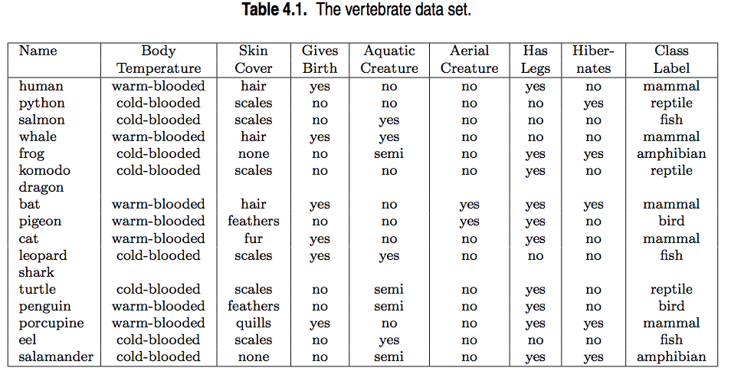
Example – data
source: http://www-users.cs.umn.edu/~kumar/dmbook/ch4.pdf

Slide 17
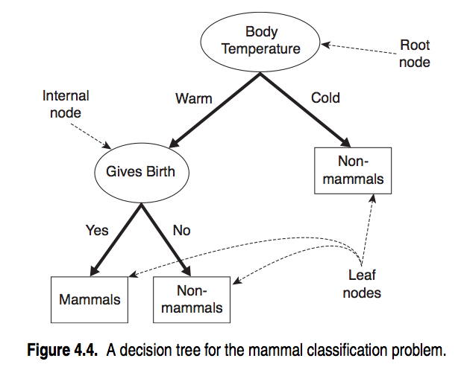
Example – Decision tree
source: http://www-users.cs.umn.edu/~kumar/dmbook/ch4.pdf

Slide 18
Example – Decision tree
NOTE
Internal nodes represent test conditions which partition the records at that node.
source: http://www-users.cs.umn.edu/~kumar/dmbook/ch4.pdf

Slide 19
II. Building decision trees
INTRO TO DATA SCIENCE

Slide 20
Building a decision tree
Q: How do we build a decision tree?

Slide 21
Building a decision tree
Q: How do we build a decision tree?
A: One possibility would be to evaluate all possible decision trees (eg, all permutations of test conditions) for a given dataset.

Slide 22
Building a decision tree
Q: How do we build a decision tree?
A: One possibility would be to evaluate all possible decision trees (eg, all permutations of test conditions) for a given dataset.
But this is generally too complex to be practical → O(2^{n}).

Slide 23
Building a decision tree
Q: How do we build a decision tree?
A: One possibility would be to evaluate all possible decision trees (eg, all permutations of test conditions) for a given dataset.
But this is generally too complex to be practical → O(2^{n}).
Q: How do we find a practical solution that works?

Slide 24
Building a decision tree
Q: How do we build a decision tree?
A: One possibility would be to evaluate all possible decision trees (eg, all permutations of test conditions) for a given dataset.
But this is generally too complex to be practical → O(2^{n}).
Q: How do we find a practical solution that works?
A: Use a heuristic algorithm.

Slide 25
Building a decision tree
The basic method used to build (or “grow”) a decision tree is Hunt’s algorithm.

Slide 26
Building a decision tree
The basic method used to build (or “grow”) a decision tree is Hunt’s algorithm.
This is a greedy recursive algorithm that leads to a local optimum.

Slide 27
Building a decision tree
The basic method used to build (or “grow”) a decision tree is Hunt’s algorithm.
This is a greedy recursive algorithm that leads to a local optimum.
greedy – algorithm makes locally optimal decision at each step
recursive – splits task into subtasks, solves each the same way
local optimum – solution for a given neighborhood of points

Slide 28
Building a decision tree
Hunt’s algorithm builds a decision tree by recursively partitioning records into smaller & smaller subsets.

Slide 29
Building a decision tree
Hunt’s algorithm builds a decision tree by recursively partitioning records into smaller & smaller subsets.
The partitioning decision is made at each node according to a metric called purity.

Slide 30
Building a decision tree
Hunt’s algorithm builds a decision tree by recursively partitioning records into smaller & smaller subsets.
The partitioning decision is made at each node according to a metric called purity.
A partition is 100% pure when all of its records belong to a single class.

Slide 31
Building a decision tree
Consider a binary classification problem with classes X, Y. Given a set of records D_{t} at node t, Hunt’s algorithm proceeds as follows:
Notes:
Draw example on whiteboard for each step

Slide 32
Building a decision tree
Consider a binary classification problem with classes X, Y. Given a set of records D_{t} at node t, Hunt’s algorithm proceeds as follows:
1) If all records in D_{t} belong to class X, then t is a leaf node corresponding to class X.

Slide 33
Building a decision tree
Consider a binary classification problem with classes X, Y. Given a set of records D_{t} at node t, Hunt’s algorithm proceeds as follows:
1) If all records in D_{t} belong to class X, then t is a leaf node corresponding to class X.
NOTE
This is the base case for the recursive algorithm.

Slide 34
Building a decision tree
Consider a binary classification problem with classes X, Y. Given a set of records D_{t} at node t, Hunt’s algorithm proceeds as follows:
2) If D_{t} contains records from both classes, then a test condition is created to partition the records further. In this case, t is an internal node whose outgoing edges correspond to the possible outcomes of this test condition.

Slide 35
Building a decision tree
Consider a binary classification problem with classes X, Y. Given a set of records D_{t} at node t, Hunt’s algorithm proceeds as follows:
2) If D_{t} contains records from both classes, then a test condition is created to partition the records further. In this case, t is an internal node whose outgoing edges correspond to the possible outcomes of this test condition.
These outgoing edges terminate in child nodes. A record d in D_{t} is assigned to one of these child nodes based on the outcome of the test condition applied to d.

Slide 36
Building a decision tree
Consider a binary classification problem with classes X, Y. Given a set of records D_{t} at node t, Hunt’s algorithm proceeds as follows:
3) These steps are then recursively applied to each child node.

Slide 37
building a decision tree
Consider a binary classification problem with classes X, Y. Given a set of records D_{t} at node t, Hunt’s algorithm proceeds as follows:
3) These steps are then recursively applied to each child node.
NOTE
Decision trees are easy to interpret, but the algorithms to create them are a bit complicated.

Slide 38
Creating partitions
Q: How do we partition the training records?

Slide 39
Creating partitions
Q: How do we partition the training records?
A: There are a few ways to do this.

Slide 40
Creating partitions
Q: How do we partition the training records?
A: There are a few ways to do this.
Test conditions can create binary splits:

Slide 41
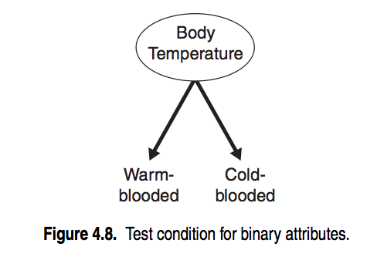
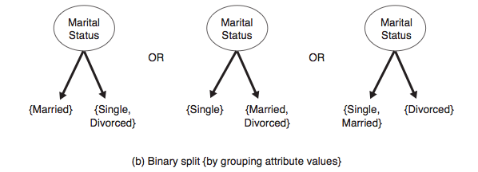
Creating partitions
Q: How do we partition the training records?
A: There are a few ways to do this.
Test conditions can create binary splits:

Slide 42
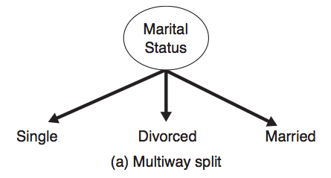
Creating partitions
Q: How do we partition the training records?
A: There are a few ways to do this.
Alternatively, we can create multiway splits:

Slide 43
Creating partitions
Q: How do we partition the training records?
A: There are a few ways to do this.
Alternatively, we can create multiway splits:
NOTE
Multiway splits can produce purer subsets, but may lead to overfitting!
Notes:
One popular implementation (CART) uses only binary splits for this reason

Slide 44
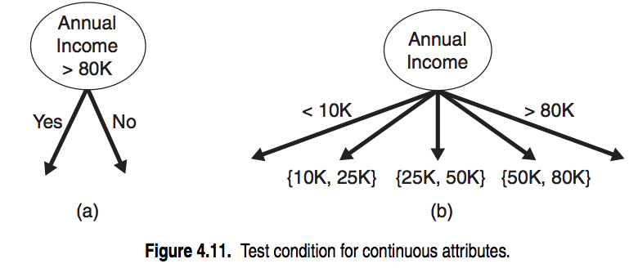
Creating partitions
Q: How do we partition the training records?
A: There are a few ways to do this.
For continuous features, we can use either method:

Slide 45
Creating partitions
Q: How do we partition the training records?
A: There are a few ways to do this.
For continuous features, we can use either method:
NOTE
There are optimizations that can improve the naïve quadratic complexity of determining the optimum split point for continuous atrributes.
Notes:
cf TSK

Slide 46
Creating partitions
Q: How do we determine the best split?

Slide 47
Creating partitions
Q: How do we determine the best split?
A: Recall that no split is necessary (at a given node) when all records
belong to the same class.

Slide 48
Creating partitions
Q: How do we determine the best split?
A: Recall that no split is necessary (at a given node) when all records
belong to the same class.
Therefore we want each step to create the partition with the highest possible purity.

Slide 49
Creating partitions
Q: How do we determine the best split?
A: Recall that no split is necessary (at a given node) when all records
belong to the same class.
Therefore we want each step to create the partition with the highest possible purity.
We need an objective function to optimize!

Slide 50
III. Optimization functions
INTRO TO DATA SCIENCE

Slide 51
Objective functions
We want our objective function to measure the gain in purity from a particular split.

Slide 52
Objective functions
We want our objective function to measure the gain in purity from a particular split.
Therefore we want it to depend on the class distribution over the nodes (before and after the split).

Slide 53
Objective functions
We want our objective function to measure the gain in purity from a particular split.
Therefore we want it to depend on the class distribution over the nodes (before and after the split).
For example, let p(i|t) be the probability of class i at node t (eg, the fraction of records labeled i at node t).

Slide 54
Objective functions
We want our objective function to measure the gain in purity from a particular split.
Therefore we want it to depend on the class distribution over the nodes (before and after the split).
For example, let p(i|t) be the probability of class i at node t (eg, the fraction of records labeled i at node t).
NOTE
We are using the frequentist definition of probability here!

Slide 55
Objective functions
Then for a binary (0/1) classification problem,

Slide 56
Objective functions
Then for a binary (0/1) classification problem,
The minimum purity partition is given by the distribution:
p(0|t) = p(1|t) = 0.5

Slide 57
Objective functions
Then for a binary (0/1) classification problem,
The minimum purity partition is given by the distribution:
p(0|t) = p(1|t) = 0.5
The maximum purity partition is given (eg) by the distribution:
p(0|t) = 1 – p(1|t) = 1

Slide 58
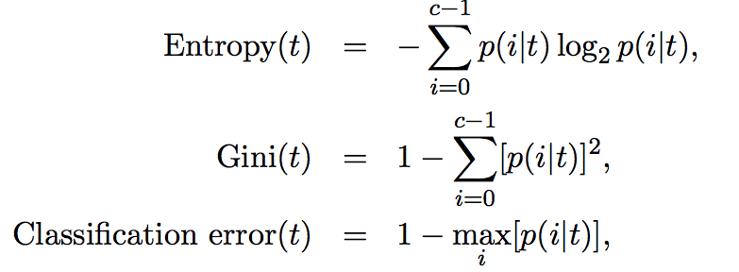
Objective functions
Some measures of impurity include:
Notes:
sum over nodes in partition

Slide 59
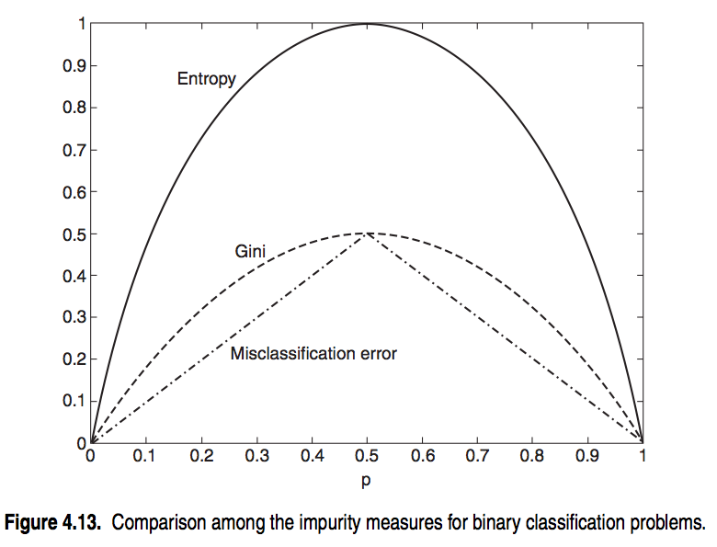
Consistency of Objective functions
Note that each measure achieves its max at 0.5, min at 0 & 1.

Slide 60
Consistency of Objective functions
Note that each measure achieves its max at 0.5, min at 0 & 1.
NOTE
Despite consistency, different measures may create different splits.

Slide 61
Objective functions
Impurity measures put us on the right track, but on their own they are not enough to tell us how our split will do.

Slide 62
Objective functions
Impurity measures put us on the right track, but on their own they are not enough to tell us how our split will do.
Q: Why is this true?

Slide 63
Objective functions
Impurity measures put us on the right track, but on their own they are not enough to tell us how our split will do.
Q: Why is this true?
A: We still need to look at impurity before & after the split.

Slide 64
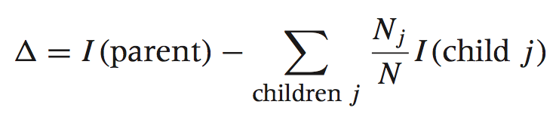
Objective functions
We can make this comparison using the gain:

Slide 65
Objective functions
We can make this comparison using the gain:
(Here I is the impurity measure, N_{j} denotes the number of records at child node j, and N denotes the number of records at the parent node.)

Slide 66
Objective functions
We can make this comparison using the gain:
(Here I is the impurity measure, N_{j} denotes the number of records at child node j, and N denotes the number of records at the parent node.)
When I is the entropy, this quantity is called the information gain.

Slide 67
Objective functions
Generally speaking, a test condition with a high number of outcomes can lead to overfitting (ex: a split with one outcome per record).

Slide 68
Objective functions
Generally speaking, a test condition with a high number of outcomes can lead to overfitting (ex: a split with one outcome per record).
One way of dealing with this is to restrict the algorithm to binary splits only (CART).

Slide 69
Objective functions
Generally speaking, a test condition with a high number of outcomes can lead to overfitting (ex: a split with one outcome per record).
One way of dealing with this is to restrict the algorithm to binary splits only (CART).
Another way is to use a splitting criterion which explicitly penalizes the number of outcomes (C4.5)

Slide 70

Objective functions
We can use a function of the information gain called the gain ratio to explicitly penalize high numbers of outcomes:
(Where p(v_{i}) refers to the probability of label i at node v)

Slide 71
Objective functions
We can use a function of the information gain called the gain ratio to explicitly penalize high numbers of outcomes:
(Where p(v_{i}) refers to the probability of label i at node v)
NOTE
This is a form of regularization!

Slide 72
IV. Preventing overfitting
INTRO TO DATA SCIENCE

Slide 73
Preventing overfitting
In addition to determining splits, we also need a stopping criterion to tell us when we’re done.

Slide 74
Preventing overfitting
In addition to determining splits, we also need a stopping criterion to tell us when we’re done.
For example, we can stop when all records belong to the same class, or when all records have the same attributes.
Notes:
Why wouldn’t you want to do this?

Slide 75
Preventing overfitting
In addition to determining splits, we also need a stopping criterion to tell us when we’re done.
For example, we can stop when all records belong to the same class, or when all records have the same attributes.
This is correct in principle, but would likely lead to overfitting.

Slide 76
Preventing overfitting
One possibility is pre-pruning, which involves setting a minimum threshold on the gain, and stopping when no split achieves a gain above this threshold.

Slide 77
Preventing overfitting
One possibility is pre-pruning, which involves setting a minimum threshold on the gain, and stopping when no split achieves a gain above this threshold.
This prevents overfitting, but is difficult to calibrate in practice (may preserve bias!)

Slide 78
Preventing overfitting
Alternatively we could build the full tree, and then perform pruning as a post-processing step.

Slide 79
Preventing overfitting
Alternatively we could build the full tree, and then perform pruning as a post-processing step.
To prune a tree, we examine the nodes from the bottom-up and simplify pieces of the tree (according to some criteria).

Slide 80
Preventing overfitting
Complicated subtrees can be replaced either with a single node, or with a simpler (child) subtree.

Slide 81
Preventing overfitting
Complicated subtrees can be replaced either with a single node, or with a simpler (child) subtree.
The first approach is called subtree replacement, and the second is subtree raising.

Slide 82
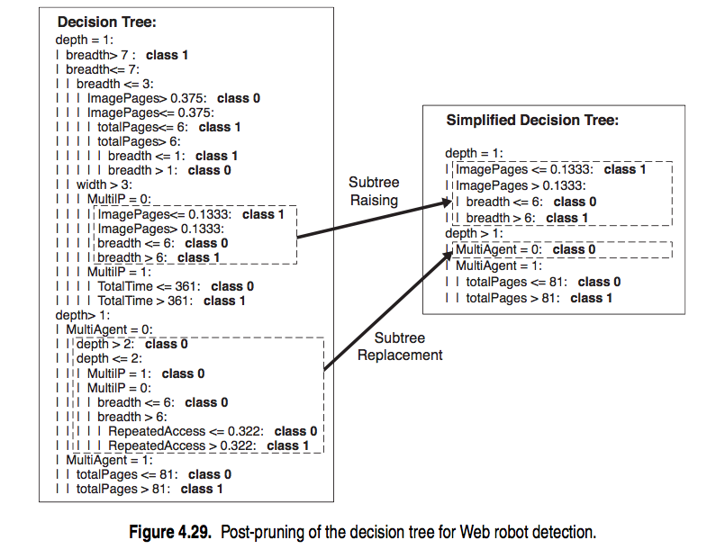
Preventing overfitting

Slide 83
Ex: decision trees in python
INTRO TO DATA SCIENCE

Slide 84
Exercise – ML in python
Key objectives
tools
- implement a decision tree classifier - scikit-learn
Notes:
datasets:
Iris
UCI cars: http://archive.ics.uci.edu/ml/datasets/Car+Evaluation
UCI space shuttle: http://archive.ics.uci.edu/ml/datasets/Statlog+(Shuttle)

Slide 85
INTRO TO DATA SCIENCE

