Slide 1
Venture Capital, Startups and Data
By
Vijay Venkatesh

Slide 2
Objective
Analyze VC and startup data
Visualize data to see if any trends are presented
Are there any predictors of funding, success or outcomes
Repeat
Project?

Slide 3
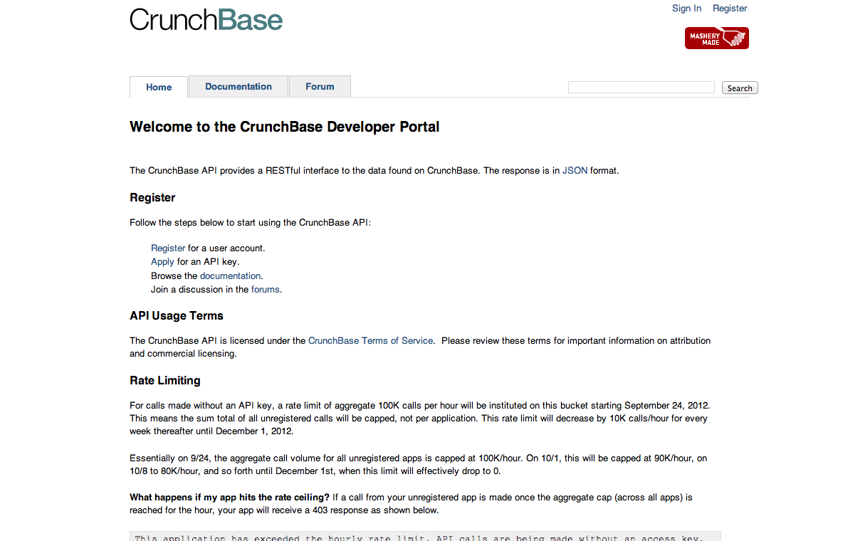
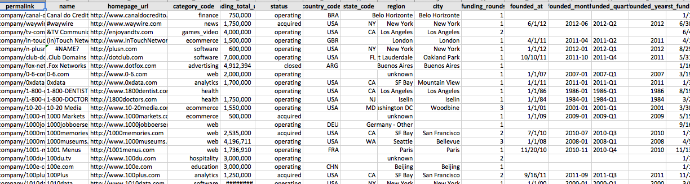
Data source
Crunchbase API
Crunchbase Dump
Notes:
Commercial options exist – not considered due to cost – 10-15K minimum

Slide 4
Data format
Excel file dump or API
5 sheets = 5 dataframes
Merge as needed
(See issues)

Slide 5
Some visuals…

Slide 6
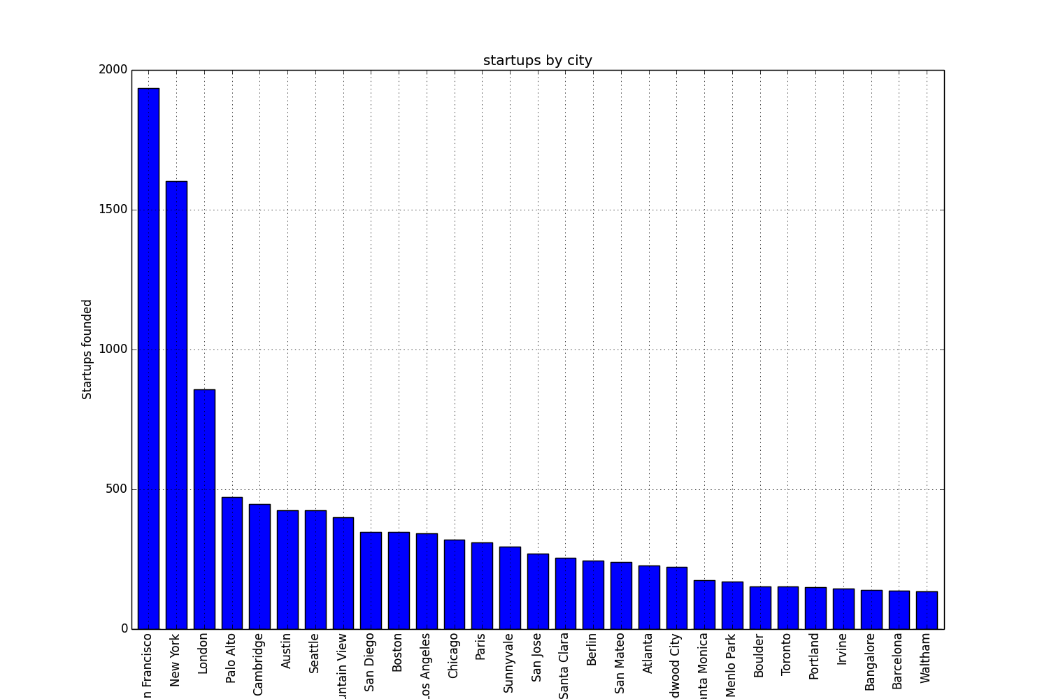
Startups by City
Notes:
Unknown – Dropped – Assumption 3300 -

Slide 7
Issues
NaN
Fill w/ mean values makes graphs spiky
Data consistency
Companies funding, and funding by companies data not consistent
Data integrity
Crowd-sourced data – Must correlate
Data completeness
Big chunks of data missing (Found out 2/18)

Slide 8
Feature selection
Funding_total_usd: Total funding received [o]
Funding_rounds: Number of rounds [o]
Founded_year: Year of founding [o]
Topvcs: 1/0 if backed by a top VC
CountOfTopVcs: # of top VCs
InTopCity: 1/0 if in one of the most active cities
Unique_investors: # of unique investors
TimeLagToFund: Time between founding and first funding
FirstLastDiff: Time between first funding and last funding
Category_code: Startup’s domain [o]
Samecity: T/F if in same city as the VC
[o] – In original dataset

Slide 9
Missing features
Balance sheet - Sales & Profits [quantifiable]
Founder / Gender bias? [quantifiable]
Customer information [quantifiable]

Slide 10
Model selection
Data – Years
Limited data to 2003-2010 to prevent survivorship bias (32k rows -> 14k rows)
Logistic regression
Predicting category – 1/0 value
Random Forest
Random slice across features – slower
Lower scores

Slide 11
Results
Features | accuracy | precision | recall | roc_auc
funding_total_usd (a) | 0.899 | 0.0 | 0.0 | 0.559
a, funding_rounds(b) | “ | “ | “ | 0.602
[a-b], founded_year(c ) | “ | “ | “ | 0.645
[a-c],topvcs(d) | “ | “ | “ | 0.660
[a-d],intopcity(e) | “ | “ | “ | 0.690
[a-e],uniqueinvestors(f) | “ | “ | “ | 0.703
[a-f],firstlastdiff(g) | “ | “ | “ | 0.704
[a-g],timelagtofund(h) | “ | 0.444 | 0.002 | 0.726
[a-h],samecity(i) | “ | 0.388 | 0.002 | 0.727
[a-i],countoftopVCs(j) | “ | “ | “ | “
[a-j],category_code(k) | “ | 0.658 | 0.007 | 0.731

Slide 12
Conclusions
For a startup….these all matter,
# of rounds and amount of funding
Being backed by a top VC(more investors and more top VCs the better)
Being in certain city clusters and in the same city as some of the top VCs
Times between founding and funding and first and last funding rounds
BUT……

Slide 13
Conclusions
These probably matter more
Solving a problem people face
Culture
Hard work and effort

