Slide 1
INTRO to DATA SCIENCE ensemble techniques

Slide 2
I. ensemble techniques II. Problems in classification III. Bagging IV. Boosting V. Random forests exercise: VI. Adaboost
agenda

Slide 3
I. ensemble techniques
INTRO TO DATA SCIENCE

Slide 4
Ensemble techniques
Q: What are ensemble techniques?

Slide 5
Ensemble techniques
Q: What are ensemble techniques?
A: Methods of improving classification accuracy by aggregating
predictions over several base classifiers.

Slide 6
Ensemble techniques
Q: What are ensemble techniques?
A: Methods of improving classification accuracy by aggregating
predictions over several base classifiers.
Ensembles are often much more accurate than the base classifiers that compose them.

Slide 7

Ensemble techniques
Q: What are ensemble techniques?
A: Methods of improving classification accuracy by aggregating
predictions over several base classifiers.
Ensembles are often much more accurate than the base classifiers that compose them.
NOTE
Base classifiers and ensemble classifiers are sometimes called weak learners and strong learners.

Slide 8
Ensemble techniques
In order for an ensemble classifier to outperform a single base classifier, the following conditions must be met:

Slide 9
Ensemble techniques
In order for an ensemble classifier to outperform a single base classifier, the following conditions must be met:
1) the bc’s must be accurate: they must outperform random
guessing

Slide 10
Ensemble techniques
In order for an ensemble classifier to outperform a single base classifier, the following conditions must be met:
1) the bc’s must be accurate: they must outperform random
guessing
2) the bc’s must be diverse: their misclassifications must occur on
different training examples

Slide 11
Ensemble techniques
In order for an ensemble classifier to outperform a single base classifier, the following conditions must be met:
1) the bc’s must be accurate: low bias
2) the bc’s must be diverse: uncorrelated

Slide 12
Ensemble techniques
In order for an ensemble classifier to outperform a single base classifier, the following conditions must be met:
1) the bc’s must be accurate: low bias
2) the bc’s must be diverse: uncorrelated
NOTE
Ideally, we would also like the base classifiers to be unstable to variations in the training set.
In other words, high variance.
Notes:
note: most of the benefit of ensemble methods comes from the first few bc’s (diminishing mgl returns)

Slide 13
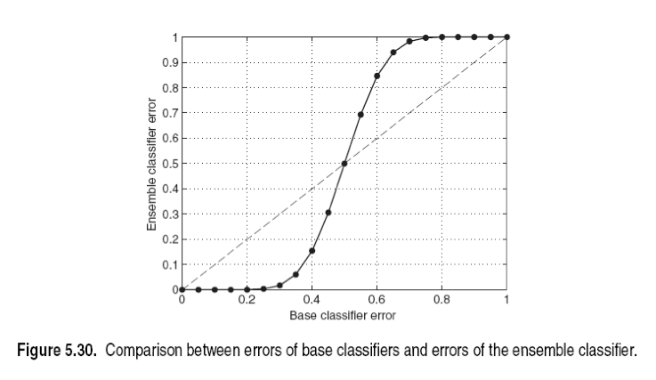
Ensemble techniques
NOTE
dashed line = perfectly correlated bc’s (no improvement using ensemble)
solid line = perfectly uncorrelated bc’s (some improvement for unbiased bc’s)

Slide 14
II. problems in classification
INTRO TO DATA SCIENCE

Slide 15
Problems in classification
In any supervised learning task, our goal is to make predictions of the true classification function f by learning the classifier h.
Notes:
h = hypothesis

Slide 16
Problems in classification
In any supervised learning task, our goal is to make predictions of the true classification function f by learning the classifier h.
There are three main problems that can prevent this:
- statistical problem
- computational problem
- representational problem

Slide 17
The statistical problem
If the amount of training data available is small, the base classifier will have difficulty converging to h.
An ensemble classifier can mitigate this problem by “averaging out” base classifier predictions to improve convergence.

Slide 18
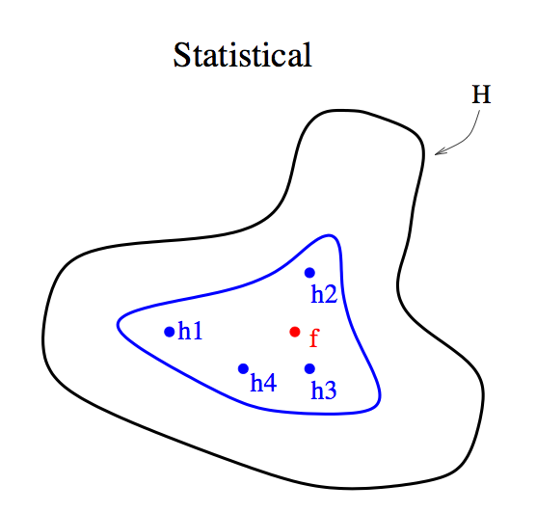
The statistical problem
NOTE
The true function f is best approximated as an average of the base classifiers.
source: http://www.cs.iastate.edu/~jtian/cs573/Papers/Dietterich-ensemble-00.pdf
Notes:
note: H = hypothesis space
blue region = unbiased subspace of H

Slide 19
The computational problem
Even with sufficient training data, it may still be computationally difficult to find the best classifier h.
For example, if our base classifier is a decision tree, an exhaustive search of the hypothesis space of all possible classifiers is extremely complex (NP-complete).

Slide 20
The computational problem
Even with sufficient training data, it may still be computationally difficult to find the best classifier h.
For example, if our base classifier is a decision tree, an exhaustive search of the hypothesis space of all possible classifiers is extremely complex (NP-complete).
NOTE
Recall that this is why we used a heuristic algorithm (greedy search).

Slide 21
The computational problem
Even with sufficient training data, it may still be computationally difficult to find the best classifier h.
For example, if our base classifier is a decision tree, an exhaustive search of the hypothesis space of all possible classifiers is extremely complex (NP-complete).
An ensemble composed of several BC’s with different starting points can provide a better approximation to f than any individual BC.

Slide 22
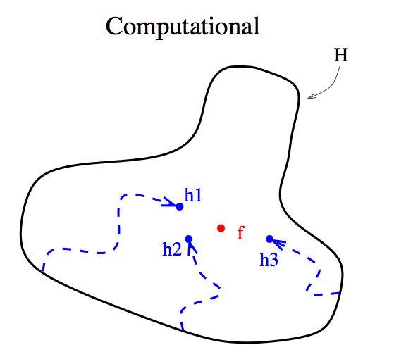
The computational problem
NOTE
The true function f is often best approximated by using several starting points to explore the hypothesis space.
source: http://www.cs.iastate.edu/~jtian/cs573/Papers/Dietterich-ensemble-00.pdf

Slide 23
The REPRESENTATIONAL problem
Sometimes f cannot be expressed in terms of our hypothesis at all.

Slide 24
The REPRESENTATIONAL problem
Sometimes f cannot be expressed in terms of our hypothesis at all.
To illustrate this, suppose we use a decision tree as our base classifier.

Slide 25
The REPRESENTATIONAL problem
Sometimes f cannot be expressed in terms of our hypothesis at all.
To illustrate this, suppose we use a decision tree as our base classifier.
A decision tree works by forming a rectilinear partition of the feature space.

Slide 26
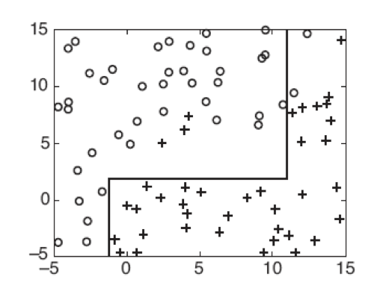
The REPRESENTATIONAL problem – 2d decision tree
NOTE
What is a rectilinear decision boundary?
One whose segments are orthogonal to the x & y axes.
Notes:
can you draw the dec tree from seeing the db?

Slide 27
The REPRESENTATIONAL problem
But what if f is a diagonal line?
Notes:
Note: this problem will exist regardless of the amount of data we have!

Slide 28
The REPRESENTATIONAL problem
But what if f is a diagonal line?
Then it cannot be represented by finitely many rectilinear segments, and therefore the true decision boundary cannot be obtained by a decision tree classifier.
Notes:
Note: this problem will exist regardless of the amount of data we have!

Slide 29
The REPRESENTATIONAL problem
But what if f is a diagonal line?
Then it cannot be represented by finitely many rectilinear segments, and therefore the true decision boundary cannot be obtained by a decision tree classifier.
However, it may be still be possible to approximate f or even to expand the space of representable functions using ensemble methods.
Notes:
Note: this problem will exist regardless of the amount of data we have!

Slide 30
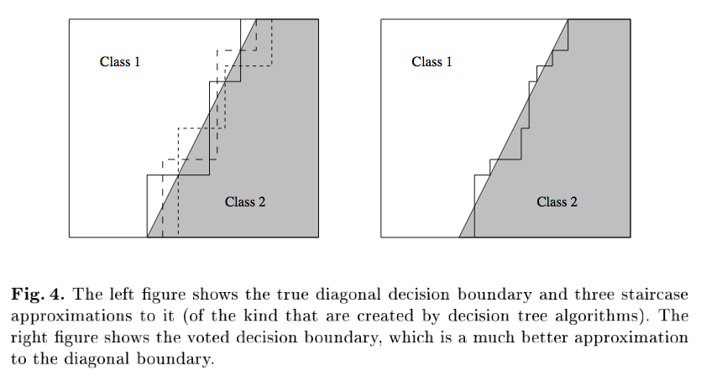
The REPRESENTATIONAL problem – approximation
NOTE
An ensemble of decision trees can approximate a diagonal decision boundary.

Slide 31
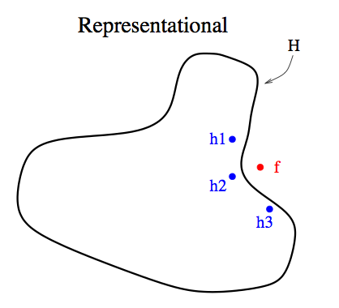
The representational problem – expanding the hypothesis space
NOTE
Ensemble classifiers can be effective even if the true decision boundary lies outside the hypothesis space.
Notes:
note: this will require a nonlinear combination of the base classifiers

Slide 32
Creating an ensemble prediction
Q: How do you create an ensemble classifier?

Slide 33
Creating an ensemble prediction

Slide 34
Creating an ensemble prediction
Q: How do you generate several base classifiers?

Slide 35
Creating an ensemble prediction
Q: How do you generate several base classifiers?
A: There are several ways to do this:
- manipulating the training set
- manipulating the output labels
- manipulating the learning algorithm itself
We will talk about a few examples of each of these.

Slide 36
III. bagging
INTRO TO DATA SCIENCE

Slide 37
bagging
Bagging (bootstrap aggregating) is a method that involves manipulating the training set by resampling.

Slide 38
bagging
Bagging (bootstrap aggregating) is a method that involves manipulating the training set by resampling.
We learn k base classifiers on k different samples of training data.
These samples are independently created by resampling the training data using uniform weights (eg, a uniform sampling distribution).

Slide 39
bagging
Bagging (bootstrap aggregating) is a method that involves manipulating the training set by resampling.
We learn k base classifiers on k different samples of training data.
These samples are independently created by resampling the training data using uniform weights (eg, a uniform sampling distribution).
NOTE
Each training sample is the same size as the original training set.

Slide 40
bagging
Bagging (bootstrap aggregating) is a method that involves manipulating the training set by resampling.
We learn k base classifiers on k different samples of training data.
These samples are independently created by resampling the training data using uniform weights (eg, a uniform sampling distribution).
NOTE
NOTE
Each training sample is the same size as the original training set.
Resampling means that some training records may appear in a sample more than once, or even not at all.

Slide 41
bagging
Bagging (bootstrap aggregating) is a method that involves manipulating the training set by resampling.
We learn k base classifiers on k different samples of training data.
These samples are independently created by resampling the training data using uniform weights (eg, a uniform sampling distribution).
The final prediction is made by taking a majority vote across bc’s.

Slide 42
bagging
Bagging reduces the variance in our generalization error by aggregating multiple base classifiers together (provided they satisfy our earlier requirements).

Slide 43
bagging
Bagging reduces the variance in our generalization error by aggregating multiple base classifiers together (provided they satisfy our earlier requirements).
If the base classifier is stable, then the ensemble error is primarily due to bc bias, and bagging may not be effective.
Notes:
stable to minor changes in training data

Slide 44
bagging
Bagging reduces the variance in our generalization error by aggregating multiple base classifiers together (provided they satisfy our earlier requirements).
If the base classifier is stable, then the ensemble error is primarily due to bc bias, and bagging may not be effective.
Since each sample of training data is equally likely, bagging is not very susceptible to overfitting with noisy data.

Slide 45
IV. boosting
INTRO TO DATA SCIENCE
Notes:
Why susceptible to noise?

Slide 46
boosting
Boosting is an iterative procedure that adaptively changes the sampling distribution of training records at each iteration.

Slide 47
boosting
Boosting is an iterative procedure that adaptively changes the sampling distribution of training records at each iteration.
The first iteration uses uniform weights (like bagging). In subsequent iterations, the weights are adjusted to emphasize records that were misclassified in previous iterations.

Slide 48
boosting
Boosting is an iterative procedure that adaptively changes the sampling distribution of training records at each iteration.
The first iteration uses uniform weights (like bagging). In subsequent iterations, the weights are adjusted to emphasize records that were misclassified in previous iterations.
The final prediction is constructed by a weighted vote (where the weights for a bc depends on its training error).

Slide 49
boosting
Boosting is an iterative procedure that adaptively changes the sampling distribution of training records at each iteration.
The first iteration uses uniform weights (like bagging). In subsequent iterations, the weights are adjusted to emphasize records that were misclassified in previous iterations.
The final prediction is constructed by a weighted vote (where the weights for a bc depends on its training error).
NOTE
The bc’s focus more and more closely on records that are difficult to classify as the sequence of iterations progresses.
Thus the bc’s are faced with progressively more difficult learning problems.

Slide 50
boosting
Like in bagging, sampling is done with replacement, and as a result some records may not appear in a given training sample.

Slide 51
boosting
Like in bagging, sampling is done with replacement, and as a result some records may not appear in a given training sample.
These omitted records will likely be misclassified, and given greater weight in subsequent iterations once the sampling distribution is updated.

Slide 52
boosting
Like in bagging, sampling is done with replacement, and as a result some records may not appear in a given training sample.
These omitted records will likely be misclassified, and given greater weight in subsequent iterations once the sampling distribution is updated.
So even if a record is left out at one stage, it will be emphasized later.

Slide 53
boosting
Updating the sampling distribution and forming an ensemble prediction leads to a nonlinear combination of the base classifiers.

Slide 54
boosting
Updating the sampling distribution and forming an ensemble prediction leads to a nonlinear combination of the base classifiers.
By explicitly trying to optimize the weighted ensemble vote, boosting attacks the representation problem head-on.

Slide 55
boosting
Updating the sampling distribution and forming an ensemble prediction leads to a nonlinear combination of the base classifiers.
By explicitly trying to optimize the weighted ensemble vote, boosting attacks the representation problem head-on.
Notes:
AdaBoost = popular implementation

Slide 56
V. random forests
INTRO TO DATA SCIENCE

Slide 57
Random forests
A random forest is an ensemble of decision trees where each base classifier is grown using a random effect.

Slide 58
Random forests
A random forest is an ensemble of decision trees where each base classifier is grown using a random effect.
One way to do this is to randomly choose one of the top k features to split each node.

Slide 59
Random forests
A random forest is an ensemble of decision trees where each base classifier is grown using a random effect.
One way to do this is to randomly choose one of the top k features to split each node.
For a small number of features, we can also create linear combinations of features and select splits from the enhanced feature set (Forest-RC).

Slide 60
Random forests
A random forest is an ensemble of decision trees where each base classifier is grown using a random effect.
One way to do this is to randomly choose one of the top k features to split each node.
For a small number of features, we can also create linear combinations of features and select splits from the enhanced feature set (Forest-RC).
Or, we can select splitting features completely at random (Forest-RI).

Slide 61
Random forests
Random forests are about as accurate as AdaBoost, more robust to noise, and can also have better runtime than other ensemble methods (since the feature space is reduced in some cases).

Slide 62
Ex: ensemble methods in scikit-learn
INTRO TO DATA SCIENCE

