Slide 1
INTRO to DATA SCIENCE python

Slide 2
I. intro to python II. Python strengths & weaknesses III. Python data structures IV. Python control flow exercise
agenda

Slide 3
I. intro to python
INTRO TO DATA SCIENCE

Slide 4
Intro to python
Q: What is Python?

Slide 5
Intro to python
Q: What is Python?
A: An open source, high-level, dynamic scripting language.

Slide 6
Intro to python
Q: What is Python?
A: An open source, high-level, dynamic scripting language.
open source: free! (both binaries and source files)
Notes:
You can download it just to use it, or you can download the source files to look around/hack/contribute to the project

Slide 7
Intro to python
Q: What is Python?
A: An open source, high-level, dynamic scripting language.
open source: free! (both binaries and source files)
high-level: interpreted (not compiled)
Notes:
Compared to ‘low-level’ language like C/C++ or even Java
→ different applications

Slide 8
Intro to python
Q: What is Python?
A: An open source, high-level, dynamic scripting language.
open source: free! (both binaries and source files)
high-level: interpreted (not compiled)
dynamic: things that would typically happen at compile time happen at runtime instead (eg, dynamic typing)
Notes:
Again, unlike lower-level language

Slide 9
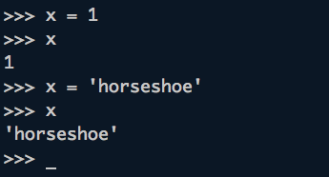
Dynamic typing
Notes:
Note: interpreted language → interpreter (can run an interactive session)
Alt: statically typed language (most lower level languages)

Slide 10
Intro to python
Q: What is Python?
A: An open source, high-level, dynamic scripting language.
open source: free! (both binaries and source files)
high-level: interpreted (not compiled)
dynamic: things that would typically happen at compile time happen at runtime instead (eg, dynamic typing)
scripting language: “middle-weight”
Notes:
eg, you may choose Python for data analysis tasks or to build a web application, but probably not to re-write the Linux kernel

Slide 11
Intro to python
Python supports multiple programming paradigms, such as:

Slide 12
Intro to python
Python supports multiple programming paradigms, such as:
- imperative programming
- object oriented programming
- functional programming (sort of)

Slide 13
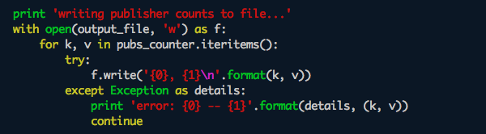
Imperative programming in python
Notes:
Imperative is probably what you think of when you think of programming
(point out some features)

Slide 14
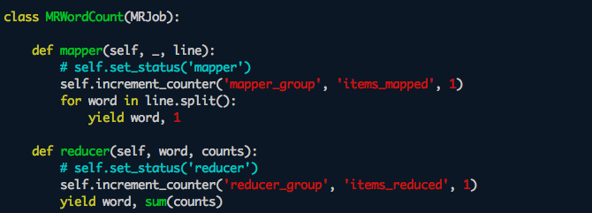
Oop in python
Notes:
Point out some features

Slide 15

Oop in python
NOTE
In Python, everything is an object.
Notes:
Just keep this in mind for the moment

Slide 16
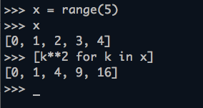
Functional programming in python
NOTE
This is called a list comprehension.
(Python also has functional map, filter, and reduce.)
Notes:
Python is explicitly not a functional language (you can read a lot about this online)
But, it does support some functional constructs, mostly for convenience
Any haskell fans?

Slide 17
Intro to python
Python is an open source project which is maintained by a large and very active community.
Notes:
Nb: you can usually find a decent package to help you out with any type of problem

Slide 18
Intro to python
Python is an open source project which is maintained by a large and very active community.
It was originally created by Guido Van Rossum in the 1990s, who currently holds the title of Benevolent Dictator For Life (BDFL).

Slide 19

guido
http://en.wikipedia.org/wiki/Guido_van_Rossum
Notes:
Guido was at Google for a long time, then went to Dropbox in Dec 2012

Slide 20

Guido: the early years
http://pytalent.zandstrasystems.com/meet_py1.html

Slide 21
Intro to python
The presence of a BDFL means that Python has a unified design philosophy.
Notes:
Very important points!

Slide 22
Intro to python
The presence of a BDFL means that Python has a unified design philosophy.
This design philosophy emphasizes readability and ease of use, and is codified in PEP8 (the Python style guide) and PEP20 (the Zen of Python).
Notes:
Very important points!

Slide 23
Intro to python
The presence of a BDFL means that Python has a unified design philosophy.
This design philosophy emphasizes readability and ease of use, and is codified in PEP8 (the Python style guide) and PEP20 (the Zen of Python).
NOTE
PEPs (or Python Enhancement Proposals) are the public design specs that the language follows.
Notes:
>> import this

Slide 24
II. Python strengths & weaknesses
INTRO TO DATA SCIENCE

Slide 25
Strengths & weaknesses
Python’s popularity comes from the strength of its design.
The syntax looks like pseudocode, and it is explicitly meant to be clear, compact, and easy to read.
This is usually summarized by saying Python is an expressive language.
Notes:
Eg, takes fewer LOC to achieve same thing in Python as in other languages

Slide 26
Strengths & weaknesses
Python is also an extremely versatile language, and it attracts fans from many different walks of life:
web development https://www.djangoproject.com/
data analysis http://pandas.pydata.org/
systems admin http://docs.fabfile.org/en/1.6/
(etc) https://github.com/languages/Python

Slide 27
The standard library
Another great strength is the Python Standard Library.
This is a collection of packages that ships with the standard Python distrubution, and “…covers everything from asynchronous processing to zip files”.
The advantages of the PSL are usually described by saying that Python comes with batteries included.

Slide 28
Strengths & weaknesses
Ultimately, Python’s most important strength is that it’s easy to learn and easy to use.
Notes:
Makes a great first language, also makes a great tool for day-to-day expert use.

Slide 29
Strengths & weaknesses
Ultimately, Python’s most important strength is that it’s easy to learn and easy to use.
Because there should be only one way to perform a given task, things frequently work the way you expect them to.
Notes:
cf pep 20

Slide 30
Strengths & weaknesses
Ultimately, Python’s most important strength is that it’s easy to learn and easy to use.
Because there should be only one way to perform a given task, things frequently work the way you expect them to.
This is a huge luxury!
Notes:
As you may have grasped from your experience with R

Slide 31
Strengths & weaknesses
Q: Python sounds amazing. What is it bad at?
Notes:
Weird bugs to creep in, but this is easy to avoid with good code hygiene.

Slide 32
Strengths & weaknesses
Q: Python sounds amazing. What is it bad at?
For one thing, Python is slower than a lower-level language (but keep in mind that this is a conscious tradeoff).
Notes:
Interpreted lang, rapid prototyping, plasticky

Slide 33
Strengths & weaknesses
Q: Python sounds amazing. What is it bad at?
For one thing, Python is slower than a lower-level language (but keep in mind that this is a conscious tradeoff).
Many people would say that Python’s Achilles heel is concurrency. This is a result of the Global Interpreter Lock (again, a conscious design decision).
Notes:
can do multiproc, but sometimes that’s not quite what you’re after…this is a specialized complaint

Slide 34
Strengths & weaknesses
Q: Python sounds amazing. What is it bad at?
For one thing, Python is slower than a lower-level language (but keep in mind that this is a conscious tradeoff).
Many people would say that Python’s Achilles heel is concurrency. This is a result of the Global Interpreter Lock (again, a conscious design decision).
There are some other subtleties regarding dynamic typing that people occasionally dislike, but again this is intentional (and a matter of opinion).
Notes:
Allegedly allows weird bugs to creep in, but this is easy to avoid with good code hygiene.

Slide 35
III. Python Data structures
INTRO TO DATA SCIENCE

Slide 36
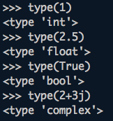
Basic Data structures
The most basic data structure is the None type. This is the equivalent of NULL in other languages.
There are four basic numeric types: int, float, bool, complex.
Notes:
note: numeric computation isn’t great in python, but numpy gives you all the matrix-based operations of Matlab (and it’s fast!)
note: j for sqrt(-1)

Slide 37
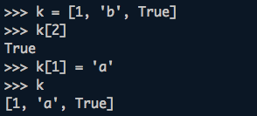
Basic Data structures
The next basic data type is the array, implemented in Python as a list.
A list is an ordered collection of elements, and these elements can be of arbitrary type. Lists are mutable, meaning they can be changed in-place.
Notes:
demo: elts, slicing, neg indices, reversal

Slide 38
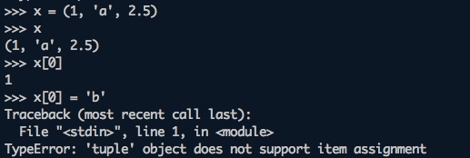
Basic Data structures
After lists we have tuples, which are immutable arrays of arbitrary elements.
Tuples are frequently used behind the scenes in a special type of variable assignment called tuple packing/unpacking.
Notes:
demo x, y = y, x
demo csv line unpacking

Slide 39
Basic Data structures
The string type in Python represents an immutable ordered array of characters (note there is no char type).
Strings support slicing and indexing operations like arrays, and have many other string-specific functions as well.
String processing is one area where Python excels.
Notes:
>> help(str)

Slide 40

Basic Data structures
Associative arrays (or hash tables) are implemented in Python as the dictionary type. This is a very efficient and useful structure that Python’s internal functions use extensively.
Dictionaries are unordered collections of key-value pairs, and dictionary keys must be immutable.
Notes:
These are very fast, flexible, and useful.

Slide 41

Basic Data structures
Another basic Python data type is the set. Sets are unordered mutable collections of distinct elements.
These are particularly useful for checking membership of an element and for ensuring element uniqueness.

Slide 42

Basic Data structures
Our final example of a data type is the Python file object. This represents an open connection to a file (e.g.) on your laptop.
These are particularly easy to use in Python, especially using the with statement context manager, which automatically closes the file handle when it goes out of scope.
Notes:
Note: stdin, stdout, stderr are also file objects

Slide 43
IV. Python control flow
INTRO TO DATA SCIENCE

Slide 44
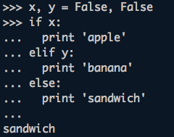
Control flow
Python has a number of control flow tools that will be familiar from other languages. The first is the if-else statement, whose compound syntax looks like this:
Notes:
Note: can also just be if (though else: pass is cleaner)

Slide 45
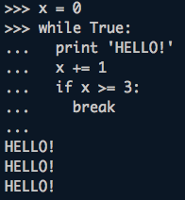
Control flow
Next is the while loop. This executes while a given condition evaluates to True.
Notes:
Useful pattern: while True - break

Slide 46
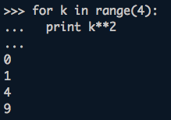
Control flow
Another familiar (and useful) construct is the for loop. This executes a block of code for a range of values.
The object that a for loop iterates over is called (appropriately) an iterable.
Notes:
Also mention lazy iterables, connection to func prog

Slide 47
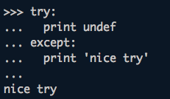
Control flow
A useful but possibly unfamiliar construct is the try-except block:
This is useful for catching and dealing with errors, also called exception handling.
Notes:
Also mention lazy iterables, connection to func prog

Slide 48
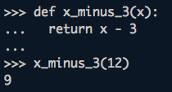
functions
Python allows you to define custom functions as you would expect:
Functions can optionally return a value with a return statement (as this example does).

Slide 49
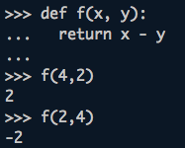
functions
Functions can take a number of arguments as inputs, and these arguments can be specified in two ways:
As positional arguments:

Slide 50
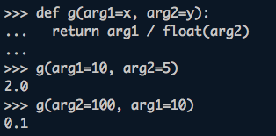
functions
Functions can take a number of arguments as inputs, and these arguments can be specified in two ways:
Or as keyword arguments:
Notes:
Can use both in same func

Slide 51
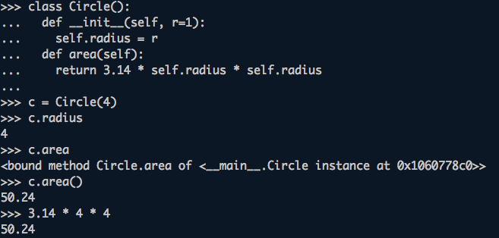
classes
Python supports classes with member attributes and functions:
Notes:
Note constructor, self, default kwarg

Slide 52
modules
A file with Python code in it is referred to as a module. Modules can be turned into executable scripts in two steps:
1) include the if __name__ == ‘__main__’ block
2) specify the interpreter (typically using a Unix shebang)
The screenshot on the next slide demonstrates both of these.
Notes:
Note constructor, self, default kwarg

Slide 53
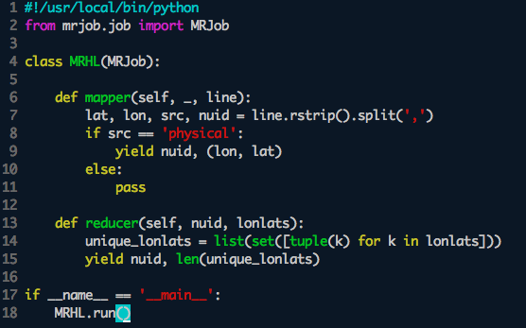
modules
Notes:
Point out class, inheritance, if/else, shebang, if name == main, list, set, tuple, list comp, etc

Slide 54
modules
NOTE
Scripts can also be run with ‘python file.py’ or made executable, with or without a __name__ == ‘__main__’ section.
Notes:
Point out class, inheritance, if/else, shebang, if name == main, list, set, tuple, list comp, etc

Slide 55

import
The previous slide also demonstrated one use of the import statement.
The import statement can be used in three ways:
The differences have to do with how each import statement interacts with the local namespace.

Slide 56
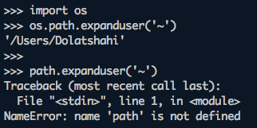
namespaces
Python has three types of namespaces: local, global, and built-in.
For our purposes, namespaces are important because they control how imported code can be accessed:

Slide 57
Syntax & indentation
Python’s syntax is (again) designed with clarity in mind, and good syntax is actually enforced by the interpreter.
This comes from the fact that instead of curly braces or ‘begin/end’ keywords, code blocks are defined by indentation.
This is unique to Python!

Slide 58
Have a look at this again
Notes:
Class, inheritance, if/else, shebang, if name == main, list, set, tuple, list comp, etc

Slide 59
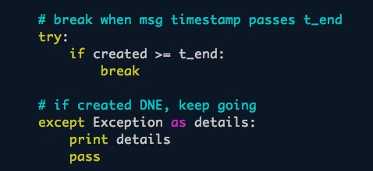
comments
Comments in Python are denoted by the ‘#’ character.

Slide 60
docstrings
There are also special comments called docstrings that immediately follow class and function definitions.
Docstrings are denoted by triple quotes.

Slide 61
Exercise
INTRO TO DATA SCIENCE

