Slide 1
MGSC 697 · Assignment 2 · June 2026
Retail Inventory
Replenishment
Training a Q-Learning Agent to Optimise Weekly Stock Orders
By Laura Manzanos (ID: 261284603)
Core Path · Tabular Q-Learning · Custom MDP · 52-week Horizon · No external libraries

Slide 2
The Business Problem
Every week, one decision: how many units to order?
ORDER TOO LITTLE
ORDER TOO MUCH
ORDER OPTIMALLY
Stockout penalty: $8/unit
Lost sale + lost customer
0.62% rate with Q-learning
Holding cost: $0.50/unit/week
Capital tied up in stock
Agent learns to avoid this
Revenue: $20/unit sold
Match supply to demand
That's the RL problem
The agent acts, demand is realised, a reward arrives, and the strategy improves - exactly the RL loop from the course slides.

Slide 3
MDP Specification
STATE
inventory_bin × demand_regime
Captures the two variables that drive the optimal order
10 bins × 3 regimes = 30 states
ACTION
Order qty ∈ {0, 5, 10, 15, 20, 25}
Discrete set mirrors real supplier MOQ constraints
6 discrete choices
REWARD
Revenue − holding − stockout pen. − order cost
All four cost levers wired in; business strategy as a number
$20 sell · $0.50 hold · $8 short · $10+$2q order
TRANSITION
Demand ~ Poisson(μ_regime); regime → Markov chain
Stochastic demand + slow seasonal drift
Low μ=5, Med μ=10, High μ=18
HORIZON
T = 52 steps (one full year)
Long enough for temporal credit assignment to work
Weekly decision cycle
DISCOUNT γ
γ = 0.97 ≈ 33-week effective horizon
Values this season's margin, not just next week's sale
Medium-term time preference

Slide 4
Three Agents
Compared on the same environment with fixed seeds
RANDOM
(s, S) RULE-BASED
Q-LEARNING
Baseline floor
Industry heuristic
Learning agent
Uniformly samples order qty
at each step.
Mean return: +$7,223
Fill rate: 93.2%
Stockout: 13.0%
Any learning agent
must beat this.
Order up to S=30 when
inventory ≤ s=10.
Mean return: +$8,882
Fill rate: 97.1%
Stockout: 9.9%
Real retail systems
use exactly this rule.
Q(s,a) ← Q(s,a) + α[r + γ·maxQ(s',a') − Q(s,a)]
Mean return: +$8,924
Fill rate: 99.76%
Stockout: 0.62%
Matches revenue.
Eliminates stockouts.

Slide 5
Key Results
200 paired episodes (greedy policy, no exploration) · Episode seeds 1000–1199
0.62%
vs 9.9%
99.76%
p=0.32
Q-Learning stockout rate
(s,S) rule stockout rate
Q-Learning fill rate
Revenue diff: not significant
Agent
Mean Return
Std
Fill Rate
Stockout Rate
Q-Learning
+$8,924
$2,120
99.76%
0.62%
(s,S) Rule
+$8,882
$1,612
97.11%
9.92%
Random
+$7,223
$1,555
93.15%
12.95%
Revenue difference Q vs (s,S): p=0.32 (not significant). Real advantage: 16× stockout reduction. Revenue metric alone is not sufficient.

Slide 6
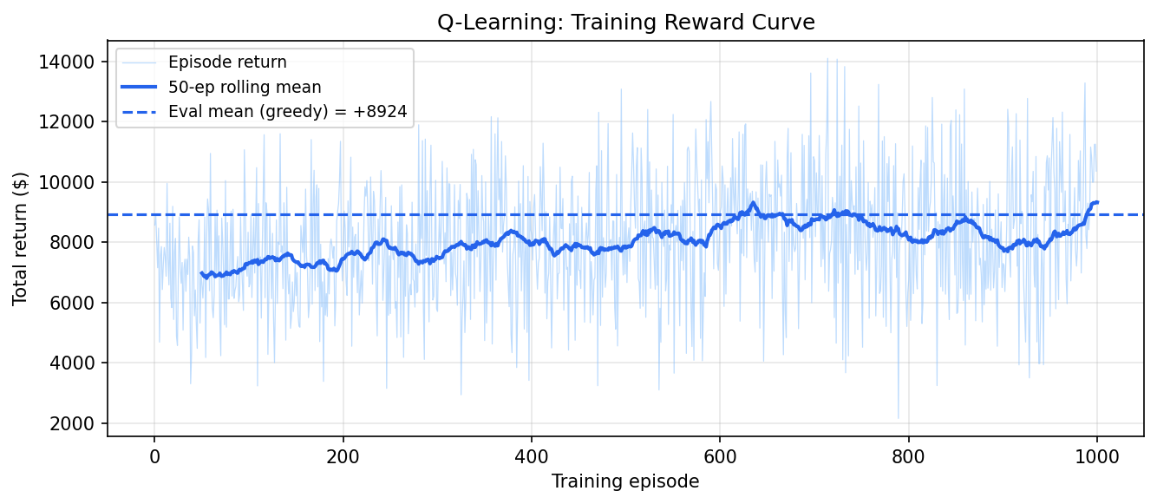
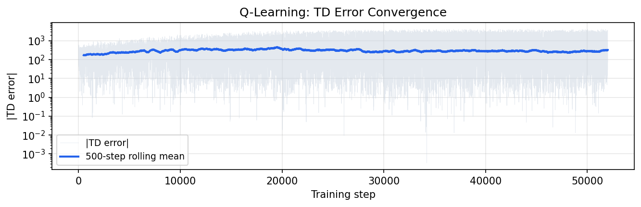
Training & Convergence
1,000 episodes · ~1 second on any laptop · no external RL library
+7,265
Mean return episodes 1–200 (exploring)
+8,453
Mean return episodes 801–1000 (converged)
+16%
Improvement over training

Slide 7
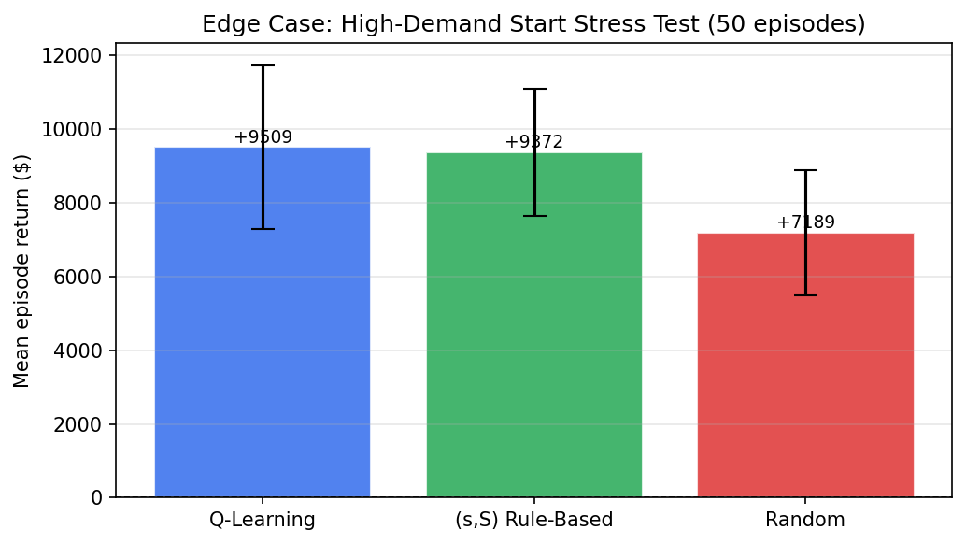
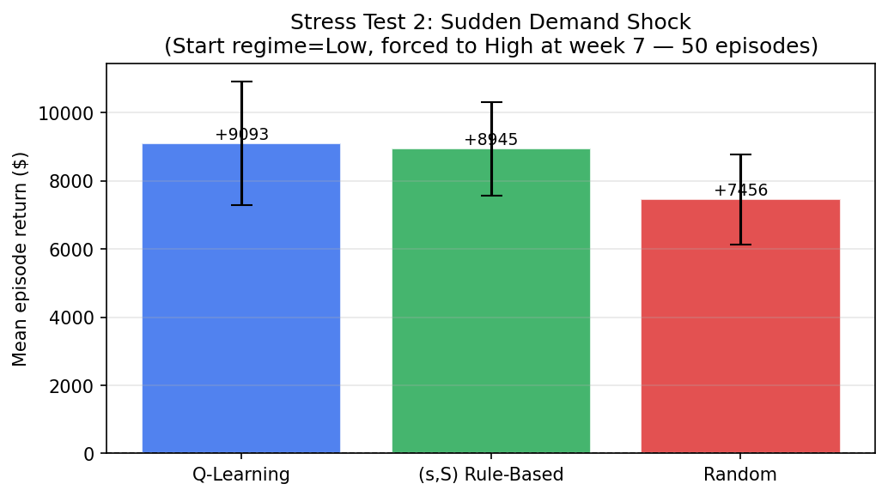
Stress Tests
Two adversarial scenarios - do agents adapt when conditions change?
Scenario
Q-Learning
(s,S) Rule
Random
Interpretation
High-demand start
+$9,509
+$9,372
+$7,189
Spike start: agent adapts fast
Sudden demand shock
+$9,093
+$8,945
+$7,456
Shock mid-ep: regime-blind rule lags
Both tests confirm: Q-learning reads the regime state immediately. The (s,S) rule has no such signal - it reacts only through inventory depletion.

Slide 8
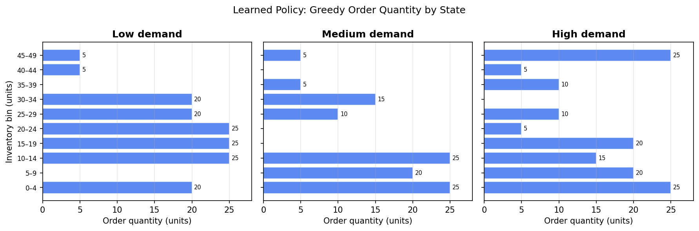
What the Agent Learned
Greedy policy: order quantity for each (inventory bin, demand regime) state
Low stock + high demand → max order (25 units)
High stock + any demand → order little or nothing
Same inventory, different regime → different order
(s,S) rule ignores regime - agent exploits it

Slide 9
Failure Analysis
Five failure modes to monitor before any production deployment
Reward Hacking
Agent aggressively minimises stockouts. If supplier MOQ < 5 units, it may order more frequently and inflate fixed ordering costs in ways the reward doesn't penalise.
Higher Variance
σ=$2,120 vs $1,612 for (s,S). In the worst decile (P10), Q-learning underperforms by ~$608/year. Managers on downside metrics may prefer the rule.
Simulator Gap
Environment uses stationary Poisson demand. Real retail has calendar effects, cross-SKU correlation, promotions. Agent was never trained on these.
Latent State
Demand regime is observed in simulation but latent in production. It must be inferred from recent sales - a separate classification problem not yet solved.
Non-Stationarity
Q-table is static after training. Sustained demand drift (new store format, new competitors) will degrade performance silently and without warning.

Slide 10
Recommendation
SHADOW DEPLOY - observe for one selling season before granting order authority
1
Real-time dashboard comparing agent recommendation to buyer's actual order. Flag divergences > one order tier.
2
Hard cap: agent may never push inventory above physical shelf capacity. Enforce at warehouse level, not just in code.
3
Regime-labelling pipeline. Until a rolling demand classifier is operational, the agent is acting on incomplete state.
4
Six-month re-training cycle on real transaction data, evaluated on held-out weeks before deploying the updated table.
"If this agent learns the wrong policy, who notices, and when?" - Shadow deployment is how we build the answer.

