Slide 1
WP2
Optimization with Gurobi

Slide 2
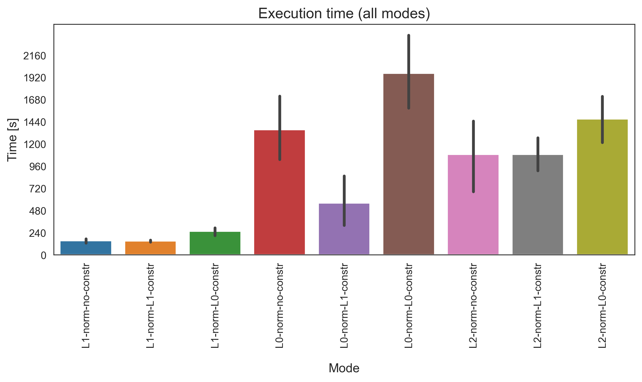
Execution time for one graph file
Full Path Enumeration
Datasets
Human geuvadis simulated
Human leukemia real
Human diverse
SRR307903 (Fibroblasts)
SRR307911 (Embryonic stem cells)
L1 norm
L0 norm
L2 norm

Slide 3
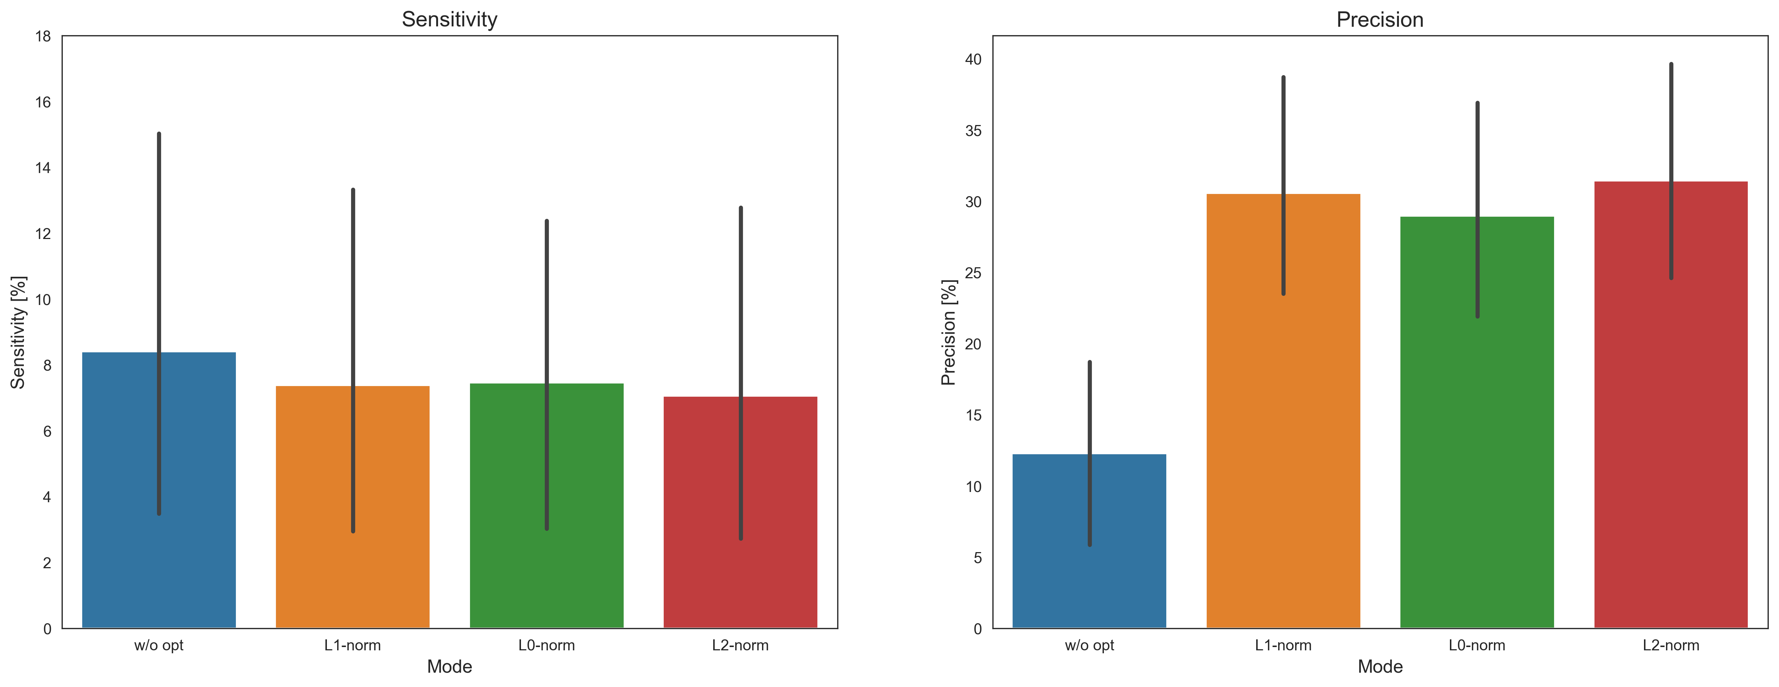
Sensitivity and Precision
Without sparsity constraints

Slide 4
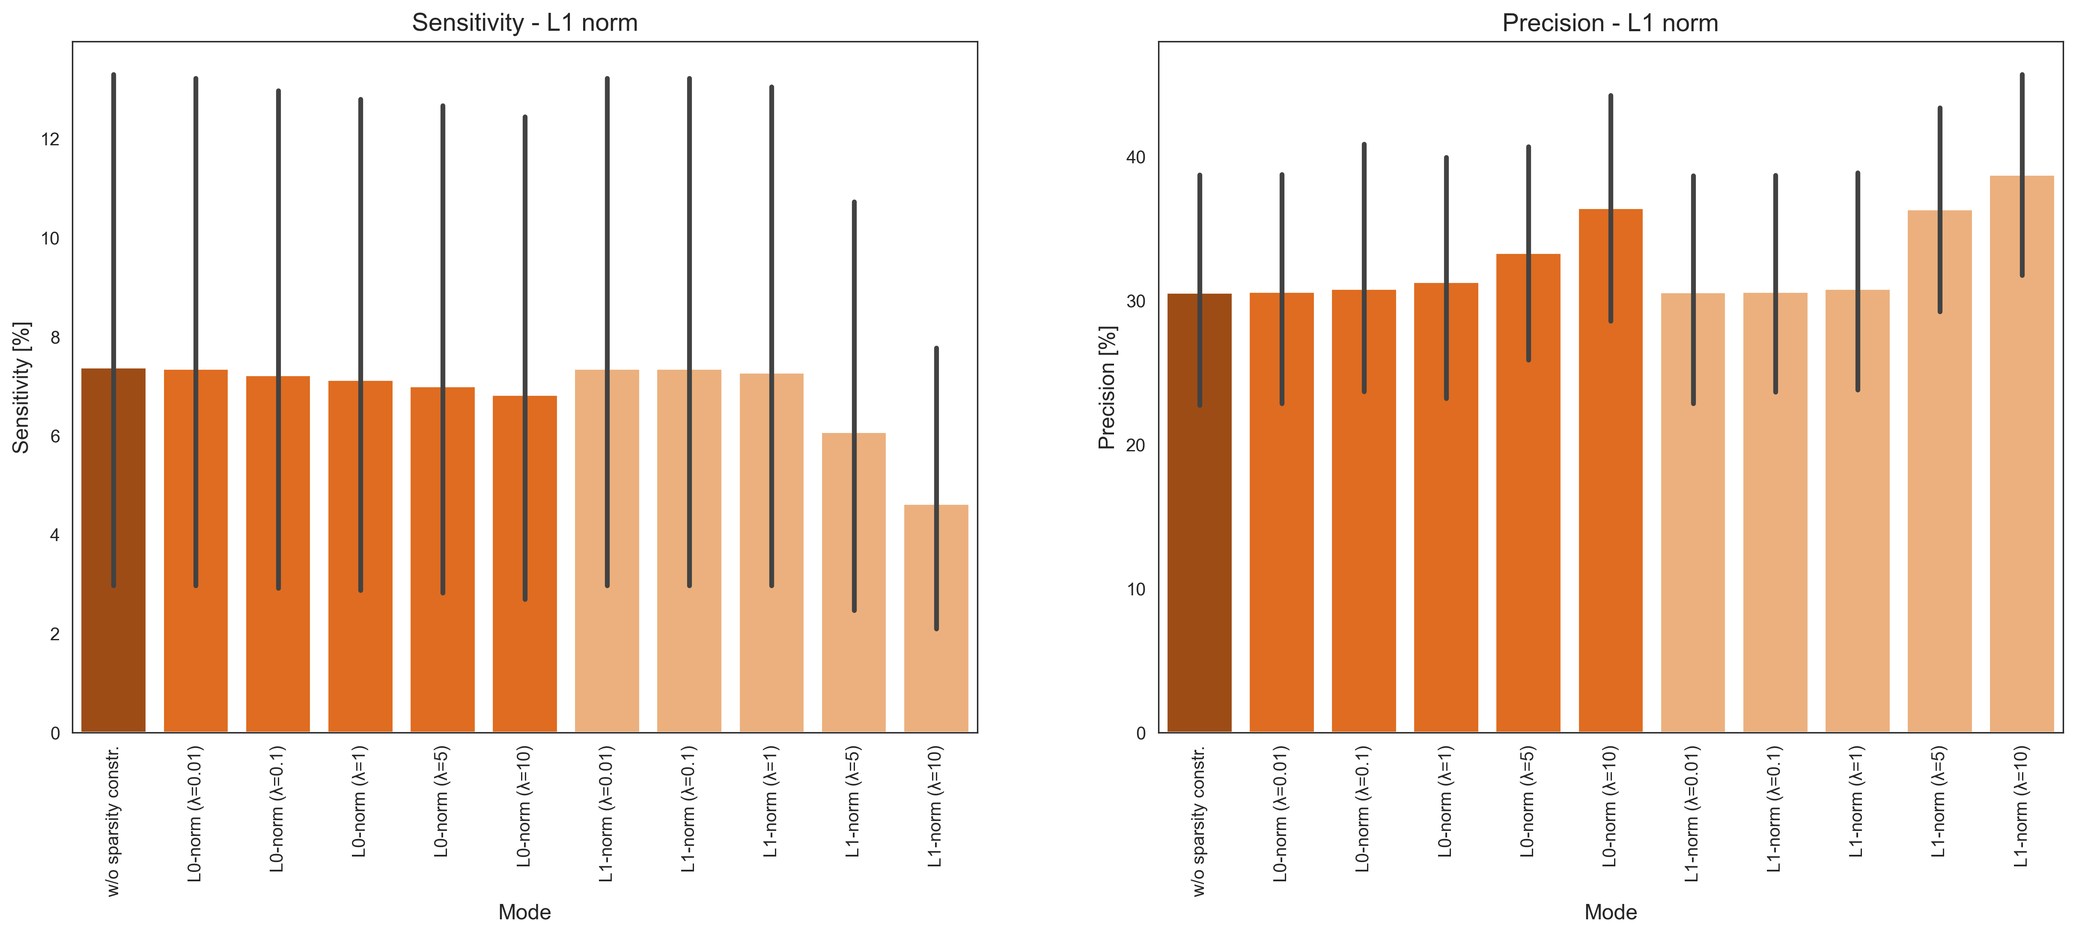
Sensitivity and Precision
With sparsity constraints

Slide 5
WP2 - Anhang

Slide 6
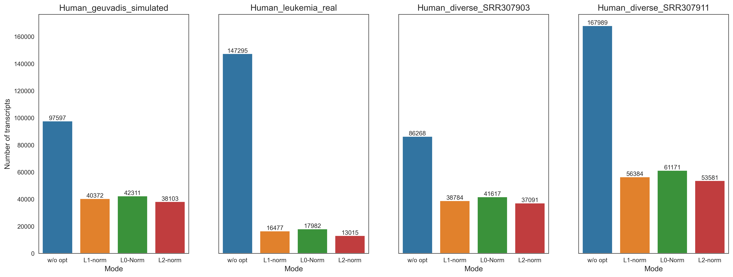
Total number of transcripts
Without sparsity constraints

Slide 7
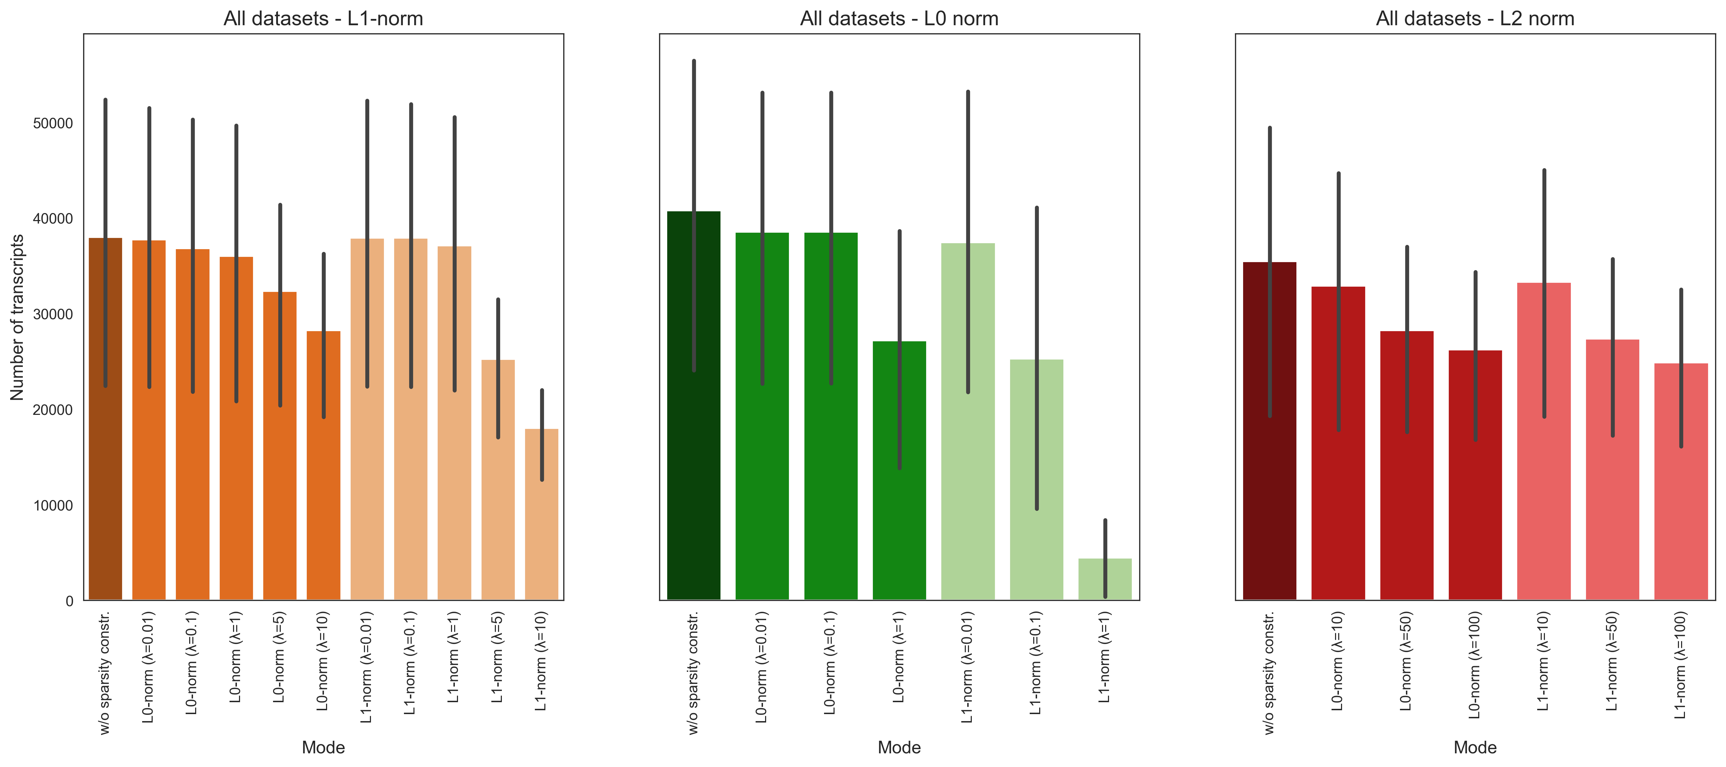
Total number of transcripts
With sparsity constraints

Slide 8
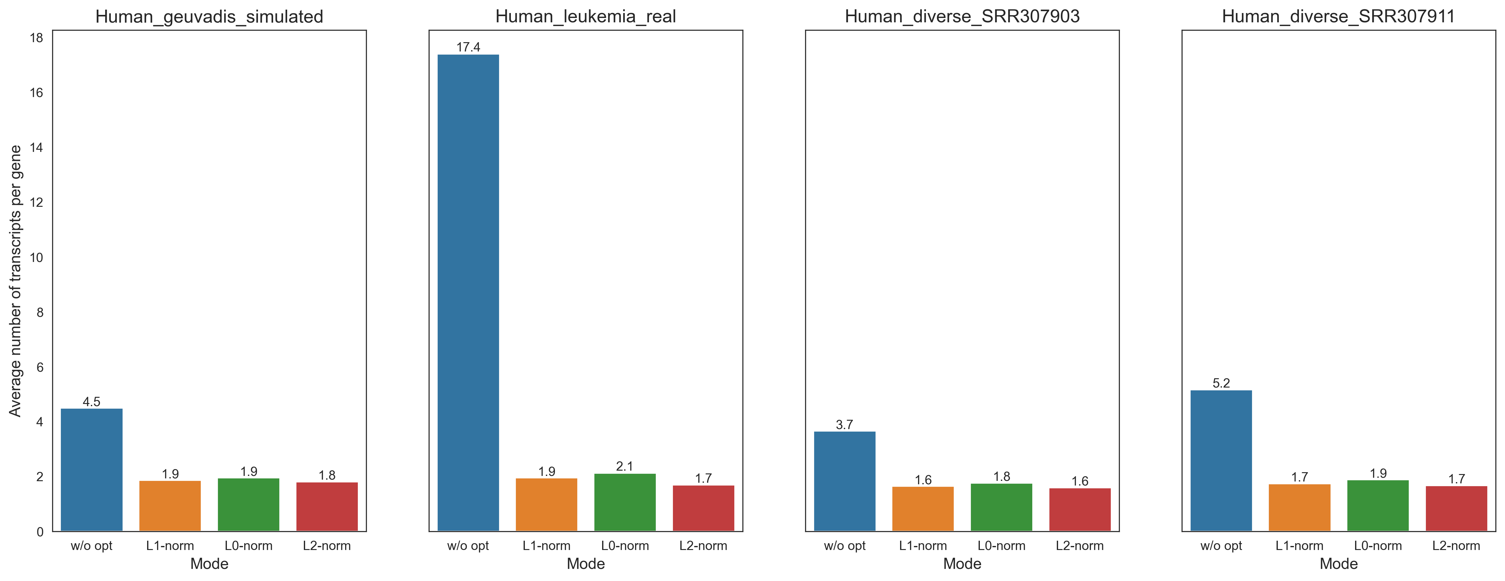
Number of transcripts per gene
Without sparsity constraints

Slide 9
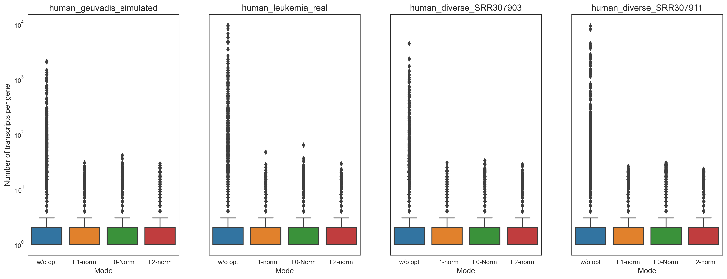
Number of transcripts per gene
Without sparsity constraints

Slide 10
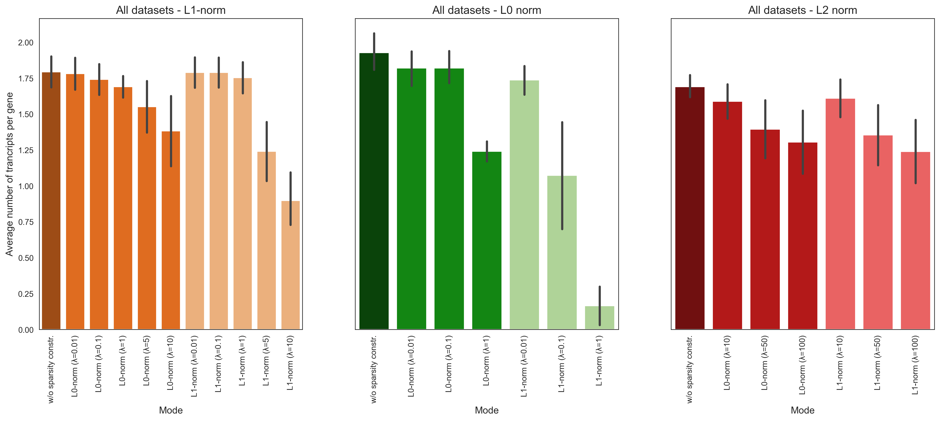
Number of transcripts per gene
With sparsity constraints

Slide 11
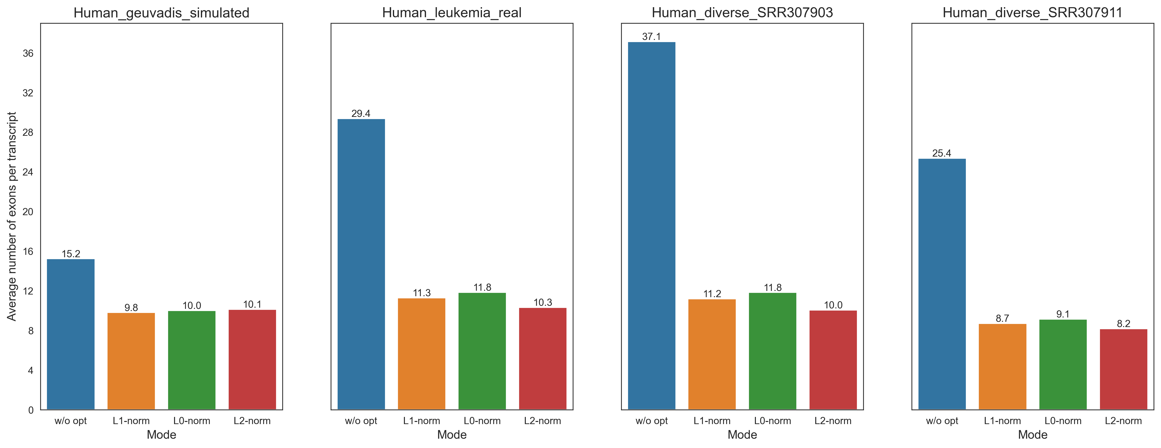
Number of exons per transcript
Without sparsity constraints

Slide 12
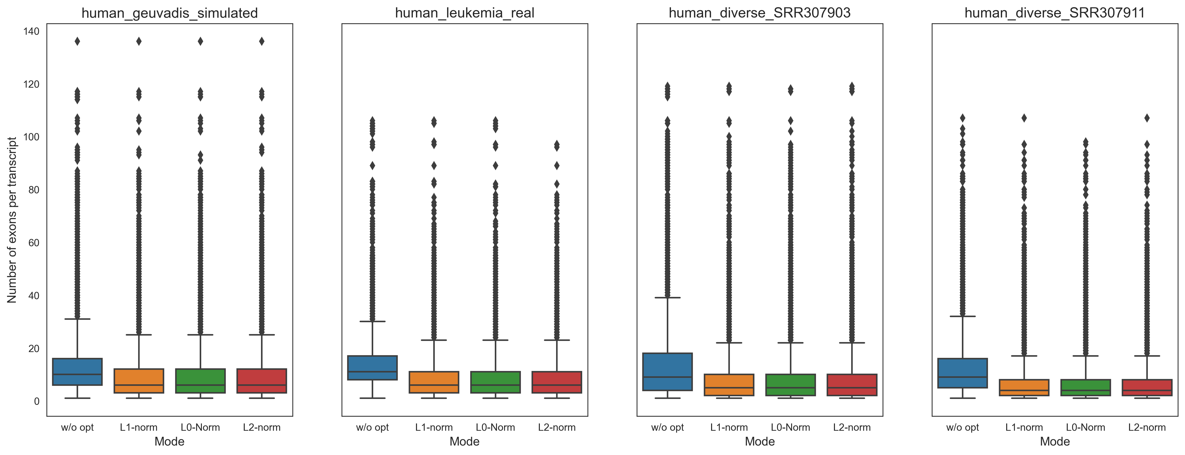
Number of exons per transcript
Without sparsity constraints

Slide 13
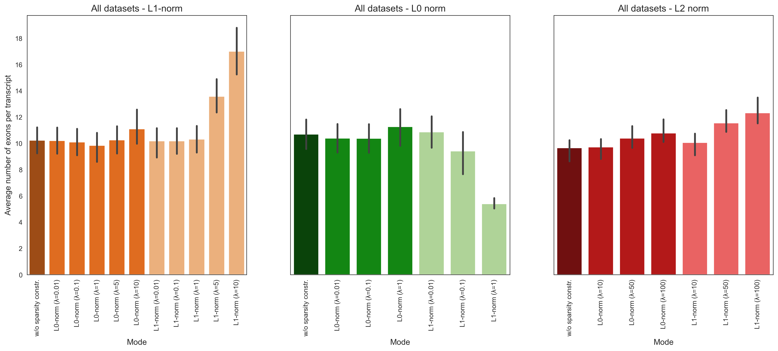
Number of exons per transcript
With sparsity constraints

Slide 14
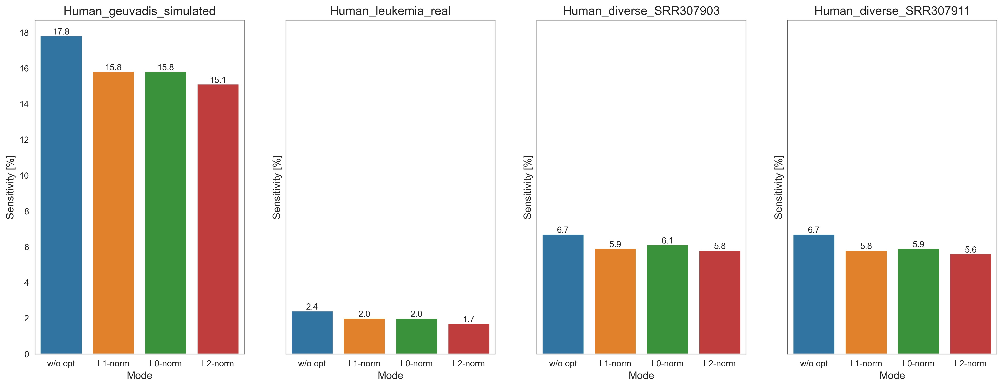

Sensitivity
Without sparsity constraints
$$Sensitivity=\frac{TP}{TP+FN}$$

Slide 15
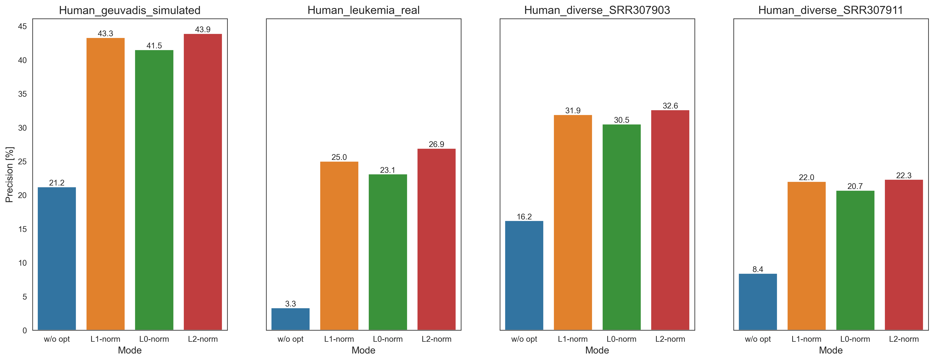
Precision
Without sparsity constraints
$$Precision=\frac{TP}{P}$$

Slide 16
Sensitivity and Precision
L1 norm
With sparsity constraints

Slide 17
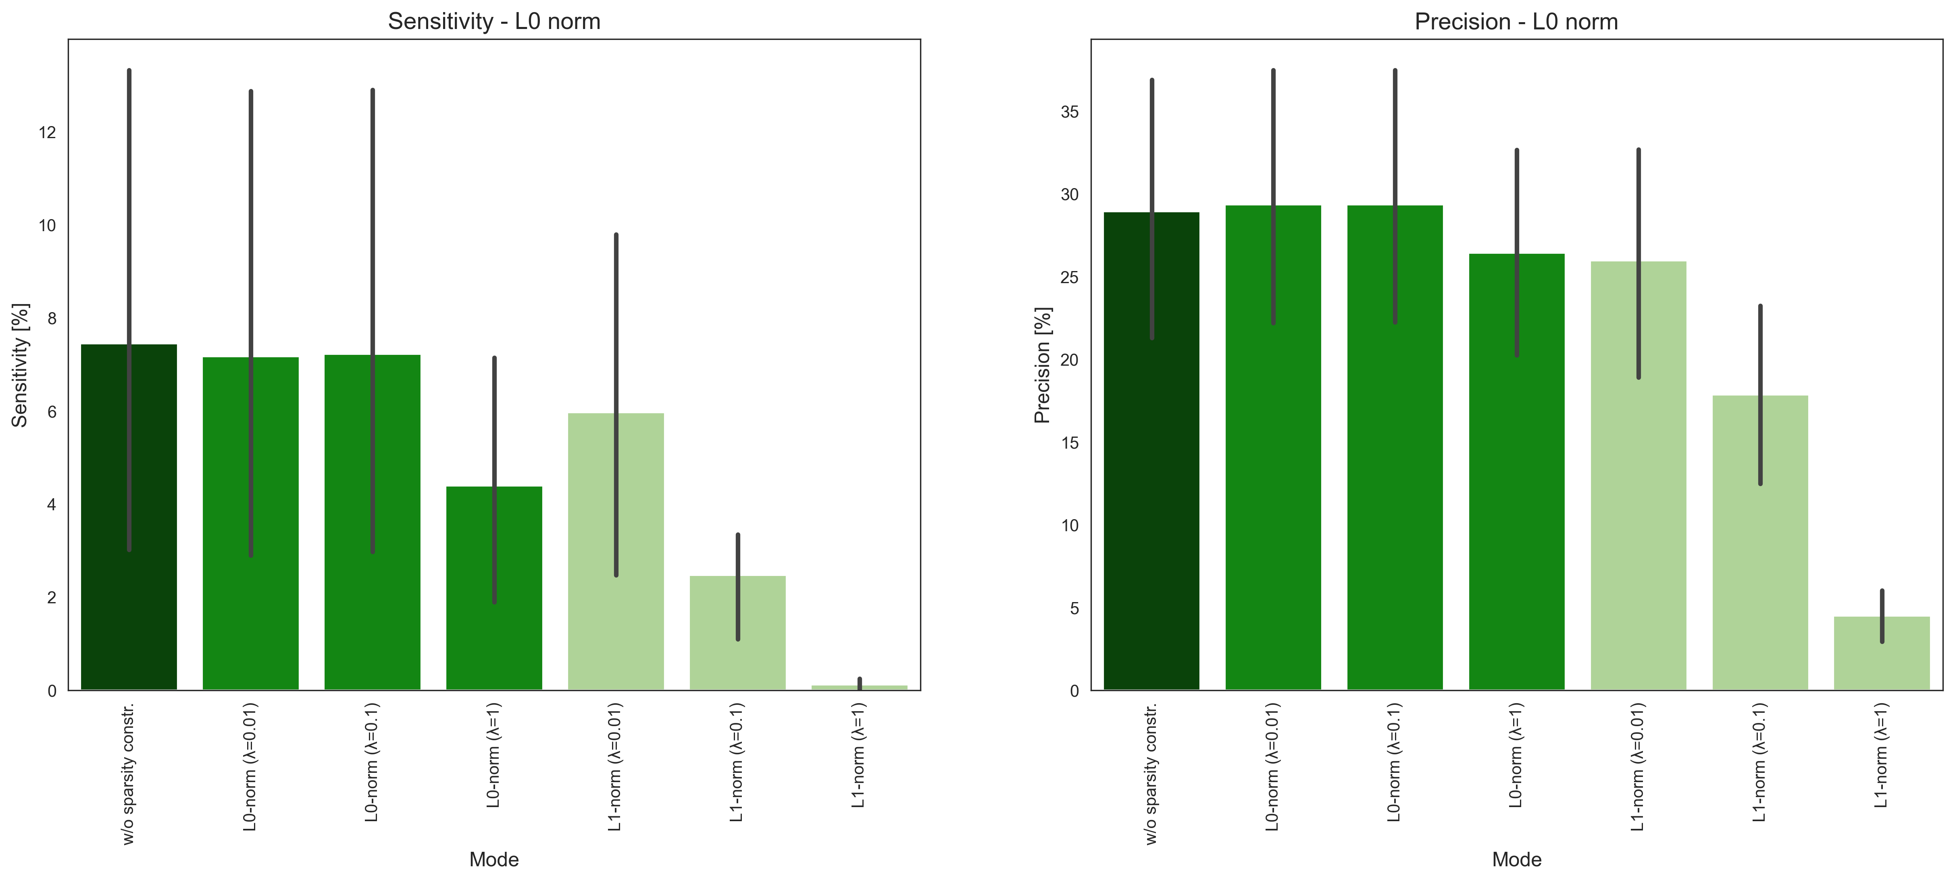
Sensitivity and Precision
L0 norm
With sparsity constraints

Slide 18
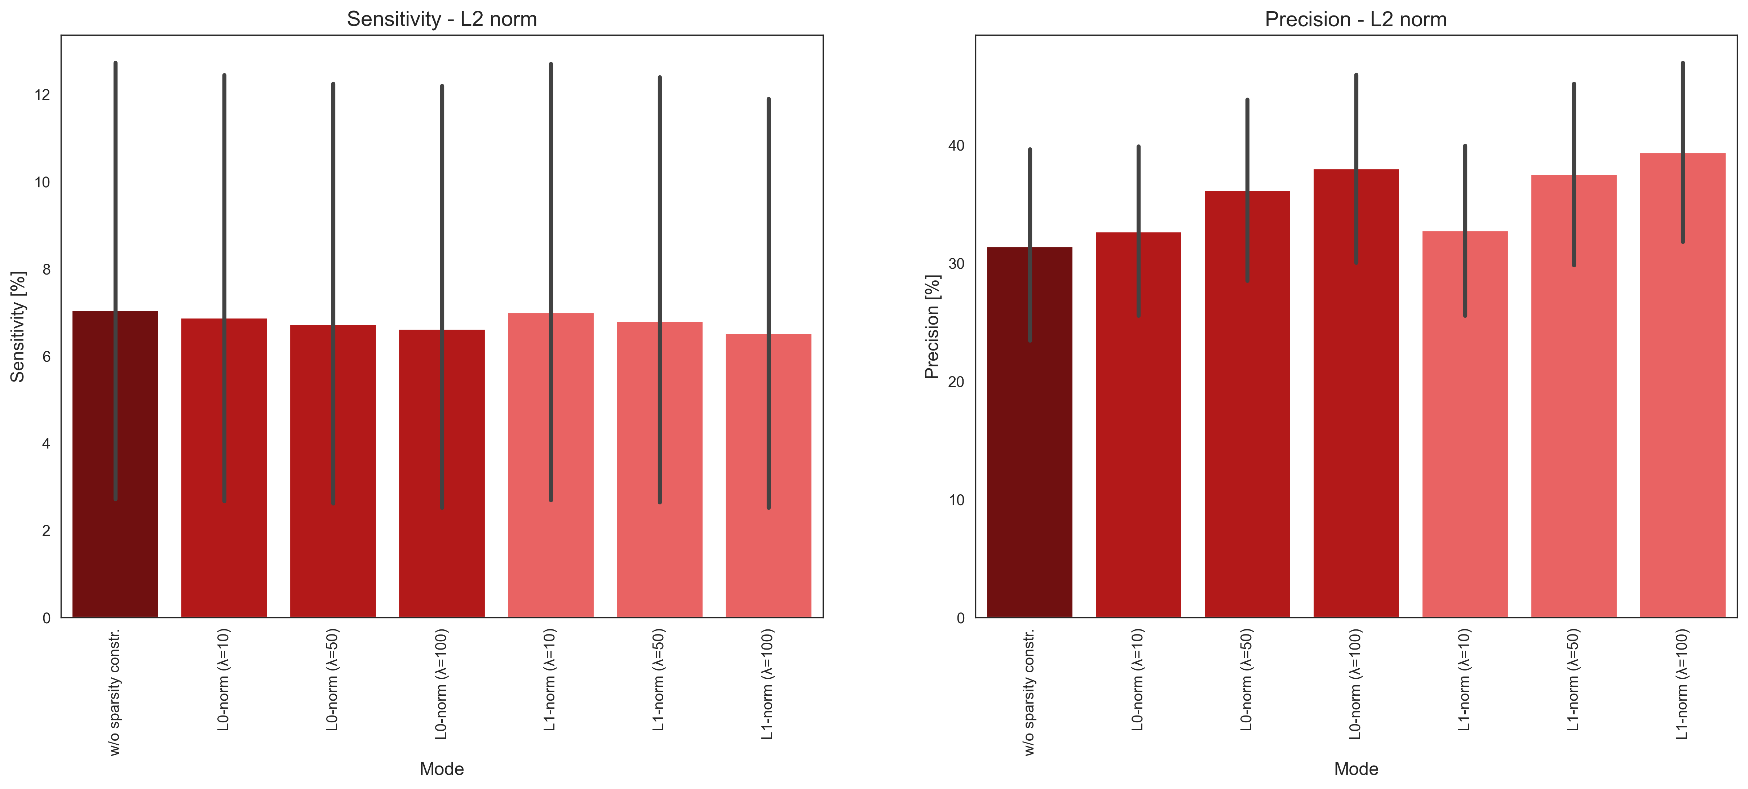
Sensitivity and Precision
L2 norm
With sparsity constraints

