Slide 1
WP1
Path Enumeration

Slide 2
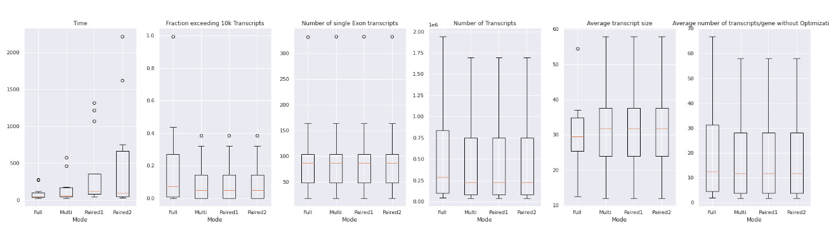

Slide 3
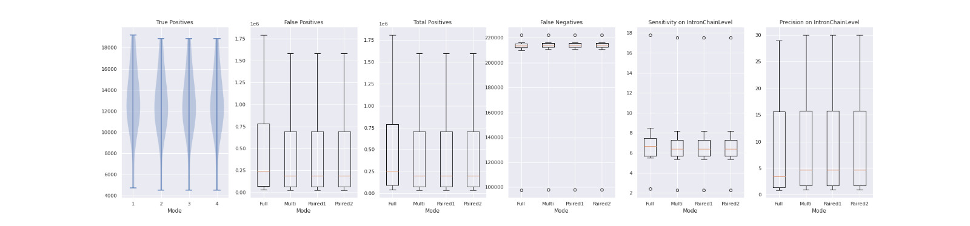

Slide 4
WP2
Optimization with Gurobi

Slide 5
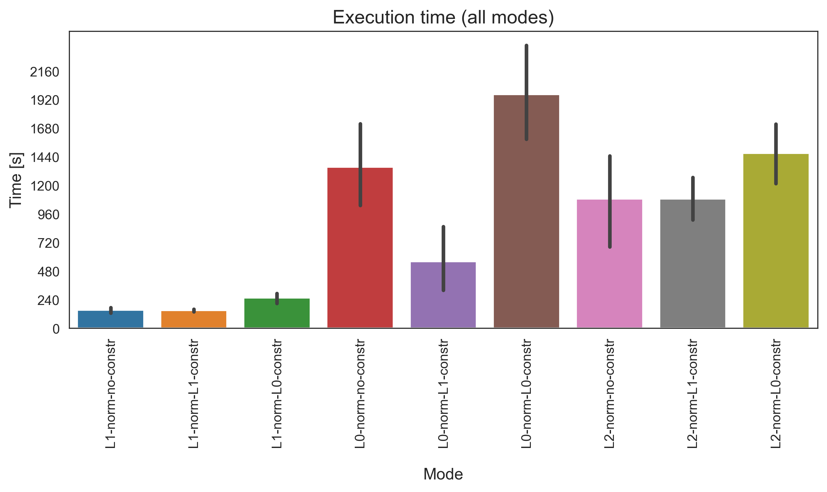
Execution time for one graph file
Full Path Enumeration
Datasets
Human geuvadis simulated
Human leukemia real
Human diverse
SRR307903 (Fibroblasts)
SRR307911 (Embryonic stem cells)
L1 norm
L0 norm
L2 norm

Slide 6
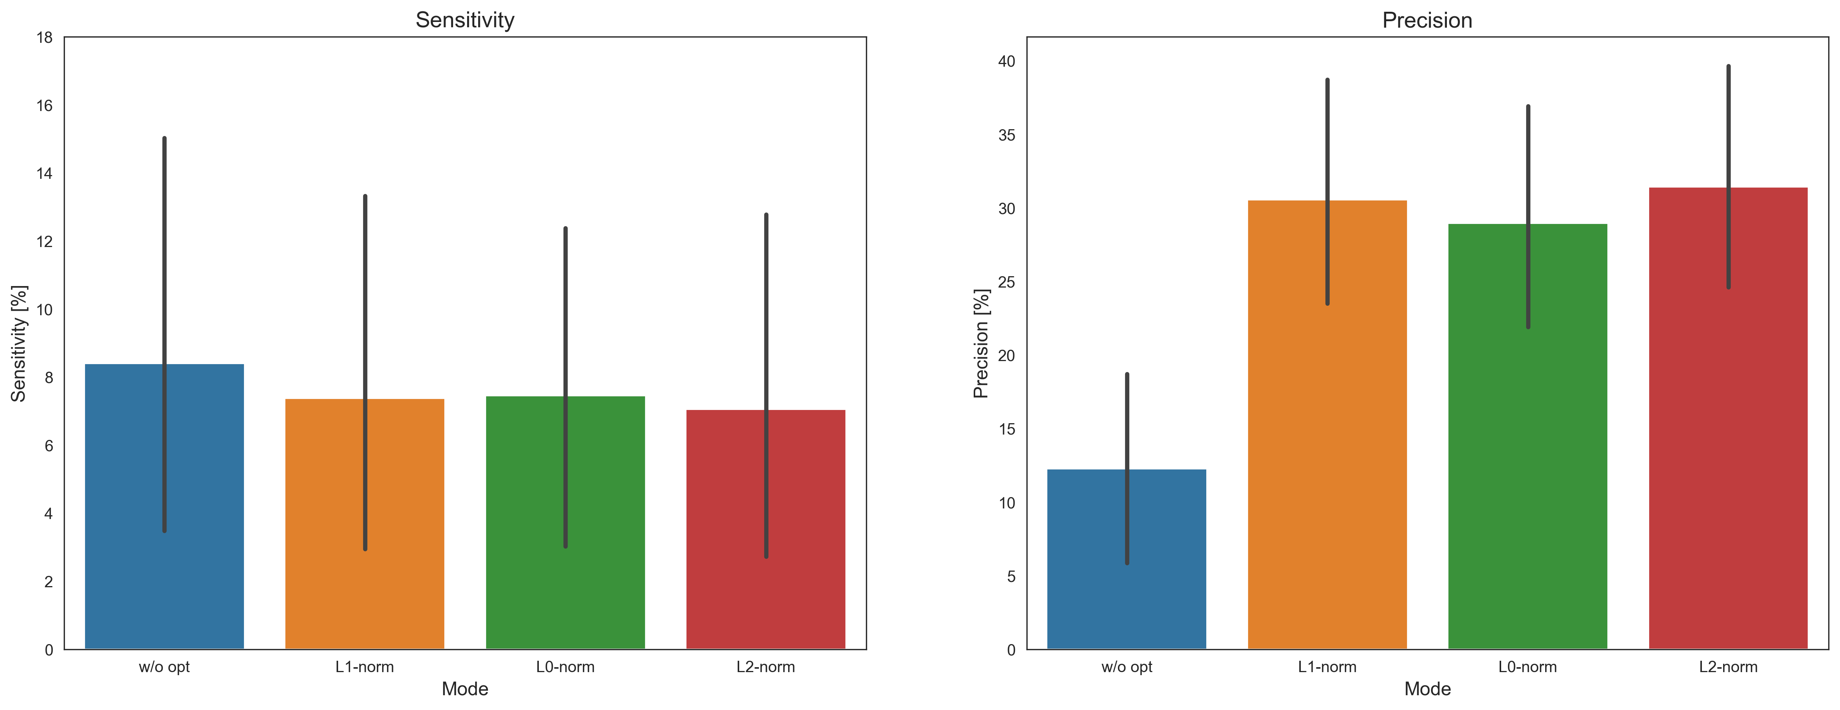
Sensitivity and Precision
Without sparsity constraints

Slide 7
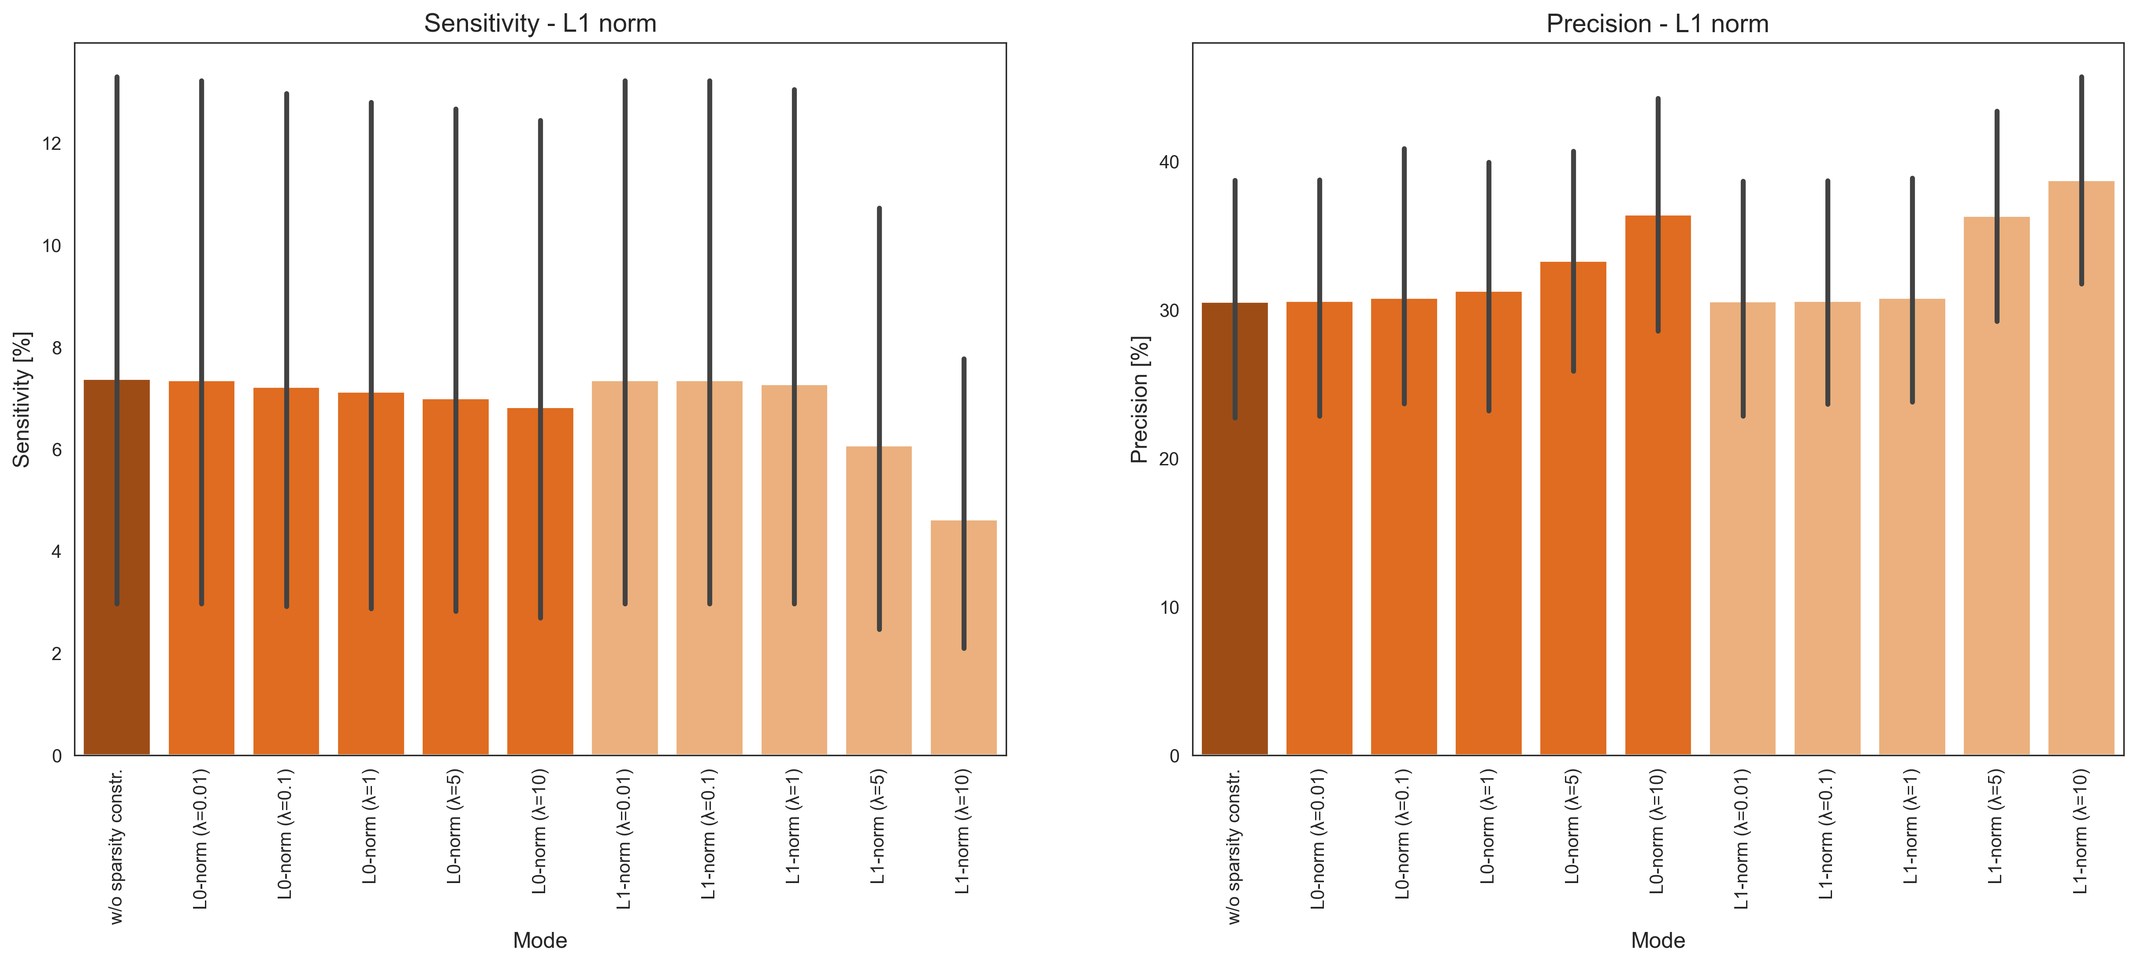
Sensitivity and Precision
With sparsity constraints

Slide 8
WP2 - Anhang

Slide 9
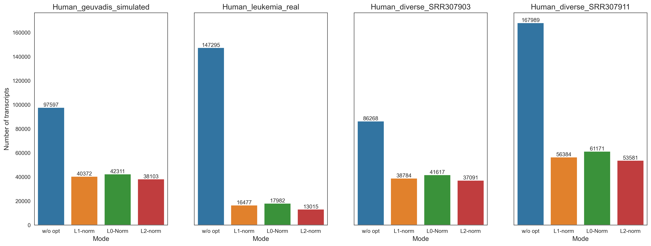
Total number of transcripts
Without sparsity constraints

Slide 10
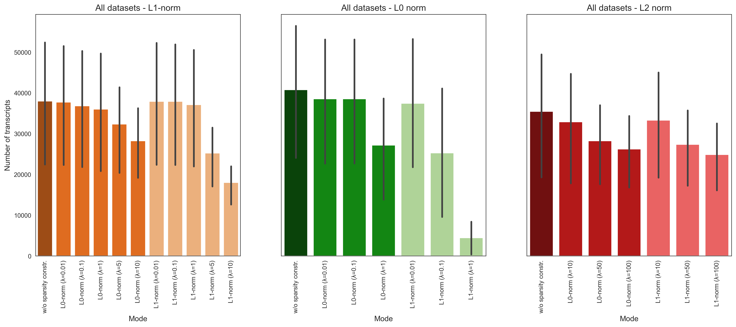
Total number of transcripts
With sparsity constraints

Slide 11
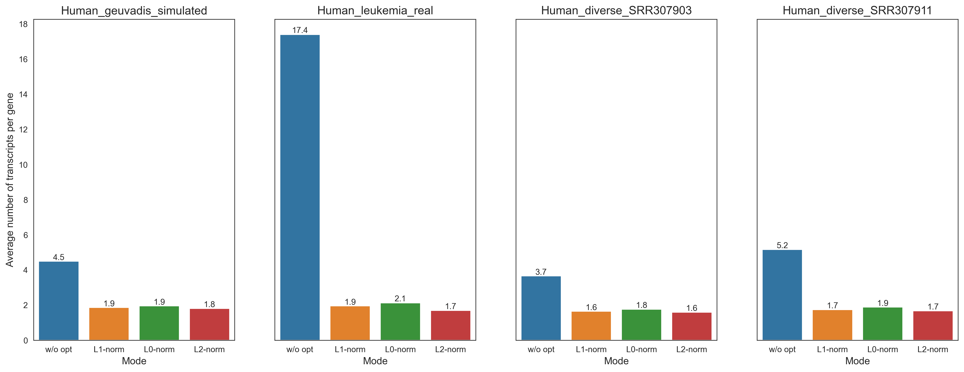
Number of transcripts per gene
Without sparsity constraints

Slide 12
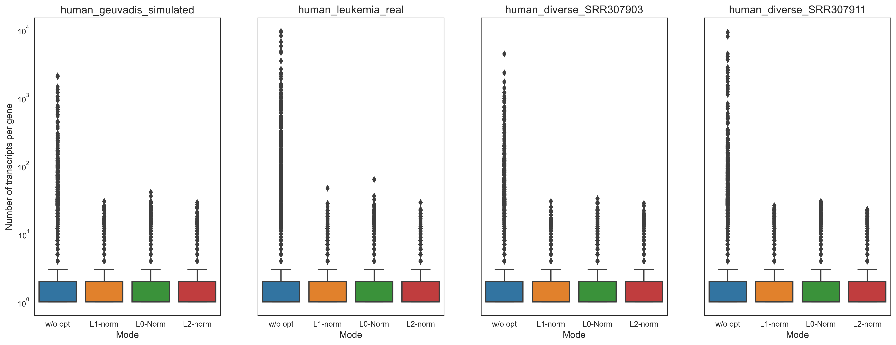
Number of transcripts per gene
Without sparsity constraints

Slide 13
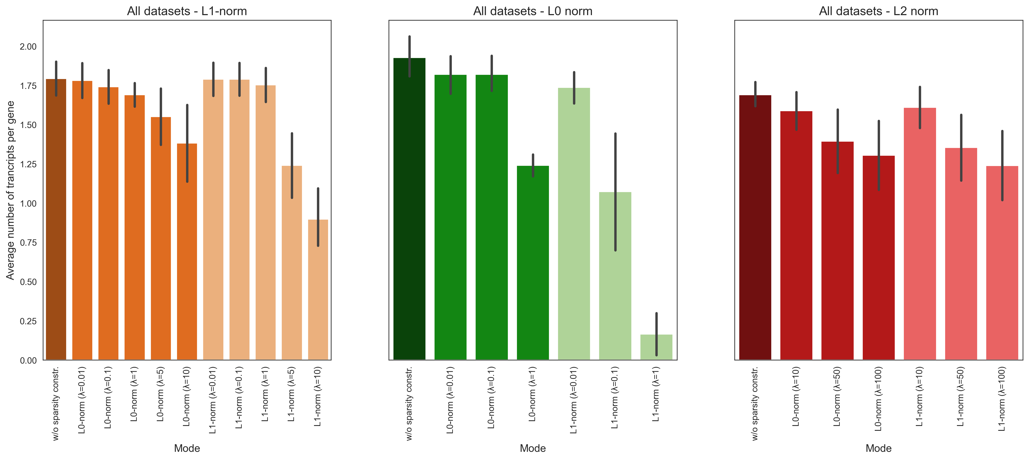
Number of transcripts per gene
With sparsity constraints

Slide 14
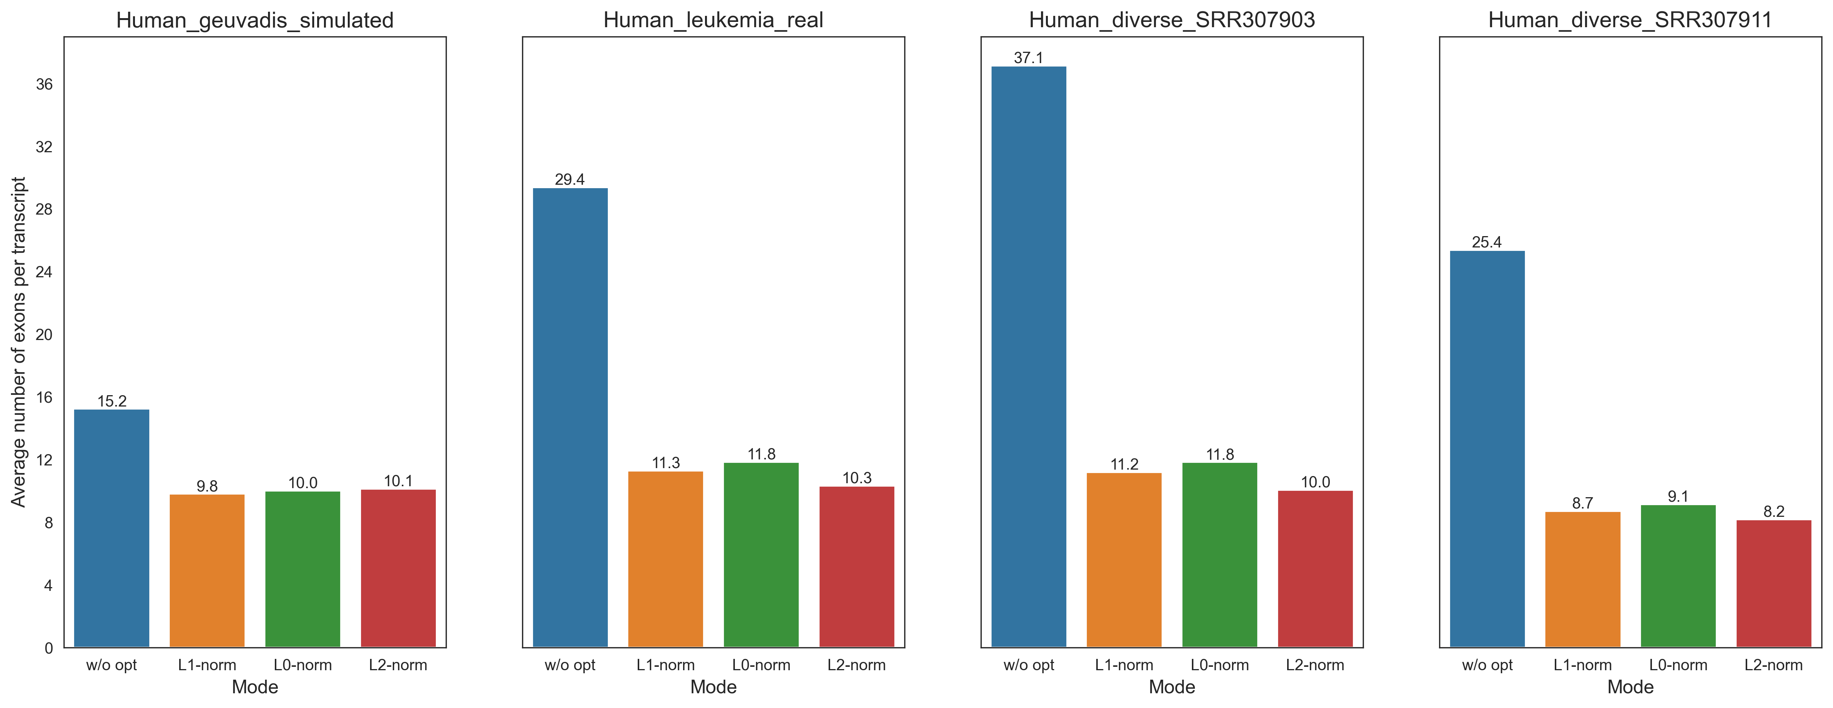
Number of exons per transcript
Without sparsity constraints

Slide 15
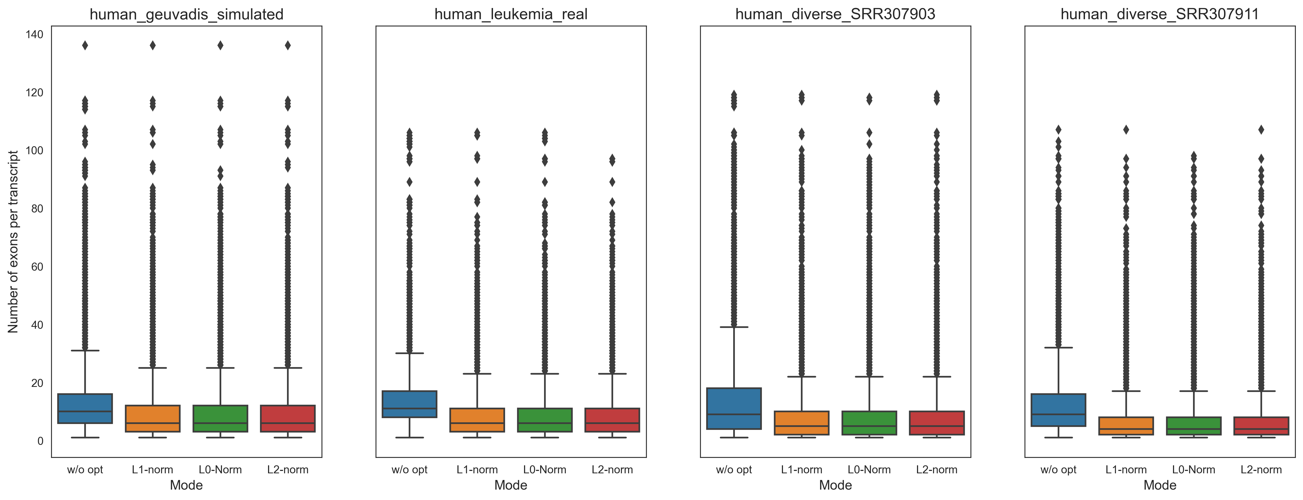
Number of exons per transcript
Without sparsity constraints

Slide 16
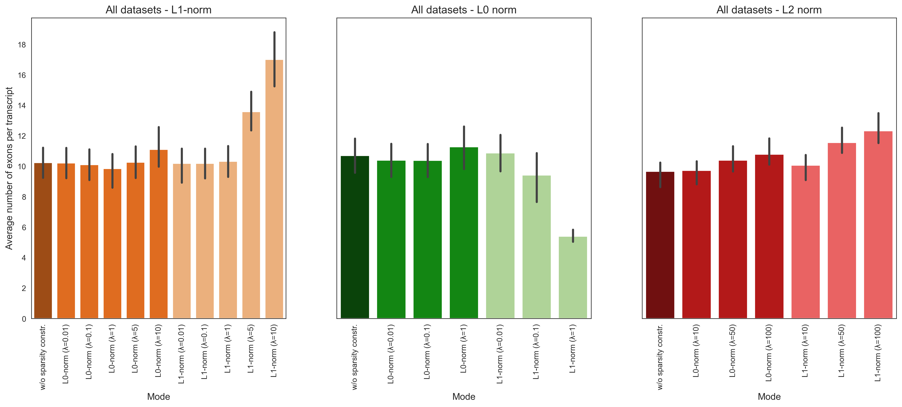
Number of exons per transcript
With sparsity constraints

Slide 17
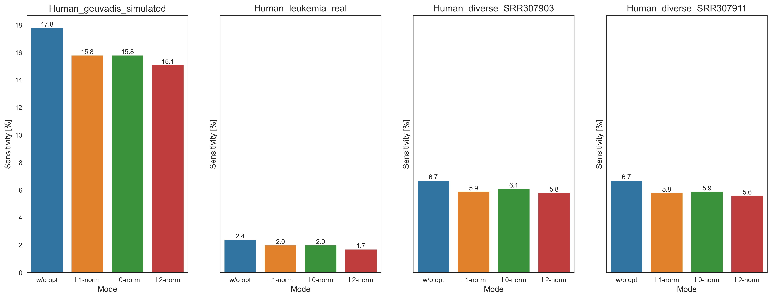

Sensitivity
Without sparsity constraints
$$Sensitivity=\frac{TP}{TP+FN}$$

Slide 18
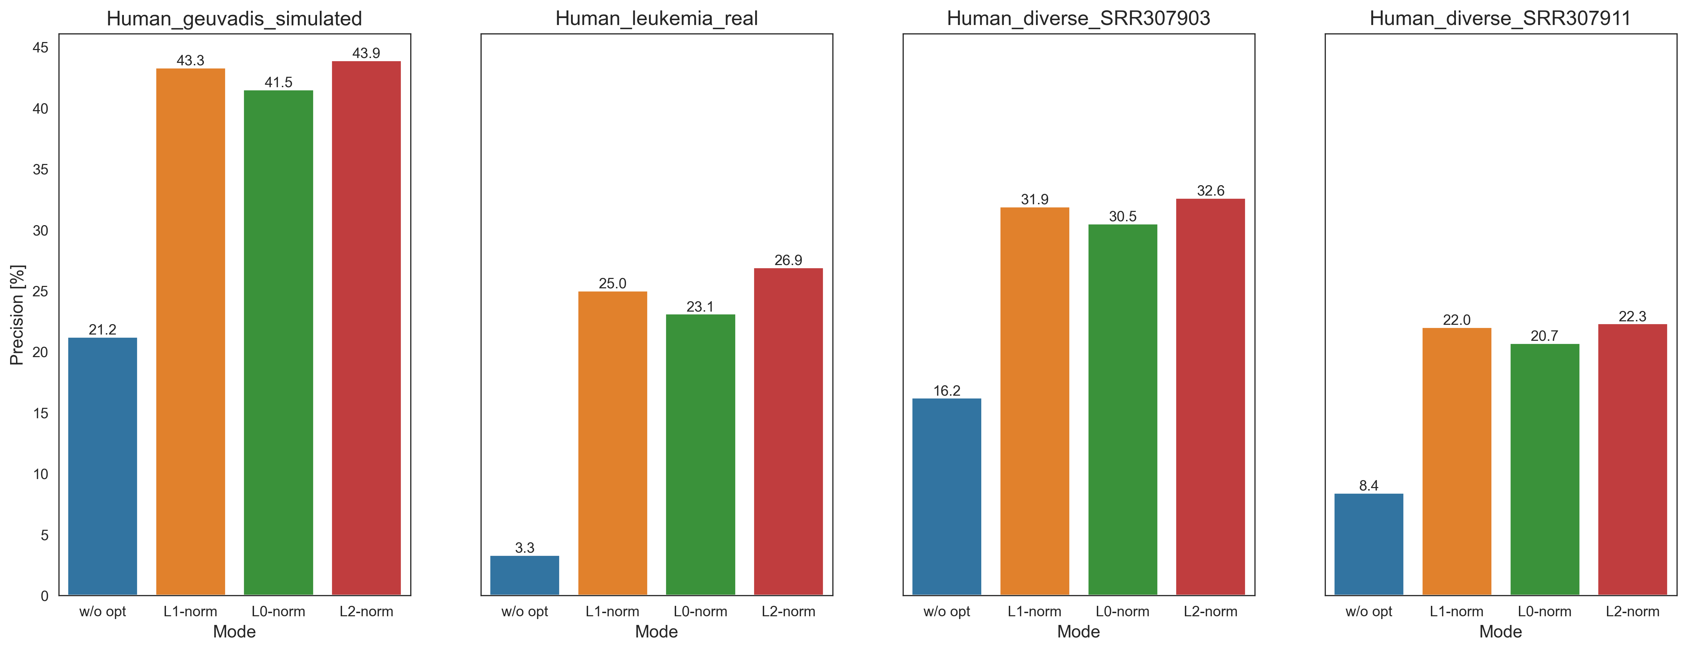
Precision
Without sparsity constraints
$$Precision=\frac{TP}{P}$$

Slide 19
Sensitivity and Precision
L1 norm
With sparsity constraints

Slide 20
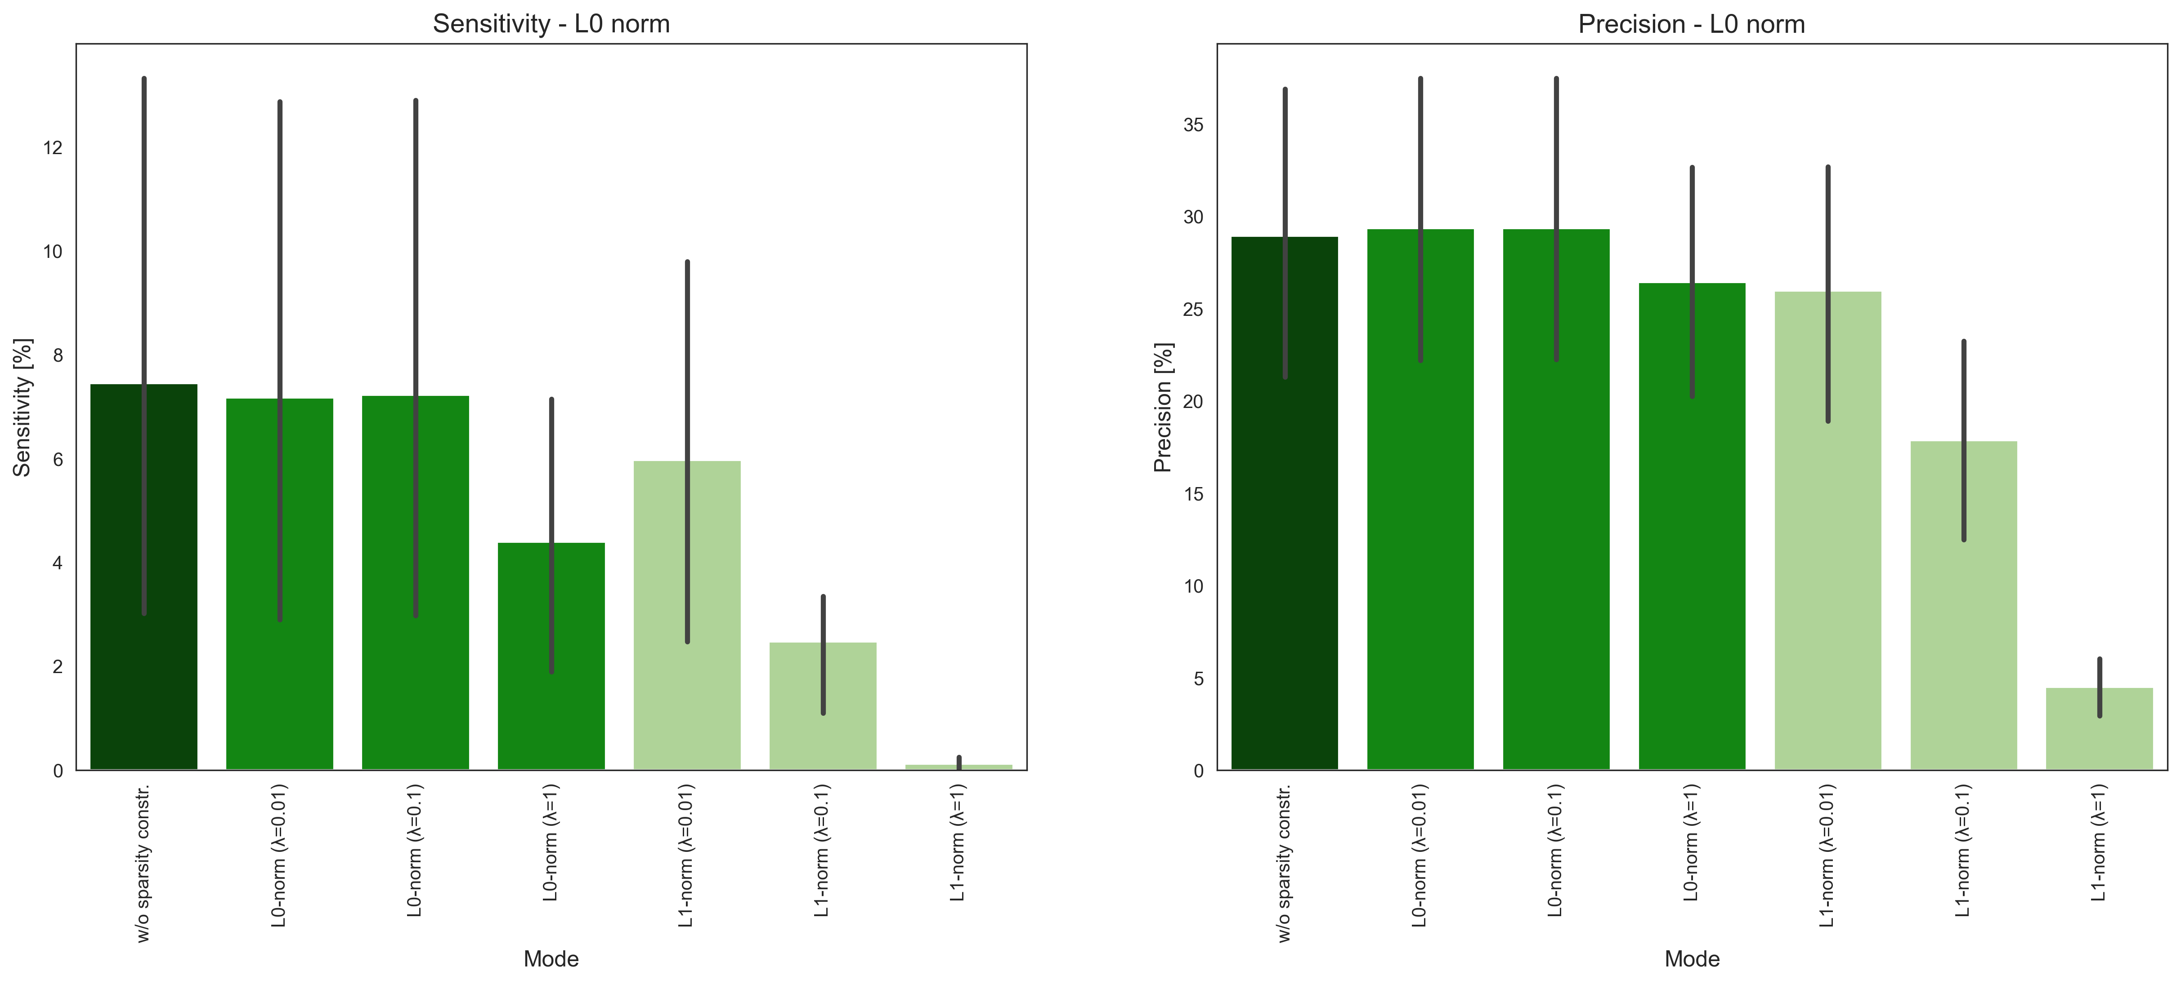
Sensitivity and Precision
L0 norm
With sparsity constraints

Slide 21
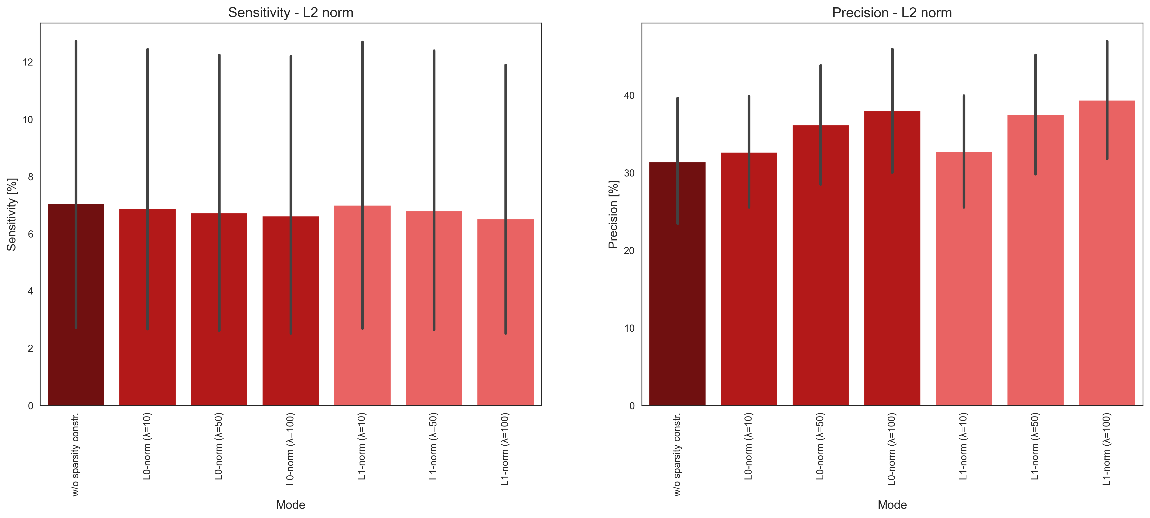
Sensitivity and Precision
L2 norm
With sparsity constraints

