Slide 1
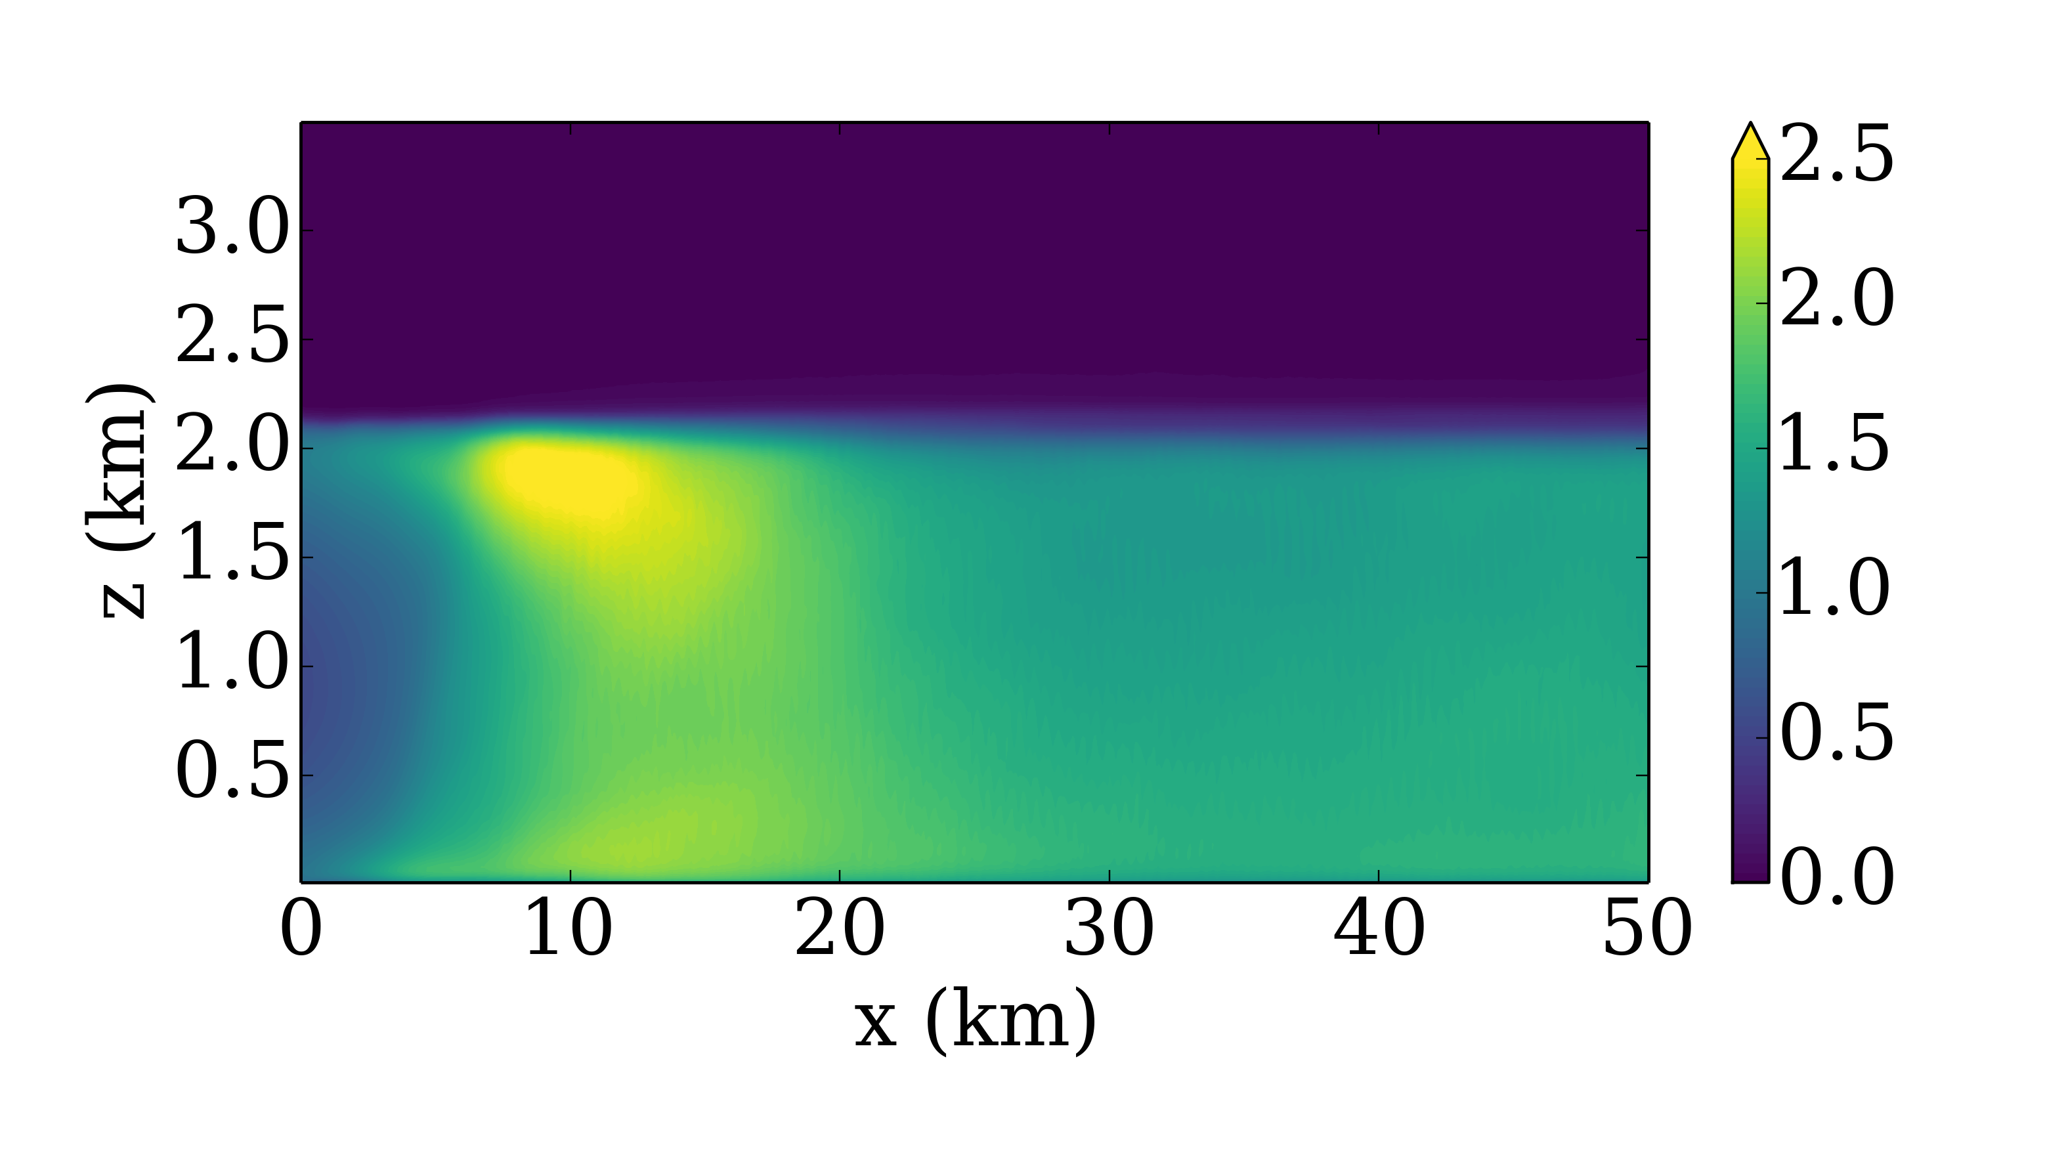
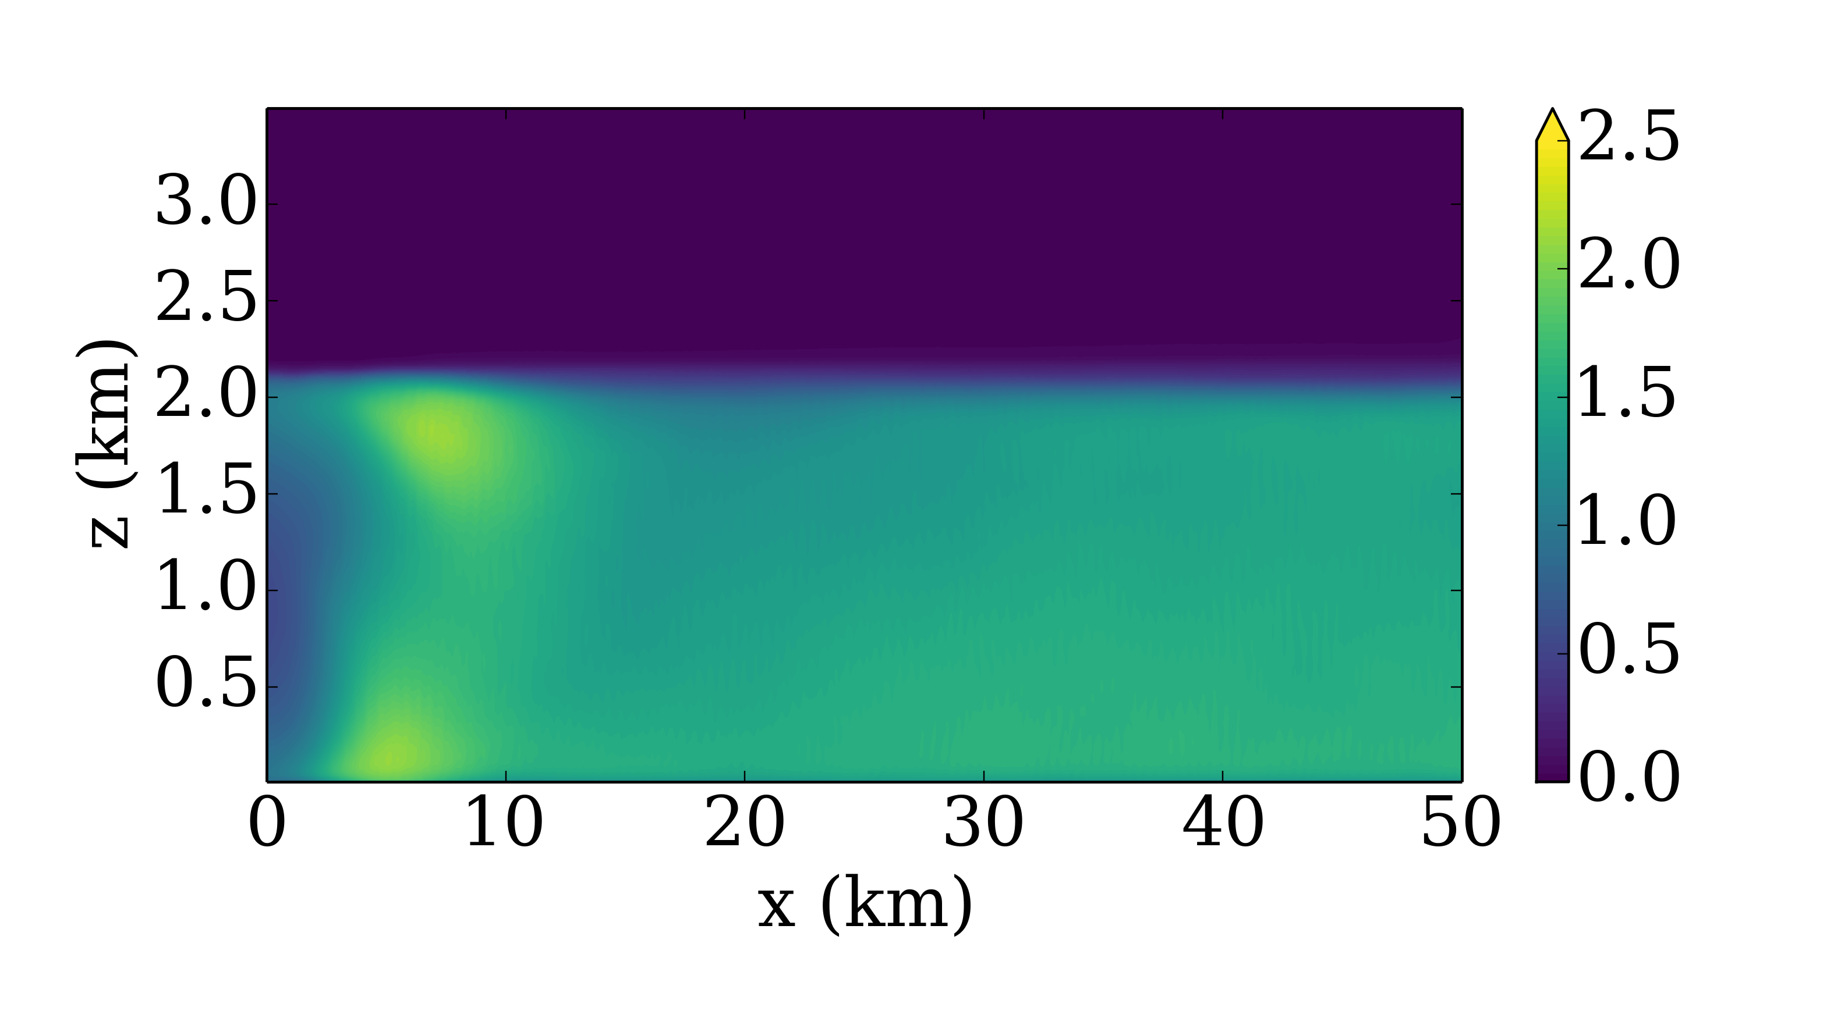
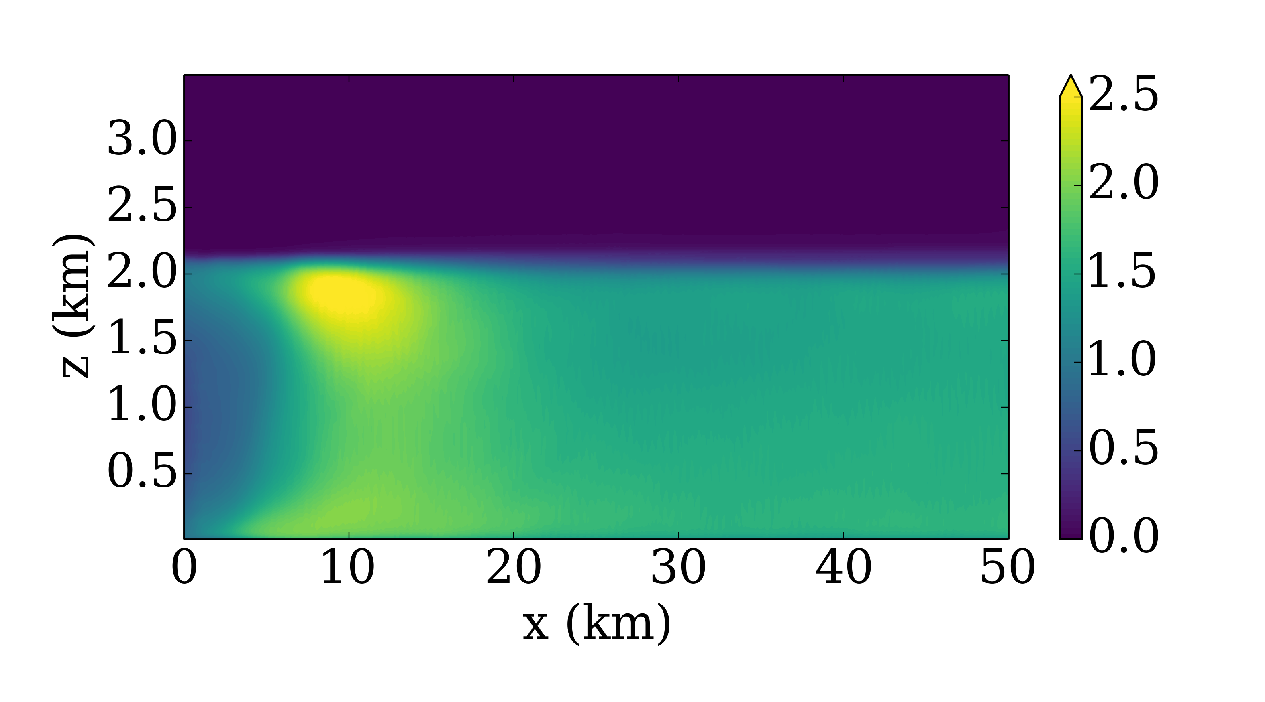
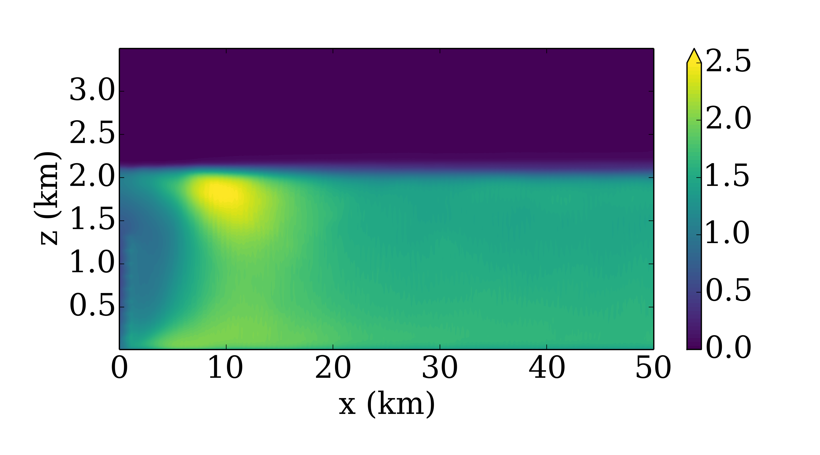
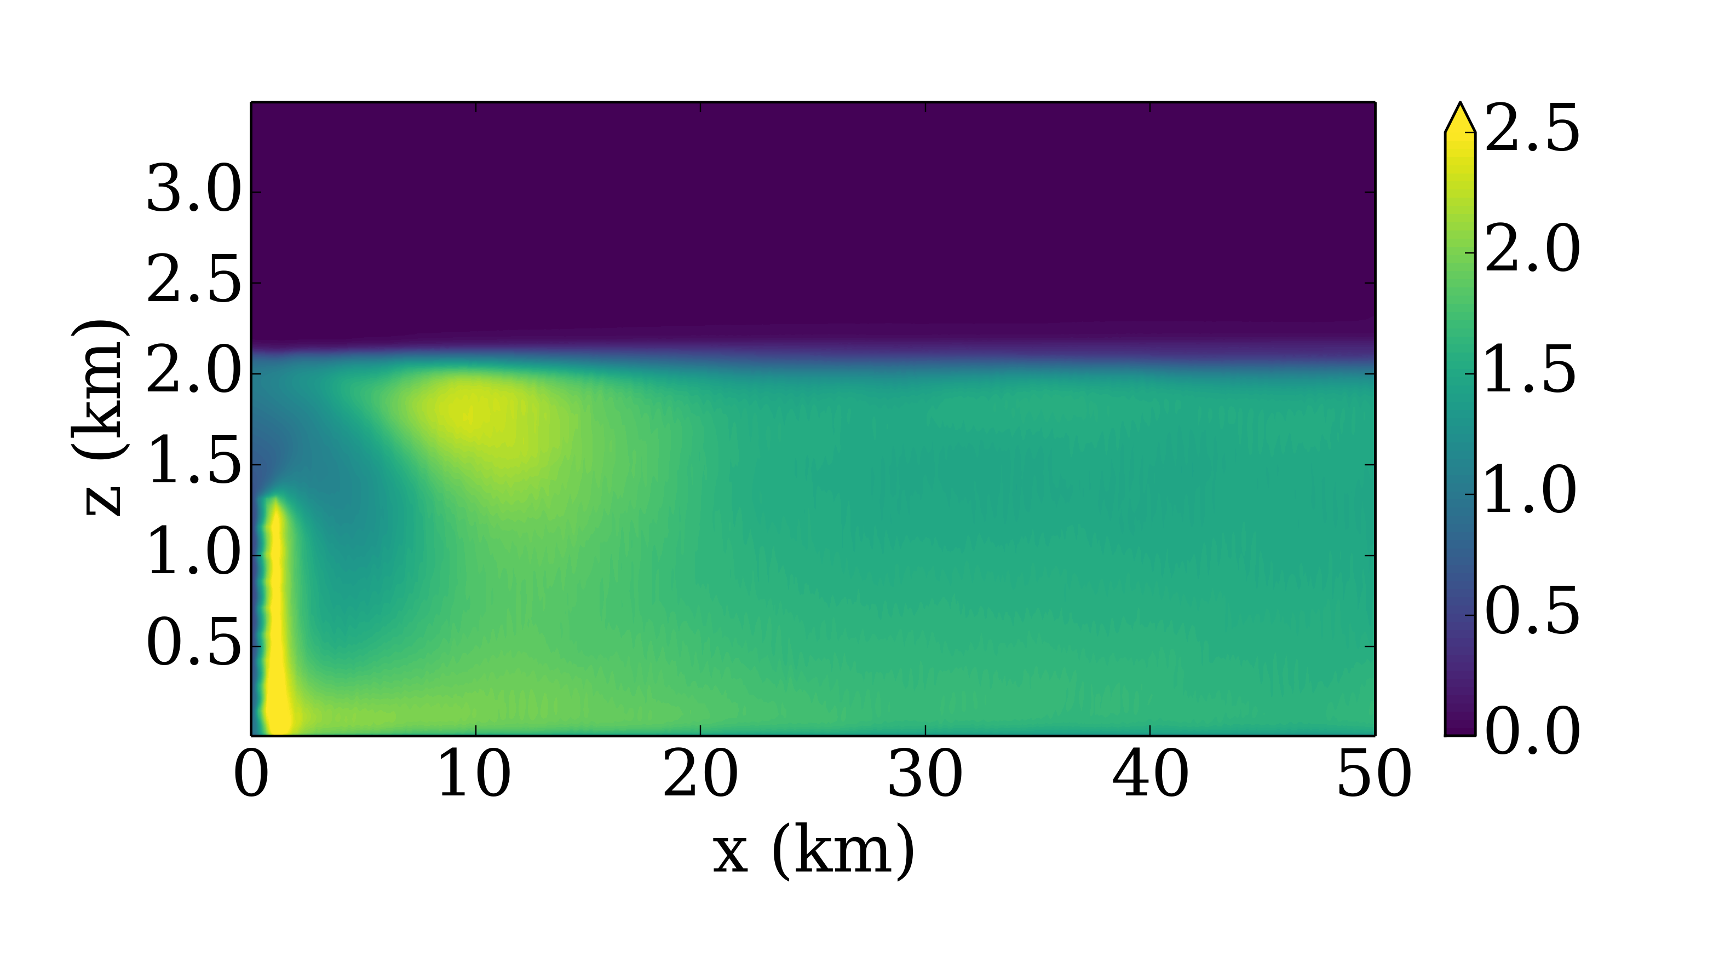
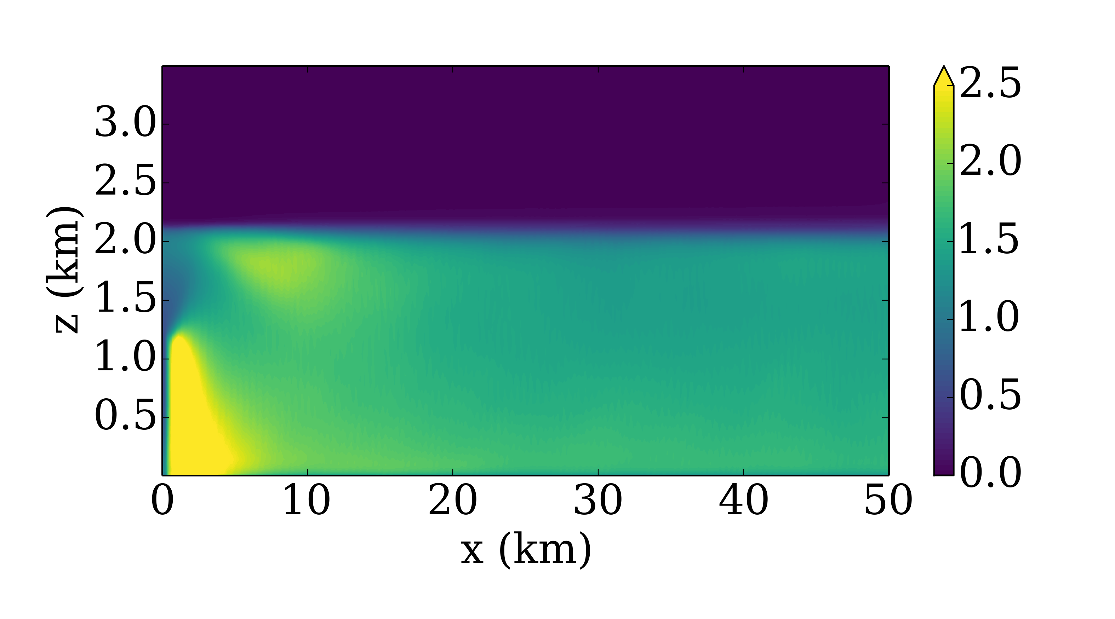
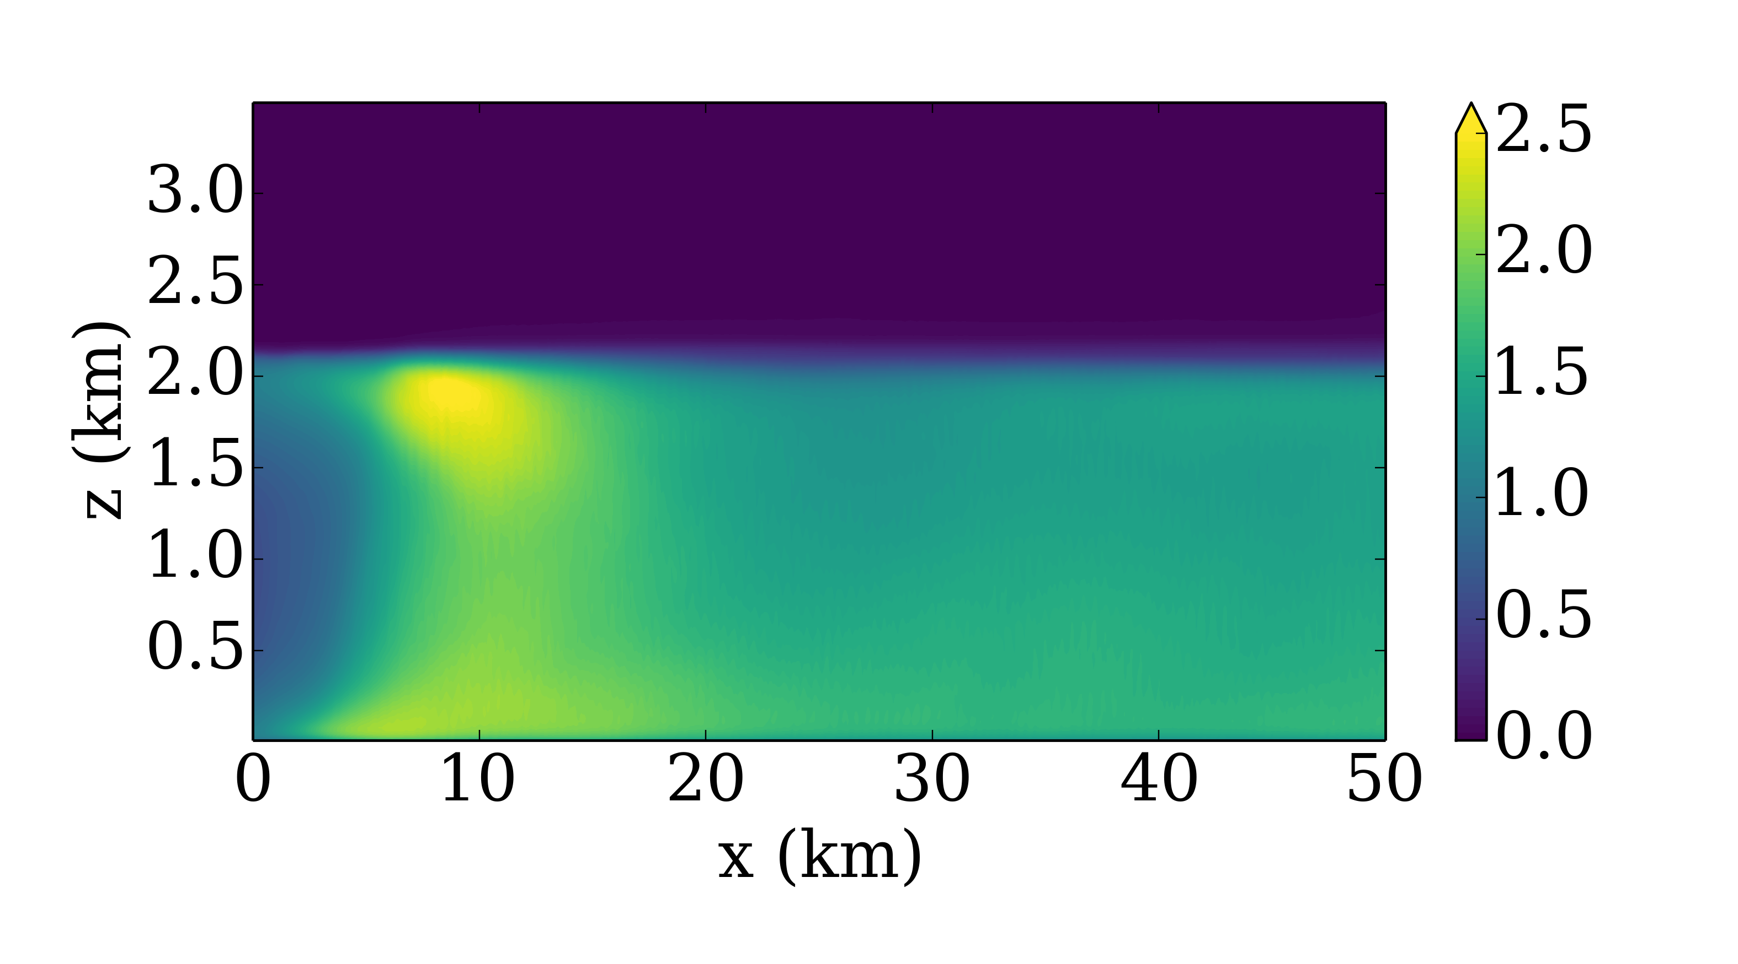
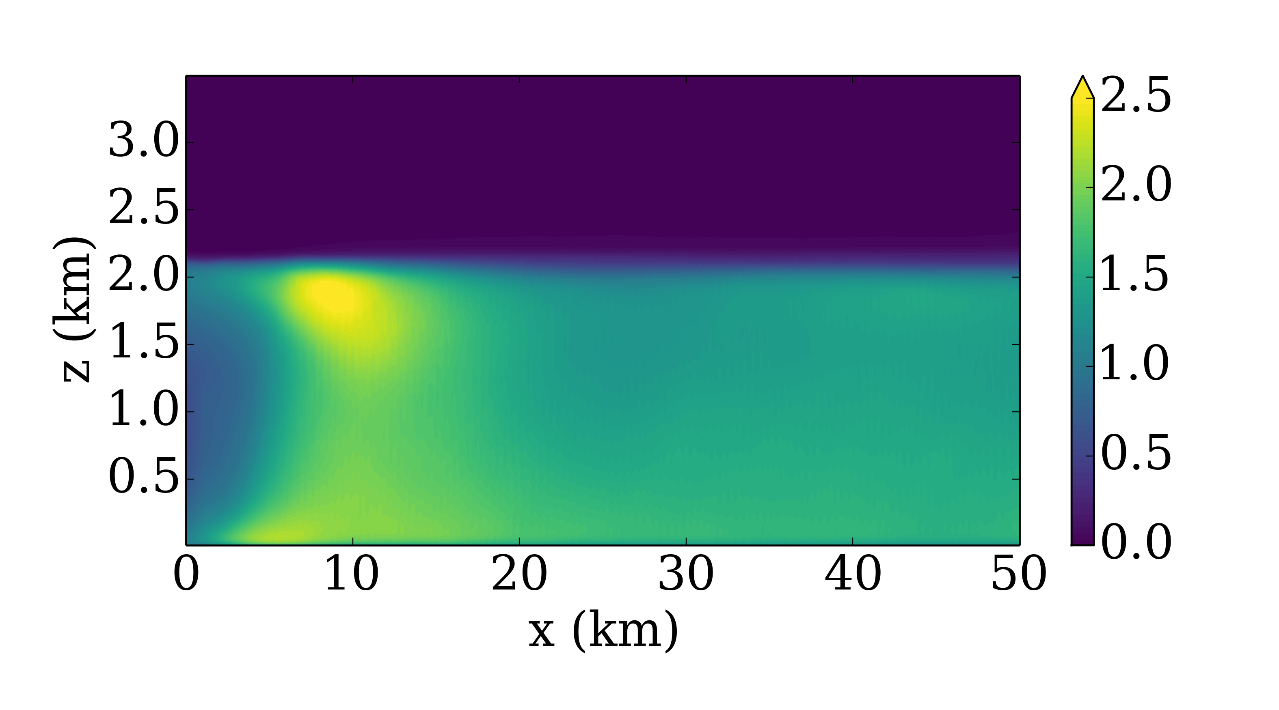

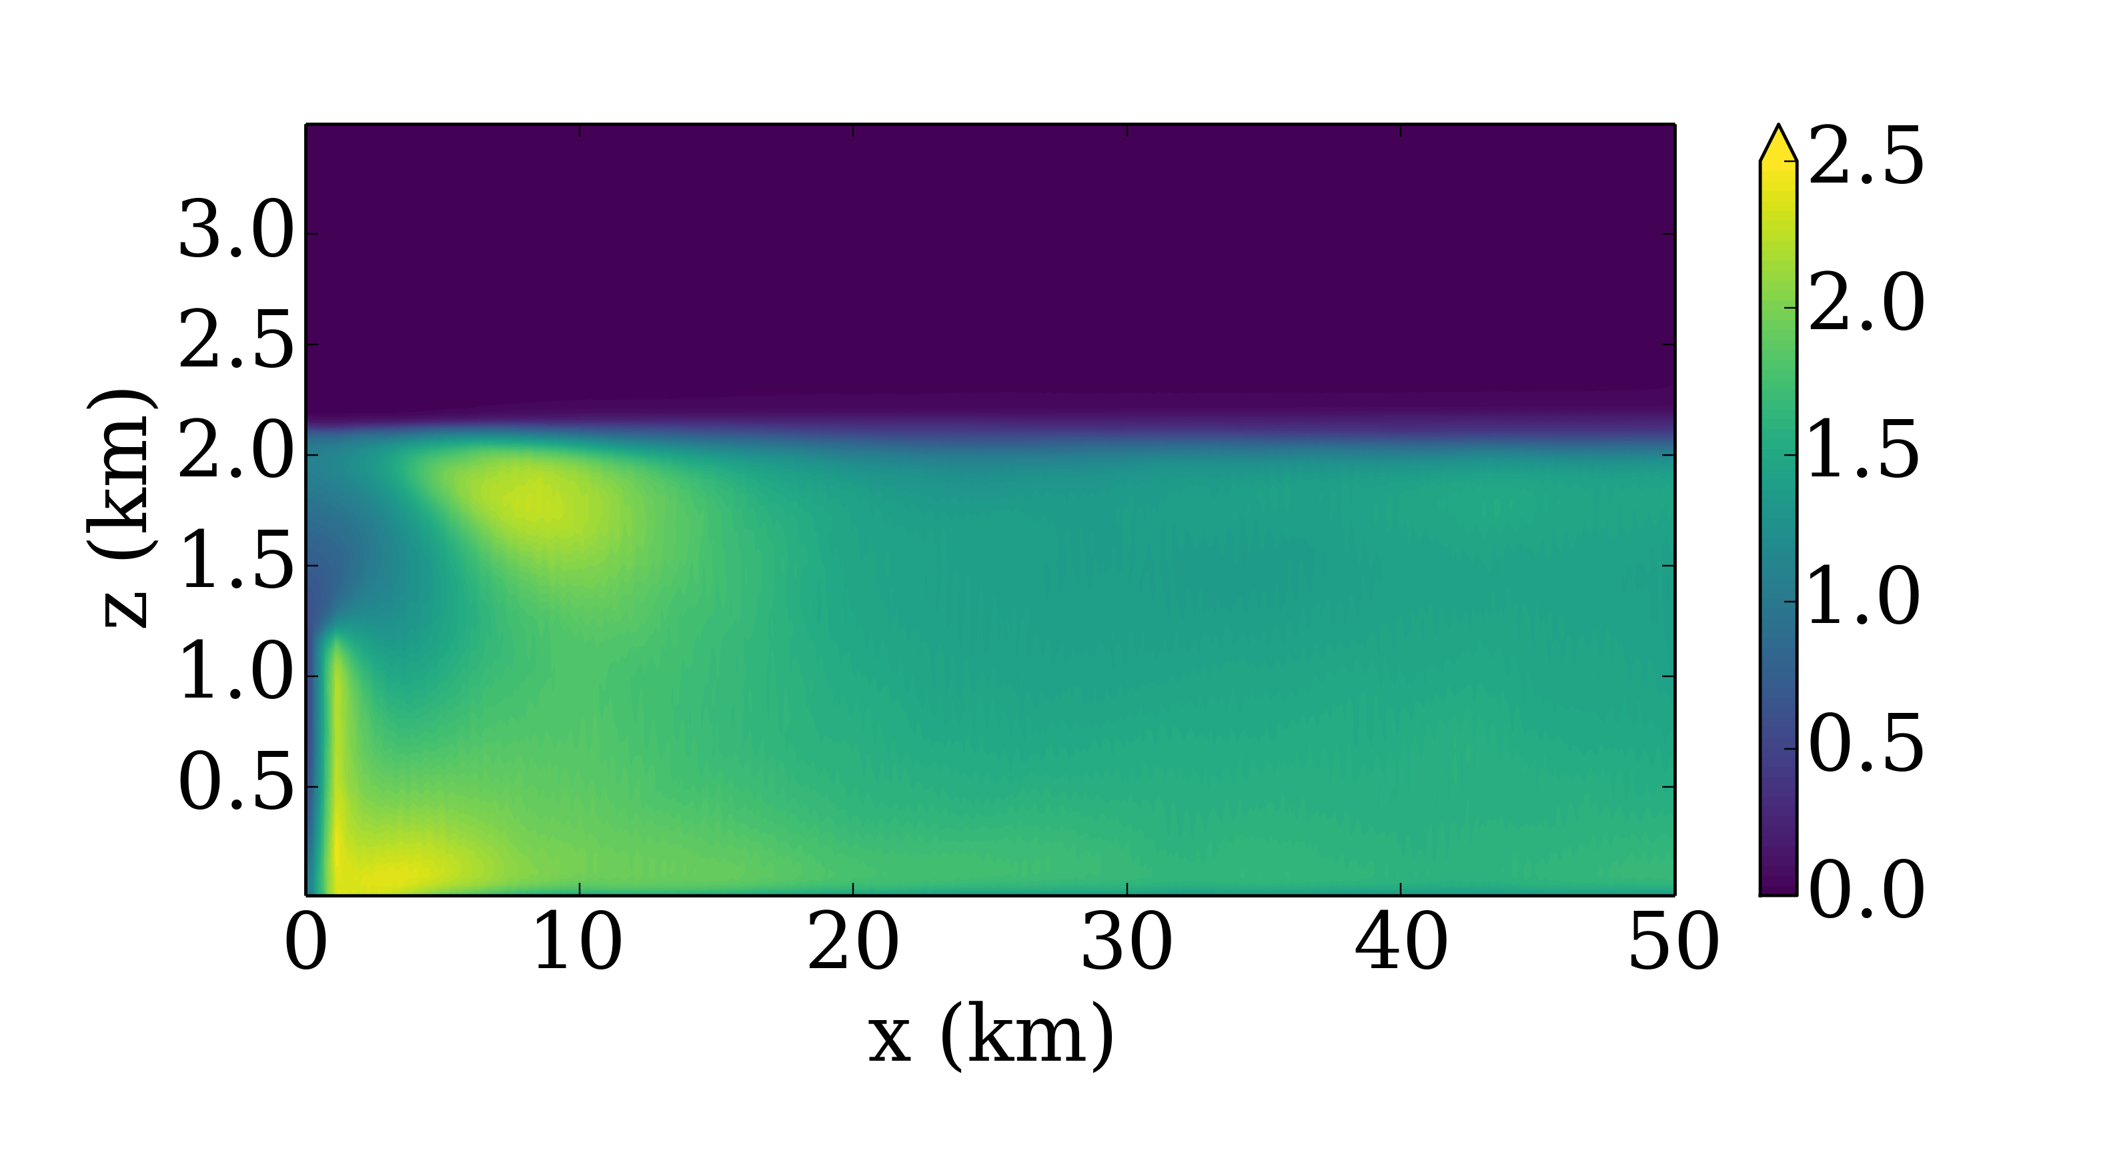
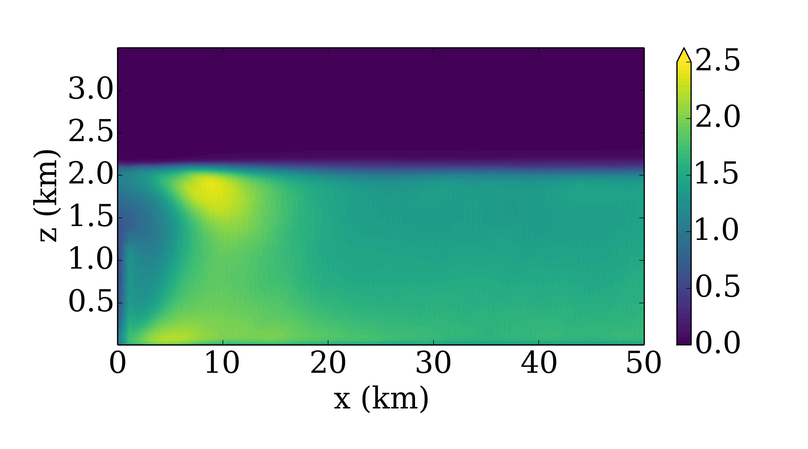
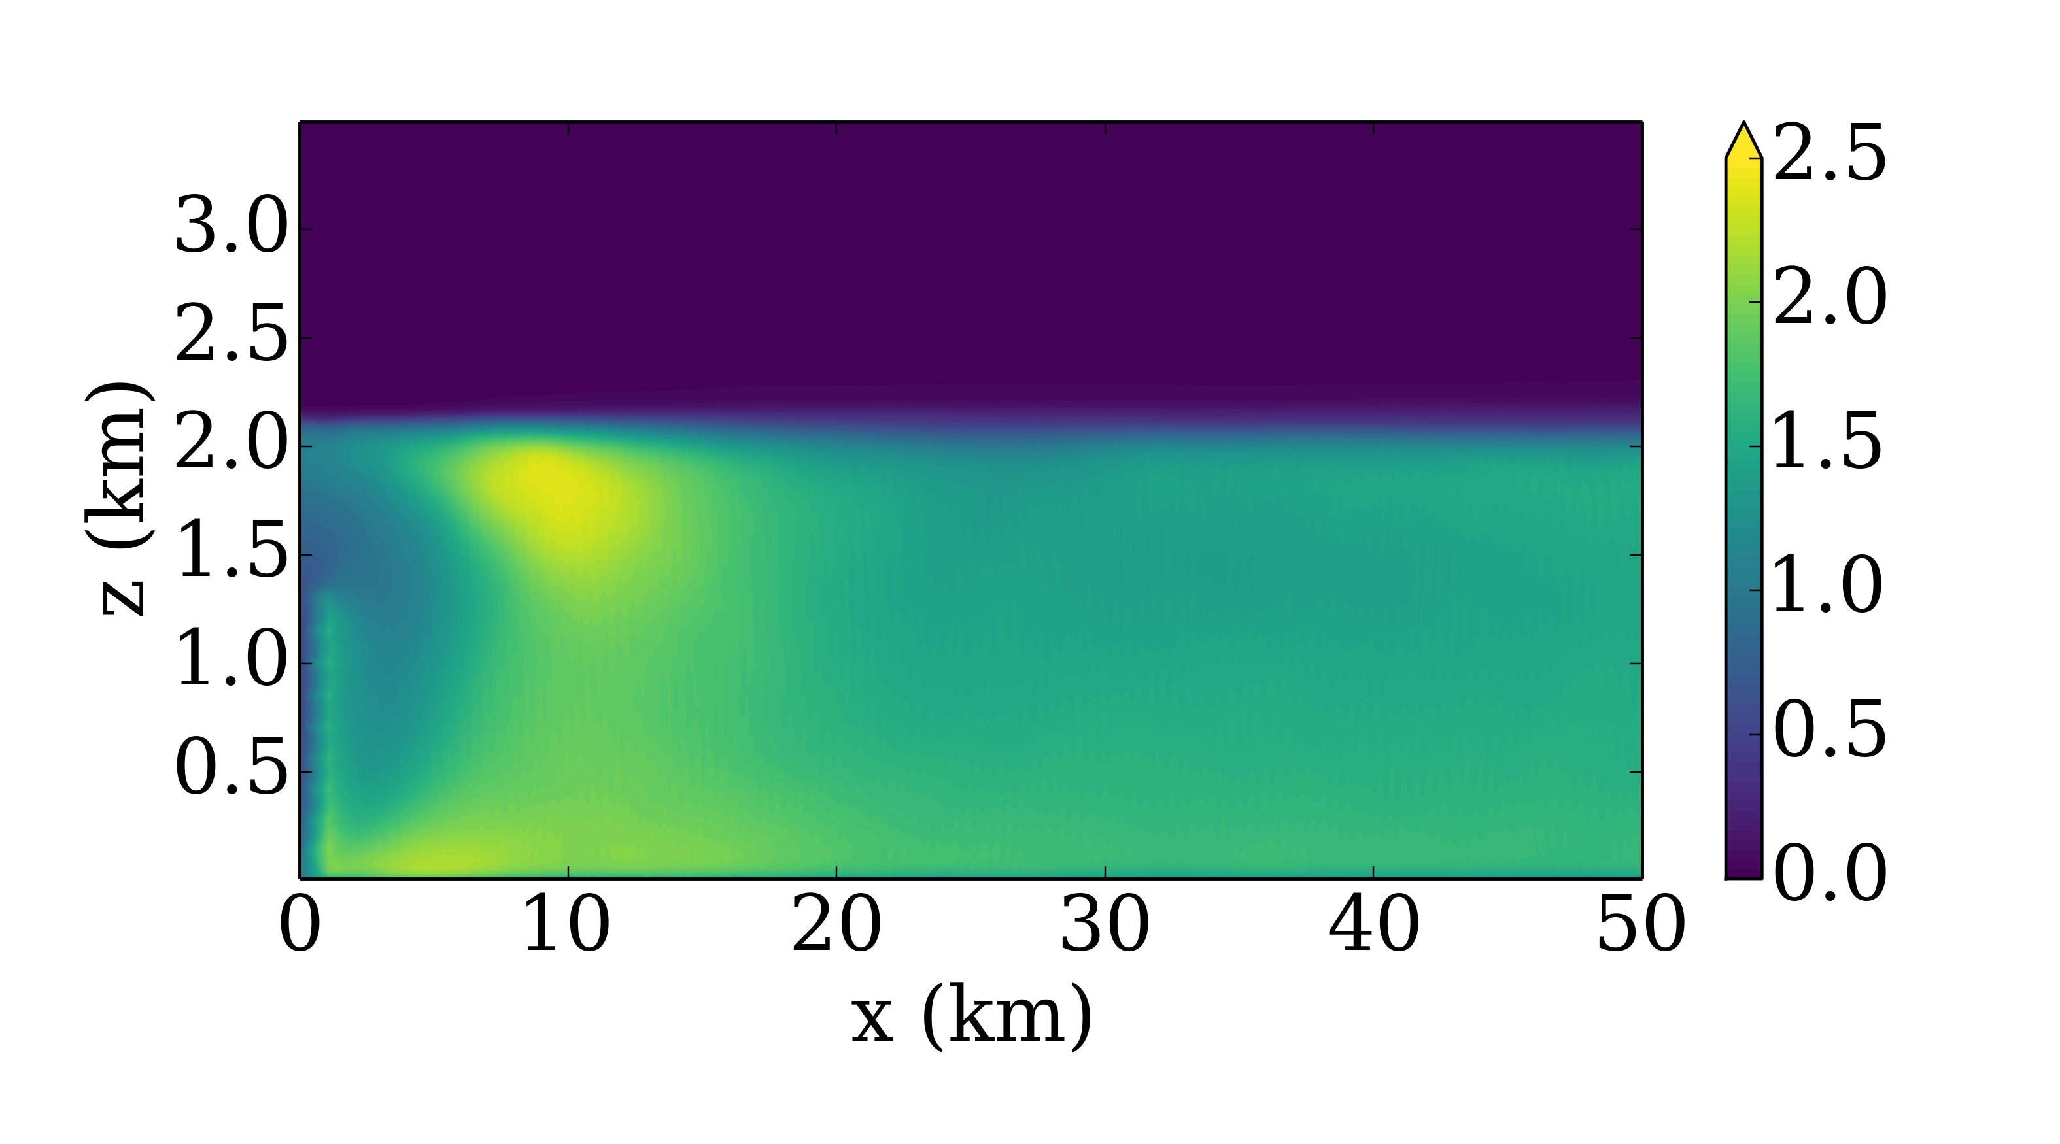
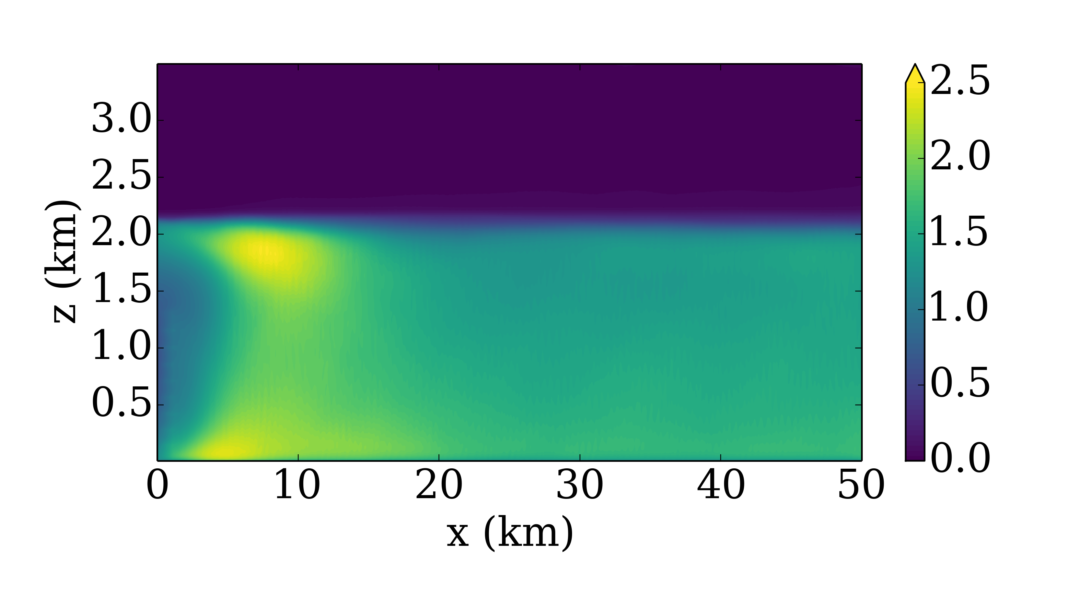
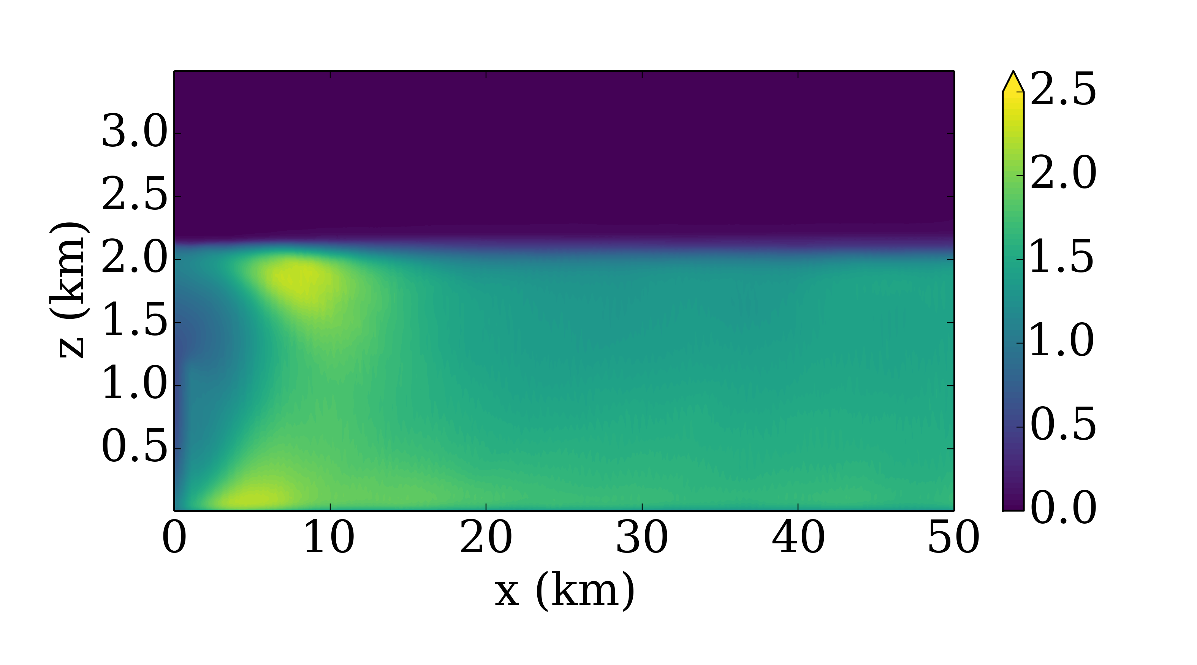
Convective – z = 100 m
No Perts
θ_{0.33K}
We’ve since added lines where the line evolution will be shown.
Will only update for final figures that will be in paper.
The lines will only be added to ONE of each stability condition, since they are pretty intrusive.
uv₁₀₀₀
uv₂₀₀₀
uv₅₀₀₀
w₁₅₀₀₀
w₁₅₀₀
w₂₅₀₀
w₅₀₀₀
w₁₀₀₀₀
uv₁₅₀₀ + w₅₀₀₀
uv₃₀₀₀ + w₁₅₀₀₀
uv₁₅₀₀ + θ_{0.16K}
W₅₀₀₀ + θ_{0.16K}

Slide 2
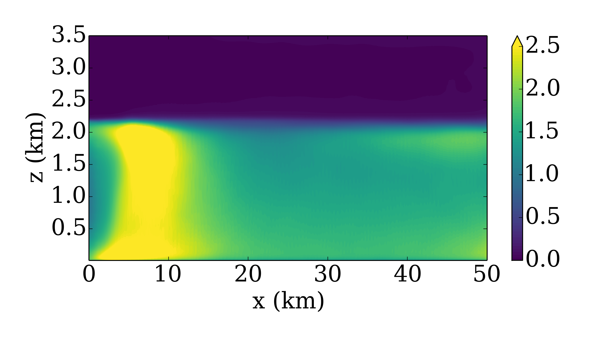
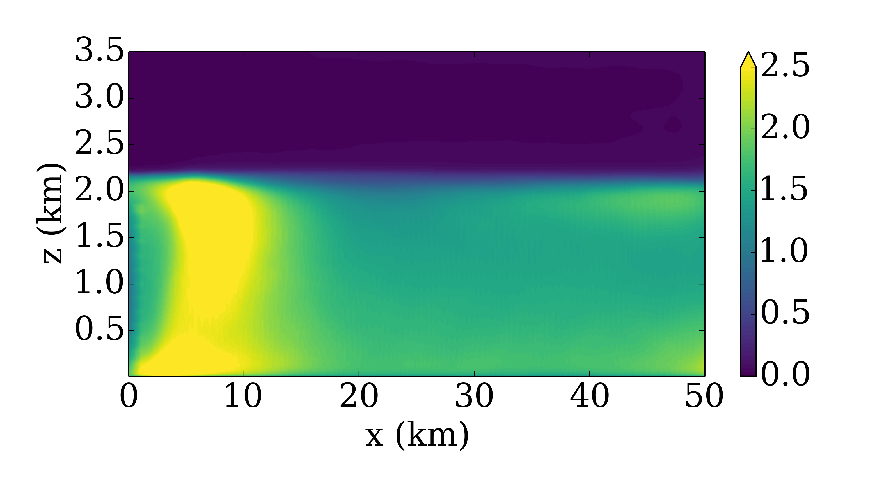
Convective – z = 100 m
No Perts
θ_{0.33K}
We’ve since added lines where the line evolution will be shown.
Will only update for final figures that will be in paper.
The lines will only be added to ONE of each stability condition, since they are pretty intrusive.
uv₂₀₀₀
uv₅₀₀₀
uv₂₅₀
uv₁₀₀₀
uv₂₀₀₀
New Heights

