Slide 1
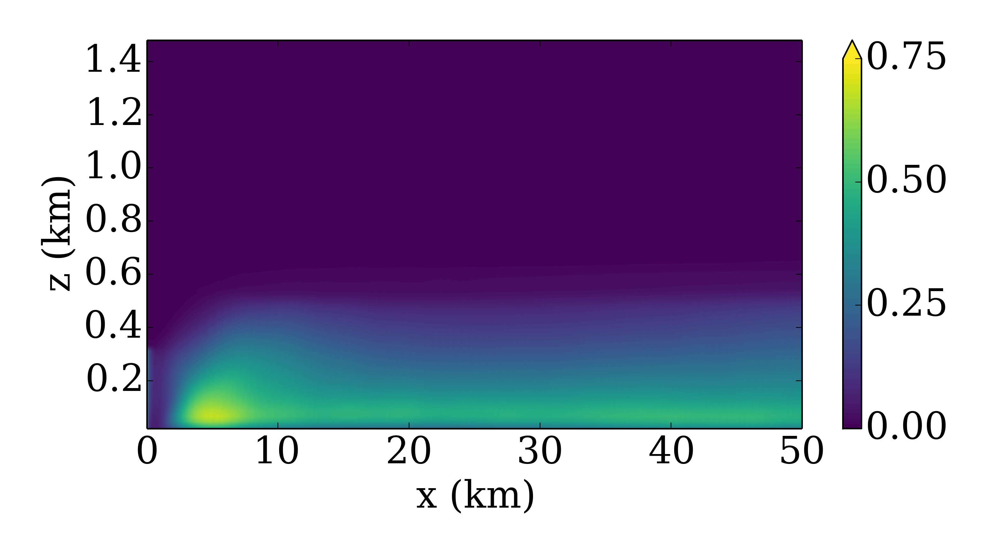
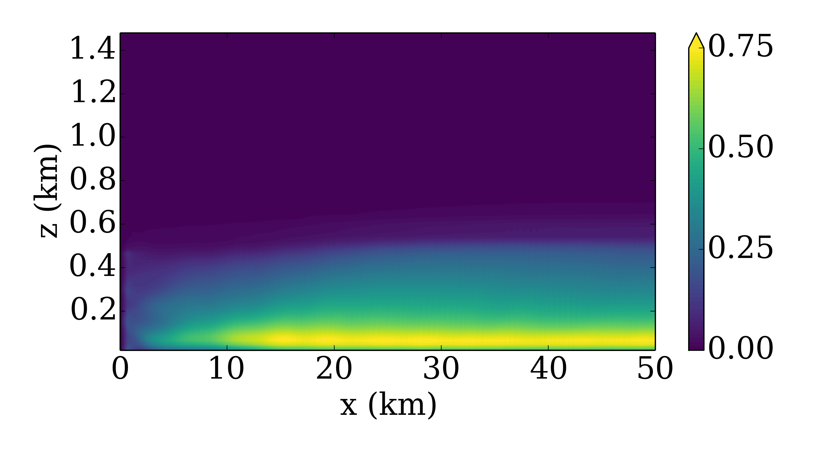
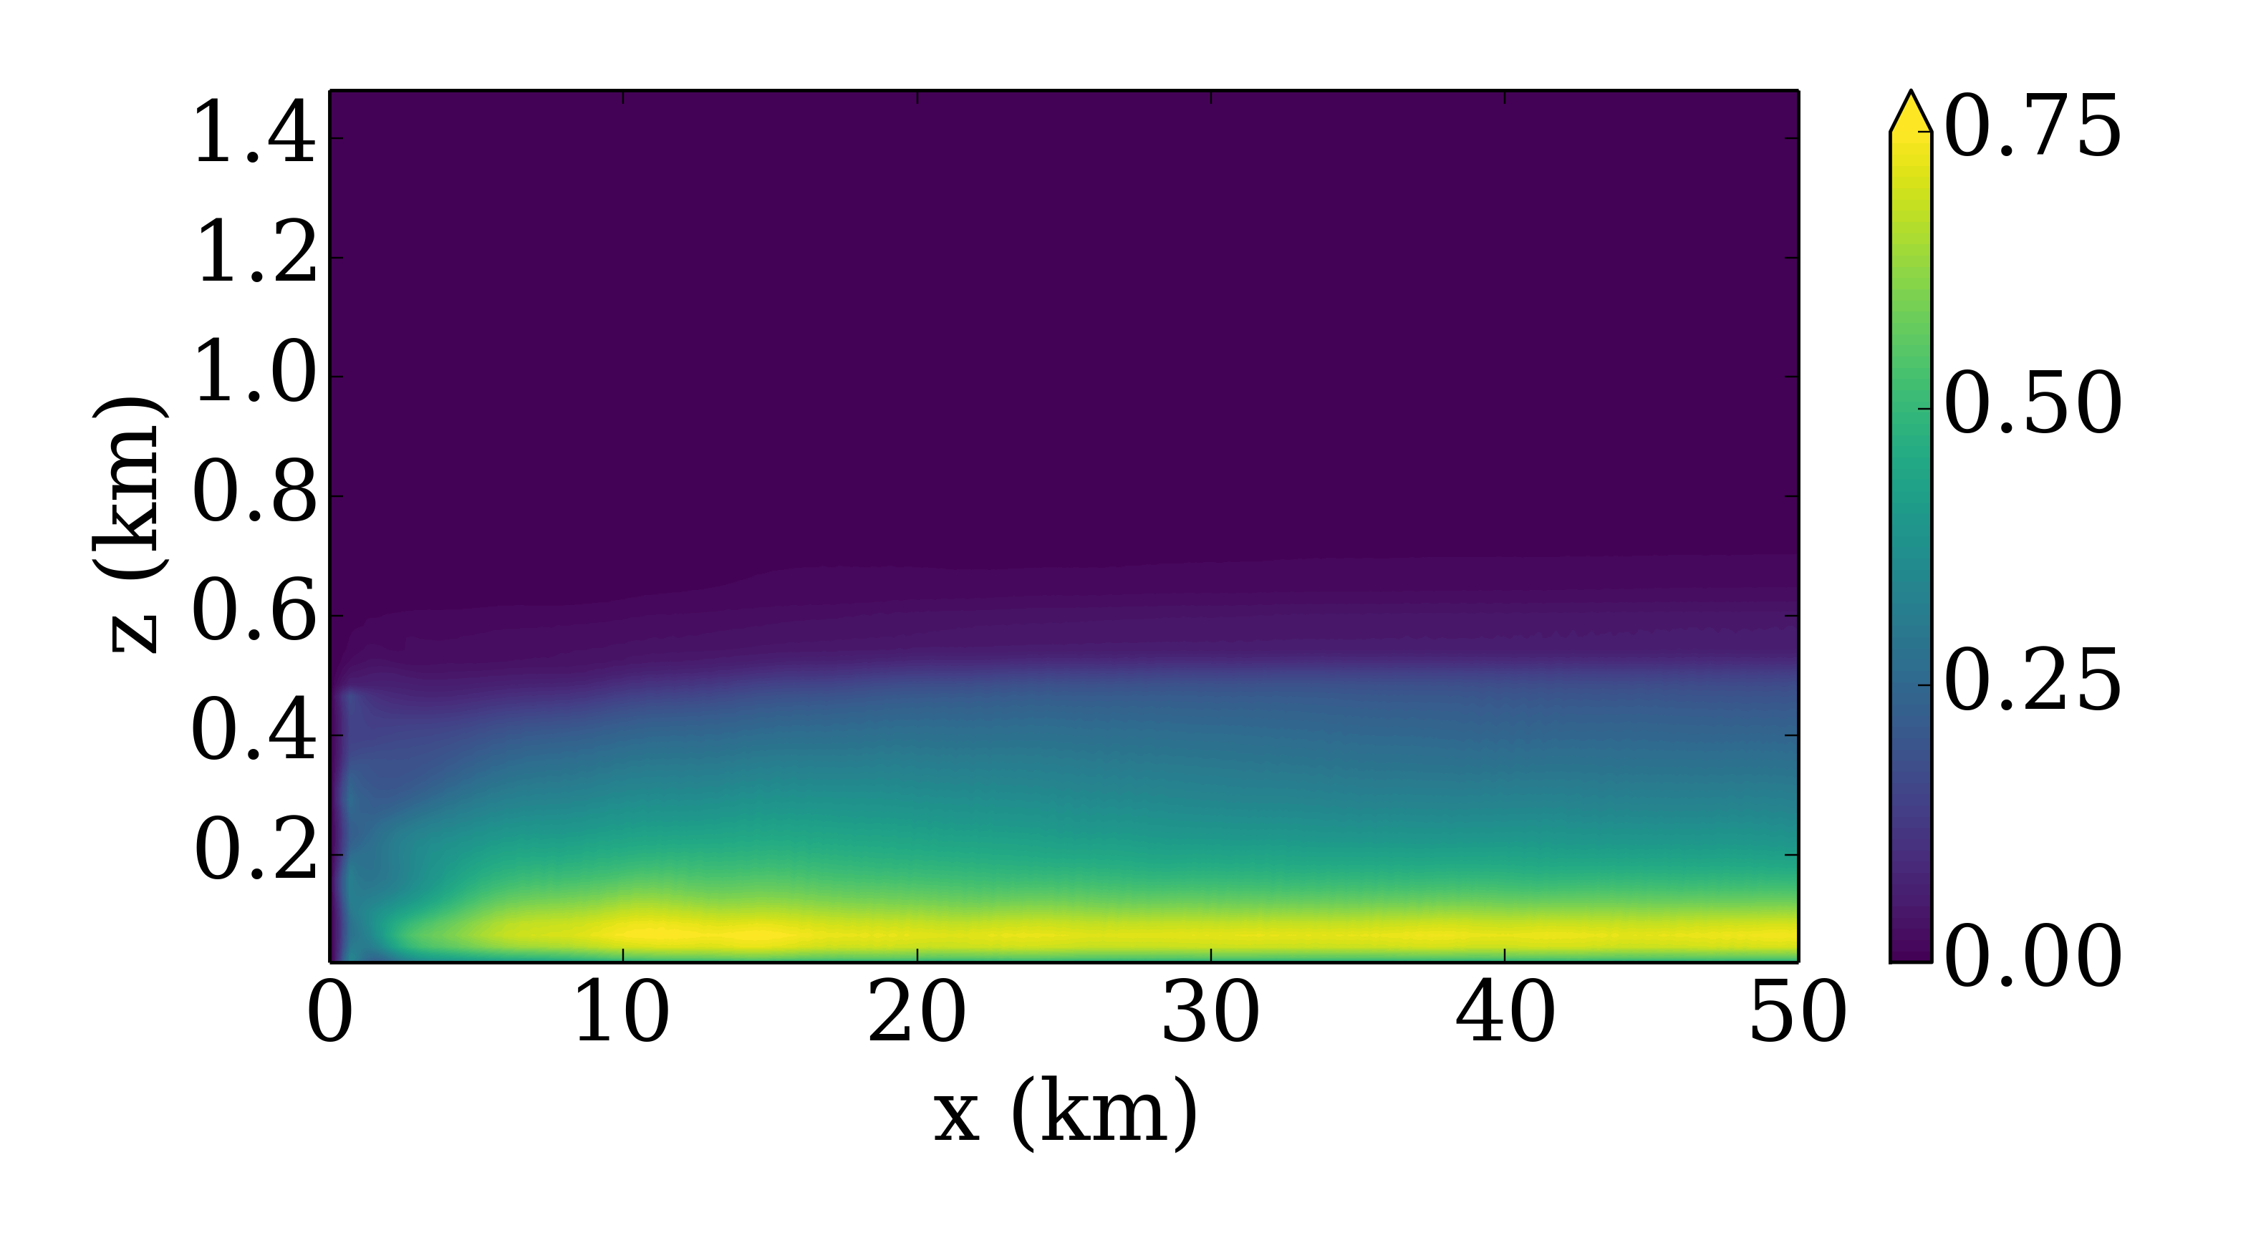
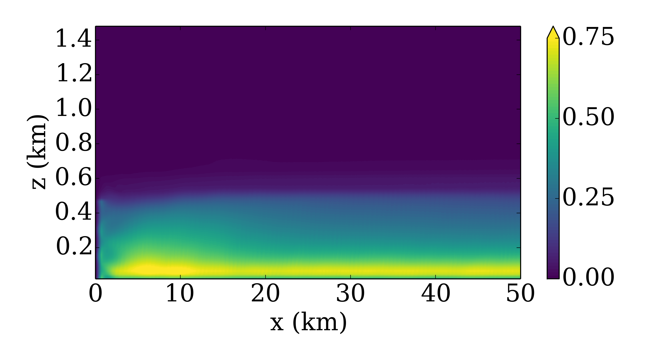
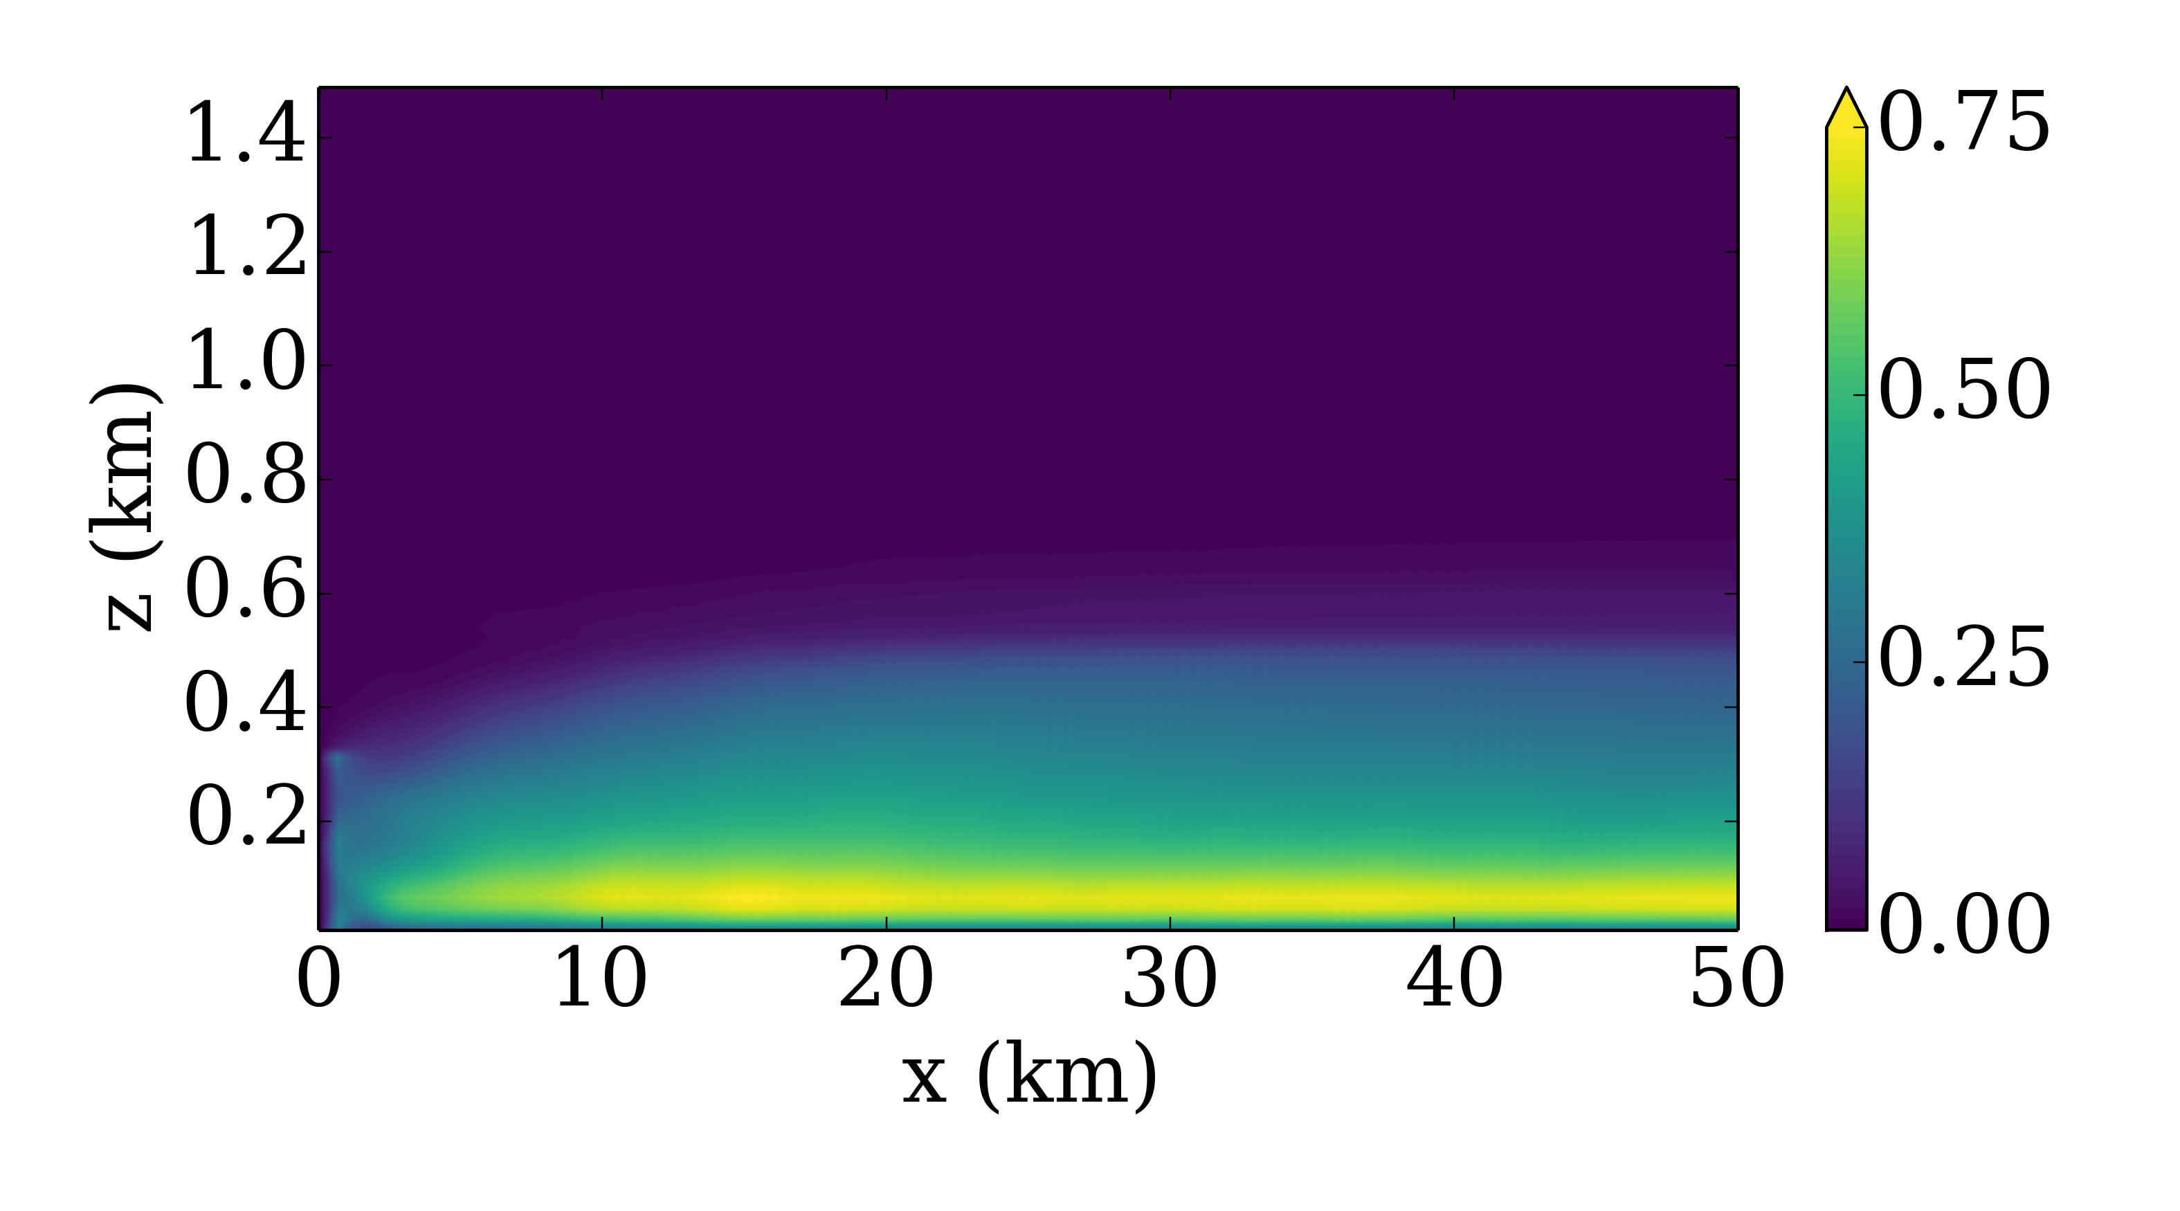
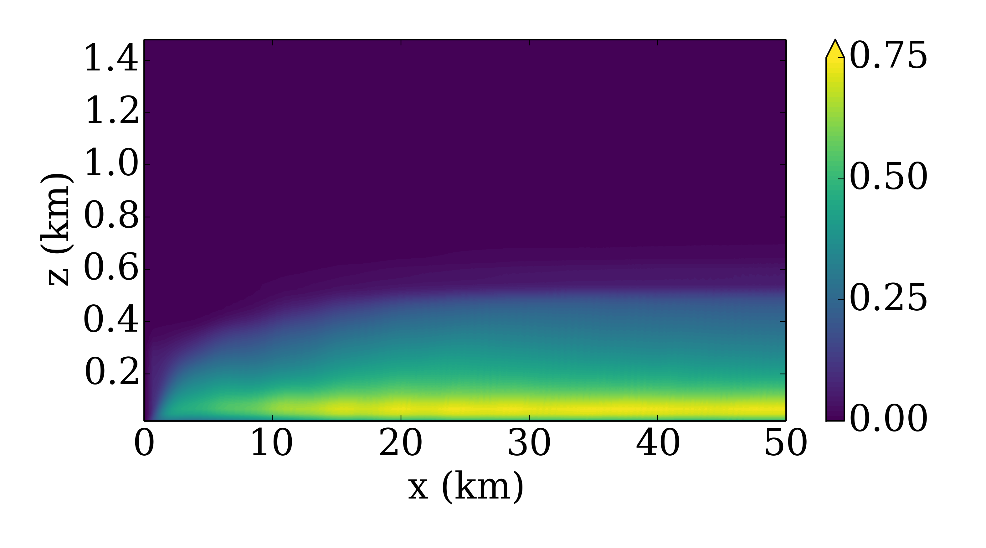
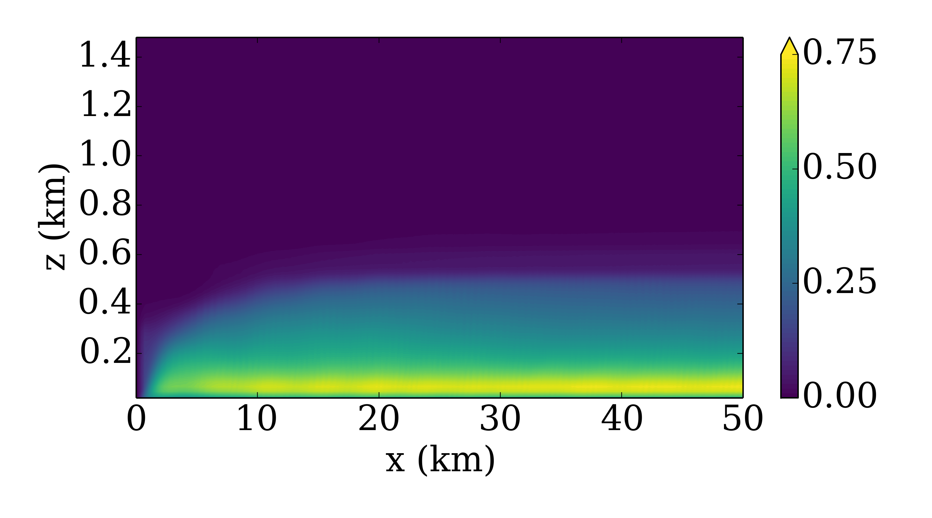
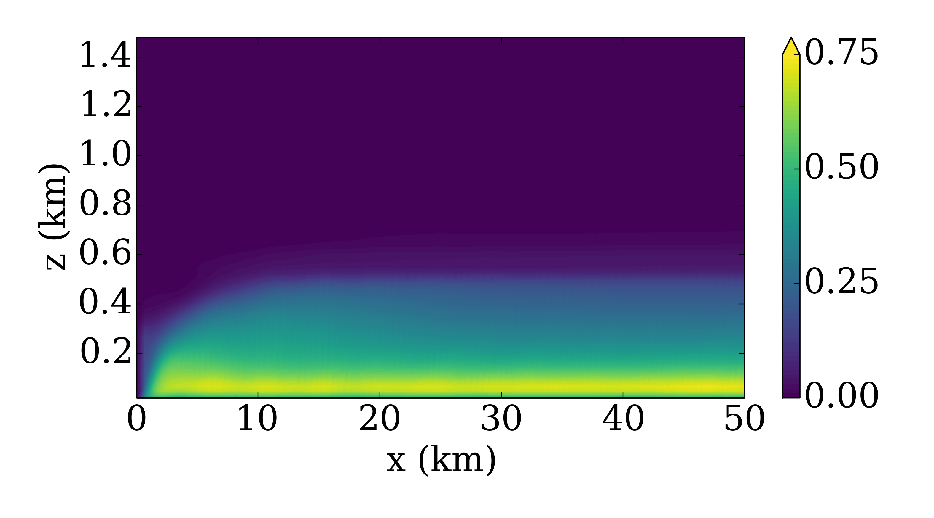
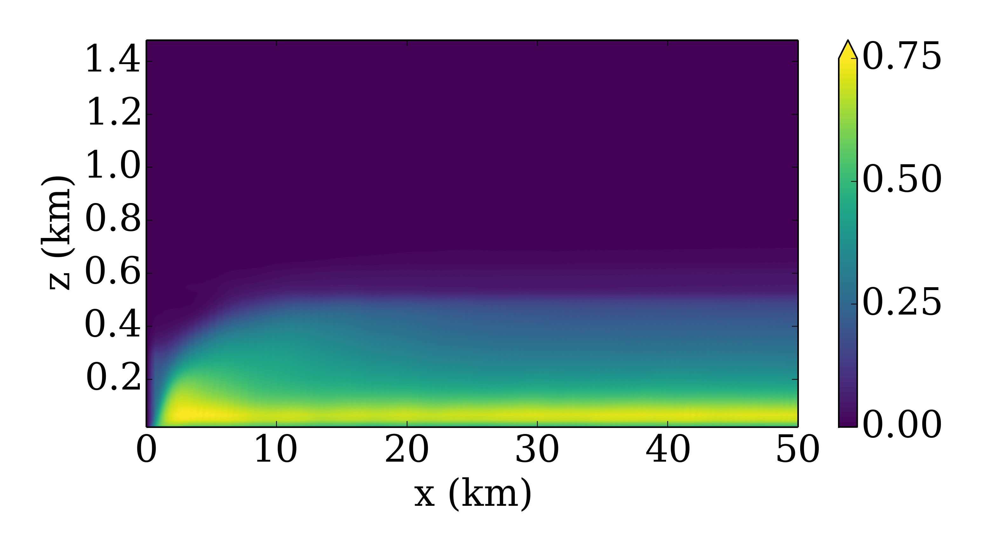
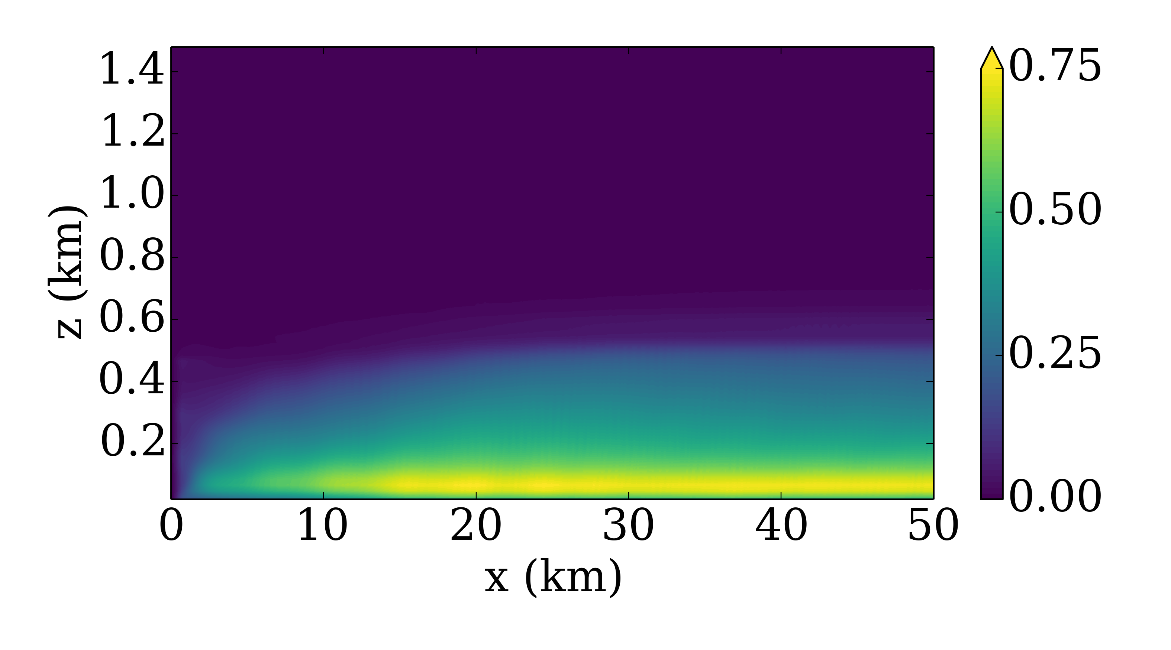
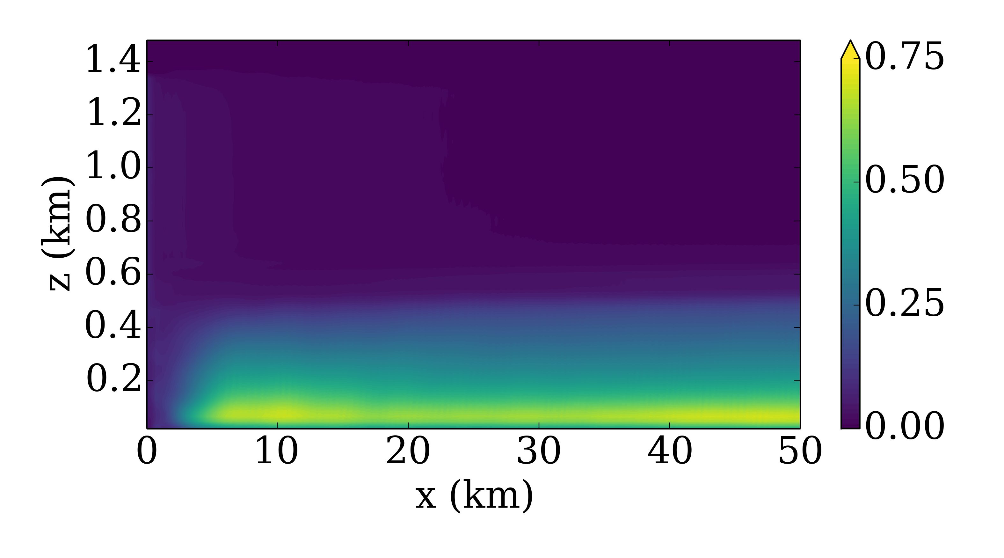
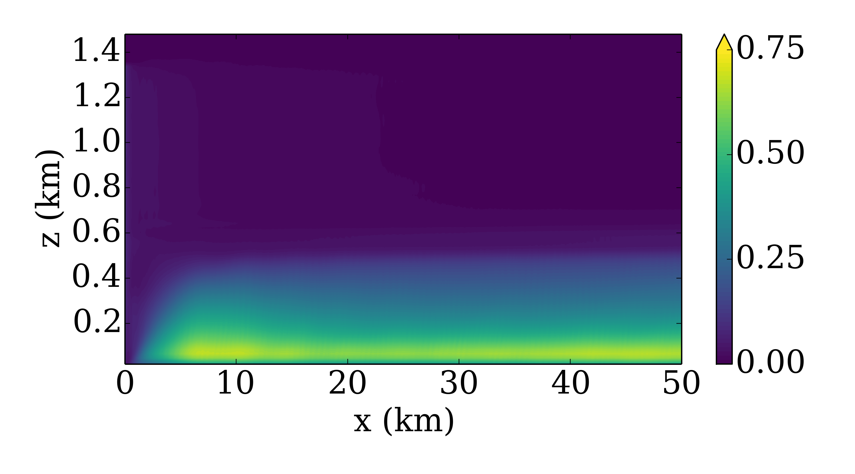
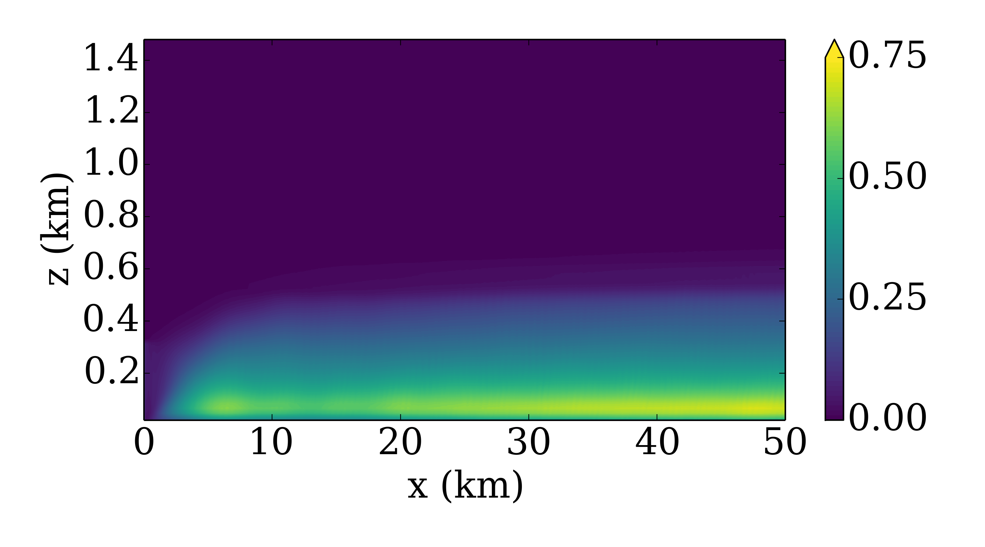
Neutral – z = 100 m
θ_{0.5K}
We’ve since added lines where the line evolution will be shown.
Will only update for final figures that will be in paper.
The lines will only be added to ONE of each stability condition, since they are pretty intrusive.
uv₇₅₀
uv₁₀₀₀
uv₁₂₅₀
Uv_{1000 – New Height}
w₁₀₀₀
w₁₂₅₀
w₁₅₀₀
w₁₇₅₀
uv₅₀₀ + w₇₅₀
uv₅₀₀ + θ_{0.25K}
w₇₅₀ + θ_{0.25K}
w₆₅₀ + θ_{0.25K}

