Slide 1

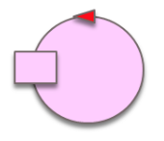
handle
Collision
goOn
sensor
goOn
init
initDone
working
endOfStep
addCell
1-robotUnitCell
stop
CoveredCells
resume
start
stop
end
stopped
result(CoveredCells)
end
resume
user

Slide 2
init
Active
Ractivated
Rstopped
initDone
start
stop
resume
resultReceived
quit
resume
stop
End
start
result
robotBoundary

Slide 3
start
stop
resume
perimeter
user
robotBoundary

Slide 4

start
stop
resume
robotBoundary
virtualRobotSupport
perimeter
socket
user
sensor(collision)

