Slide 1
Statistics Replications: The Impact of Campaign Finance Laws on Party Competition
Does fund parity impact the number of parties in the electoral system?
Laura McPhillips
11/04/2022

Slide 2
Hypothesis, Data and Methods
Hypothesis: As fund parity increases, the effective number of parties (ENP) at the national level should increase as well.
Dependent variable: Effective number of parties in the electoral system
Main independent variable: Fund parity (regulations on campaign finance resources)
Fund parity is measured under 4 categories:
whether there is a limit on the amount of money an individual can donate to a political party
whether there is a limit on the amount of money a political party can expend in contesting an election
whether parties are entitled to free media access
whether parties are entitled to direct public subsidization.
Other independent variables measured are; number of years democratic, whether or not presidential, whether or not federal, ethnolinguistic fractionalization, and district magnitude (entered in logged form to account for its non-normal distribution across their cases). They include an interaction term for ethnolinguistic fractionalization and district magnitude.

Slide 3
Control for Endogeneity
Objection 1: Systems with a large ENP encourage fund parity to allow for more competition access, whereas systems with a low ENP might want to use their electoral advantage and restrict access for smaller parties.
Measured countries that democratized post-1974, where finance laws were established before party system.
Objection 2: The instability of these newer party systems resulted in a higher ENP, as voters had yet to grow accustomed to democratic electoral institutions. Therefore, the cause of the ENP isn’t fund parity, but an open, instable system.
Used data from 2003 and 2012 so inflated ENP would have settled in new democracies
Objection 3: The previous ENP could have determined fund parity, which affects current ENP.
Ran correlation between previous ENP and fund parity, weak correlation of 0.11.
Concluded that the causality runs from fund parity to ENP, not the other way round.

Slide 4
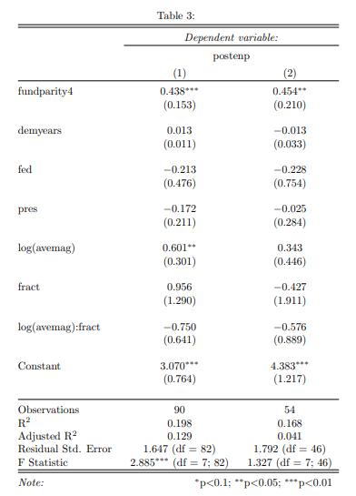
Results
My replication results gave the same as the author’s results using their R code.
For every unit increase in fund parity, ENP increases by ~ 0.45, holding all other variables constant.
Fund parity is the only variable that is statistically significant in both models.
These models support the author’s hypothesis that, as fund parity increases, the effective number of parties (ENP) at the national level should increase as well.

Slide 5
Issues/Comments
They originally had 237 data points, but there are a lot of NA data points which were removed, so there was only 93 data points in the end.
The R² for the first model is 0.2, and 0.17 for the second model, which means that ENP is only explained by 20% and 17% of the input variables, respectively. There are a lot of other variables which have not been examined in this model.
They examined 118 international countries. This is too generalized. It ignores the complexity and diversity of different political systems. A single theoretical framework of party systems is not universally applicable to all democracies. Campaign finance sources vary greatly between democratic countries, as does the driving forces behind the ENP of a given country. This may have worked better on countries with more similar institutional frameworks. e.g., European countries over a greater time period.

Slide 6
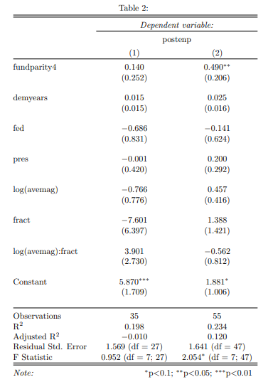
My Analysis
I created a subset; a European Union category, including 28 EU countries, and a subset of non-EU countries
For EU countries, for every unit increase in fund parity, there is only a 0.14 increase in ENP, which is not statistically significant.
For non-EU countries, for every unit increase in fund parity, there is a 0.49 increase in ENP, which is statistically significant.

Slide 7
My Analysis
The model in the study only really holds for non-EU countries but doesn’t apply to EU countries. This highlights how the source of campaign funds for European countries is not a major influence on ENP, and that something else determines the ENP in Europe, which needs to be examined.
The dynamics at play in EU and non-EU countries varies quite a bit when it comes to campaign finance law regulations and how it affects elections.
A breakdown of countries into smaller subcategories based on, for example, their geographical location or institutional structure would be a more accurate examination of what causes ENP.
The author’s hypothesis is too generalized and does not hold for European countries, and possibly other countries with further examination.

