Slide 1




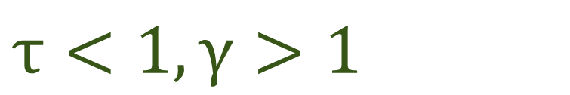
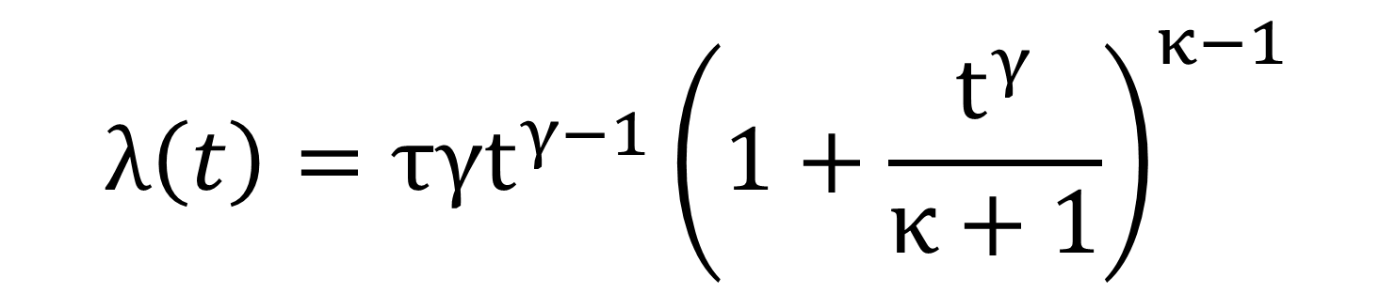

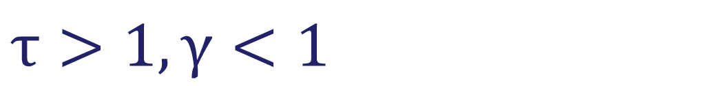
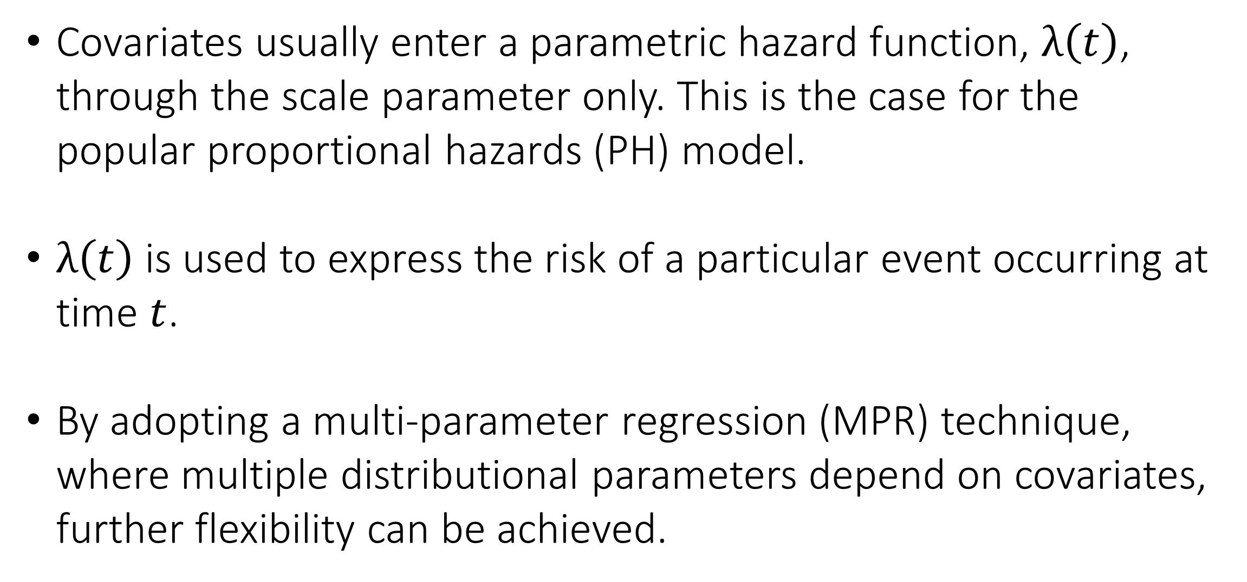
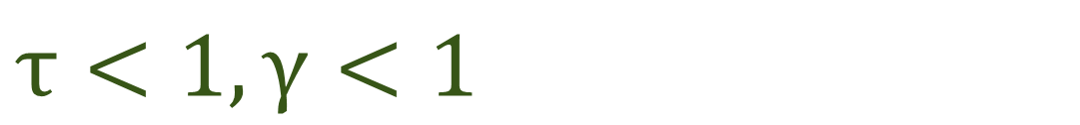

Penalized Power-Generalized Weibull
Distributional Regression
Laura McQuaid, Shirin Moghaddam, Kevin Burke
University of Limerick, Ireland
Background
Simulation Study
Covariates usually enter a parametric hazard function, $λ\left(t\right)$, through the scale parameter only. This is the case for the popular proportional hazards (PH) model.
$λ\left(t\right)$ is used to express the risk of a particular event occurring at time $t$.
By adopting a multi-parameter regression (MPR) technique, where multiple distributional parameters depend on covariates, further flexibility can be achieved.
Scale (β) |  |  |  | Shape (α)
n | C(7) | MSE | PT | C(7) | MSE | PT
500 | 6.86 | 0.02 | 0.87 | 6.78 | 0.00 | 0.81
2000 | 6.95 | 0.00 | 0.96 | 6.96 | 0.00 | 0.96
Table 1. C, average correct zeros; MSE, average mean squared error; PT, probability of choosing the true model.
The model performs well from a variable selection perspective where the average correct zeros is tending towards the oracle values as the sample size increases.
Inference was also carried out which showed good performance.
Power-Generalized Weibull (PGW)
Data Application
$$λ\left(t\right)=τγt^{γ−1}{\left(1+\frac{t^{γ}}{κ+1}\right)}^{κ−1}$$
Weibull/Gompertz
Veteran dataset – Survival package in R
Randomized trial of two treatment groups for lung cancer
137 observations
Weibull Extension
 | PH | MPR
cell type: squamous | β | α
cell type: large | β | β
karno | β | α, β
Tuning Parameter | 0.01706318 | 0.02833773
BIC | 1466.42 | 1463.72
Log-logistic/Burr
Exponential
Log-logistic/Weibull
Table 2. β = “selected in scale”, α = “selected in shape”, and those which are non-significant (at the 5% level) are shown in gray.
Figure 1. PGW hazard shapes.
 | Intercept | Large | Squamous | Karno
β | -2.38 | -0.42 | - | -0.06
α | 0.59 | - | -0.13 | 0.01
ω | 0.35 | - | - | -
Distributional Regression
The PGW MPR model used in this research allows covariates to enter the hazard through the scale (τ) and shape (γ) parameters where the additional shape (κ) parameter is independent of covariates:
Table 4. Coefficient estimation from MPR output where those which are non-significant (at the 5% level) are shown in gray.
$$log\left(τ\right)=x^{T}β$$
$$log\left(γ\right)=x^{T}α$$
$$log\left(κ+1\right)= ω$$
where $x$ is the covariate vector and $β$, $α$and $ω$ are the regression coefficients associated with $τ$, $γ$ and $κ$.
Scale: $τ>0⇒$Magnitude of the hazard
Shape: $γ>0⇒$Time evolution of the hazard
Shape: $κ>−1⇒$Specifies the baseline distribution
$$τ<1,γ>1$$
$$τ>1,γ>1$$
$$τ<1, γ<1$$
Figure 4. Cell type hazard ratios.
Unlike PH models, MPR models allow for time-varying hazard ratios.
This is the case for the squamous cell which has a smaller hazard relative to the reference category and this hazard is also decreasing over time
$$τ>1,γ<1$$
Conclusions
Figure 2. Impact of the shape ($γ$) and scale (τ) on the hazard.
Greater flexibility can be achieved by using an MPR model.
Time-varying hazard ratios occur naturally by allowing the shape parameter to depend on covariates.
Increased understanding of real-world data.
Variable selection and parameter estimation are carried out using penalized regression (adaptive lasso penalty).
Contact Details
References
laura.mcquaid@ul.ie
Burke et al. (2017). Multi‐parameter regression survival modeling. Biometrics.
Jaouimaa et al. (2019). Penalized Variable Selection in Multi-Parameter Regression Survival Modelling. arXiv:1907.01511.
Burke et al. (2020). A flexible parametric modelling framework for survival analysis. JRSS-C.
lauramcquaid
Notes:
When you create a research poster you need to ask yourself which information you would like to communicate and how you can present that so that your audience will immediately know what to expect of your full report, dissertation or publication. However, you do not need to wait for a finished product to create a research poster. A research poster can work like a mind-map for you when you are in the planning stage of your enquiry, as it gives you the bigger picture of all aspects of your research at a glance.
Helpful Tips on Making Posters
Academic posters are a good way to showcase your work and help you to engage colleagues in conversation.
Preparing posters in advance is vital. Don’t wait until the last minute. Creating and printing an effective poster presentation takes time.
Stick to a clear format which is easy to read from 1 m away.
Your audience will be from diverse academic backgrounds and may not understand the intricacies of your specific field, so be prepared to present your poster to a general audience.
Make sure to have your supervisor has proofread the poster before printing.
Practice your presentation in advance and think about questions you may be asked after your presentation.
An effective poster is focused on a single message.
Let’s graphs and images tell the story.
LinkedIn: https://www.linkedin.com/pulse/phd-skills-create-research-poster-henri-achten

