Slide 1





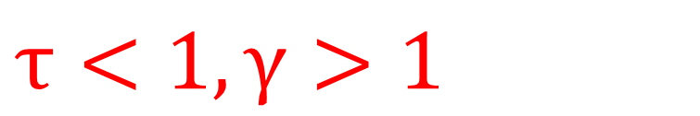
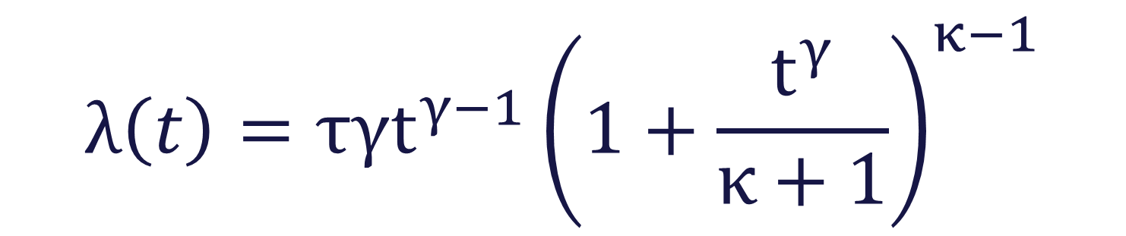

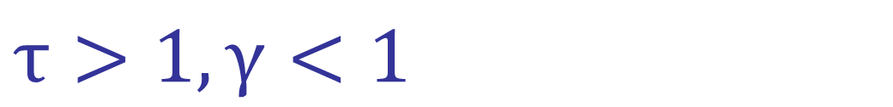
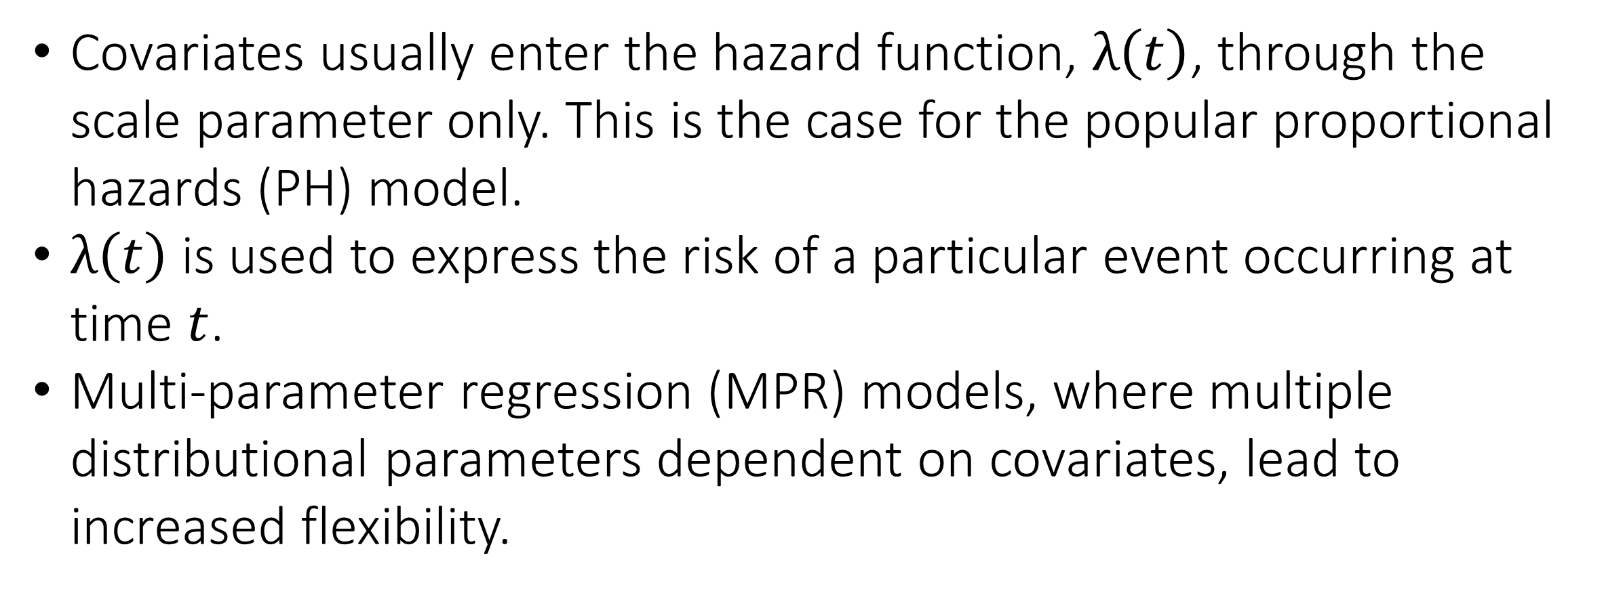
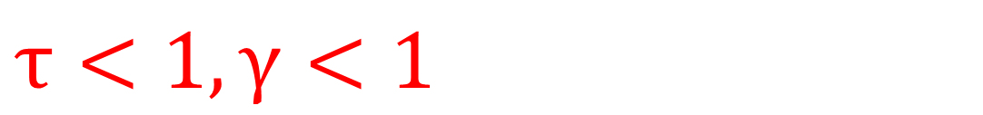
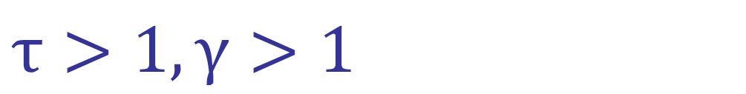
Penalized Power-Generalized Weibull
Distributional Regression
Laura McQuaid, Shirin Moghaddam, Kevin Burke
University of Limerick, Ireland
1. Background
4. Simulation Study
Covariates usually enter the hazard function, $λ\left(t\right)$, through the scale parameter only. This is the case for the popular proportional hazards (PH) model.
$λ\left(t\right)$ is used to express the risk of a particular event occurring at time $t$.
Multi-parameter regression (MPR) models, where multiple distributional parameters dependent on covariates, lead to increased flexibility.
A simulation study was carried out to assess the performance of the penalized PGW MPR model.
Variable selection and inference were of interest.
Good performance across all metrics.
Scale (β) |  |  |  | Shape (α)
n | C(7) | MSE | PT | C(7) | MSE | PT
500 | 6.86 | 0.02 | 0.87 | 6.78 | 0.00 | 0.81
2000 | 6.95 | 0.00 | 0.96 | 6.96 | 0.00 | 0.96
2. Power-Generalized Weibull (PGW)
$$λ\left(t\right)=τγt^{γ−1}{\left(1+\frac{t^{γ}}{κ+1}\right)}^{κ−1}$$
Weibull/Gompertz
Table 1. C, average correct zeros; MSE, average mean squared error; PT, probability of choosing the true model – Variable selection results.
Weibull Extension
5. Data Application
Log-logistic/Burr
Veteran dataset – Survival package in R
Randomized trial of two treatment groups for lung cancer
 | PH | MPR
cell type: squamous | β | α
cell type: large | β | β
karno | β | α, β
Tuning Parameter | 0.01706318 | 0.02833773
BIC | 1466.42 | 1463.72
Exponential
Log-logistic/Weibull
Figure 1. PGW hazard shapes.
3. Distributional Regression
Table 2. β = “selected in scale”, α = “selected in shape”, and those which are non-significant (at the 5% level) are shown in gray.
Our model allows covariates to enter the PGW hazard through the scale (τ) and shape (γ) parameters where the additional shape (κ) parameter is independent of covariates:
 | Intercept | Large | Squamous | Karno
β | -2.38 | -0.42 | - | -0.06
α | 0.59 | - | -0.13 | 0.01
ω | 0.35 | - | - | -
$$log\left(τ\right)=x^{T}β$$
$$log\left(γ\right)=x^{T}α$$
$$log\left(κ+1\right)= ω$$
where $x$ is the covariate vector and $β$, $α$and $ω$ are the regression coefficients associated with $τ$, $γ$ and $κ$.
Table 3. Coefficient estimation from MPR output where those which are non-significant (at the 5% level) are shown in gray.
Scale: $τ>0⇒$Magnitude of the hazard
Unlike PH models, MPR models allow for time-varying hazard ratios.
This is the case for the squamous cell which has a smaller hazard, relative to the reference category, and this hazard is also decreasing over time.
Shape: $γ>0⇒$Time evolution of the hazard
Shape: $κ>−1⇒$Specifies the baseline distribution
$$τ<1,γ>1$$
$$τ>1,γ>1$$
$$τ<1, γ<1$$
$$τ>1,γ<1$$
Figure 2. Impact of the shape ($γ$) and scale (τ) on the hazard.
Variable selection and parameter estimation are carried out using penalized regression (via the adaptive lasso penalty).
Figure 3. Cell type hazard ratios.
6. Conclusions
Time-varying hazard ratios occur naturally by allowing the shape parameter to depend on covariates.
Increased understanding of real-world data.
Contact Details and References
laura.mcquaid@ul.ie
@lauramcquaid
Burke et al. (2020). A flexible parametric modelling framework for survival analysis. JRSS-C.
Jaouimaa et al. (2019). Penalized Variable Selection in Multi-Parameter Regression Survival Modelling. arXiv.
Notes:
When you create a research poster you need to ask yourself which information you would like to communicate and how you can present that so that your audience will immediately know what to expect of your full report, dissertation or publication. However, you do not need to wait for a finished product to create a research poster. A research poster can work like a mind-map for you when you are in the planning stage of your enquiry, as it gives you the bigger picture of all aspects of your research at a glance.
Helpful Tips on Making Posters
Academic posters are a good way to showcase your work and help you to engage colleagues in conversation.
Preparing posters in advance is vital. Don’t wait until the last minute. Creating and printing an effective poster presentation takes time.
Stick to a clear format which is easy to read from 1 m away.
Your audience will be from diverse academic backgrounds and may not understand the intricacies of your specific field, so be prepared to present your poster to a general audience.
Make sure to have your supervisor has proofread the poster before printing.
Practice your presentation in advance and think about questions you may be asked after your presentation.
An effective poster is focused on a single message.
Let’s graphs and images tell the story.
LinkedIn: https://www.linkedin.com/pulse/phd-skills-create-research-poster-henri-achten

