Slide 1
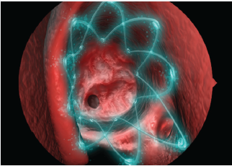

PROPEL is clinically proven to improve surgical outcomes for chronic sinusitis sufferers.
When placed in the sinus following surgery, PROPEL decreases scarring and inflammation, reducing the need for additional surgical procedures and oral steroids that can have serious side effects¹.
The spring-like PROPEL implant props open the ethmoid sinus to maintain the surgical opening, delivers an anti-inflammatory medication directly to the sinus lining, and then dissolves, avoiding the need for removal.
Talk with your doctor to see if PROPEL is the right option for you.
1 Murr AH, Smith TL, Hwang PH et al. Int Forum Allergy Rhinol. 2011; 1 (1):23-32.
Caution: Federal law (USA) restricts this product to sale by or on the order of a physician. See instructions for use for full prescribing information, including indications, contraindications, warnings, precautions and adverse events. www.intersectENT.com
2012 © Intersect ENT Inc. All rights reserved. INTERSECT ENT™ and PROPEL™ are trademarks of Intersect ENT, Inc.
MPM 00009 Rev. A

