Slide 1
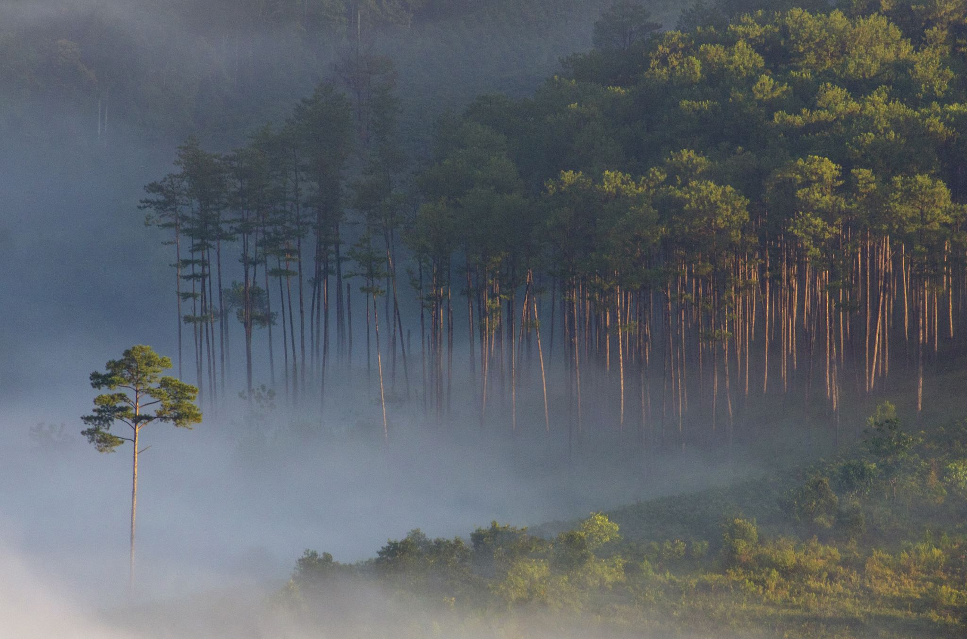
Seattle vs Portland
Themes and suggestions for reddit advertising in the PNW
By Laura Minter

Slide 2
Background
Audience: Companies looking to market their product on reddit to users in the PNW
Problem: Identify both common & disparate themes for the Seattle and Portland redditors based on submissions. Provide suggestions for marketing in each city as well as across the PNW.

Slide 3
Data source and features
Reddit: r/Portland, r/Seattle, r/SeattleWA*
120k from Seattle (half from each)
150k from Portland
Acquired via Pushshift Reddit API
Standard Features
Title
Selftext
Author
* Competing subreddits in same market, roughly same size

Slide 4
Data source and features
Reddit: r/Portland, r/Seattle, r/SeattleWA*
120k from Seattle (half from each)
150k from Portland
Acquired via Pushshift Reddit API
Standard Features
Title
Selftext
Author
270k posts
84k individual authors
Null model: 55% accuracy
Engineered features
Full text (title + selftext)
Vectorized text (3k)
Length of text
Sentiment
* Competing subreddits in same market, roughly same size

Slide 5
Exploring the data
Length of text
Characters, words
Title, full text
Sentiment analysis
VADER

Slide 6
Exploring the data
Length of text
Characters, words
Title, full text
Sentiment analysis
VADER

Slide 7
The Model
Logistic Regression
C = 1.0
Accuracy 82%
Look at words with high/low coefficients
Penalty = l2
Max iterations = 10,000
TFIDF Vectorizer
excluded stop words
83% on train data, 82% on test data
Precision 86%
Recall 72%
Null model accuracy 55%

Slide 8
Findings
Bikes
Friends
Buy/pay
Weather
Family/kids
Suggest/ recommend
Seattle
Portland
Local
Community
City, state
Downtown
Parks

Slide 9
Suggestions and Recommendations
Reddit has an active PNW community, providing a good advertising opportunity
Focus on community and local events
Seattle: weather and family
Portland: bikes and friends
Next: investigate effect of time
Seasonal variation
Multiyear trends

