Slide 1
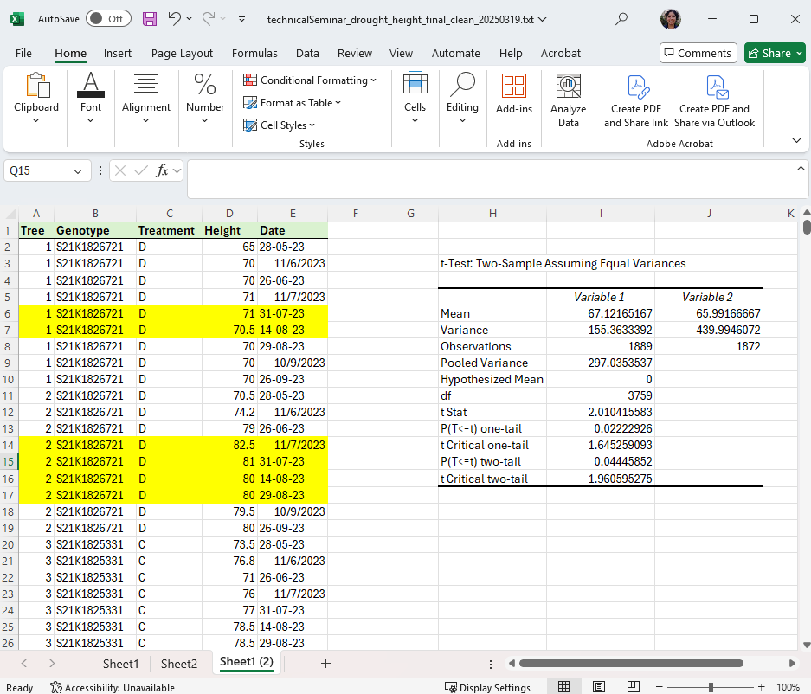

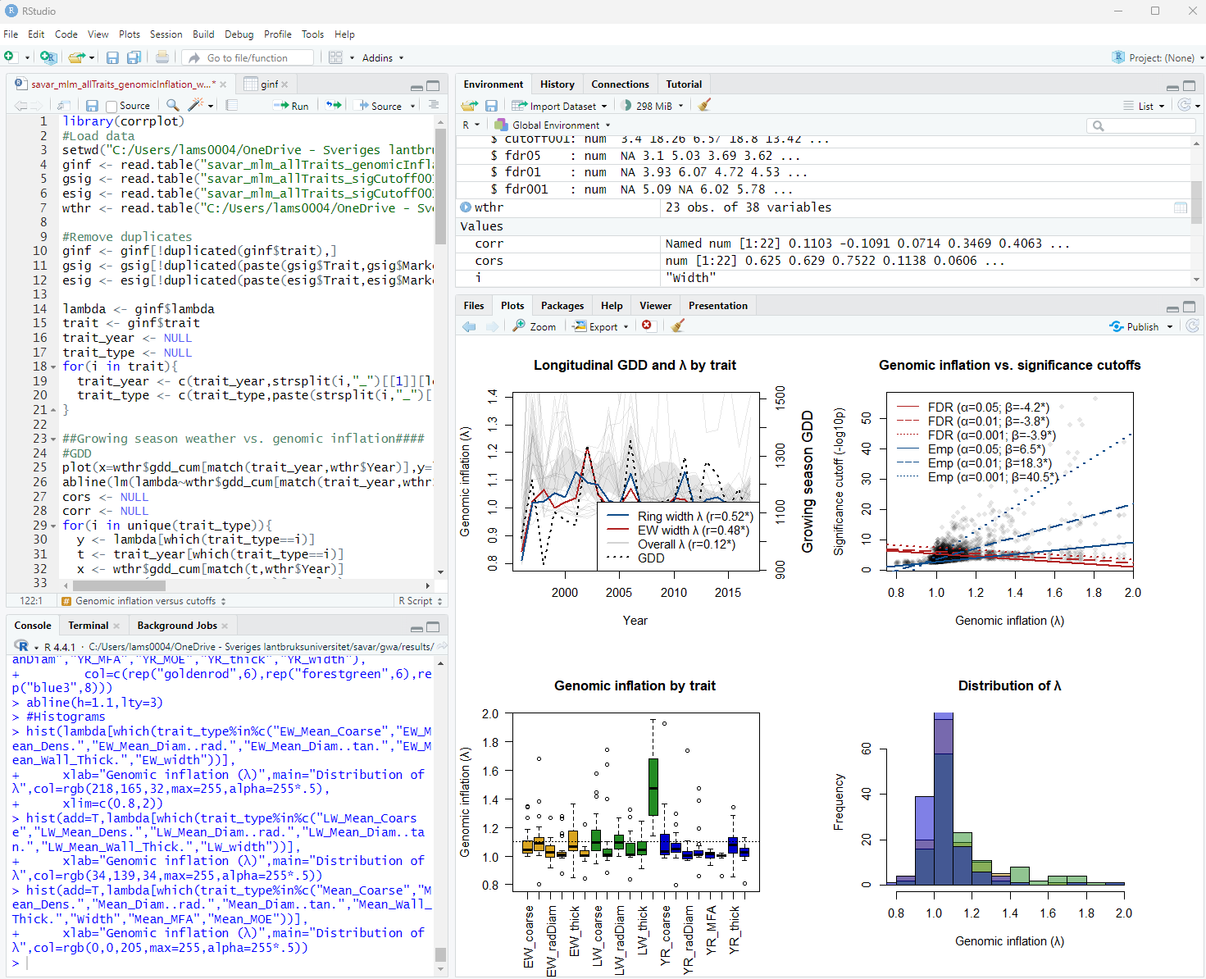
Getting started with R preparing, analyzing, and visualizing data
UPSCtech Seminar
April 8, 2025
Laura Morales
laura.morales@slu.se

Slide 2
Topics and exercises today
Introduction to data types and structures in R
Preparing data for use in R
Importing data into R from text and Excel files
Basic functions for data analysis and plotting

Slide 3

Data types
Number
Character
Logical
Empty

Slide 4
Data types
Number
Numeric: number that may contain a decimal
1, 1.0
1000, 1e3
0.001, 1e-3
Integer: whole number
0, 1, 2, 3…
Complex: imaginary numbers
Character
Logical
Empty

Slide 5
Data types
Number
Character
Character: text
“a”, “5”
“abc”, “12345”, “a1b2c3”
Factor: categorical text with specific levels/order
“small”, “medium”, “large”
By default, levels are alphabetical: “large”, “medium”, “small”
Can specify levels in desired order: “small”, “medium”, “large”
Logical
Empty

Slide 6
Data types
Number
Character
Logical
Logical: TRUE, FALSE, T, F
Missing value: NA
Empty

Slide 7
Data types
Number
Character
Logical
Empty
Empty or undefined variable: NULL

Slide 8
Data structures
Vector
Matrix
Array
List
Data frame

Slide 9
Data structures
Vector
Matrix
Array
List
Data frame
All elements must have the same data type
(plus NA)

Slide 10
Data structures
Vector: one-dimensional
Must only contain one data type, with missing values as NA
Can contain ≥1 elements
Examples
character: c(“a”)
character: c(“a”, ”b”, “c”, NA, “d”)
numeric: c(NA, 2, 3, 4, NA)
logical: c(T, NA, F, F, F)
“a”
“a”
“b”
“c”
NA
“d”
NA
2
3
4
NA
T
NA
F
F
F

Slide 11
Data structures
Vector: one-dimensional
Matrix: two-dimensional
Array: n-dimensional
Must only contain one data type, with missing values as NA
1
2
3
4
5
1 | 0 | 9 | NA | 4
5 | 8 | 4 | 1 | 6
7 | 6 | 0 | 9 | NA
3 | 9 | 1 | 5 | NA
4 | 2 | 2 | 8 | 3
T | T | F | NA | T
F | T | F | NA | T
F | NA | F | T | F
T | T | T | F | T
T | T | F | T | F
T | T | F | NA | T
F | T | F | NA | T
F | NA | F | T | F
T | T | T | F | T
T | T | F | T | F
T | T | F | NA | T
F | T | F | NA | T
F | NA | F | T | F
T | T | T | F | T
T | T | F | T | F

Slide 12
Data structures
Vector
Matrix
Array
Data frame
List
Can hold different data types

Slide 13
Data structures
Vector
Matrix
Array
Data frame
Like matrix, two-dimensional
Unlike matrix, different columns can contain different data types
List
Genotype (character) | Replicate (factor) | Height (numeric) | Albino (logical)
mutant | 1 | 12.5 | TRUE
wild-type | 1 | 28.0 | FALSE
wild-type | 2 | 24.6 | FALSE
mutant | 2 | 9.7 | TRUE
mutant | 3 | 11.1 | TRUE
wild-type | 3 | 25.3 | FALSE

Slide 14
Data structures
vector
“a”
“b”
“c”
NA
“d”
vector
1.5
Vector
Matrix
Array
Data frame
List
Like vector, one-dimensional
Unlike vector, can contain anything that R can store
Different data types, data structures, and even functions
list(a,b,c,d,e)
data frame
1 | T | “a”
5 | T | “b”
7 | F | “c”
3 | T | “d”
4 | T | “e”
list(x,y,z)
T | T | F | NA | T
F | T | F | NA | T
F | NA | F | T | F
T | T | T | F | T
T | T | F | T | F
T | T | F | NA | T
F | T | F | NA | T
F | NA | F | T | F
T | T | T | F | T
T | T | F | T | F
T | T | F | NA | T
F | T | F | NA | T
F | NA | F | T | F
T | T | T | F | T
T | T | F | T | F
array

Slide 15
R is column-oriented
columns
Data is organized by column
Columns contain variables
Rows correspond to observations/records
Genotype (character) | Replicate (factor) | Height (numeric) | Albino (logical)
mutant | 1 | 12.5 | TRUE
wild-type | 1 | 28.0 | FALSE
wild-type | 2 | 24.6 | FALSE
mutant | 2 | 9.7 | TRUE
mutant | 3 | 11.1 | TRUE
wild-type | 3 | 25.3 | FALSE
rows

Slide 16
Preparing data for use in R
FIRST need to consider experimental design
How was your response/dependent variable (e.g. phenotype) observed?
Numeric (e.g. height) or categorical (e.g. albino, not albino)?
Across time points: model together or separately?
What kinds of independent variables do you want to consider?
Replicates, treatments, genotypes, time point, etc.
Design: randomized complete block design (RCBD)
Plant material: 9 genotypes
Replication: 4 reps (blocks)
Phenotype: plant height @ 1, 2, 3 weeks

Slide 17
Preparing data for use in R
FIRST need to consider experimental design
How was your response/dependent variable (e.g. phenotype) observed?
Numeric (e.g. height) or categorical (e.g. albino, not albino)?
Across time points: model together or separately?
What kinds of independent variables do you want to consider?
Replicates, treatments, genotypes, time point, etc.
THEN consider analyses and plotting

Slide 18
Preparing data for use in R
FIRST need to consider experimental design
THEN consider analyses and plotting
Formatting considerations
How did you record/save your data (e.g. Excel, csv, etc.)?
What data types correspond to your experimental variables?
Phenotype: numeric (e.g. height) of categorical (e.g. albino, not albino)?
Experimental design: replicates, blocks (character or categorical?)
Covariates: associated traits, environmental data (numeric, character, etc?)

Slide 19
Preparing data for use in R
FIRST need to consider experimental design
THEN consider analyses and plotting
Formatting considerations → be consistent!
Cannot mix data types within the same column
Decimal formatting needs to be the same throughout data file
Period OR comma
Spelling should be the same throughout
Capitalization, spaces, underscores, etc. in text matter (“Wild-type” ≠ “wild type”)
If dates are included, they need to be in the same format throughout
Missing data should be the same throughout the file
NA or empty cells are both fine

Slide 20

Real-time exercises
If you would like to participate on your laptop…
Download R and RStudio, if you haven’t already
R: https://cran.r-project.org/
RStudio: https://posit.co/downloads/
Data files and R scripts on GitHub
https://github.com/lauramoralesphd/gettingStartedWithR
Time-permitting, also available for one-on-one help

Slide 21
Example: Norway spruce drought experiment
Greenhouse experiment
Experimental design: completely randomized design
Plant material: seedlings from 16 Norway spruce genotypes
Treatments: drought vs. well-watered (control) conditions
Replication: 5 reps/genotype/treatment
Phenotypes: plant height measured at 9 time points
What do we want to know?
Does height differ under drought vs. control conditions? ..overall vs. rate?
How does height differ among genotypes? ...under drought vs. control?

