Slide 1
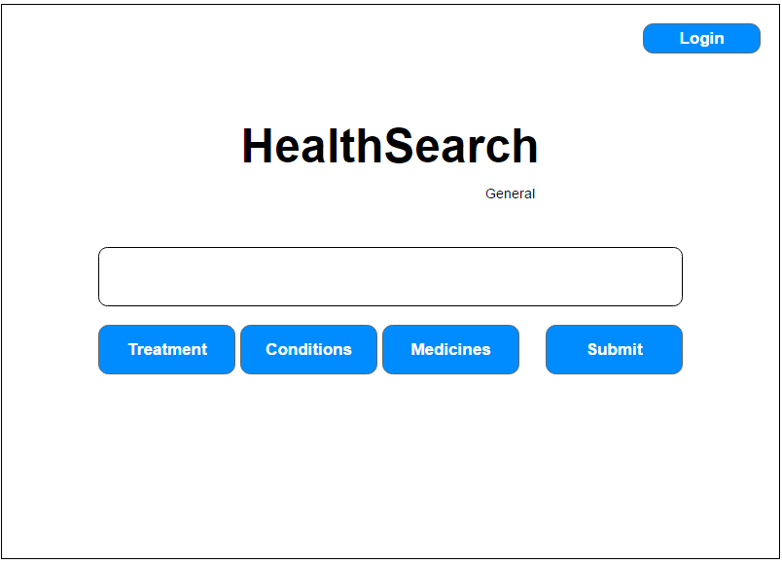
Navigate to login page
Title
Display the type of search user is in
Search box
Generate Result page
Types of search

Slide 2
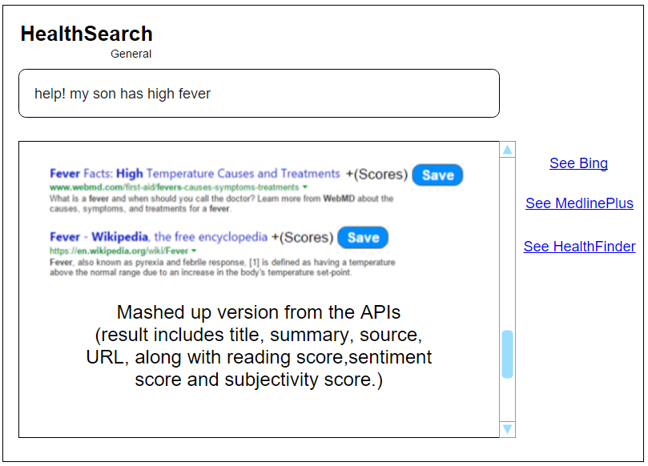
Search box
Title, summary, source, URL along with score and save button
Links to different API’s result
Save to their existing category or create a new category then save this page into the new category

Slide 3
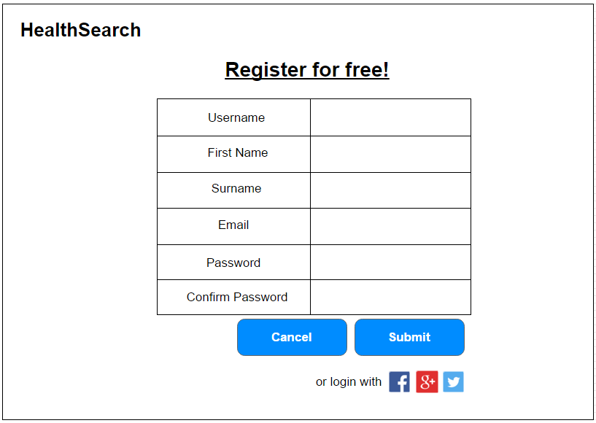
Link to the homepage. Appear in all wireframes as a mean to go back to homepage
Textboxes to enter details required for registration
To cancel registration process and go back to previous page
Submit details entered to create new account
Different options to create account

Slide 4
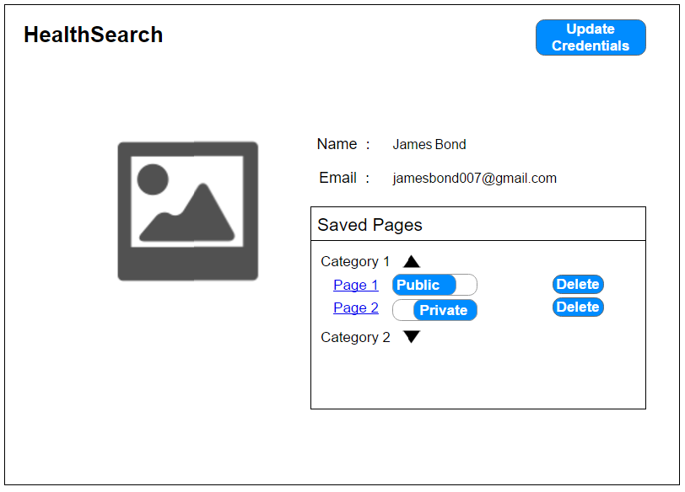
Edit user profile. Includes changing password
Example of name and email of user
Profile picture of user
Show or hide pages
Saved pages with public/private option
(private by default)
Delete particular page

Slide 5
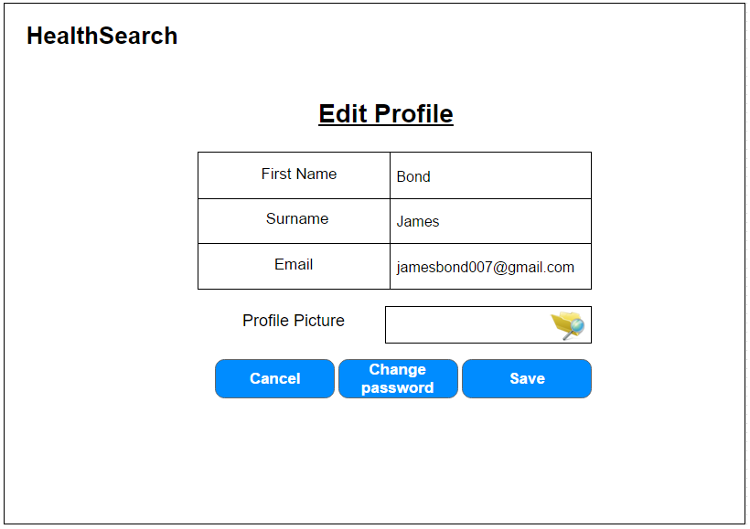
Editable fields
User can upload their preferred photo as their profile photo
(optional)
Cancel the changes and go back to user profile
Save and update the changes done
Give user the option to change password

Slide 6
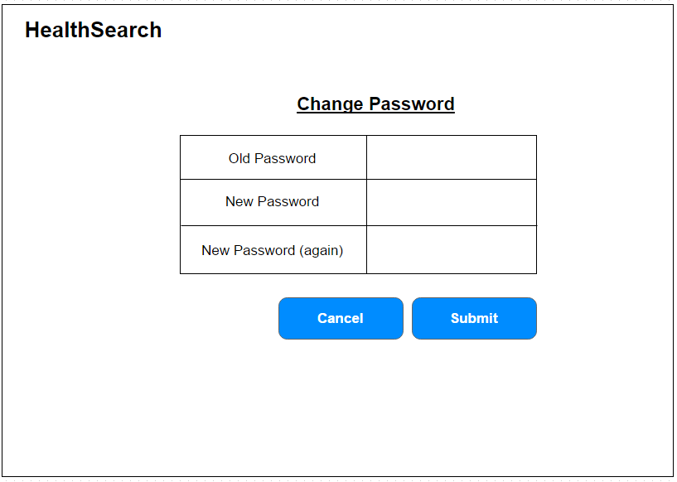
Old and new password fields
Cancel login process and go back to previous page
Submit the request to change password

Slide 7
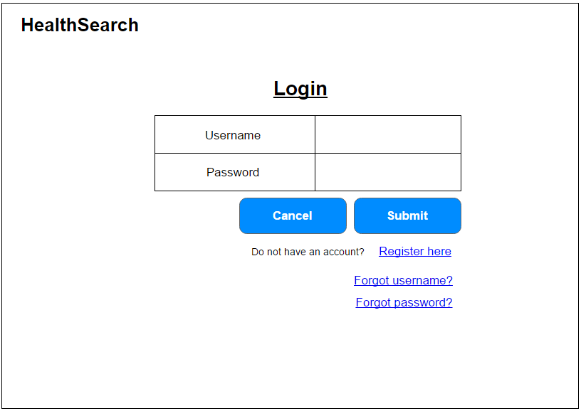
Fields needed to login
Cancel login process and go back to previous page
Submit the details
New user able to register
Recovery option in case user forgot username/pass-word

Slide 8
Additional Features

Slide 9
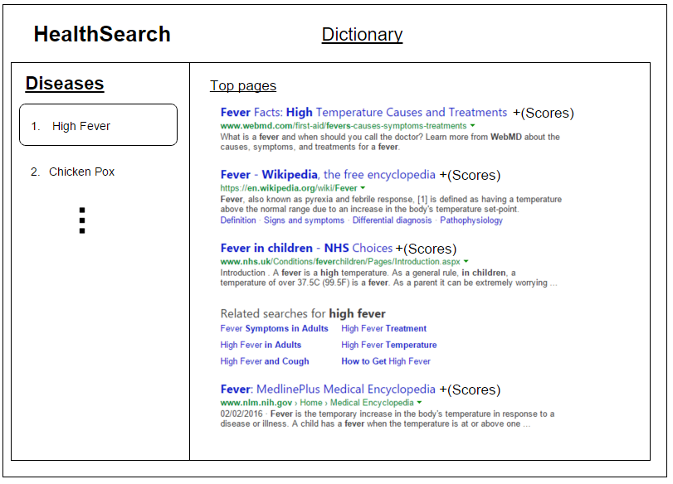


Slide 10
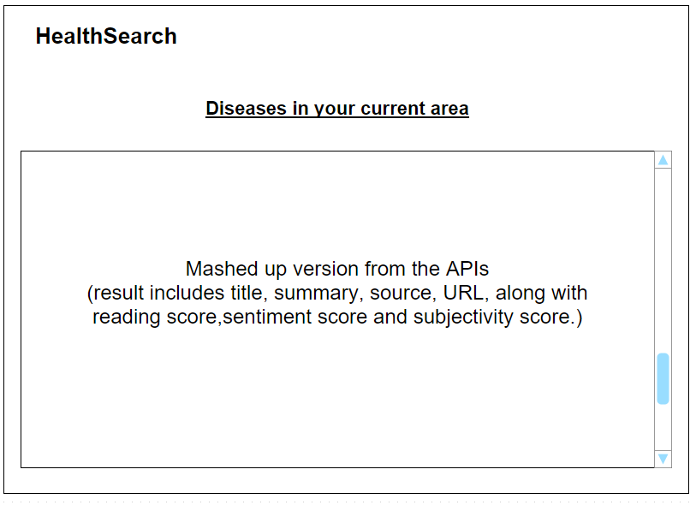

Slide 11
Walkthrough

Slide 12
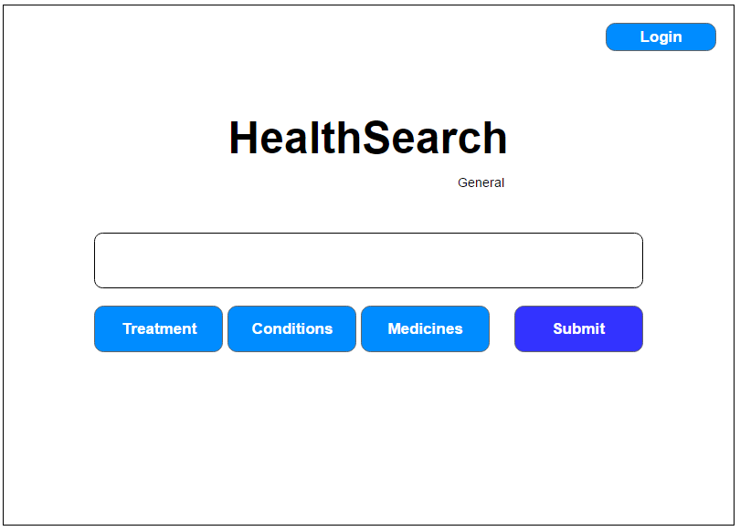
Submit button pressed

Slide 13
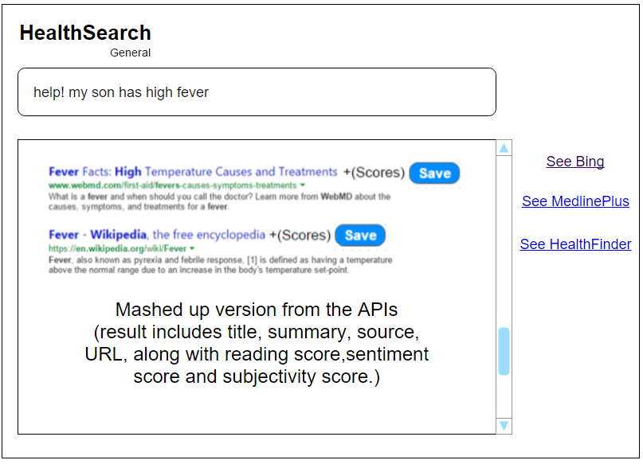

Slide 14
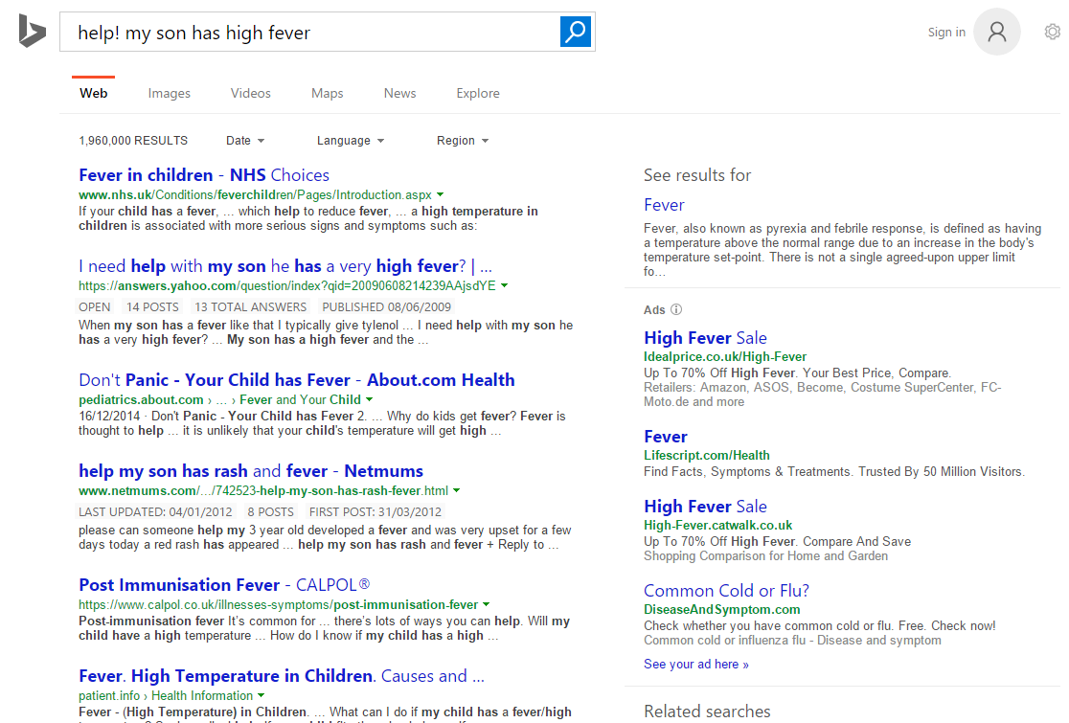

Slide 15
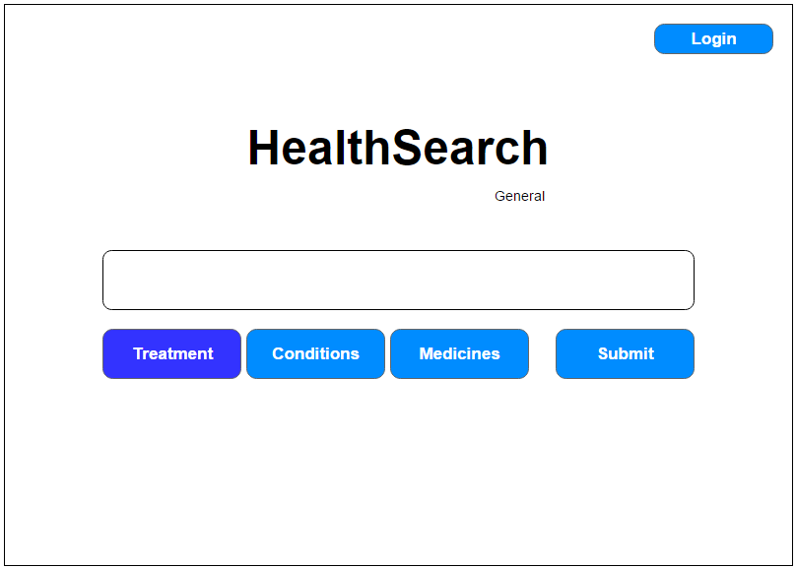
Treatment button pressed

Slide 16
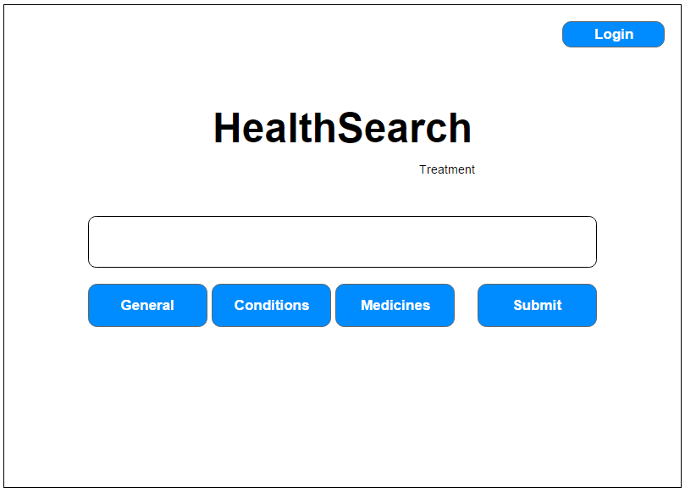
Now, we are searching for treatments

Slide 17
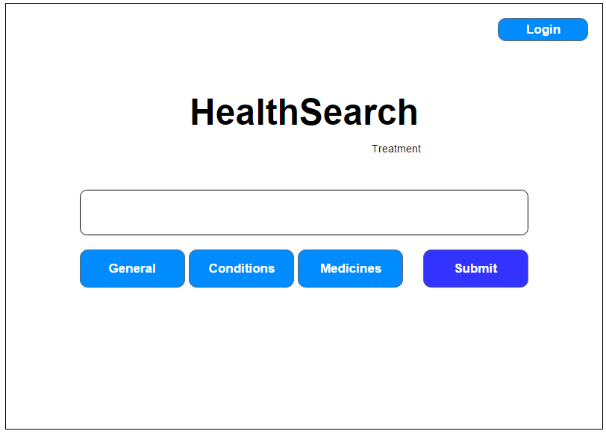
Submit button is pressed

Slide 18
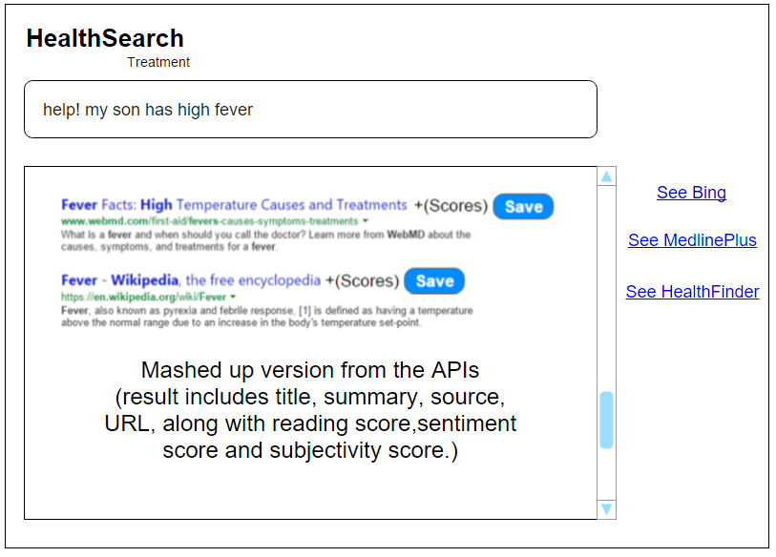
We are looking at treatments now instead of general
Save button pressed

Slide 19
When user is logged in

Slide 20
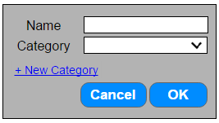
Give name to the page
Create new category
Save page into chosen category

Slide 21
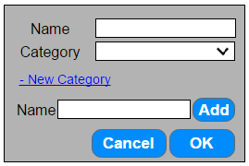

Slide 22
When try to save while not logged in, prompt user to log in

Slide 23
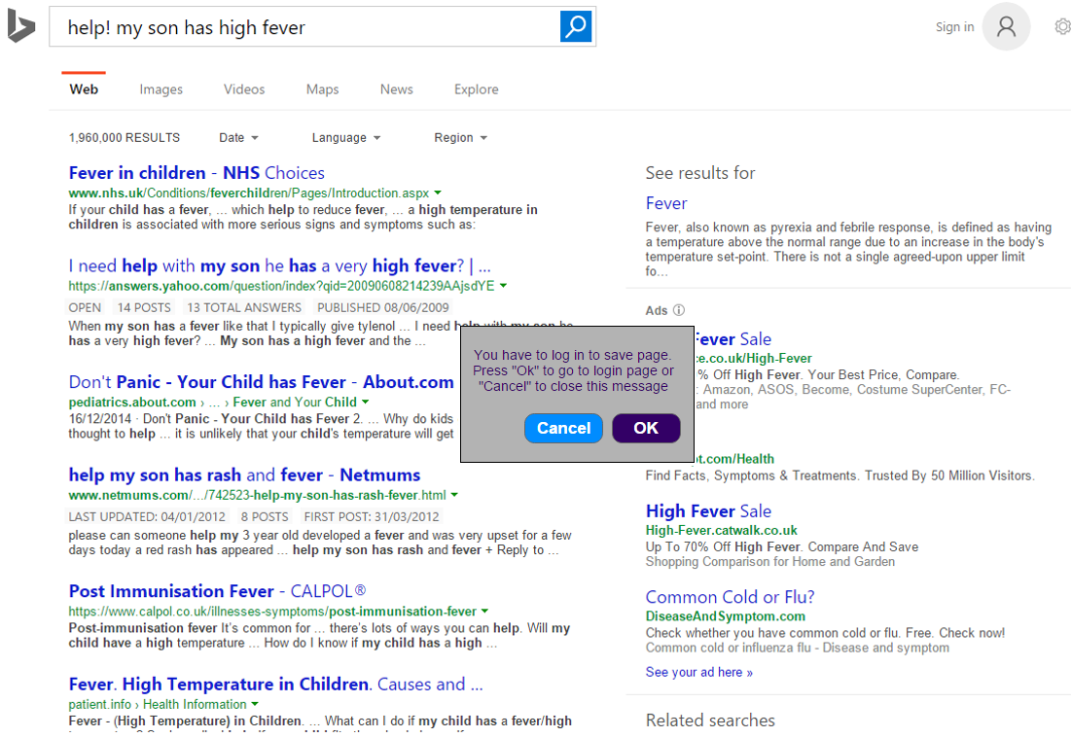
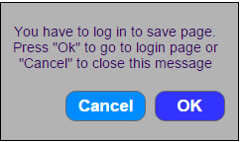
User press OK

Slide 25

Register link pressed

Slide 26
