Slide 1
Graduation Project Management with Network Optimization for Non-Traditional Students
By: Laura Moses
Faculty Advisor: Dr. Timothy Redl
Committee Members: Mr. John Henderson and
Dr. Katherine Shoemaker
Spring 2021
Notes:
Hello, my name is Laura Moses and the title of my project in fulfillment of DATA 4395 is Graduation Project Management with Network Optimization for Non-traditional Students. I would like to acknowledge my faculty advisor, Dr. Timothy Redl and committee members, Mr. John Henderson and Dr. Katherine Shoemaker.

Slide 2
Definition of Terms
Network
Consists of a set of nodes linked by arcs
Has directed or undirected flow
Path is a sequence of distinct arcs that join two nodes through other nodes
In a connected network every two distinct nodes are linked by at least one path
Project
A collection of interrelated activities with each activity consuming time and resources
CPM (Critical Path Method)
Project management technique that uses the longest path to determine the project duration and the most important tasks that constitute the project
Tasks must be completed and in a specific order
Tasks have known durations
Critical path is the longest path, consisting of activities with zero slack time
PERT (Program Evaluation Review Technique)
Project management technique similar to CPM except it uses probabilistic timelines.
Task durations are unknown and estimated using optimistic, most probable, and pessimistic times.
Notes:
To begin, I’d like to define some terms I will be using. First and foremost, a network consists of set of nodes linked by arcs (or branches). Associated with each network is a flow, generally limited by the capacity of its arcs. The flow is directed if it allows positive flow in one direction and zero flow in the opposite direction, Hence a directed network has all directed arcs. A path is a sequence of distinct arcs that join two nodes through other nodes regardless of the direction of flow in each arc. In a connected network, every two distinct nodes are linked by at least one path. In this project, I will be using connected networks with directed arcs in order to represent three university graduation planning scenarios in Data Science.
Before doing so, I will model the graduation path as a project, which is a collection of interrelated activities that consume both time and resources. Then I can use network-based project management techniques known as CPM and PERT, whose objective is to provide analytic means for scheduling activities. CPM stands for the Critical Path Method, and uses the longest path, known as the critical path, to determine the project duration and the most important tasks that constitute the project. These tasks must be completed in a specific order and have known, realistic durations. Activities which constitute the critical path are those which cannot run late, otherwise it will result in a delay of the overall project duration. While the critical activities are those without slack time, all activities must be completed in order to complete the project.
PERT stands for Program Evaluation Review Technique, and is similar to CPM except that it uses probabilistic timelines: optimistic, expected, and pessimistic, in order to calculate an average project duration. While CPM is useful for modeling most likely scenarios, PERT can model best and worst-case scenarios.
Both CPM and PERT can answer when the entire project will be completed, and what the critical and non-critical activities are. More specifically, you can determine the earliest and latest start times per activity, as well as the earliest and latest finishing times. To make these computations, I will be using a software known as Tora.

Slide 3
Understanding a Network Representation
Activity is represented by an arc pointing in the direction of progress
Activities feed into and out of numbered nodes representing events
An event is the completion of an activity or the commencement of an activity
Single start and end node
Distinct end nodes for every arc/activity
Use nodes to establish the precedence relationships among activities
Notes:
When turning a project into a network, there are additional characteristics these networks must have.
Each activity/task of the project is represented by an arc (an arrow) pointing in the direction of progress in the project. These activities feed into and out of numbered nodes representing events, where an event is the completion of an activity or activities. The nodes of the network establish the precedence relationships among the different activities, since there must be distinct end nodes for every arc. Additionally, there can only be one start node and one end node.

Slide 4
Senior Project Objectives
To model graduation path as a network of tasks
Identify the critical path using CPM
Correlate Critical Path into a Fall/Spring/Summer degree plan for students with added constraints:
Minimum of 12 hours (6 in summer) to meet financial aid requirements
Average 4 courses/Maximum 15 hours per semester course load
Determine realistic graduation timeline that correspond to these constraints
Use PERT to generate what-if scenarios
Notes:
So what is the purpose of this project?
Although UHD currently offers a four-year degree map for data science majors, it consists of 8 semesters of heavy course-loads, which are not suitable for non-traditional students such as myself who are parents or work full-time, which limits our time commitment. Moreover, I personally had a difficult undergraduate journey, as it has taken me ten years and 189 credit hours to get to this point. So this has me wondering, if I had started my undergraduate career at UHD knowing what I know now, how long would it have taken me to graduate?
By modeling a graduation path in Data Science as a network of tasks, I will be able to use CPM and PERT to identify the longest and most essential sequence of courses to start with, in order to graduate without delays. Using this information, I can then design a degree plan for non-traditional students with additional time constraints in mind. For these constraints, minimum hours for financial aid must be met, but I will be adding a limit of 15 hours per semester, and an average of 4 courses per semester.
This degree plan will then be used to answer several key questions. First and foremost, can a non-traditional student with more time constraints than a typical college student still, realistically, graduate in four years? Which classes should and must be taken immediately, and which can wait? How does math placement affect the graduation timeline, and what are the benefits to bypassing lower-level math courses?

Slide 5
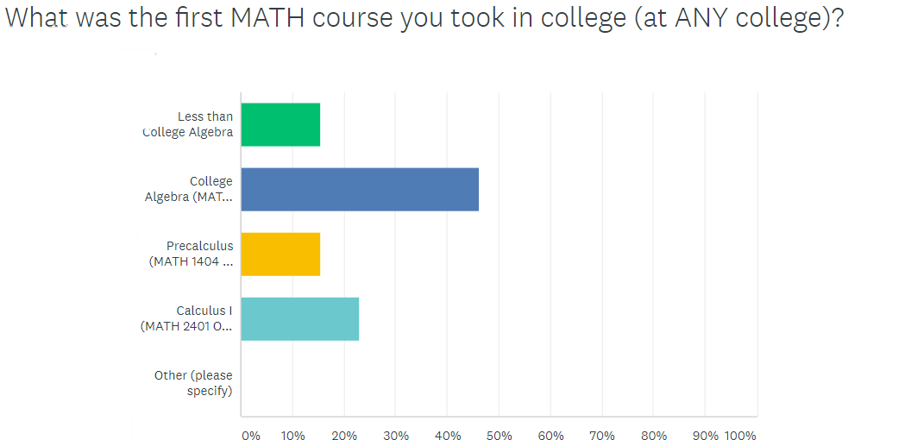
Step One: Compile a List of Activities
UHD course catalog:
Major requirements
Core Components
Survey classmates to determine:
Non-curriculum activities to include
Most common math starting points
Most common domain focus
Sentiment analysis – what info would have made process better?
Notes:
The first step in building a project is to compile a list of tasks. The two primary sources of information I used for this was the UHD catalog and a survey I created sent to all current data science majors.
I used the survey results to determine the 3 most likely beginning math courses and the most popular domain focus choice among data science majors. Additionally, I used the survey to gauge awareness of things like senior project qualifications, graduation applications, fafsa applications and math bypass exams.
The responses I gathered lead me to create 3 graduation paths, with different math starting points, since there are opportunities to bypass college algebra and precalculus to accelerate your education. Because Computer Science was the most popular domain choice, and as an added perk grants the student with a third minor in computer science, I created all 3 projects based on the CS domain and minor. The courses that satisfy the core, major and domain requirements from the catalog were listed as activities, as well as some non-curriculum activities mentioned before.

Slide 6
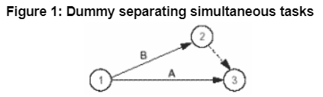
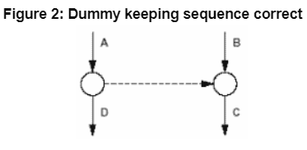
Step Two: Determine Activity Dependencies
Two types of activities:
Dependent
Concurrent
To determine activity precedence, ask:
What activities must immediately precede the current activity?
What activities must follow the current activity?
What activities can or must occur concurrently with the current activity?
Notes:
The next step was to determine activity dependecencies. To maintain the correct precedence relationships, the following questions must be answered as each activity is added to the network
First, - what activities must immediately precede the current activity?
For example, CS 1311 immediately precedes CS 2311.
We also ask - what activities must follow the current activity?
Immediately following MATH 1301 is MATH 1505
(c) what activities can or must occur concurrently with the current activity?
SPAN 1401 CAN occur concurrently with PHIL 2305, but ENG 1301 MUST precede or occur concurrently with all core classes.
Dummy arcs are sometimes necessary to preserve precedence relationships. Figures 1 and 2 show examples of how dummy arcs are used. In Figure 1, A and B are concurrent activities, therefore start from the same event and must conclude at the same event. However, Since each arc must have distinct end nodes, a dummy arc which takes no time or resources is introduced to take activity B to node 3.
In Figure 2, the dummy arc is introduced to keep the precedence relationships of activities D and C. While only activity A precedes activity D, both activity A and B precede activity C.

Slide 7
Step Three: Determine Activity Durations
CPM—known activity times:
Choose average, mostly likely completion times
For example, you would expect to complete a course in 1 semester
PERT—unknown activity times:
3 duration times – optimistic, expected, pessimistic time estimates
For example, to complete ENG 1301 you could have the following:
Optimistic = 0 semesters (you have an AP credit!)
Expected = 1 semester
Pessimistic = 2 semesters (you failed and must retake it)
Notes:
The third step is to determine the activity durations. The activity durations differ when using CPM and PERT. For CPM, I chose realistic estimated completion times in units of semesters, so the durations for most of the activities and courses was simply 1 semester. For PERT, in which activity times are unknown, 3 duration times must be specified: optimistic, expected, and pessimistic. For classes where it is possible to credit by exam or have AP credits, the optimistic duration is zero. The pessimistic durations assume you failed the course once and must repeat, making the activity duraiton 2 semesters. For courses that are offered fall only or spring only, the pessimistic duration would be 3 semesters to fail and retake the course. The expected duration is the same as the CPM most likely, realistic, duration.

Slide 8
Notes:
And Here is an example of what one of the completed activities lists look like in order to build the graduation network.

Slide 9
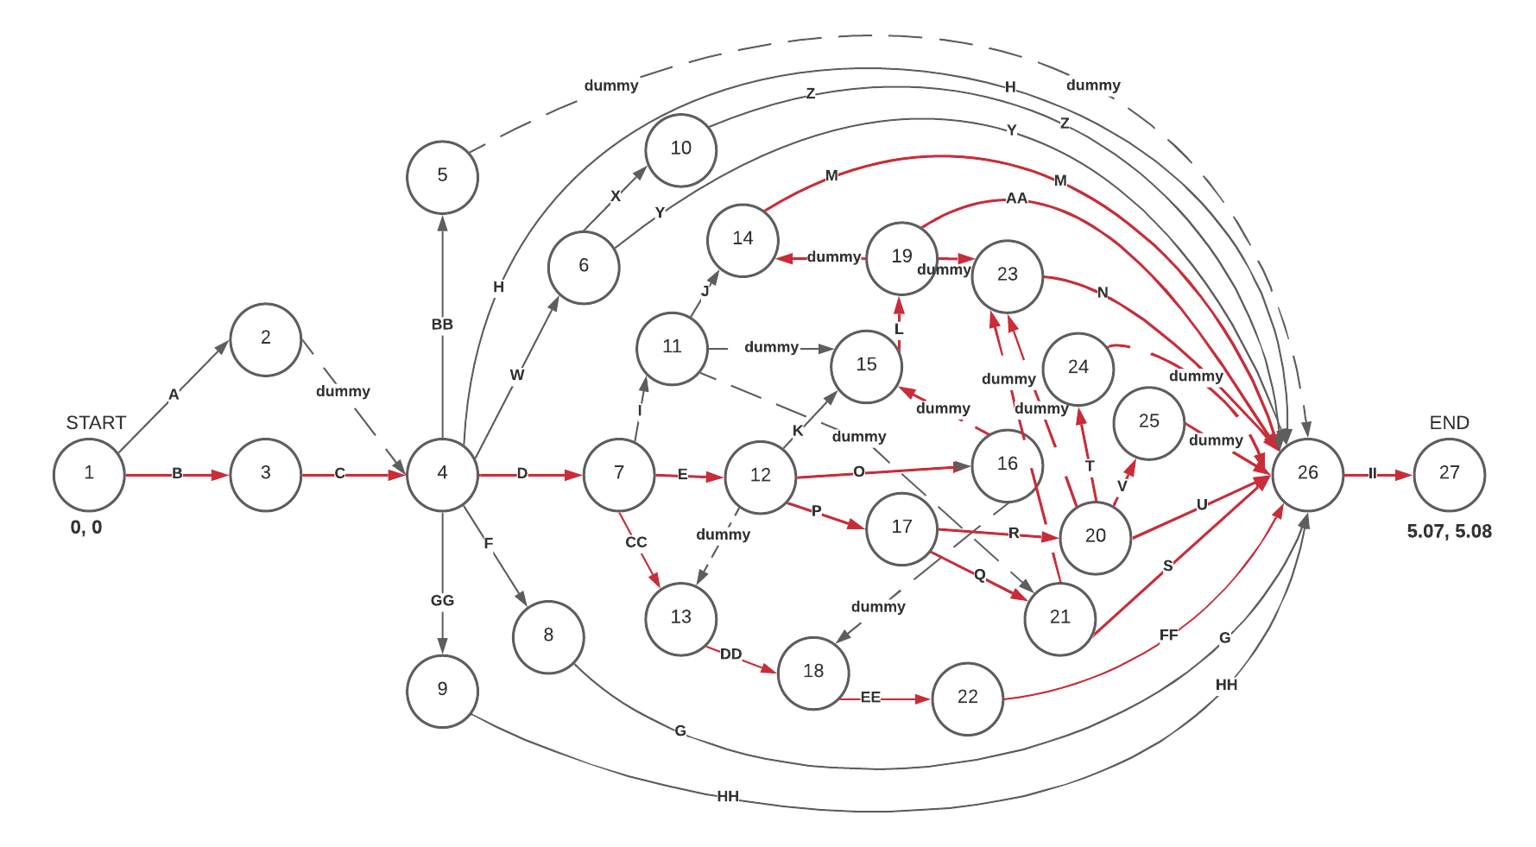
First Math Course: MATH 1301
Notes:
This is the first graduation path network representation, with the first math course being college algebra. The highlighted numbers at the beginning and end are the computed values for the earliest and latest start and finish times. You can see that latest finish time is just over 5 semesters worth of courses and tasks. However, I am NOT implying that a student can finish their degree in 5 semesters. What this overall project duration computation indicates is the minimum number of semesters necessary to complete the sequence of critical courses for the degree plan, since there are additional conditions placed on those.
In red, is the longest path aka the critical path. Again, the critical path is not just the activities that have to be done (they all have to be done!) it’s the activities that can’t run late! You’ll notice that there are multiple critical paths. In large complex projects such as this, there can be more than one critical path. Multiple critical paths means these grouped sequences of activities take the same amount of time to complete.
Also highlighted are activities/arcs D and E. These are where the most change will occur between networks and plans because these are our initial math courses. Here, D is college algebra while E is precalculus, each with a one semester duration.

Slide 10
Degree Plan for Non-traditional Students Starting with MATH 1301
Degree Plan for Non-traditional Students Starting with MATH 1301
Year | Fall | Spring | Summer
1 | MATH 1301* ENG 1301 UHD 1302 (TX CORE) TX CORE PHIL 2305 | MATH 1505* ENG 1302 TX CORE CS 1311 | TX CORE TX CORE
Semester Total: | 15 hrs | 14 hrs | 6 hrs
2 | DATA 2401* MATH 2305* MATH 2421* CS 2311 | DATA 3401* MATH 2422* MATH 3302* CS 1410* | TX CORE TX CORE
Semester Total: | 14 hrs | 15 hrs | 6 hrs
3 | DATA 3402* STAT 3333* STAT 4303 or 4311* MATH 3423* | STAT 4310* CS 2410* DATA 4300* DATA 4319*
Semester Total: | 14 hrs | 13 hrs
4 | DATA 4395 CS 3304* SPAN 1401 TX CORE | TX CORE CS 3321* SPAN 1402 TX CORE
Semester Total: | 13 hrs | 13 hrs
 |  | TOTAL: | 123 hrs
* indicates critical task, delay can result in delayed graduation
Notes:
And here is the resulting degree plan for students starting at MATH 1301. Again, I’ve highlighted the initial math courses. Note that the cs domain courses could alternatively be taken in the first year, as well, substituting any of the texas core classes for cs 1410, 2410 and 3304 in the summer if desired, as it is a course that is offered in the summer. The issue with this is that you would have to rely on the course being offered in the summer (no future guarantee of that) and you would not be able to take CS 3321 immediately after so your C++ might be a bit rusty.

Slide 11
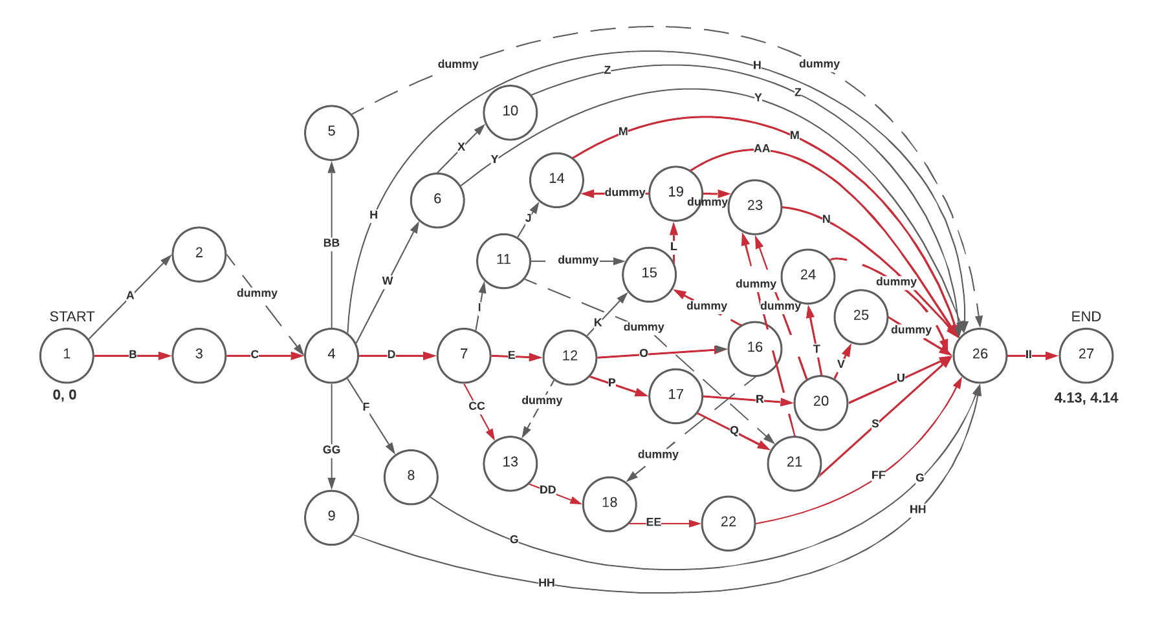
First Math Course: MATH 1505
Notes:
This is the second graduation path which starts math from precalculus. Now D no longer represents college algebra, but instead represents taking the Math 1301 bypass exam so it has a duration of 1 week versus 1 semester. The Network is visually the same. The difference is seen in the computations of the latest start and finishing times. Now our critical path(s) are just over 4 semesters long rather than 5.

Slide 12
Degree Plan for Non-traditional Students Starting with MATH 1505
Degree Plan for Non-traditional Students Starting with MATH 1505
Year | Fall | Spring | Summer
1 | MATH 1505* ENG 1301 UHD 1302 (TX CORE) CS 1311 | DATA 2401* MATH 2305* MATH 2421* CS 2311 | TX CORE TX CORE
Semester Total: | 14 hrs | 14 hrs | 6 hrs
2 | DATA 3401* MATH 2422* MATH 3302* ENG 1302 | DATA 3402* STAT 3333* MATH 3423* TX CORE | TX CORE TX CORE
Semester Total: | 14 hrs | 14 hrs | 6 hrs
3 | DATA 4300* DATA 4319* STAT 4303 or 4311* CS 1410* | STAT 4310* TX CORE PHIL 2305 CS 2410*
Semester Total: | 13 hrs | 13 hrs
4 | DATA 4395 CS 3304* SPAN 1401 TX CORE | TX CORE CS 3321* SPAN 1402 TX CORE
Semester Total: | 13 hrs | 13 hrs
 |  | TOTAL: | 120 hrs
* indicates critical task, delay can result in delayed graduation
Notes:
I have highlighted the differences between this degree plan and the previous one, which started at MATH 1301.
The first semester of the second year shifts back into the spring semester of the first year. Effectively putting you ahead an entire semester for the critical data/math/stat courses. This also means that apart from the CS domain courses and senior project, by the summer after your junior year you’ll have completed all the pertinent courses hopefully making you an ideal prospect for internships. The last year in both (1301 and 1505) are the same. CS 1410 is also taken later, but it’s now in consecutive semesters with the rest of the C++ courses.

Slide 13
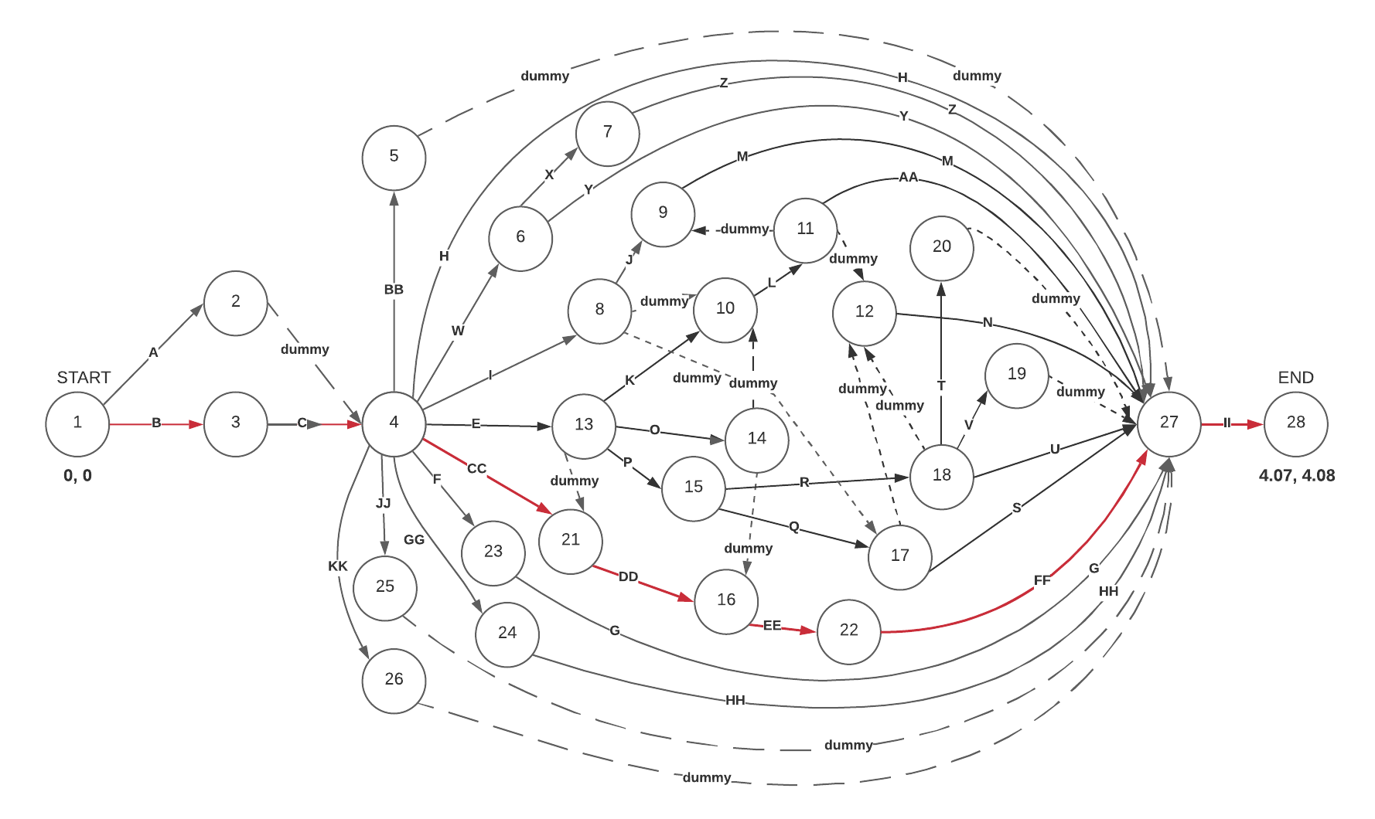





First Math Course: MATH 2421
Notes:
We can see the most visible changes in the third network. Activity D is now gone, and no longer a predecessor for E. E is no longer MATH 1505, but is now the bypass exam for MATH 1505 so it is no longer a semester duration. Thus, your first actual Math courses are now Math 2305 Discrete Math and 2421 Differential and Integral Calculus with Applications. You’ll also notice that there have been two new activities added highlighted below. These are electives to compensate for the elimination of Math 1505 to satisfy the 120 credit hour requirement.

Slide 14
Degree Plan for Non-traditional Students Starting with MATH 2421
Degree Plan for Non-traditional Students Starting with MATH 2421
Year | Fall | Spring | Summer
1 | MATH 2305 MATH 2421 ENG 1301 UHD 1302 (TX CORE) | DATA 2401 MATH 2422 MATH 3302 CS 1311 | TX CORE TX CORE
Semester Total: | 13 hrs | 14 hrs | 6 hrs
2 | DATA 3401 STAT 3333 MATH 3423 CS 2311 | DATA 3402 DATA 4319 STAT 4310 ENG 1302 | TX CORE TX CORE TX CORE
Semester Total: | 14 hrs | 13 hrs | 9 hrs
3 | DATA 4300 SPAN 1401 STAT 4303 or 4311 CS 1410* | FREE ELECTIVE SPAN 1402 TX CORE CS 2410*
Semester Total: | 14 hrs | 14 hrs
4 | DATA 4395 CS 3304* PHIL 2305 TX CORE | FREE ELECTIVE CS 3321* TX CORE TX CORE
Semester Total: | 12 hrs | 12 hrs
 |  | TOTAL: | 121 hrs
* indicates critical task, delay can result in delayed graduation
Notes:
When starting with Math 2421, there is a greater difference in how the degree plan lays out. One notable difference, you are actually starting and completing python courses (1311 and 2311) a semester later than the MATH 1505 degree plan. This is due to the necessity in taking Eng 1301 and the availability of UHD 1302 (freshman math seminar). It doesn’t delay graduation but does change the sets of classes being taken together. Also note, ENG 1302 is not taken in consecutive semesters with ENG 1301, and is delayed until the spring semester of the second year, unless the student chooses to take a shortened summer version and swap with another core class. More importantly, DATA 4319 Machine Learning can be completed as soon as sophomore year! Again, all pertinent major courses are finished by the summer of junior year, leaving it open for internship possibilities. An extra summer course will need to be taken, or 5th class in a long semester. Domain courses remain the same, with less flexibility to be able to take sooner without impacting the math/data/stat courses

Slide 15
Using PERT Probabilistic Durations
Considers AP credits which shorten durations
Considers repeat courses which lengthen durations
Project 1 (MATH 1301):
Mean duration of 5.5 semesters (CPM = 5.08)
= .42 increase
Longest path goes through MATH 1301, MATH 1505, MATH 2421, MATH 3302 and STAT 4303
Project 3 (MATH 2421):
Mean duration of 4.58 semesters (CPM = 4.08)
= .50 increase
Longest path goes through CS minor reqs: CS 1410, CS 2410, CS 3304, CS 3321
Notes:
How would AP credits affect these affect the degree plan? or repeat courses if a student fails… how much time will this add? In order to answer these questions you have to switch from deterministic durations to probabilistic durations. Using Tora software to compute PERT calculations determined Mean duration of 5.5 semesters for the longest path using the same nodes and arcs from the first network. This means the longest path increased from 5.08 sem to 5.5 semesters, meaning that AP credits alone could not compensate fully for delays incurred by repeating courses. So, the student might need to take another summer semester or extra classes in an already planned summer. What’s important is that this does NOT amount to another year in delayed graduation if the student has earned some AP credits or credit by examination. Using the third network arcs and nodes, there is a slightly greater chance of being set back by repeat courses, but again this should not result in a years delay.

Slide 16
Summary of Findings
In all three scenarios, it is possible to graduate in four years provided you complete two summer semesters.
The most balanced degree plan starts with taking MATH 1505, so it is worth taking the MATH 1301 Bypass Exam, but not as beneficial to bypass MATH 1505 (unless you want to take more electives)
MATH 1505 degree plan requires the least amount of courses (one less than both MATH 1301 and MATH 2421 starting points)
It’s possible to complete pertinent major courses by summer of junior year; optimal for a prospective internship
Notes:
The biggest question I had for myself was If four years was a realistic graduation timeline, having taken almost 10 years myself to get to this point. Taking a couple of summer semesters into consideration, for all three scenarios, it is. When comparing degree plans, I found that the most balanced plan was the second, which starts by taking the MATH 1301 bypass exam and Math 1505. In doing so, you have to take one less course overall than in the other two plans. So while I think it is beneficial to bypass math 1301, it might not necessarily be worth it to bypass math 1505. Nearly almost all of the data, math and stat courses are critical, along with the computer science minor courses, so those should be prioritized.
For future research, I believe there is much more than can be done with PERT to model specific best and worst case scenarios. For instance, I could model the over-achieving student who is NOT likely to fail a course but has many incoming AP credits. What would the graduation timeline look like for them since they could start at MATH 2422? I could also, look more deeply into historical passing rates for specific courses, because it might NOT be realistic to pass in one semester. Are there particular courses in the data science track that are more difficult than others? Then adjust the degree plan accordingly. Additionally it is my hope that this project can be used as a resource for students so they don’t have to struggle like I did, so working with the science and technology advising department could make that happen.
This concludes my presentation. Thank you for your time viewing it, and should you have any questions feel free to email me.

