Slide 1
Study for the computational resolution of conservation equations of mass, momentum and energy. Possible application to different aeronautical and industrial engineering problems: Case 1B
Author: Laura Pla Olea
Director: Carlos David Perez Segarra
Co-Director: Asensio Oliva Llena
Degree: Grau en Enginyeria en Tecnologies Aeroespacials
Delivery date: 10-06-2017 (Spring 2016-2017)
Notes:
Good morning. I am Laura Pla Olea and I am going to present my study on the computational resolution of the conservation equations.

Slide 2
List of contents
Objectives & Methodology
Conservation equations
Numerical methods
Basic cases
Smith-Hutton problem
Driven cavity problem
Differentially heated cavity
Application ― Square cylinder
Conclusions

Slide 3
Objectives
Objectives & Methodology
Provide knowledge in computational methods
Study of a specific case
Methodology
Basic cases
Mathematical formulation
Numerical method
Code development
Specific application
Notes:
What were the objectives of this work? Well, the main objective was to increase my knowledge in the field of the computational methods in order to solve the conservation equations. However, in order to summarize all the knowledge obtained, a second objective was to use these methods to solve a specific case.
To do so, the methodology was to begin solving some simple cases that required the use of numerical schemes. These cases would provide an introduction to different computational methods. For each case, the resolution began with the identification of the mathematical formulation needed to solve the problem. Then, a convenient discretization method was applied and, finally, a code was developed. At the end of the study, all this knowledge was applied to the specific case, following the same methodology

Slide 4
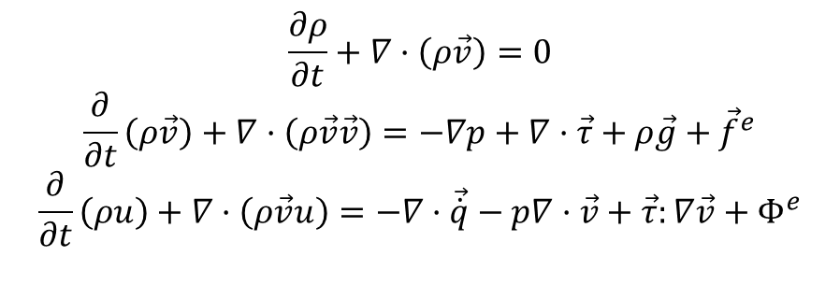
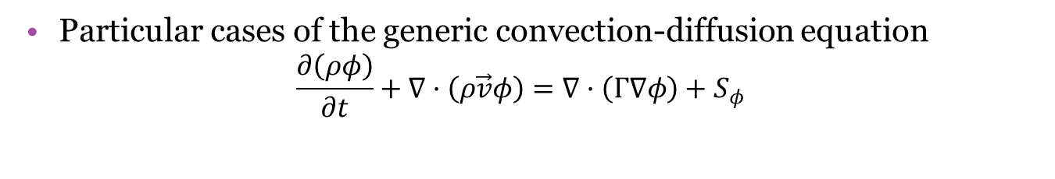
Conservation equations
Conservation equations
$$\frac{∂ρ}{∂t}+∇·\left(ρ\vec{v}\right)=0$$
$$\frac{∂}{∂t}\left(ρ\vec{v}\right)+∇·\left(ρ\vec{v}\vec{v}\right)=−∇p+∇·\vec{τ}+ρ\vec{g}+{\vec{f}}^{e}$$
$$\frac{∂}{∂t}\left(ρu\right)+∇·\left(ρ\vec{v}u\right)=−∇·\vec{\dot{q}}−p∇·\vec{v}+\vec{τ}:∇\vec{v}+Φ^{e}$$
Describe heat transfer and fluid flow
No analytical solution
Particular cases of the generic convection-diffusion equation
$$\frac{∂\left(ρφ\right)}{∂t}+∇·\left(ρ\vec{v}φ\right)=∇·\left(Γ∇φ\right)+S_{φ}$$
Notes:
Explicar això de forma que quedi ORDENAT.

Slide 5





Numerical methods
Numerical methods
N
Divide the domain ― Discretization
Finite difference method
Finite volume method
Etc.
Space integration
Time integration
W
P
E
S
$$t^{n+1}$$
$$t^{n}$$
$$Δt$$
$$t=0$$
$$\left(x,y\right)$$
Notes:
Explicació ULTRA SIMPLE dels mètodes numèrics.

Slide 6
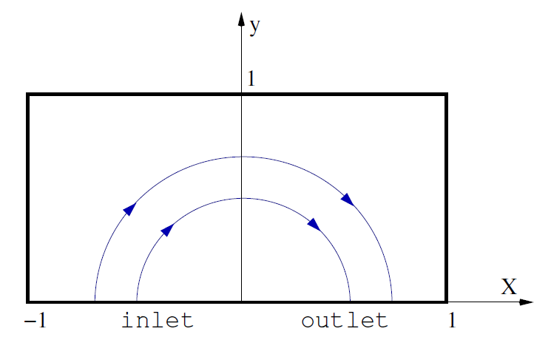

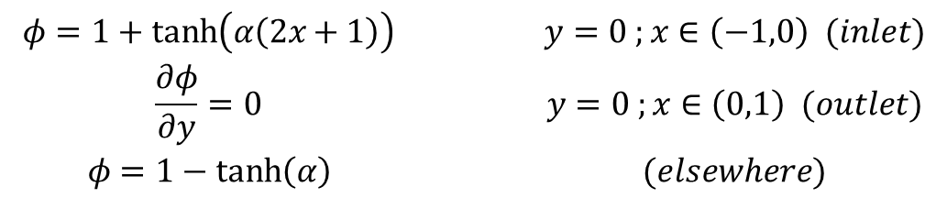
Smith-Hutton problem
Basic cases – Smith-Hutton problem
$$u\left(x,y\right)=2y\left(1−x^{2}\right)$$
$$v\left(x,y\right)=−2x\left(1−y^{2}\right)$$
$$\begin{matrix}φ=1+\tanh\left(α\left(2x+1\right)\right) & y=0 ;x∈\left(−1,0\right) (inlet) \\ \frac{∂φ}{∂y}=0 & y=0 ;x∈\left(0,1\right) (outlet) \\ φ=1−\tanh\left(α\right) & (elsewhere)\end{matrix}$$
Notes:
Si em falta temps hauré de prescindir del Smith-Hutton. :/

Slide 7

Smith-Hutton problem
Basic cases – Smith-Hutton problem
Generic convection-diffusion equation
$$\frac{∂\left(ρφ\right)}{∂t}+∇·\left(ρ\vec{v}φ\right)=∇·\left(Γ∇φ\right)$$
Steady
Incompressible

Slide 8
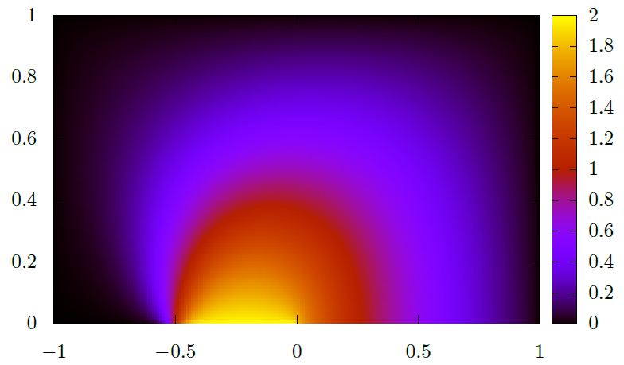
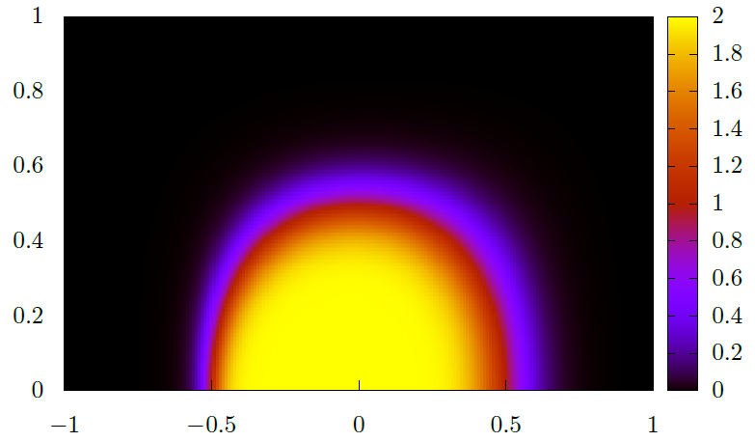


Smith-Hutton problem ― Results
Basic cases – Smith-Hutton problem
$$ρ/Γ={10}^{3}$$
$$ρ/Γ=10$$
Notes:
Igual aniria millor posar la distribució de phi en tot el domini.

Slide 9
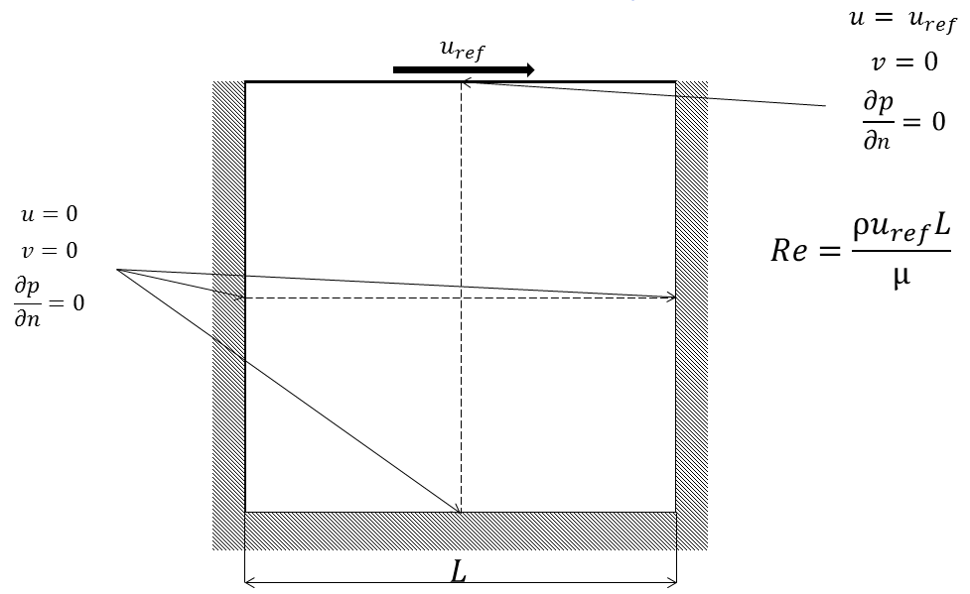
Driven cavity problem
Basic cases – Driven cavity problem

Slide 10


Driven cavity problem
Basic cases – Driven cavity problem
Conservation of mass and momentum
$$\left\{\begin{aligned}∇·\vec{v}=0 \\ ρ\frac{∂\vec{v}}{∂t}+ρ\left(\vec{v}·∇\right)\vec{v}=−∇p+μ∇^{2}\vec{v}\end{aligned}\right.$$
Transient
Incompressible
Velocity Pressure

Slide 11
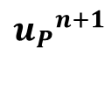
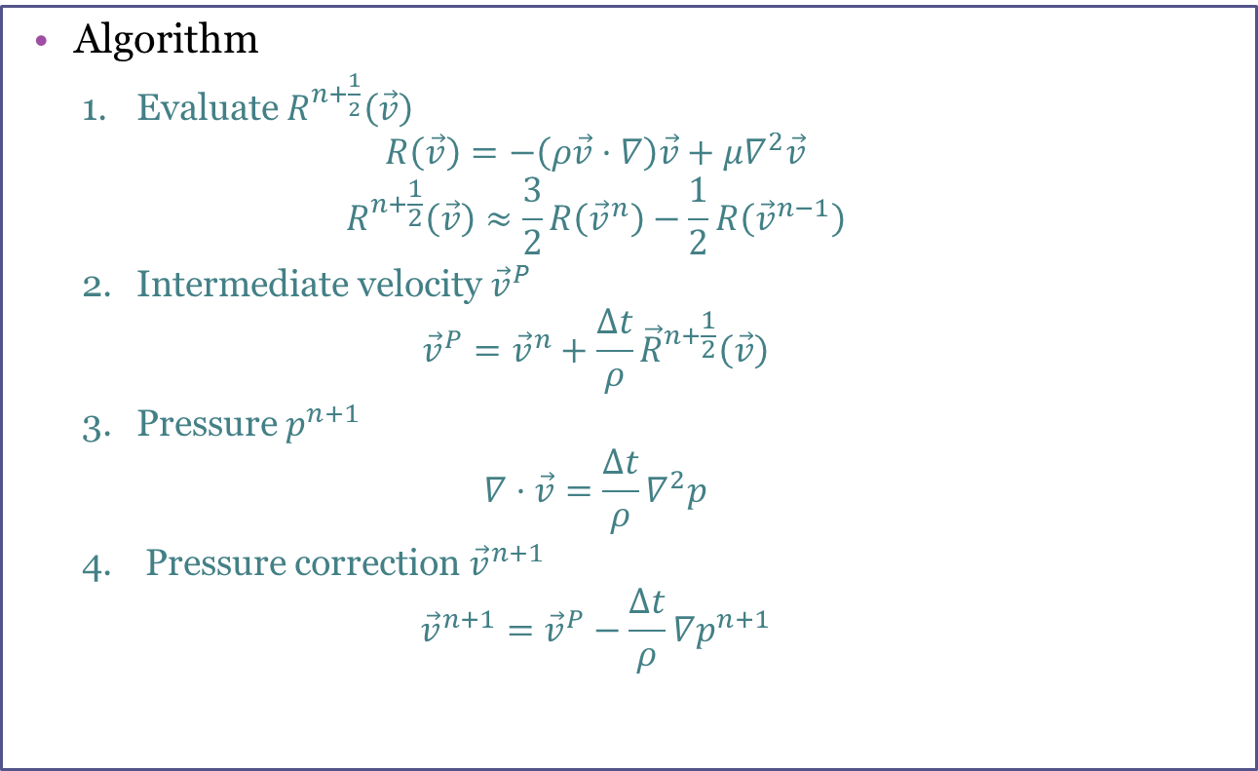

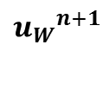

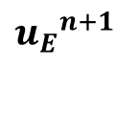


Fractional Step Method
Basic cases – Driven cavity problem
Explicit method
Based on the Helmholtz-Hodge decomposition theorem
Algorithm
Evaluate $R^{n+\frac{1}{2}}\left(\vec{v}\right)$
$$R\left(\vec{v}\right)=−\left(ρ\vec{v}·∇\right)\vec{v}+μ∇^{2}\vec{v}$$
$$R^{n+\frac{1}{2}}\left(\vec{v}\right)≈\frac{3}{2}R\left({\vec{v}}^{n}\right)−\frac{1}{2}R\left({\vec{v}}^{n−1}\right)$$
Intermediate velocity ${\vec{v}}^{P}$
$${\vec{v}}^{P}={\vec{v}}^{n}+\frac{Δt}{ρ}{\vec{R}}^{n+\frac{1}{2}}\left(\vec{v}\right)$$
Pressure $p^{n+1}$
$$∇·\vec{v}=\frac{Δt}{ρ}∇^{2}p$$
Pressure correction ${\vec{v}}^{n+1}$
$${\vec{v}}^{n+1}={\vec{v}}^{P}−\frac{Δt}{ρ}∇p^{n+1}$$
$${p_{W}}^{n+1}$$
$${p_{P}}^{n+1}$$
$${p_{E}}^{n+1}$$
$${p_{P}}^{n+1}$$
$${u_{W}}^{n+1}$$
$${u_{P}}^{n+1}$$
$${u_{E}}^{n+1}$$
Notes:
Trobar una forma d’explicar això sense que quedi molt que no ve al cas.

Slide 12
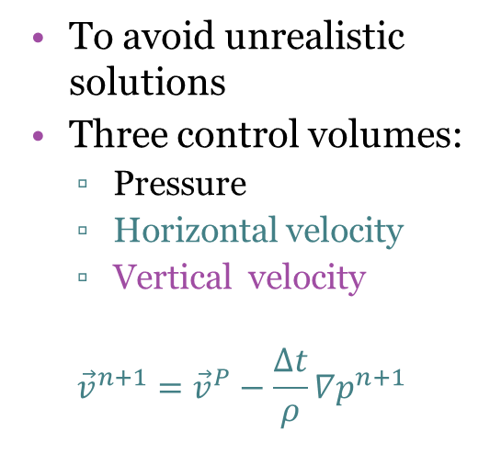
Staggered meshes
Basic cases – Driven cavity problem
To avoid unrealistic solutions
Three control volumes:
Pressure
Horizontal velocity
Vertical velocity
$${\vec{v}}^{n+1}={\vec{v}}^{P}−\frac{Δt}{ρ}∇p^{n+1}$$
$${p_{P}}^{n+1}$$
$${p_{W}}^{n+1}$$
$${p_{P}}^{n+1}$$
$${p_{E}}^{n+1}$$
$${u_{W}}^{n+1}$$
$${u_{P}}^{n+1}$$
$${u_{E}}^{n+1}$$

Slide 13
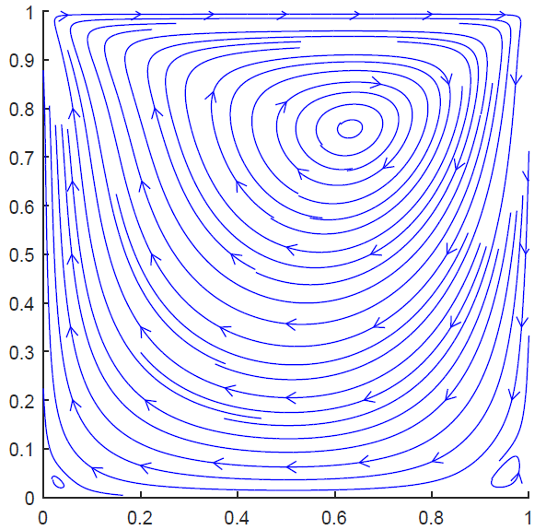
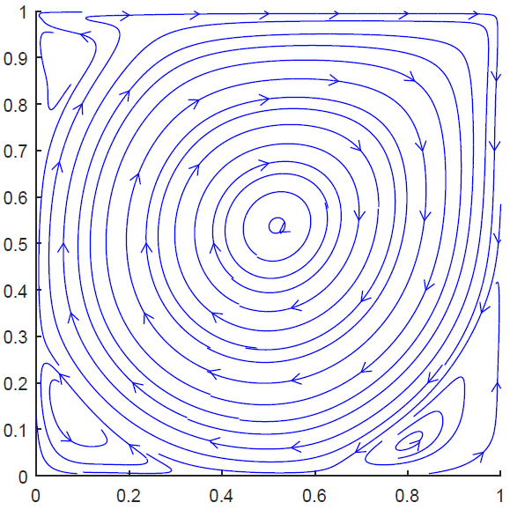
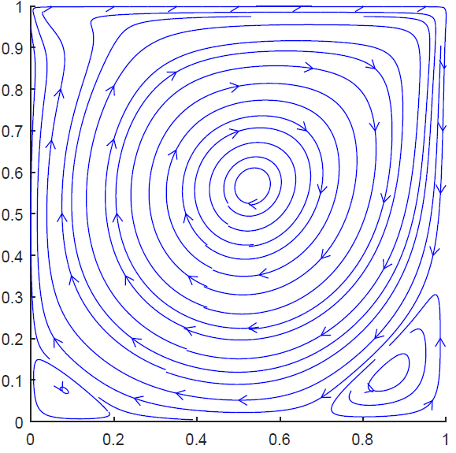
Driven cavity problem ― Results
Basic cases – Driven cavity problem
Re = 1000
Re = 100
Re = 5000

Slide 14
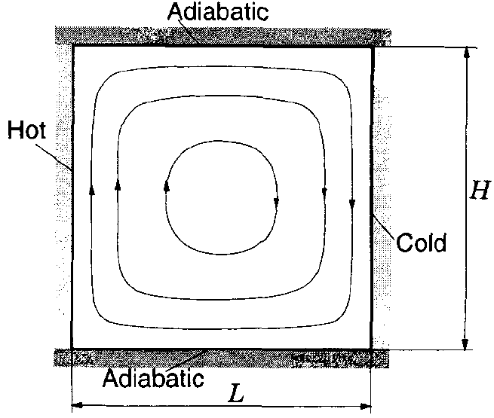
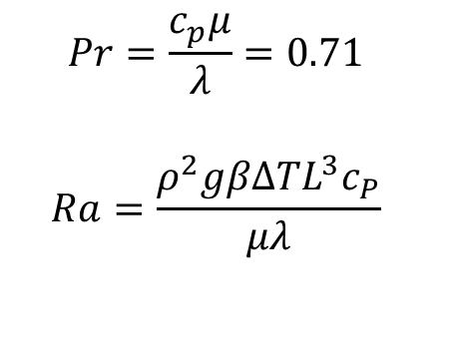
Differentially heated cavity
Basic cases – Differentially heated cavity
$$Pr=\frac{c_{p}μ}{λ}=0.71$$
$$Ra=\frac{ρ^{2}gβΔTL^{3}c_{P}}{μλ}$$

Slide 15
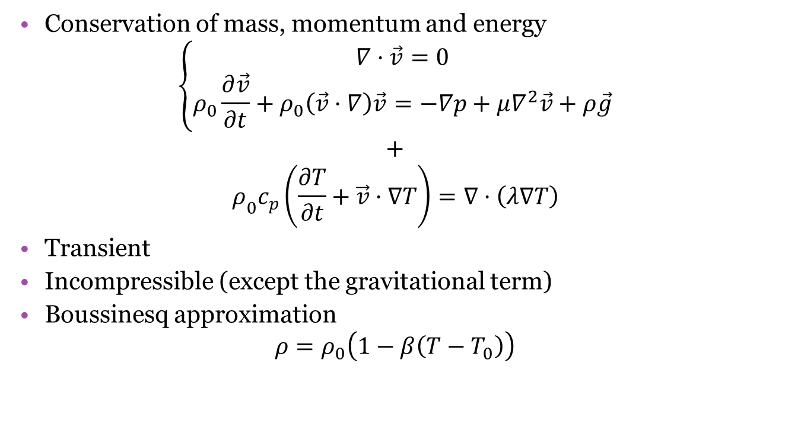
Differentially heated cavity
Basic cases – Differentially heated cavity
Conservation of mass, momentum and energy
$$\left\{\begin{aligned}∇·\vec{v}=0 \\ ρ_{0}\frac{∂\vec{v}}{∂t}+ρ_{0}\left(\vec{v}·∇\right)\vec{v}=−∇p+μ∇^{2}\vec{v}+ρ\vec{g}\end{aligned}\right.$$
$$+$$
$$ρ_{0}c_{p}\left(\frac{∂T}{∂t}+\vec{v}·∇T\right)=∇·\left(λ∇T\right)$$
Transient
Incompressible (except the gravitational term)
Boussinesq approximation
$$ρ=ρ_{0}\left(1−β\left(T−T_{0}\right)\right)$$
Notes:
He de trobar una forma d’explicar bé això de la densitat.

Slide 16
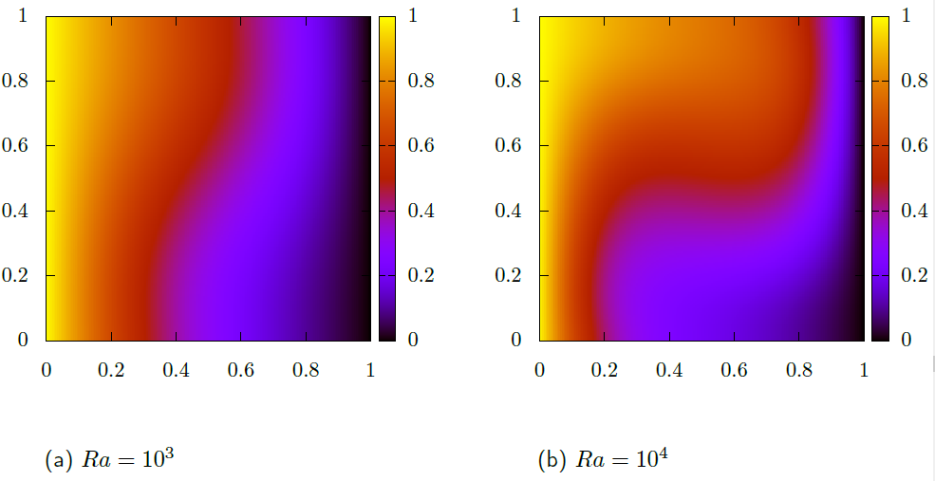
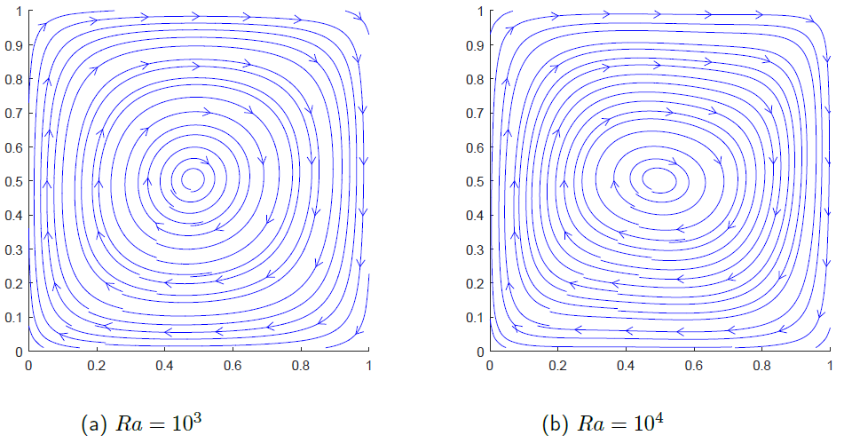
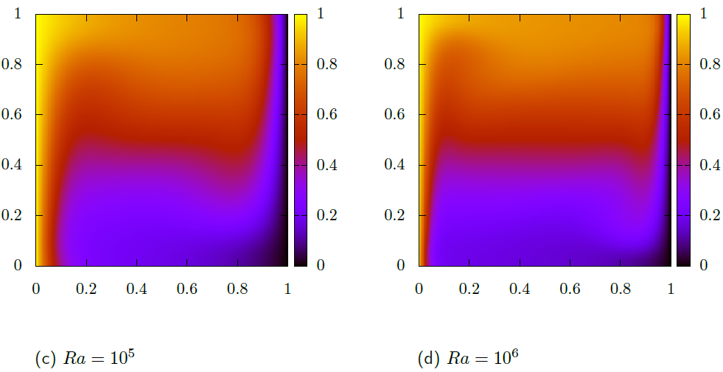
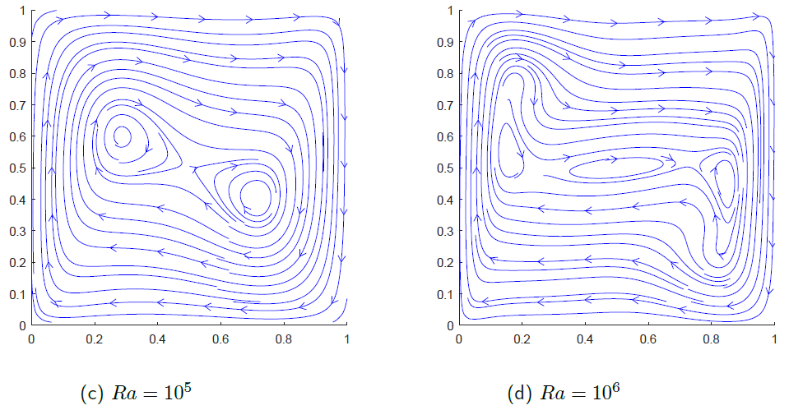
Differentially heated cavity ― Results
Basic cases – Differentially heated cavity

Slide 17
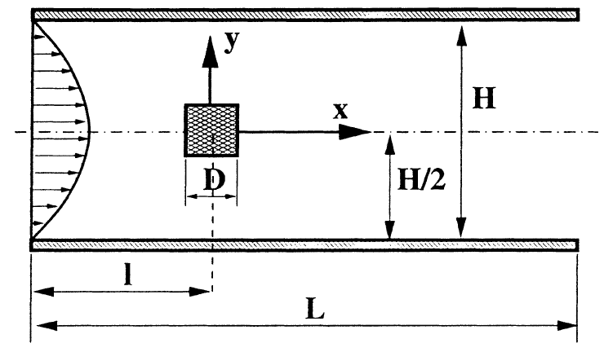
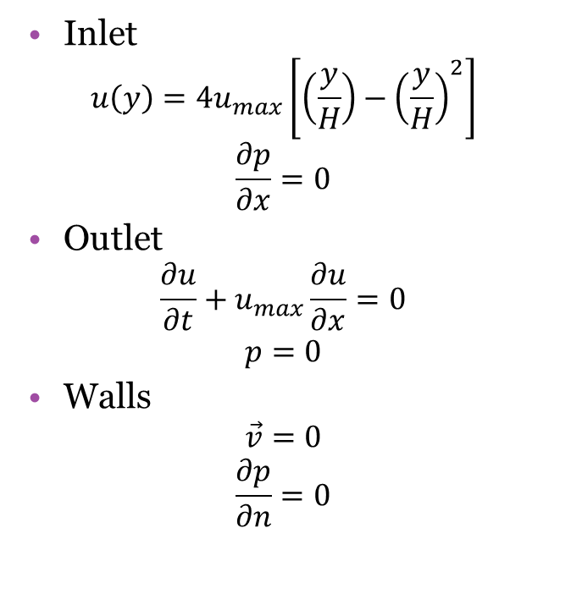
Square cylinder
Application – Square cylinder
Inlet
$$u\left(y\right)=4u_{max}\left[\left(\frac{y}{H}\right)−{\left(\frac{y}{H}\right)}^{2}\right]$$
$$\frac{∂p}{∂x}=0$$
Outlet
$$\frac{∂u}{∂t}+u_{max}\frac{∂u}{∂x}=0$$
$$p=0$$
Walls
$$\vec{v}=0$$
$$\frac{∂p}{∂n}=0$$

Slide 18
Square cylinder
Application – Square cylinder
Conservation of mass and momentum
$$\left\{\begin{aligned}∇·\vec{v}=0 \\ ρ\frac{∂\vec{v}}{∂t}+ρ\left(\vec{v}·∇\right)\vec{v}=−∇p+μ∇^{2}\vec{v}\end{aligned}\right.$$
Transient
Incompressible
Notes:
Eh… Això sobra una mica. Si no afegeixo res més, aquesta diapositiva només està aquí per passar-la ràpid i ja està.

Slide 19
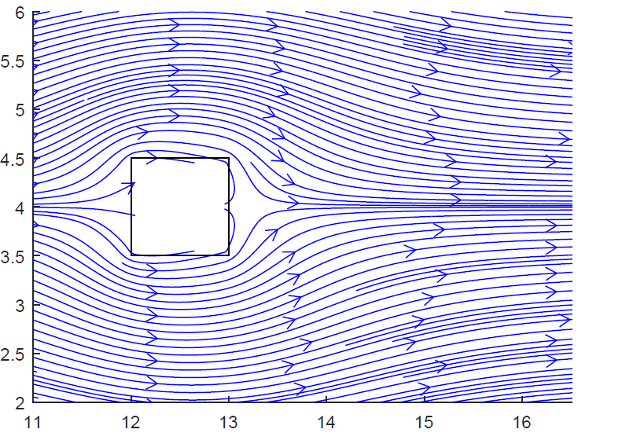
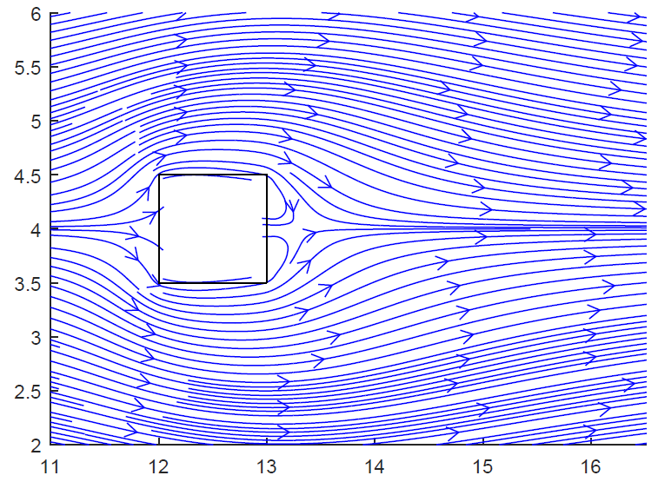
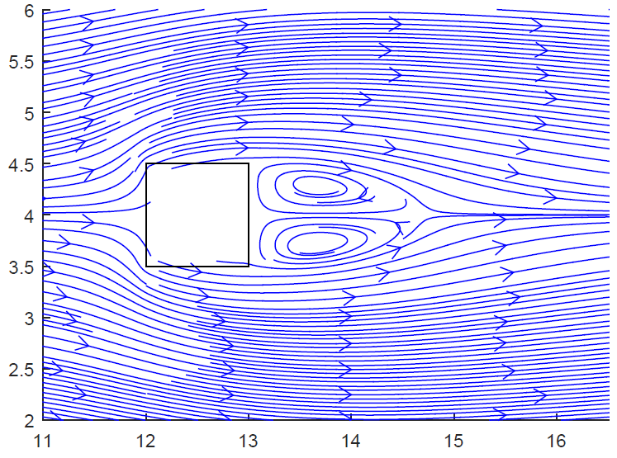
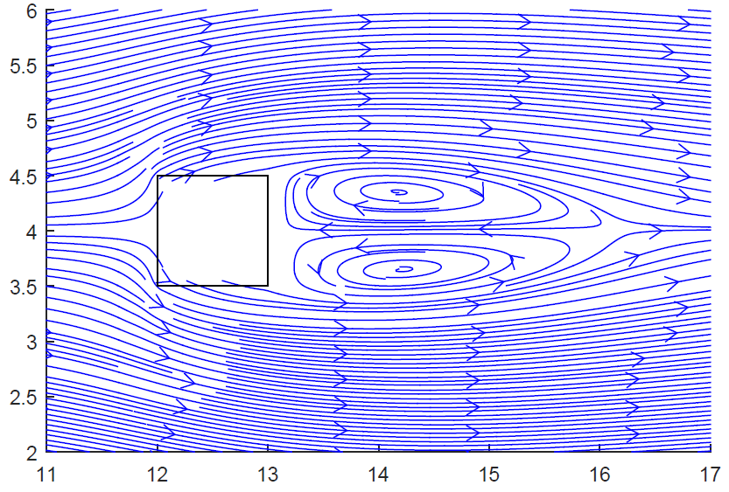
Square cylinder ― Results
Application – Square cylinder
Re = 1
Re = 5
Re = 30
Re = 50

Slide 20
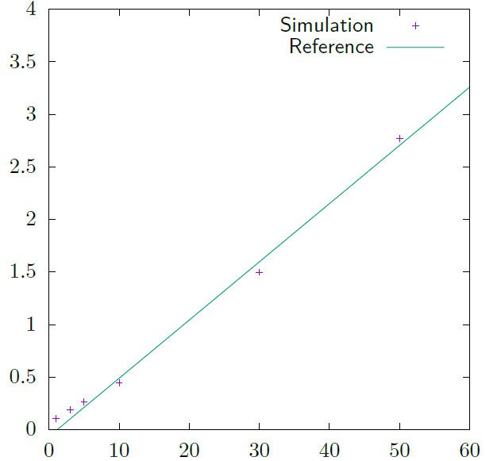
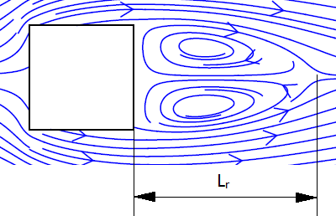

Square cylinder - Results
Application – Square cylinder
Recirculation length
$$L_{r}/D=−0.065+0.0554Re$$
for $5<Re<60$
Notes:
Vale, he de trobar una forma intel·ligent i coherent de posar perquè calculo això.

Slide 21
Conclusions
Conclusions
Improved knowledge in numerical methods
Discretization
Interpolation schemes
Fractional Step Method
…
Realistic results
Application case: Square cylinder
Steady solutions
Accurate results
Notes:
Hauria d’afegir el future work?

Slide 22

Thank you
Questions?
Notes:
He de treure això de questions o posar una altra cosa perquè després la gent encara preguntarà i preferiria que no ho fessin.

