Slide 1
Study for the computational resolution of conservation equations of mass, momentum and energy. Possible application to different aeronautical and industrial engineering problems: Case 1B
Author: Laura Pla Olea
Director: Carlos David Perez Segarra
Co-Director: Asensio Oliva Llena
Degree: Grau en Enginyeria en Tecnologies Aeroespacials
Delivery date: 10-06-2017 (Spring 2016-2017)
Notes:
Good morning. I am Laura Pla Olea and I am going to present my study on the computational resolution of the conservation equations.

Slide 2
List of contents

Slide 3
Objectives
Provide knowledge in computational methods
Study of a specific case
Methodology
Basic cases
Mathematical formulation
Numerical method
Code development
Specific application
Notes:
What were the objectives of this work? Well, the main objective was to increase my knowledge in the field of the computational methods in order to solve the conservation equations. However, in order to summarize all the knowledge obtained, a second objective was to use these methods to solve a specific case.
To do so, the methodology was to begin solving some simple cases that required the use of numerical schemes. These cases would provide an introduction to different computational methods. For each case, the resolution began with the identification of the mathematical formulation needed to solve the problem. Then, a convenient discretization method was applied and, finally, a code was developed. At the end of the study, all this knowledge was applied to the specific case, following the same methodology

Slide 4
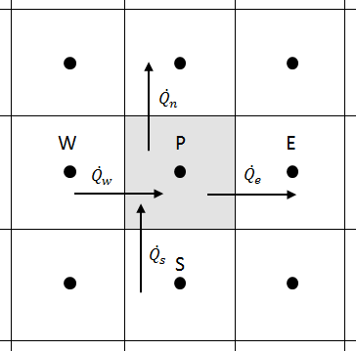
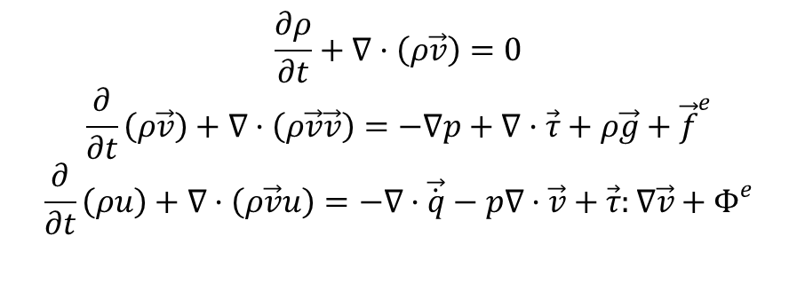
Conservation equations
$$\frac{∂ρ}{∂t}+∇·\left(ρ\vec{v}\right)=0$$
$$\frac{∂}{∂t}\left(ρ\vec{v}\right)+∇·\left(ρ\vec{v}\vec{v}\right)=−∇p+∇·\vec{τ}+ρ\vec{g}+{\vec{f}}^{e}$$
$$\frac{∂}{∂t}\left(ρu\right)+∇·\left(ρ\vec{v}u\right)=−∇·\vec{\dot{q}}−p∇·\vec{v}+\vec{τ}:∇\vec{v}+Φ^{e}$$
Numerical methods
Finite Volume Method (FVM)
Mesh
Time integration
Interpolation scheme

Slide 5

Fractional Step Method
Explicit method
Helmholtz-Hodge decomposition theorem
Algorithm
Evaluate $R^{n+\frac{1}{2}}\left(\vec{v}\right)$
Intermediate velocity ${\vec{v}}^{P}$
Pressure $p^{n+1}$
Pressure correction ${\vec{v}}^{n+1}$

Slide 6
Staggered meshes

Slide 7
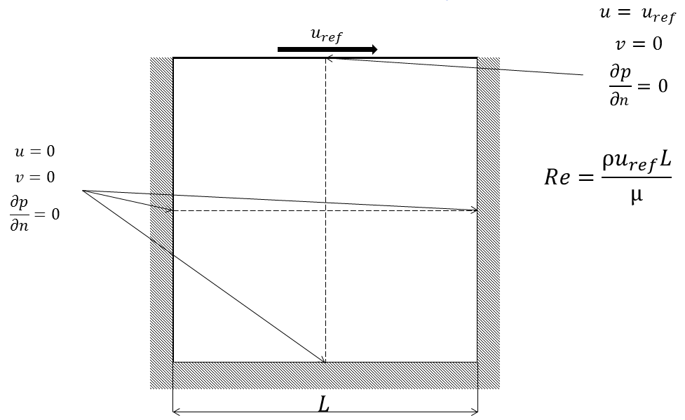
Driven cavity problem
Fractional Step Method

Slide 8
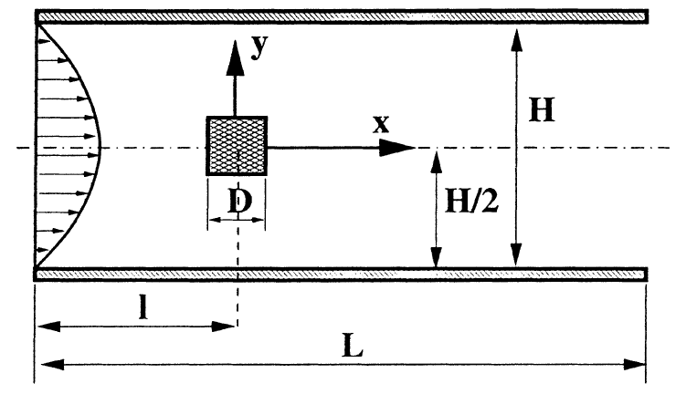
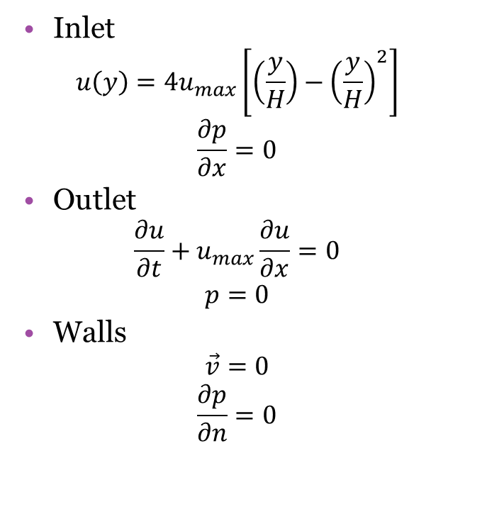
Square cylinder
Inlet
$$u\left(y\right)=4u_{max}\left[\left(\frac{y}{H}\right)−{\left(\frac{y}{H}\right)}^{2}\right]$$
$$\frac{∂p}{∂x}=0$$
Outlet
$$\frac{∂u}{∂t}+u_{max}\frac{∂u}{∂x}=0$$
$$p=0$$
Walls
$$\vec{v}=0$$
$$\frac{∂p}{∂n}=0$$

Slide 9
Square cylinder ― Results

Slide 10
Conclusions

