Slide 1
Study for the computational resolution of conservation equations of mass, momentum and energy. Possible application to different aeronautical and industrial engineering problems: Case 1B
Author: Laura Pla Olea
Director: Carlos David Perez Segarra
Co-Director: Asensio Oliva Llena
Degree: Grau en Enginyeria en Tecnologies Aeroespacials
Delivery date: 10-06-2017 (Spring 2016-2017)
Notes:
Good morning. I am Laura Pla Olea and I am going to present my study on the computational resolution of the conservation equations.

Slide 2
List of contents
Objectives & Methodology
Conservation equations
Numerical methods
Basic cases
Four materials problem
Smith-Hutton problem
Driven cavity problem
Differentially heated cavity
Burgers’ equation
Application ― Square cylinder
Conclusions
Future work

Slide 3
Objectives
Provide knowledge in computational methods
Study of a specific case
Methodology
Basic cases
Mathematical formulation
Numerical method
Code development
Specific application
Notes:
What were the objectives of this work? Well, the main objective was to increase my knowledge in the field of the computational methods in order to solve the conservation equations. However, in order to summarize all the knowledge obtained, a second objective was to use these methods to solve a specific case.
To do so, the methodology was to begin solving some simple cases that required the use of numerical schemes. These cases would provide an introduction to different computational methods. For each case, the resolution began with the identification of the mathematical formulation needed to solve the problem. Then, a convenient discretization method was applied and, finally, a code was developed. At the end of the study, all this knowledge was applied to the specific case, following the same methodology

Slide 4
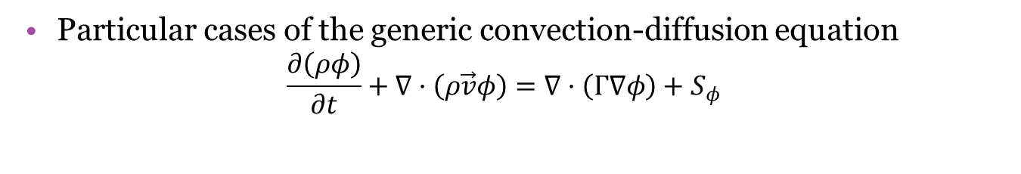
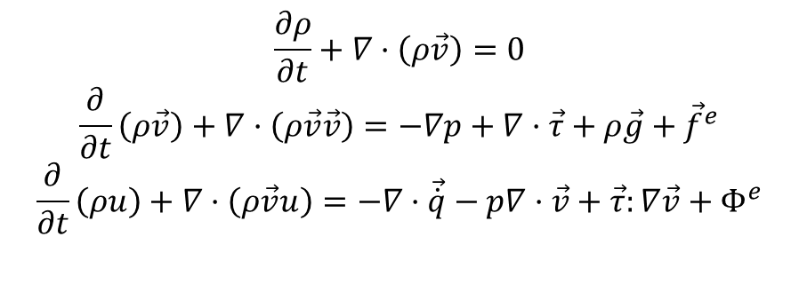
Conservation equations
$$\frac{∂ρ}{∂t}+∇·\left(ρ\vec{v}\right)=0$$
$$\frac{∂}{∂t}\left(ρ\vec{v}\right)+∇·\left(ρ\vec{v}\vec{v}\right)=−∇p+∇·\vec{τ}+ρ\vec{g}+{\vec{f}}^{e}$$
$$\frac{∂}{∂t}\left(ρu\right)+∇·\left(ρ\vec{v}u\right)=−∇·\vec{\dot{q}}−p∇·\vec{v}+\vec{τ}:∇\vec{v}+Φ^{e}$$
Describe heat transfer and fluid flow
No analytical solution
Particular cases of the generic convection-diffusion equation
$$\frac{∂\left(ρφ\right)}{∂t}+∇·\left(ρ\vec{v}φ\right)=∇·\left(Γ∇φ\right)+S_{φ}$$

Slide 5






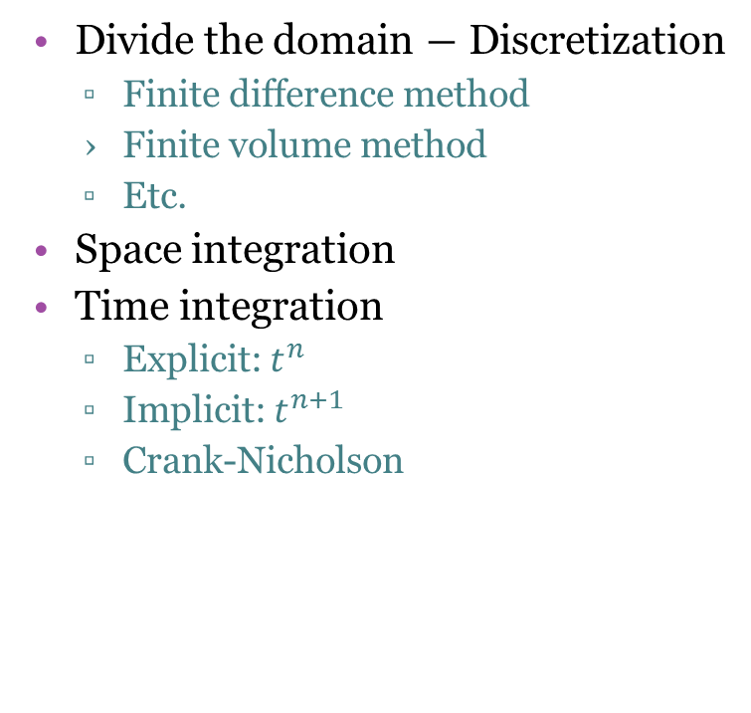









Numerical methods
Divide the domain ― Discretization
Finite difference method
Finite volume method
Etc.
Space integration
Time integration
Explicit: $t^{n}$
Implicit: $t^{n+1}$
Crank-Nicholson
$${\dot{Q}}_{n}$$
W
P
E
$${\dot{Q}}_{w}$$
$${\dot{Q}}_{e}$$
$${\dot{Q}}_{s}$$
S
$${\dot{Q}}^{n+1}$$
$${\dot{Q}}^{n+1}$$
$${\dot{Q}}^{n+1}$$
$${\dot{Q}}^{n}$$
$${\dot{Q}}^{n}$$
$${\dot{Q}}^{n}$$
$$t^{n}$$
$$t^{n+1}$$
$$t^{n}$$
$$t^{n+1}$$
$$t^{n}$$
$$t^{n+1}$$

Slide 6
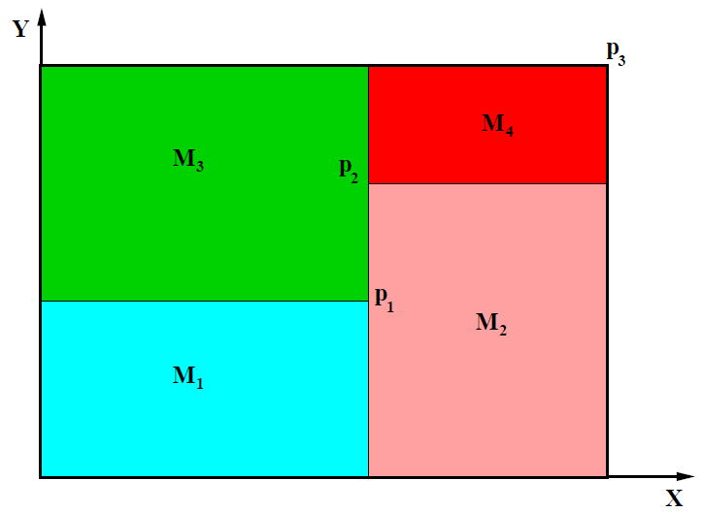
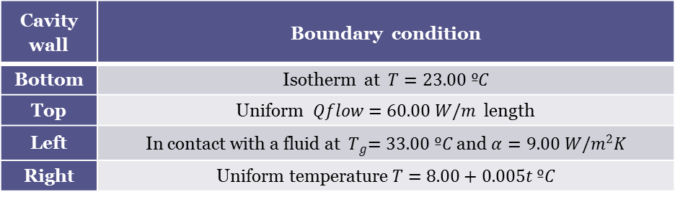
Four materials problem
 | ρ [kg/m³] | c_{P} [J/kgK] | λ [W/mK]
M₁ | 1500.00 | 750.00 | 170.00
M₂ | 1600.00 | 770.00 | 140.00
M₃ | 1900.00 | 810.00 | 200.00
M₄ | 2500.00 | 930.00 | 140.00
Cavity wall | Boundary condition
Bottom | Isotherm at $T=23.00 ºC$
Top | Uniform $Qflow=60.00 W/m$ length
Left | In contact with a fluid at ${ T}_{g}=33.00 ºC$ and $α=9.00 W/m^{2}K$
Right | Uniform temperature $T=8.00+0.005t ºC$

Slide 7

Four materials problem
Energy equation in a solid
$$ρc_{p}\frac{∂T}{∂t}=∇·\left(λ∇T\right)+{\dot{q}}_{v}$$
Transient
Incompressible
No viscous dissipation

Slide 8
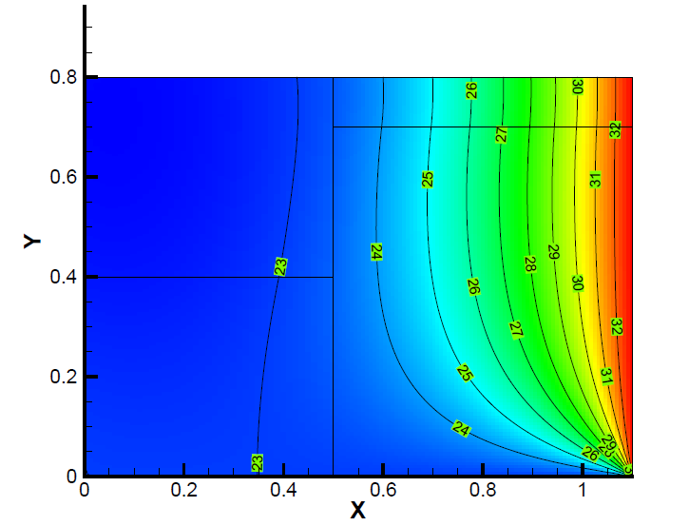
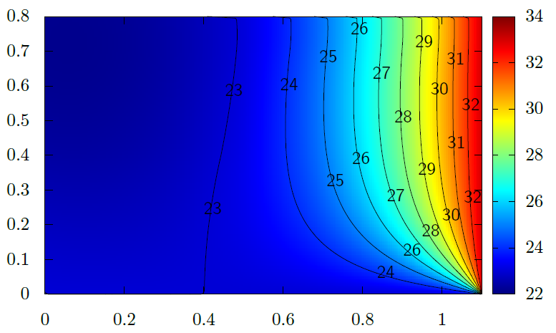
Four materials problem ― Results

Slide 9
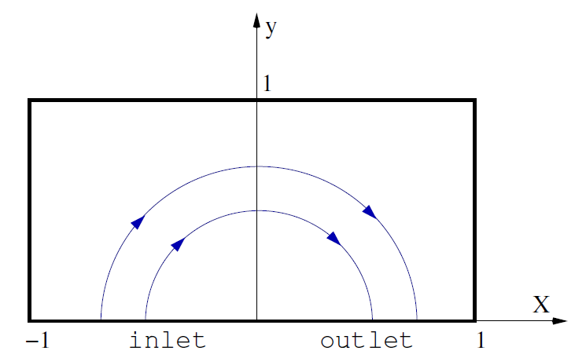
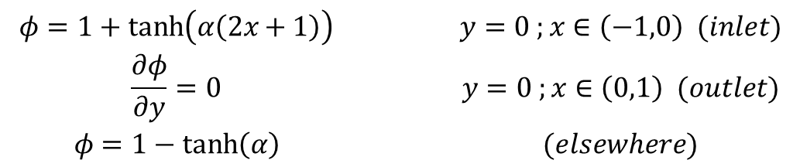

Smith-Hutton problem
$$u\left(x,y\right)=2y\left(1−x^{2}\right)$$
$$v\left(x,y\right)=−2x\left(1−y^{2}\right)$$
$$\begin{matrix}φ=1+\tanh\left(α\left(2x+1\right)\right) & y=0 ;x∈\left(−1,0\right) (inlet) \\ \frac{∂φ}{∂y}=0 & y=0 ;x∈\left(0,1\right) (outlet) \\ φ=1−\tanh\left(α\right) & (elsewhere)\end{matrix}$$

Slide 10
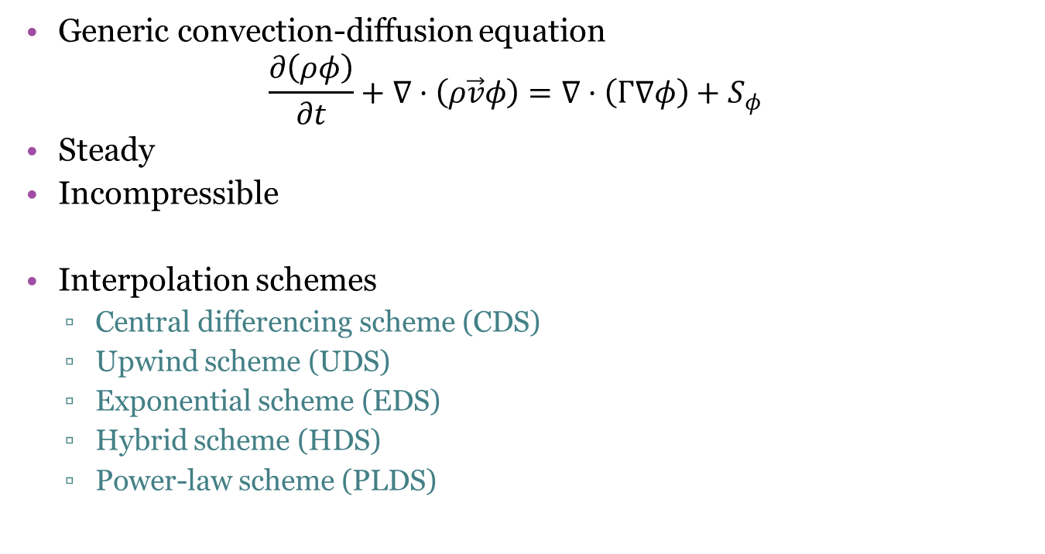
Smith-Hutton problem
Generic convection-diffusion equation
$$\frac{∂\left(ρφ\right)}{∂t}+∇·\left(ρ\vec{v}φ\right)=∇·\left(Γ∇φ\right)+S_{φ}$$
Steady
Incompressible
Interpolation schemes
Central differencing scheme (CDS)
Upwind scheme (UDS)
Exponential scheme (EDS)
Hybrid scheme (HDS)
Power-law scheme (PLDS)

Slide 11
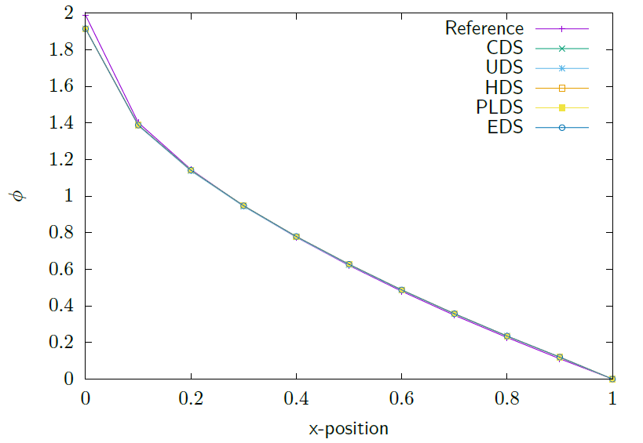
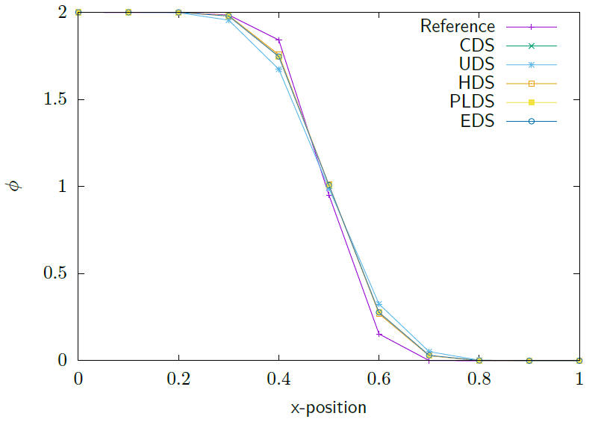


Smith-Hutton problem ― Results
Output for$ρ/Γ={10}^{3}$
Output for$ρ/Γ=10$

Slide 12
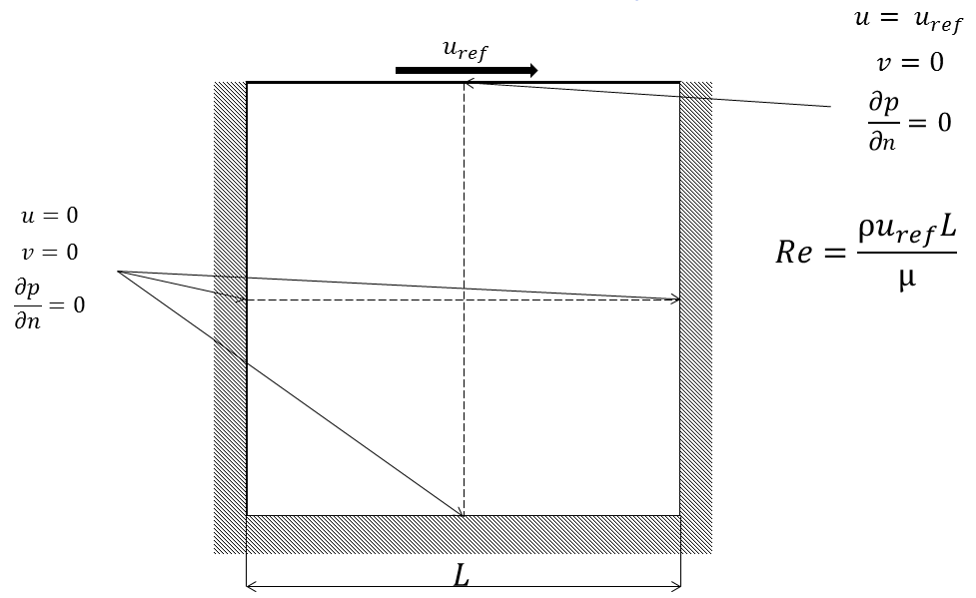
Driven cavity problem

Slide 13

Driven cavity problem
Conservation of mass and momentum
$$\left\{\begin{aligned}∇·\vec{v}=0 \\ ρ\frac{∂\vec{v}}{∂t}+ρ\left(\vec{v}·∇\right)\vec{v}=−∇p+μ∇^{2}\vec{v}\end{aligned}\right.$$
Transient
Incompressible
Velocity Pressure

Slide 14
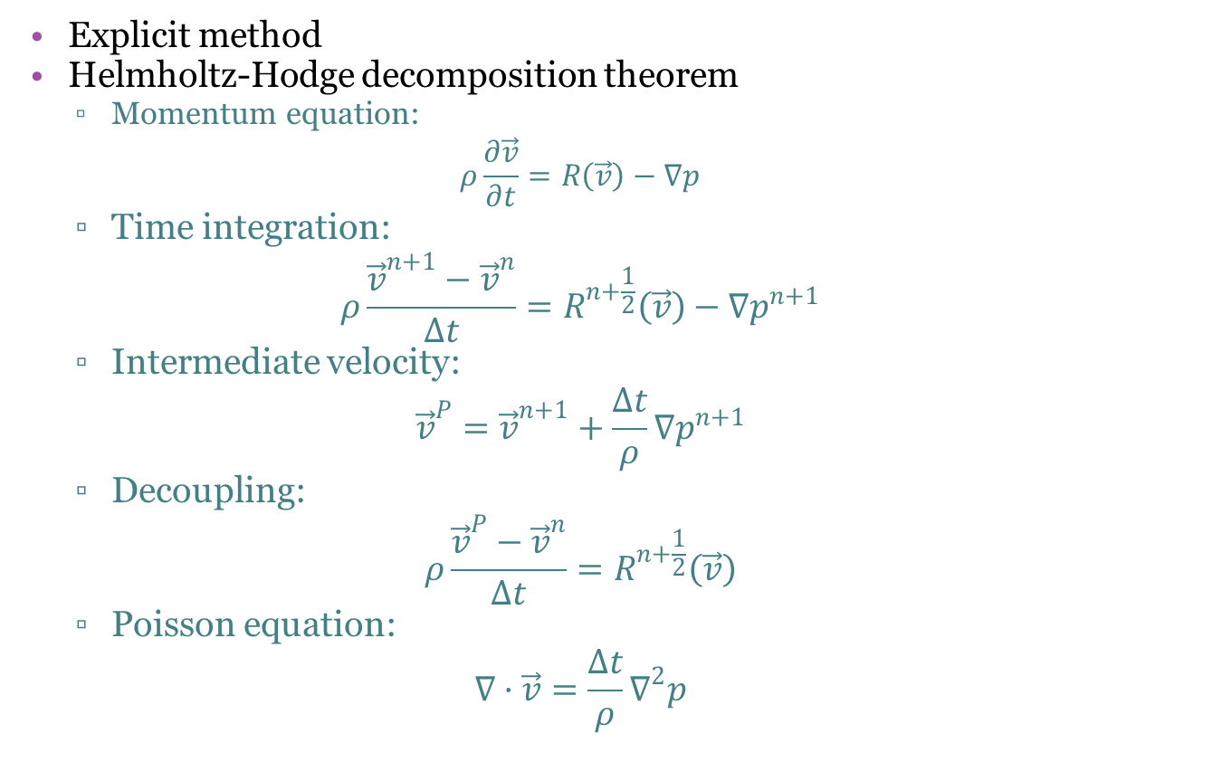
Fractional Step Method
Explicit method
Helmholtz-Hodge decomposition theorem
Momentum equation:
$$ρ\frac{∂\vec{v}}{∂t}=R\left(\vec{v}\right)−∇p$$
Time integration:
$$ρ\frac{{\vec{v}}^{n+1}−{\vec{v}}^{n}}{Δt}=R^{n+\frac{1}{2}}\left(\vec{v}\right)−∇p^{n+1}$$
Intermediate velocity:
$${\vec{v}}^{P}={\vec{v}}^{n+1}+\frac{Δt}{ρ}∇p^{n+1}$$
Decoupling:
$$ρ\frac{{\vec{v}}^{P}−{\vec{v}}^{n}}{Δt}=R^{n+\frac{1}{2}}\left(\vec{v}\right)$$
Poisson equation:
$$∇·\vec{v}=\frac{Δt}{ρ}∇^{2}p$$

Slide 15


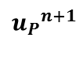
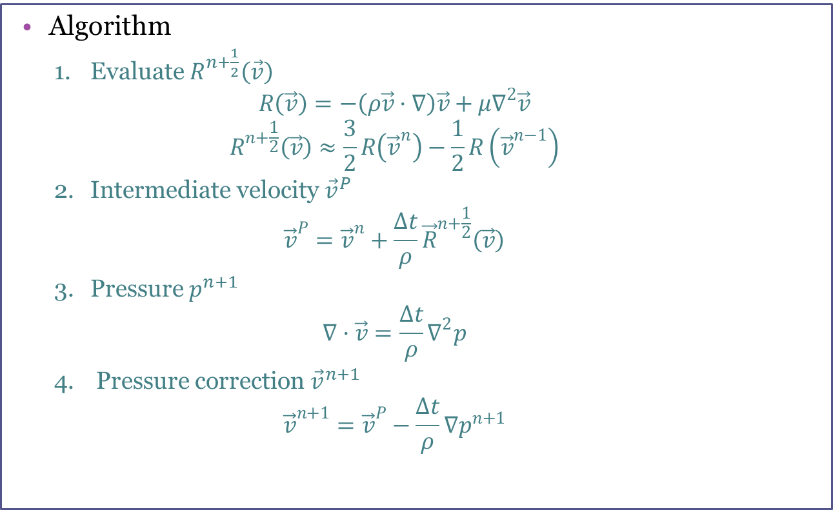

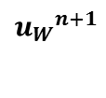

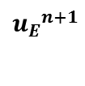
Fractional Step Method
Algorithm
Evaluate $R^{n+\frac{1}{2}}\left(\vec{v}\right)$
$$R\left(\vec{v}\right)=−\left(ρ\vec{v}·∇\right)\vec{v}+μ∇^{2}\vec{v}$$
$$R^{n+\frac{1}{2}}\left(\vec{v}\right)≈\frac{3}{2}R\left({\vec{v}}^{n}\right)−\frac{1}{2}R\left({\vec{v}}^{n−1}\right)$$
Intermediate velocity ${\vec{v}}^{P}$
$${\vec{v}}^{P}={\vec{v}}^{n}+\frac{Δt}{ρ}{\vec{R}}^{n+\frac{1}{2}}\left(\vec{v}\right)$$
Pressure $p^{n+1}$
$$∇·\vec{v}=\frac{Δt}{ρ}∇^{2}p$$
Pressure correction ${\vec{v}}^{n+1}$
$${\vec{v}}^{n+1}={\vec{v}}^{P}−\frac{Δt}{ρ}∇p^{n+1}$$
$${p_{W}}^{n+1}$$
$${p_{P}}^{n+1}$$
$${p_{E}}^{n+1}$$
$${p_{P}}^{n+1}$$
$${u_{W}}^{n+1}$$
$${u_{P}}^{n+1}$$
$${u_{E}}^{n+1}$$

Slide 16






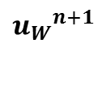
Staggered meshes
To avoid unrealistic solutions
Three control volumes:
Pressure
Horizontal velocity
Vertical velocity
$${p_{P}}^{n+1}$$
$${p_{W}}^{n+1}$$
$${p_{P}}^{n+1}$$
$${p_{E}}^{n+1}$$
$${u_{W}}^{n+1}$$
$${u_{P}}^{n+1}$$
$${u_{E}}^{n+1}$$

Slide 17
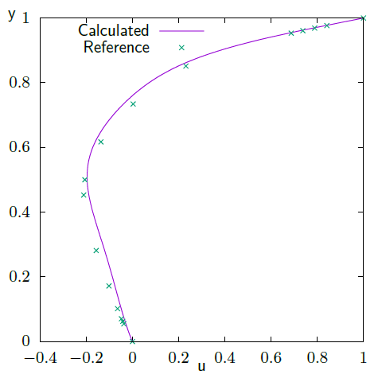
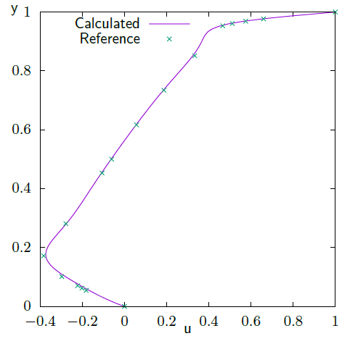
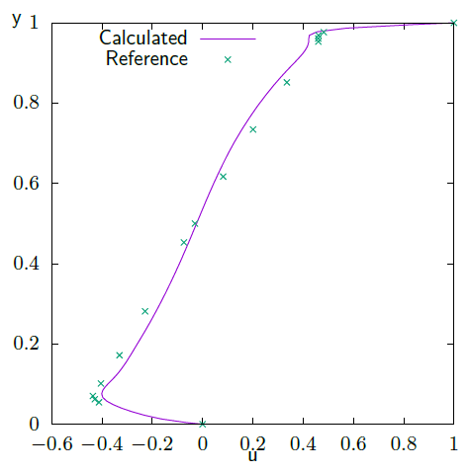
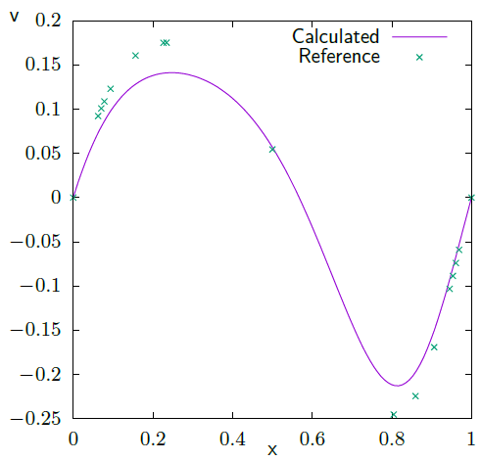
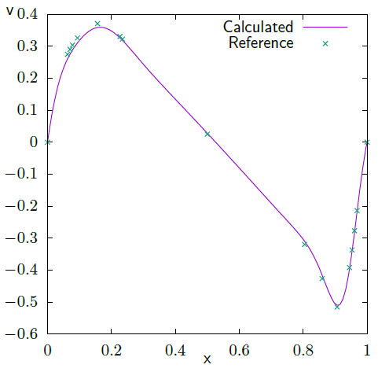
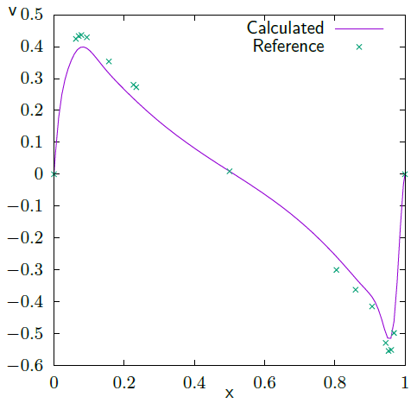
Driven cavity problem ― Results

Slide 18
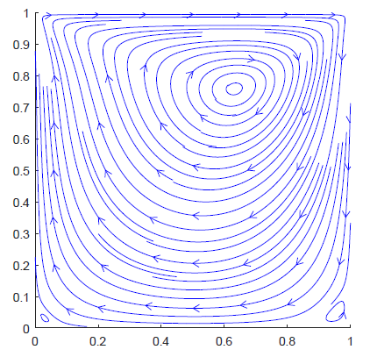
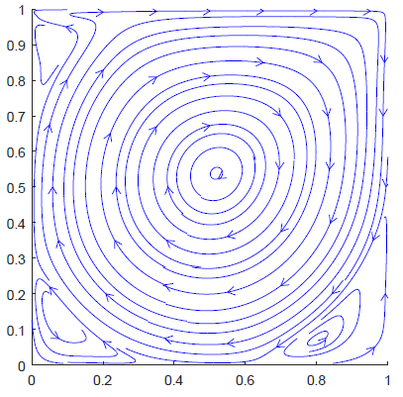
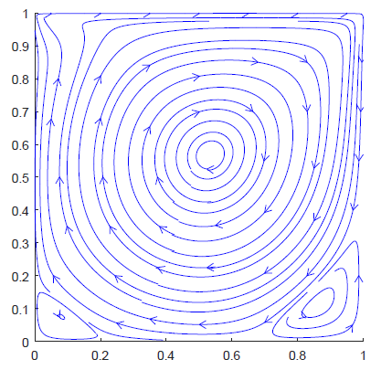
Driven cavity problem ― Results
Re = 1000
Re = 100
Re = 5000

Slide 19
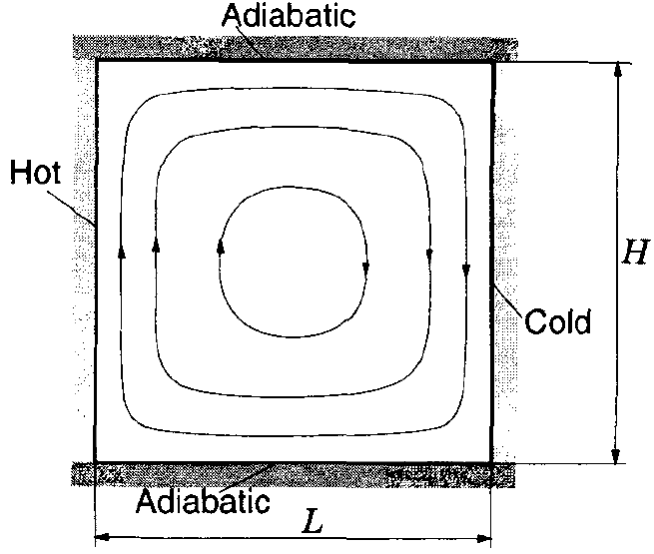

Differentially heated cavity
$$Pr=\frac{c_{p}μ}{λ}$$
$$Ra=\frac{ρ^{2}gβΔTL^{3}c_{P}}{μλ}$$

Slide 20
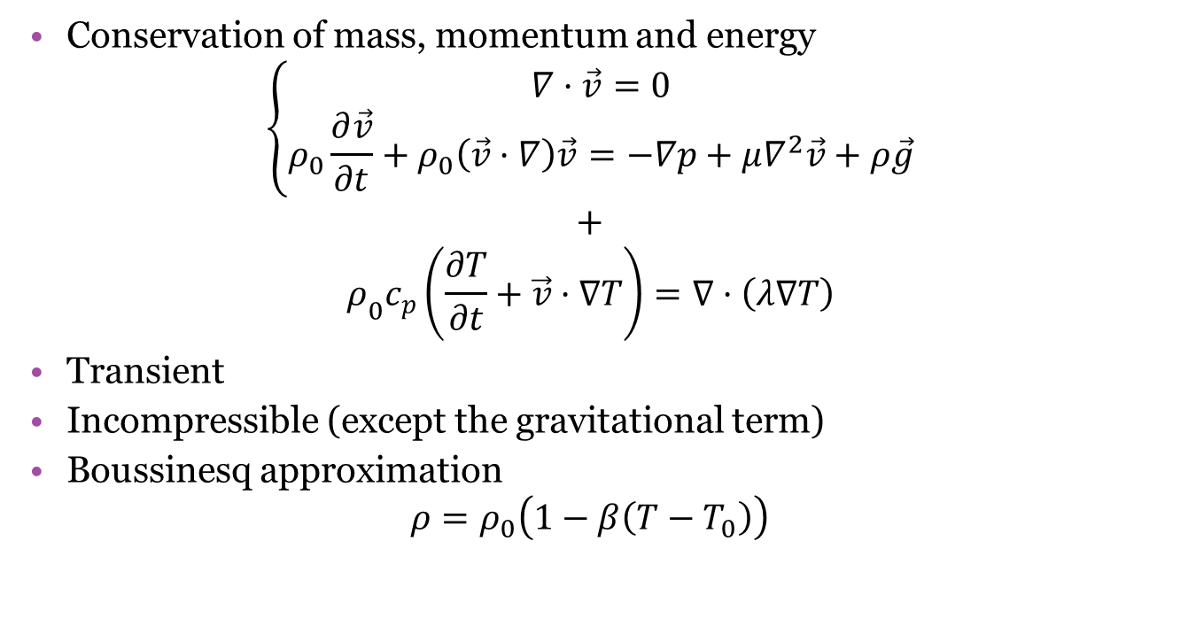
Differentially heated cavity
Conservation of mass, momentum and energy
$$\left\{\begin{aligned}∇·\vec{v}=0 \\ ρ_{0}\frac{∂\vec{v}}{∂t}+ρ_{0}\left(\vec{v}·∇\right)\vec{v}=−∇p+μ∇^{2}\vec{v}+ρ\vec{g}\end{aligned}\right.$$
$$+$$
$$ρ_{0}c_{p}\left(\frac{∂T}{∂t}+\vec{v}·∇T\right)=∇·\left(λ∇T\right)$$
Transient
Incompressible (except the gravitational term)
Boussinesq approximation
$$ρ=ρ_{0}\left(1−β\left(T−T_{0}\right)\right)$$

Slide 21
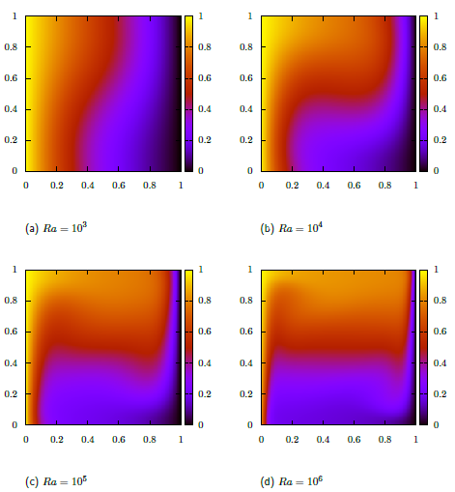
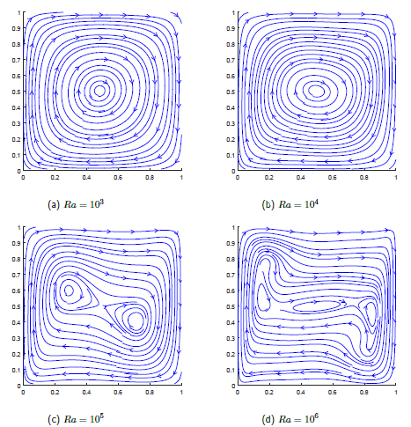
Differentially heated cavity ― Results

Slide 22
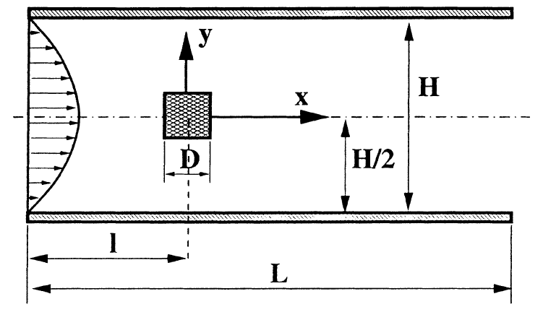
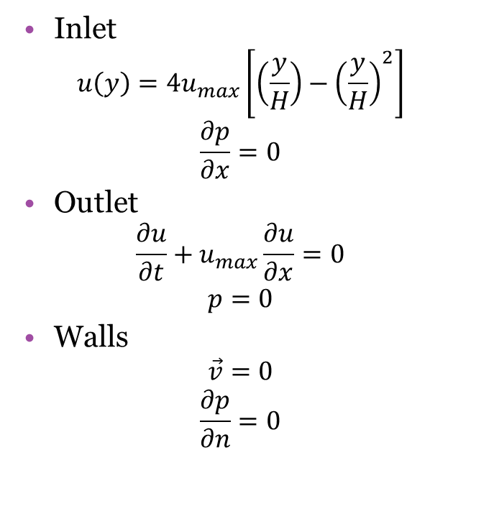
Square cylinder
Inlet
$$u\left(y\right)=4u_{max}\left[\left(\frac{y}{H}\right)−{\left(\frac{y}{H}\right)}^{2}\right]$$
$$\frac{∂p}{∂x}=0$$
Outlet
$$\frac{∂u}{∂t}+u_{max}\frac{∂u}{∂x}=0$$
$$p=0$$
Walls
$$\vec{v}=0$$
$$\frac{∂p}{∂n}=0$$

Slide 23

Square cylinder
Conservation of mass and momentum
$$\left\{\begin{aligned}∇·\vec{v}=0 \\ ρ\frac{∂\vec{v}}{∂t}+ρ\left(\vec{v}·∇\right)\vec{v}=−∇p+μ∇^{2}\vec{v}\end{aligned}\right.$$
Transient
Incompressible

Slide 24
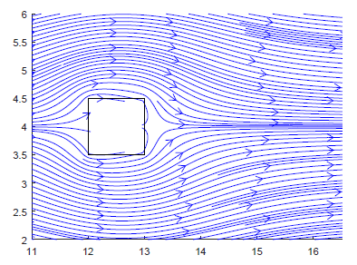
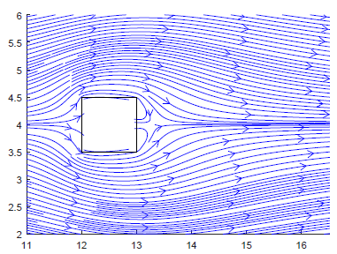
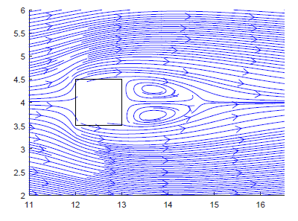
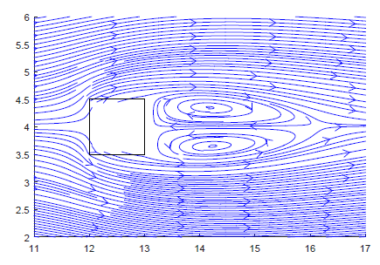
Square cylinder ― Results
Re = 1
Re = 5
Re = 30
Re = 50

Slide 25
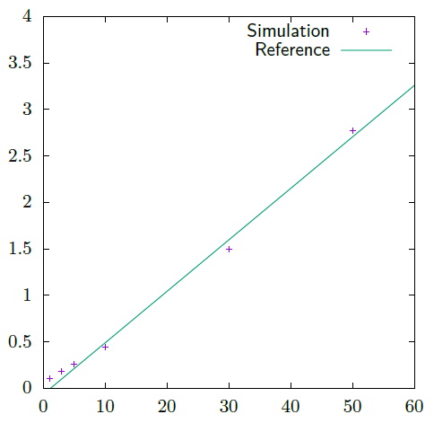
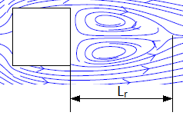

Square cylinder - Results
Recirculation length
$$L_{r}/D=−0.065+0.0554Re$$
for $5<Re<60$

Slide 26
Conclusions
Improved knowledge in numerical methods
Discretization
Interpolation schemes
Fractional Step Method
…
Realistic results
Application case: Square cylinder
Steady solutions
Accurate results

Slide 27

Thank you
Questions?

