Slide 1



V2 Evaluations for V3
Presenter: Angelique Raihany Hadiva
Advisor: Ping-Lang Yen, PhD.
10th August 2026
Weekly Lab Meeting

Slide 2
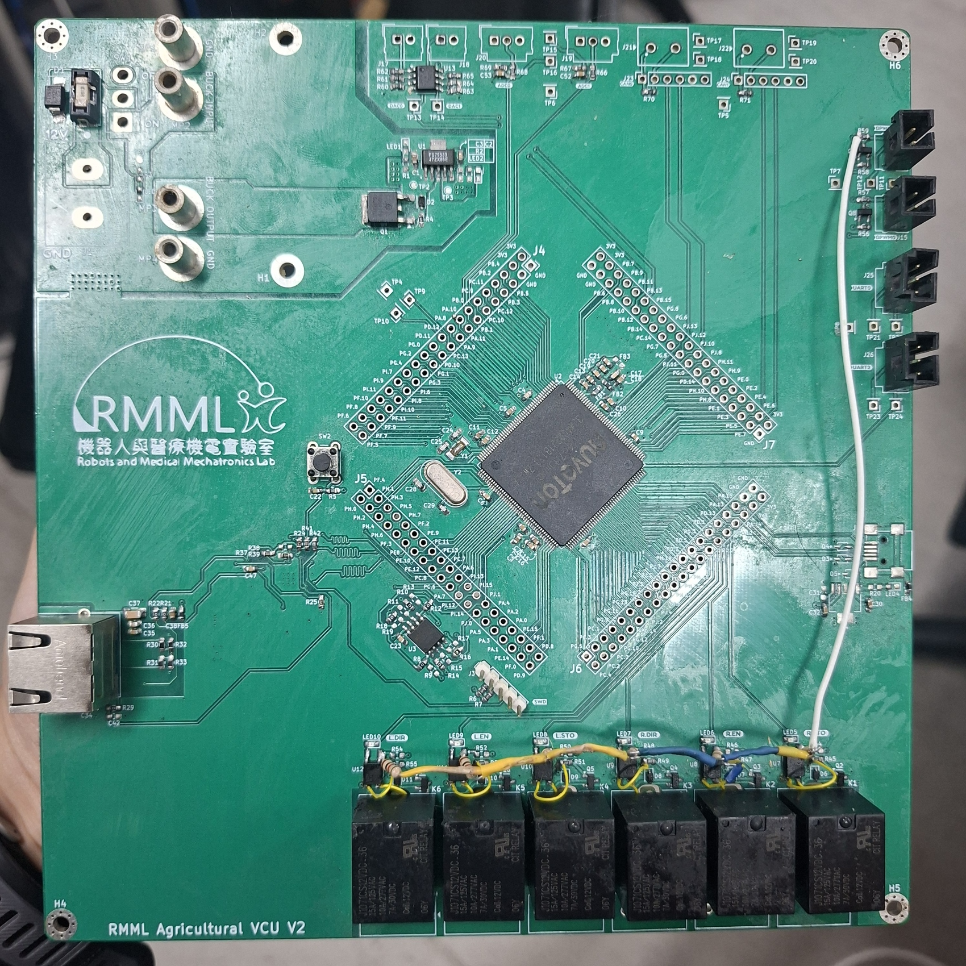
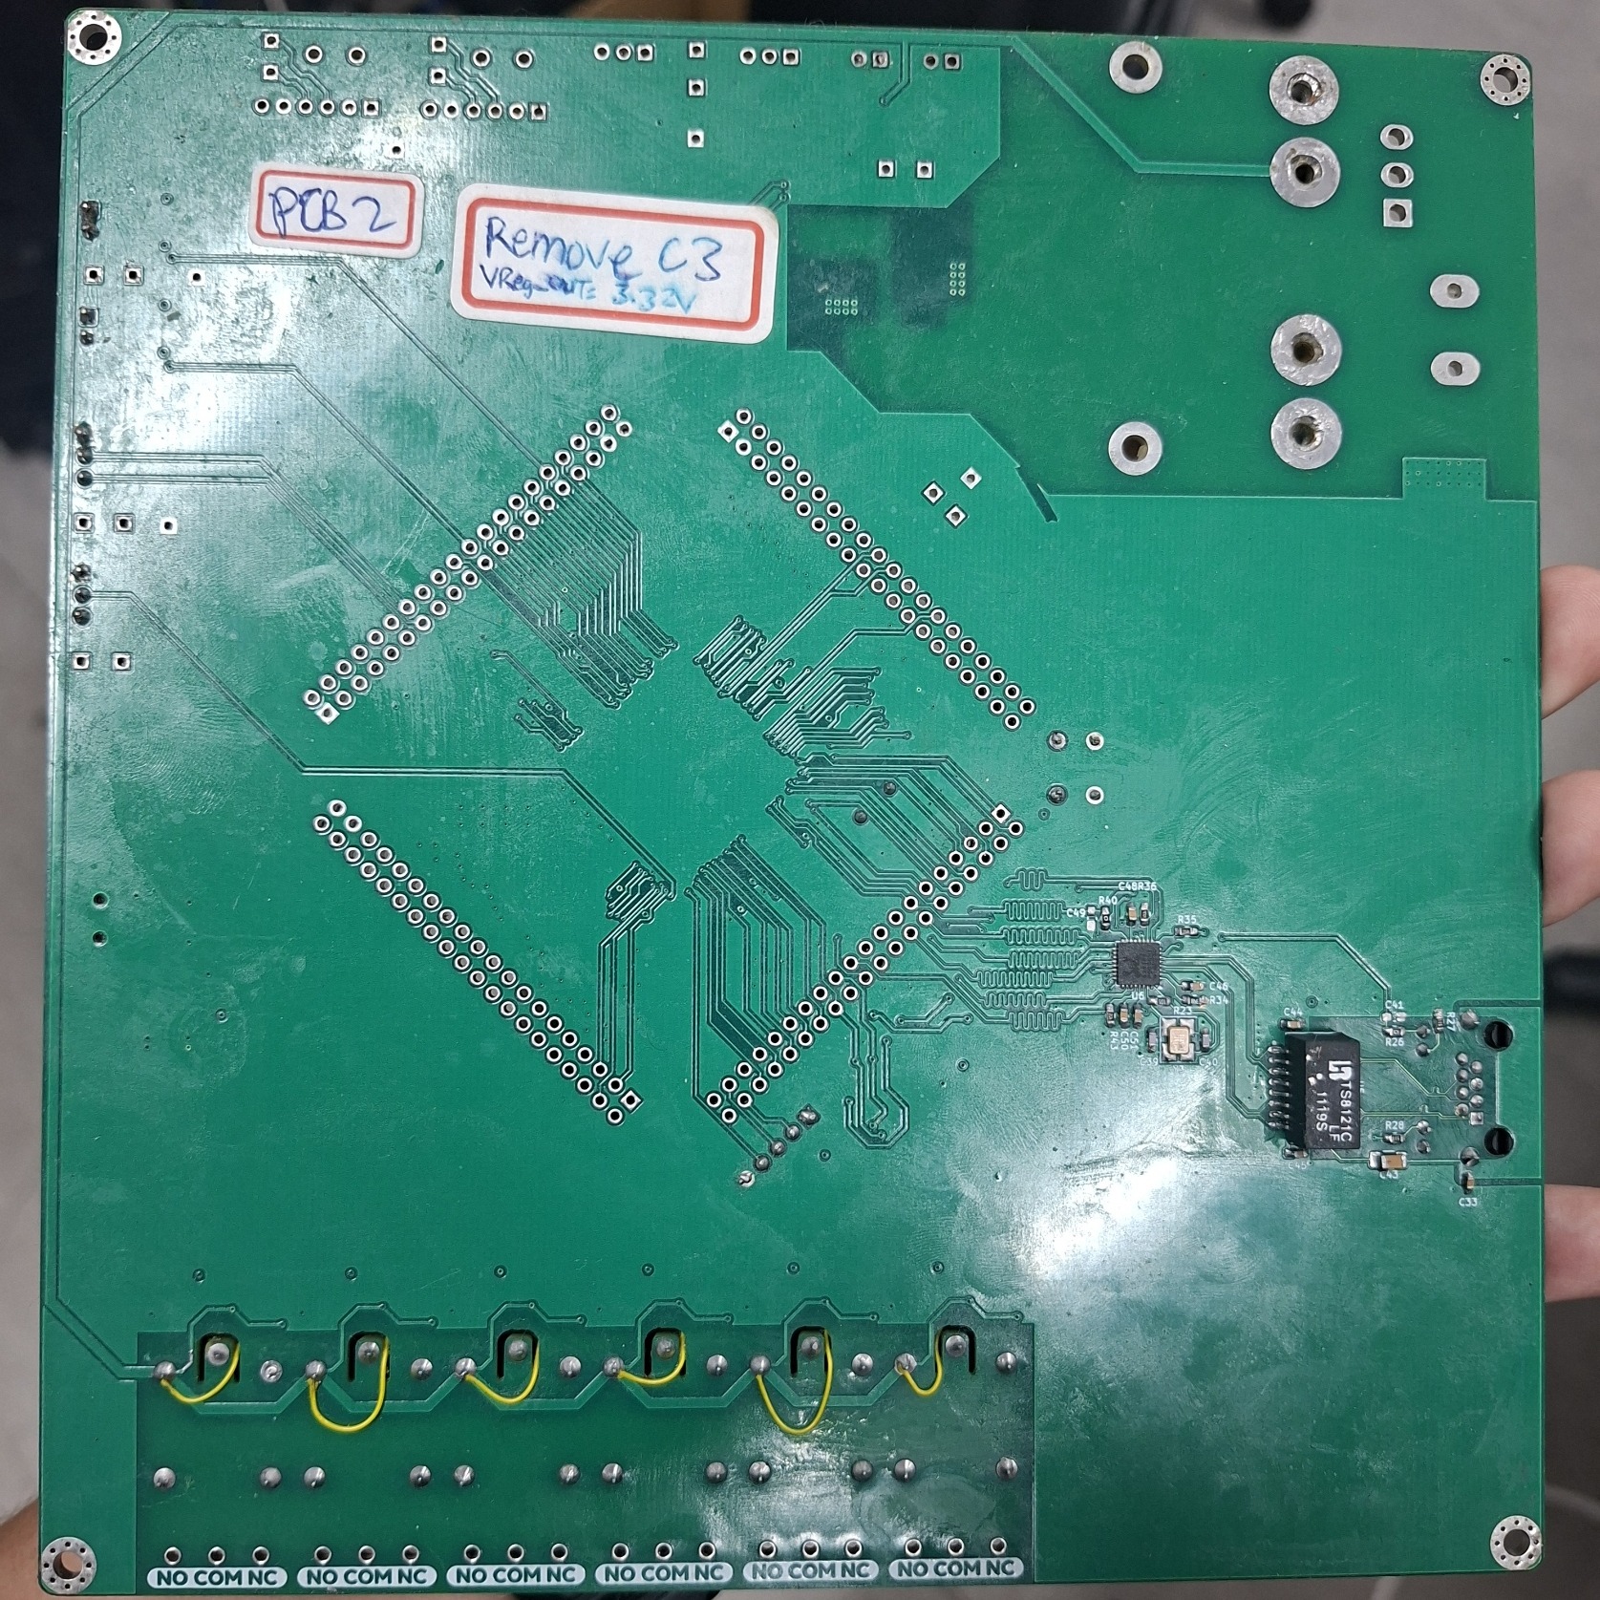

Assembled PCB
  Assembled PCB (after rework)

Slide 3
Considerations for V3
  Power supply circuit
  Copper pour setting
  Relay circuit
  USB circuit
  Test points and extension pins
  Module to bare IC interface + SD Card
  Ethernet

Slide 4
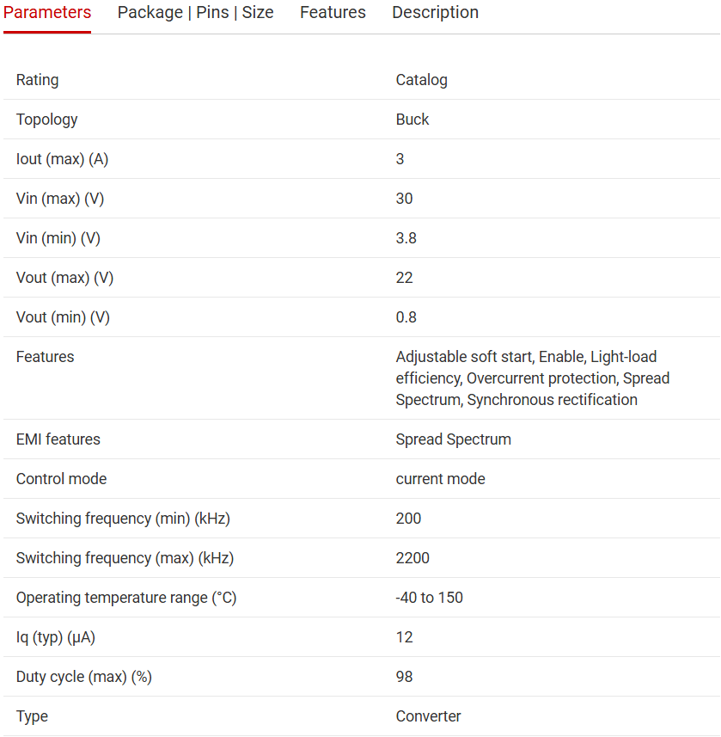
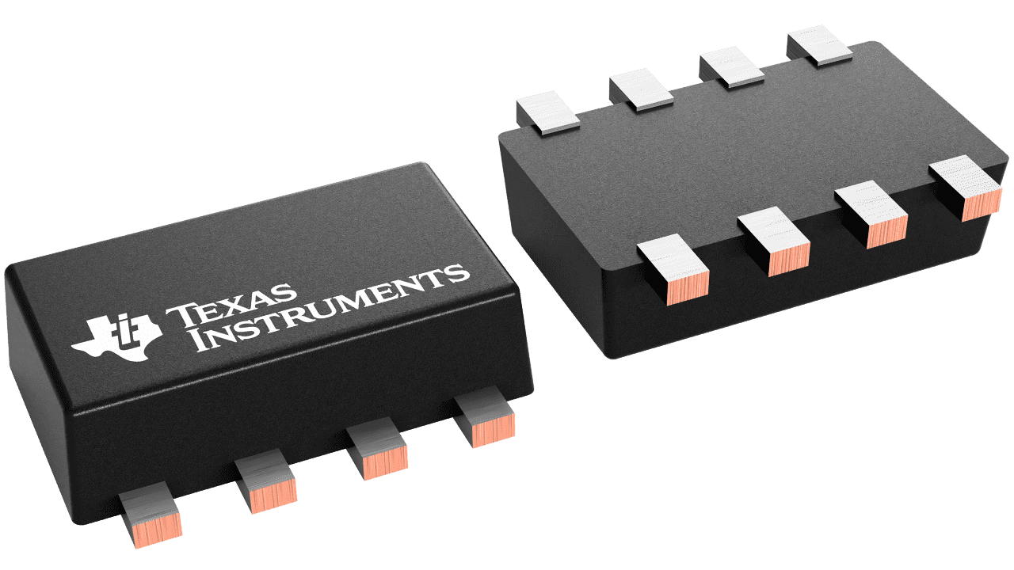
V3 Considerations - Power
  Change module to buck IC
  Scheme: 12V input → 12to5V buck → 3V3 regulator
  5V buck IC example: TPS62933. Footprint: SOT-583 (8) (1.6mm x 2.1mm)
  3V3 Regulator will keep using TPS79533
  Need proof-of-concept test in simulation and real test first

Slide 5
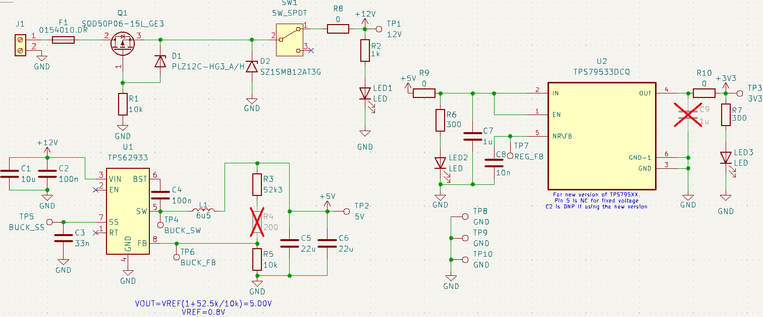
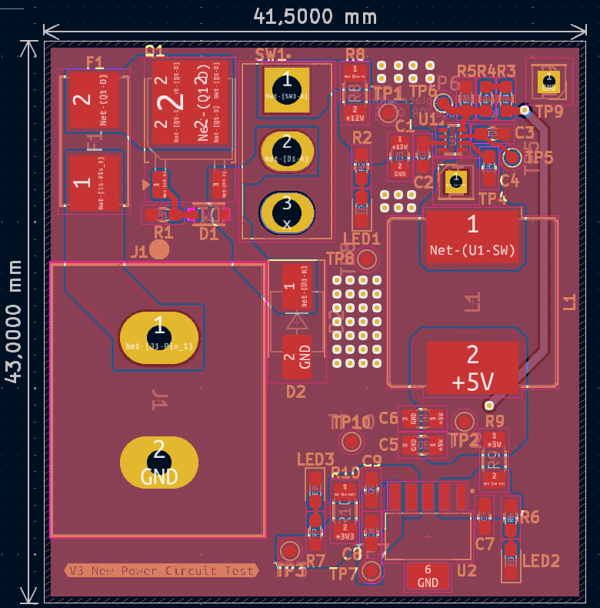
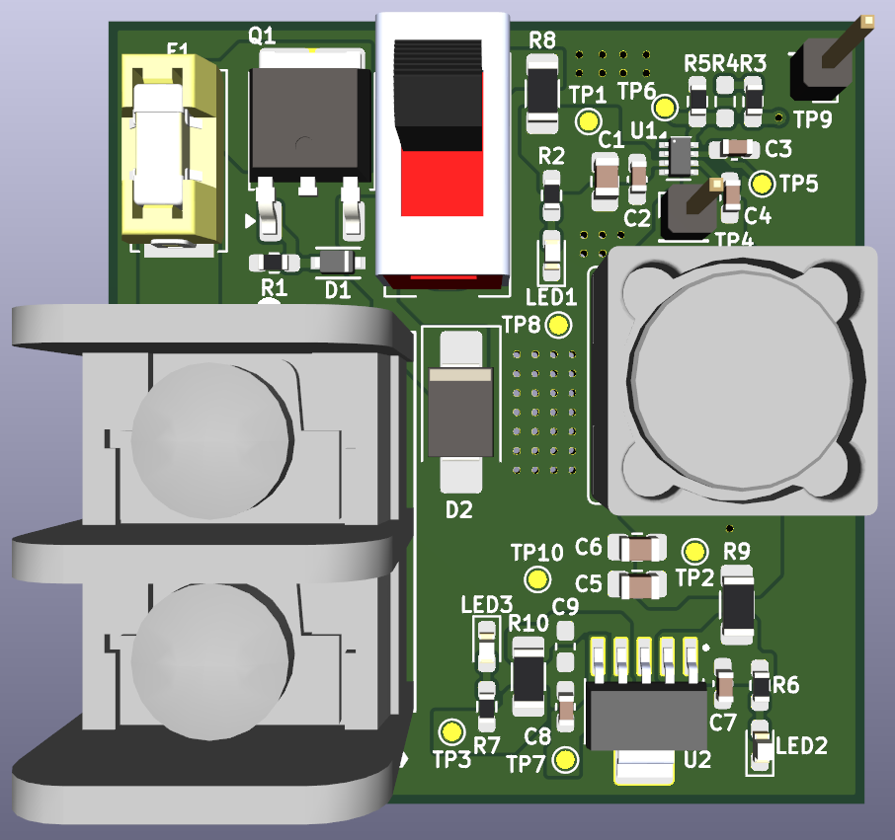
V3 Considerations – Power (initial test board, optional)
  R8, R9, and R10 are 0R which can be removed for current testing of 12V, 5V, and 3V3, respectively
  Reverse voltage protection moved to 12V rail
  5V to 3V3 remains the same
  TP4 uses pin header as test point for checking the switching frequency in oscilloscope

Slide 6
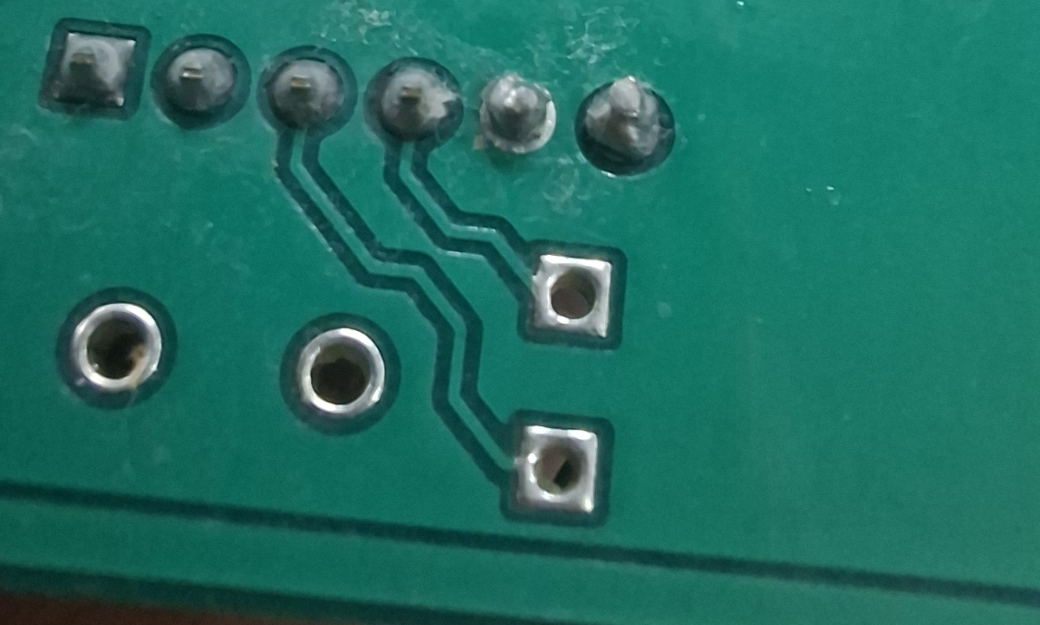
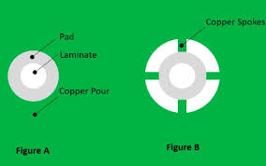
Copper pour
  In PCB v2, ground pads have bad solder joints because the solder is hard to stick to the pad
  Copper pour affects heat dissipation and soldering quality, specifically for outer layer copper pour
  Thermal reliefs limit heat loss; heat from the solder tip only spreads within the spokes, while heat spreads too early when using solid copper pour
Soldered pads example
Solid
Thermal relief

Slide 7
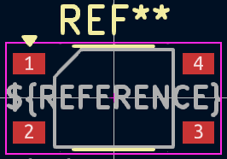
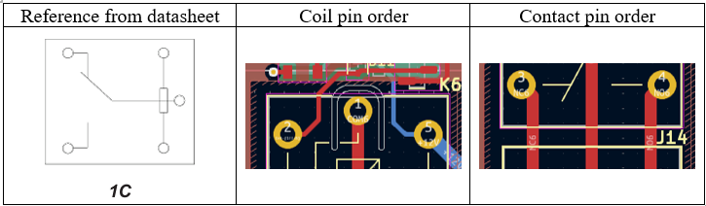
Relay circuit
3
Footprint used
4
Corrected footprint
  Datasheet shows bottom-view footprint layout without pin numbering, which makes confusion
  In V2, the contact pin order is NC-COM-NO. Correct order: NO-COM-NC
  Pin 3 and 4 of the optocoupler footprint were swapped
  Low voltage side should be pulled up to 5V

Slide 8
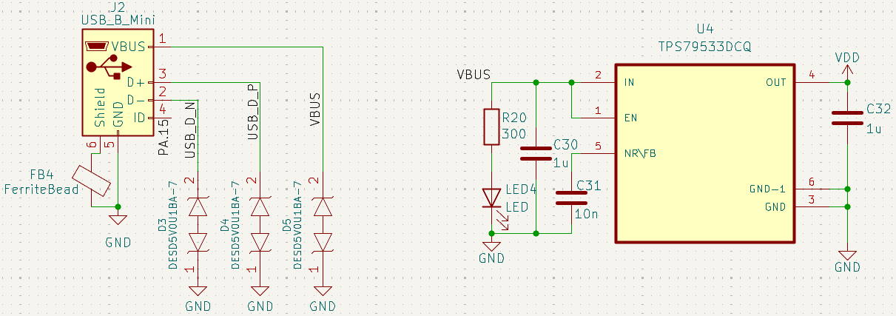
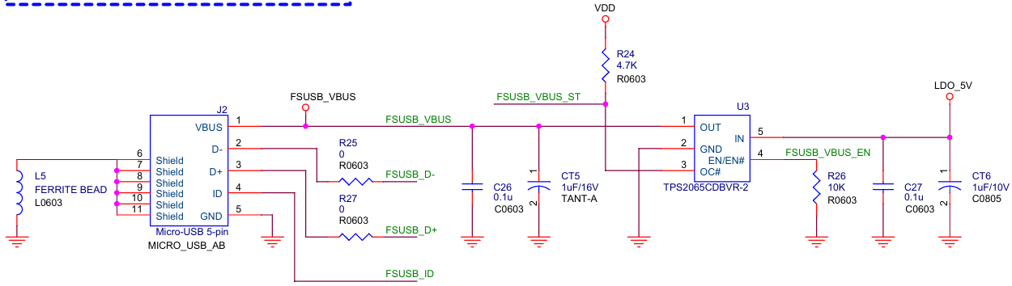
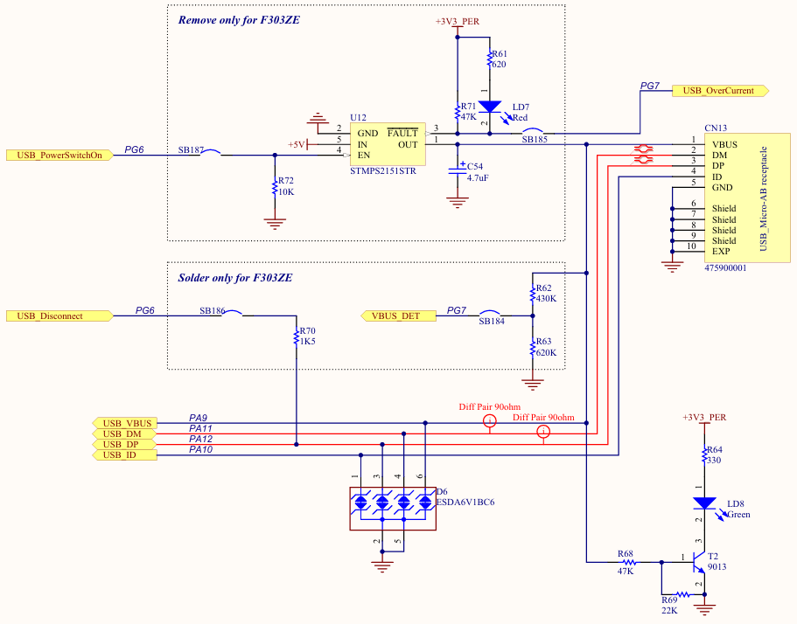
USB Circuit
  Current PCB v2 USB circuit acts as device-only USB, but is not connected to FSUSB_VBUS pin (PA12 in M467HJHAN)
  MCU needs FSUSB_VBUS signal to detect that a USB host has supplied VBUS
  VBUS switch (e.g., TPS2065C) is required for USB host/OTG: it provides controlled 5V power to the USB connector with current limiting, short-circuit protection, and fault reporting
  VBUS must be enabled only in host mode via FSUSB_VBUS_EN to avoid back-powering.
PCB v2 USB circuit
Numaker FS USB
Nucleo USB

Slide 9
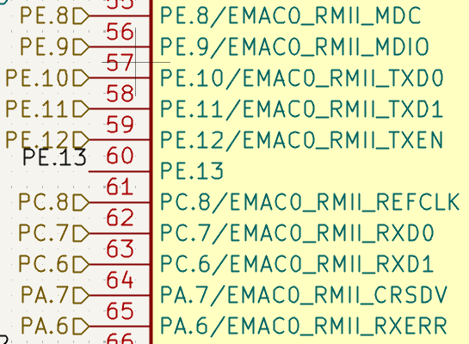
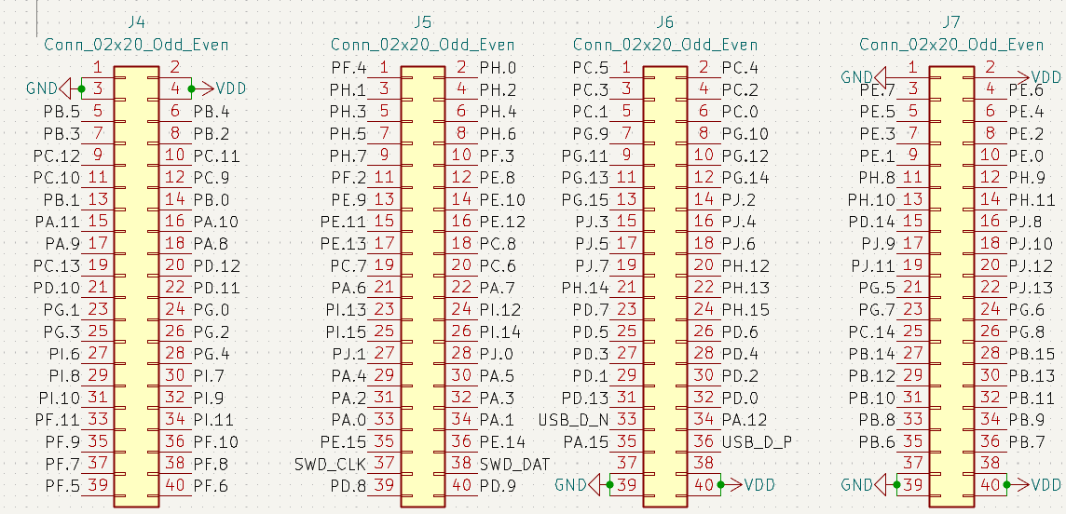
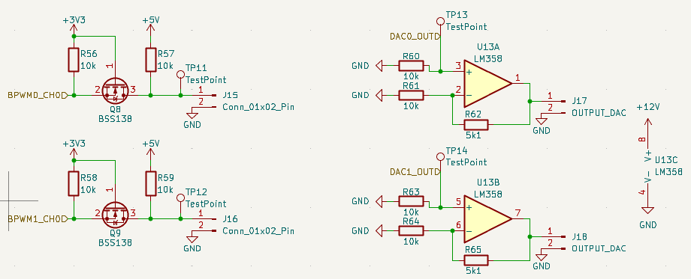

Test Points and Extension Pins
  In Numaker M467, pins used for Ethernet are included in the extension pins
  Length matching for the RMII pins is more difficult because the through-hole pads create extra routing distance and possible branch stubs
  For PWM and DAC, test points should be on both input and output

Slide 10
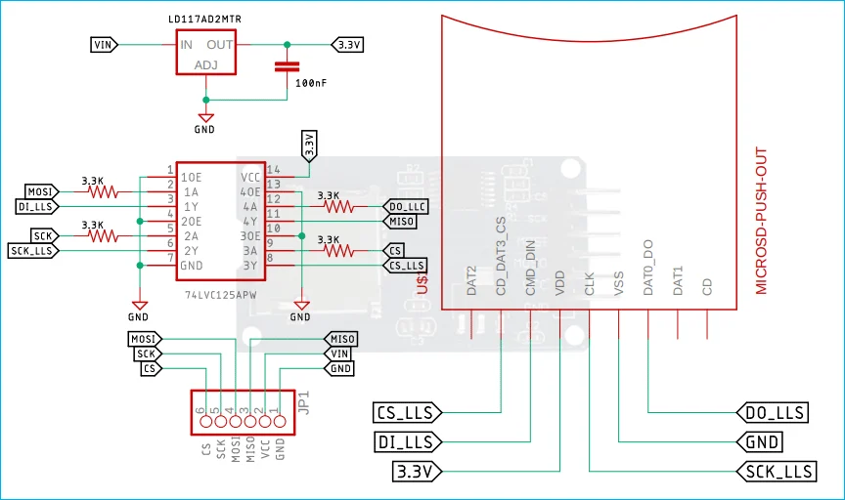
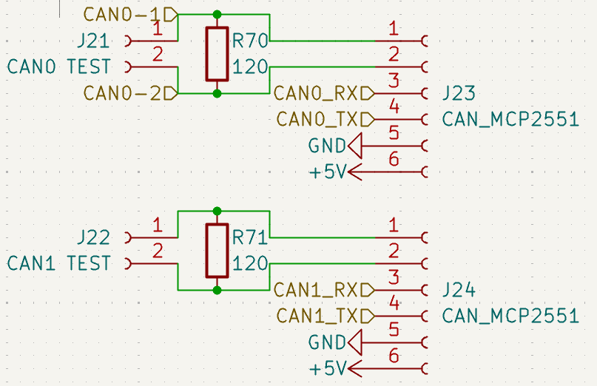
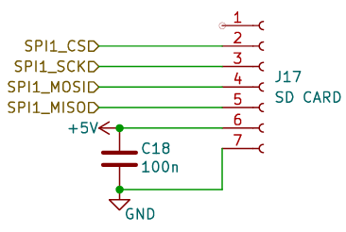
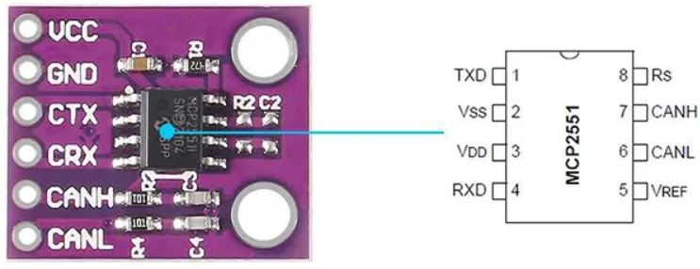
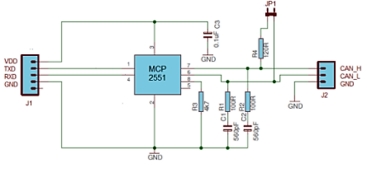
Module to Embedded for CAN and SD Card
  SD card was available on V1 in a module connector but removed in V2. CAN is available on both versions
  Using module is easier, but embedding the interface on the PCB save more spaces

Slide 11
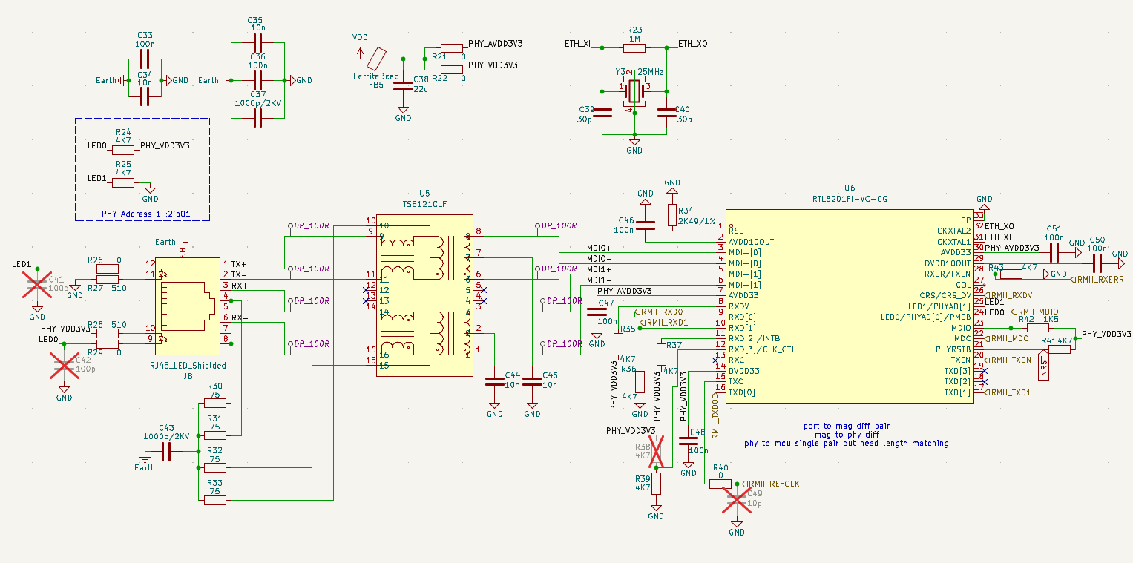
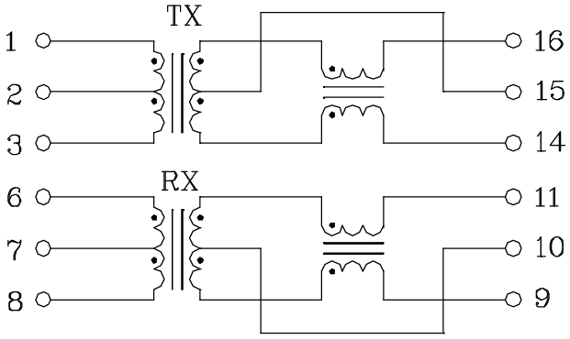
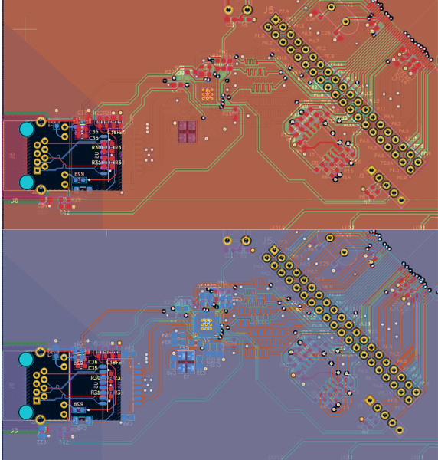
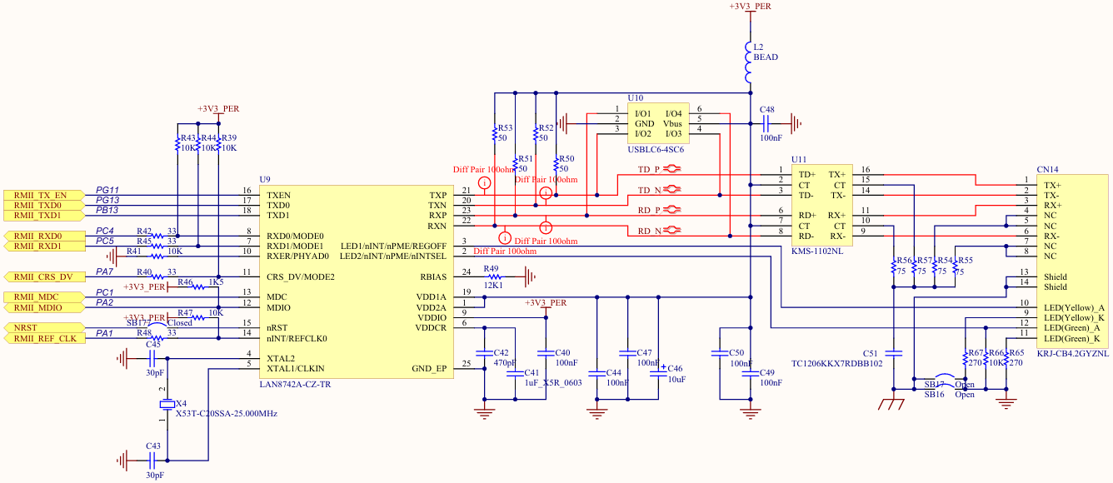
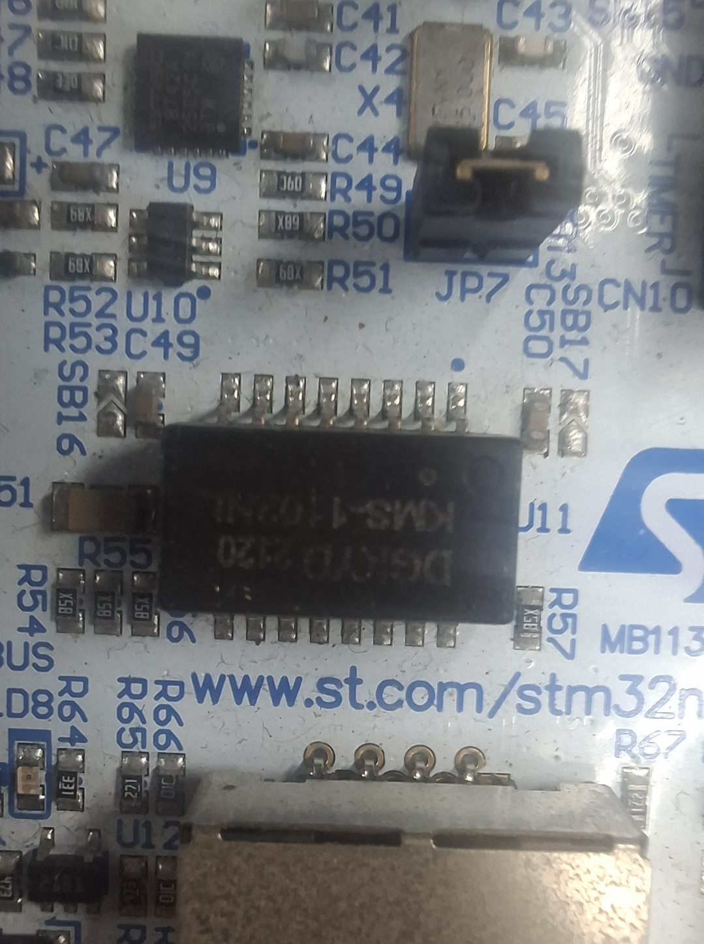
Ethernet
TS8121CLF pinout
PCB v2 Ethernet schematic
PCB v2 Ethernet layout
Nucleo Ethernet schematic
  Current schematic and component placement follow the Numaker M467 Ethernet circuit
  Nucleo’s Ethernet uses different components, but the transformer pinout is compatible with PCB v2 ethernet transformer
  Since both transformer have 1:1 turns ratio on RX and TX, the transformer, also PHY IC, can be placed on top layer like Nucleo’s Ethernet
Nucleo Ethernet placement

Slide 12
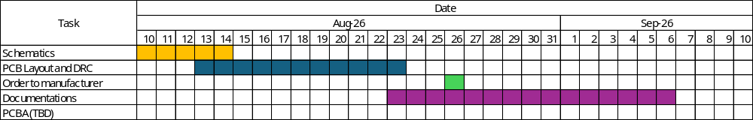
Current Progress and Timeline
  Schematics 50%
  Timeline

