Slide 1
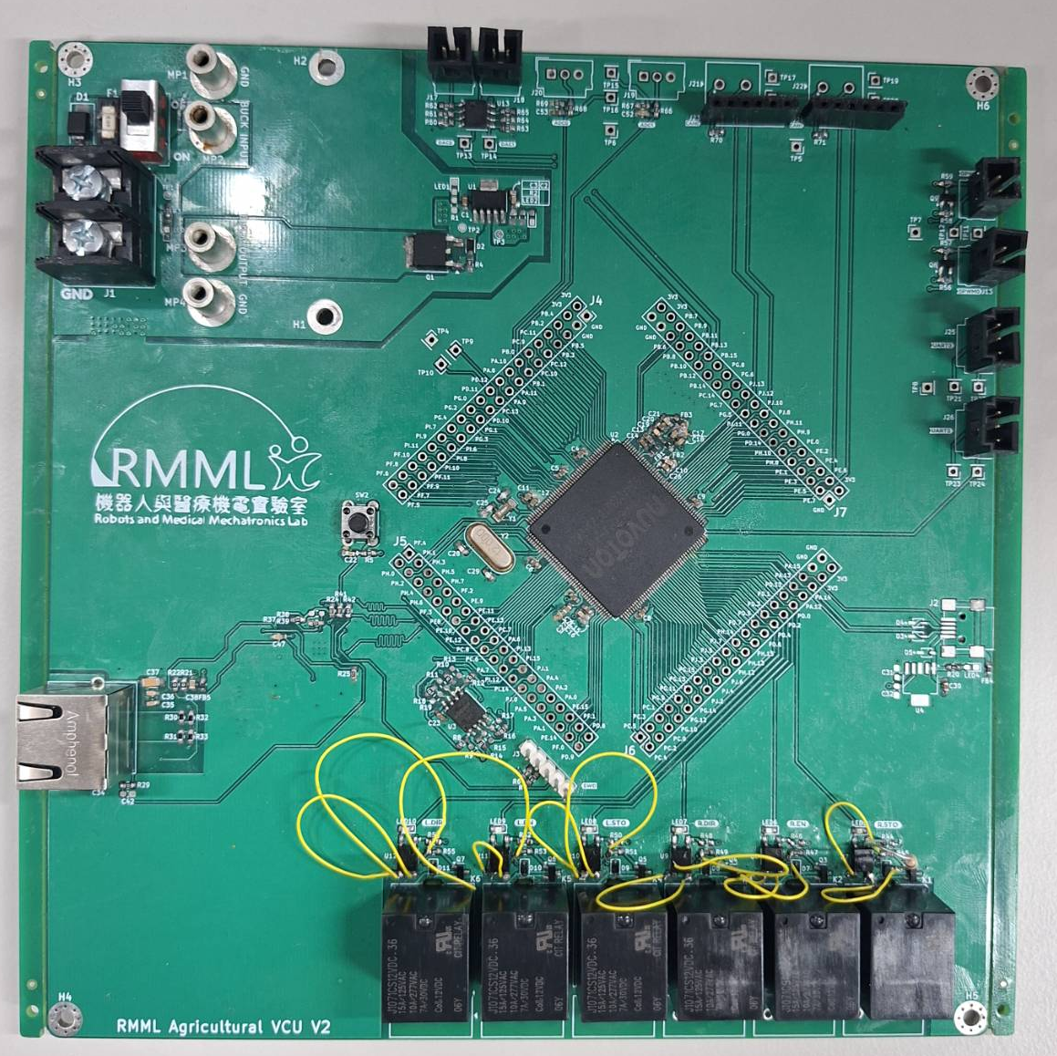
4
5
6
Power input 12V
Buck module 12V → 5V
Reverse voltage protection and 3V3 regulator
DAC
ADC
CAN with MCP2551
PWM
UART
MCU Nuvoton M467HJHAN
Reset button
USB
Relay
Ethernet
1
3
7
2
9
8
10
11
13
12

