Slide 1



APP PROJECT OVERVIEW · MILESTONE I
AI-powered financial planning for small businesses
Turning the data a business already has into clear, forward-looking cash decisions.
TEAM
[Team name]
Laura Rodríguez Ortega · [Member name] · [Member name]
Notes:
Aheadly is an AI financial co-pilot for small, local businesses in Latin America. Today we walk through the problem, our solution and the role of AI, the MVP scope, our persona and storyboard, and the three UML diagrams.

Slide 2




Small business owners are forced to guess
PROJECT SUMMARY · PROBLEM & TARGET USER
Who
Owners of small, local businesses in Colombia (bakeries, cafés, shops) with 1 to 15 employees and no finance staff.
The problem
They can't see a cash shortfall coming, so payroll, supplier bills and big purchases are decided blind.
Why it matters
One surprise shortfall means a late supplier, an overdraft fee or a missed payroll.
HOW THEY COPE TODAY
Bank balance
Spreadsheets
Gut feel
Shows today, not next month
Only show what already happened
Plus an accountant once a month
Notes:
Our user is the owner of a small, local business in Colombia, like a neighborhood bakery. They have the numbers, but not the answers. Today they cope with the bank balance, spreadsheets, gut feel and a monthly accountant, all backward looking.

Slide 3




A financial co-pilot that sees what's next
PROJECT SUMMARY · SOLUTION & ROLE OF AI
Aheadly connects to the business’s bank and QuickBooks, forecasts cash for the next 8 weeks, warns early in plain words and answers what-if questions.
AI JOB
KIND OF AI
WHY AI, AND NOT A FIXED RULE
Forecast cash flow
Time-series ML model
Learns each business’s seasonality, weekly rhythm and recurring bills. A fixed spreadsheet rule can’t adapt to every business.
Runs daily in the background
Prophet (Python), trained on her own transactions
Write plain alerts
LLM API
Turns forecast numbers into a short message with the cause and 2 to 3 actions. A template can’t explain the why for each case.
When a shortfall or idle cash is coming
Claude or Gemini
Answer & run what-ifs
LLM + function calling
Turns “What if I buy the oven next month?” into scenario inputs and reruns the forecast. No finance skills or menus needed.
In a simple chat, in her own words
Claude or Gemini calls our forecast engine
Guardrail: every number comes from the forecast engine. The LLM only explains and translates, so it never invents figures.
Notes:
AI does three specific jobs. A time-series model forecasts cash. An LLM writes alerts in plain language. The same LLM, with function calling, turns a question into a scenario and our forecast engine computes the answer.

Slide 4


Four core features, nothing more
PROJECT SUMMARY · MVP SCOPE
1
2
OUT OF SCOPE FOR NOW
Moving money or paying bills
Bookkeeping, invoicing and taxes
Loans or credit offers
Native mobile app (MVP is a Streamlit web app)
Multiple users or accountant access
Live Colombian bank feeds (MVP uses Plaid sandbox data)
Connect financial accounts
Receive early-warning alert
Link the bank (Plaid sandbox) and QuickBooks once. Transactions then sync on their own.
The forecast runs daily. A plain-language alert arrives when a shortfall or idle cash is coming.
3
4
Ask about my numbers
Test a what-if scenario
Chat with Aheadly about balances, trends and upcoming bills, in everyday words.
Model a purchase or change before deciding, with best, base and worst case.
Stack: Python, Streamlit, SQLite, Prophet, Plaid, QuickBooks API, Claude or Gemini API
Notes:
Our MVP is exactly four features, and they map one to one to the use cases. Everything that moves money, files taxes or needs real Colombian bank connections is out of scope for this semester.

Slide 5


Meet Maria, the owner we design for
STORYBOARD · PERSONA
Maria Gómez, 45
Owner of Panadería La Esquina, Bogotá
Opened her neighborhood bakery 12 years ago. 6 employees, walk-in customers and two cafés she supplies.
Goals
Never miss payroll or a supplier bill
Know if she can afford a new oven
Worry less about the numbers
Pain points
Only sees today’s bank balance
Accountant’s report arrives a month late
Bills pile up in one week and surprise her
Tech comfort: medium
Daily: smartphone, WhatsApp, online banking
QuickBooks set up by her accountant
Won’t learn a complex finance tool
“I know how to bake. I just need to know if I’ll have enough cash next month.”
Notes:
Maria is our target user made concrete: a bakery owner with goals, pain points and medium tech comfort. She is also the Business Owner actor in our use case diagram.

Slide 6
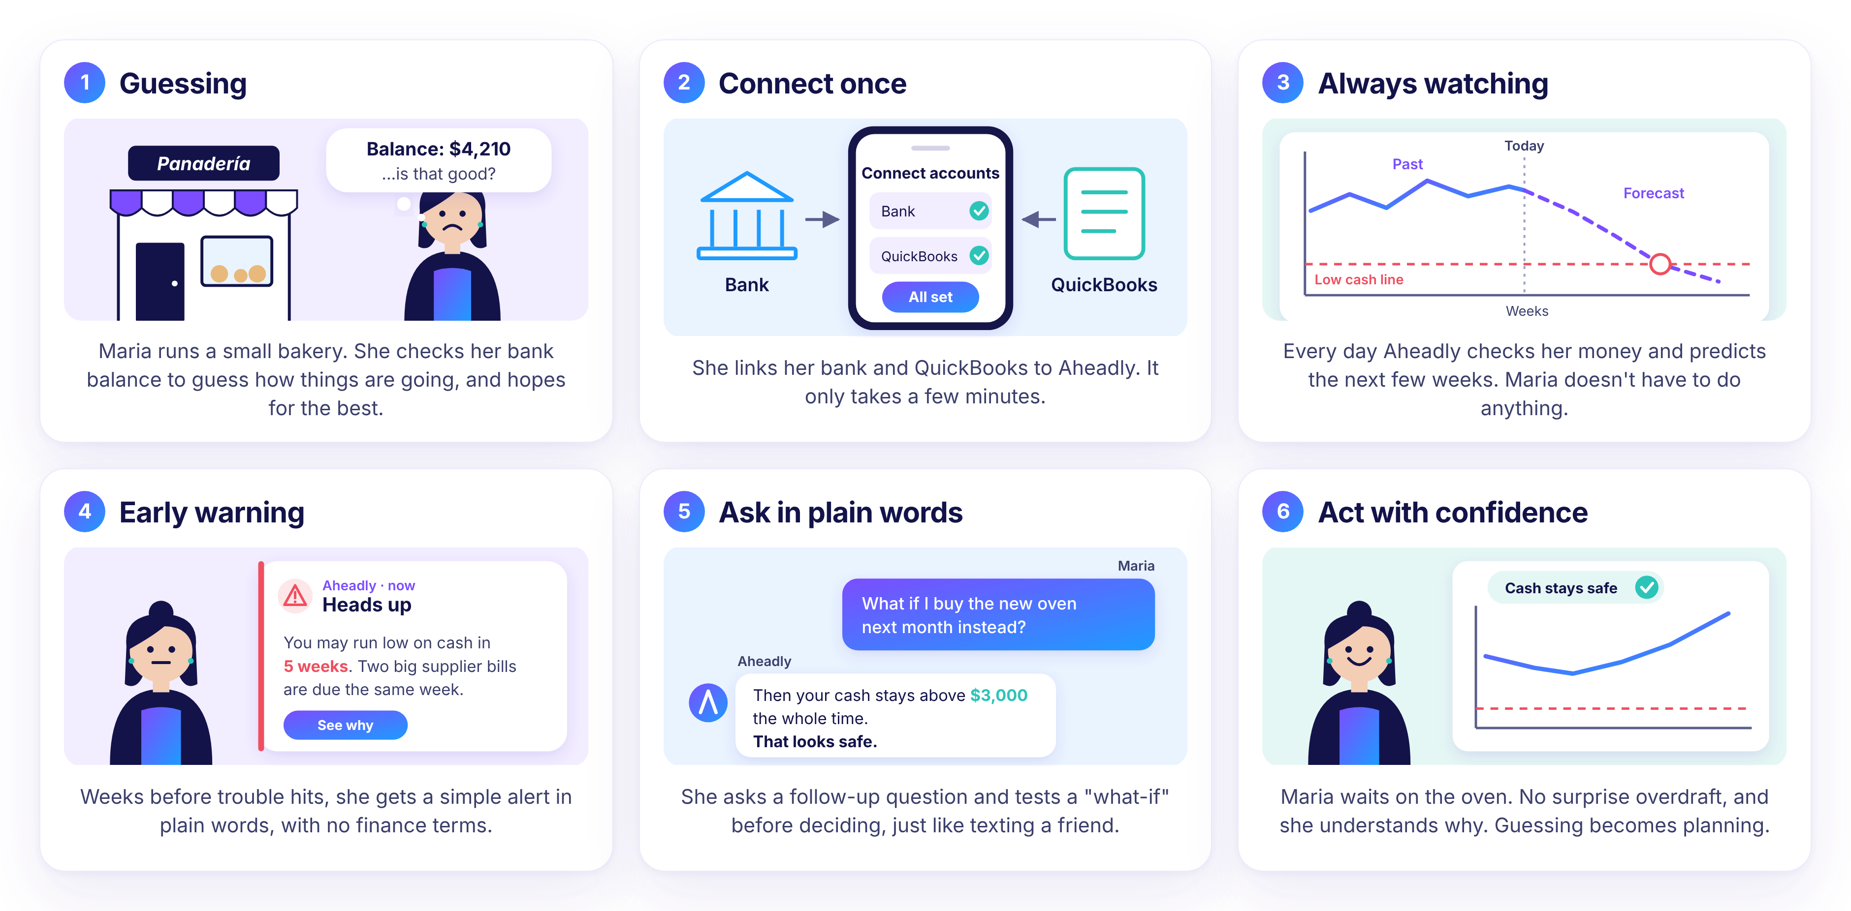
How Maria avoids a cash crunch
STORYBOARD · MAIN FLOW
Notes:
Trigger: Maria only guesses from her balance. She connects once, Aheadly watches every day, and five weeks before trouble the AI sends a plain alert. She asks a what-if in her own words and decides to wait on the oven. Guessing becomes planning.

Slide 7
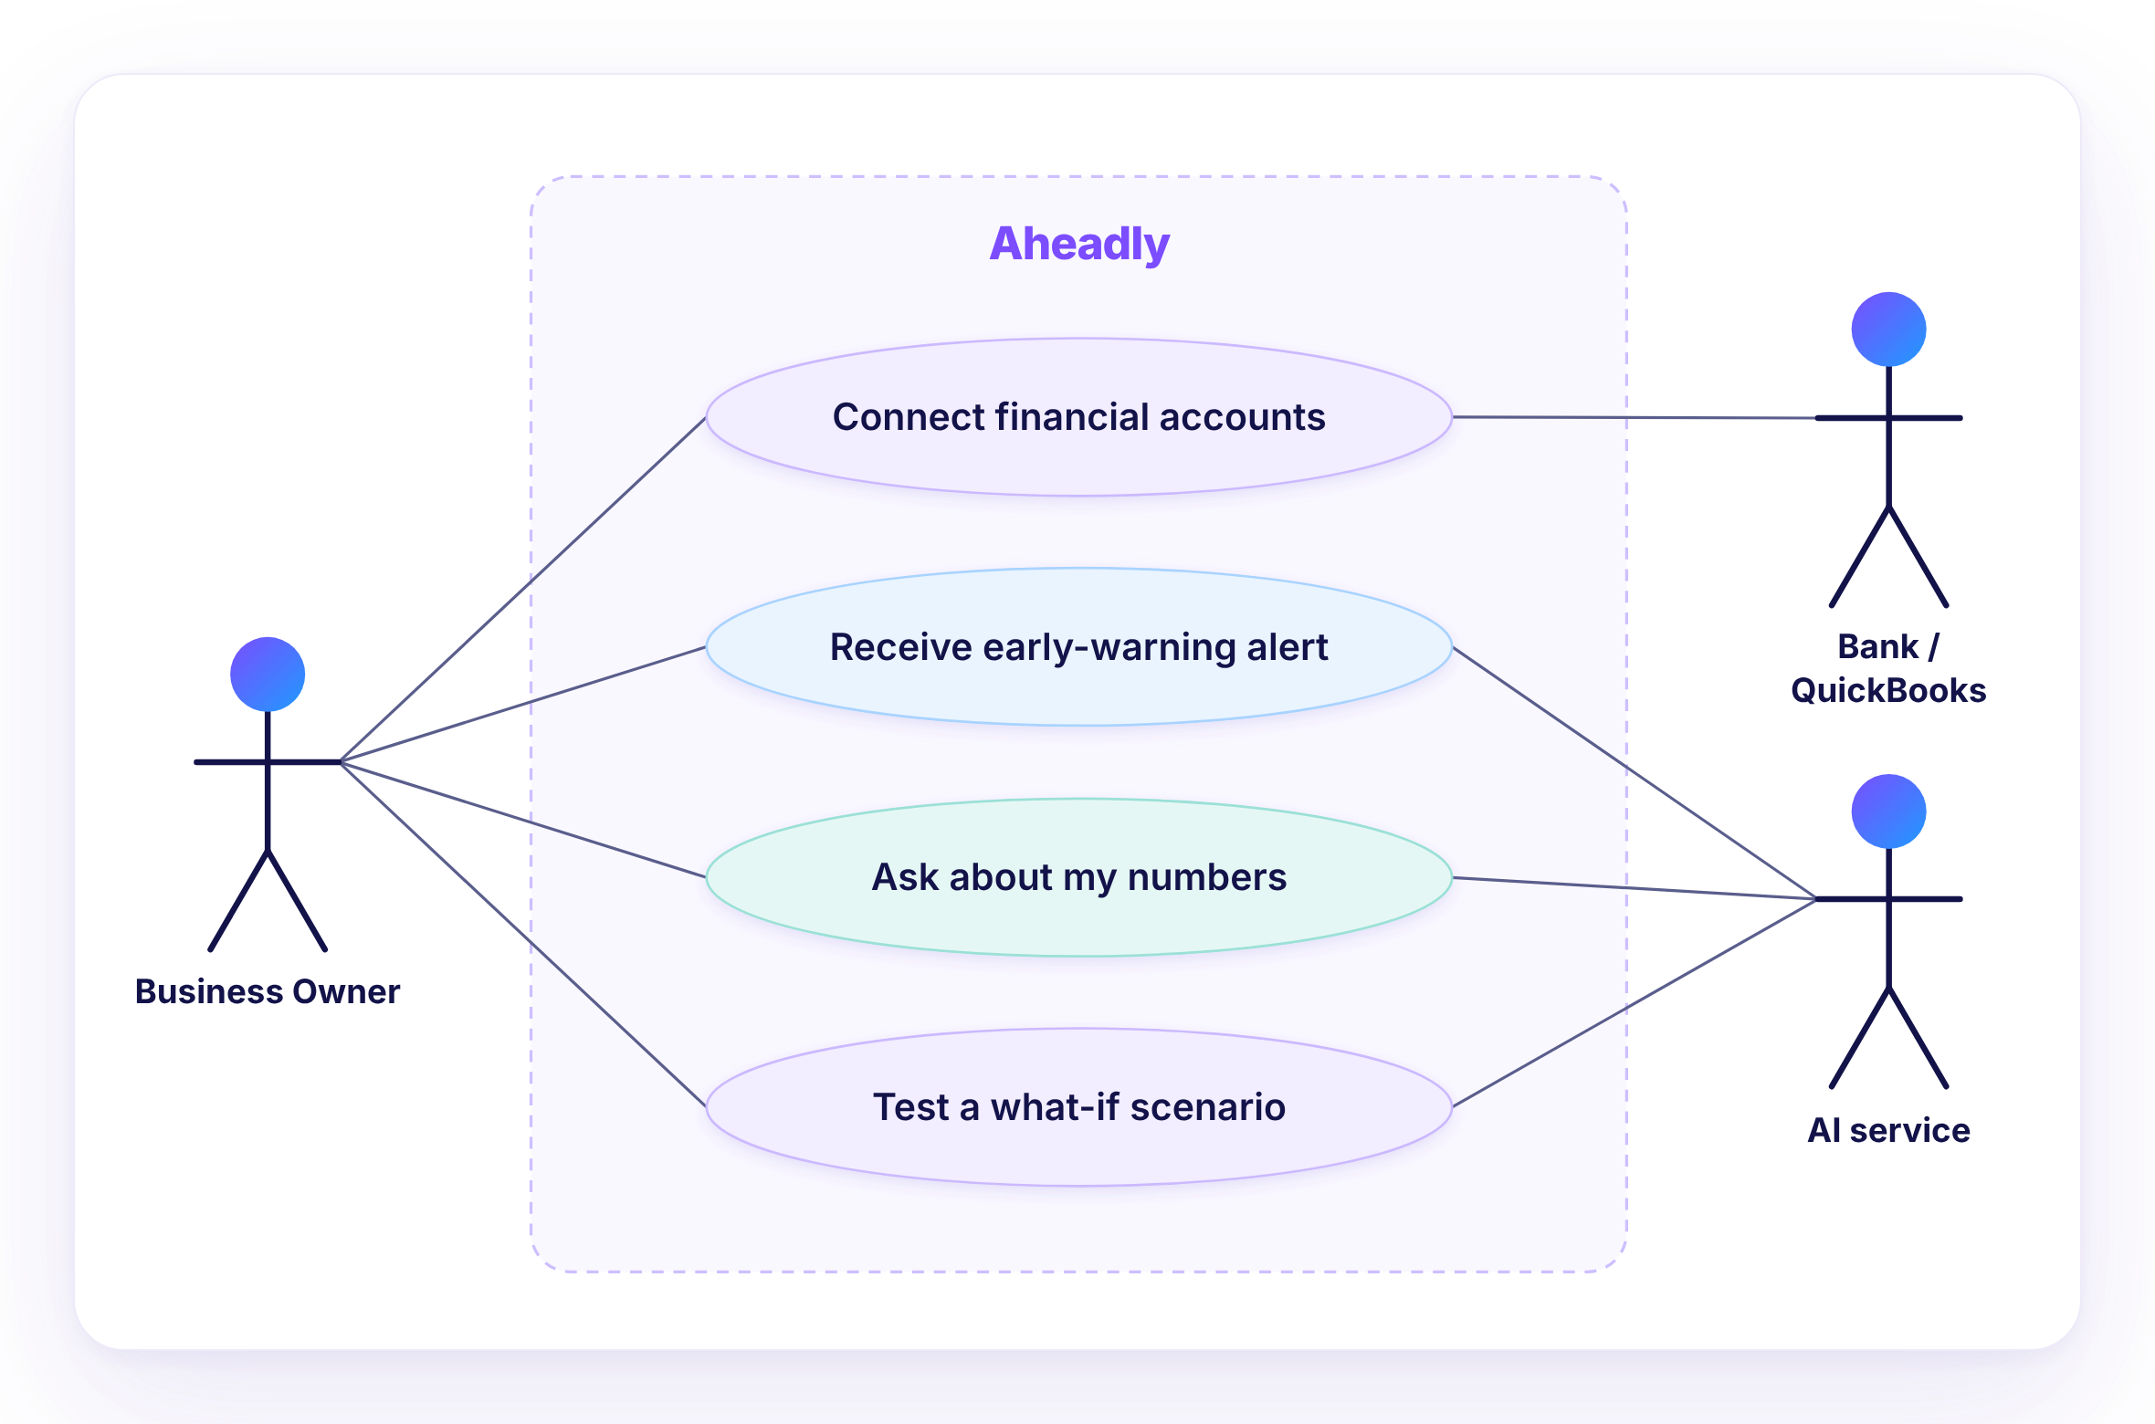

Four goals, one primary actor
UML · USE CASE DIAGRAM
Primary actor
Business Owner: our persona Maria.
Secondary actors
Bank / QuickBooks for data, and an external AI service (Claude or Gemini LLM API).
Use cases = MVP
Each of the 4 MVP features is one goal-named use case inside the Aheadly boundary.
Notes:
The system boundary is Aheadly. Maria is the primary actor on the left. The bank or QuickBooks and the AI service are secondary actors on the right. The four use cases are our four MVP features.

Slide 8
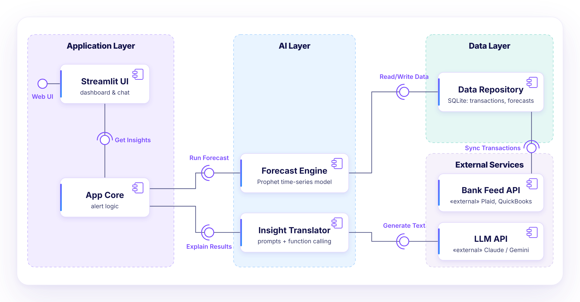



Three layers, two external services
UML · COMPONENT DIAGRAM
Application
Streamlit UI and the App Core alert logic
AI
Prophet forecasts, an LLM explains them
Data
SQLite store fed by Plaid and QuickBooks
«external» = services we call, not build. Ball = provided interface, socket = required.
Notes:
Three layers. Application: Streamlit UI and App Core. AI: the Forecast Engine and the Insight Translator. Data: our repository. External services are the bank feed and the LLM API. Each dependency is a ball and socket.

Slide 9
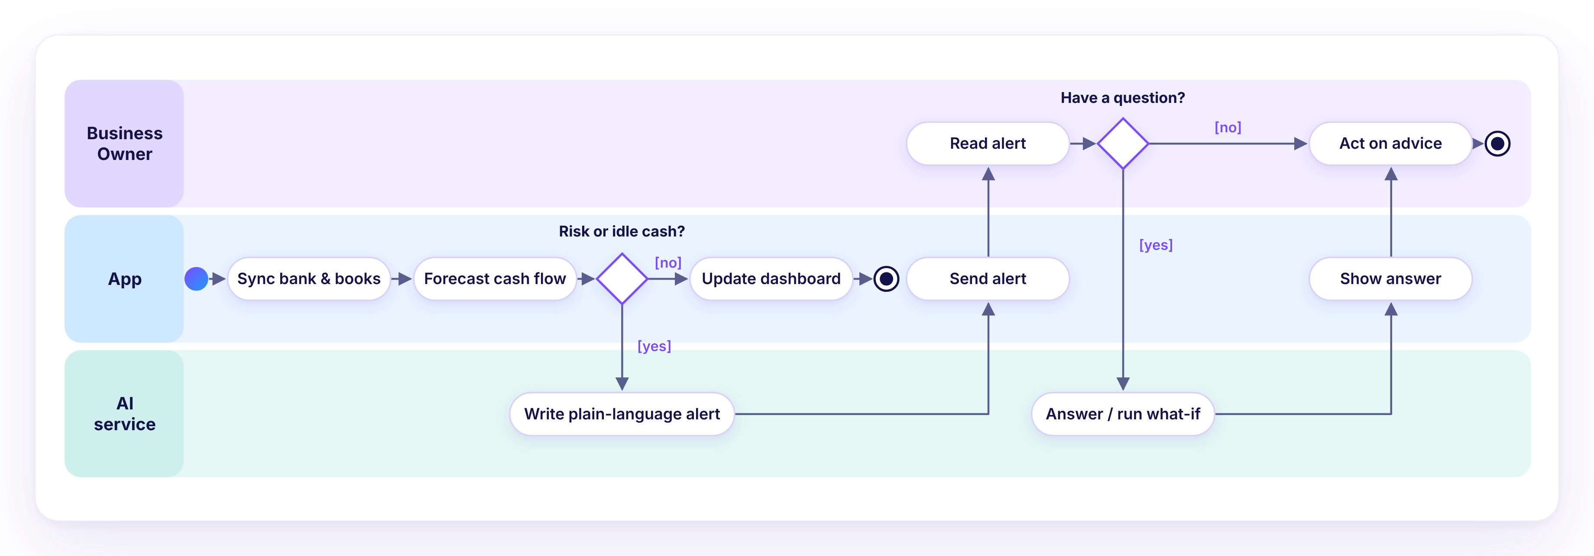


Core flow: from data to decision
UML · ACTIVITY DIAGRAM
Start
AI steps
Decisions
A daily sync of bank and books starts each run.
Alert writing and what-if answers have their own swimlane.
Two labeled decisions. Every path ends at a final node.
Notes:
This is the core use case end to end. The app syncs and forecasts. If there is a risk or idle cash, the AI writes the alert. If Maria has a question, the AI answers or runs a what-if, and she acts on the advice.

Slide 10

One product, one story
CONSISTENCY ACROSS DELIVERABLES
Maria
Target user in the summary = persona = primary actor in the use case diagram
4 MVP features
The same 4 goals appear as the 4 use cases
Storyboard frames 3 to 6
The activity diagram: forecast, alert, question, decision
Plaid, QuickBooks, Claude, Gemini
The «external» services in the component diagram
Clarity today. A brighter tomorrow.
Notes:
Every deliverable describes the same product: Maria is our target user and primary actor, the MVP features are the use cases, the storyboard follows the activity flow, and the external services match the component diagram.

