Slide 1
King County
House Price Analysis
Predicting real estate prices in King County, WA
May 2014 – May 2015 · 21,613 transactions · 21 features
21,596
24.6%
$450K
R² 0.74
Clean Records
Luxury (≥$650K)
Median Price
Best Model

Slide 2
Agenda
King County House Price Analysis
Data Overview & Cleaning
EDA & Key Findings
01
02
21,613 records · targeted outlier removal · 0 nulls
Distributions, correlations, density lens, geo map
Feature Engineering
Preprocessing
03
04
7 new features: house_age, renovation flags, ratios
Log-transform, StandardScaler, 80/20 split
Model Comparison
Results & Luxury Segment
05
06
5 models: Linear → Gradient Boosting
R²=0.74 overall · R²=0.56 luxury · feature importance

Slide 3
01 · Data Overview & Cleaning
King County House Price Analysis
Dataset Facts
Cleaning Decisions
Records
21,613 (21,596 after cleaning)
Removed
▸ bedrooms = 33 — data entry error (sqft_living doesn't match)
Features
21 raw → 19 used in model
▸ bedrooms = 0 or bathrooms = 0 — likely land plots, not houses
Period
May 2014 – May 2015
Missing values
No imputation needed
Kept as-is
▸ sqft_basement = 0 — normal, many houses have no basement
Price min
$78,000
▸ yr_renovated = 0 — normal, means never renovated
Price median
$450,000
▸ Large lots, high prices — real market data, not errors
Price mean
$540,198
Price max
$7,700,000
Targeted cleaning based on domain logic — not blanket IQR removal.

Slide 4
02 · EDA — Key Findings
King County House Price Analysis
📈 Price is Right-Skewed
🏠 sqft_living Dominates
🌊 Waterfront Premium
Skewness: 4.026
r = 0.702
~3× price
Log-transform reduces to 0.430 — needed for linear models
Highest linear correlation with price among all raw features
Waterfront properties command dramatically higher prices
Top Correlations with Price
Luxury vs Standard Segment
sqft_living
0.702
Standard <$650K
Luxury ≥$650K
grade
0.668
Count
16,274 (75.4%)
5,322 (24.6%)
sqft_above
0.605
sqft_living avg
1,680 sqft
2,895 sqft
sqft_living15
0.585
Grade avg
7.1
9.2
bathrooms
0.526
Bathrooms avg
1.9
2.8
view
0.397
Waterfront
0.4%
4.1%

Slide 5
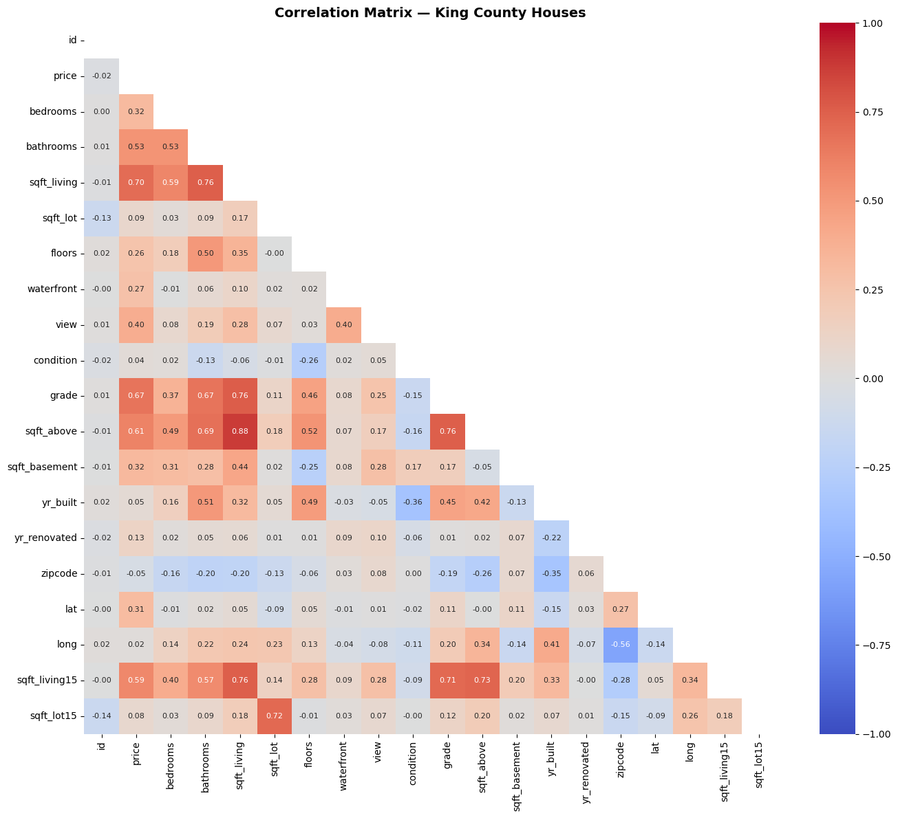
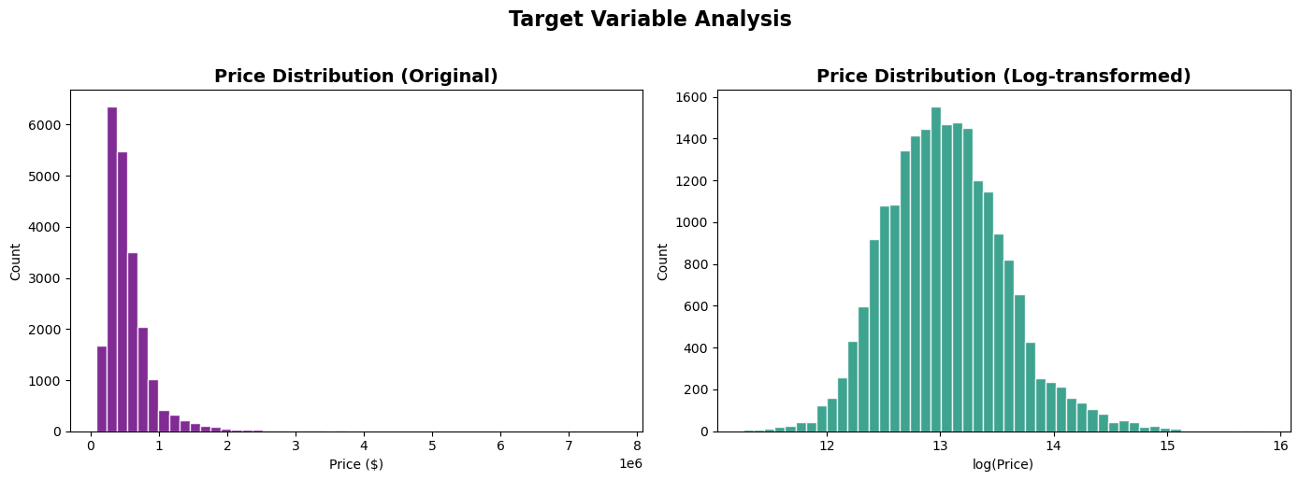
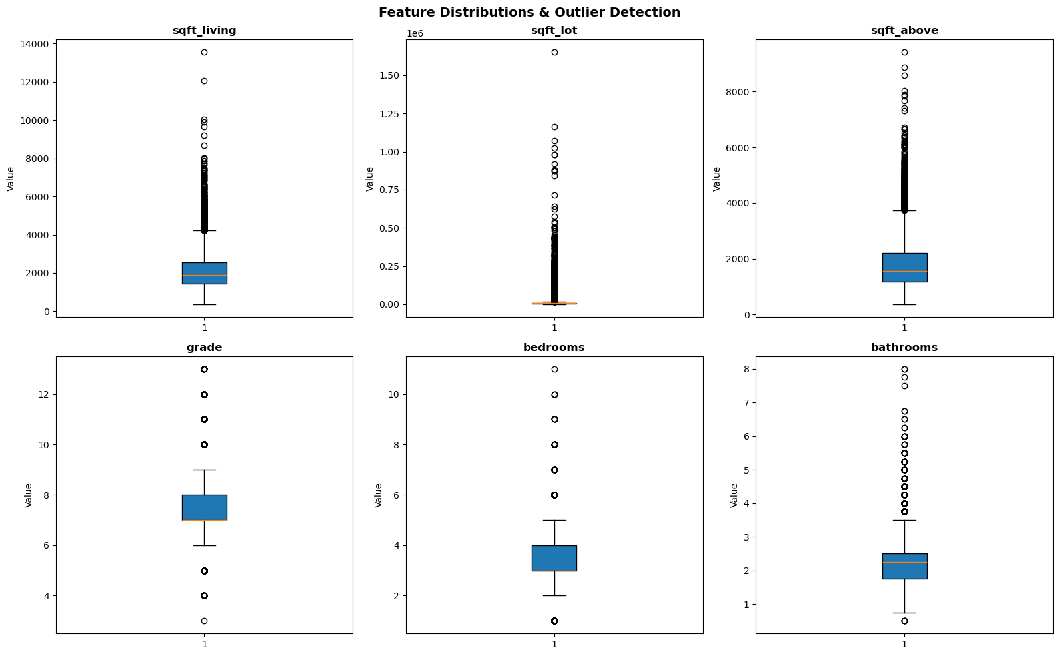
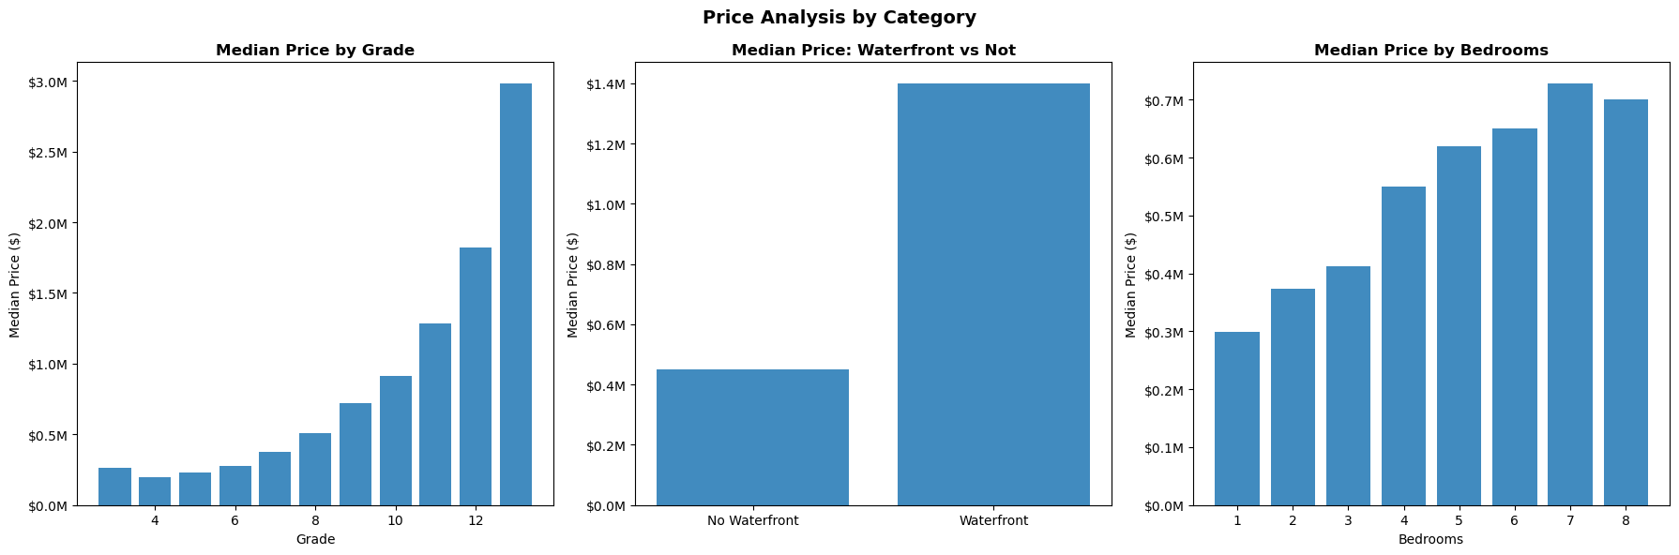
02. EDA - Visualizations
King County House Price Analysis
King County House Price Analysis

Slide 6
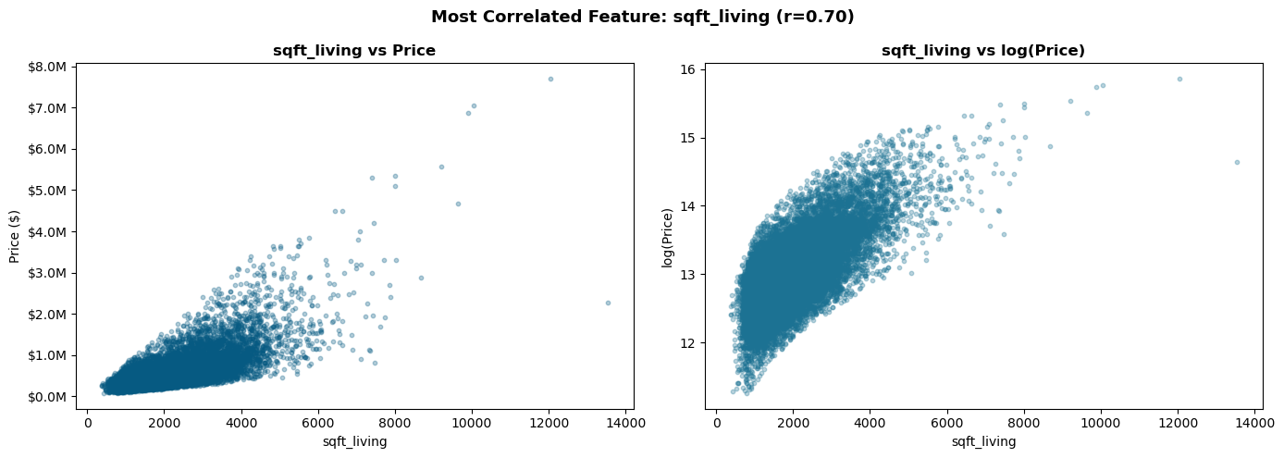
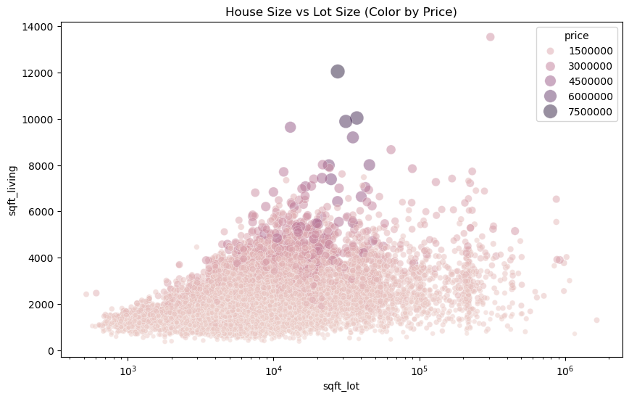
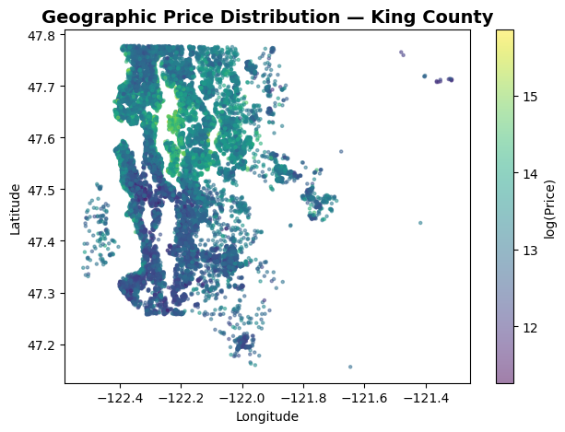
02. EDA - Visualizations
King County House Price Analysis
King County House Price Analysis

Slide 7
03–04 · Feature Engineering & Preprocessing
King County House Price Analysis
7 New Features Created
Preprocessing Pipeline
house_age
sale_year − yr_built
Log-transform target
1
Skewness: 4.026 → 0.430
Back-transform with np.expm1() for metrics
was_renovated
Binary: renovated or not
Train / Test Split
years_since_reno
Recency of last renovation
2
80% train (17,276) · 20% test (4,320)
random_state=42 for reproducibility
has_basement
Binary: basement present
StandardScaler
3
living_vs_neighbors
sqft_living / sqft_living15
Fit on train ONLY → transform both
Prevents data leakage from test set
sale_month
Seasonal price variation
No null imputation
4
lot_utilization
EDA only — not used in model
0 missing values in dataset
Step skipped entirely
price_per_sqft also computed for EDA only — both excluded to avoid data leakage.

Slide 8
05 · Model Selection & Comparison
King County House Price Analysis
5 models trained on log(price) — metrics evaluated on back-transformed dollar predictions
R² Score (higher = better)
RMSE & MAE
Gradient Boosting
0.7408
RMSE: $184,198 | MAE: $119,308
Random Forest
0.7268
RMSE: $189,096 | MAE: $114,498
Lasso
0.7048
RMSE: $196,553 | MAE: $129,807
Ridge
0.7037
RMSE: $196,930 | MAE: $129,942
Linear Regression
0.7037
RMSE: $196,941 | MAE: $129,944
Why Gradient Boosting? Sequentially corrects errors from prior trees. Captures non-linear interactions (e.g. grade × sqft). No distribution assumptions. +14pp R² vs linear baseline.

Slide 9
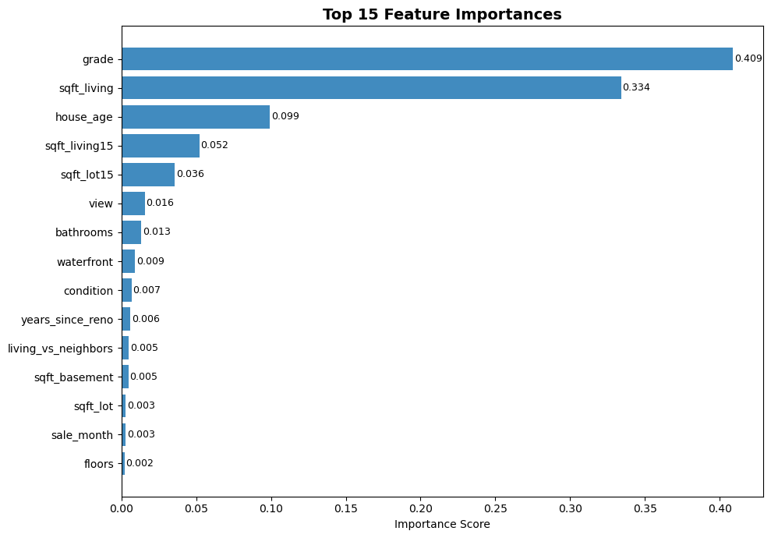
06 · Results, Feature Importance & Luxury Segment
King County House Price Analysis
0.7408
$184K
0.5631
$314K
R² Overall
RMSE Overall
R² Luxury ≥$650K
RMSE Luxury
74% variance explained
On original price scale
1,025 test houses
Higher variance segment
Feature Importances (Gradient Boosting)
Key Insights
⭐ grade ranks #1 in importance (40.9%) despite r=0.668 — non-linear multiplier effect
📐 sqft_living is #2 (33.4%) — consistent with highest linear correlation (r=0.702)
🏗️ house_age (#3, 9.9%) not in raw data — confirms value of feature engineering
🌊 waterfront only 0.9% importance despite 3× price premium — rare in test set (n<50)
⚠️ Luxury R² drops from 0.74 → 0.56 — idiosyncratic pricing not captured by standard features
💡 Separate dedicated model recommended for the luxury segment

Slide 10
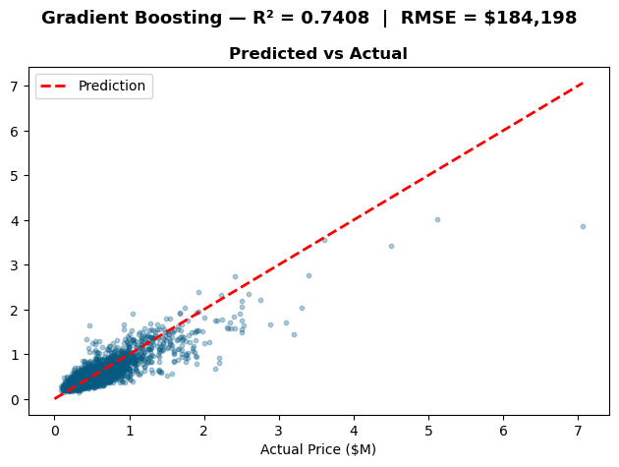
Conclusions
✓ Gradient Boosting best model: R²=0.74, RMSE=$184K
✓ grade is the #1 driver (40.9%) — non-linear multiplier effect
✓ Log-transforming price is critical: skewness 4.026 → 0.430
✓ house_age (#3) validates feature engineering value
✓ Luxury segment (24.6%) harder to predict: R²=0.56
✓ Targeted cleaning beats blanket outlier removal
Dataset: Kaggle — King County Houses · minasameh55

