Slide 1
Trends & Dynamics in Football Transfers
Notes:
Today I'm presenting my EDA project on football transfers, specifically looking at trends and dynamics in how players are bought, sold, and valued across football. The data comes from Transfermarkt, one of the most comprehensive public databases for football valuations and transfer records.

Slide 2
Project Overview
Focus: Analysing trends and dynamics in football transfers.
Objective: Answer a set of questions using Python and SQL with a free source database containing data extracted from Transfermarkt (a German-based football website that, (among other data) provides estimated market values for players).
The questions to answer are subdivided into 4 categories:
Market Value & Player Worth
Transfer Market Dynamics
League & Geography Economics
Career & Value Trajectories
Notes:
The objective was to answer 10 analytical questions using both Python/SQL. The questions are grouped into four themes: Market Value and Player Worth, Transfer Market Dynamics, League and Geography Economics, and Career and Value Trajectories. I'll walk you through each.

Slide 3
Project Overview: Questions
Market Value & Player Worth
Which positions command the highest market values?
Has this shifted over the last decade?
Is the agile foot determinant?
Transfer Market Dynamics
How has the overall transfer market inflated yearly, are fees growing faster than market values?
Which clubs consistently buy undervalued players?
Which clubs consistently sells overvalued players?
Does a high transfer fee actually translate into better performance (goals, assists, minutes played)?
League & Geography Economics
Which nationalities command a market value premium beyond what their stats would suggest?
Career & Value Trajectories
How does a player's market value evolve after moving to a bigger or smaller league?
Do players with more international caps earn a market value premium independent of club performance?
Notes:
Here's the full list of questions. You can see they range from fairly descriptive — which positions are worth the most — to more investigative ones like whether paying a high fee actually gets you better performance, or whether a player's market value grows after moving to a bigger league. I'll go through them in order.

Slide 4
Importing to SQL
glob: built-in Python module that finds files matching a pattern
import sqlite3
import pandas as pd
import glob
BASE_PATH = r"C:\Users\laura\OneDrive\Documents\Estudios\DATA SCIENCE & ML\w3\project\football-datasets\datalake\transfermarkt"
DB_PATH = BASE_PATH + r"\transfermarkt.db"
conn = sqlite3.connect(DB_PATH)
for csv_file in glob.glob(BASE_PATH + r"\**\*.csv", recursive=True):
table_name = csv_file.split("\\")[-2]
df = pd.read_csv(csv_file, low_memory=False)
df.to_sql(table_name, conn, if_exists="replace", index=False)
conn.close()
Notes:
The first step was getting the data into SQL. The dataset is structured as a set of CSVs, one per table. I used Python's glob module to loop through all the files recursively and load each one into a SQLite database using pandas.to_sql. This gave me a single .db file I could then query in DB Browser.

Slide 5
Data Cleaning - Python
Get rid of players without:
- Market value.
- Position.
- Main position.
- Info of agile foot.
- Where position == main position (not fully defined, except GK).
df_latest_market_value = pd.read_csv("player_latest_market_value/player_latest_market_value.csv")
df_player_profiles= pd.read_csv("player_profiles/player_profiles.csv", low_memory=False)
df_mv_hist = pd.read_csv("player_market_value/player_market_value.csv")
cols = ['player_id', 'position', 'main_position', 'foot']
df_pp = df_player_profiles[cols].copy()
df = df_latest_market_value.merge(df_pp, on='player_id', how='inner')
# EDA & CLEANING
df = df[df['value'].notna() & (df['value'] > 0)]
df = df[df['position'].notna() & (df['position']!= '')]
df = df[df['main_position'].notna() & (df['main_position']!= '')]
df = df[df['foot'].notna()& (df['foot']!= '')]
df = df[(df['main_position'] != df['position']) | (df['main_position'] == 'Goalkeeper')]
df = df[df['date_unix'].notna()]
df['value_year'] = pd.to_datetime(df['date_unix'], unit='s').dt.year.astype(int)
df['value_m'] = df['value'] / 1_000_000
Normalization of year
Readable value
Notes:
Before any analysis, I cleaned the data. The main filters were removing players without a market value, without a position, without foot preference data, and without a main position properly assigned. I also normalised the value column into millions and extracted the year from a Unix timestamp. This left me with a clean, analysis-ready DataFrame. I did this whenever it was necessary or to excluye outliers.

Slide 6
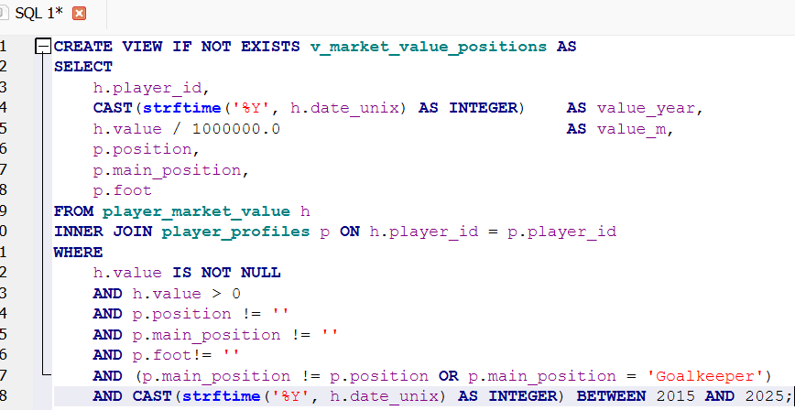
Data Cleaning - SQL
Notes:
On the SQL side, the equivalent cleaning was done at query time using WHERE clauses — filtering out nulls, zero values, and incomplete records inline. The SQL and Python cleaning logic mirrors each other, which was important for consistency across both tools.

Slide 7
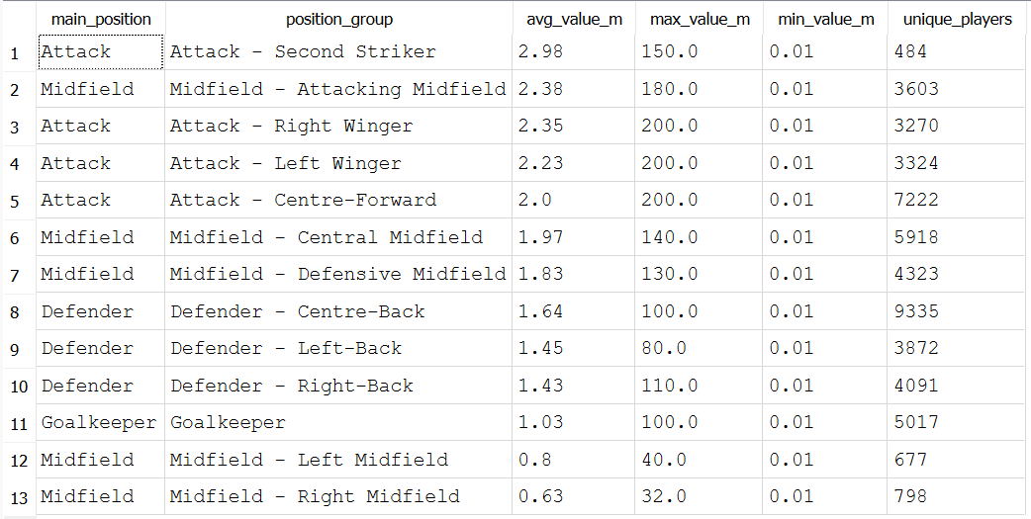
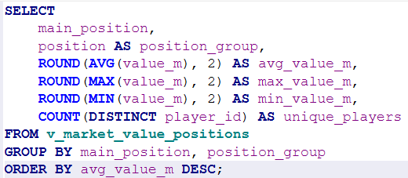
1. Which positions command the highest market values?
Market Value & Player Worth 💎
Which positions have the highest average market value across all years?
Notes:
which positions command the highest market values? The SQL shows the average value grouped by position. We can already see from the table that attacking positions — forwards and attacking midfielders — come out on top.

Slide 8
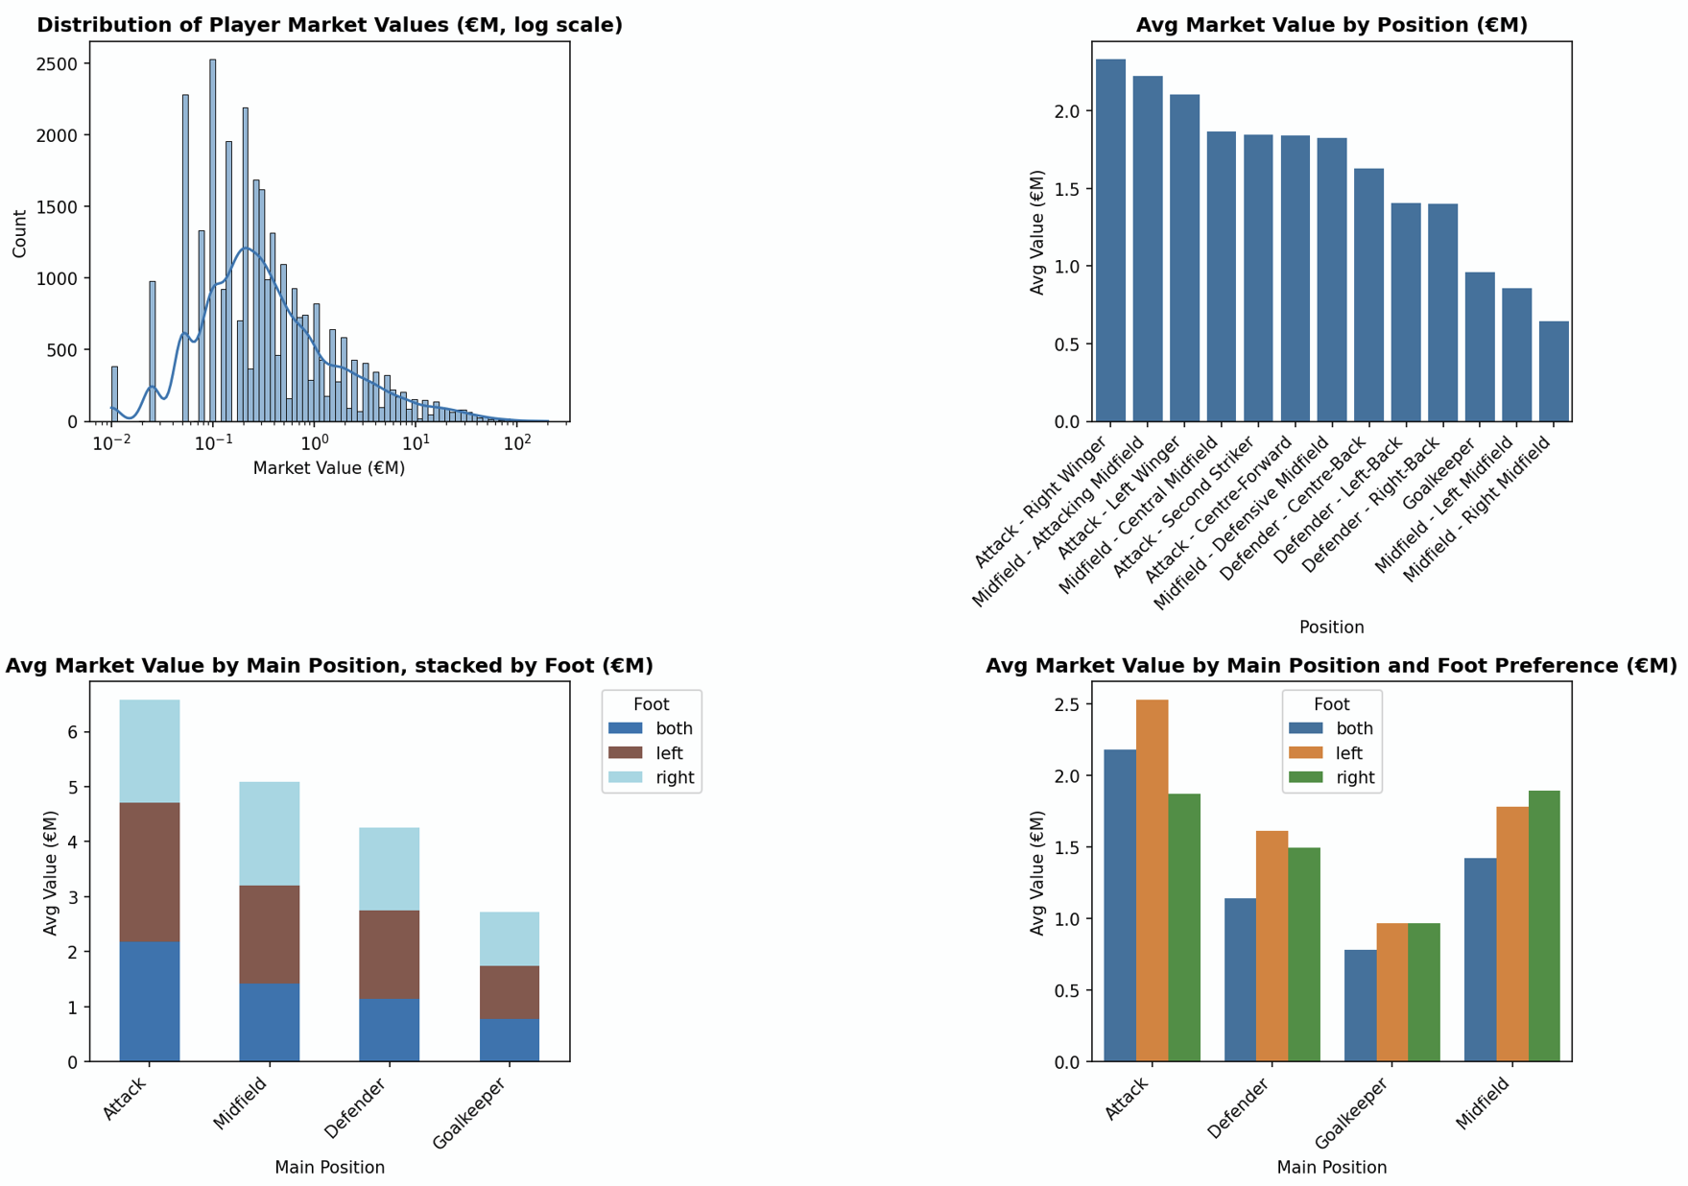
1. Which positions command the highest market values?
Market Value & Player Worth 💎
# VIZ 1 — Distribution of market values (log scale)
ax1 = fig.add_subplot(4, 2, 1)
sns.histplot(df['value_m'], bins=80, log_scale=True, kde=True, ax=ax1)
ax1.set_title("Distribution of Player Market Values (€M, log scale)", fontsize=12, fontweight='bold')
ax1.set_xlabel("Market Value (€M)")
ax1.set_ylabel("Count")
# VIZ 2 — Avg market value by main position
ax2 = fig.add_subplot(4, 2, 2)
main_pos_avg = (df.groupby('position')['value_m'].mean().sort_values(ascending=False).reset_index())
sns.barplot(data=main_pos_avg, x='position', y='value_m', ax=ax2)
plt.setp(ax2.get_xticklabels(), rotation=45, ha='right')
ax2.set_title("Avg Market Value by Position (€M)", fontsize=12, fontweight='bold')
ax2.set_xlabel("Position")
ax2.set_ylabel("Avg Value (€M)")
# VIZ 3 — Avg market value by position group, stacked by foot
ax3 = fig.add_subplot(4, 2, 3)
foot_pos = (df.groupby(['main_position', 'foot'])['value_m'].mean().reset_index())
pivot3 = foot_pos.pivot(index='main_position', columns='foot', values='value_m').fillna(0)
pivot3 = pivot3.loc[pivot3.sum(axis=1).sort_values(ascending=False).index]
pivot3.plot(kind='bar', stacked=True, colormap='tab20', ax=ax3)
plt.setp(ax3.get_xticklabels(), rotation=45, ha='right')
ax3.set_title("Avg Market Value by Main Position, stacked by Foot (€M)", fontsize=12, fontweight='bold')
ax3.set_xlabel("Main Position")
ax3.set_ylabel("Avg Value (€M)")
ax3.legend(title="Foot", bbox_to_anchor=(1.05, 1), loc='upper left')
# VIZ 4 — Avg market value by position group + foot (grouped)
ax4 = fig.add_subplot(4, 2, 4)
pos_foot = (df.groupby(['main_position', 'foot'])['value_m'].mean().reset_index())
sns.barplot(data=pos_foot, x='main_position', y='value_m', hue='foot', palette='tab10', ax=ax4)
plt.setp(ax4.get_xticklabels(), rotation=45, ha='right')
ax4.set_title("Avg Market Value by Main Position and Foot Preference (€M)", fontsize=12, fontweight='bold')
ax4.set_xlabel("Main Position")
ax4.set_ylabel("Avg Value (€M)")
ax4.legend(title="Foot")
Notes:
The charts confirm it visually. The distribution of market values is heavily right-skewed — most players are worth under €5M, but a small number of elite players pull the average up significantly. When we break it down by position, forwards lead clearly, followed by attacking mids. Interestingly, the foot preference charts show that left-footed players often carry a slight premium — particularly in wide attacking positions.

Slide 9
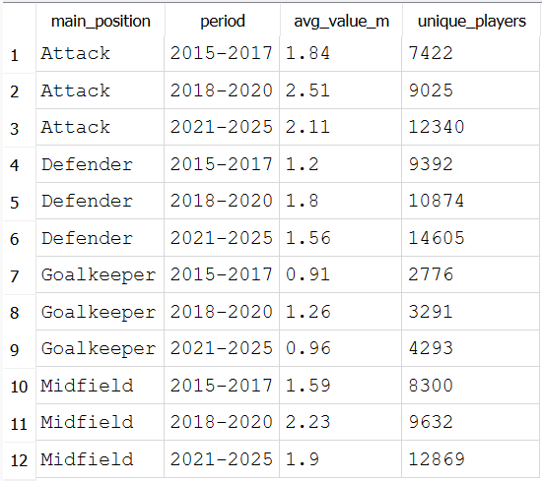
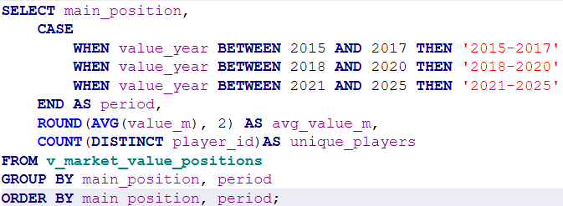
2. Has this shifted over the last decade?
Market Value & Player Worth 💎
Has it shifted? Avg value per main position
Notes:
Question 2 asks whether these position rankings have changed over time. I filtered to the last decade, 2015 to 2025, and grouped average value by position and year.

Slide 10
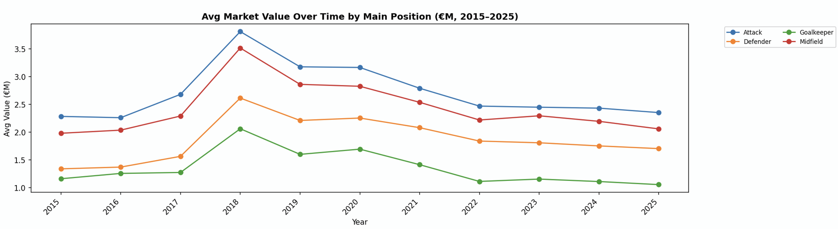
2. Has this shifted over the last decade?
Market Value & Player Worth 💎
# VIZ 5 — Avg market value over time by main position (2015–2025)
ax5 = fig.add_subplot(4, 2, (5, 6))
time_pos = (df_hist[df_hist['value_year'].isin(valid_years) &(df_hist['value_year'] >= 2015)].groupby(['value_year', 'main_position'])['value_m'].mean().reset_index())
pivot5 = time_pos.pivot(index='value_year', columns='main_position', values='value_m')
for col in pivot5.columns:
ax5.plot(pivot5.index, pivot5[col], marker='o', label=col)
ax5.set_xticks(pivot5.index)
plt.setp(ax5.get_xticklabels(), rotation=45, ha='right')
ax5.set_title("Avg Market Value Over Time by Main Position (€M, 2015–2025)",fontsize=12, fontweight='bold')
ax5.set_xlabel("Year")
ax5.set_ylabel("Avg Value (€M)")
ax5.legend(bbox_to_anchor=(1.05, 1), loc='upper left', fontsize=8, ncol=2)
Notes:
The trend lines show that all positions have inflated in value over the decade, but the ranking has remained fairly stable — forwards consistently at the top. The gap between positions has actually widened slightly, suggesting the premium on attacking talent has grown faster than other roles.

Slide 11
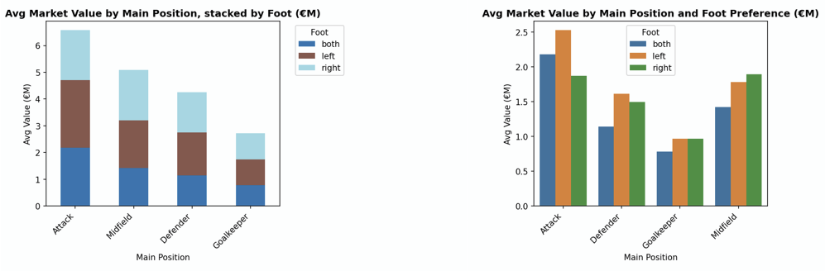
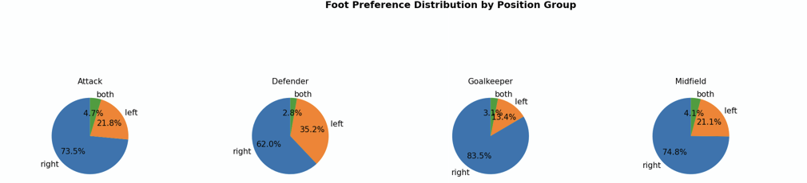
3. Is the agile foot relevant?
Market Value & Player Worth 💎
# VIZ 6 — Pie charts: foot distribution per position group
positions = sorted(df['main_position'].unique())
pie_axes = [fig.add_subplot(4, 4, 13 + i) for i in range(4)]
for ax, pos in zip(pie_axes, positions):
foot_counts = df[df['main_position'] == pos]['foot'].value_counts()
ax.pie(foot_counts,labels=foot_counts.index,autopct='%1.1f%%',colors=sns.color_palette('tab10', len(foot_counts)),startangle=90)
ax.set_title(pos, fontsize=10)
fig.text(0.5, 0.2, "Foot Preference Distribution by Position Group",ha='center', fontsize=12, fontweight='bold')
Notes:
Question 3 zooms in on foot preference. The pie charts show the distribution of left-footed versus right-footed players per position. Left-footed players are a minority across all positions, and this scarcity likely contributes to their premium.

Slide 12
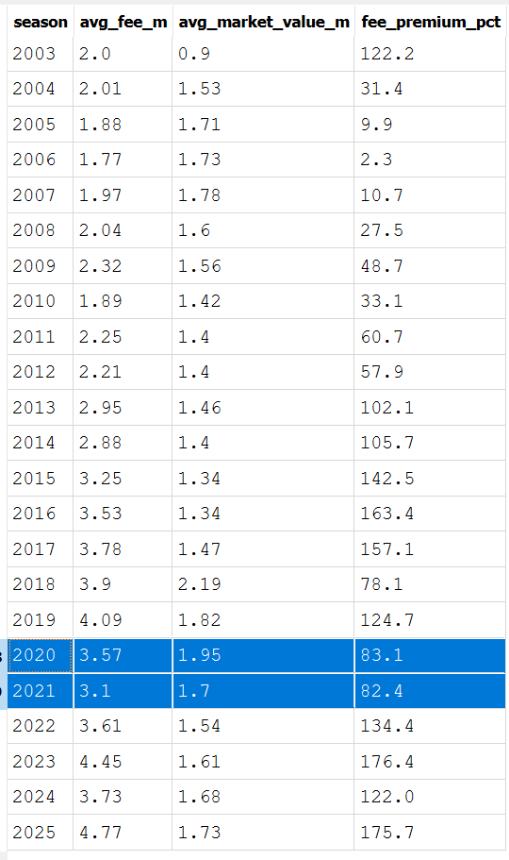
4. How has the overall transfer market inflated yearly, are fees growing faster than market values?
Transfer Market Dynamics 💱
SELECT season_name AS season, ROUND(AVG(transfer_fee) / 1000000.0, 2) AS avg_fee_m, ROUND(SUM(transfer_fee) / 1000000.0, 2) AS total_fee_m, COUNT(*) AS num_transfers
FROM transfer_history
WHERE transfer_fee IS NOT NULL AND transfer_fee > 0
GROUP BY season_name
ORDER BY season_name;
SELECT CAST(strftime('%Y', date_unix) AS INTEGER) AS season, ROUND(AVG(value) / 1000000.0, 2) AS avg_market_value_m
FROM player_market_value
WHERE value IS NOT NULL AND value > 0
GROUP BY season
ORDER BY season;
WITH fee_by_season AS (SELECT CAST(strftime('%Y', transfer_date) AS INTEGER) AS season, ROUND(AVG(transfer_fee) / 1000000.0, 2) AS avg_fee_m
FROM transfer_history
WHERE transfer_fee IS NOT NULL AND transfer_fee > 0
GROUP BY season),value_by_season AS (SELECT CAST(strftime('%Y', date_unix) AS INTEGER) AS season, ROUND(AVG(value) / 1000000.0, 2) AS avg_market_value_m
FROM player_market_value
WHERE value IS NOT NULL AND value > 0
GROUP BY season)
SELECT f.season, f.avg_fee_m, v.avg_market_value_m, ROUND((f.avg_fee_m - v.avg_market_value_m) / v.avg_market_value_m * 100, 1) AS fee_premium_pct
FROM fee_by_season f
INNER JOIN value_by_season v ON f.season = v.season
ORDER BY f.season;
Notes:
Question 4 looks at the overall transfer market. I compared average transfer fees to average market values season by season to see whether fees are growing faster than the underlying valuations. The SQL calculates this as a fee premium percentage. 2020-2021 are highlighted bc of covid, you can see that they are not as consistent when comparing them to the other years.

Slide 13
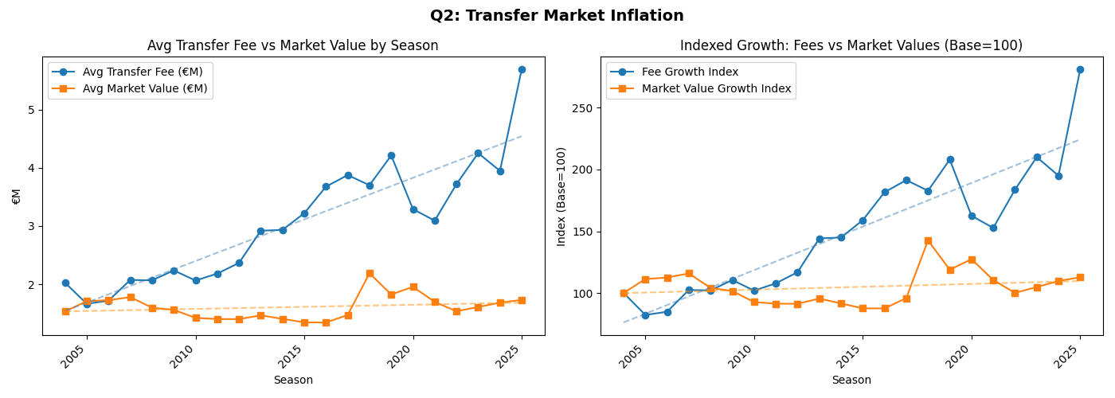
4. How has the overall transfer market inflated yearly, are fees growing faster than market values?
Transfer Market Dynamics 💱
# PLOTS
fig, axes = plt.subplots(1, 2, figsize=(14, 5))
# raw values
axes[0].plot(df_inflation['season_year'], df_inflation['avg_fee_m'], marker='o', label='Avg Transfer Fee (€M)')
axes[0].plot(df_inflation['season_year'], df_inflation['avg_value_m'], marker='s', label='Avg Market Value (€M)')
# Trend lines
for col, color in [('avg_fee_m', 'steelblue'), ('avg_value_m', 'darkorange')]:
z = np.polyfit(df_inflation['season_year'], df_inflation[col], 1)
p = np.poly1d(z)
axes[0].plot(df_inflation['season_year'], p(df_inflation['season_year']),'--', color=color, alpha=0.5, linewidth=1.5)
axes[0].set_title("Avg Transfer Fee vs Market Value by Season")
axes[0].set_xlabel("Season")
axes[0].set_ylabel("€M")
axes[0].legend()
plt.setp(axes[0].get_xticklabels(), rotation=45, ha='right')
# indexed growth + trend lines
axes[1].plot(df_inflation['season_year'], df_inflation['fee_idx'], marker='o', label='Fee Growth Index')
axes[1].plot(df_inflation['season_year'], df_inflation['value_idx'], marker='s', label='Market Value Growth Index')
# Trend lines
for col, color in [('fee_idx', 'steelblue'), ('value_idx', 'darkorange')]:
z = np.polyfit(df_inflation['season_year'], df_inflation[col], 1)
p = np.poly1d(z)
axes[1].plot(df_inflation['season_year'], p(df_inflation['season_year']),'--', color=color, alpha=0.5, linewidth=1.5)
axes[1].set_title("Indexed Growth: Fees vs Market Values (Base=100)")
axes[1].set_xlabel("Season")
axes[1].set_ylabel("Index (Base=100)")
axes[1].legend()
plt.setp(axes[1].get_xticklabels(), rotation=45, ha='right')
Notes:
The charts tell a clear story. Both fees and values have grown substantially, but fees have grown faster — the gap between the two lines has widened over time. This suggests the market is increasingly willing to pay above market value, driven by competition for elite talent and the fear of losing key players.

Slide 14
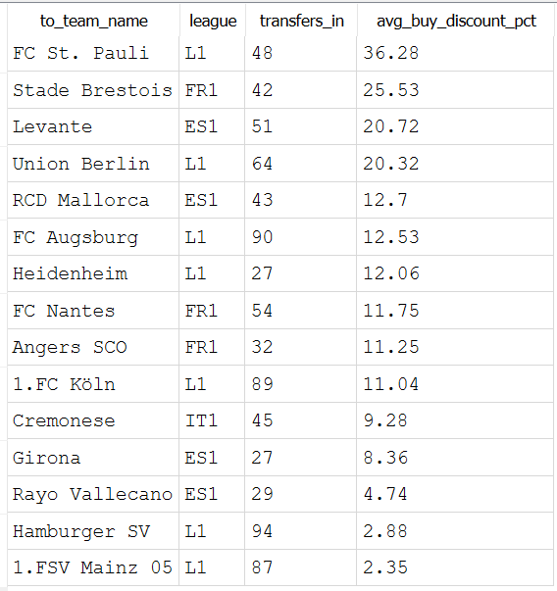
5. Which clubs consistently buys undervalued players? (Scouting efficiency when buying)
Transfer Market Dynamics 💱
SELECT t.to_team_name,d.competition_id AS league, COUNT(t.player_id) AS transfers_in, ROUND(ABS(AVG((t.transfer_fee - t.value_at_transfer) * 1.0 / t.value_at_transfer * 100)), 2) AS avg_buy_discount_pct
FROM transfer_history t
INNER JOIN team_details d ON t.to_team_id = d.club_id
WHERE d.competition_id IN ('ES1', 'GB1', 'FR1', 'L1', 'IT1') AND t.transfer_fee > 0 AND t.value_at_transfer > 0
GROUP BY t.to_team_id, t.to_team_name, d.competition_id -- anchor on ID, not just name
HAVING AVG( (t.transfer_fee - t.value_at_transfer) * 1.0 / t.value_at_transfer * 100 ) < 0 AND COUNT(t.player_id) > 10
ORDER BY avg_buy_discount_pct DESC
LIMIT 15;
Notes:
Question 5: which clubs consistently buy below market value? I filtered to Big 5 league buyers, required at least 10 transfers per club, and took the average discount percentage — only including clubs where the average fee is lower than the average value at transfer.

Slide 15
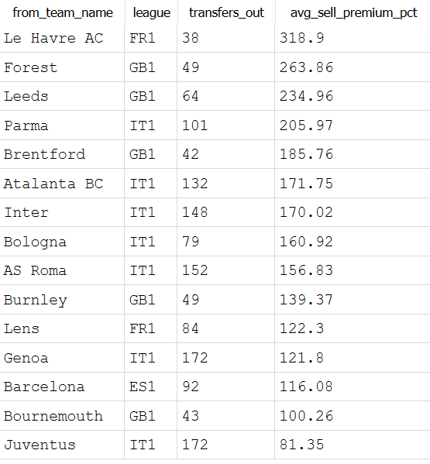
6. Which clubs consistently sells overvalued players? (Scouting efficiency when selling)
Transfer Market Dynamics 💱
SELECT t.from_team_name, d.competition_id AS league, COUNT(t.player_id) AS transfers_out, ROUND(AVG((t.transfer_fee - t.value_at_transfer) * 1.0/ t.value_at_transfer * 100), 2) AS avg_sell_premium_pct
FROM transfer_history t
INNER JOIN team_details d ON t.from_team_id = d.club_id
WHERE d.competition_id IN ('ES1', 'GB1', 'FR1', 'L1', 'IT1') AND t.transfer_fee > 0 AND t.value_at_transfer > 0
GROUP BY t.from_team_id, t.from_team_name, d.competition_id
HAVING AVG((t.transfer_fee - t.value_at_transfer) * 1.0/ t.value_at_transfer * 100) > 0 AND COUNT(t.player_id) > 10
ORDER BY avg_sell_premium_pct DESC
LIMIT 15;
Notes:
The mirror question — which clubs sell above market value? Same logic, but from the seller's perspective, looking at clubs whose average fee exceeds the player's market value at the time of sale.

Slide 16
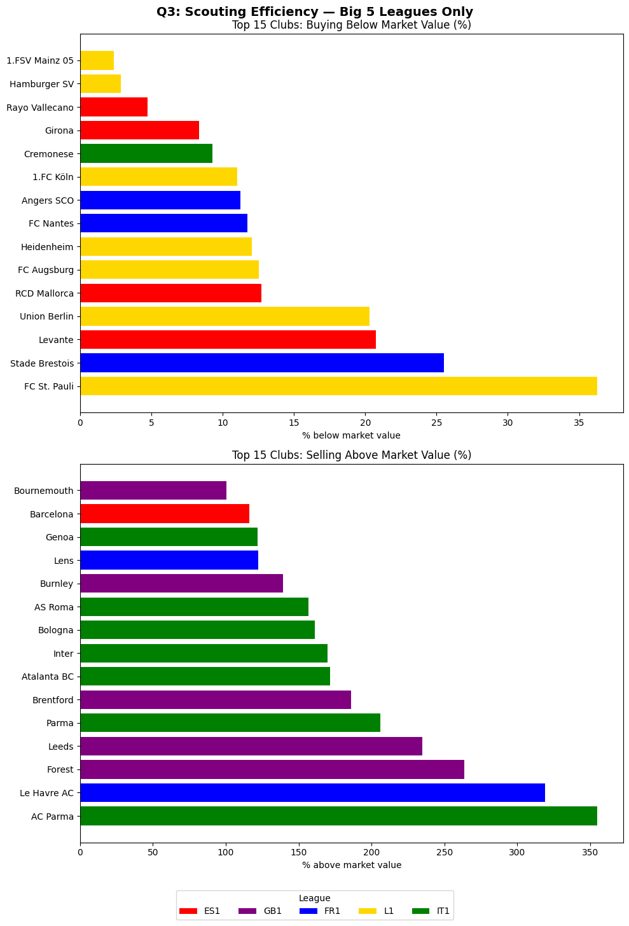
5&6. Overall Scouting efficiency
Transfer Market Dynamics 💱
# Min threshold
MIN_TRANSFERS = 10
valid_buyers = df_fees['to_team_id'].value_counts()
valid_buyers = valid_buyers[valid_buyers >= MIN_TRANSFERS].index
df_fees = df_fees[df_fees['to_team_id'].isin(valid_buyers)]
# Plot
league_colors = {'ES1': 'red', 'GB1': 'purple', 'FR1': 'blue', 'L1': 'gold', 'IT1': 'green'}
fig, axes = plt.subplots(2, 1, figsize=(10, 14))
axes[0].barh(top_buyers['to_team_name'], top_buyers['avg_buy_discount_pct'],color=[league_colors.get(l, 'gray') for l in top_buyers['buy_league']])
axes[0].set_title("Top 15 Clubs: Buying Below Market Value (%)")
axes[0].set_xlabel("% below market value")
axes[1].barh(sell_eff['from_team_name'], sell_eff['avg_sell_premium_pct'], color=[league_colors.get(l, 'gray') for l in sell_eff['sell_league']])
axes[1].set_title("Top 15 Clubs: Selling Above Market Value (%)")
axes[1].set_xlabel("% above market value")
legend_elements = [Patch(facecolor=c, label=l) for l, c in league_colors.items()]
fig.legend(handles=legend_elements, title='League', loc='lower center',ncol=5, bbox_to_anchor=(0.5, -0.05))
plt.suptitle("Q3: Scouting Efficiency — Big 5 Leagues Only", fontsize=14, fontweight='bold')
plt.tight_layout()
plt.savefig("q3_scouting_efficiency.png", bbox_inches='tight')
Notes:
The combined chart shows the top 15 buyers and sellers by efficiency. You can see interesting patterns by league — some leagues appear more frequently in the buying efficiency chart, others in the selling chart. The colour coding by league makes it easy to spot these trends.

Slide 17
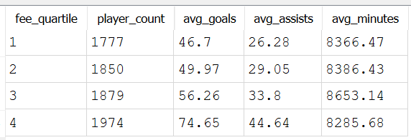
7. Does a high transfer fee actually translate into better performance (goals, assists, minutes played)?
Transfer Market Dynamics 💱
WITH player_perf AS (SELECT player_id, SUM(goals) AS total_goals, SUM(assists) AS total_assists, SUM(minutes_played) AS total_minutes FROM player_performances GROUP BY player_id),transfer_quartiles AS (
SELECT t.player_id, t.transfer_fee, NTILE(4) OVER (ORDER BY t.transfer_fee) AS fee_quartile FROM transfer_history t INNER JOIN team_details d ON t.to_team_id = d.club_id
WHERE d.competition_id IN ('ES1', 'GB1', 'FR1', 'L1', 'IT1') AND t.transfer_fee > 0 AND t.value_at_transfer > 0)
SELECT tq.fee_quartile, COUNT(tq.player_id) AS player_count, ROUND(AVG(pp.total_goals), 2) AS avg_goals, ROUND(AVG(pp.total_assists), 2) AS avg_assists, ROUND(AVG(pp.total_minutes), 2) AS avg_minutes
FROM transfer_quartiles tq
INNER JOIN player_perf pp ON tq.player_id = pp.player_id
INNER JOIN player_profiles prof ON tq.player_id = prof.player_id
WHERE prof.main_position != 'Goalkeeper'
GROUP BY tq.fee_quartile
ORDER BY tq.fee_quartile;
Notes:
Question 7 asks whether paying more actually gets you better performance. I split players into transfer fee quartiles and compared average goals, assists, and minutes played — excluding goalkeepers since their contribution isn't captured by these metrics.

Slide 18
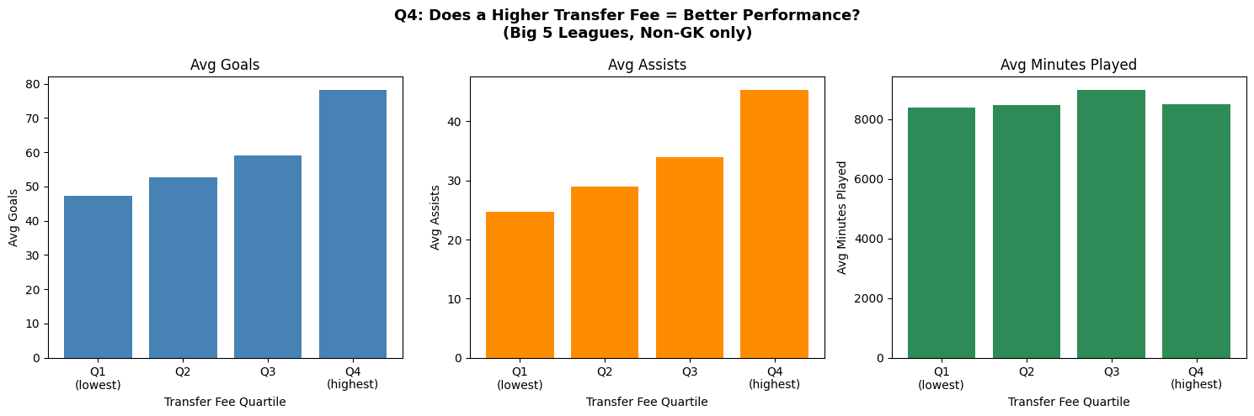
7. Does a high transfer fee actually translate into better performance (goals, assists, minutes played)?
Transfer Market Dynamics 💱
Notes:
The bar charts show a clear positive correlation — Q4 players, the most expensive quarter, average significantly more goals, assists, and minutes. However, the relationship is not perfectly linear. Q2 and Q3 are closer together than you might expect. This suggests that you're not necessarily getting twice the performance for twice the price.

Slide 19
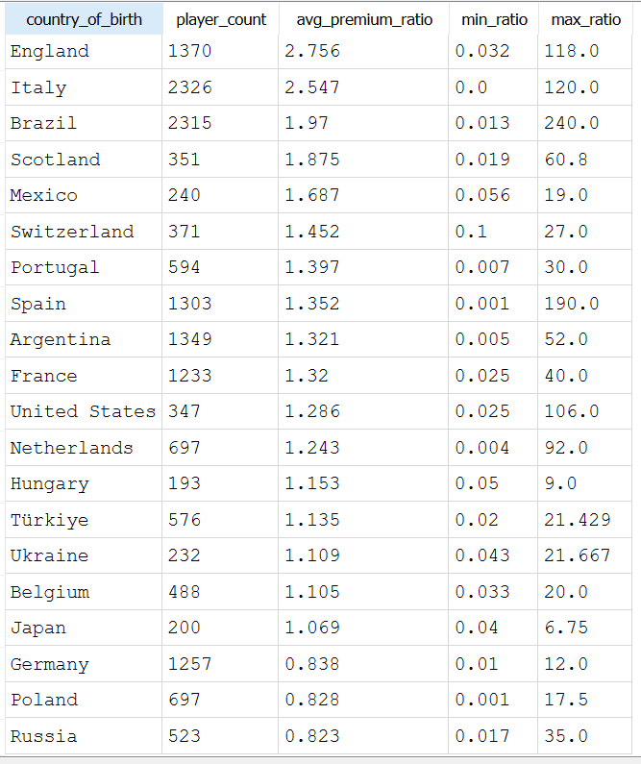
8. Which nationalities command a premium market value?
League & Geography Economics 🌍
WITH top_countries AS (SELECT country_of_birth
FROM player_profiles WHERE country_of_birth IS NOT NULL
GROUP BY country_of_birth
ORDER BY COUNT(*) DESC
LIMIT 20),
premiums AS (
SELECT prof.country_of_birth, t.transfer_fee * 1.0 / t.value_at_transfer AS fee_premium_ratio
FROM transfer_history t
INNER JOIN player_profiles prof ON t.player_id = prof.player_id
INNER JOIN top_countries tc ON prof.country_of_birth = tc.country_of_birth
WHERE t.transfer_fee > 0
AND t.value_at_transfer > 0
AND t.transfer_fee IS NOT NULL
AND t.value_at_transfer IS NOT NULL)
SELECT
country_of_birth,
COUNT(*) AS player_count,
ROUND(AVG(fee_premium_ratio), 3) AS avg_premium_ratio,
ROUND(MIN(fee_premium_ratio), 3) AS min_ratio,
ROUND(MAX(fee_premium_ratio), 3) AS max_ratio
FROM premiums
GROUP BY country_of_birth
ORDER BY avg_premium_ratio DESC;
Notes:
Question 8 looks at nationality. Rather than trying to control for stats — which gets complicated — I looked at the distribution of transfer fee to market value ratios across the top 20 countries of birth. A ratio above 1 means the player transferred above their listed value.

Slide 20
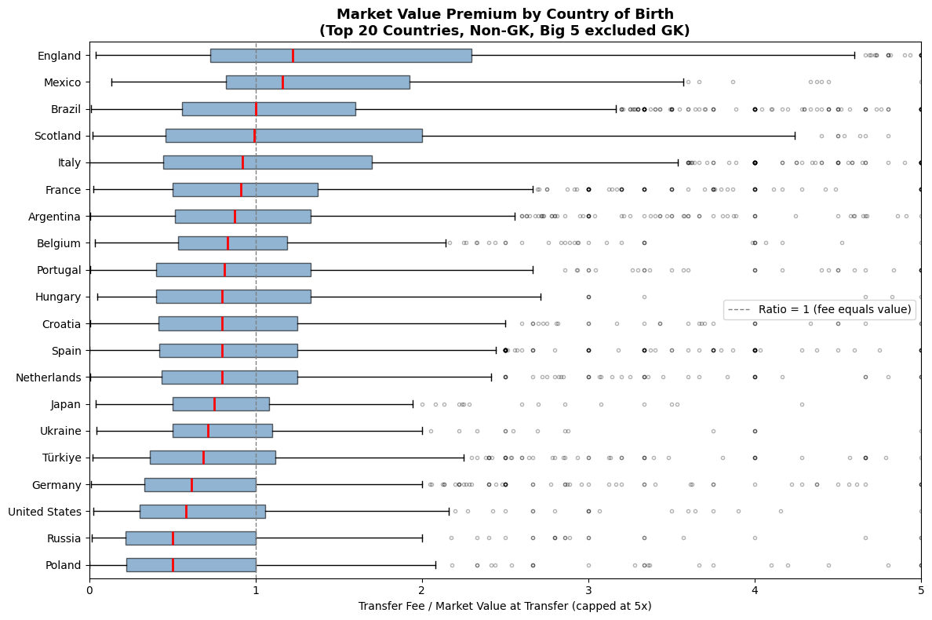
8. Which nationalities command a premium market value?
League & Geography Economics 🌍
Notes:
The box plots show the distribution per country, sorted by median ratio. Some nationalities cluster consistently above 1, while others sit at or below it. The outliers are particularly interesting — a few transfers involve ratios far above any reasonable premium, likely driven by exceptional players from those countries.

Slide 21
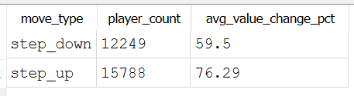
9. How does a player's market value evolve after moving to a bigger or smaller league?
Career & Value Trajectories 🔀
WITH transfer_leagues AS (
SELECT t.player_id, t.transfer_date, t.value_at_transfer, t.from_team_id, t.to_team_id, d_from.competition_id AS from_league, d_to.competition_id AS to_league
FROM transfer_history t
LEFT JOIN team_details d_from ON t.from_team_id = d_from.club_id
LEFT JOIN team_details d_to ON t.to_team_id = d_to.club_id
WHERE t.value_at_transfer > 0 AND t.value_at_transfer IS NOT NULL),
classified AS (SELECT *,
CASE
WHEN from_league NOT IN ('ES1','GB1','FR1','L1','IT1') AND to_league IN ('ES1','GB1','FR1','L1','IT1') THEN 'step_up'
WHEN from_league IN ('ES1','GB1','FR1','L1','IT1') AND to_league NOT IN ('ES1','GB1','FR1','L1','IT1') THEN 'step_down'
END AS move_type
FROM transfer_leagues
WHERE from_league IS NOT NULL AND to_league IS NOT NULL),
with_next_value AS (SELECT *, LEAD(value_at_transfer) OVER (PARTITION BY player_id ORDER BY transfer_date) AS next_value
FROM classified
WHERE move_type IS NOT NULL)
SELECT move_type,COUNT(*) AS player_count, ROUND(AVG((next_value - value_at_transfer) * 1.0/ value_at_transfer * 100), 2) AS avg_value_change_pct
FROM with_next_value
WHERE next_value IS NOT NULL AND next_value > 0
GROUP BY move_type
ORDER BY move_type;
ROUND(AVG((next_value - value_at_transfer) * 1.0/ value_at_transfer * 100), 2) AS avg_value_change_pct
Notes:
Question 9: does a player's market value grow after moving to a bigger league? I classified each transfer as a step-up — from outside the Big 5 to inside — or step-down, and then looked at the next recorded transfer value to measure the change.

Slide 22
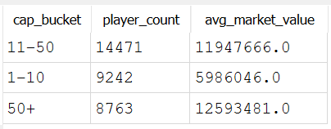
10. Do players with more international caps have a higher market value?
Career & Value Trajectories 🔀
WITH active_players AS (SELECT player_id FROM player_profiles WHERE current_club_name NOT IN ('Retired', '---', '0')AND current_club_name IS NOT NULL),
national_caps AS (SELECT player_id, SUM(matches) AS total_caps
FROM player_national_performances
WHERE career_state = 'CURRENT_NATIONAL_PLAYER' AND matches > 0
GROUP BY player_id), market_values AS (SELECT p.player_id,
CASE
WHEN lmv.value > 0 AND lmv.value IS NOT NULL THEN lmv.value
WHEN mv.value > 0 AND mv.value IS NOT NULL THEN mv.value
ELSE NULL
END AS market_value
FROM active_players p
LEFT JOIN player_latest_market_value lmv ON p.player_id = lmv.player_id
LEFT JOIN player_market_value mv ON p.player_id = mv.player_id)
SELECT
CASE
WHEN nc.total_caps BETWEEN 1 AND 10 THEN '1–10'
WHEN nc.total_caps BETWEEN 11 AND 50 THEN '11–50'
ELSE '50+'
END AS cap_bucket,
COUNT(*) AS player_count,
ROUND(AVG(mv.market_value)) AS avg_market_value
FROM national_caps nc
INNER JOIN market_values mv ON nc.player_id = mv.player_id
WHERE mv.market_value IS NOT NULL AND nc.total_caps > 0
GROUP BY cap_bucket
ORDER BY cap_bucket;
Notes:
Question 10: do players with more international caps earn a market value premium? I bucketed players into 1–10, 11–50, and 50+ caps, using only active players — no retired ones — and using the most up-to-date available market value. The result is fairly conclusive: the 50+ caps group has a dramatically higher median and average value than the other two groups.

Slide 23
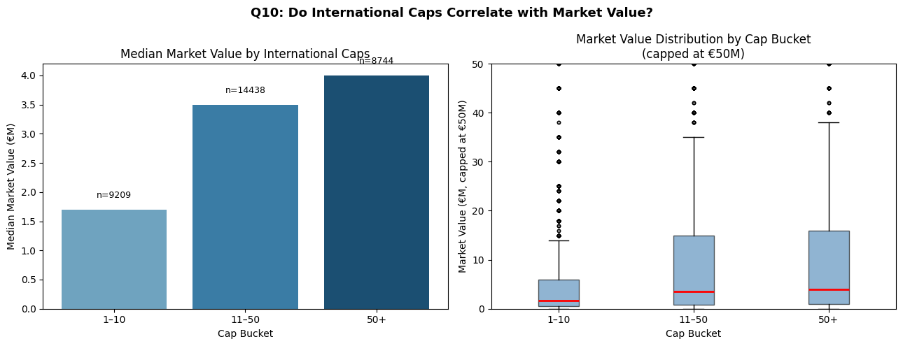
10. Do players with more international caps have a higher market value?
Career & Value Trajectories 🔀

Slide 24
Challenges and Solutions
Outliers collapsing visualizations
Extreme transfer ratios (up to 40,000%) compressed all meaningful data to the left. Fixed by capping axes and switching from mean to median to reduce outlier influence.
Buyer filter contaminating seller analysis
Applying the min-transfer threshold only to buyers was silently dropping valid sellers. Fixed by splitting into separate df_buy and df_sell DataFrames before filtering.

Slide 25
Tools and Technologies
Python (pandas, matplotlib, numpy)
Core stack for data loading, cleaning, transformation, and all visualizations. Codebase handles EDA, filtering, aggregation, and charting without switching tools.
SQLite3 + DB Browser
Used to ingest all CSV files into a relational database via glob and pandas.to_sql(), then queried with DB Browser. Lightweight and zero-setup, ideal for a local dataset of this size.
Transfermarkt Open Dataset
Free-source database covering player profiles, transfer history, market valuations, performance stats, and national team appearances, rich enough to answer all 10 questions without external APIs.

Slide 26
Major Obstacle
Keeping SQL and Python analyses in sync
The biggest challenge was ensuring SQL and Python produced consistent results. Subtle differences in scope, which side of a transfer to filter, how to handle both-team Big 5 constraints, or which table to join, meant the two tools returned different clubs for the same question.
What we learned
Defining the exact scope of each question before writing any code would have saved significant rework. Ambiguity in the question directly causes ambiguity in the filter logic.
What we would do differently
Write a shared data dictionary upfront, agreeing on exact table names, column semantics, and filter rules before coding in either tool.

Slide 27
Conclusion and Insights
Objectives met
All 10 questions were answered using SQL/Python, with consistent results across both tools. The project successfully combined EDA, aggregation, and visual storytelling on a real-world dataset.
Limitations and open questions
Value_at_transfer may not always reflect updated market values between consecutive transfers, limiting the reliability of value evolution analysis. Age-adjusted performance and injury history were not available, which would significantly strengthen causal claims.

Slide 28
Any Questions?

