Slide 1

Authors:
Diego Ávila, 903988
Laura Schiatti, 904738
Sukhpreet Virdi, 904204
TrackMe
Project presentation
Software Engineering II Project (A.Y. 2018/2019) – Politecnico di Milano

Slide 2
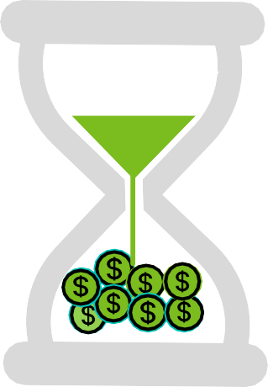
Context

Slide 3
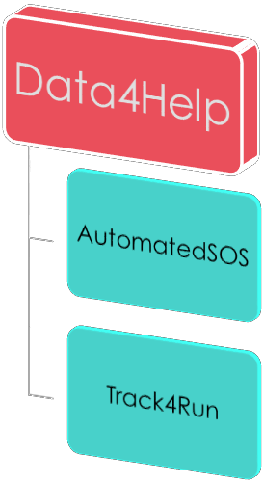

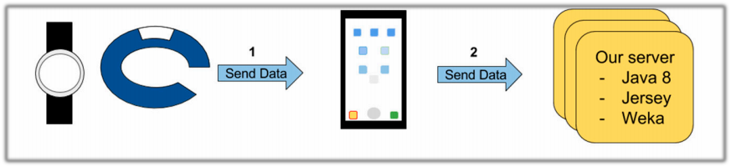



Problem and Scope
TrackMe develops health-monitoring devices devoted to measure and record different parameters related to the health status of a person and location.
To improve customers’ experience, TrackMe decided to
offer three new services
Our Server

Slide 4

World and shared phenomena
S h a r e d
Emergency contacts
Running
path
Individuals
Wearable devices
Third-parties
Collected data (health status
and location)
Individuals’ current location
W o r l d

Slide 5
Goals <<Data4help>>
The individual can allow (or refuse) Data4Help to use their data
G1
The third party company should be able to access data of a
specific individual
G2
The third-party company should be able to access anonymized data of groups of individuals under certain constraints
G3
The third-party company could subscribe to get new data related
to specific individuals or previously saved search
G4

Slide 6
Goals <<AutomatedSOS - Track4Run>>
Provide a service capable to send a notification to the health-care
service when any individual’s parameter is out of range
G5
Run organizers could define the path for a given run and TrackMe
users can enroll to it
G6
Run spectators could track the position of all the runners during a
race
G7

Slide 7
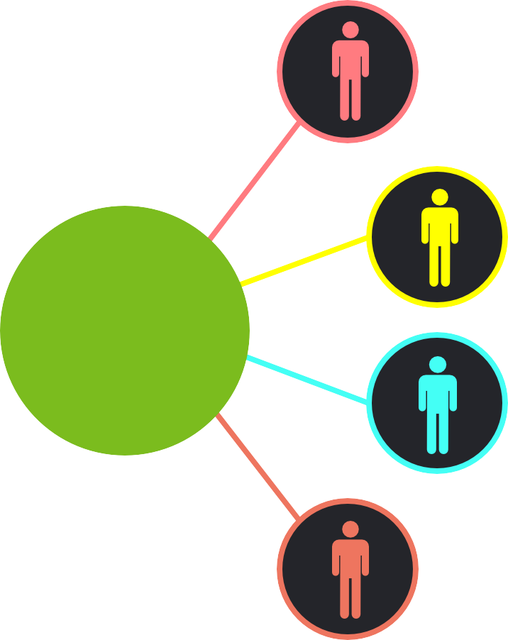
User characteristics
Individuals
Third-party companies
Users
Organizers
Spectators

Slide 8

Domain assumptions
Wearables accuracy when monitoring individuals
[D1]
TrackMe addresses data protection and integrity against possible attacks.
[D2]
The organizers hold all needed permissions to set up a run
[D7]
TrackMe devices are up and running during monitoring.
[D3]
Out of coverage scenarios cannot be handled by ASOS
[D6]
The data collected schema is directly related to the individuals' by their SSN and has the proper structure.
SSN provided by the individual
is valid and trustable
[D4]
[D5]

Slide 9
TrackMe Use Cases

Slide 10
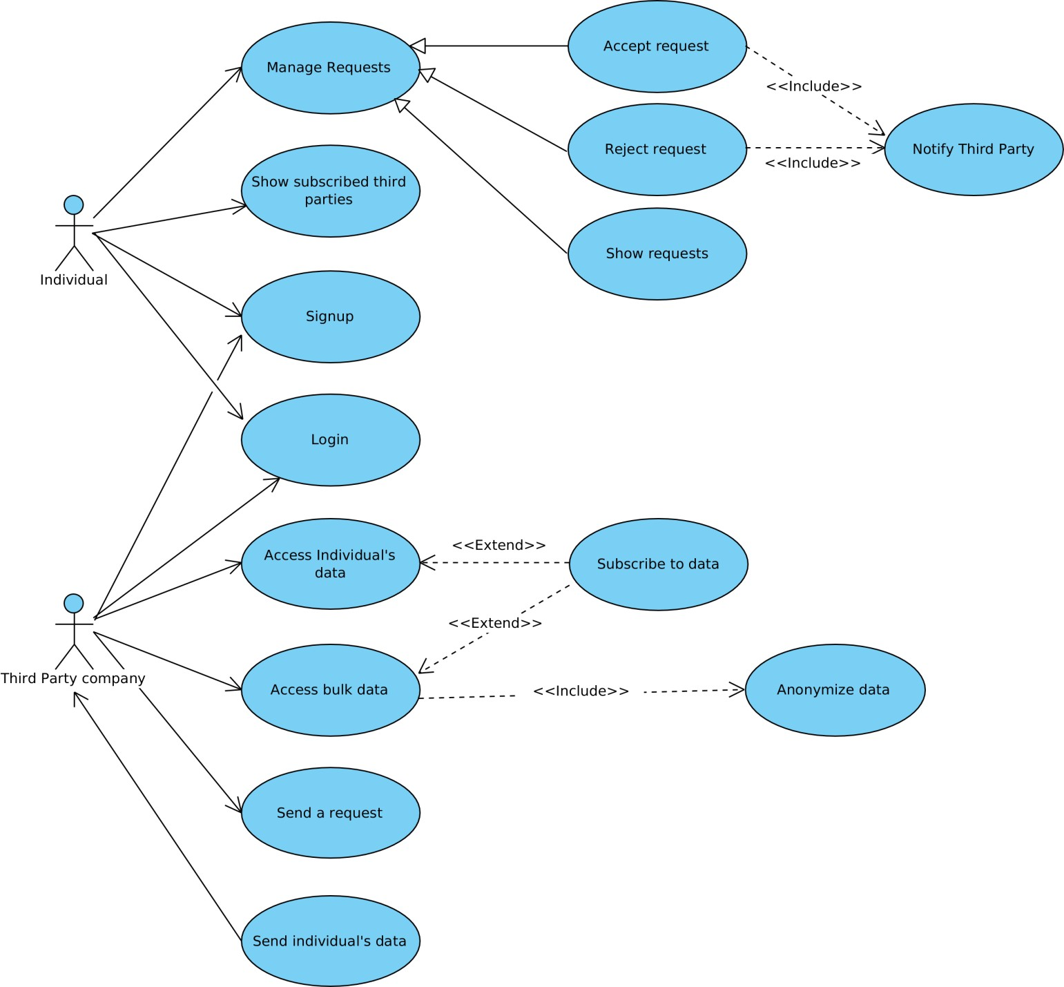
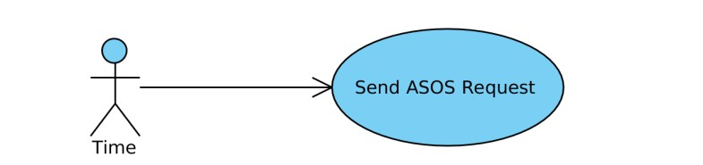
Use case diagram
<<Data4Help>>

Slide 11
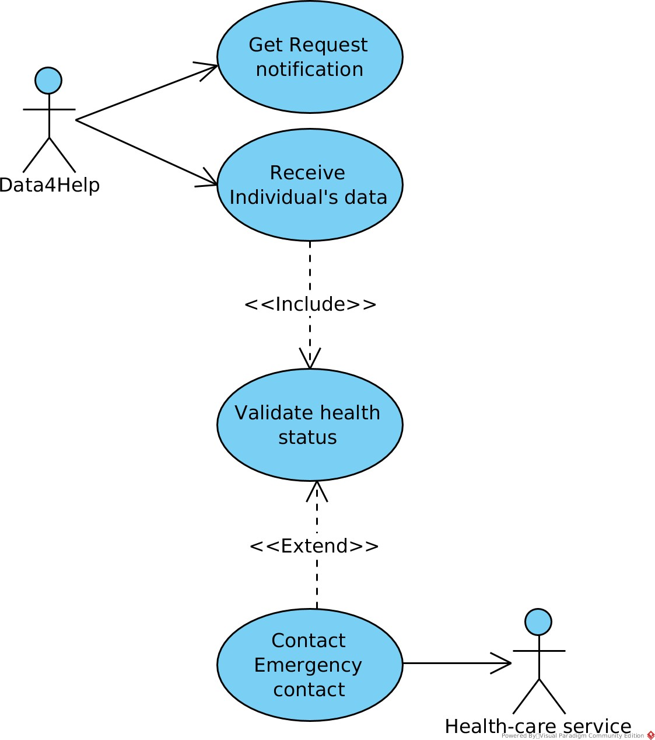
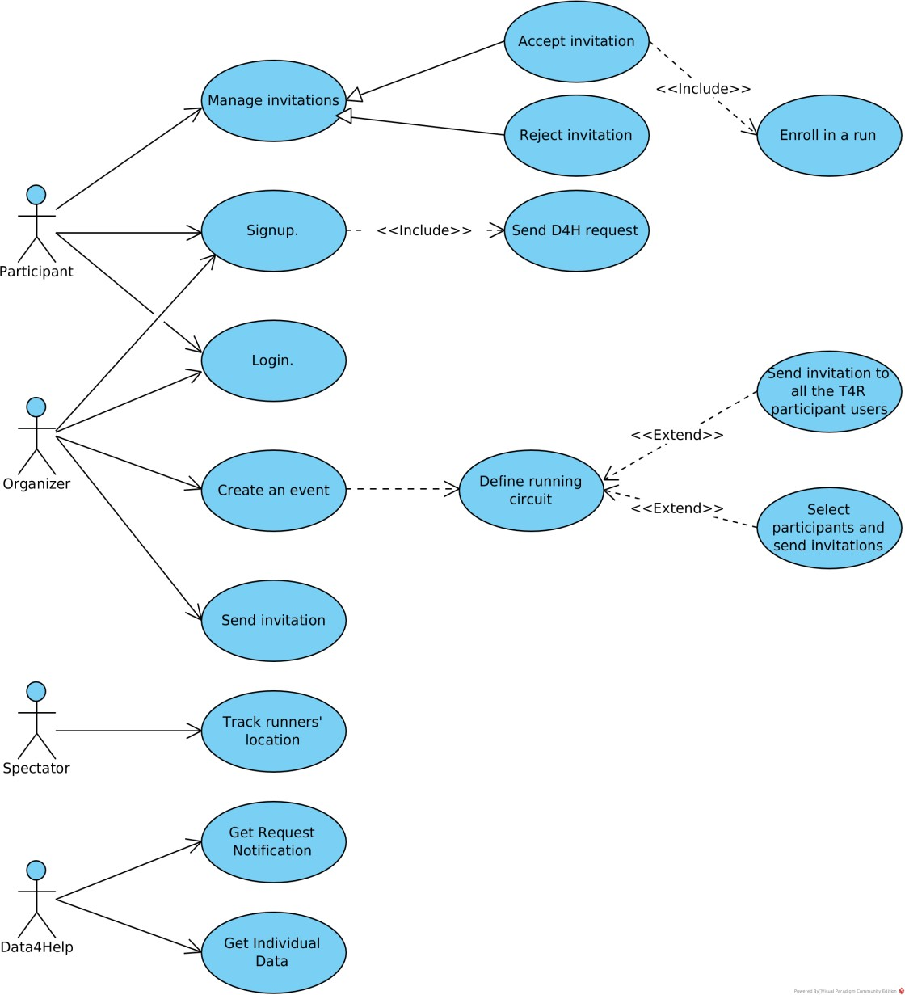
Use case diagram
<<AutomatedSOS>>
Use case diagram
<<Track4Run>>

Slide 12
Architectural design

Slide 13
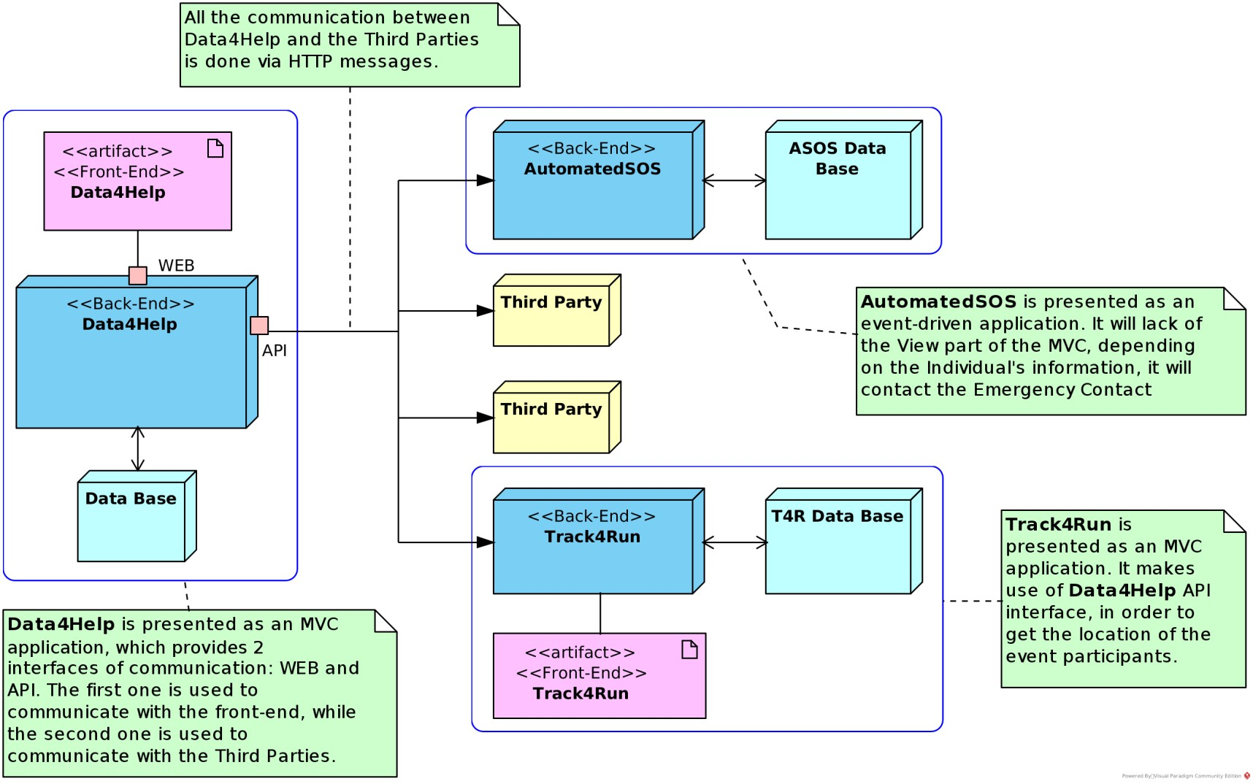
Overview

Slide 14
Overview
Data4Help and Track4Run
MVC architecture << web interface >>
AutomatedSOS
Event-driven architecture << no interface for users >>
Third parties
communicate with Data4Help using HTTP messages

Slide 15
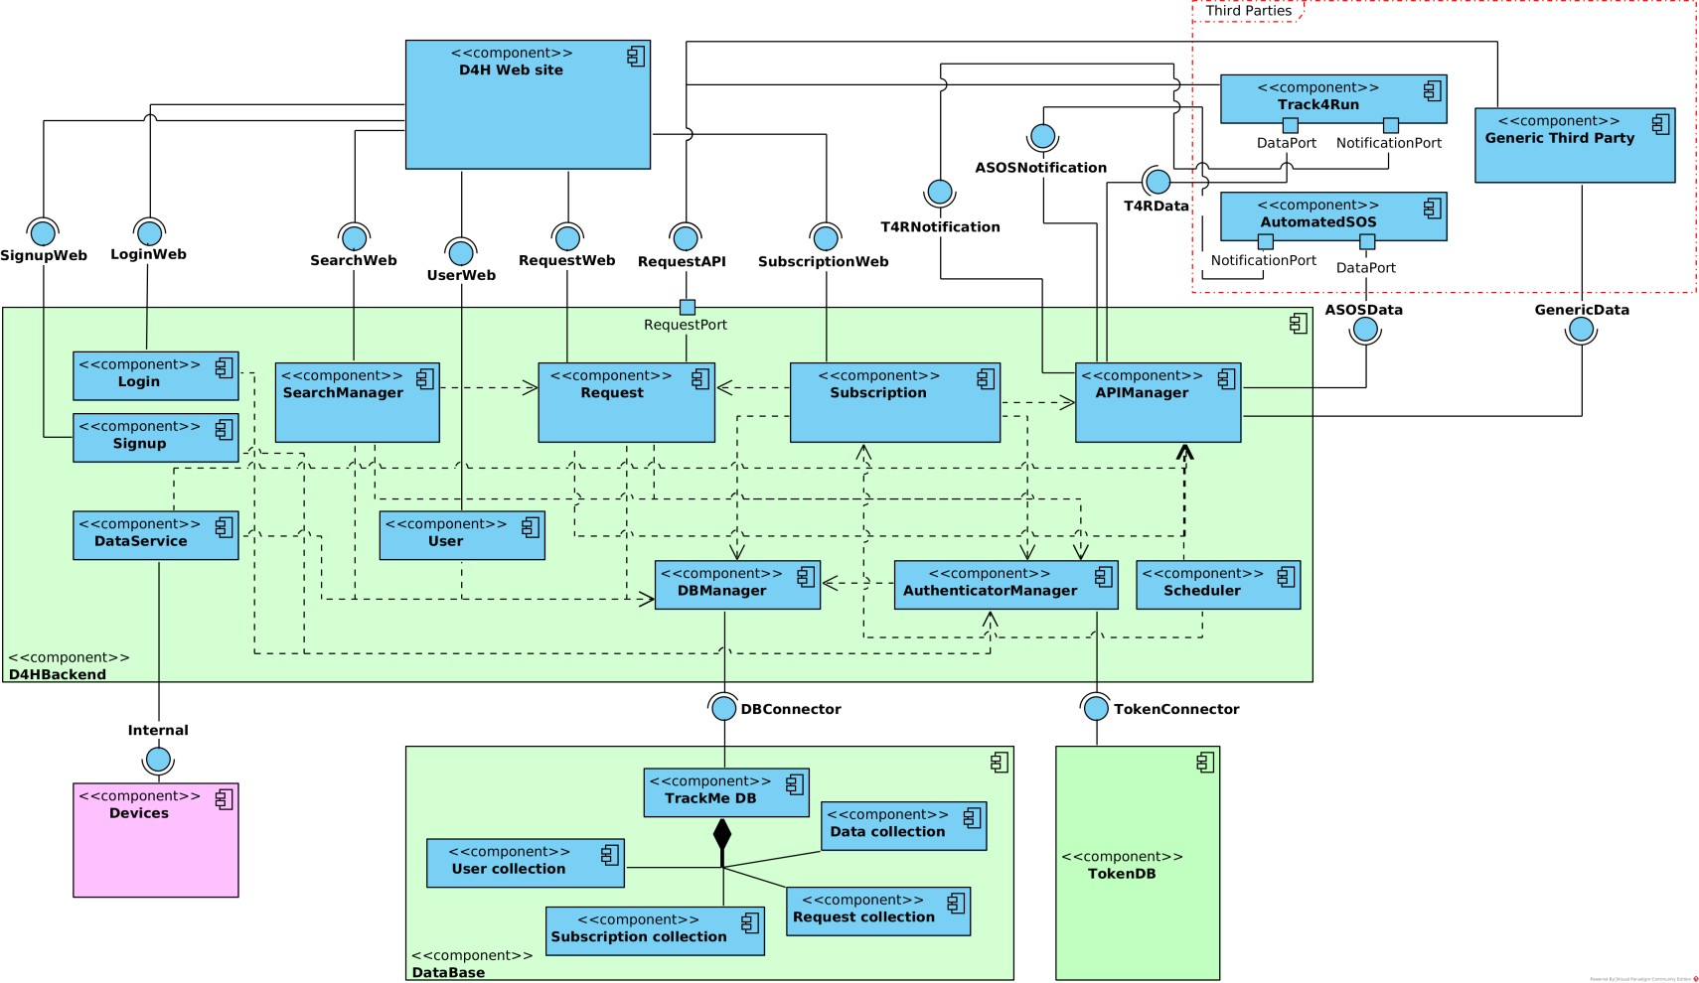
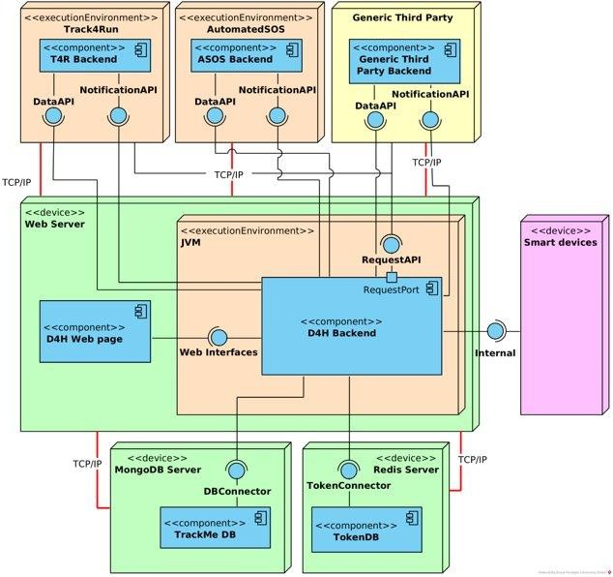
Components & Deployment <<Data4Help>>

Slide 16
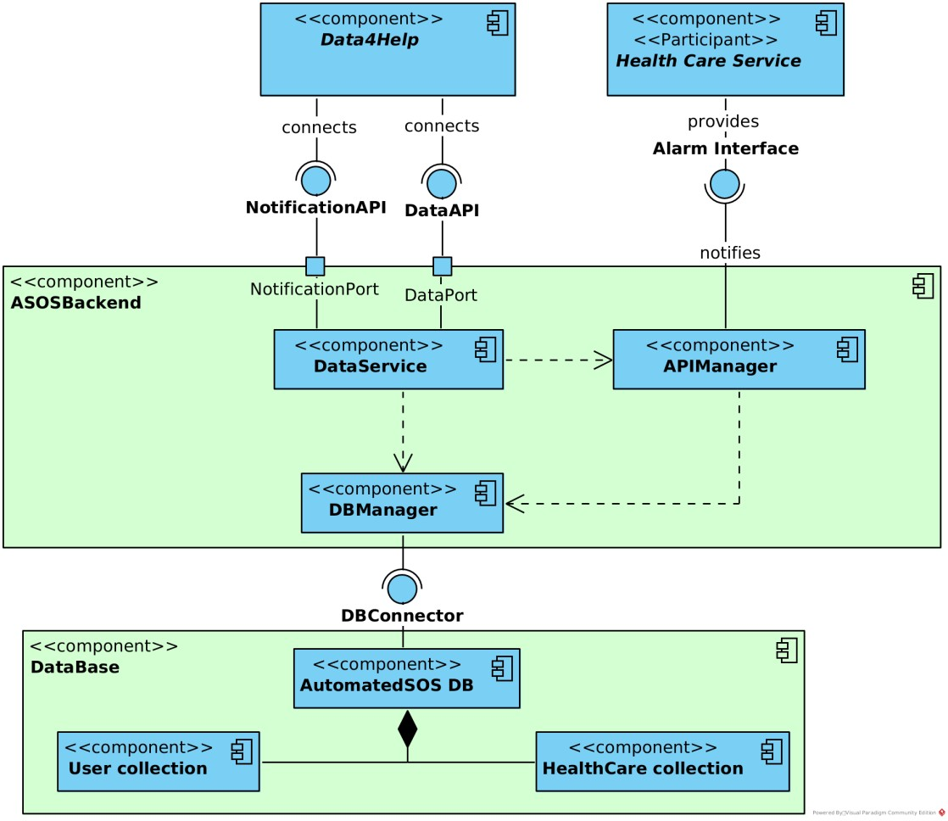
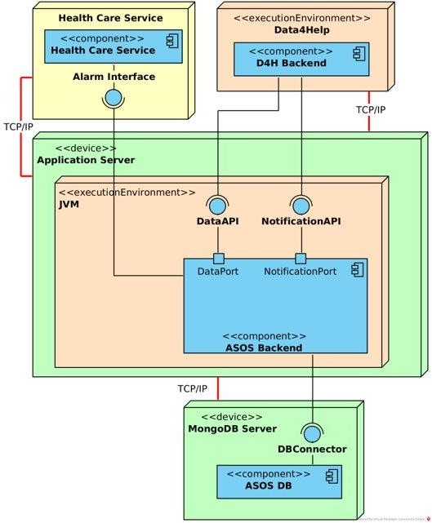
Components & Deployment
<<AutomatedSOS>>

Slide 17
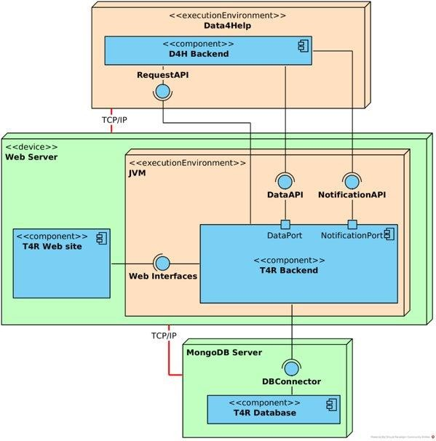
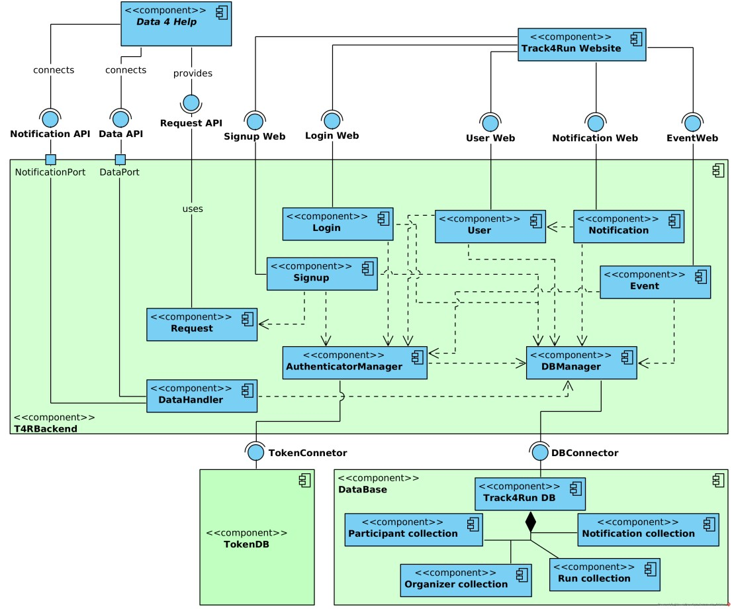
Components & Deployment
<<Track4Run>>

Slide 18
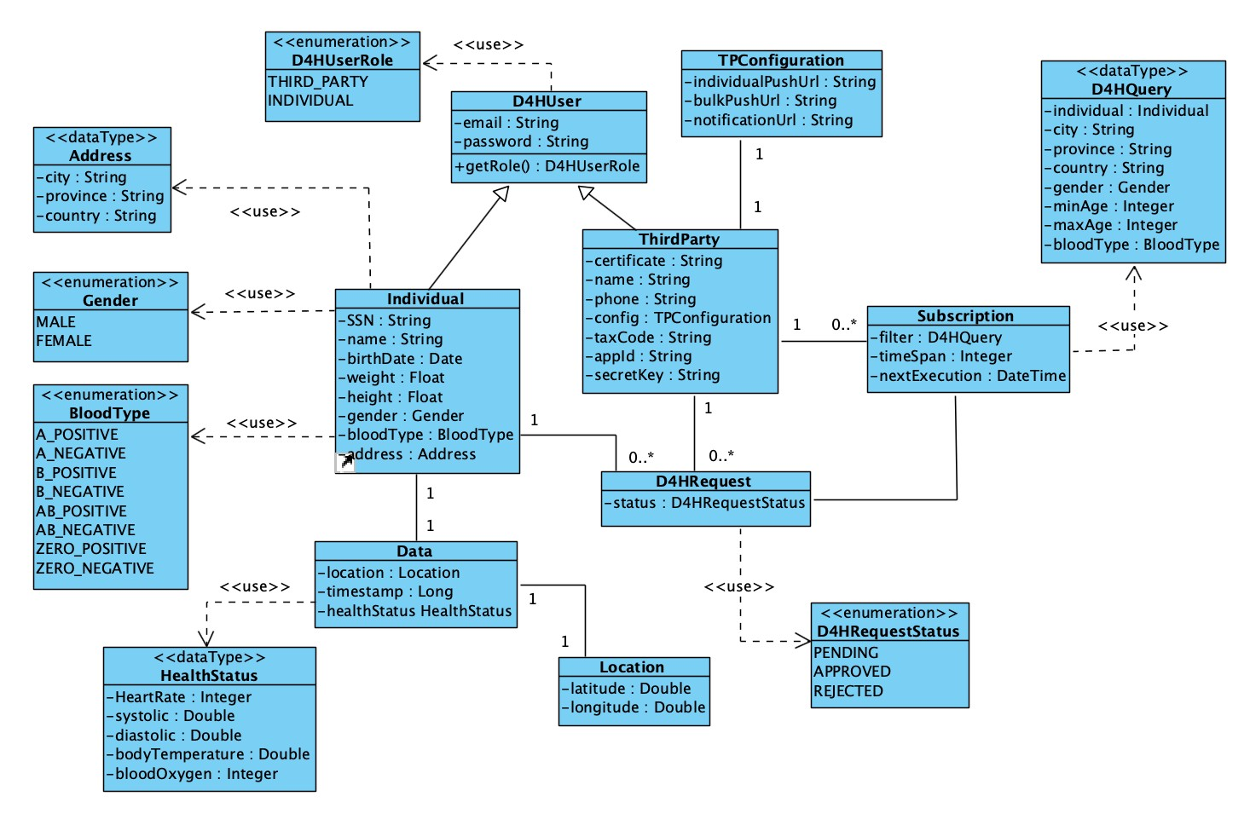
Data model
<<Data4Help>>

Slide 19
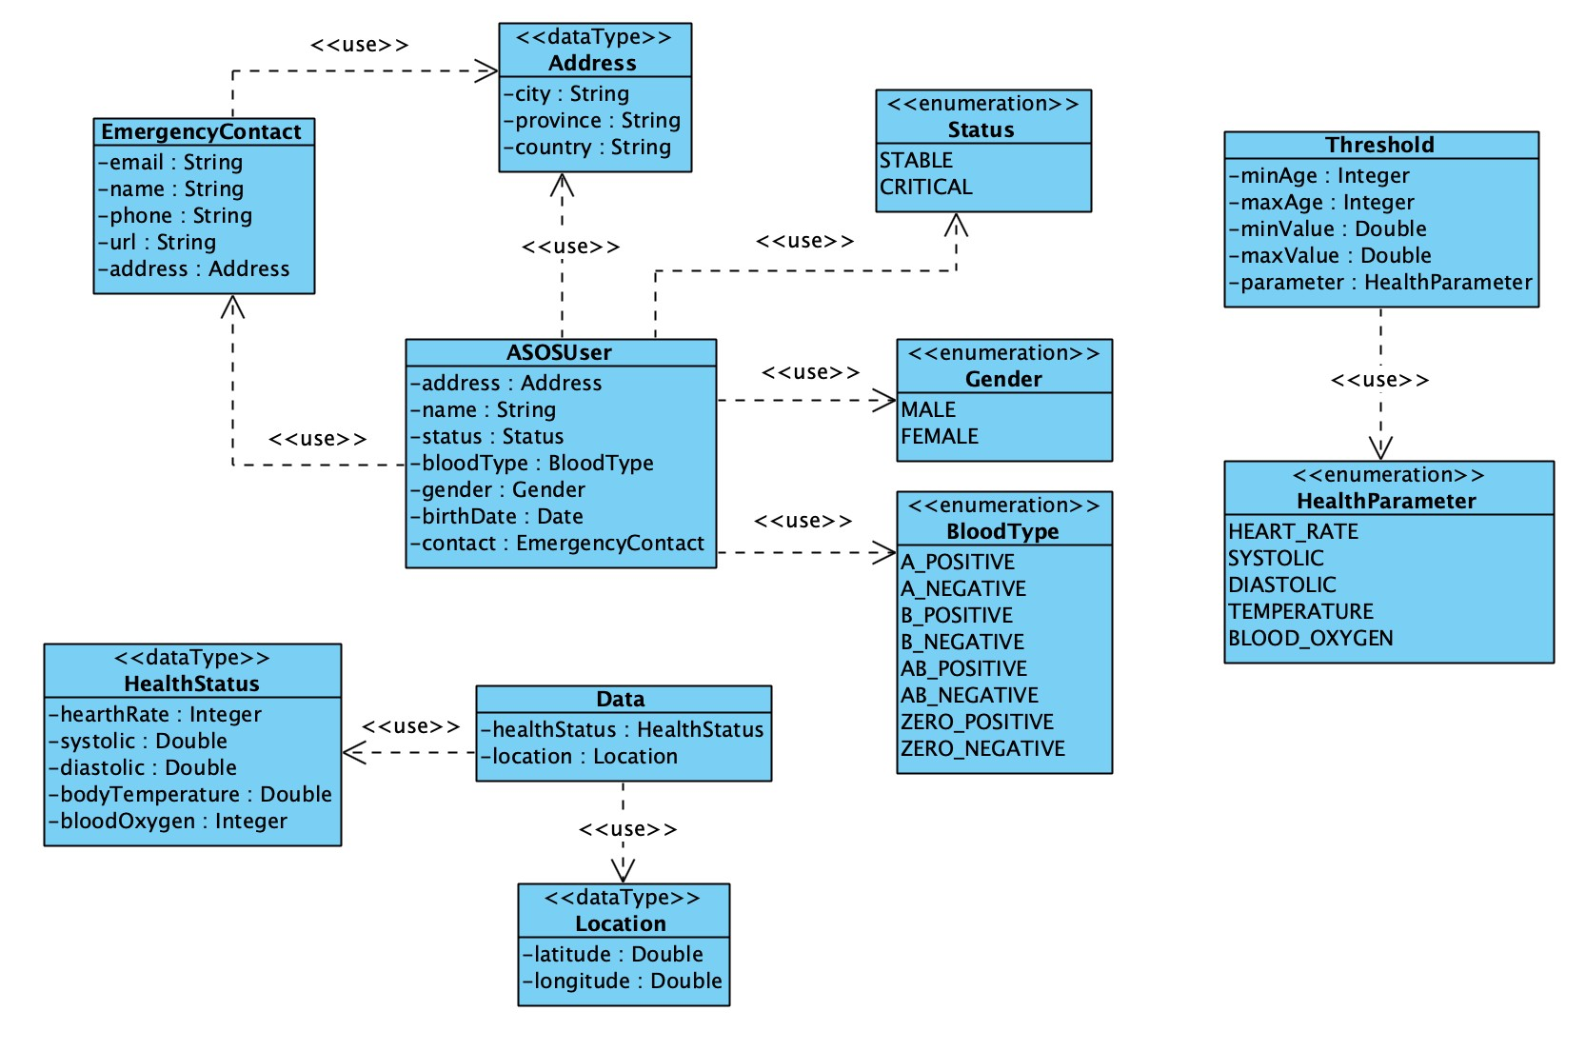
Data model
<<AutomatedSOS>>

Slide 20
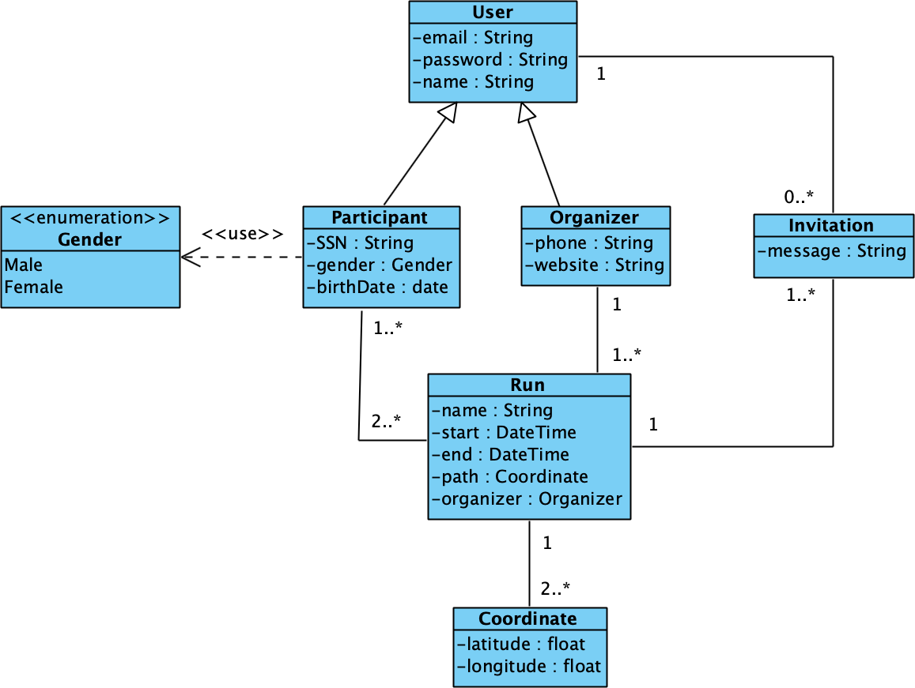
Data model
<<Track4Run>>

Slide 21
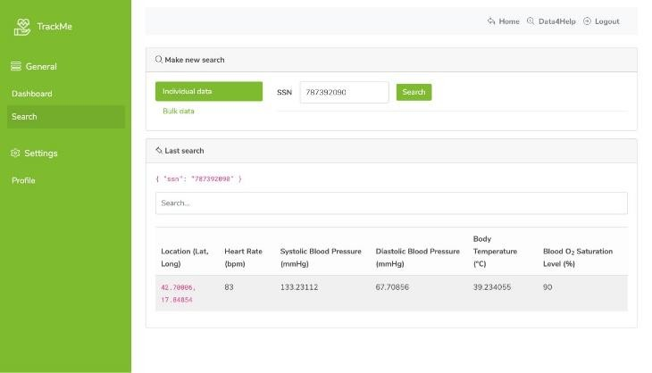
Implementation
Data4Help & AutomatedSOS

Slide 22
Implemented requirements
<<Data4Help>>
[R1/R5] Individuals and Third parties registration
Users management
[R2/R6] Individuals and Third parties login
[R7] Notify the individual that a third party company wants to access its data
[R3] Individuals can accept or reject requests of accessing their personal data
Request

Slide 23
[R4] Data4Help can obtain the health status and location of an individual
[R8] Third parties can search for an individual health status and location using his/her SSN
[R9] Third parties can filter data of a group of individuals according to some criteria
[R10] Data of a group of individuals can be anonymized
Search
[R11] Third parties are automatically subscribed to an individual health status and location when the request is approved
[R12] Third parties can subscribe to data of an anonymized group of individuals
Subscription

Slide 24
Implemented requirements
<<AutomatedSOS>>
[R13] The system must send a request for monitoring an
individual’s data when he/she is older than 60 years old
[R14] The system must monitor, and compare against defined thresholds, the health status of an individual
[R15] The system must be able to contact the health-care service associated to an individual
Data

Slide 25



Development frameworks and technologies
<< Backend>>

Slide 26





Development frameworks and technologies
<< Frontend>>
HTML
CSS
JS

Slide 27



Development frameworks and technologies
<< Additional>>

Slide 28

Integration & Testing
Data4Help & AutomatedSOS

Slide 29
Integration strategy <<bottom-up>>
Integration order:
Data4Help Components Data4Help Web Site
DBManager, AuthenticationManager
LoginService and SignupService RequestService, SubscriptionService SearchManager, UserService, DataService
Schedulers
AutomatedSOS Components DataService, DBManager APIManager
Track4Run Components Track4RunWebService Track4RunDB RunCollection TokenService, DataBase

Slide 30

System integration testing
Integration order of subsystems:
AuthenticationManager and LoginService
SearchManager, RequestService and SubscriptionService
DataService, DBManager and APIManager
RunCollection and ParticipantCollection
User Interaction Integration:
UserInterface and RequestService
UserInterface and SearchService
UserInferface and SubscriptionService
UserInterface and NotificationService
UserInterface and RunCollection

Slide 31
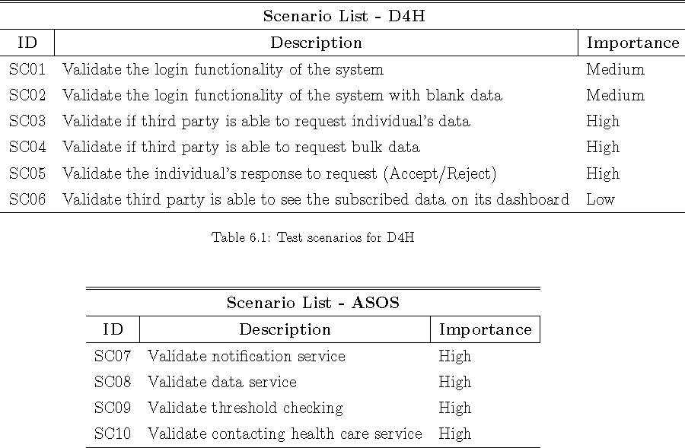
Test plan

Slide 33
Questions?

