Slide 1

A6 Project Presentation
Salt Lake County, Utah
742 square miles
1,185,238 population (2020 Census)
Laura Thriftwood

Slide 2
Analysis Phases
Phase 1 | Phase 2 | Phase 3 | Phase 4
Infection Rates and Mask Mandates | Mask Mandates and Crash Behavior | Crash Behavior Pre- and Post-COVID | Crash Severity Pre- and Post-COVID
Visualization | One-Way ANOVA F-Test | Two-Sample Z-Test to Compare Population Means | Visualization

Slide 3
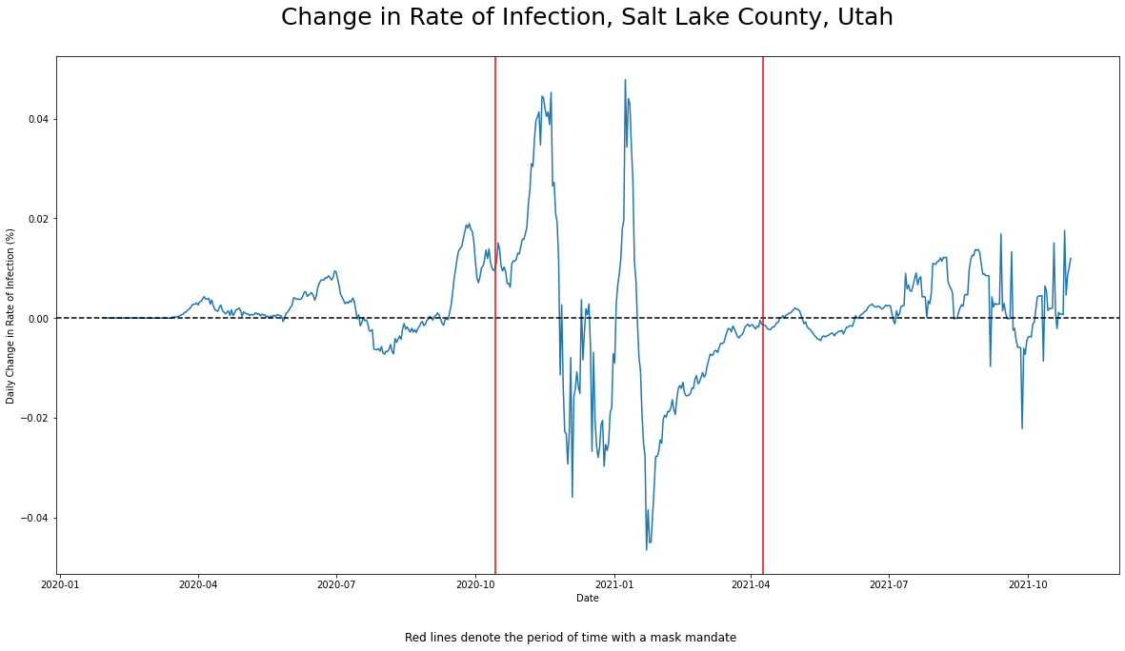
Change in Infection Rates Visualized
As it relates to the implementation and suspension of county mask mandates
7-day rolling average for new cases to smooth noise
Assumes a 14-day infection period

Slide 4
Research Question
Did the widespread shift to remote work at the beginning of the pandemic have a statistically significant impact on vehicle crash behavior as a result of an overall decrease in traffic volume?
Number of vehicles involved in crashes
Severity of crash incidents
First, looking at the time periods relating to the implementation and suspension of county mask mandates in the previous analysis
Second, comparing crash data from the 5 years prior to the start of the pandemic with crash data during the pandemic

Slide 5
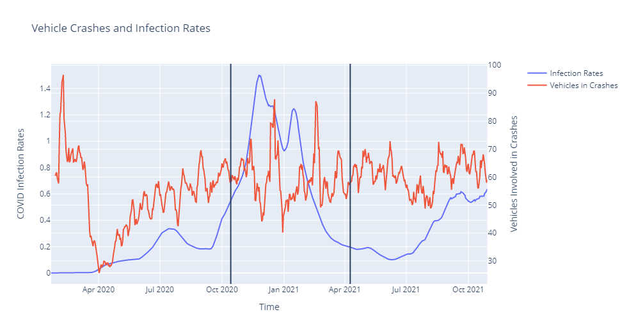
Vehicle Crashes and Infection Rates Visualized
Crash data comes from the Utah Department of Public Safety and is derived from Utah crash reports completed by law enforcement officers throughout the state who investigate crash scenes on public roadways.
Black vertical lines denote the period of time with an active mask mandate

Slide 6
One-Way ANOVA F-Test
A: Pre-Mandate
n = 287
mean = 54.61
st.dev. = 21.18
B: Mandate
n = 178
mean = 59.68
st.dev. = 20.95
C: Post-Mandate
n = 211
mean = 60.14
st.dev. = 16.99
The null hypothesis is defined as
H₀ : µ_{A} = µ_{B} = µ_{C}
The alternative hypothesis is defined as
H₁ : the three populations means are not all equal
where µ_{A}, µ_{B}, and µ_{C} are the mean number of vehicles involved in crash incidents in the county for the three time periods.
comparison of the group means
Independence between groups
Equal variances
Normally distributed populations

Slide 7
One-Way ANOVA F-Test
A: Pre-Mandate
n = 287
mean = 54.61
st.dev. = 21.18
B: Mandate
n = 178
mean = 59.68
st.dev. = 20.95
C: Post-Mandate
n = 211
mean = 60.14
st.dev. = 16.99
The null hypothesis is defined as
H₀ : µ_{A} = µ_{B} = µ_{C}
The alternative hypothesis is defined as
H₁ : the three populations means are not all equal
-------------------------------------------------------------------------------------------------------------------------------------------------------------------------
F Statistic: 5.904 P-Value: 0.0029
At a significance level of 0.05, we reject the null hypothesis that all three population means are equal. A pairwise test of the three groups suggests that the population of groups A and B differ in a statistically significant way. The risk of interpreting multiple pairwise t-tests is the increase in overall type I error.
comparison of the group means
Independence between groups
Equal variances
Normally distributed populations

Slide 8
Methodology and Assumptions
Compare two population means pre- and post-COVID using a Two-Sample Z-Test.
The date used to determine pre- and post-COVID populations is 3/1/2020
First recorded case in Salt Lake County on 3/13/2020
First recorded case in Utah State on 3/11/2020
First recorded case in United States was 1/21/2020
Pre-COVID crash data was restricted to the 5 years prior to the start of the pandemic
Analysis focused on the number of vehicles involved in crash incidents

Slide 9
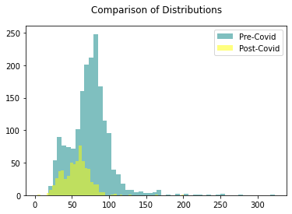
Two-Sample Z-Test to Compare Population Means
A: Pre-Covid
n = 1827
mean = 74.32
st.dev. = 27.62
B: Post-Covid
n = 616
mean = 56.25
st.dev. = 18.4
populations are independent
does not require assumption of equal variances
large sample sizes (>30) for both populations
The null hypothesis is defined as
H₀ : µ_{A} = µ_{B}
The alternative hypothesis is defined as
H₁ : µ_{A} ≠ µ_{B}
where µ_{A} and µ_{B} are the mean number of vehicles involved in crash incidents in the county for time period A (5 years prior to the pandemic) and period B (during the pandemic).

Slide 10
Two-Sample Z-Test to Compare Population Means
A: Pre-Covid
n = 1827
mean = 74.32
st.dev. = 27.62
B: Post-Covid
n = 616
mean = 56.25
st.dev. = 18.4
populations are independent
does not require assumption of equal variances
large sample sizes (>30) for both populations
The null hypothesis is defined as
H₀ : µ_{A} = µ_{B}
The alternative hypothesis is defined as
H₁ : µ_{A} ≠ µ_{B}
------------------------------------------------------------------------------------------------------------------------------------------------------------------------------------------------------
Z Statistic: 15.1406
P-Value: 8.7436e-52
At a significance level of 0.05, we reject the null hypothesis that the two population means are equal. There is enough evidence

Slide 11
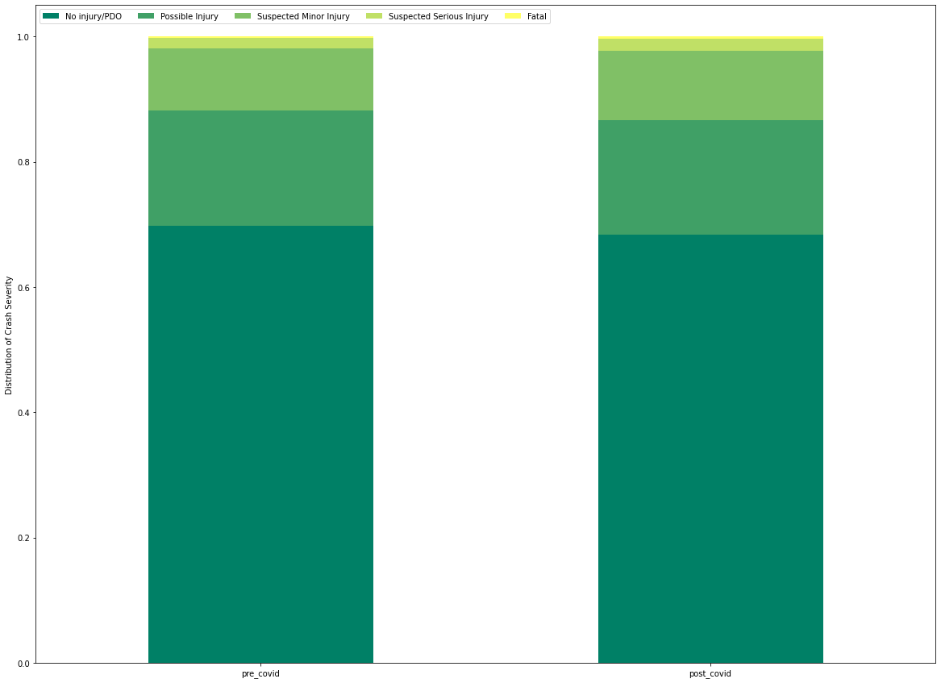
Additional Analysis – KABCO Crash Severity
 | pre_covid | post_covid
No injury/PDO | 0.697835 | 0.684071
Possible Injury | 0.184558 | 0.182238
Suspected Minor Injury | 0.098791 | 0.110370
Suspected Serious Injury | 0.016297 | 0.019800
Fatal | 0.002519 | 0.003521
KABCO Crash Severity is a scale established by the Federal Highway Safety Administration (FHWA) to evaluate the severity of auto collision injuries

Slide 12
Summary/Conclusion
The mean number of vehicles involved in crashes prior to the pandemic differs in a statistically significant way from the mean number of vehicles involved in crashes after the start of the pandemic.
The distribution of vehicle crash severity did not differ significantly.
The implementation of mask mandates in Salt Lake County, UT is likely not correlated with changes in crash behavior.

