Slide 1
EDA — ACME Solar Prediction
Group 2

Slide 2
Dataset Snapshot
Rows × Columns | 6,990 × 656
Target | ACME (J/m²)
Feature Groups | Mesonet station columns + Exogenous PCA features (V*, PC*)
Date Column | Date (daily)
Train Period | Up to 2007‑12‑31
Test Period | 2008‑01‑01 to 2012‑11‑30
Example Station Columns | ADAX, ALTU, APAC, ARNE, BEAV, BESS, BIXB, BLAC …
Example Exogenous Columns | V2073_y, V1785_y, V8137_y, V377_y, V254_y …

Slide 3
1) Data & Missingness

Slide 4
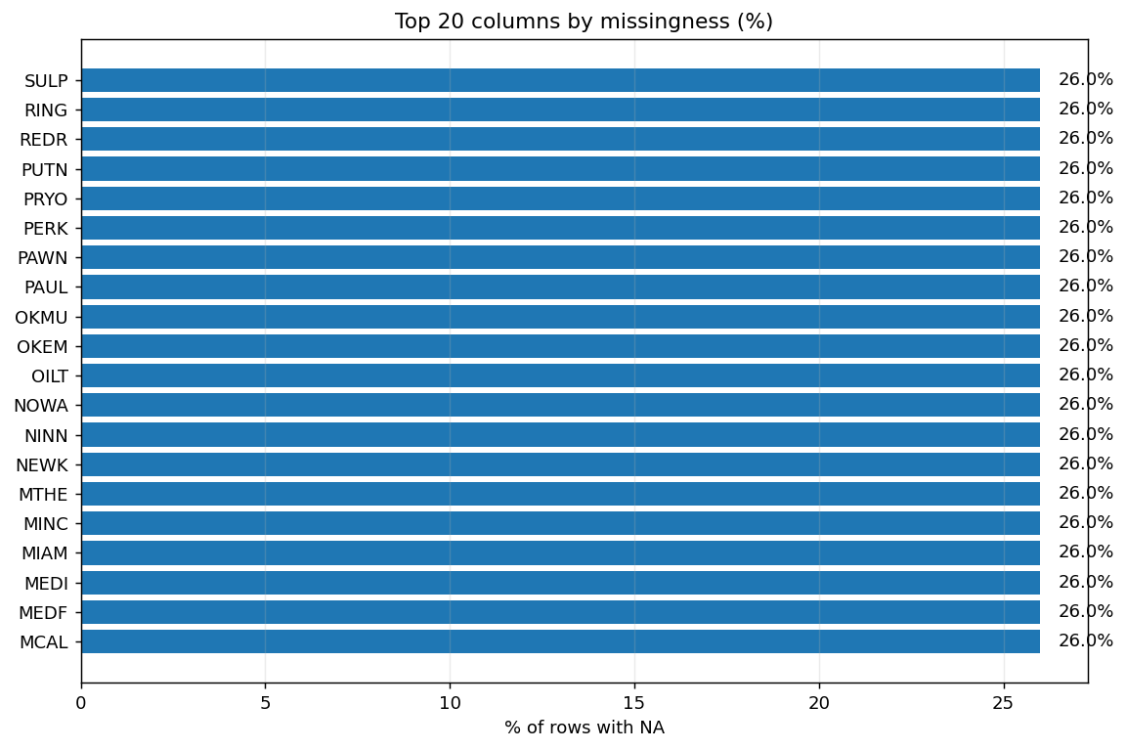
Where Data Is Missing?
Each bar ≈26% NA — uniform gaps across top-20 variables

Slide 5
Missingness: Key Metrics
Metric | Value
Any‑NA columns | 298 / 656
Stations — median NA% | 26% (all 98 cols >10% & >25% NA)
Exogenous — median / mean NA% | 0% / 1.39% (no col >10% NA)
Train vs Test — mean NA% | 1.17% vs 16.13%

Slide 6
2) ACME Behavior (Pre-2008)

Slide 7
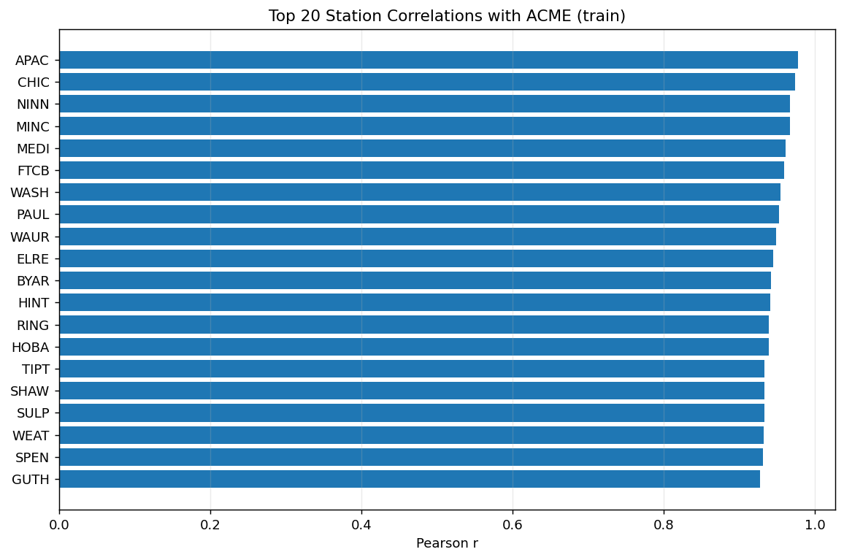
Strongest Co-Movers with ACME (Train Set)

Slide 8
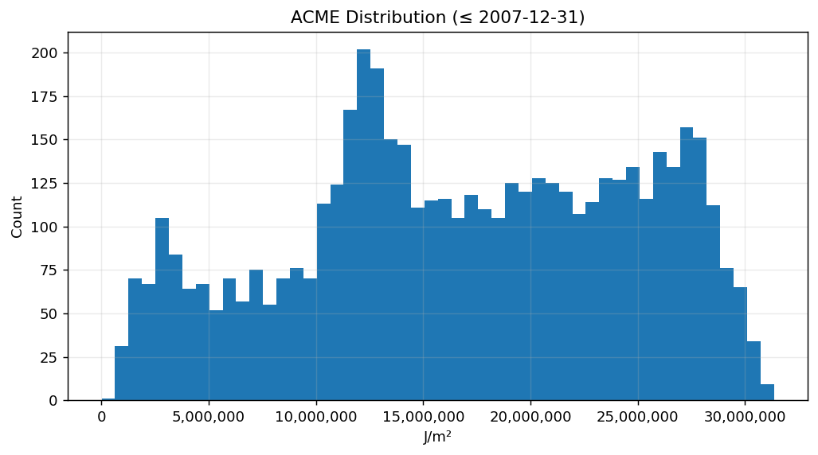
Distribution: What ACME Looks Like Before 2008

Slide 9
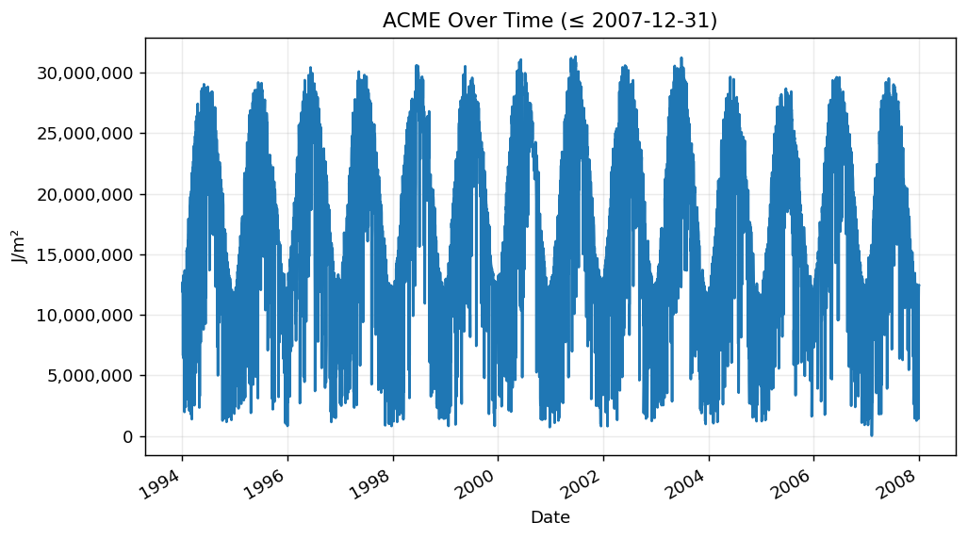
Time Series: What ACME Looks Like Before 2008

Slide 10
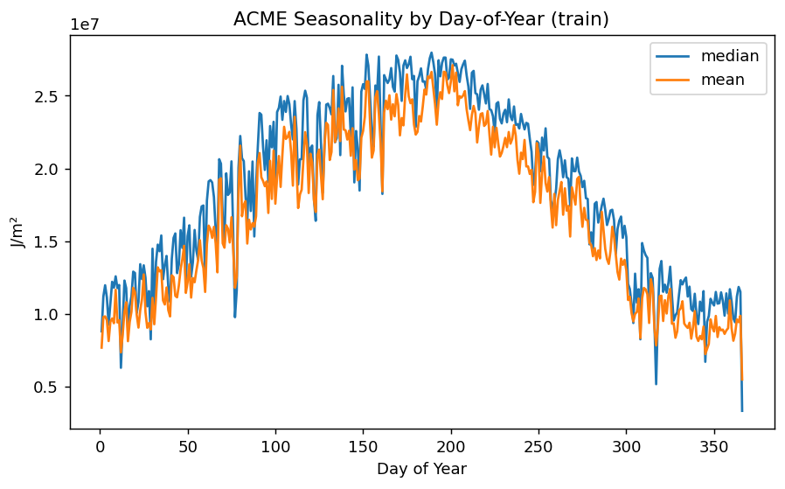
Seasonal Pattern of ACME (DOY)

Slide 11
3) Linear Model (Ridge/Lasso)

Slide 12
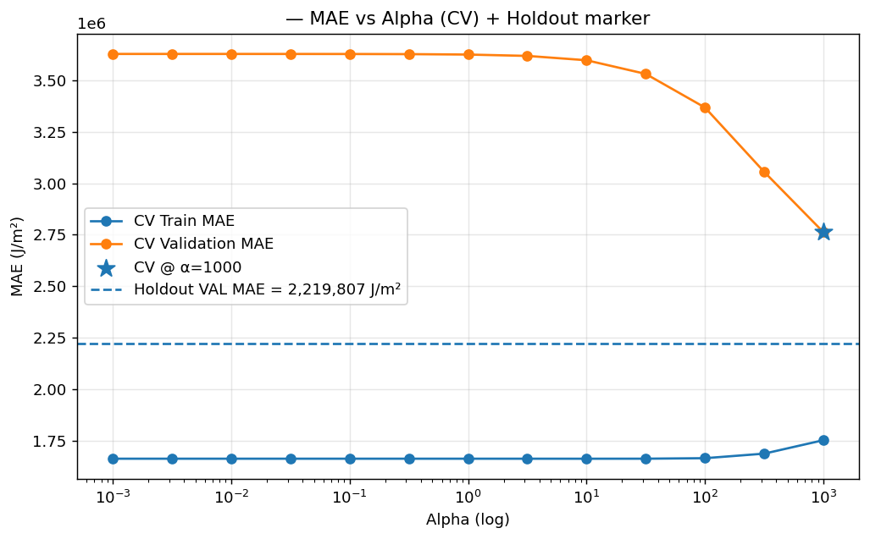
Linear Model: Cross-Validation MAE Across α
Best model: Lasso

Slide 13
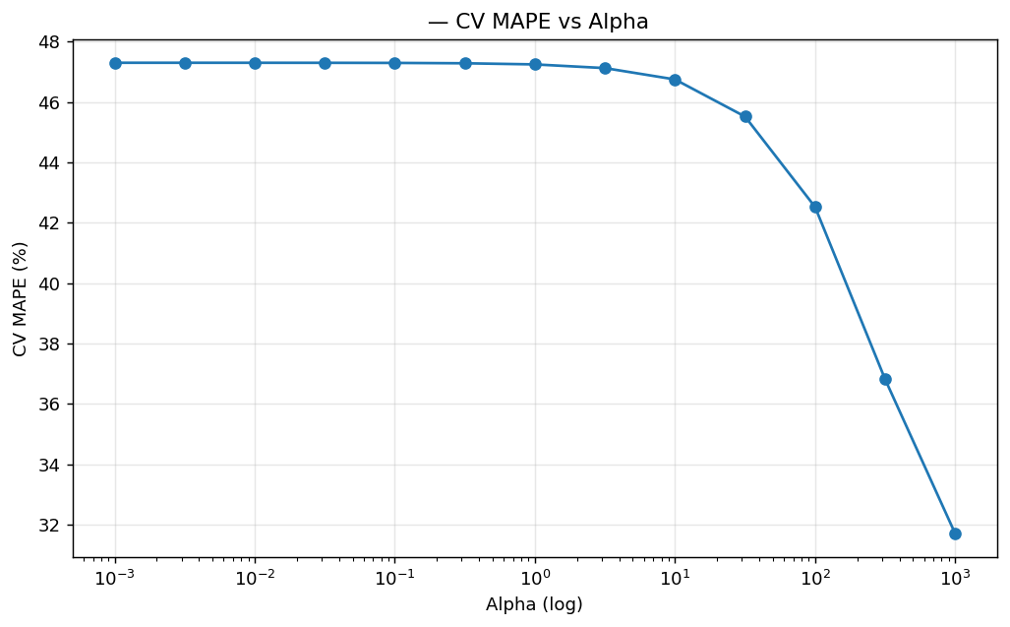
Linear Model: Cross-Validation MAPE vs α
Best model: Lasso

Slide 14
3) Non-Linear Model (Gradient Boosting)

Slide 15
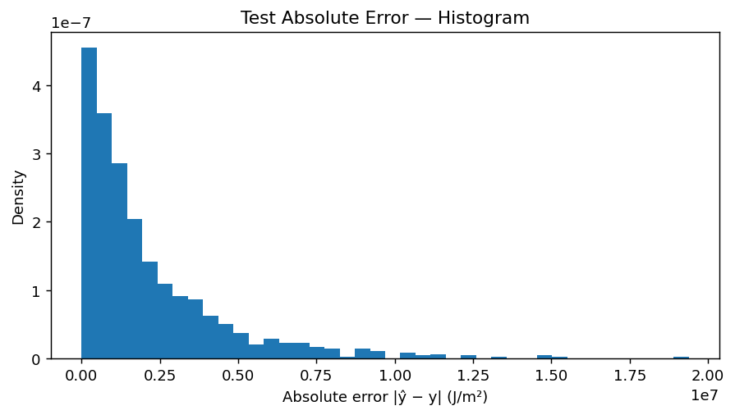
Non-linear Model: MAE histogram
Best model: GradientBoostingRegressor
Errors are right-skewed: most predictions are close; a long tail of larger misses drives MAE.
Notes:
1) Test Absolute Error — Histogram
What it shows: the distribution of per-sample absolute errors $∣\hat{y}−y∣$on the test set.
Takeaway: strong right-skew — most predictions have small to moderate error, with a long tail of larger misses. The long tail is why MAE is noticeably above the median error.
Histogram: “Errors are right-skewed: most predictions are close; a long tail of larger misses drives MAE.”

Slide 16
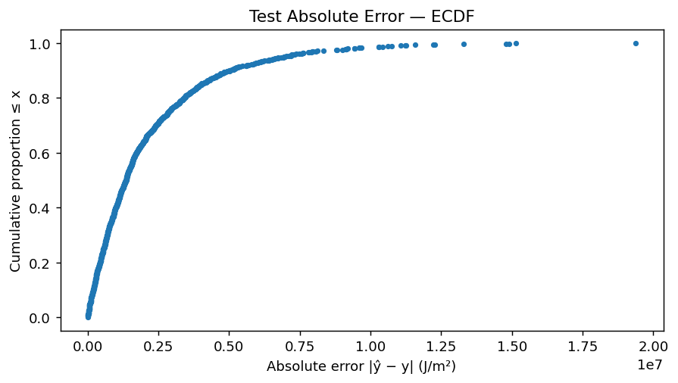

Non-linear Model: MAE coverage Curve
Best model: GradientBoostingRegressor
90% of predictions have $∣\hat{y}−y∣$≤ P90 J/m²
Notes:
2) Test Absolute Error — ECDF
What it shows: for any error threshold $x$, the curve gives the fraction of test cases with error ≤ $x$.
Takeaway: coverage view. You can read values like “X% of predictions are within K J/m².”
Use this to report service levels (e.g., P50/P90).
Example phrasing: “Median abs. error (P50) is …; 90% of errors are below … J/m².”
(Compute with np.percentile(abs_err, [50,90,95]) and drop the numbers into the slide.)
ECDF: “Coverage: P50 = …, P90 = … J/m² → 90% of predictions fall within this error.”

Slide 17
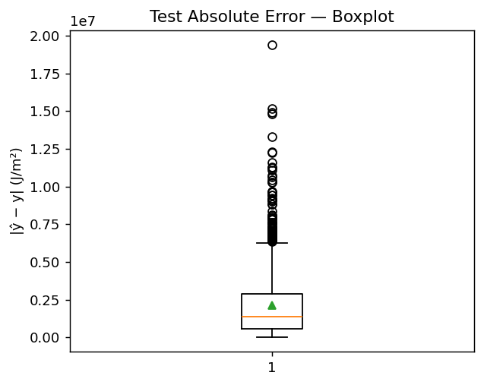
Non-linear Model: MAE Boxplot
Best model: GradientBoostingRegressor
Median error < mean error → long-tail misses inflate the average; typical error is lower than the MAE
Notes:
3) Test Absolute Error — Boxplot
What it shows: median (line), IQR (box), whiskers, and outliers (dots). The green triangle is the mean.
Takeaway: median < mean ⇒ outliers are inflating the mean (MAE). Most errors are concentrated in a lower range, with a cluster of large mistakes.
Test boxplot: “Median error below mean → outliers inflate MAE; IQR shows typical variability.”

Slide 18
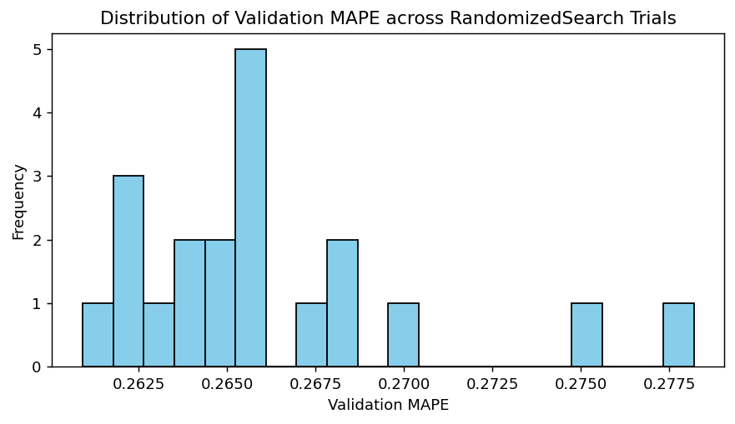
Non-linear Model: Validation MAPE histogram
Best model: GradientBoostingRegressor

Slide 19
4) Feature Importance

Slide 20
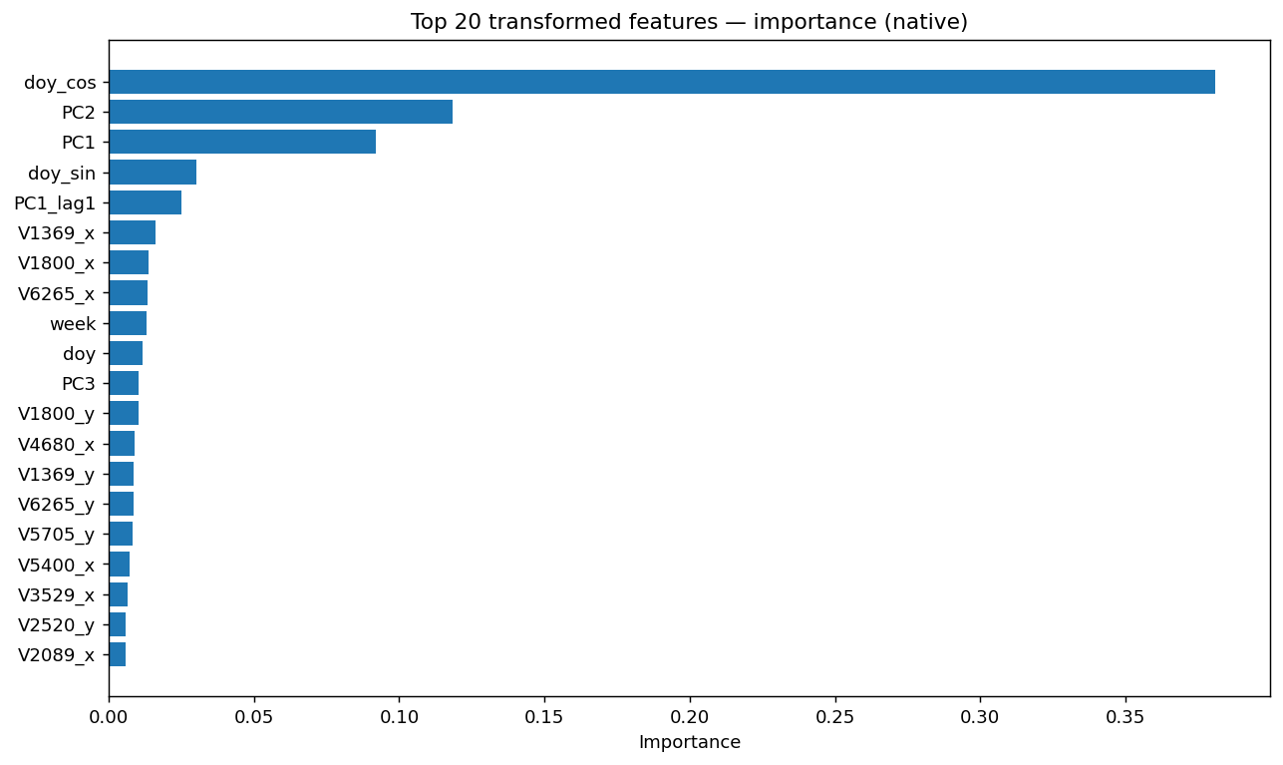
Linear model coefficients feature importance (from Ridge/Lasso)
Notes:
Positive ↑ increases prediction; negative ↓ decreases. Magnitudes are conditional on other features.

Slide 21
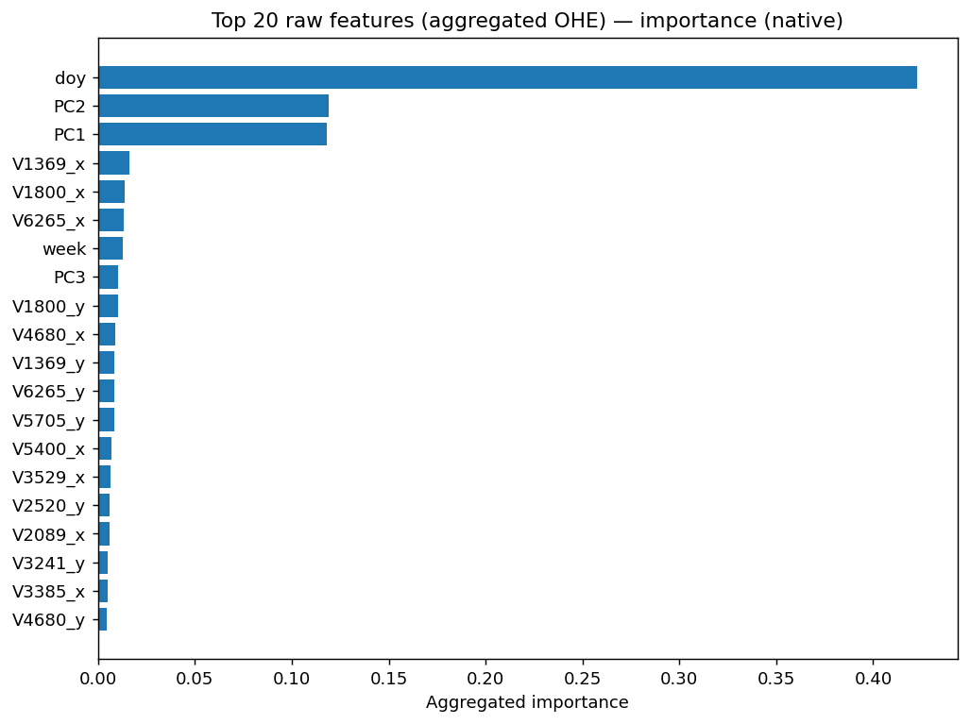
Tree model feature importance
(from GradientBoostingRegressor)
Notes:
Importance = total loss reduction from splits using each feature. Unsigned; higher = more useful to the trees.

Slide 22
5) Forecasts & Seasonality Check (2008–2013)

Slide 23
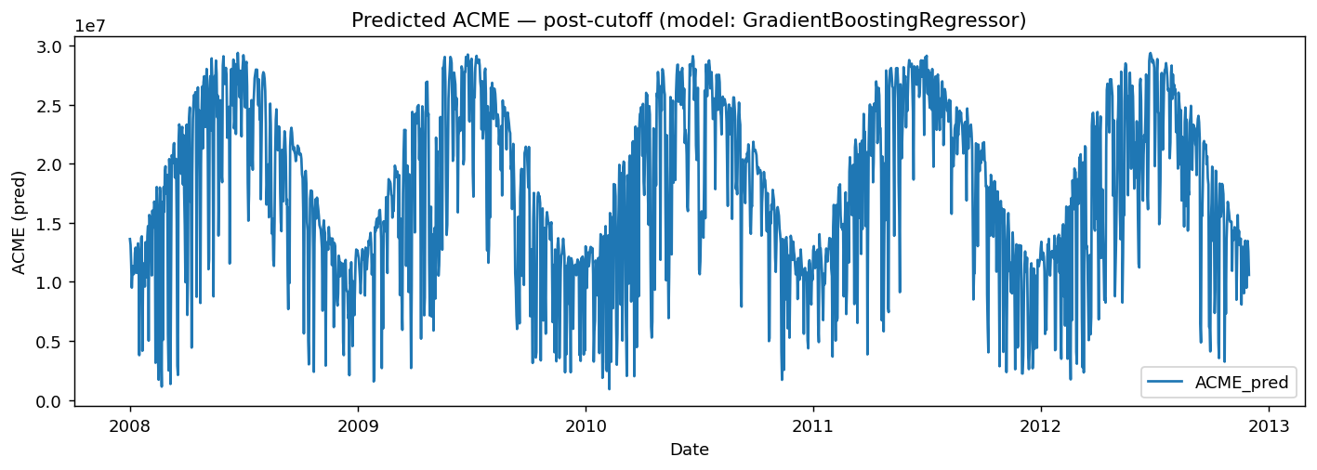
Do We Capture Seasonality? Predicted ACME 2008–2013

