Slide 1

Aliens Task
Practice
RIGHT
PRESS THE RIGHT KEY TO CONTINUE
Notes:
Outside the scanner

Slide 2
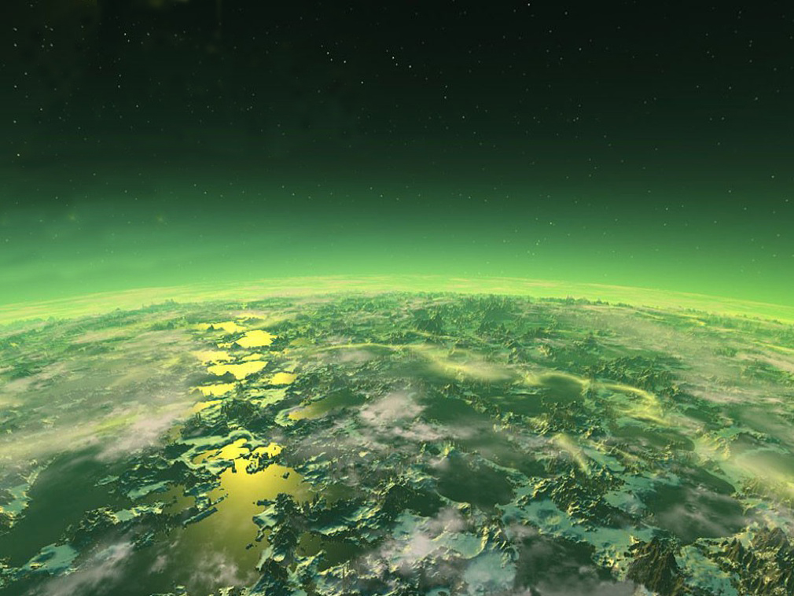


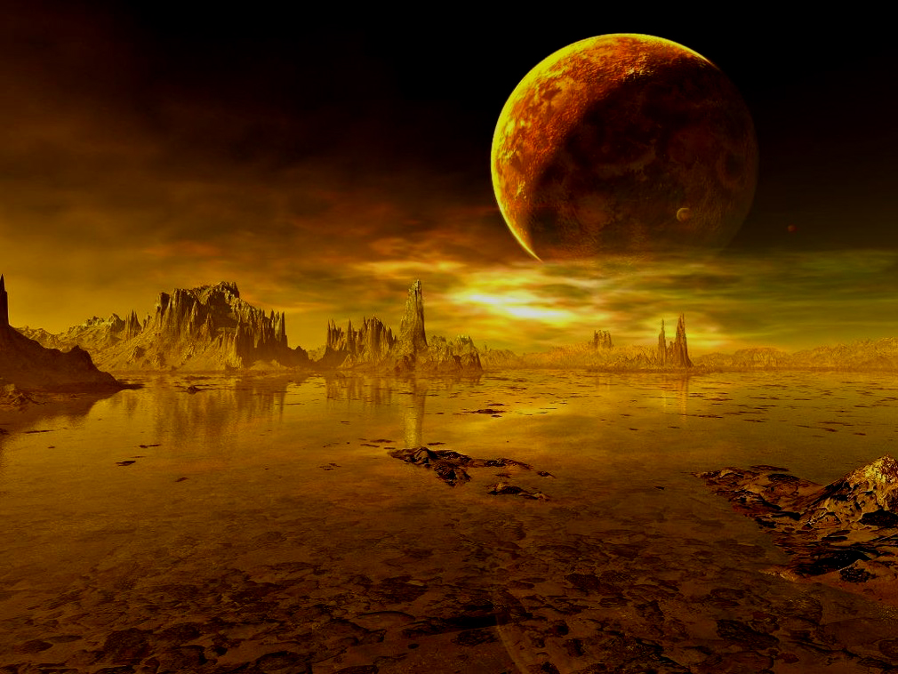
In this task, you will be taking a spaceship from earth to look for space treasure on two different planets.
LEFT
PRESS THE RIGHT KEY TO CONTINUE
RIGHT
Notes:
Add screenshots of an X and an O screen – like a timeline of screenshots.

Slide 3




Each planet has two aliens on it.
And each alien has its own space treasure mine.
LEFT
PRESS THE RIGHT KEY TO CONTINUE
RIGHT
Notes:
Add screenshots of an X and an O screen – like a timeline of screenshots.

Slide 4
On each planet, you will pick one alien to ask for space treasure.
LEFT
PRESS THE RIGHT KEY TO CONTINUE
RIGHT
Notes:
Add screenshots of an X and an O screen – like a timeline of screenshots.

Slide 5
These aliens are nice, so if an alien just brought treasure up from the mine, it will share it with you.
LEFT
PRESS THE RIGHT KEY TO CONTINUE
RIGHT
Notes:
Add screenshots of an X and an O screen – like a timeline of screenshots.

Slide 6
For each choice, choose the LEFT alien by pressing the 1 key
and the RIGHT alien by pressing the 0 key.
The choice you make will be highlighted.
LEFT
PRESS THE RIGHT KEY TO CONTINUE
RIGHT
Notes:
Add screenshots of an X and an O screen – like a timeline of screenshots.

Slide 7
Try practicing a few times now.
LEFT
PRESS THE RIGHT KEY TO CONTINUE
RIGHT
Notes:
Add screenshots of an X and an O screen – like a timeline of screenshots.

Slide 8
Trials for choosing an alien
Notes:
Add screenshots of an X and an O screen – like a timeline of screenshots.

Slide 9
After you choose an alien, you will find out whether you got treasure.
LEFT
PRESS THE RIGHT KEY TO CONTINUE
RIGHT
Notes:
Add screenshots of an X and an O screen – like a timeline of screenshots.

Slide 10
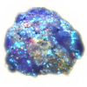
After you choose an alien, you will find out whether you got treasure.
Which looks like this:
LEFT
PRESS THE RIGHT KEY TO CONTINUE
RIGHT
Notes:
Add screenshots of an X and an O screen – like a timeline of screenshots.

Slide 11
If the alien couldn’t bring treasure up this time you’ll see an empty circle.
LEFT
PRESS THE RIGHT KEY TO CONTINUE
RIGHT
Notes:
Add screenshots of an X and an O screen – like a timeline of screenshots.

Slide 12

If the alien couldn’t bring treasure up this time you’ll see an empty circle.
Which looks like this:
LEFT
PRESS THE RIGHT KEY TO CONTINUE
RIGHT
Notes:
Add screenshots of an X and an O screen – like a timeline of screenshots.

Slide 13
If an alien has a good mine that means it can easily dig up space treasure and it will be very likely to have some to share.
It might not have treasure EVERY time you ask, but it will most of the time.
Another alien might have a bad mine that is hard to dig through at the moment and won’t have treasure to share most times you ask.
LEFT
PRESS THE RIGHT KEY TO CONTINUE
RIGHT
Notes:
Add screenshots of an X and an O screen – like a timeline of screenshots.

Slide 14
For Example, the alien on the yellow planet has a good mine right now. Try asking it for treasure 10 times by pressing either the 1 or 0 key.
LEFT
PRESS THE RIGHT KEY TO CONTINUE
RIGHT
Notes:
Add screenshots of an X and an O screen – like a timeline of screenshots.

Slide 15
See, this alien shared most of the times you asked, but not every time.
LEFT
PRESS THE RIGHT KEY TO CONTINUE
RIGHT
Notes:
Add screenshots of an X and an O screen – like a timeline of screenshots.

Slide 16


Every alien has a treasure in it’s mine, but they can’t share every time.
Some will be more likely to share because it is easier to dig right now.
LEFT
PRESS THE RIGHT KEY TO CONTINUE
RIGHT
Notes:
Add screenshots of an X and an O screen – like a timeline of screenshots.

Slide 17
You can practice choosing now.
You have 20 choices to try to figure out which alien has a good mine.
Remember, 1 key is for LEFT alien, and 0 key is for the RIGHT alien.
LEFT
PRESS THE RIGHT KEY TO CONTINUE
RIGHT
Notes:
Add screenshots of an X and an O screen – like a timeline of screenshots.

Slide 18
Press the RIGHT key to Start.
Notes:
Add screenshots of an X and an O screen – like a timeline of screenshots.

Slide 19
Good. You might have learned that this alien had treasure more often.
Also, even if this alien had a better mine, you couldn’t be sure if it had treasure all the time.
LEFT
PRESS THE RIGHT KEY TO CONTINUE
RIGHT
Notes:
Post Pratice Instruction

Slide 20
The treasure an alien can give you will change during the game.
Those with a good mine might get to a part of the mine that is hard to dig.
Those with little to share might find easier treasure to dig.
Any changes in an alien’s mine will happen slowly, so try to focus to get as much treasure as possible.
LEFT
PRESS THE RIGHT KEY TO CONTINUE
RIGHT
Notes:
Post Pratice Instruction

Slide 21
Now that you know how to pick aliens, you can learn to play the whole game. You will travel from earth to one of two planets.
LEFT
PRESS THE RIGHT KEY TO CONTINUE
RIGHT
Notes:
Post Pratice Instruction

Slide 22
Here is the green planet.
RIGHT
PRESS THE RIGHT KEY TO CONTINUE
LEFT
Notes:
Post Pratice Instruction

Slide 23
Here is the yellow planet.
RIGHT
PRESS THE RIGHT KEY TO CONTINUE
LEFT
Notes:
Post Pratice Instruction

Slide 24
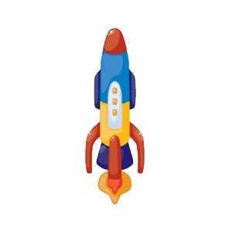
First you need to choose which spaceship to take.
The spaceships can fly to either planet, but one will fly mostly to the green planet and the other mostly to the yellow planet.
LEFT
PRESS THE RIGHT KEY TO CONTINUE
RIGHT
Notes:
Post Pratice Instruction

Slide 25
The planet a spaceship goes to most won’t change during the game. Pick one that you think will take you to the alien with the best mine, but remember, sometimes you’ll go to the other planet!
LEFT
PRESS THE RIGHT KEY TO CONTINUE
RIGHT
Notes:
Post Pratice Instruction

Slide 26
Press the 1 key to choose the LEFT spaceship.
Press the 0 key to choose the RIGHT spaceship.
LEFT
PRESS THE RIGHT KEY TO CONTINUE
RIGHT
Notes:
Post Pratice Instruction

Slide 27
Let’s practice before doing the full game.
Remember, you want to find as much space treasure as you can by asking an alien to share with you.
LEFT
PRESS THE RIGHT KEY TO CONTINUE
RIGHT
Notes:
Post Pratice Instruction

Slide 28
How much bonus money you make is based on how much space treasure you find.
This is just a practice round of 20 flights, you’re not playing for money now.
LEFT
PRESS THE RIGHT KEY TO CONTINUE
RIGHT
Notes:
Post Pratice Instruction

Slide 29


You will have three seconds to make each choice.
If you are too slow, you will see a large X appear on each alien and that choice will be over.
LEFT
PRESS THE RIGHT KEY TO CONTINUE
RIGHT
Notes:
Post Pratice Instruction

Slide 30
Don’t feel rushed, but please try to make a choice every time.
LEFT
PRESS THE RIGHT KEY TO CONTINUE
RIGHT
Notes:
Post Pratice Instruction

Slide 31
Good luck!
Remember that the 1 key selects LEFT and
The 0 key selects the RIGHT.
LEFT
PRESS THE RIGHT KEY TO CONTINUE
RIGHT
Notes:
Post Pratice Instruction

Slide 32
Press the RIGHT key to Start.
Notes:
Add screenshots of an X and an O screen – like a timeline of screenshots.

Slide 33
That is the end of the practice.
LEFT
PRESS THE RIGHT KEY TO CONTINUE
RIGHT
Notes:
Post Practice Session

Slide 34
In the real game, the planets, aliens, and spaceships will be new colors, but the rules will be the same.
The game is hard, so you will need to concentrate, but don’t be afraid to trust your instincts.
Here are three hints on how to play the game
LEFT
PRESS THE RIGHT KEY TO CONTINUE
RIGHT
Notes:
Post Practice Session

Slide 35
Hint #1
Remember which aliens have treasure. How good a mine is changes slowly, so an alien that has a lot of treasure to share now, will probably be able to share a lot in the near future.
LEFT
PRESS THE RIGHT KEY TO CONTINUE
RIGHT
Notes:
Post Practice Session

Slide 36
Hint #2
Remember, each alien has its own mine.
Just because one alien has a bad mine and can’t share very often, does not mean another has a good mine.
Also, there are no funny pattern in how an alien shares, like every time you ask, or depending on which spaceship you took.
The aliens are not trying to trick you.
LEFT
PRESS THE RIGHT KEY TO CONTINUE
RIGHT
Notes:
Post Practice Session

Slide 37
Hint #3
The spaceship you choose is important because often an alien on one planet may be better than the ones on another planet.
You can find more treasure by finding the spaceship that is most likely to take you to the right planet
LEFT
PRESS THE RIGHT KEY TO CONTINUE
RIGHT
Notes:
Post Practice Session

Slide 38
OK! Now you know how to play.
In the real game we’ll count how many pieces of space treasure you find and pay you real money for it at the end
Ready? Now its time to play the game!
Good luck space traveler!
LEFT
PRESS THE RIGHT KEY TO CONTINUE
RIGHT
Notes:
Post Practice Session

Slide 39
Aliens Task
Run 1
RIGHT
PRESS THE RIGHT KEY TO CONTINUE
Notes:
Outside the scanner

Slide 40
Aliens Task
Run 2
RIGHT
PRESS THE RIGHT KEY TO CONTINUE
Notes:
Outside the scanner

Slide 41
Aliens Task
Run 3
RIGHT
PRESS THE RIGHT KEY TO CONTINUE
Notes:
Outside the scanner

Slide 42
Press the RIGHT key to Start.

