Slide 1
Ice Bath
RIGHT
PRESS THE RIGHT KEY TO CONTINUE

Slide 2
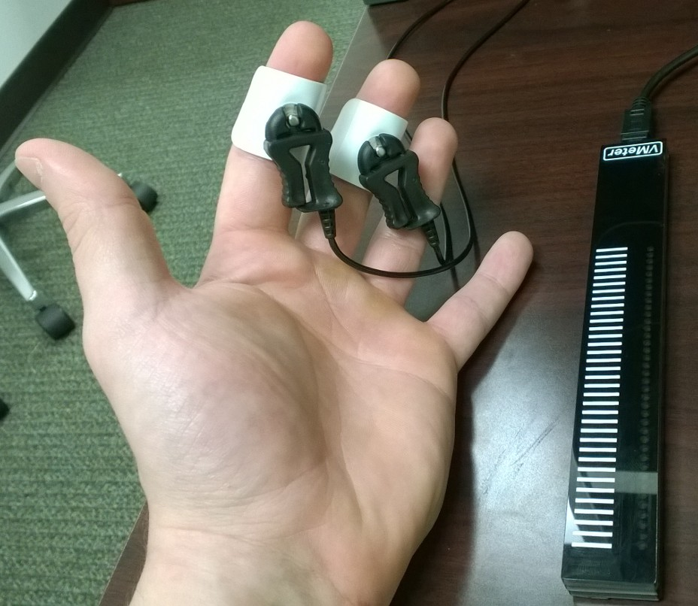
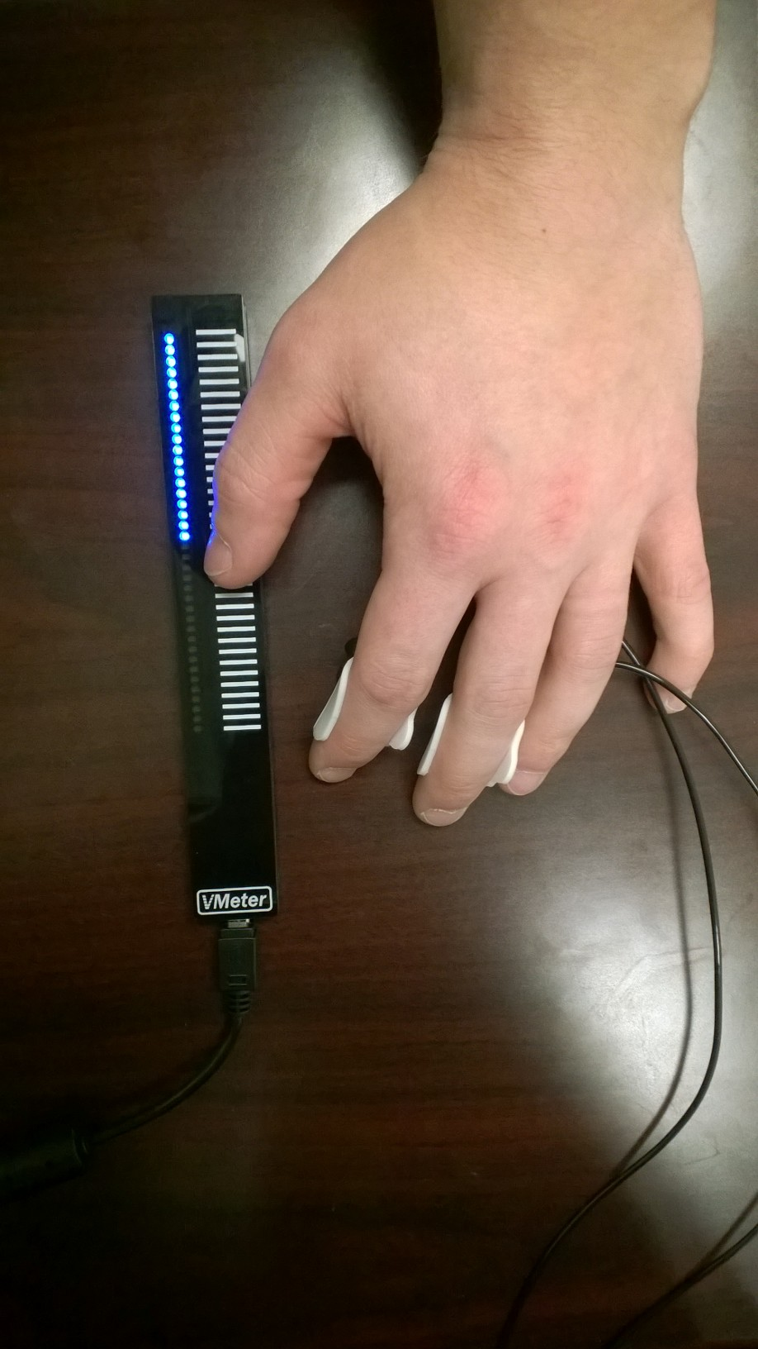
For this test, you will place your dominant hand in a pool of cold water and hold it there as long as you can tolerate.
It’s really important that you keep your hand in the water
for as long as you can.
While your hand is in the water, you will use the device shown to rate the intensity of the pain you are experiencing.
Your rating will be shown by the lights on the device and also on the screen.
[press RIGHT to practice rating]
RIGHT

Slide 3
For this test, you will place your dominant hand in a pool of cold water and hold it there as long as you can tolerate.
It’s really important that you keep your hand in the water
for as long as you can.
While your hand is in the water, you will use the up and down arrows to rate the intensity of the pain you are experiencing.
Your rating will be shown on the screen.
[press RIGHT to practice rating]
RIGHT

Slide 4
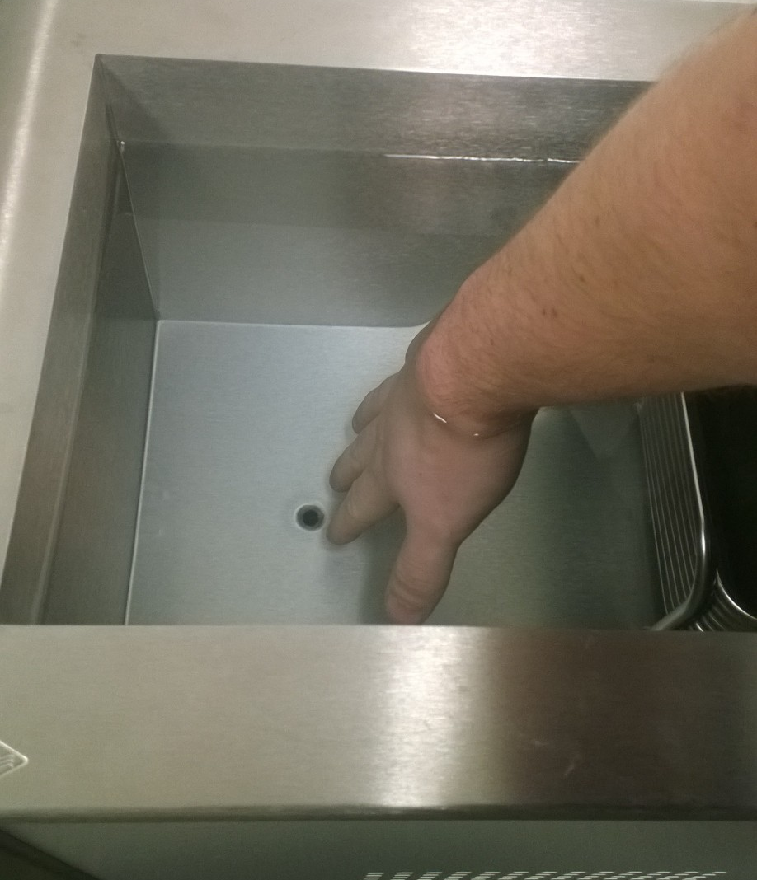
The trial will begin with a three second countdown. Please place your hand in the water up to the wrist as shown when the voice says go and don’t forget to rate the pain intensity with your other hand.
Try to face the screen and look at your rating during the task.
There is a maximum time limit, and if you reach this limit you will be instructed to stop.
The water will be cold. Please keep your hand in for as long as you can tolerate and do not make a fist in the water.
[Experimenter: attach the temperature probe and leave the room]
[Participant: press RIGHT to begin the countdown]

