Slide 1
DRIVING: CAR
TRIGGER
PRESS THE TRIGGER TO CONTINUE

Slide 2
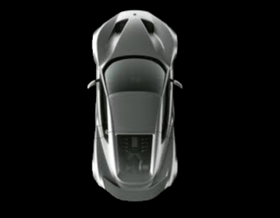
Trials in this experiment are
divided into different blocks.
In each trial, you will control a car using a joystick.
You can control the speed of the car by
pushing the joystick forward or pulling it backward.
TRIGGER
PRESS THE TRIGGER TO CONTINUE
Notes:
Replace the car screenshot with whatever is most relevant for this part of the task.

Slide 3
Each trial starts with a 2 second count-down.
You have 10 seconds to complete each trial.
A timing bar will appear on the screen to indicate
the time left, and it will turn green once the
car is getting close to the stop sign.
TRIGGER
PRESS THE TRIGGER TO CONTINUE
Notes:
Replace the car screenshot with whatever is most relevant for this part of the task.

Slide 4
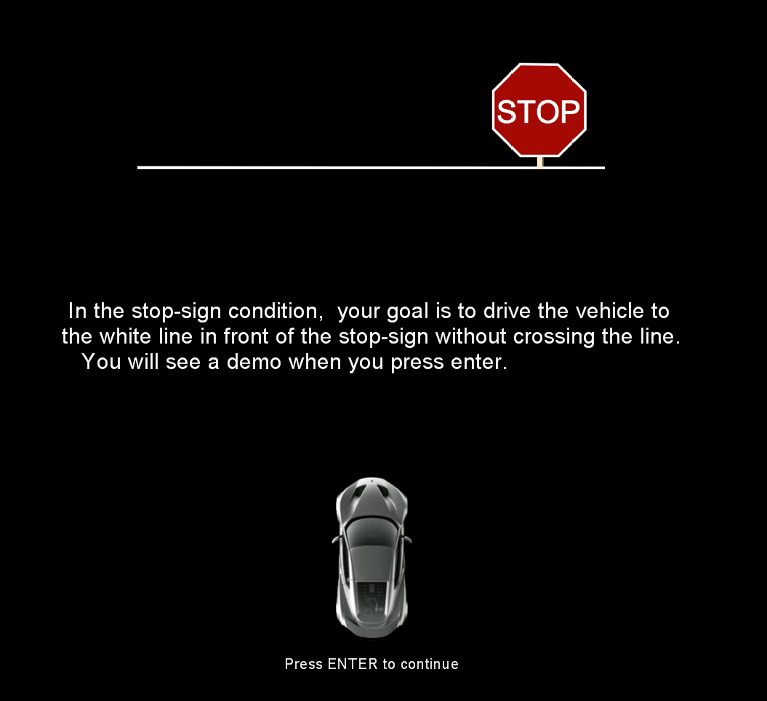
Your goal is to drive the car to the white line in front of the stop-sign without crossing it as quickly as possible. You will see a demo when you press the TRIGGER.
TRIGGER
PRESS THE TRIGGER TO CONTINUE

Slide 5
Your goal is to drive the car to the white line in front of the stop-sign without crossing it.
You should drive as quickly and accurately as possible.
You should not drive too slowly.
You will see a demo when you press the TRIGGER.
TRIGGER
PRESS THE TRIGGER TO CONTINUE

Slide 6
Each block of trials will begin with text telling you how sensitive the joystick is, and that sensitivity will be the same for the entire block.
Low sensitivity: Slow
High sensitivity: Fast
TRIGGER
PRESS THE TRIGGER TO CONTINUE

Slide 7
Press the TRIGGER when you are ready to begin.
TRIGGER
PRESS THE TRIGGER TO CONTINUE
Notes:
Outside the scanner

Slide 8
DRIVING: CAR
TRIGGER
PRESS THE TRIGGER TO CONTINUE

Slide 9
Press the TRIGGER when you are ready to begin.
TRIGGER
PRESS THE TRIGGER TO CONTINUE
Notes:
Outside the scanner

Slide 10
DRIVING: MOTORCYCLE
TRIGGER
PRESS THE TRIGGER TO CONTINUE

Slide 11

This task is like the last one, except this time you will be controlling a motorcycle on a slick road.
TRIGGER
PRESS THE TRIGGER TO CONTINUE
Notes:
Replace the car screenshot with whatever is most relevant for this part of the task.

Slide 12
Each block of trials will begin with text telling you how slick the road is, and that slickness will be the same for the entire block.
Low slickness: Easy
Medium slickness: Medium
High slickness: Hard
TRIGGER
PRESS THE TRIGGER TO CONTINUE

Slide 13
Press the TRIGGER when you are ready to begin.
TRIGGER
PRESS THE TRIGGER TO CONTINUE
Notes:
Outside the scanner

Slide 14
DRIVING: MOTORCYCLE
TRIGGER
PRESS THE TRIGGER TO CONTINUE

Slide 15
Press the TRIGGER when you are ready to begin.
TRIGGER
PRESS THE TRIGGER TO CONTINUE
Notes:
Outside the scanner

