Slide 1
Rajita’s original task
9 separate scans, 11 images each
ratings
self-paced
fixation
66s
ratings
self-paced
fixation
66s
ratings
self-paced
fixation
66s
ratings
self-paced
ratings
self-paced
images
66s
ratings
self-paced
images
66s
ratings
self-paced
images
66s
ratings
self-paced
4.5-5 min each
~20 minutes total per image type, ~60 minutes total
ratings
self-paced
images
66s
ratings
self-paced
images
66s
ratings
self-paced
images
66s
ratings
self-paced
5 minutes relaxation audio and rest

Slide 2
What we decided to go with
One continuous scan per condition
~11 minutes per scan, ~35 minutes total
fixation
31s
Ratings
20s
fixation
31s
ratings
20s
fixation 8-12s
images
31.2s
ratings
20s
fixation 8-12s
images
31.2s
ratings
20s
fixation 8-12s
images
31.2s
ratings
20s
fixation 8-12s
images
31.2s
ratings
20s
fixation 31s
Or 39-43s?
ratings
20s
5 minutes relaxation audio and rest
6 images per block
24 images per condition per visit
4 visits -> 96 images per condition needed, we have 120
Category order to be counterbalanced across participants, but held constant between visits
Rajita only had 66 stressful images total, so we will need to add some or do our own selection

Slide 3
A few notes
Rajita’s images are displayed for 5s each, with 1s fixation cross between them
Hamed’s were 5s with 200ms blank between them
Use this one
Rajita had 11 images per block for 66s blocks, Hamed had 6 for 31s blocks
Will add box trials, like in Hamed’s task
Keep same questions as during Rajita’s version, or change them a bit?
Counterbalancing based on subject ID, so that subject ID + visit -> image set + category order
Category order to be kept constant within subject
24 image set orders, 6 category orders
A set of images will

Slide 4
Image Selection Criteria
For each category, need 4 sets of 24 images
For neutral/opioid images
Select those with lowest/highest craving ratings
Each block of 6 images to have one image from each category
Check match of 4 sets on valence, arousal, HSV
Also, check HSV match between neutral/opioid images within each set
For IAPS images, start with Rajita’s and add to it?
Estimate HSV for IAPS, and be sure it’s matched? YES
Within stress images between sessions
Within session between IAPS/neutral/opioid

Slide 5
Image categories
neutral object
neutral object with hand
neutral tools
neutral tools with hands, simple
neutral tools with hands, complex
neutral tools with faces
opioid
opioid and hand
opioid instruments
opioid instruments and hands
opioid injection and hands
opioid activities and faces

Slide 6
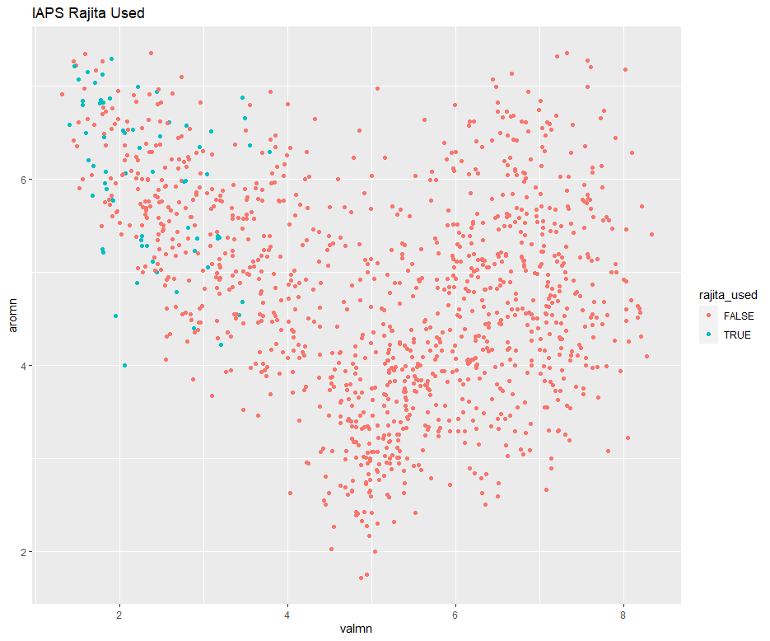
Rajita’s images
Randomly select some with
Low valence?
Low valence + high arousal?
Pick 30 more images with valence below 4 and arousal above 4

Slide 7
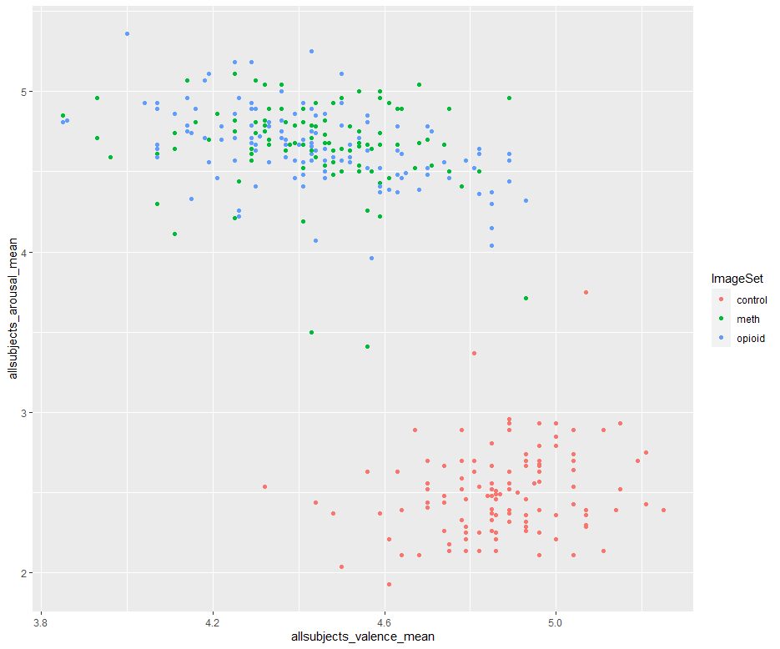
Hamed’s database valence/arousal

Slide 8
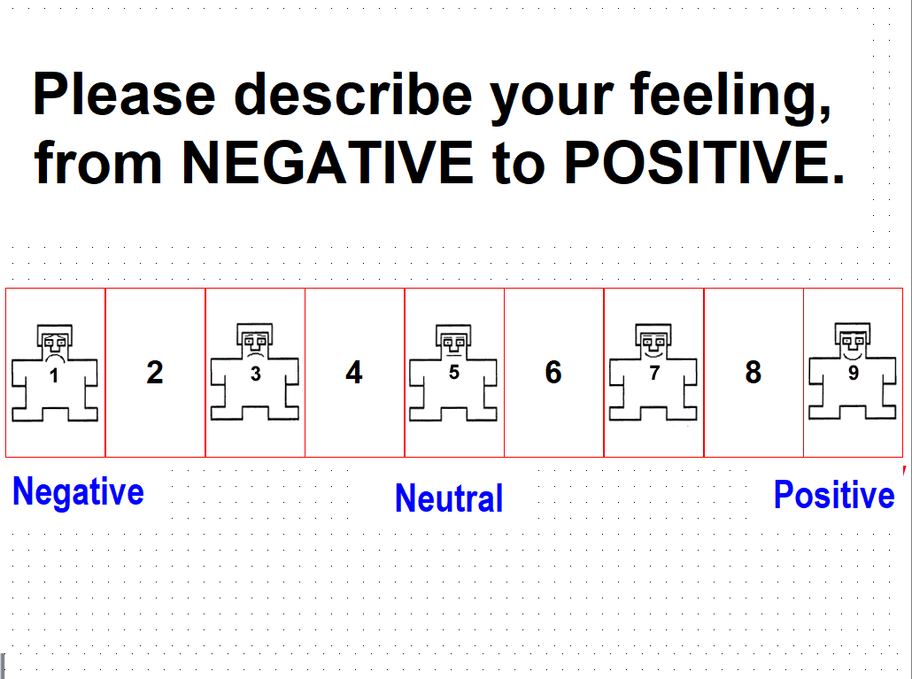
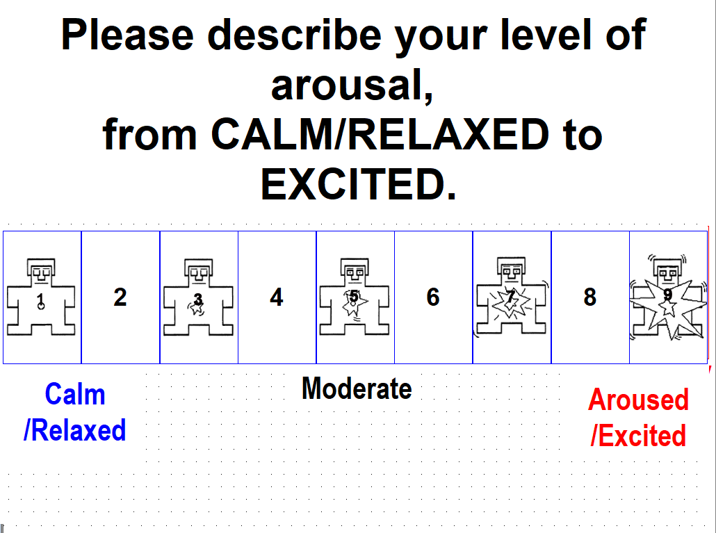
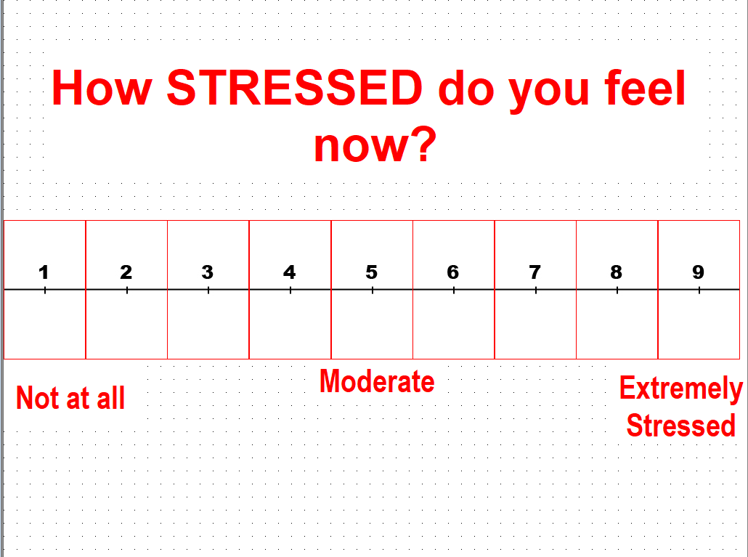
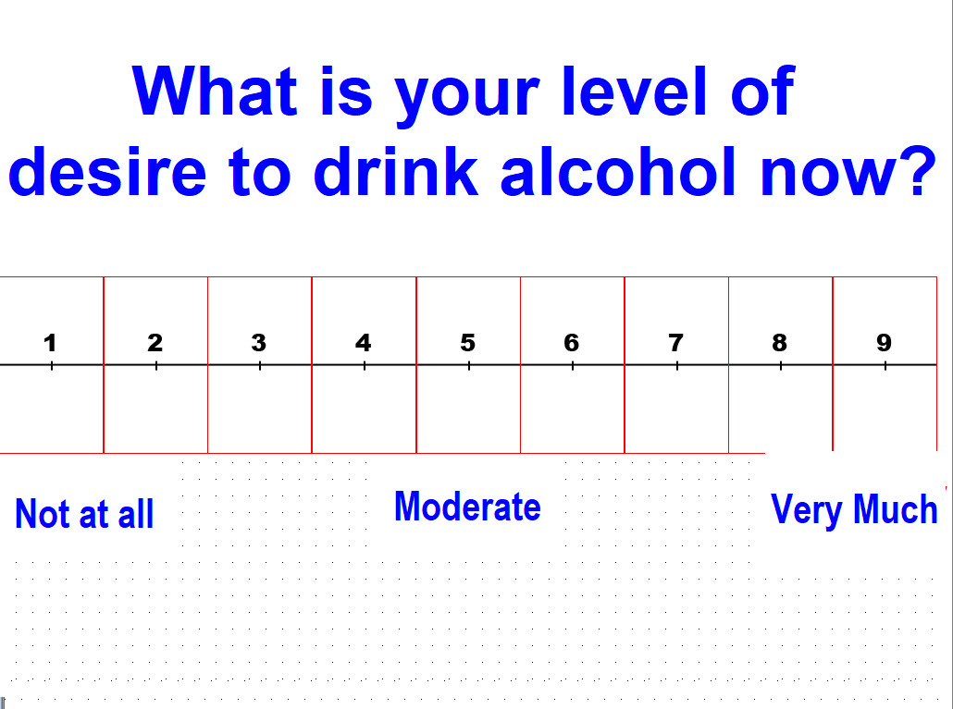
Questions asked at the beginning of each run
Use these questions, all black, replace “drink alcohol” with “use drugs” and make all present tense.
Neutral in middle for both valence and arousal

Slide 9
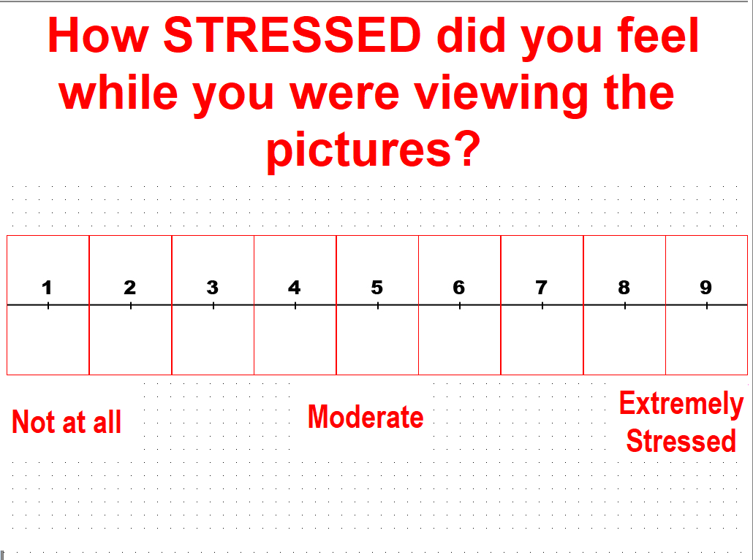
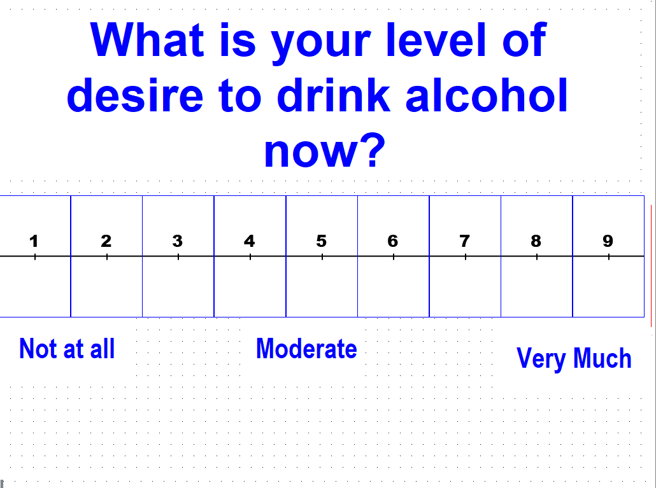
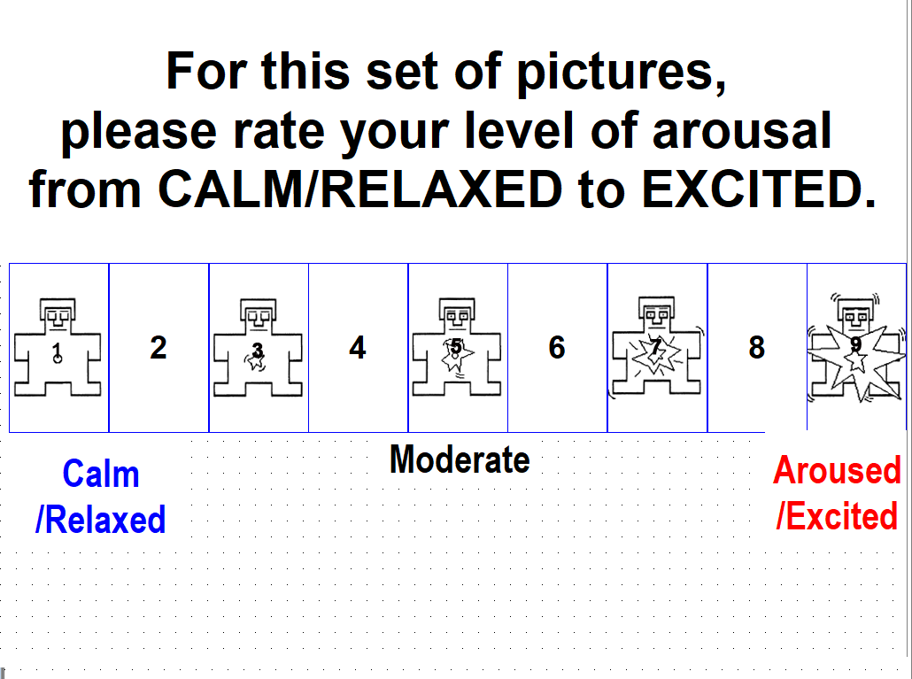
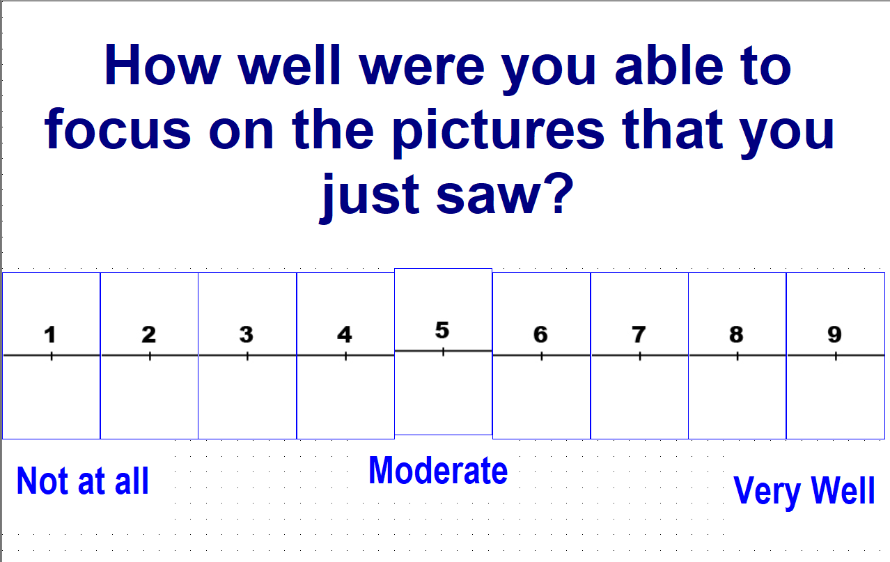
Questions asked during each run

Slide 10
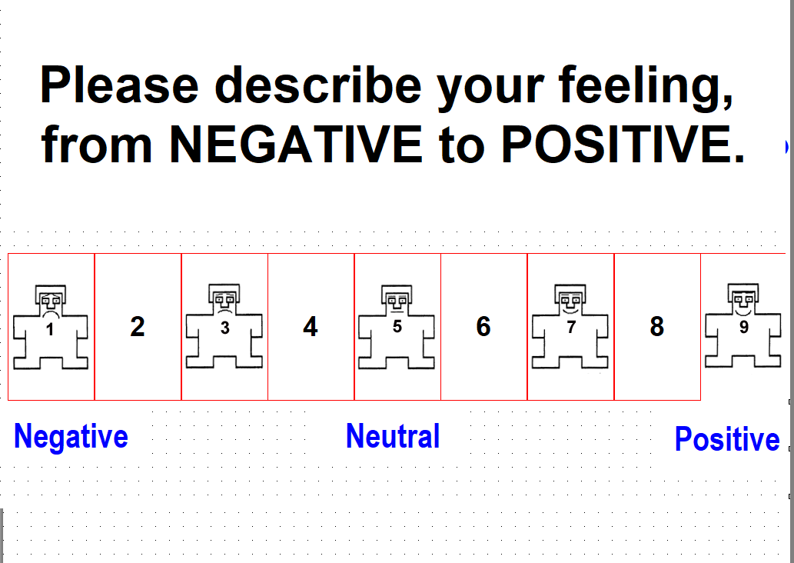
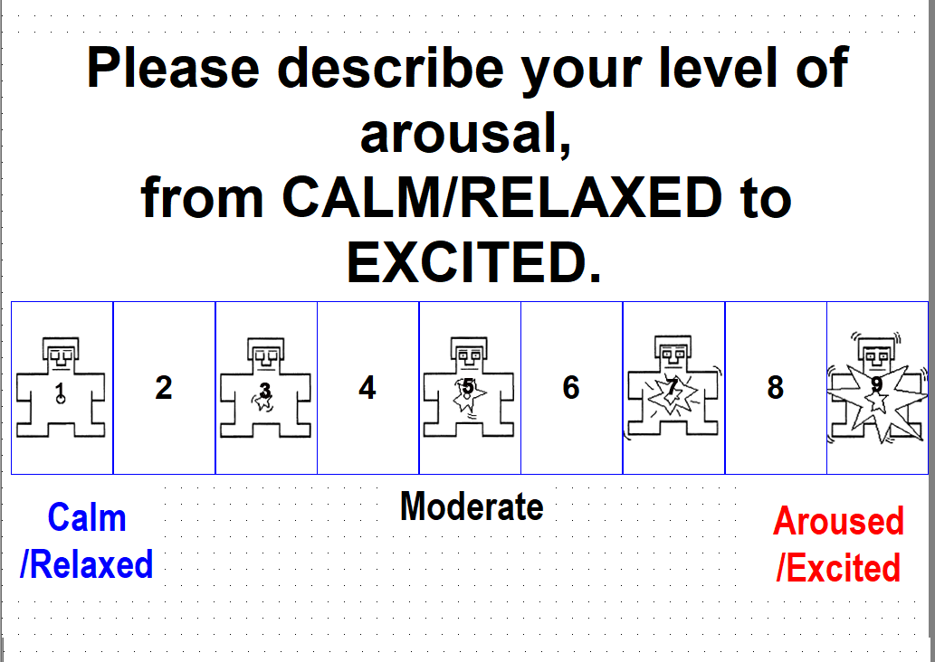
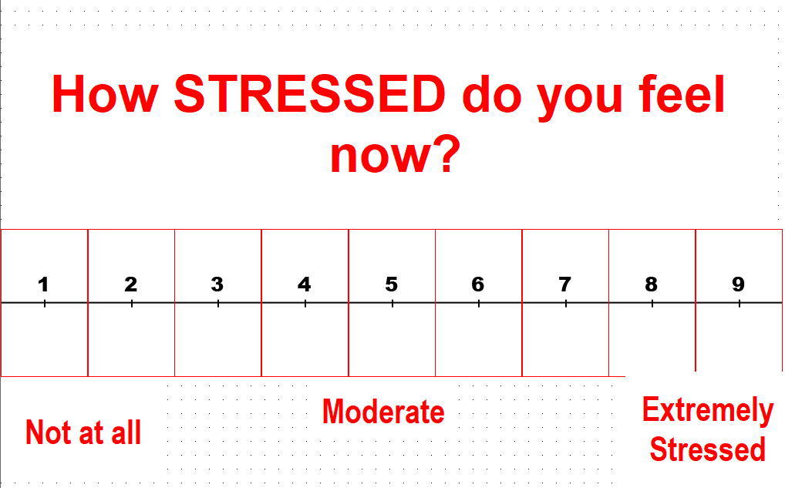
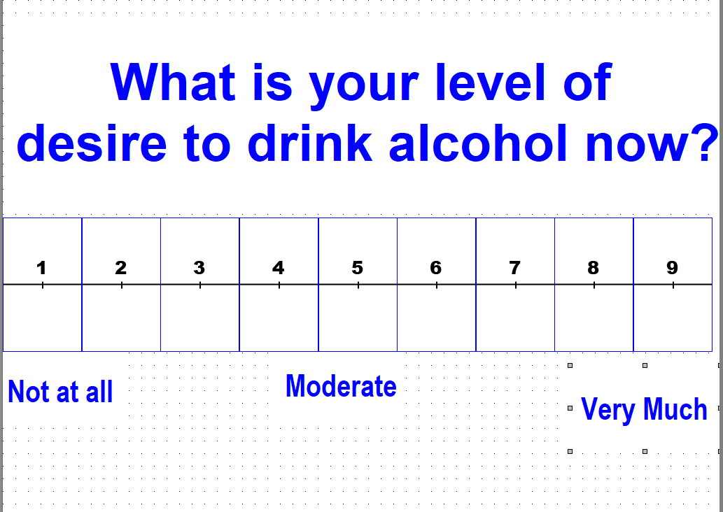
Questions asked at the end of each run, before the relaxation audio

Slide 11
Other Behavioral Tasks
5-Trial Adjusting Delay Discounting Task
Delay Discounting Task
Attentional Network Test
Attentional Network Test
Cue Interference Task/Attentional Bias Line Counting Task
Line Counting Task
Emotional Go/NoGo Task
Emotional Go NoGo Task
Stop Signal Reaction Task
Stop Signal Task
Visual Digit Span
Backward Visual Digit Span
Heartbeat counting Task
Heartbeat Counting (although this always should have been named heartbeat detection, oh well)
Cold Pressor
Cold Pressor

Slide 12
Text for relaxation tape screen
Please keep your eyes closed and relax, as you listen to the relaxation tape

Slide 13
Notes
Study entry date (14 days +- 5 of abstinence or treatment entry, consistent throughout protocol)
I don’t think we can exclude subjects who relapse
What physio during behavioral session?
Need description of BIOPAC for behavioral and functional sessions
% days abstinent or time to relapse (or both), but don’t use the terms interchangeably
Some image categories (e.g. control objects with hands) only have 12 images, so not every block has one image from each of the 6 categories—so some categories are repeated
Matching HSV may not be possible
Need to get rid of vMeter in cold pressor
3dMAGIC
Add a couple sentences today
Also BIOPAC & videos for behavioral session
Check T1K lifetime opioid use among HCs

Slide 14
Notes
Changed desire to urge

