Slide 1
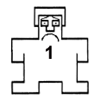
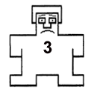
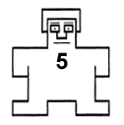
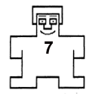
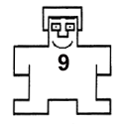
Describe your feeling, from NEGATIVE to POSITIVE
1
2
3
4
5
6
7
8
9
Negative
Neutral
Positive

Slide 2
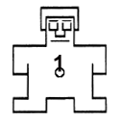
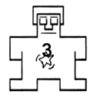



Describe your level of arousal, from CALM to EXCITED
1
2
3
4
5
6
7
8
9
Calm
Neutral
Excited

Slide 3
How STRESSED do you feel?
1
2
3
4
5
6
7
8
9
Not at all
Moderately
Extremely

Slide 4
What is your urge to use drugs?
1
2
3
4
5
6
7
8
9
No Urge
Moderate Urge
Extreme Urge

Slide 5

How STRESSED do you feel?
1
2
3
4
5
6
7
8
9
Not at all
Moderately
Extremely

